Slide 1

Point of Sale System
Victor Abraham · Aman Khoja · Aayush Goyal · Quoc Dat Vo
CS 4347.006
Final Project

Slide 2
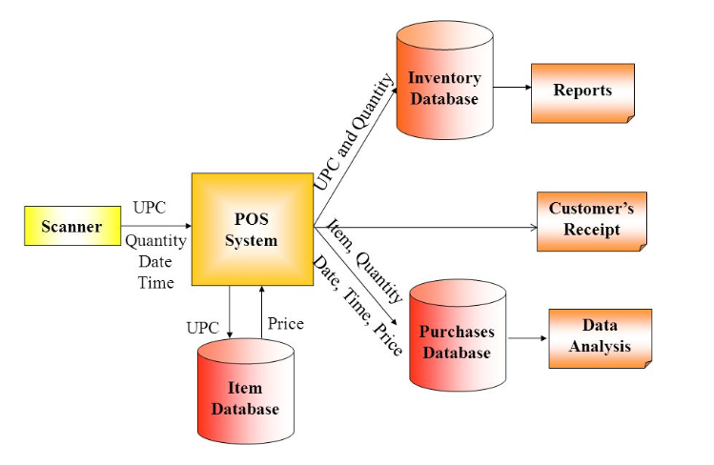
Overview of the Business
Point of sale (POS) system is the spot where your customer makes the payment for goods or services that are offered by your company.
Tool to modularize and manage a business unit
An efficient and portable point of sales system

Slide 3
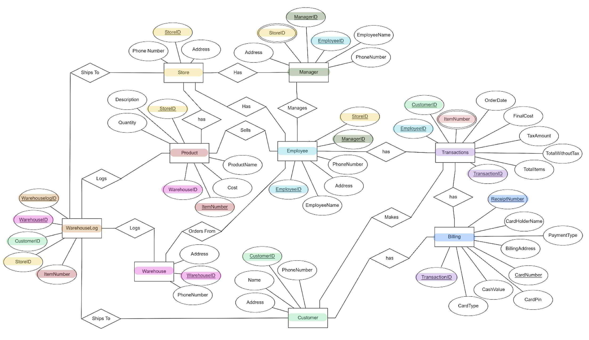
Data Model

Slide 4
Challenges
Emphasis on flexible schema to encompass specific requirements
Consideration of scaling for larger corporations
Working to minimize potential of a single point of failure

Slide 5
Further Development
Potential NoSQL development to handle scalability
Addition of client-side features for customer end users
Expand transport manufacturing scope to freight & shipping

Slide 6
Database Demo

