Slide 1
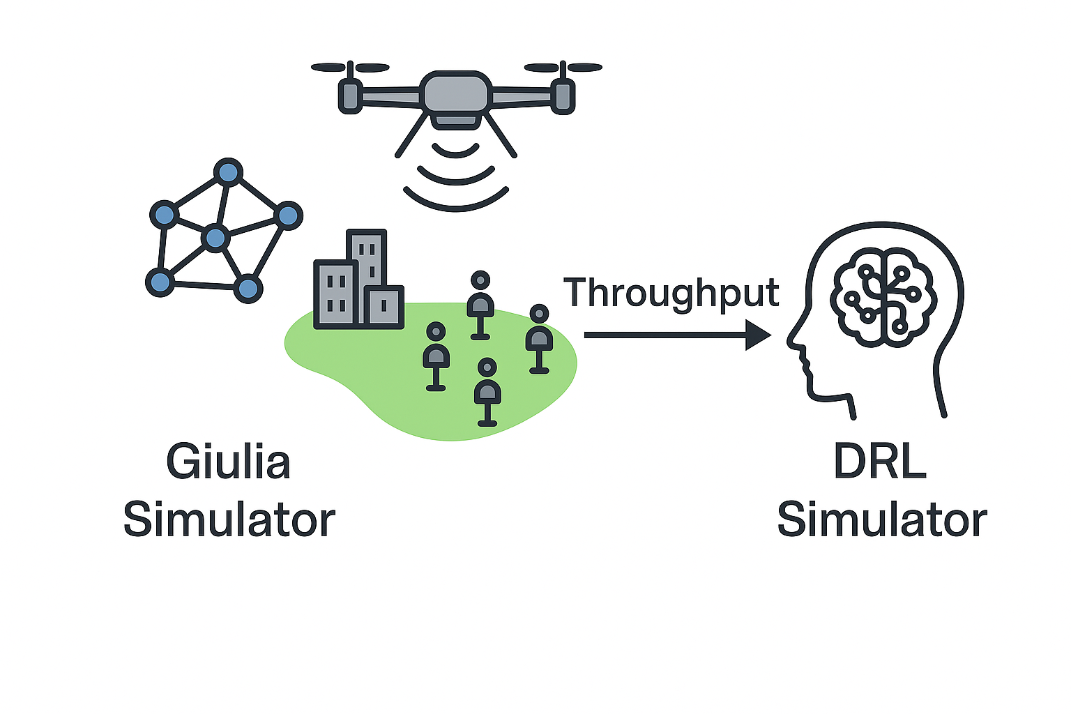
Introduction
Project Overview: DRL-Based UAV Positioning and Mobility optimization
Simulation Tools
Giulia Simulator
Computes KPIs:
Throughput (TP)
Signal-to-Interference-plus-Noise Ratio (SINR)
Angle of Arrival (AoA)
DRL Simulator: We present the Deep Reinforcement Learning (DRL) simulation results for multiple scenarios involving three UE hotspots and UAVs deployed within a playground.
Trains and evaluates UAV agents
Optimizes decision-making and movement patterns
Objective: The objective is to develop a DRL framework that optimizes UAV positioning and mobility to serve multiple UE hotspots by maximizing the reward and enabling each UAV to learn optimal trajectories for efficient coverage.

Slide 2
Section 2: Scenarios and Results
Scenario 1: Mobile HSs in Straight-walk
Scenario 2: Mobile HSs in Circular-walk
Scenario 3: Mobile HSs in Cosine-walk

Slide 3
General Explanation
In each scenario, we consider a specific case where UAVs learn to follow UE hotspots moving along a defined trajectory.
To assess the agents’ training performance, we measure the mean reward during both the training and evaluation phases at selected position.
Hotspots are represented by red user groups, while UAVs are depicted as blue flyer-shaped icons.

Slide 4
Scenario 1: Mobile HSs in Straight-walk Key configuration parameters
Parameter | Value/status
Playground size | 400×1200m^2
UE distribution | Uniform with hotspot
Radius of hotspots | 0.1m
Number of hotspots | 3
Number of UE per hotspots | 10
Movement direction | R2L & L2R
UE mobility | Straight walk-Circular-Cosine
Link direction | Downlink
UE velocity | 15 km/h
Number of UAVs | 3
Initial UAV velocity | 30 km/h
UAV initial movement direction | L2R
Channel state | Random

Slide 5
Straight walk: Evaluation at [(-180,180,-180),(380,-380,0)]
Before training/ learning
After training/ learning

Slide 6
Circular walk: Evaluation at [(-180,180,-180),(180,-180,0)]
Before training/ learning
After training/ learning

Slide 7
Cosine walk: Evaluation at [(-180,180,-180),(180,-180,0)]
Before training/ learning
After training/ learning

