Slide 1
INTERNSHIP PORTFOLIO
Multi-Domain
Data Analysis
Five complete Python projects across retail, education, weather, healthcare, and finance
DATA CLEANING • STATISTICS • VISUALIZATION • BUSINESS INSIGHTS
01

Slide 2
A complete end-to-end analytical portfolio
02
One shared workflow applied across five very different decision environments.
5
15,986
25
complete domain projects
clean analytical records
professional visualizations
15 automated tests • 5 notebooks • 6 executive PDF reports
MULTI-DOMAIN DATA ANALYSIS PORTFOLIO

Slide 3
The workflow: raw records to responsible decisions
03
01
02
03
04
Validate
Clean
Analyse
Communicate
Schema, duplicates, missingness, ranges
Types, imputation, exclusions, raw-data preservation
Mean, median, trends, correlations, domain KPIs
Charts, recommendations, assumptions, limitations
Every build is reproducible through fixed seeds, modular source code, saved validation evidence, and automated tests.
MULTI-DOMAIN DATA ANALYSIS PORTFOLIO

Slide 4
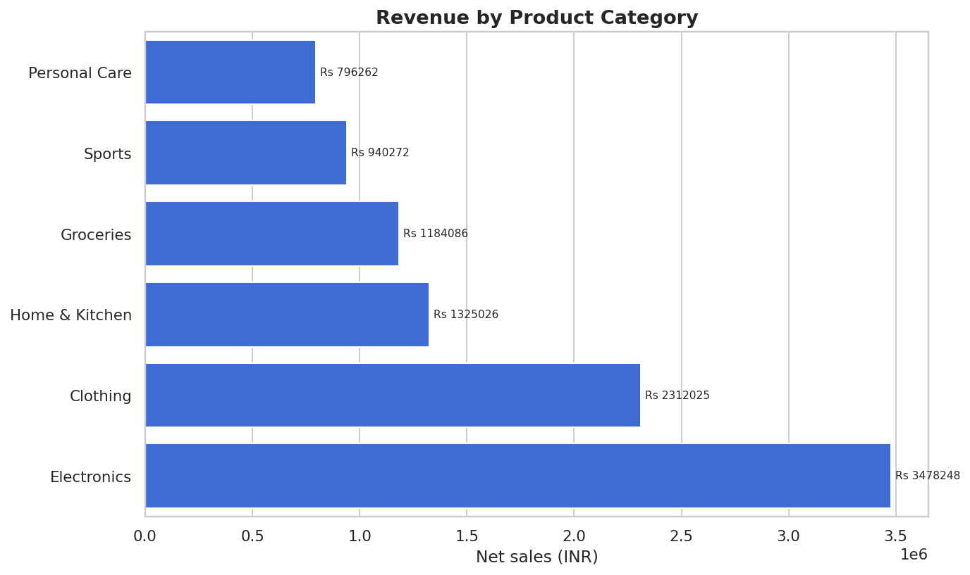
Retail: identify what, when, and who drives sales
04
₹10.04M
net sales across 2,500 transactions
Electronics
highest revenue category
Action
Align inventory, promotions, and staffing with category demand and peak periods.
MULTI-DOMAIN DATA ANALYSIS PORTFOLIO

Slide 5
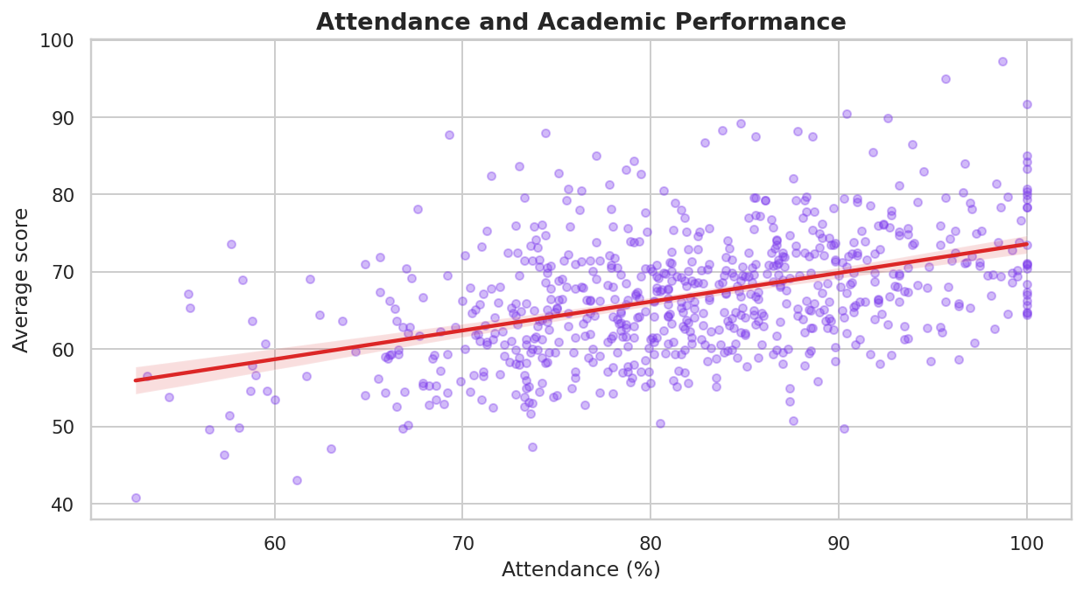
Education: turn performance signals into support
05
93.8%
all-subject pass rate
321
students flagged for human review
Safeguard
Risk flags support teacher outreach; they should never become automatic penalties.
MULTI-DOMAIN DATA ANALYSIS PORTFOLIO

Slide 6
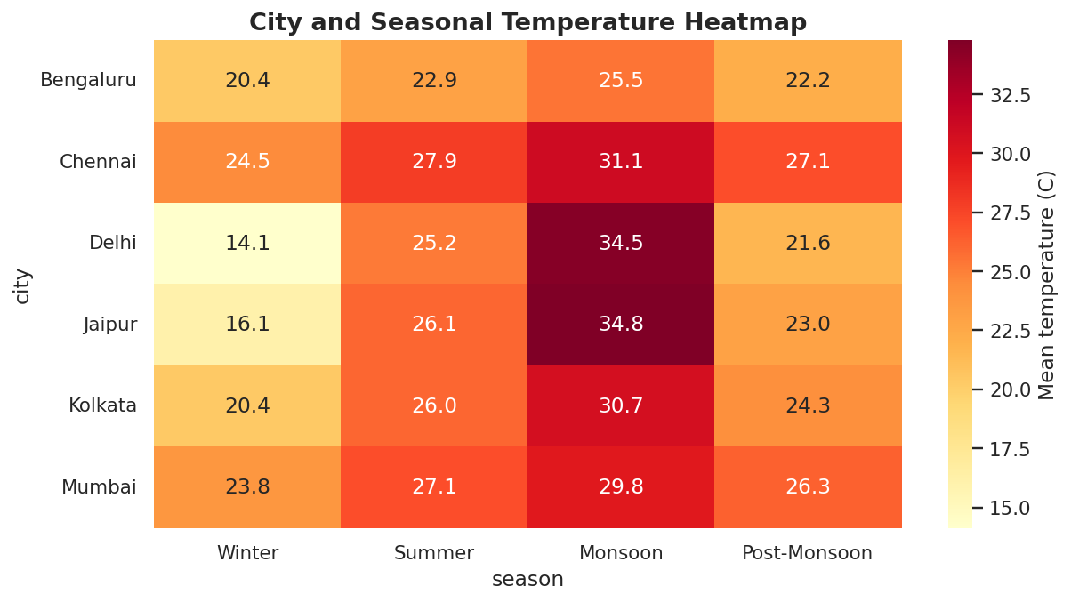
Weather: seasonal patterns require local planning
06
6,576
daily city observations
6 cities
three years of simulated daily data
Action
Build city-specific heat and rainfall calendars; replace simulation with verified observations for real use.
MULTI-DOMAIN DATA ANALYSIS PORTFOLIO

Slide 7
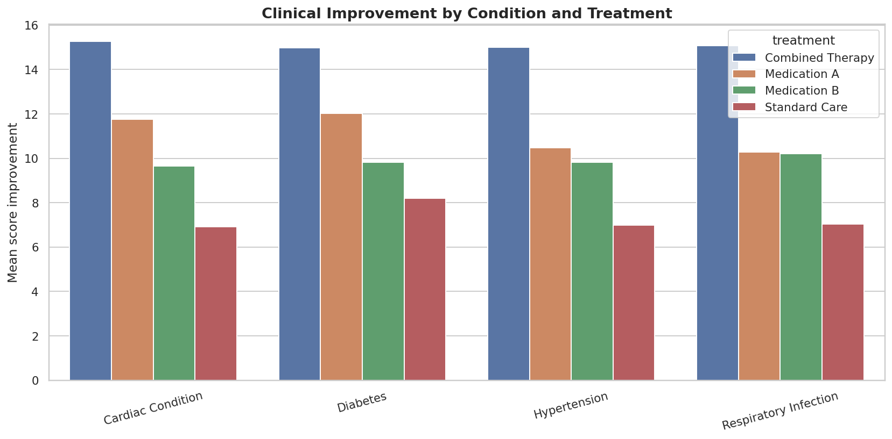
Healthcare: stratification changes interpretation
07
1,800
simulated de-identified encounters
50.2%
favourable outcome rate
Boundary
Descriptive associations are not causal treatment effects and must not guide patient care.
MULTI-DOMAIN DATA ANALYSIS PORTFOLIO

Slide 8
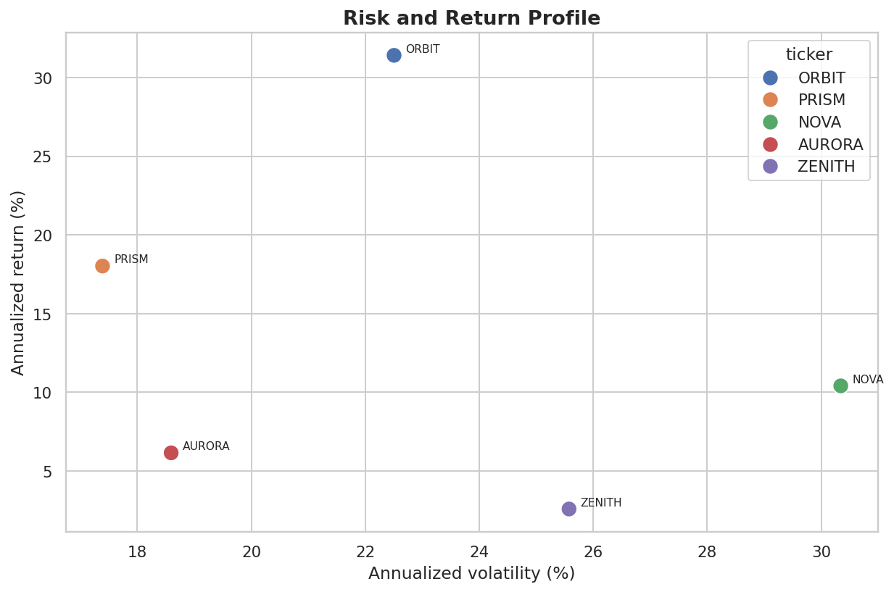
Finance: performance only matters in context of risk
08
15.1%
simulated portfolio annualised return
−18.0%
maximum portfolio drawdown
Boundary
Fictional assets, simplified assumptions, and historical simulation—not investment advice.
MULTI-DOMAIN DATA ANALYSIS PORTFOLIO

Slide 9
Engineering quality: results that can be rebuilt and checked
09
PROJECT
CORE TEST EVIDENCE
STATUS
Retail
Validation • cleaning • KPI reconciliation
3 passed
Education
Duplicate • risk logic • pass rate
3 passed
Weather
Duplicate • extreme flags • KPI reconciliation
3 passed
Healthcare
Duplicate • outcome logic • readmission
3 passed
Finance
Duplicate • returns/drawdown • portfolio
3 passed
Final verification: 15 / 15 automated tests passed
MULTI-DOMAIN DATA ANALYSIS PORTFOLIO

Slide 10
Five domains. One disciplined analytical standard.
10
Validated inputs
Submission package
Auditable transformations
5 notebooks
6 PDF reports
25 charts
15 tests
Complete documentation
Demo script
Evidence-led visuals
Responsible recommendations
Thank you
10
MULTI-DOMAIN DATA ANALYSIS PORTFOLIO

