Slide 1

pollution

Slide 2
WELCOME TO THE AI GENERATED PPT POWERED BY
RPA

Slide 3

Air Conta

Slide 4

"Air Contamination: Widespread release of harmful substances into the atmosphere, compromising air quality and endangering human health. Sources include industrial emissions, vehicular exhaust, and various pollutants affecting ecosystems."

Slide 5
Air contamination poses severe threats, including respiratory diseases and climate change. Combustion of fossil fuels releases pollutants like particulate matter, nitrogen oxides, and volatile organic compounds. Industrial processes and deforestation contribute to the problem. Ozone depletion and acid rain result from certain air pollutants. Addressing this issue requires global efforts, transitioning to cleaner energy sources, and adopting sustainable practices to mitigate the impact on both human health and the environment.

Slide 6
Wat

Slide 7
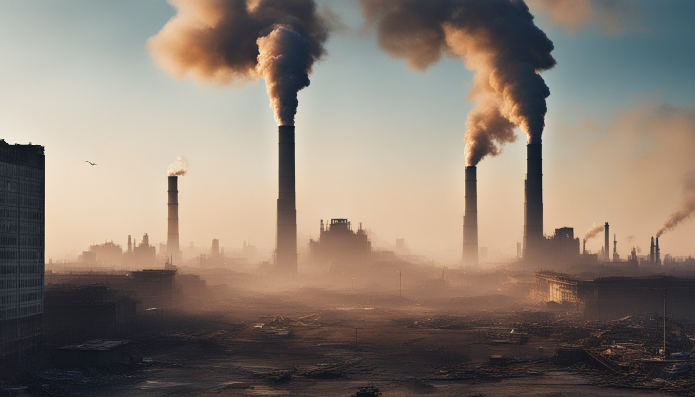
"Water Pollution: Introduction of harmful substances into water bodies, such as rivers and oceans, adversely impacting aquatic ecosystems and endangering human health. Sources include industrial discharges, agricultural runoff, and improper waste disposal."

Slide 8
Water pollution poses significant threats, affecting biodiversity, fisheries, and human access to clean water. Agricultural runoff introduces pesticides and fertilizers, while industrial discharges release toxins. Improper waste disposal introduces plastic and hazardous chemicals. Polluted water can cause waterborne diseases, posing a global health risk. Sustainable water management practices, stricter regulations, and community awareness are vital to safeguarding water quality and ecosystems.

Slide 9
Soil Degradation

Slide 10
"Soil Degradation: Deterioration of soil quality due to human activities, including deforestation, improper agricultural practices, and industrial pollution. This jeopardizes agricultural productivity, biodiversity, and overall ecosystem health."

Slide 11
Soil degradation results in loss of fertile topsoil, reducing the land's ability to support plant life. Deforestation and improper land use expose soil to erosion, depleting essential nutrients. Agricultural practices like overuse of chemical fertilizers and pesticides contribute to soil pollution. This threatens food security, biodiversity, and ecosystem stability. Implementing sustainable farming methods, reforestation, and soil conservation practices are crucial for mitigating soil degradation's detrimental effects.

Slide 12
Noise Dist

Slide 13
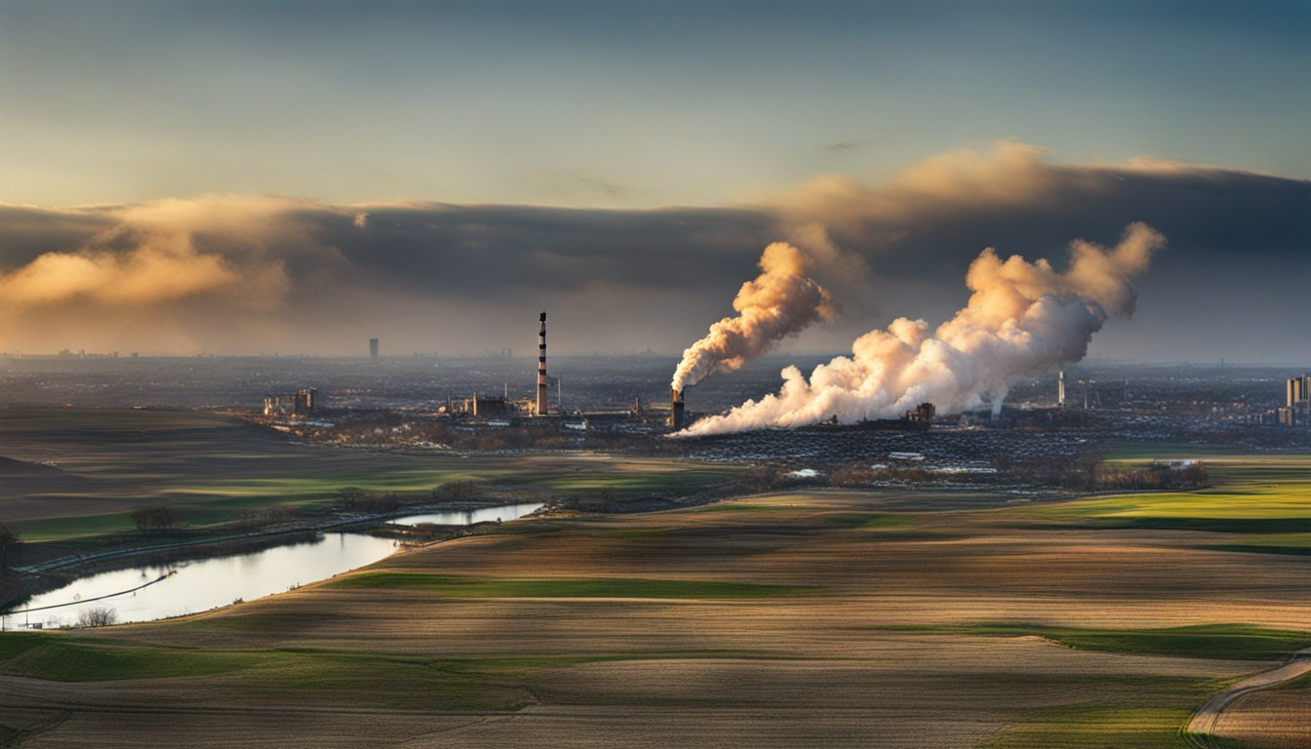
"Noise Disturbance: Unwanted, excessive sound causing harm or discomfort. Common sources include traffic, industry, and recreational activities. Prolonged exposure can lead to stress, hearing loss, and adverse health effects."

Slide 14
Excessive noise disrupts sleep patterns, impairs cognitive function, and contributes to mental health issues. Urbanization and transportation systems amplify noise pollution. Wildlife is also impacted, affecting communication and behavior. Regulations, noise barriers, and public awareness campaigns are essential to address this pervasive issue and minimize its adverse effects on human well-being and the environment.

Slide 15
Light Pollution

Slide 16
"Light Pollution: Excessive or misdirected artificial light disrupting the natural darkness of the night sky. This affects ecosystems, wildlife behavior, and human health. Sources include urban lighting and outdoor fixtures."

Slide 17
Light pollution disrupts natural circadian rhythms, impacting human sleep patterns and causing health issues. It affects wildlife by disrupting their breeding and feeding behaviors. Astronomical observations are hindered as well. Solutions involve using efficient outdoor lighting, shielding fixtures, and promoting awareness about the importance of preserving natural darkness. Balancing the need for illumination with environmental considerations is vital for mitigating the impact of light pollution.

Slide 18

THANK YOU
FOR WATCHING
Thank you

