Slide 1
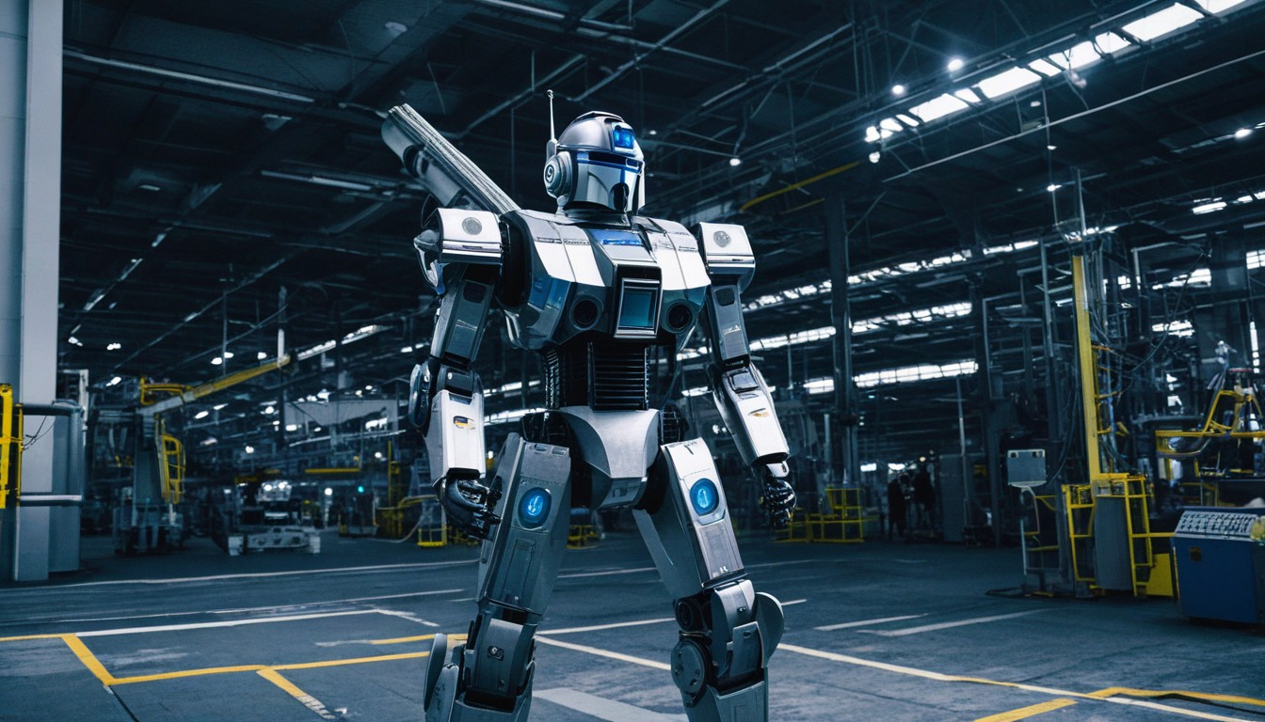
robot

Slide 2
WELCOME TO THE AI GENERATED PPT POWERED BY
RPA

Slide 3

Metal Minds

Slide 4

"Metal Minds explores the cutting-edge realm of robotics, delving into artificial intelligence, machine learning, and advanced automation. This dynamic field brings together technology and creativity to redefine the future."

Slide 5
"Metal Minds unveils the latest breakthroughs in robotics, from autonomous drones to humanoid companions. It investigates the ethical implications of AI and the integration of robots into daily life. This exploration extends to industrial automation, showcasing how robots enhance efficiency. The series also spotlights innovators shaping the field, offering a glimpse into the fascinating intersection of technology and human ingenuity."

Slide 6
Tech Tita

Slide 7

"Tech Titans examines the powerful influence of industry leaders in the technology sector. This series unveils the visionary minds and groundbreaking innovations shaping the digital landscape and transforming society."

Slide 8
"Tech Titans delves into the relentless pace of technological evolution, spotlighting the giants driving innovation. It explores the impact of breakthroughs on daily life, from AI-driven solutions to transformative hardware. The series also delves into the competitive landscape, revealing the strategies employed by tech leaders to stay ahead. Discover the dynamic stories behind the companies shaping our digital future."

Slide 9
Robo Rea

Slide 10
"Robo Realms explores diverse robotic ecosystems, from autonomous vehicles to smart homes. This series showcases the seamless integration of robots into various environments, redefining how we live, work, and interact with technology."

Slide 11
"Robo Realms immerses viewers in the dynamic landscapes where robots thrive. It highlights the role of robotics in healthcare, showcasing advancements in robotic surgery and patient care. The series also delves into the fascinating world of space exploration, revealing how robots contribute to scientific discovery. Experience the evolving relationship between humans and robots in a multitude of environments, from homes to outer space."

Slide 12
Circui

Slide 13
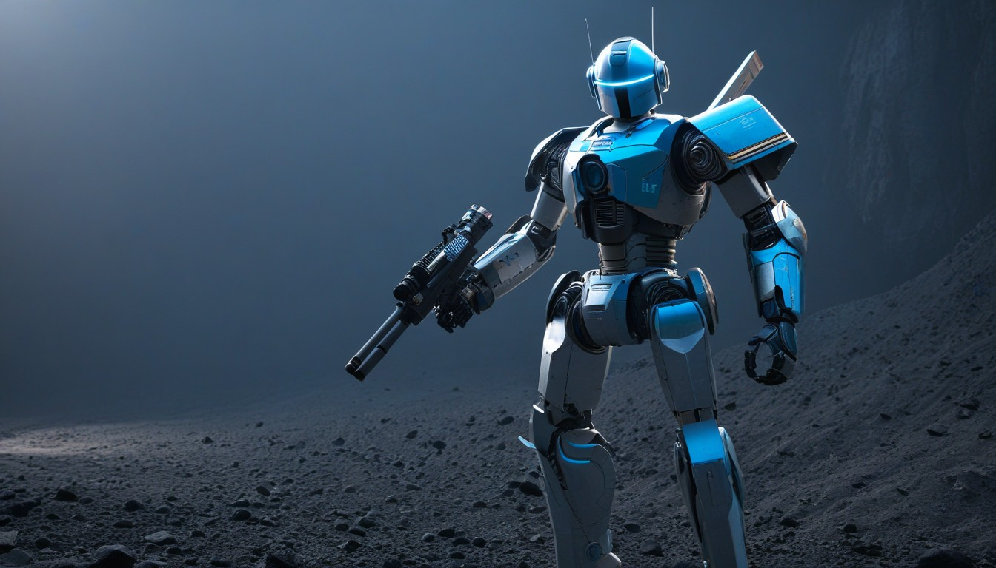
"Circuit Creators explores the minds behind revolutionary robotics, unraveling the intricate process of designing and building advanced circuits. This series unveils the creative minds shaping the future of robotic technology."

Slide 14
"Circuit Creators takes a closer look at the genius innovators shaping the intricate world of robotic circuitry. Delve into the design philosophies and breakthroughs that propel robotics forward. The series spotlights collaborative efforts, revealing how diverse talents converge to create the circuits that power the machines of tomorrow. Witness the fusion of creativity and engineering expertise in this captivating exploration of robotic circuit creation."

Slide 15
Mech Marvels

Slide 16
"Mech Marvels explores awe-inspiring mechanical wonders, showcasing the marvels of engineering and robotics. This series unveils the incredible capabilities and applications of cutting-edge mechanical systems, from exoskeletons to industrial giants."

Slide 17
"Mech Marvels invites viewers into the realm of extraordinary mechanical feats, from bionic limbs revolutionizing mobility to colossal industrial machines reshaping manufacturing. The series delves into the synergy of mechanics and robotics, uncovering the brilliance behind each innovation. Discover the real-world applications and the profound impact of these mechanical marvels on industries and daily life, highlighting the evolving landscape of advanced machinery."

Slide 18

THANK YOU
FOR WATCHING
Thank you

