Slide 1
Artificial Intelligence Survey
CMPT 310, Spring 2020
Slide credits: Dan Klein and Pieter Abbeel

Slide 2
Course outline

Slide 3
People
Instructor: Yağız Aksoy
Office: TASC1 9215
Office hours:
TA’s:
Matthew Lynn
Yiqi Yan
Office hours TBA

Slide 4
Topics
Search
Depth-first, breadth-first, informed
Games and adversarial search
Constraint satisfaction problems
Probability
Bayesian networks
Hidden Markov models
Machine learning
Decision trees
Neural networks
Training and evaluation
Advanced applications (NLP, Computer Vision)

Slide 5
Grading
Prerequisites: (i) CMPT 225
(ii) MACM 101 or ENSC 251 and ENSC 252
Coding assignments - 4 x 6.25% = 25%
Midterm exam (March 13, during lecture) – 25%
Final exam (April 22, 8:30-11:30) – 50%
Piazza discussion participation: 5% bonus

Slide 6
Coding assignments
4 coding assignments
Due early Feb, late Feb, mid March, early April
Late policy:
4 days of penalty-free late submission throughout the semester
After that, 33% penalty per day
1 hour late = 23 hours late
Plagiarism policy

Slide 7
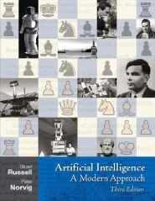
Textbook

Slide 8
Misc.
We will use Piazza for discussions
We will use Coursys for announcements and assignments
Course website: http://yaksoy.github.io/ais/
Please no laptops during lectures
The slides will be posted online
The best way to take notes is on paper!

Slide 9
What is AI?
What is this course about?

Slide 10
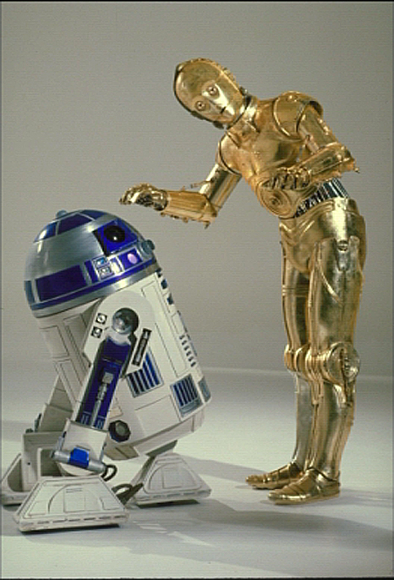

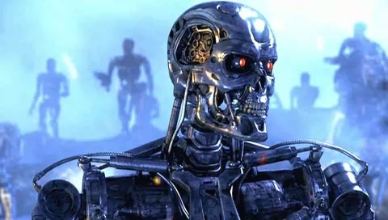
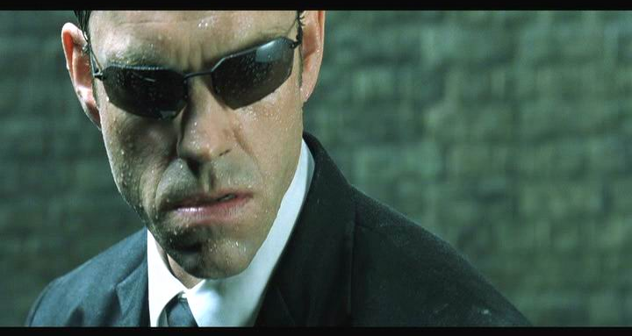
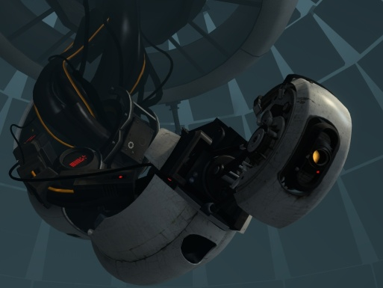
Sci-Fi AI?
Notes:
Who are these? C3PO, what does he do? Essentially google translate, (but with anxiety disorder!)
Smal guy? R2D2 – what does he do, yeah, not so sure
Things got darker: machines come back from the future – to kill us!
90’s : software is scary
Basic fear about what technology might do ?
What if we can’t even tell technology apart from ourselves?
OR maybe it’ll look really different and snarky
Some exceptions like wall-E, positive view of technology (but maybe not of us humans!)
But mostly a worry
[not very worried myself, at least at present]

Slide 11
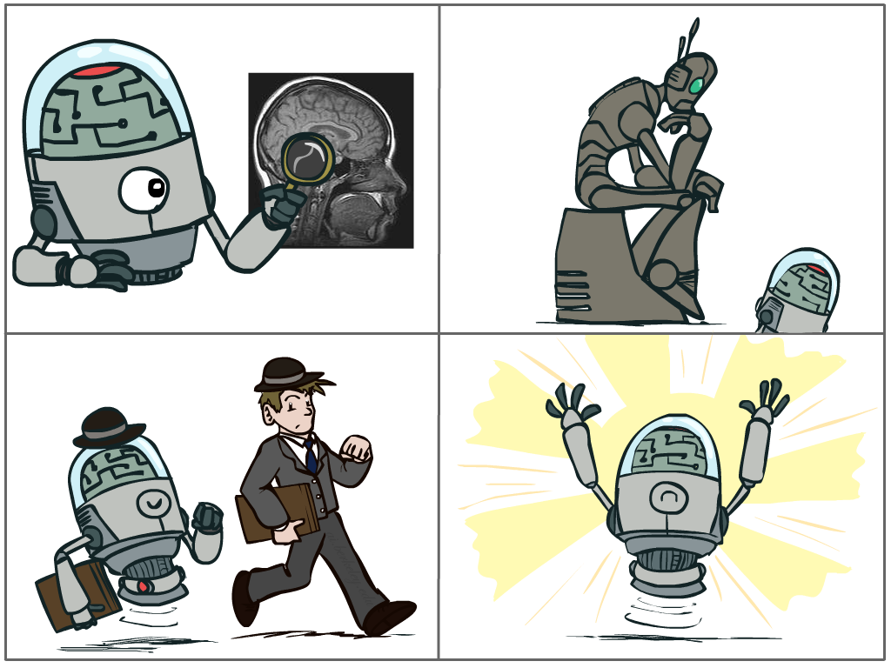
What is AI?
The science of making machines that:
Think like people
Think rationally
Act like people
Act rationally
Notes:
Top left: Think like people --- cognitive science, neuroscience
Bottom left: act like people --- actually very early definition, dating back to Alan Turing --- Turing test; problem to do really well you start focusing on things like don’t answer too quickly what the square root of 1412 is, don’t spell too well, and make sure you have a favorite movie etc. So it wasn’t really leading us to build intelligence
Think rationally – long tradition dating back to Aristotle --- but not a winner, because difficult to encode how to think, and in the end it’s not about how you think, it’s about how you end up acting

Slide 12
Rational Decisions
We’ll use the term rational in a very specific, technical way:
Rational: maximally achieving pre-defined goals
Rationality only concerns what decisions are made
(not the thought process behind them)
Goals are expressed in terms of the utility of outcomes
Being rational means maximizing your expected utility
A better title for this course would be:
Computational Rationality
Notes:
Example of utilities. 10 for A, 1 for each Friday with friends

Slide 13
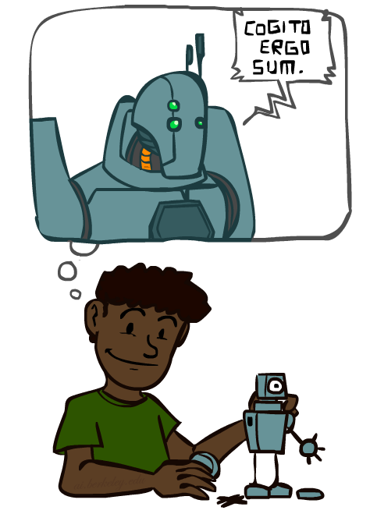
A (Short) History of AI
1940-1950: Early days
1943: McCulloch & Pitts: Boolean circuit model of brain
1950: Turing's “Computing Machinery and Intelligence”
1950—70: Excitement: Look, Ma, no hands!
1950s: Early AI programs, including Samuel's checkers program, Newell & Simon's Logic Theorist, Gelernter's Geometry Engine
1956: Dartmouth meeting: “Artificial Intelligence” adopted
1965: Robinson's complete algorithm for logical reasoning
1970—90: Knowledge-based approaches
1969—79: Early development of knowledge-based systems
1980—88: Expert systems industry booms
1988—93: Expert systems industry busts: “AI Winter”
1990—: Statistical approaches
Resurgence of probability, focus on uncertainty
General increase in technical depth
Agents and learning systems… “AI Spring”?
2000—: AI Revolution?
Notes:
Million dollar computer with less computation than your phone
MT was

Slide 14

What Can AI Do?
Quiz: Which of the following can be done at present?
Play a decent game of table tennis?
Play a decent game of Jeopardy?
Drive safely along a curving mountain road?
Drive safely along Hastings?
Buy a week's worth of groceries on the web?
Buy a week's worth of groceries at Nester’s?
Discover and prove a new mathematical theorem?
Converse successfully with another person for an hour?
Perform a surgical operation?
Put away the dishes and fold the laundry?
Translate spoken Chinese into spoken English in real time?
Write an intentionally funny story?

Slide 15
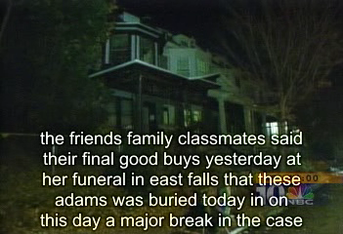
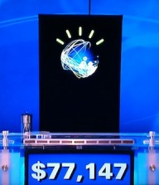
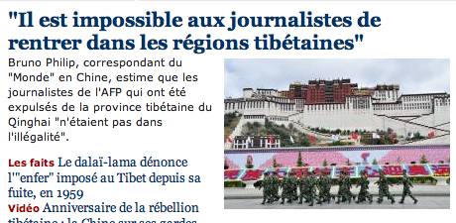
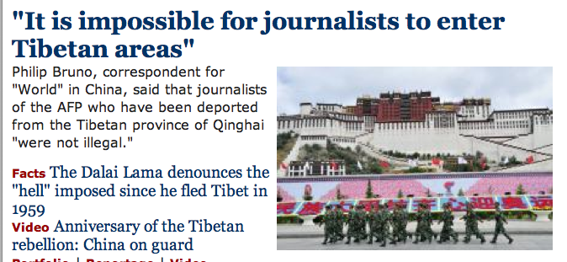
Natural Language
Speech technologies (e.g. Siri)
Automatic speech recognition (ASR)
Text-to-speech synthesis (TTS)
Dialog systems
Language processing technologies
Question answering
Machine translation
Web search
Text classification, spam filtering, etc…

Slide 16
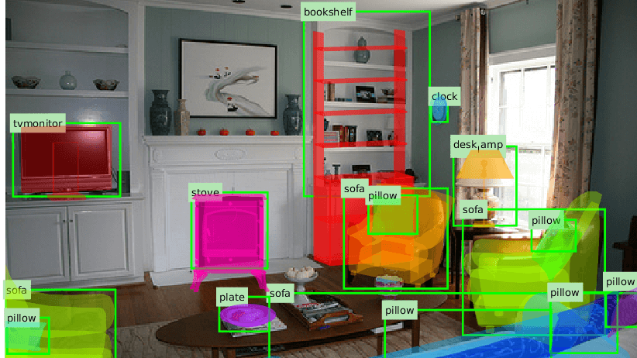
Vision (Perception)
Object and face recognition
Scene segmentation
Image classification

Slide 17
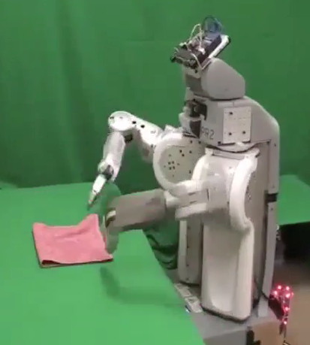
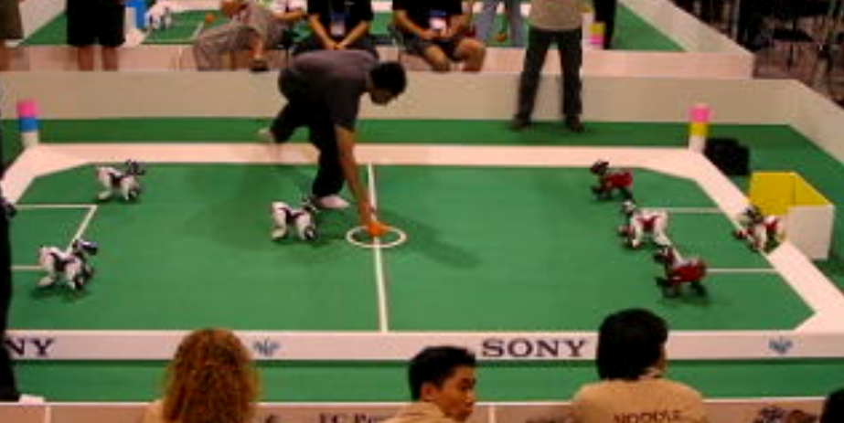
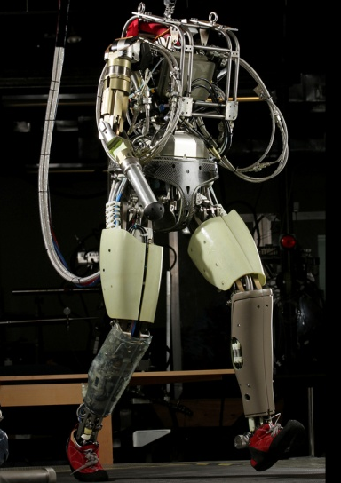
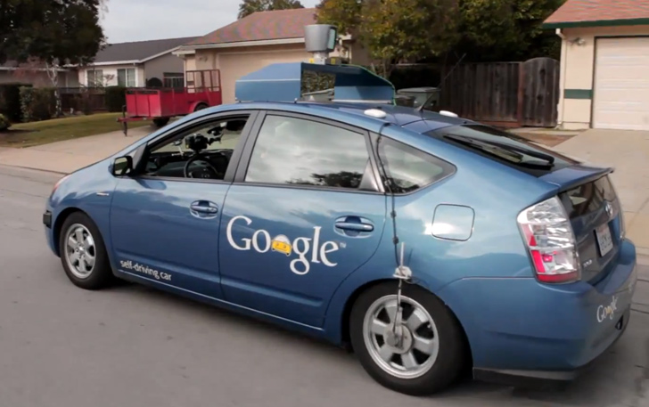
Robotics
Robotics
Part mech. eng.
Part AI
Reality much
harder than
simulations!
Technologies
Vehicles
Rescue
Soccer!
Lots of automation…
In this class:
We ignore mechanical aspects
Methods for planning
Methods for control
Images from UC Berkeley, Boston Dynamics, RoboCup, Google

