Slide 1
Artificial Intelligence Survey
CMPT 310, Spring 2020
Slide credits: Dan Klein and Pieter Abbeel

Slide 2
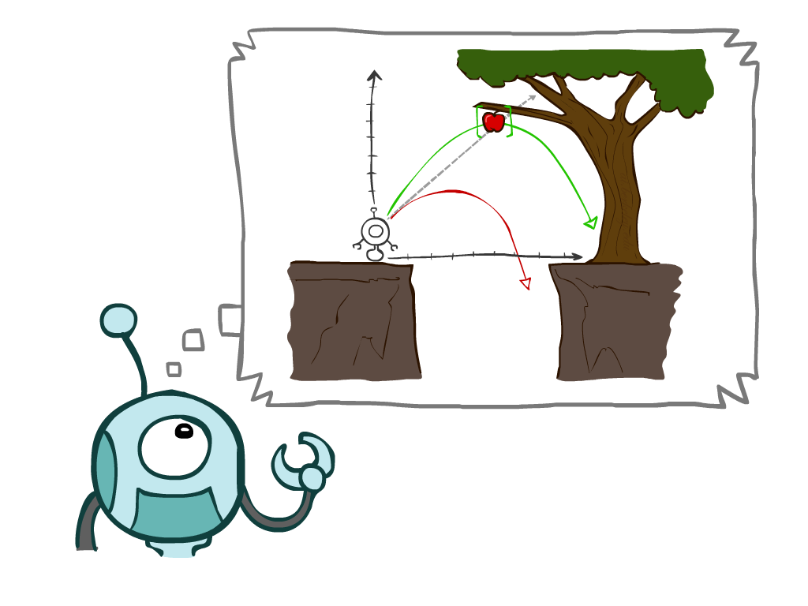
This week
Agents that Plan Ahead
Search Problems
Uninformed Search Methods
Depth-First Search
Breadth-First Search
Uniform-Cost Search
Notes:
General theme in the class:
A goal we have in mind.
A mathematical abstraction to formalize this
Algorithms that operate on these abstractions

Slide 3
Agents that Plan

Slide 4

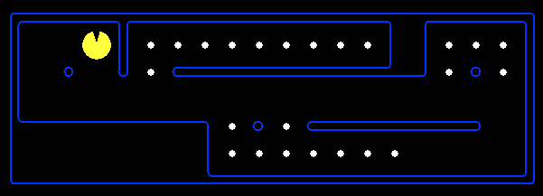
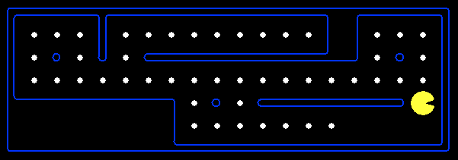
Reflex Agents
Reflex agents:
Choose action based on current percept (and maybe memory)
May have memory or a model of the world’s current state
Do not consider the future consequences of their actions
Consider how the world IS
Can a reflex agent be rational?
[Demo: reflex optimal (L2D1)]
[Demo: reflex optimal (L2D2)]
Notes:
Examples: blinking your eye (not using your entire thinking capabilities), vacuum cleaner moving towards nearest dirt

Slide 5
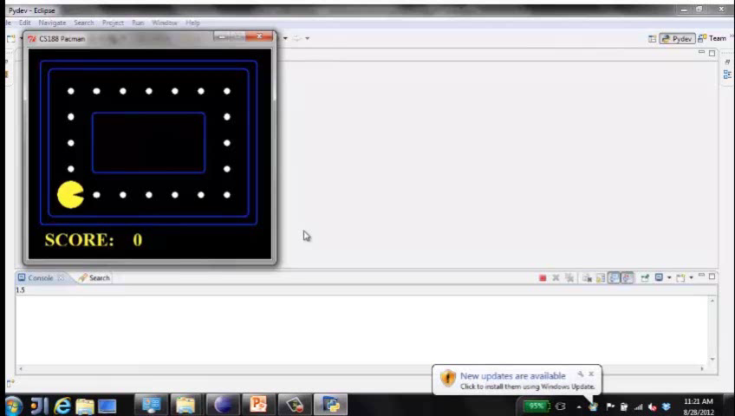
Video of Demo Reflex Optimal

Slide 6
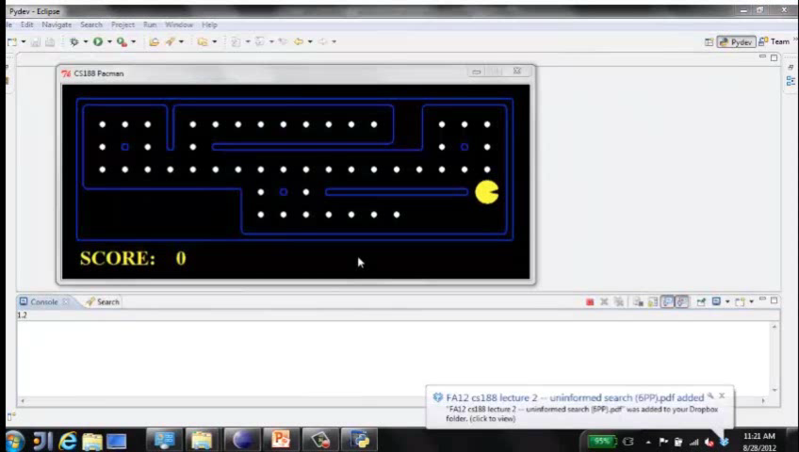
Video of Demo Reflex Odd

Slide 7
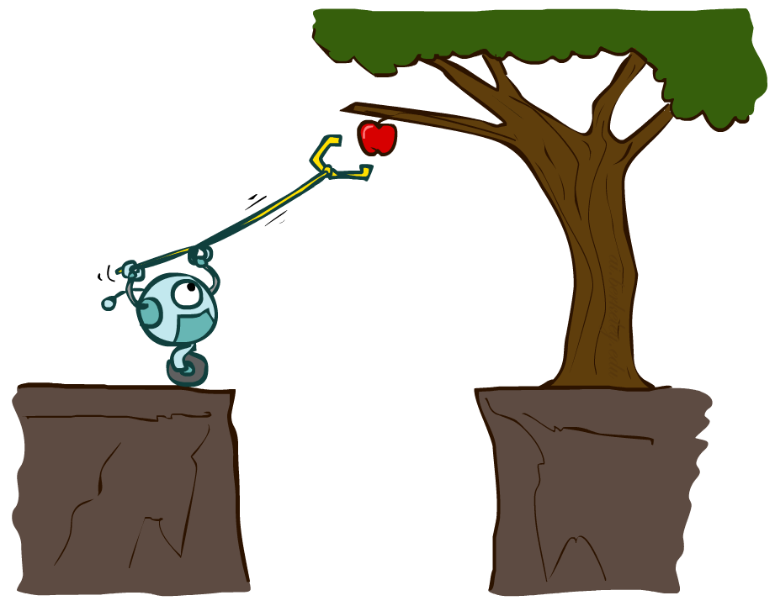
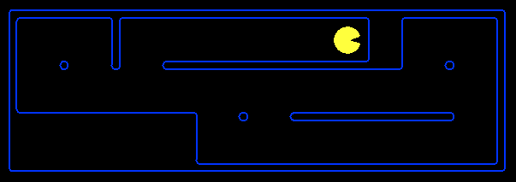
Planning Agents
Planning agents:
Ask “what if”
Decisions based on (hypothesized) consequences of actions
Must have a model of how the world evolves in response to actions
Must formulate a goal (test)
Consider how the world WOULD BE
Optimal vs. complete planning
Planning vs. replanning
[Demo: replanning (L2D3)]
[Demo: mastermind (L2D4)]

Slide 8
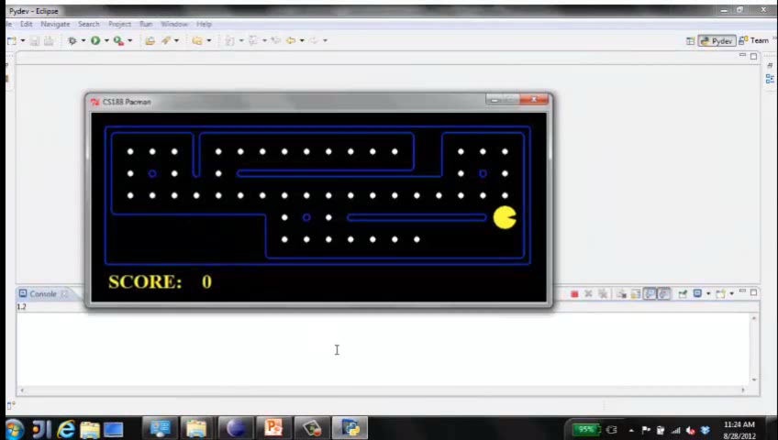
Video of Demo Replanning

Slide 9
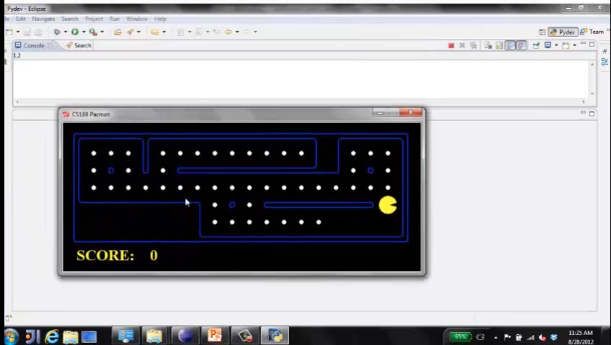
Video of Demo Mastermind

Slide 10

Search Problems

Slide 11







Search Problems
A search problem consists of:
A state space
A successor function
(with actions, costs)
A start state and a goal test
A solution is a sequence of actions (a plan) which transforms the start state to a goal state
“N”, 1.0
“E”, 1.0
Notes:
Often comes back on exams
Goal test – sometimes more than one state that satisfies having achieved the goal, for example, “eat all the dots”
Abstraction

Slide 12

Search Problems Are Models

Slide 13
Example: Traveling in Romania
State space:
Cities
Successor function:
Roads: Go to adjacent city with cost = distance
Start state:
Arad
Goal test:
Is state == Bucharest?
Solution?

Slide 14
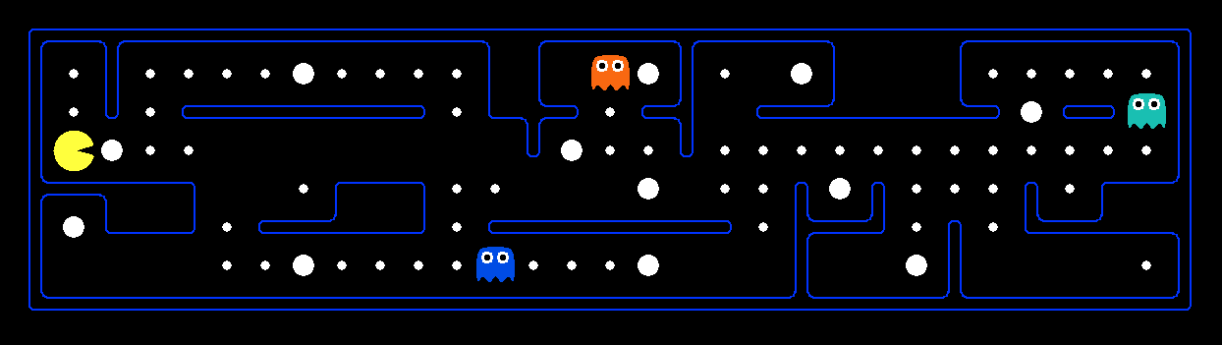
What’s in a State Space?
The world state includes every last detail of the environment
A search state keeps only the details needed for planning (abstraction)
Problem: Pathing
States: (x,y) location
Actions: NSEW
Successor: update location only
Goal test: is (x,y)=END
Problem: Eat-All-Dots
States: {(x,y), dot booleans}
Actions: NSEW
Successor: update location and possibly a dot boolean
Goal test: dots all false
Notes:
Wrong example for “eat-all-dots”: (x, y, dot count)

Slide 15
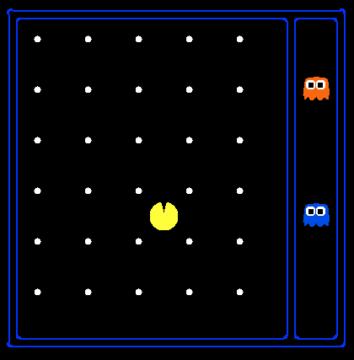
State Space Sizes?
World state:
Agent positions: 120
Food count: 30
Ghost positions: 12
Agent facing: NSEW
How many
World states?
120x(2³⁰)x(12²)x4
States for pathing?
120
States for eat-all-dots?
120x(2³⁰)
Notes:
90 * (2^30-1) + 30 * 2^29 = 145 billion
2^29 = 536 870 912

Slide 16
Quiz: Safe Passage
Problem: eat all dots while keeping the ghosts perma-scared
What does the state space have to specify?
(agent position, dot booleans, power pellet booleans, remaining scared time)

Slide 17
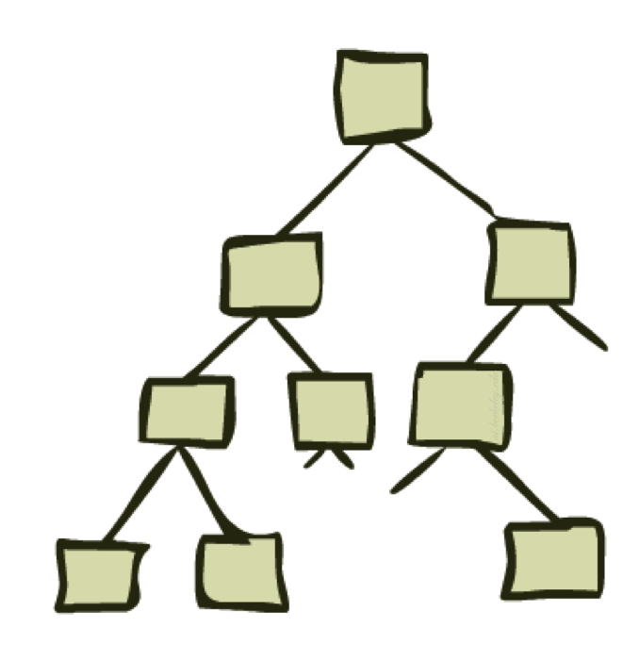
State Space Graphs and Search Trees

Slide 18
State Space Graphs
State space graph: A mathematical representation of a search problem
Nodes are (abstracted) world configurations
Arcs represent successors (action results)
The goal test is a set of goal nodes (maybe only one)
In a state space graph, each state occurs only once!
We can rarely build this full graph in memory (it’s too big), but it’s a useful idea

Slide 19
State Space Graphs
State space graph: A mathematical representation of a search problem
Nodes are (abstracted) world configurations
Arcs represent successors (action results)
The goal test is a set of goal nodes (maybe only one)
In a search graph, each state occurs only once!
We can rarely build this full graph in memory (it’s too big), but it’s a useful idea
a
G
b
c
e
d
f
S
h
p
q
r
Tiny search graph for a tiny search problem

Slide 20
Search Trees
This is now / start
“N”, 1.0
“E”, 1.0
Possible futures
A search tree:
A “what if” tree of plans and their outcomes
The start state is the root node
Children correspond to successors
Nodes show states, but correspond to PLANS that achieve those states
For most problems, we can never actually build the whole tree
Notes:
Different plans that achieve the same state, will be different nodes in the tree.

Slide 21
State Space Graphs vs. Search Trees
State Space Graph
Each NODE in in the search tree is an entire PATH in the state space graph.
Search Tree
S
a
G
d
e
p
b
c
q
b
c
e
h
r
d
e
f
a
a
h
r
p
q
f
S
h
We construct both on demand – and we construct as little as possible.
p
q
f
q
c
G
p
q
r
q
c
G
a
a

Slide 22

Quiz: State Space Graphs vs. Search Trees
Consider this 4-state graph:
How big is its search tree (from S)?
a
S
G
b
Important: Lots of repeated structure in the search tree!

Slide 23
Tree Search

Slide 24
Search Example: Romania

Slide 25
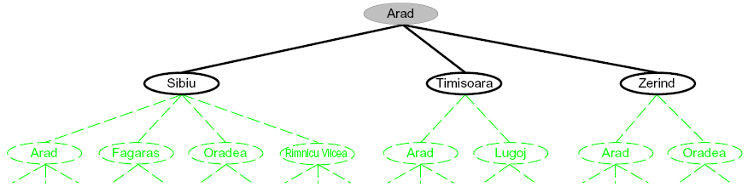
Searching with a Search Tree
Search:
Expand out potential plans (tree nodes)
Maintain a fringe of partial plans under consideration
Try to expand as few tree nodes as possible

Slide 26
General Tree Search
Important ideas:
Fringe
Expansion
Exploration strategy
Main question: which fringe nodes to explore?

Slide 27
Example: Tree Search
a
G
b
c
d
e
f
S
h
p
q
r
Notes:
Left: show tree
Right: fringe

