Slide 1
Artificial Intelligence Survey
CMPT 310, Spring 2020
Slide credits: Dan Klein and Pieter Abbeel

Slide 2

Today
Informed Search
Heuristics
Greedy Search
A* Search

Slide 3
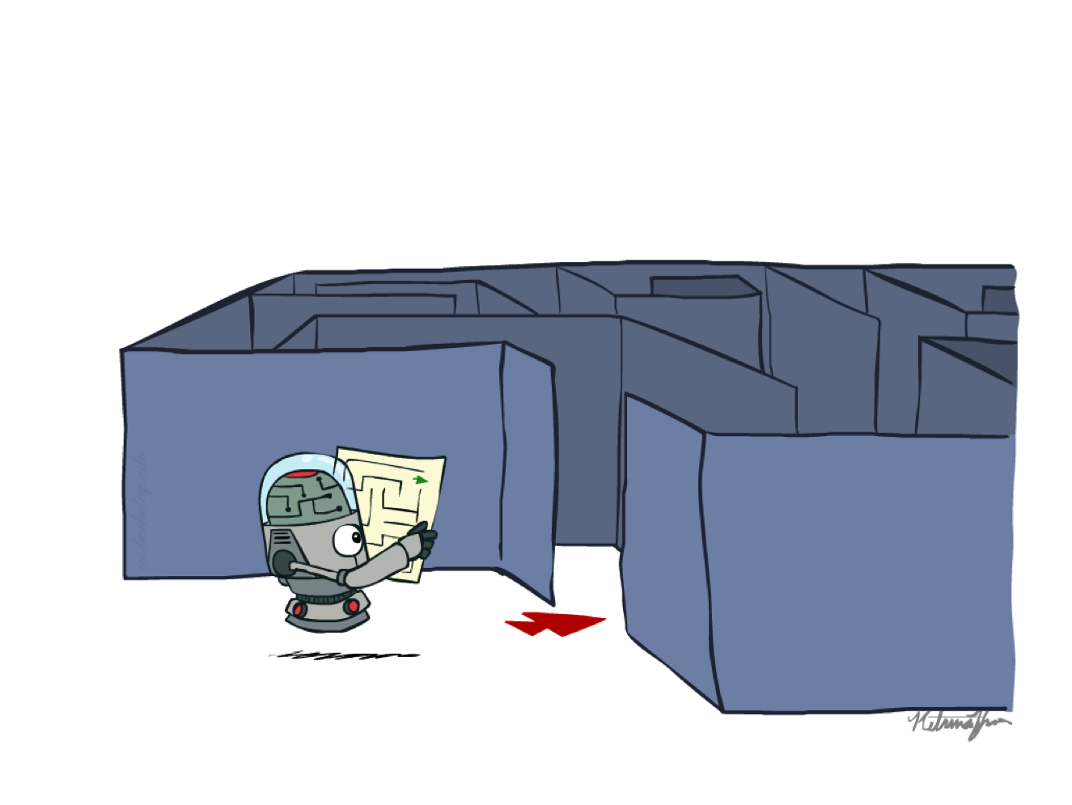
Recap: Search

Slide 4
Recap: Search
Search problem:
States (configurations of the world)
Actions and costs
Successor function (world dynamics)
Start state and goal test
Search tree:
Nodes: represent plans for reaching states
Plans have costs (sum of action costs)
Search algorithm:
Systematically builds a search tree
Chooses an ordering of the fringe (unexplored nodes)
Optimal: finds least-cost plans

Slide 5
Example: Pancake Problem
Cost: Number of pancakes flipped
Notes:
Gates, W. and Papadimitriou, C., "Bounds for Sorting by Prefix Reversal.", Discrete Mathematics. 27, 47-57, 1979.

Slide 6
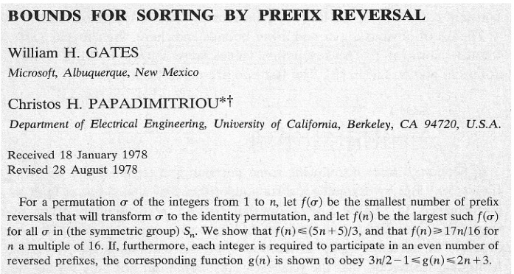
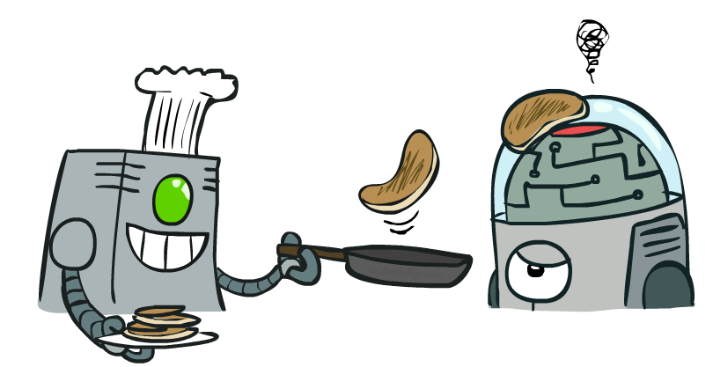
Example: Pancake Problem
Notes:
Gates, W. and Papadimitriou, C., "Bounds for Sorting by Prefix Reversal.", Discrete Mathematics. 27, 47-57, 1979.

Slide 7
Example: Pancake Problem
State space graph with costs as weights
4
2
3
2
3
4
3
4
2
3
2
2
4
3
Notes:
A* expanded 8100 ; Path cost = 33
UCS expanded 25263 . Path cost = 33
Greedy expanded 10 . Path cost = 41
[0, 7, 5, 3, 2, 1, 4, 6]
(7, 0, 5, 3, 2, 1, 4, 6)
(6, 4, 1, 2, 3, 5, 0, 7)
(3, 2, 1, 4, 6, 5, 0, 7)
(1, 2, 3, 4, 6, 5, 0, 7)
(5, 6, 4, 3, 2, 1, 0, 7)
(6, 5, 4, 3, 2, 1, 0, 7)
(0, 1, 2, 3, 4, 5, 6, 7)

Slide 8
General Tree Search
Action: flip top two Cost: 2
Action: flip all four Cost: 4
Path to reach goal:
Flip four, flip three
Total cost: 7
Notes:
You know exactly where you came from and how you got there, but you have no idea where you’re going. But, you’ll know it when you see it.

Slide 9
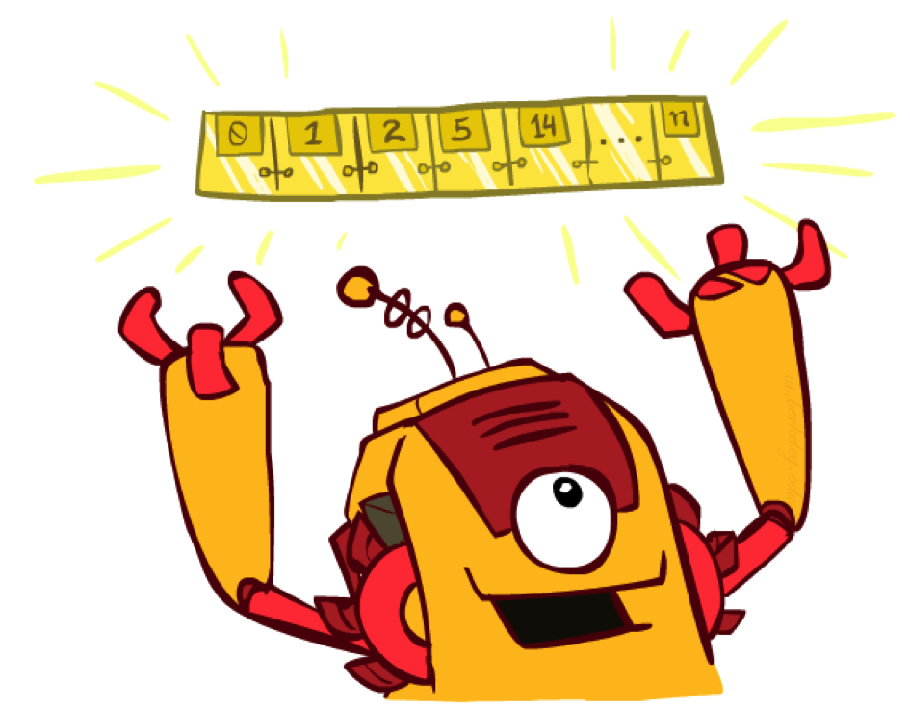
The One Queue
All these search algorithms are the same except for fringe strategies
Conceptually, all fringes are priority queues (i.e. collections of nodes with attached priorities)
Practically, for DFS and BFS, you can avoid the log(n) overhead from an actual priority queue, by using stacks and queues
Can even code one implementation that takes a variable queuing object

Slide 10
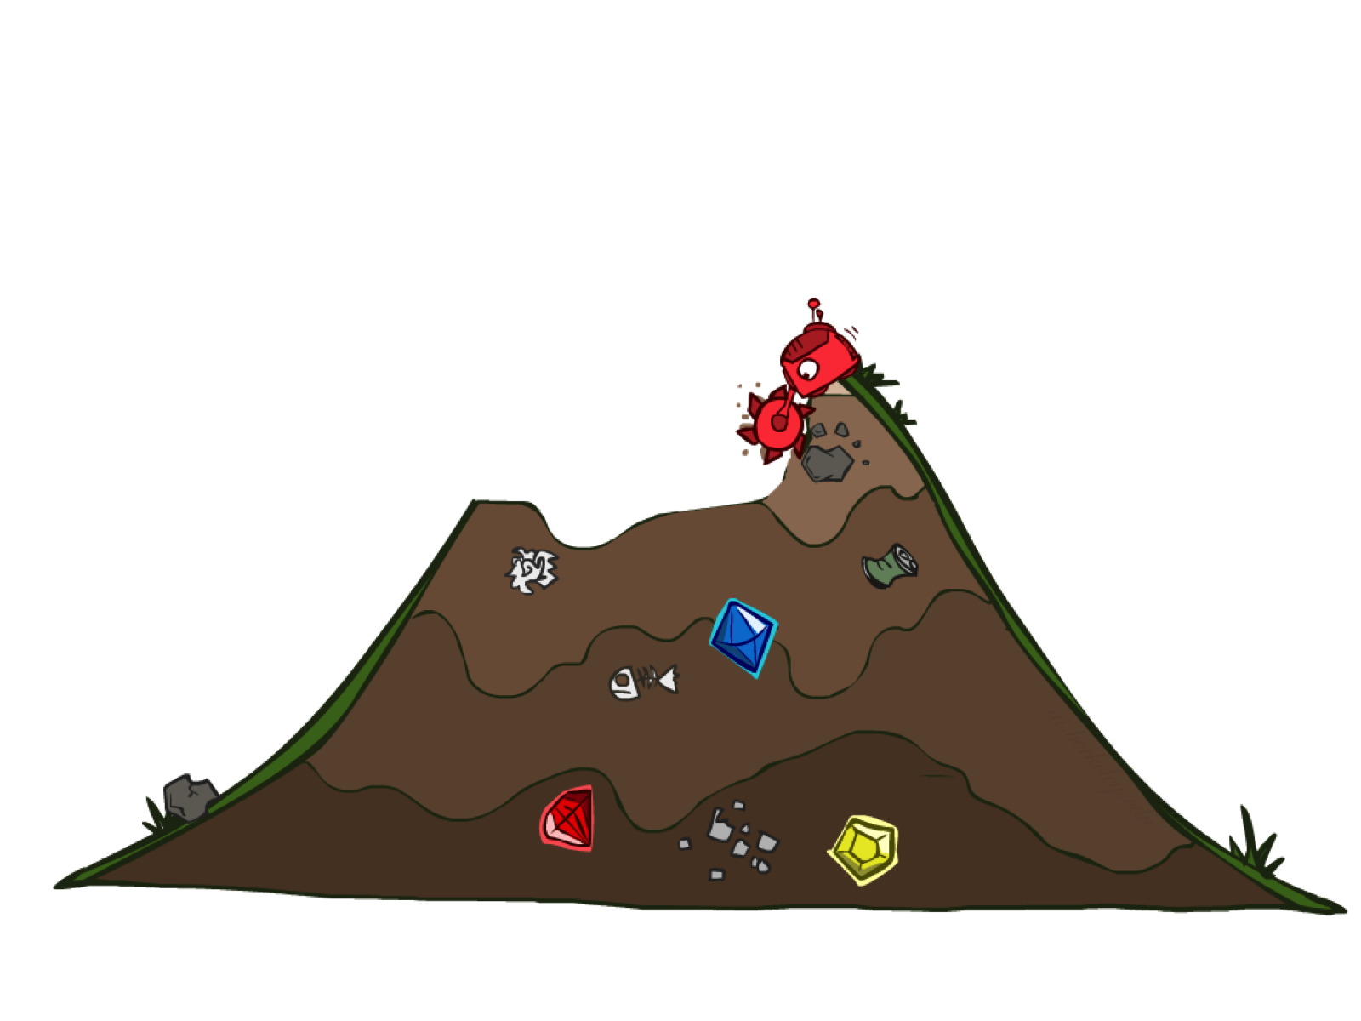
Uninformed Search

Slide 11
Uniform Cost Search
Strategy: expand lowest path cost
The good: UCS is complete and optimal!
The bad:
Explores options in every “direction”
No information about goal location
c ≤ 1
…
c ≤ 2
c ≤ 3
Start
Goal

Slide 12

Video of Demo Contours UCS Empty

Slide 13
Video of Demo Contours UCS Pacman Small Maze

Slide 14
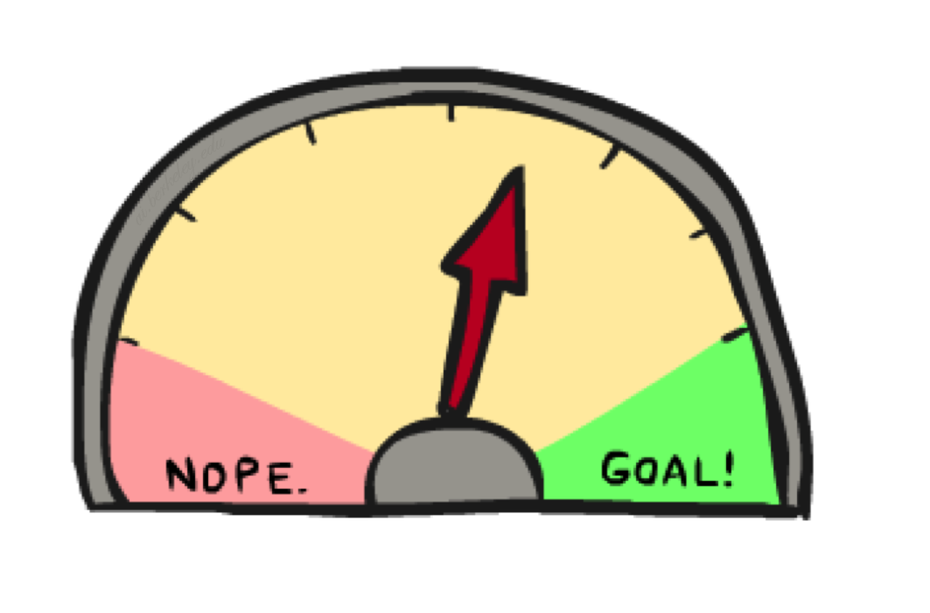
Informed Search

Slide 15
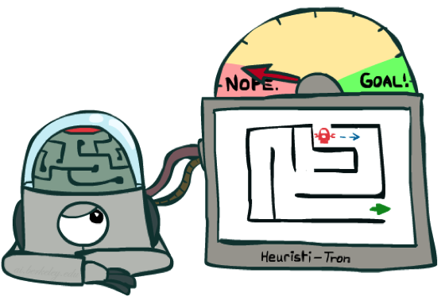
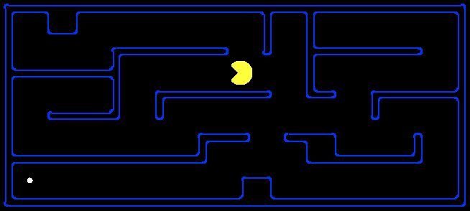
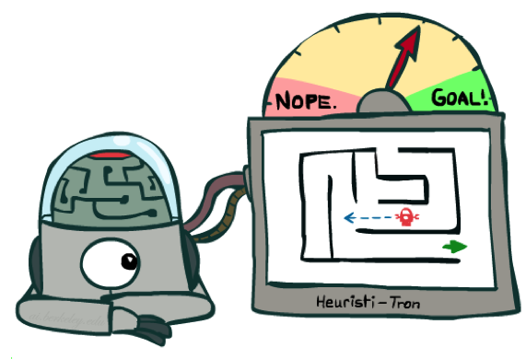
Search Heuristics
A heuristic is:
A function that estimates how close a state is to a goal
Designed for a particular search problem
Examples: Manhattan distance, Euclidean distance for pathing
10
5
11.2

Slide 16
Example: Heuristic Function
h(x)

Slide 17
Example: Heuristic Function
Heuristic: the number of the largest pancake that is still out of place
3
h(x)
4
3
4
3
0
4
4
3
4
4
2
3
Notes:
A* expanded 8100 ; Path cost = 33
UCS expanded 25263 . Path cost = 33
Greedy expanded 10 . Path cost = 41
[0, 7, 5, 3, 2, 1, 4, 6]
(7, 0, 5, 3, 2, 1, 4, 6)
(6, 4, 1, 2, 3, 5, 0, 7)
(3, 2, 1, 4, 6, 5, 0, 7)
(1, 2, 3, 4, 6, 5, 0, 7)
(5, 6, 4, 3, 2, 1, 0, 7)
(6, 5, 4, 3, 2, 1, 0, 7)
(0, 1, 2, 3, 4, 5, 6, 7)

Slide 18
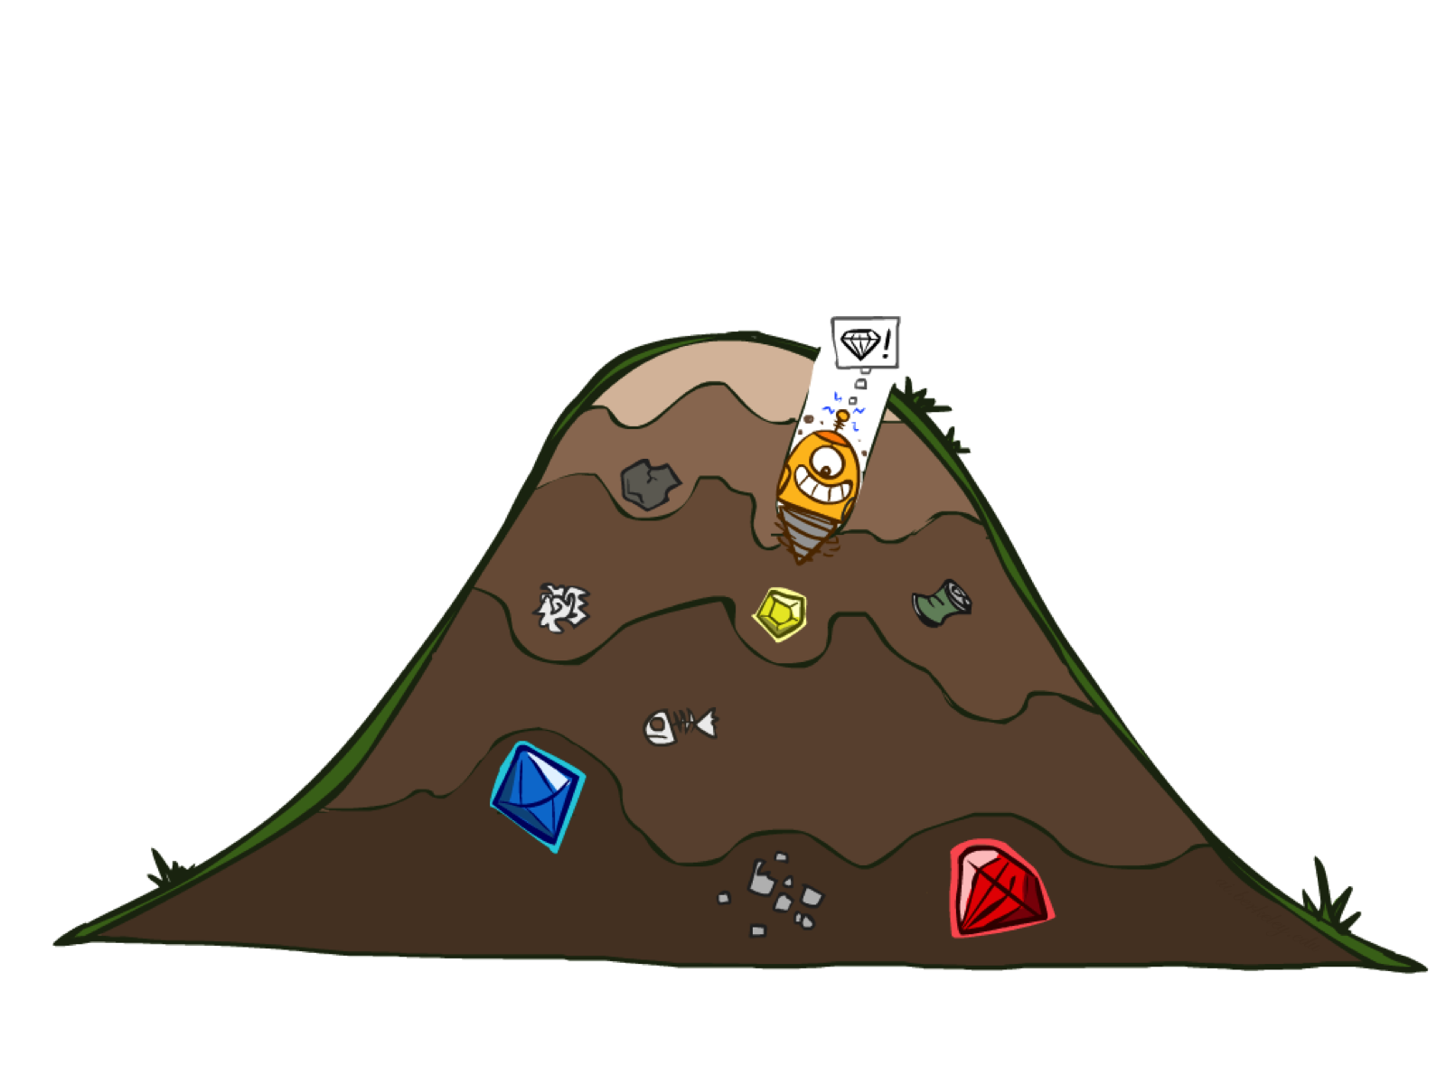
Greedy Search

Slide 19
Example: Heuristic Function
h(x)

Slide 20

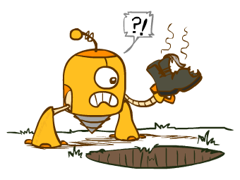
Greedy Search
Expand the node that seems closest…
What can go wrong?

Slide 21
Greedy Search
b
Strategy: expand a node that you think is closest to a goal state
Heuristic: estimate of distance to nearest goal for each state
A common case:
Best-first takes you straight to the (wrong) goal
Worst-case: like a badly-guided DFS
…
b
…
[Demo: contours greedy empty (L3D1)]
[Demo: contours greedy pacman small maze (L3D4)]
Notes:
For any search problem, you know the goal. Now, you have an idea of how far away you are from the goal.

Slide 22
Video of Demo Contours Greedy (Empty)

Slide 23
Video of Demo Contours Greedy (Pacman Small Maze)

Slide 24
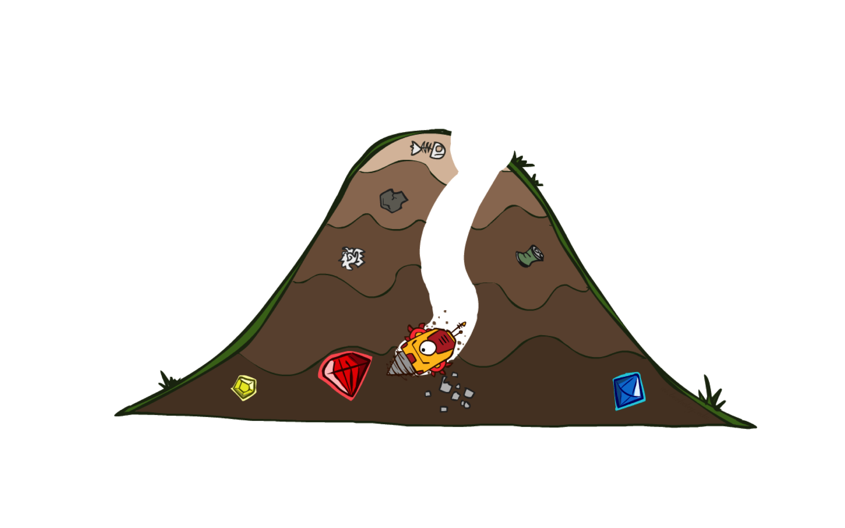
A* Search

Slide 25
Combining UCS and Greedy
Uniform-cost orders by path cost, or backward cost g(n)
Greedy orders by goal proximity, or forward cost h(n)
A* Search orders by the sum: f(n) = g(n) + h(n)
8
g = 0 h=6
S
e
h=1
g = 1 h=5
a
1
1
3
2
g = 2 h=6
g = 9 h=1
S
a
d
G
b
d
g = 4 h=2
e
h=6
1
h=5
h=2
h=0
1
g = 3 h=7
g = 6 h=0
g = 10 h=2
c
b
c
G
d
h=7
h=6
g = 12 h=0
G
Example: Teg Grenager

Slide 26
When should A* terminate?
Should we stop when we enqueue a goal?
No: only stop when we dequeue a goal
h = 2
A
2
2
S
h = 3
h = 0
G
2
B
3
h = 1

Slide 27
Is A* Optimal?
h = 6
1
A
3
S
h = 7
G
h = 0
5
What went wrong?
Actual bad goal cost < estimated good goal cost
We need estimates to be less than actual costs!

