Slide 1
Artificial Intelligence Survey
CMPT 310, Spring 2020
Slide credits: Dan Klein and Pieter Abbeel

Slide 2
Announcements
Piazza: https://piazza.com/sfu.ca/spring2020/cmpt310/home
Office hours:
Yagiz: Friday following the lecture, 4:30, TASC1 9215
Matthew: Tuesday, 4:00 – 5:00, ASB 9810
Yiqi: Thursday, 3:30 – 4:30, ASB 9808
First assignment coming soon…
Reading

Slide 3
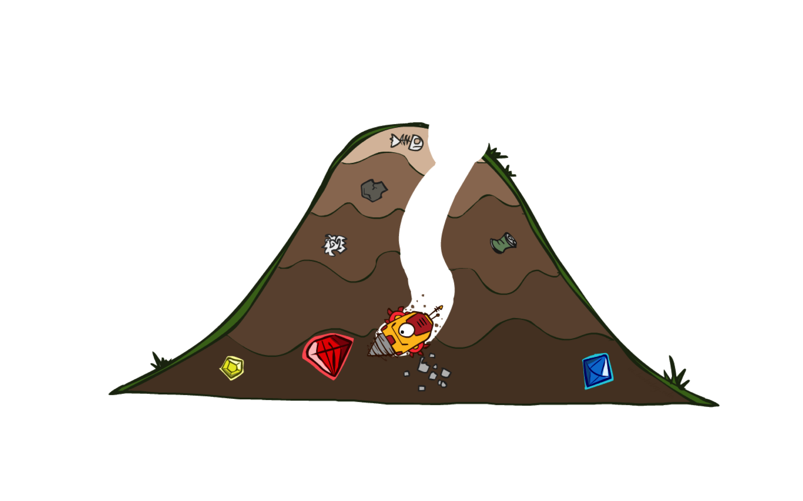
A* Search

Slide 4
Combining UCS and Greedy
Uniform-cost orders by path cost, or backward cost g(n)
Greedy orders by goal proximity, or forward cost h(n)
A* Search orders by the sum: f(n) = g(n) + h(n)
8
g = 0 h=6
S
e
h=1
g = 1 h=5
a
1
1
3
2
g = 2 h=6
g = 9 h=1
S
a
d
G
b
d
g = 4 h=2
e
h=6
1
h=5
h=2
h=0
1
g = 3 h=7
g = 6 h=0
g = 10 h=2
c
b
c
G
d
h=7
h=6
g = 12 h=0
G
Example: Teg Grenager

Slide 5

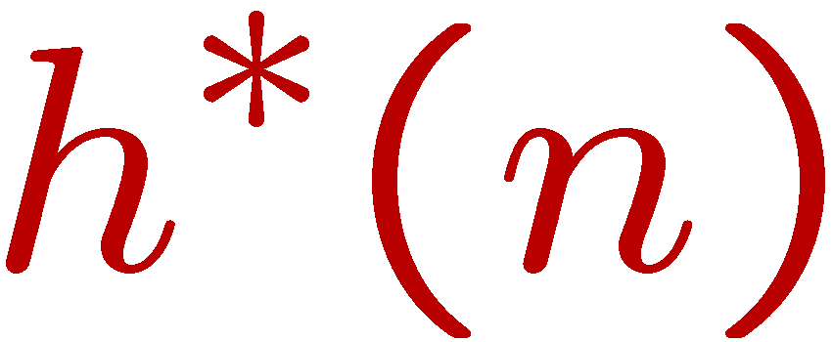
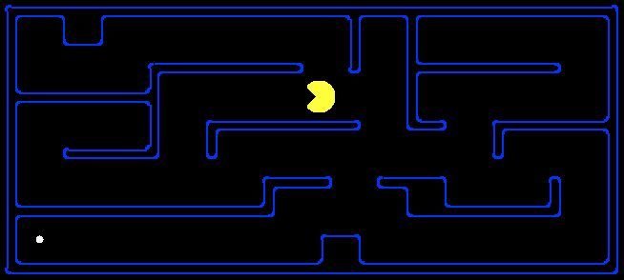
Admissible Heuristics
A heuristic h is admissible (optimistic) if:
where is the true cost to a nearest goal
Examples:
Coming up with admissible heuristics is most of what’s involved in using A* in practice.
4
15

Slide 6
Creating Admissible Heuristics
Most of the work in solving hard search problems optimally is in coming up with admissible heuristics
Often, admissible heuristics are solutions to relaxed problems, where new actions are available
Inadmissible heuristics are often useful too
15
366

Slide 7
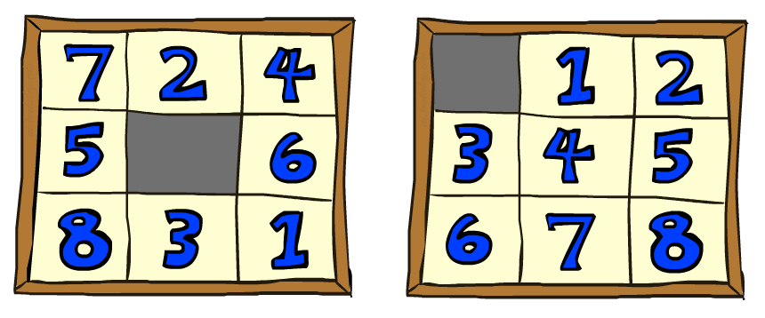
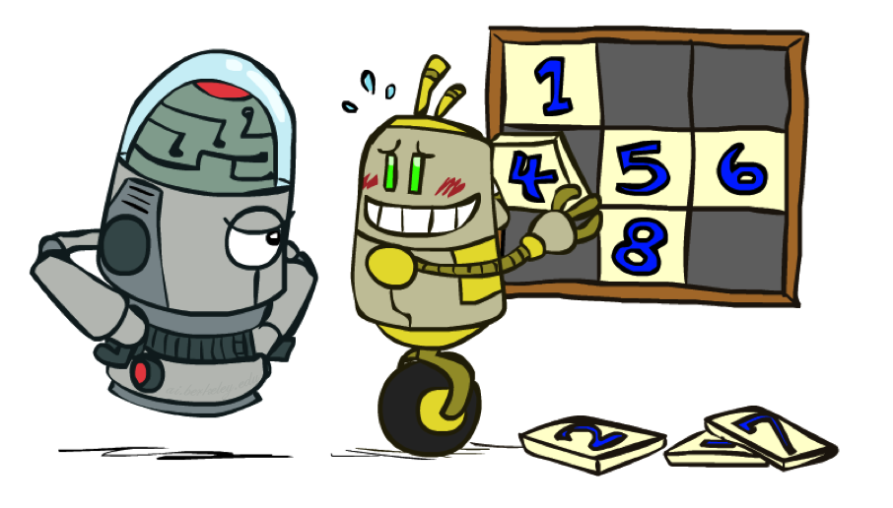
8 Puzzle I
Heuristic: Number of tiles misplaced
Why is it admissible?
h(start) =
This is a relaxed-problem heuristic
8
Start State
Goal State
 | Average nodes expanded when the optimal path has…
 | …4 steps | …8 steps | …12 steps
UCS | 112 | 6,300 | 3.6 x 10⁶
TILES | 13 | 39 | 227
Statistics from Andrew Moore

Slide 8
8 Puzzle II
What if we had an easier 8-puzzle where any tile could slide any direction at any time, ignoring other tiles?
Total Manhattan distance
Why is it admissible?
h(start) =
Start State
Goal State
 | Average nodes expanded when the optimal path has…
 | …4 steps | …8 steps | …12 steps
TILES | 13 | 39 | 227
MANHATTAN | 12 | 25 | 73
3 + 1 + 2 + … = 18

Slide 9







Trivial Heuristics, Dominance
Dominance: h_{a} ≥ h_{c} if
Heuristics form a semi-lattice:
Max of admissible heuristics is admissible
Trivial heuristics
Bottom of lattice is the zero heuristic (what does this give us?)
Top of lattice is the exact heuristic
Notes:
Semi-lattice: x <= y <-> x = x ^ y

Slide 10
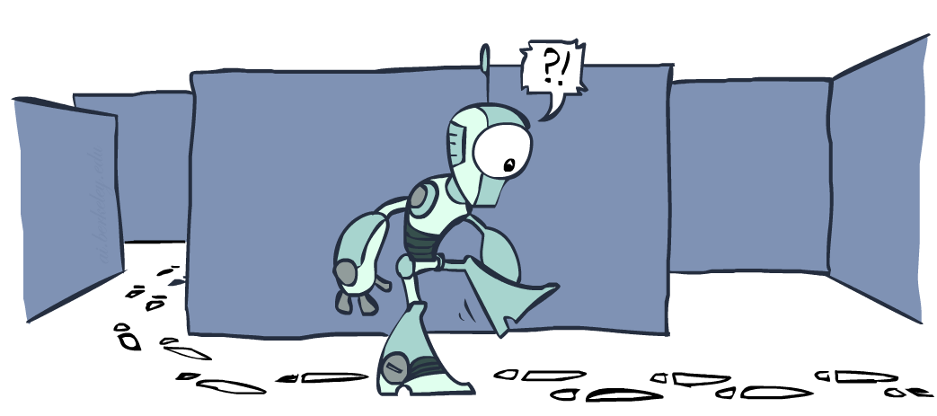
Graph Search

Slide 11
Tree Search: Extra Work!
Failure to detect repeated states can cause exponentially more work.
State Graph
Search Tree

Slide 12
Graph Search
In BFS, for example, we shouldn’t bother expanding the circled nodes (why?)
S
d
e
p
b
c
e
h
r
q
a
a
h
r
p
q
f
p
q
f
q
c
G
q
c
G
a
a

Slide 13
Graph Search
Idea: never expand a state twice
How to implement:
Tree search + set of expanded states (“closed set”)
Expand the search tree node-by-node, but…
Before expanding a node, check to make sure its state has never been expanded before
If not new, skip it, if new add to closed set
Important: store the closed set as a set, not a list
Can graph search wreck completeness? Why/why not?
How about optimality?

Slide 14
A* Graph Search Gone Wrong?
State space graph
Search tree
A
S (0+2)
1
S
1
C
h=4
h=1
A (1+4)
B (1+1)
h=2
1
2
B
3
C (2+1)
C (3+1)
h=1
G
G (5+0)
G (6+0)
h=0

Slide 15
Consistency of Heuristics
Main idea: estimated heuristic costs ≤ actual costs
Admissibility: heuristic cost ≤ actual cost to goal
h(A) ≤ actual cost from A to G
Consistency: heuristic “arc” cost ≤ actual cost for each arc
h(A) – h(C) ≤ cost(A to C)
Consequences of consistency:
The f value along a path never decreases
h(A) ≤ cost(A to C) + h(C)
A* graph search is optimal
A
1
C
h=4
h=1
h=2
3
G

Slide 16

Optimality of A* Graph Search

Slide 17
Optimality of A* Graph Search
Sketch: consider what A* does with a consistent heuristic:
Fact 1: In tree search, A* expands nodes in increasing total f value (f-contours)
Fact 2: For every state s, nodes that reach s optimally are expanded before nodes that reach s suboptimally
Result: A* graph search is optimal
…
f ≤ 1
f ≤ 2
f ≤ 3

Slide 18
Optimality
Tree search:
A* is optimal if heuristic is admissible
UCS is a special case (h = 0)
Graph search:
A* optimal if heuristic is consistent
UCS optimal (h = 0 is consistent)
Consistency implies admissibility
In general, most natural admissible heuristics tend to be consistent, especially if from relaxed problems

Slide 19

A*: Summary

Slide 20

A*: Summary
A* uses both backward costs and (estimates of) forward costs
A* is optimal with admissible / consistent heuristics
Heuristic design is key: often use relaxed problems

Slide 21
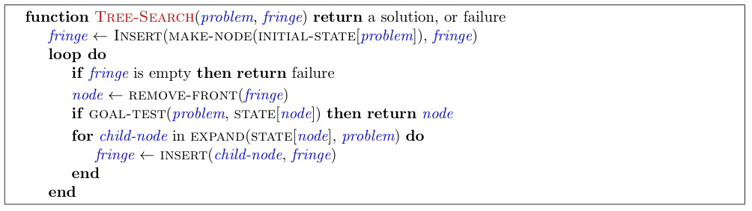
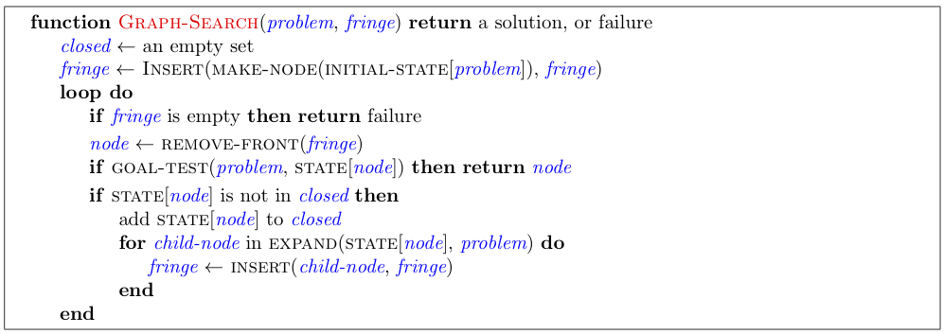

Slide 22
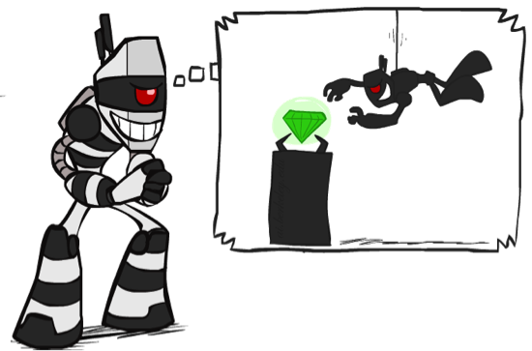

What is Search For?
Assumptions about the world: a single agent, deterministic actions, fully observed state, discrete state space
Planning: sequences of actions
The path to the goal is the important thing
Paths have various costs, depths
Heuristics give problem-specific guidance
Identification: assignments to variables
The goal itself is important, not the path
All paths at the same depth (for some formulations)
CSPs are specialized for identification problems

Slide 23

Constraint Satisfaction Problems

Slide 24


Constraint Satisfaction Problems
Standard search problems:
State is a “black box”: arbitrary data structure
Goal test can be any function over states
Successor function can also be anything
Constraint satisfaction problems (CSPs):
A special subset of search problems
State is defined by variables X_{i} with values from a domain D (sometimes D depends on i)
Goal test is a set of constraints specifying allowable combinations of values for subsets of variables
Allows useful general-purpose algorithms with more power than standard search algorithms
Notes:
Goal test has structure, it ‘s more like a manual describing a set of constraints that have to hold true

Slide 25
CSP Examples

Slide 26


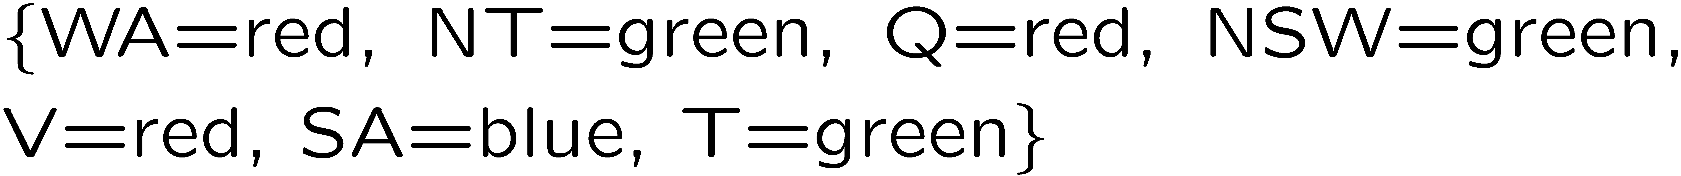
Example: Map Coloring
Variables:
Domains:
Constraints: adjacent regions must have different colors
Solutions are assignments satisfying all constraints, e.g.:
Implicit:
Explicit:

Slide 27
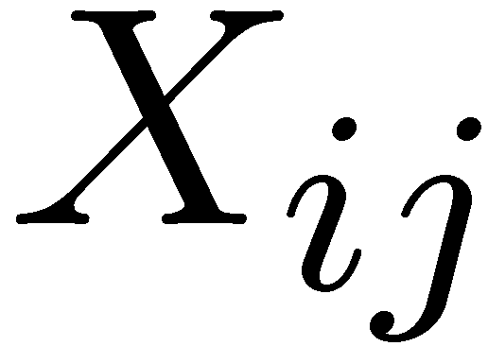
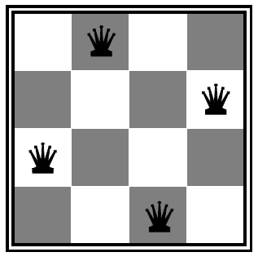
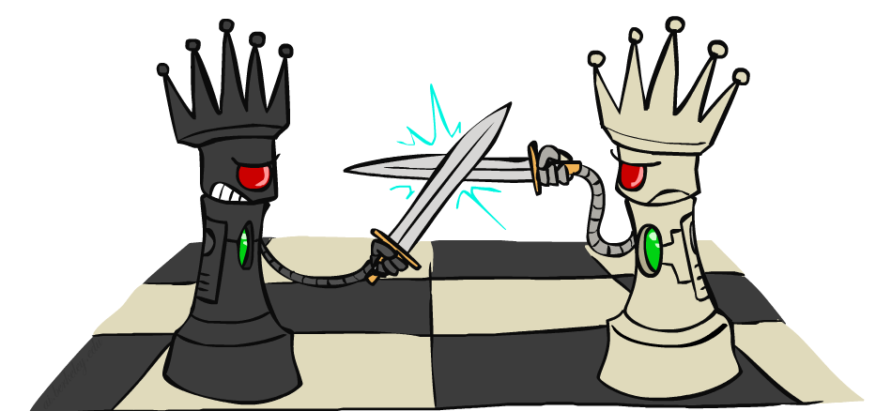

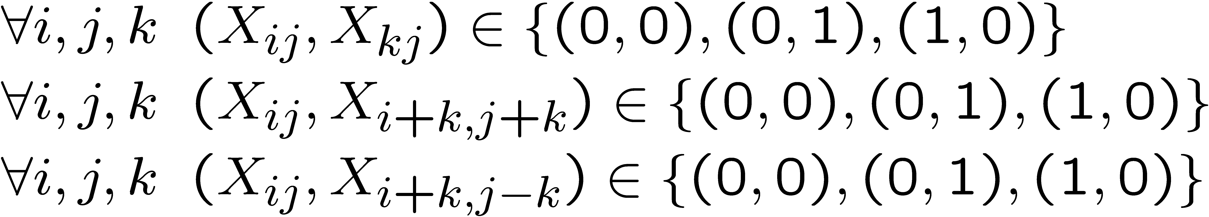
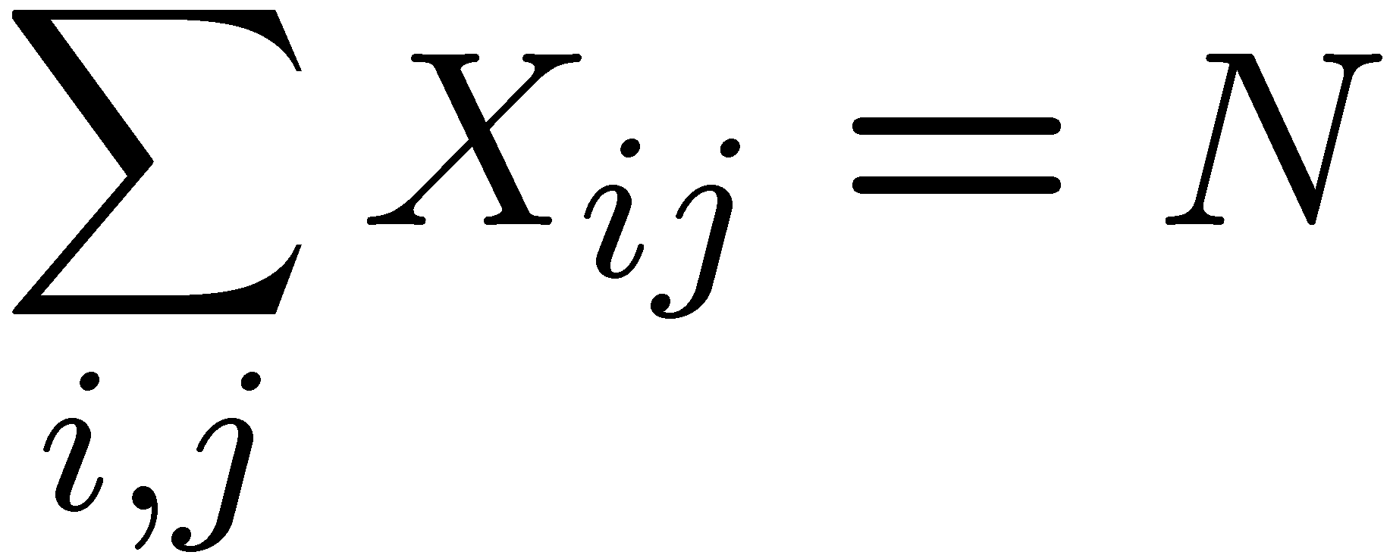
Example: N-Queens
Formulation 1:
Variables:
Domains:
Constraints

Slide 28



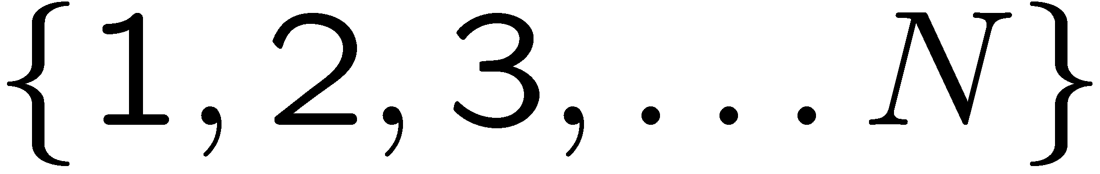



Example: N-Queens
Formulation 2:
Variables:
Domains:
Constraints:
Implicit:
Explicit:

