Slide 1
Artificial Intelligence Survey
CMPT 310, Spring 2020
Slide credits: Dan Klein and Pieter Abbeel

Slide 2


Reminder: CSPs
CSPs:
Variables
Domains
Constraints
Implicit (provide code to compute)
Explicit (provide a list of the legal tuples)
Unary / Binary / N-ary
Goals:
Here: find any solution
Also: find all, find best, etc.

Slide 3
Backtracking Search

Slide 4
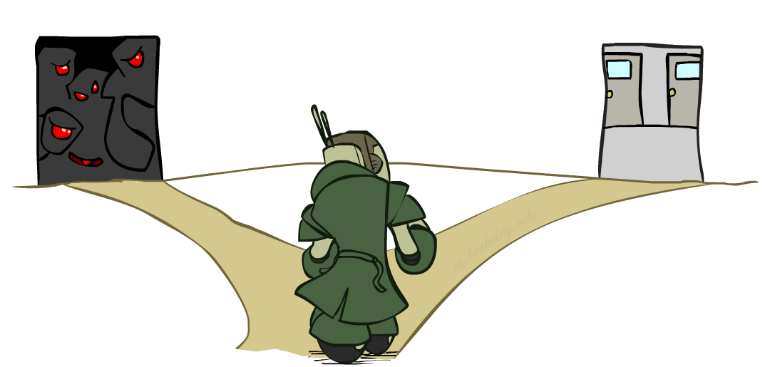

Improving Backtracking
General-purpose ideas give huge gains in speed
… but it’s all still NP-hard
Filtering: Can we detect inevitable failure early?
Ordering:
Which variable should be assigned next? (MRV)
In what order should its values be tried? (LCV)
Structure: Can we exploit the problem structure?

Slide 5
Filtering: Forward Checking
Filtering: Keep track of domains for unassigned variables and cross off bad options
Forward checking: Cross off values that violate a constraint when added to the existing assignment
WA
NT
Q
SA
NSW
V
[Demo: coloring -- forward checking]
Notes:
Demo:
CS188 javascript demos -> source -> exercises -> csps -> CSPs demos -> CSPs demos.html
Settings:
Graph = Simple
Algorithm = Backtracking
Ordering = None
Filtering = Forward Checking

Slide 6
Filtering: Constraint Propagation
Forward checking propagates information from assigned to unassigned variables, but doesn't provide early detection for all failures:
NT and SA cannot both be blue!
Why didn’t we detect this yet?
Constraint propagation: reason from constraint to constraint
NT
Q
WA
SA
NSW
V
Notes:
Western Australia
Queensland
Northern territories
South Australia

Slide 7

Consistency of A Single Arc
An arc X → Y is consistent iff for every x in the tail there is some y in the head which could be assigned without violating a constraint
Forward checking: Enforcing consistency of arcs pointing to each new assignment
NT
Q
WA
SA
NSW
V
Delete from the tail!

Slide 8
Arc Consistency of an Entire CSP
A simple form of propagation makes sure all arcs are consistent:
Important: If X loses a value, neighbors of X need to be rechecked!
Arc consistency detects failure earlier than forward checking
Can be run as a preprocessor or after each assignment
What’s the downside of enforcing arc consistency?
NT
Q
WA
SA
NSW
V
Remember: Delete from the tail!

Slide 9
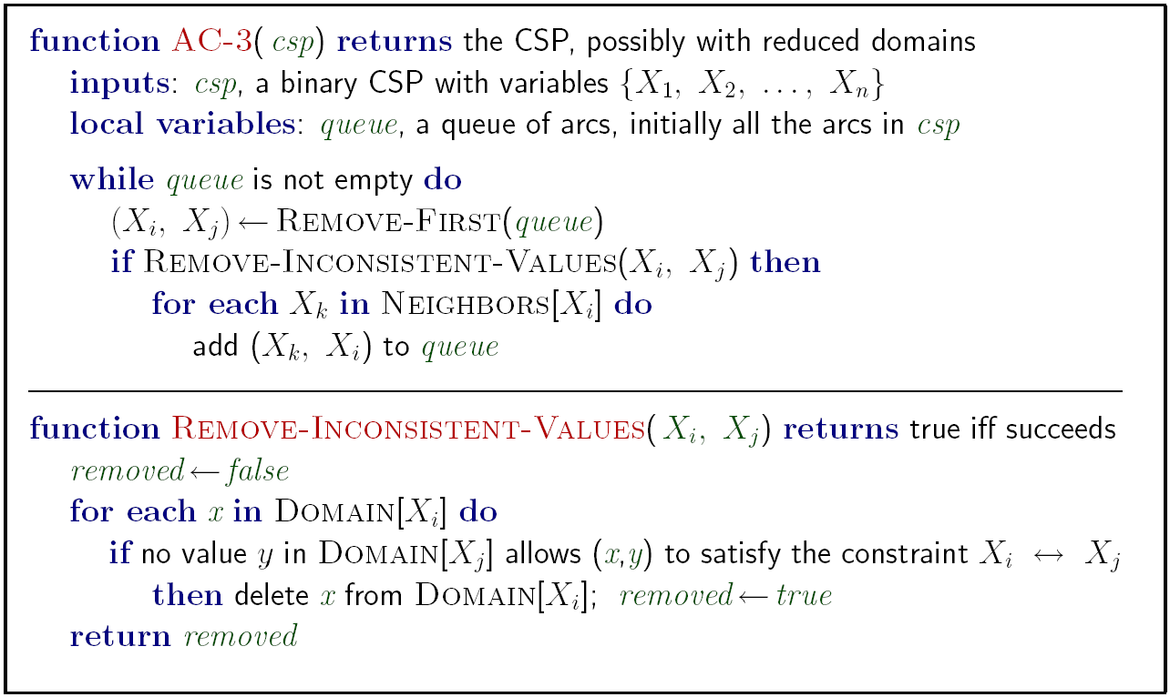
Enforcing Arc Consistency in a CSP
Runtime: O(n²d³), can be reduced to O(n²d²)
… but detecting all possible future problems is NP-hard – why?
[Demo: CSP applet (made available by aispace.org) -- n-queens]
Notes:
Auto-consistency (note initially nothing gets deleted/pruned since there are consistent options for all constraints for initial variable domains)
Flashes whenever something needs to be re-checked

Slide 10
Limitations of Arc Consistency
After enforcing arc consistency:
Can have one solution left
Can have multiple solutions left
Can have no solutions left (and not know it)
Arc consistency still runs inside a backtracking search!
What went wrong here?
Notes:
Demo:
CS188 javascript demos -> source -> exercises -> csps -> CSPs demos -> CSPs demos.html
Settings:
Graph = Complex
Algorithm = Backtracking
Ordering = None
Filtering = Forward Checking (first) / Arc Consistency (second)

Slide 11

Ordering

Slide 12
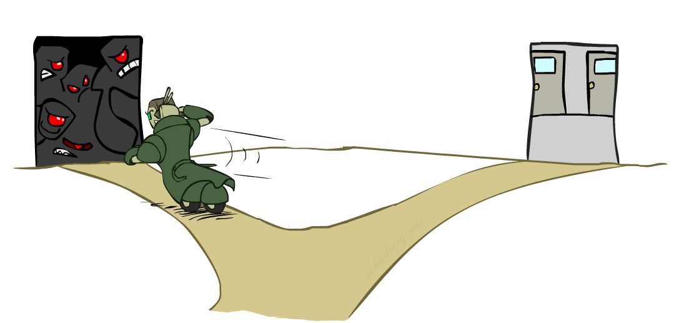
Ordering: Minimum Remaining Values
Variable Ordering: Minimum remaining values (MRV):
Choose the variable with the fewest legal left values in its domain
Why min rather than max?
Also called “most constrained variable”
“Fail-fast” ordering

Slide 13
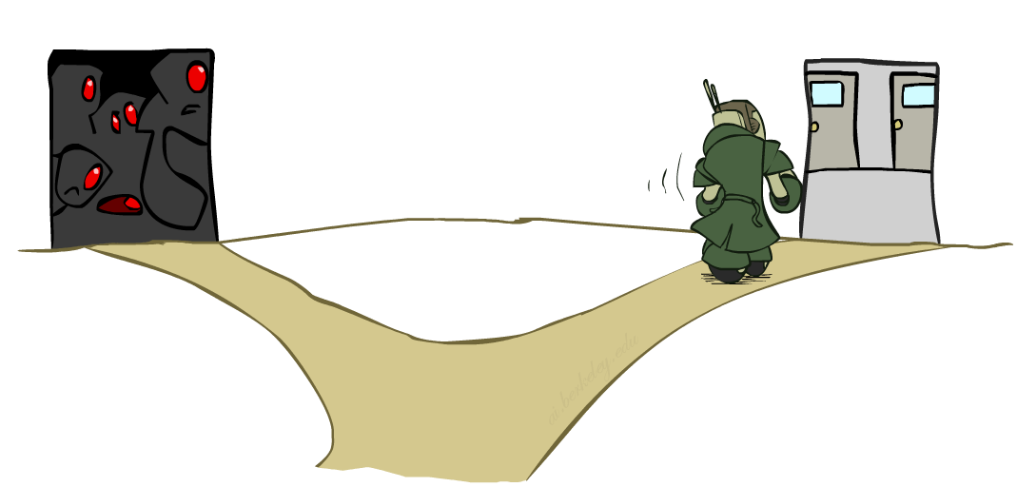
Ordering: Least Constraining Value
Value Ordering: Least Constraining Value
Given a choice of variable, choose the least constraining value
I.e., the one that rules out the fewest values in the remaining variables
Note that it may take some computation to determine this! (E.g., rerunning filtering)
Why least rather than most?
Combining these ordering ideas makes
1000 queens feasible

Slide 14
Limitations of Arc Consistency
After enforcing arc consistency:
Can have one solution left
Can have multiple solutions left
Can have no solutions left (and not know it)
Arc consistency still runs inside a backtracking search!
What went wrong here?
Notes:
Demo:
CS188 javascript demos -> source -> exercises -> csps -> CSPs demos -> CSPs demos.html
Settings:
Graph = Complex
Algorithm = Backtracking
Ordering = None
Filtering = Forward Checking (first) / Arc Consistency (second)

Slide 15

K-Consistency

Slide 16
K-Consistency
Increasing degrees of consistency
1-Consistency (Node Consistency): Each single node’s domain has a value which meets that node’s unary constraints
2-Consistency (Arc Consistency): For each pair of nodes, any consistent assignment to one can be extended to the other
K-Consistency: For each k nodes, any consistent assignment to k-1 can be extended to the k^{th} node.
Higher k more expensive to compute
(You need to know the k=2 case: arc consistency)

Slide 17
Strong K-Consistency
Strong k-consistency: also k-1, k-2, … 1 consistent
Claim: strong n-consistency means we can solve without backtracking!
Why?
Choose any assignment to any variable
Choose a new variable
By 2-consistency, there is a choice consistent with the first
Choose a new variable
By 3-consistency, there is a choice consistent with the first 2
…
Lots of middle ground between arc consistency and n-consistency! (e.g. k=3, called path consistency)

Slide 18
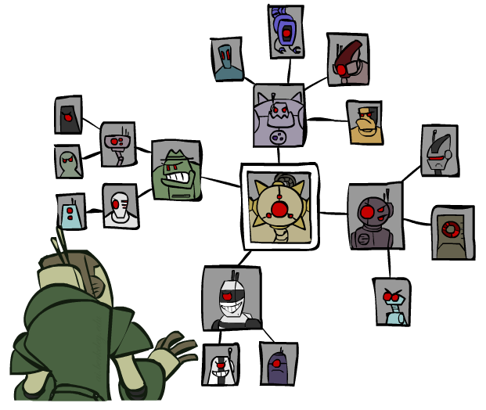
Structure

Slide 19
Problem Structure
Extreme case: independent subproblems
Example: Tasmania and mainland do not interact
Independent subproblems are identifiable as connected components of constraint graph
Suppose a graph of n variables can be broken into subproblems of only c variables:
Worst-case solution cost is O((n/c)(d^{c})), linear in n
E.g., n = 80, d = 2, c =20
2⁸⁰ = 4 billion years at 10 million nodes/sec
(4)(2²⁰) = 0.4 seconds at 10 million nodes/sec

Slide 20
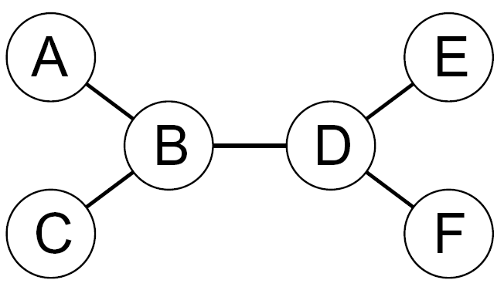
Tree-Structured CSPs
Theorem: if the constraint graph has no loops, the CSP can be solved in O(n d²) time
Compare to general CSPs, where worst-case time is O(d^{n})
This property also applies to probabilistic reasoning (later): an example of the relation between syntactic restrictions and the complexity of reasoning

Slide 21
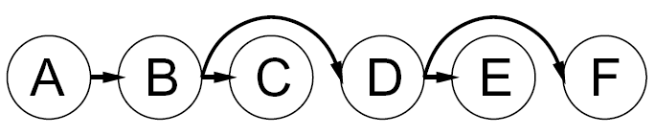

Tree-Structured CSPs
Algorithm for tree-structured CSPs:
Order: Choose a root variable, order variables so that parents precede children
Remove backward: For i = n : 2, apply RemoveInconsistent(Parent(X_{i}),X_{i})
Assign forward: For i = 1 : n, assign X_{i} consistently with Parent(X_{i})
Runtime: O(n d²) (why?)

Slide 22
Tree-Structured CSPs
Claim 1: After backward pass, all root-to-leaf arcs are consistent
Proof: Each X→Y was made consistent at one point and Y’s domain could not have been reduced thereafter (because Y’s children were processed before Y)
Claim 2: If root-to-leaf arcs are consistent, forward assignment will not backtrack
Proof: Induction on position
Why doesn’t this algorithm work with cycles in the constraint graph?
Note: we’ll see this basic idea again with Bayes’ nets

