Slide 1

Java – Collections API

Slide 2
Topics
Collections
Collections Hierarchy
Collection Interface
List
Set
Queue
Collection classes
Generics
Non-Iterable Data Structures
Hashtable
HashMap

Slide 3

Collections
A collection is an object that groups multiple elements into a single unit
Used to store, retrieve, transform, and manipulate data
Reduces programming effort by providing useful data structures and algorithms
Increases program speed and quality
Collections “collect” things

Slide 4
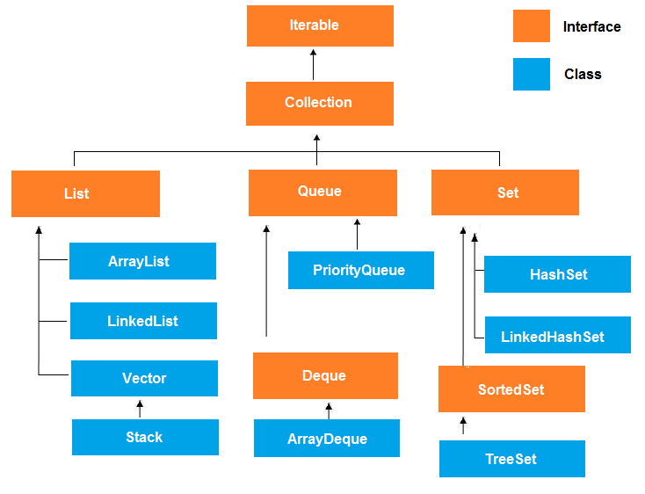
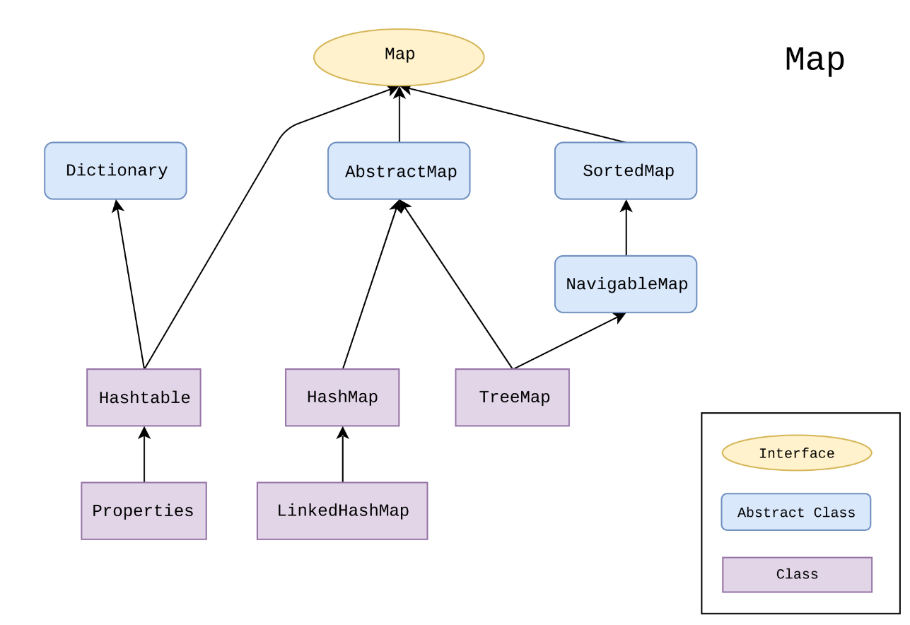
Collections Hierarchy
A Map is NOT an Iterable!

Slide 5
Collection Interface
add(Object obj)
addAll(Collection c)
clear()
contains(Object obj)
equals (Object obj)
isEmpty()
iterator()
remove(Object obj)
removeAll(Object obj)
size()

Slide 6

List Interface
Elements can be inserted or accessed by their position in the list
Like array, List uses a zero-based index
May contain duplicate elements
Methods include:
add (int index, Object obj)
get (int index)
remove (int index)

Slide 7
List Implementations
ArrayList
Array-backed list
Dynamic size – starts out by default at size 10, increases capacity 50% when limit reached
Faster retrieval – by index
Slower insertion & deletion – elements must be moved around within the array
LinkedList
Implements List and Queue interfaces
Backed by a doubly-linked list
Consists of nodes with references to previous, next nodes
Faster insertion & deletion – simply change the references to prev/next node
Slower retrieval – must iterate through list to get to specific index
Vector
Synchronized version of ArrayList

Slide 8
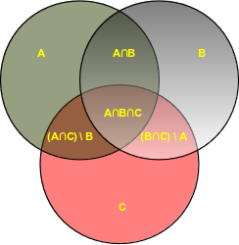
Set Interface
The Set interface defines a collection of distinct elements
Set does NOT allow duplicate elements
Elements are accessed by iterating over the whole set
Methods include:
add(Object obj)
clear()
remove(Object obj)
size()
toArray()

Slide 9
Set Implementations
HashSet
Backed by a HashMap
No guarantees of iteration order
O(1) performance for adding, removing elements
TreeSet
Elements ordered based on natural ordering (or, alternatively, a Comparator)
O(log(n)) performance for adding, removing elements
LinkedHashSet
Backed by a LinkedList which defines iteration order, which is the same as the insertion order
O(1) performance for adding, removing elements

Slide 10
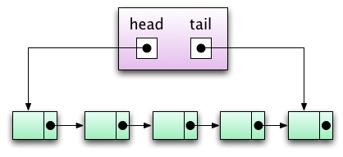
Queue Interface
Places objects on a “waiting list”, typically based on First-In-First-Out (FIFO)
Useful for storing objects prior to processing
Elements are added to the tail of the queue
Elements can be popped off the head of the queue
Methods include:
add(Object obj)
element()
peek()
poll()
remove()

Slide 11
Deque Interface
Extends the Queue interface
Short for “double-ended queue”
Pronounced “deck”
Supports element insertion and removal from both ends of the queue
Can be used to implement a stack, with Last-In-First-Out (LIFO) behavior

Slide 12
Queue Implementations
LinkedList – already mentioned
ArrayDeque
Resizable-array implementation of Deque interface
PriorityQueue
Elements in the queue are ordered by priority based on their natural ordering (or a Comparator)
ArrayBlockingQueue
Array-backed, implements BlockingQueue interface which supports operations that wait on the queue to contain an element or for space to become available in the queue
Solution to the producer-consumer problem, where a producer thread inputs elements into the array while a consumer thread removes them for processing

Slide 13




Generics
Generics enforce the type of object allowed in a Collection
Uses the Diamond operator < >
Insert the Class in the Diamond: <Employee>
Generics provide compile-time safety
Notes:
Generics say that: This barrel is for monkeys.
Lions do not belong in monkey barrels…

Slide 14
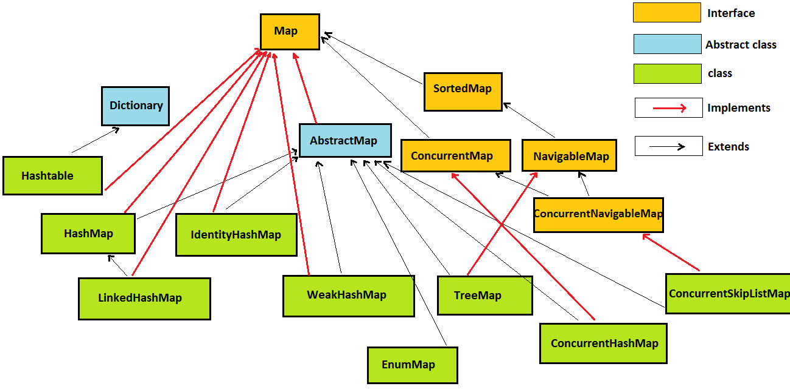
Non-Iterable Data Structures

Slide 15
Map Interface
The Map interface defines a data structure of key – value pairs
Items are added and retrieved by their keys
Map does NOT extend the Iterable interface, therefore it cannot be directly iterated over
Instead, you can iterate over the Set of keys, a Collection of values, or a Set of key-value mappings
.keySet(), .entrySet(), or .values() methods allow iteration
Other important methods:
.get()
.put()
.remove()
.replace()

Slide 16
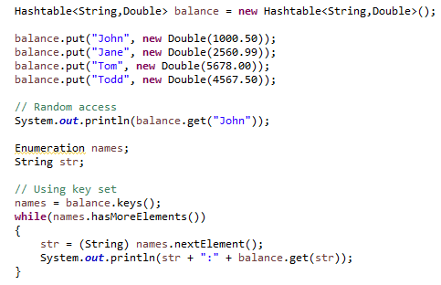
Hashtable
Hashtable stores key/value pairs
When using a Hashtable, you must specify:
An object that is used as a key
The value that you want linked to that key
Allows random access by key
Iterate over key set

Slide 17
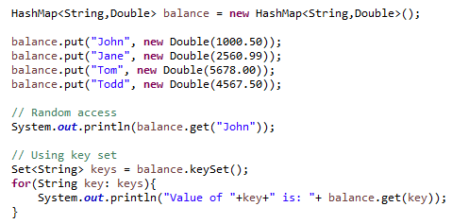
HashMap
HashMap stores key/value pairs
When using a HashMap, you must specify:
An object that is used as a key
The value that you want linked to that key
Allows random access by key
Iterate over key set and get values

Slide 18
Hashtable VS HashMap
Hashtable
hashmap
Thread-safe, synchronized
Does not allow null keys and null values
Uses Enumeration to iterate key set
Legacy class
Not thread-safe
Allows one null key and any number of null values
Uses iterator or for:each loop to iterate over key set
Better performance

Slide 19
TreeMap
Red-black tree based - https://en.wikipedia.org/wiki/Red%E2%80%93black_tree
Map is sorted based on natural ordering (or a Comparator)
Guaranteed O(log(n)) time for get, put, and remove operations
Not synchronized

Slide 20


Common Concrete Collection Classes
Class | Synchronized? | Unique? | Sorted? | Retrieval | Insertion
ArrayList |  |  |  | O(1) | O(n)
LinkedList |  |  |  | O(n) | O(1)
Vector |  |  |  | O(1) | O(n)
HashSet |  |  |  | O(1) | O(1)
TreeSet |  |  |  | O(log(n)) | O(log(n))
ArrayDeque |  |  |  | O(1) | O(n)
ArrayBlockingQueue |  |  |  | O(1) | O(n)
PriorityQueue |  |  |  | O(1) | O(log(n))
HashMap |  |  |  | O(1) | O(1)
TreeMap |  |  |  | O(log(n)) | O(log(n))

Slide 21
Assignment
Create an ArrayList and a HashSet. Insert 3 objects into each.
Iterate over each collection and print each object.
Review Vector and other collections online.
Review Comparator and Comparable in your book or online.
Review java.util.Collections methods (sort, reverseOrder, shuffle, etc.)

