Slide 1

SMART INDIA HACKATHON 2026
TITLE PAGE
Problem Statement ID – 14
Problem Statement Title – Intelligent Safe-Route Navigation System for Women & Vulnerable Groups
Theme - Viksit Bharat 2047
PS Category- Software
Team Name : RouteGuard

Slide 2
Understanding The Problem & Our Solution
SafePath – An AI Assistant for Safer, Smarter Navigation
Understanding The Problem
Our Solution
Fragmented Safety Data: Crime records, streetlight & CCTV coverage, and crowd density all live in disconnected datasets — no single view of how safe a street really is.
Multi-Factor Safety Graph: Every road segment scored on crime proximity, lighting, CCTV coverage, amenity access and live crowd density.
Static, Time-Blind Routing: Everyday map apps optimize only for time or distance — a dark, isolated shortcut can rank above a longer, well-lit street.
ML-Predicted Safety Score: A trained regression model estimates a 0–100 safety score per segment, refreshed as new data arrives.
Reactive, Not Preventive: Panic-button apps help after an incident starts, not before a risky route is even chosen.
Multi-Objective Routing: Balances travel time against safety score to surface a ‘slightly longer, far safer’ alternative route.
No Personalization: A solo woman walking at 11 PM and a group walking at 5 PM get identical directions today.
Time & Profile Aware: Routing adapts automatically for night hours, solo travel, or vulnerable groups such as elders or children.
Connectivity Dependence: Most safety tools assume always-on data, and fail exactly where coverage is weakest.
One-Tap SOS + Live Share: Instant alert to trusted contacts and the nearest police station, with live tracking along the chosen path.
SafePath | Intelligent Safe-Route Navigation for Women & Vulnerable Groups
2

Slide 3


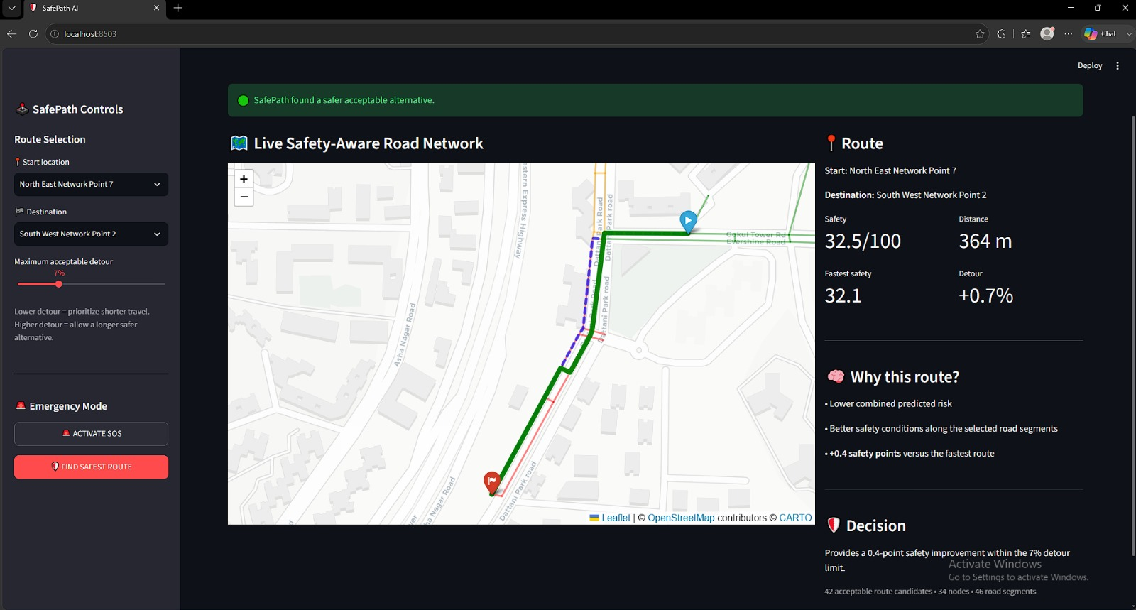
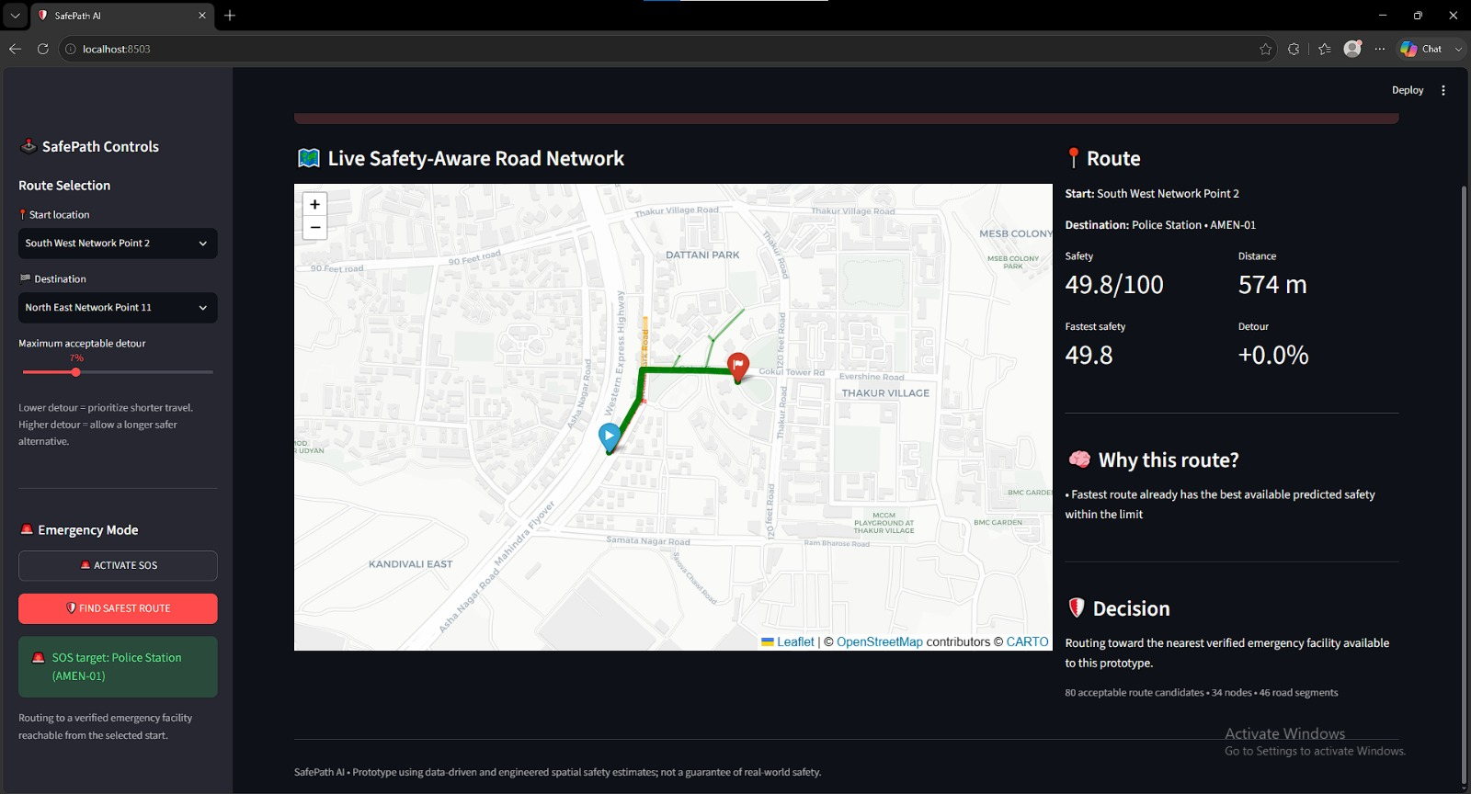
Technical Approach
Backend Safety-Scoring Engine + Live Streamlit Prototype
Backend — Safety Model Pipeline
Frontend — Live Prototype (Streamlit)
▸ Data Ingestion — Crime records, verified amenities (police / hospitals / pharmacies) and ambient sensors (streetlight lux, CCTV %) per city zone.
▸ Risk-Priority Feature Engineering — Distance-to-nearest-amenity/crime per segment feeds a composite Risk Priority Score — crime severity, low lighting, weak CCTV, isolation.
▸ Safety Scoring — Crime (25%), lighting (20%), CCTV (15%), amenity access (15%), crowd (10%), connectivity (10%), road type (5%) → 0–100 safety_score.
▸ ML Model — Random Forest Regressor — 200-tree model trained on road + safety features to predict scores for unseen segments.
▸ Safety Graph (OSMnx + NetworkX) — Predicted scores attached to the city's OSM road network — the live graph the router runs on.
Safest Acceptable Route — rejects the pure-shortest path for a higher average safety score within the detour limit.
▸ Adaptive Route Engine — Balances distance vs safety on a sliding scale set by the user's detour tolerance (0–25%).
▸ SOS Emergency Routing — One click re-targets the destination to the nearest verified police station / hospital reachable from the user.
Tech Stack:
Python • pandas/NumPy • scikit-learn • OSMnx • NetworkX • GeoPandas • Streamlit • Folium
SOS Emergency Mode — one tap re-routes to the nearest verified police station, no manual search needed.
SafePath | Intelligent Safe-Route Navigation for Women & Vulnerable Groups
3

Slide 4





Feasibility & Risk / Vulnerability
Feasibility Analysis
• Proven ML approach — Random Forest regression on spatial safety features is well studied in urban-safety analytics.
• Incremental rollout — city-by-city launch (e.g. Mumbai pilot) instead of needing nationwide data on day one.
• Open data availability — municipal crime data, OSM road networks and lighting/CCTV audits already exist for most Indian cities.
• Offline-safe fallback — the last-synced safety graph is cached on-device so routing still works with weak connectivity.
• Lightweight serving — the safety graph and trained model run comfortably inside a single Streamlit process; routing is sub-second.
What Ifs — Strategies to Overcome Challenges
Safety data goes stale?
Model misjudges a new road?
User ignores the safer route?
SOS triggers with no network?
A false sense of security?
Community-reported incidents plus periodic municipal refresh keep scores current.
Road-type & connectivity features let the model generalize; nearest-neighbor fallback for edge cases.
Both routes shown transparently with a clear safety delta — the choice always stays with the user.
SMS-based fallback alert reaches trusted contacts the moment data connectivity drops.
App messaging is explicit: scores are probabilistic guidance, never a safety guarantee.
SafePath | Intelligent Safe-Route Navigation for Women & Vulnerable Groups
4

Slide 5
Impact & Benefits
Impact on Users
Illustrative Impact Split Across Focus Areas
Safer Commutes: Routes chosen with a quantified safety trade-off, not guesswork.
Faster Help: SOS + live share cuts response time during an incident.
Confidence to Move Freely: Encourages independent travel at more hours of the day.
Community Voice: Every crowd-reported hazard helps the next traveler.
Mission & Operational Benefit
Data-Driven Urban Planning: Low-safety zones highlight where cities should add lighting or CCTV.
Strategic Gains
Faster Emergency Response: SOS geolocation feeds directly to the nearest police control room.
• Positions the city as a leader in citizen-centric public-safety AI.
Scalable Across Cities: Same feature pipeline, new local data — city-agnostic by design.
• Aggregated, anonymized safety insights support smarter street-lighting and patrol budgets.
Public-Private Synergy: Safety graph can plug into existing government safety-app initiatives.
• Modular pipeline scales from one ward to an entire metro region with no redesign.
SafePath | Intelligent Safe-Route Navigation for Women & Vulnerable Groups
5

Slide 6
Research & References
Feature | Our Proposed Solution | Existing Conventional Solutions
Routing Objective | Multi-factor, safety-weighted routing | Pure shortest-time / distance routing
Data Sources | Crime + lighting + CCTV + crowd density fused | Traffic data only
Personalization | Time-of-day & traveler-profile aware | One-size-fits-all directions
Response Mechanism | Proactive route avoidance + one-tap SOS | Reactive panic button only
Adaptability | ML model updates as new city data arrives | Static, rule-based scoring
Transparency | Shows the safety-vs-time trade-off to the user | Routing rationale hidden from user
Research & Dataset References
OpenStreetMap / OSMnx
Road-network extraction & graph routing library.
osmnx.readthedocs.io
NCRB – Crime in India
City-wise crime statistics used for the risk model.
ncrb.gov.in
Safetipin Urban Safety Audits
Streetlight, CCTV & crowd-density audit methodology.
safetipin.com
scikit-learn RandomForestRegressor
ML model used for safety-score prediction.
Prototype Status
scikit-learn.org
NetworkX
Data pipeline, safety-scoring model and adaptive route engine are running end-to-end in a live Streamlit + Folium web app, including one-tap SOS routing to verified emergency facilities — demoed on a Mumbai pilot network.
Graph algorithms powering multi-objective routing.
networkx.org
UN Women – Safe Cities Initiative
Backend pipeline: functional
Web prototype: live demo
Global framework on safe public spaces for women.
unwomen.org
SafePath | Intelligent Safe-Route Navigation for Women & Vulnerable Groups
6

