Slide 1
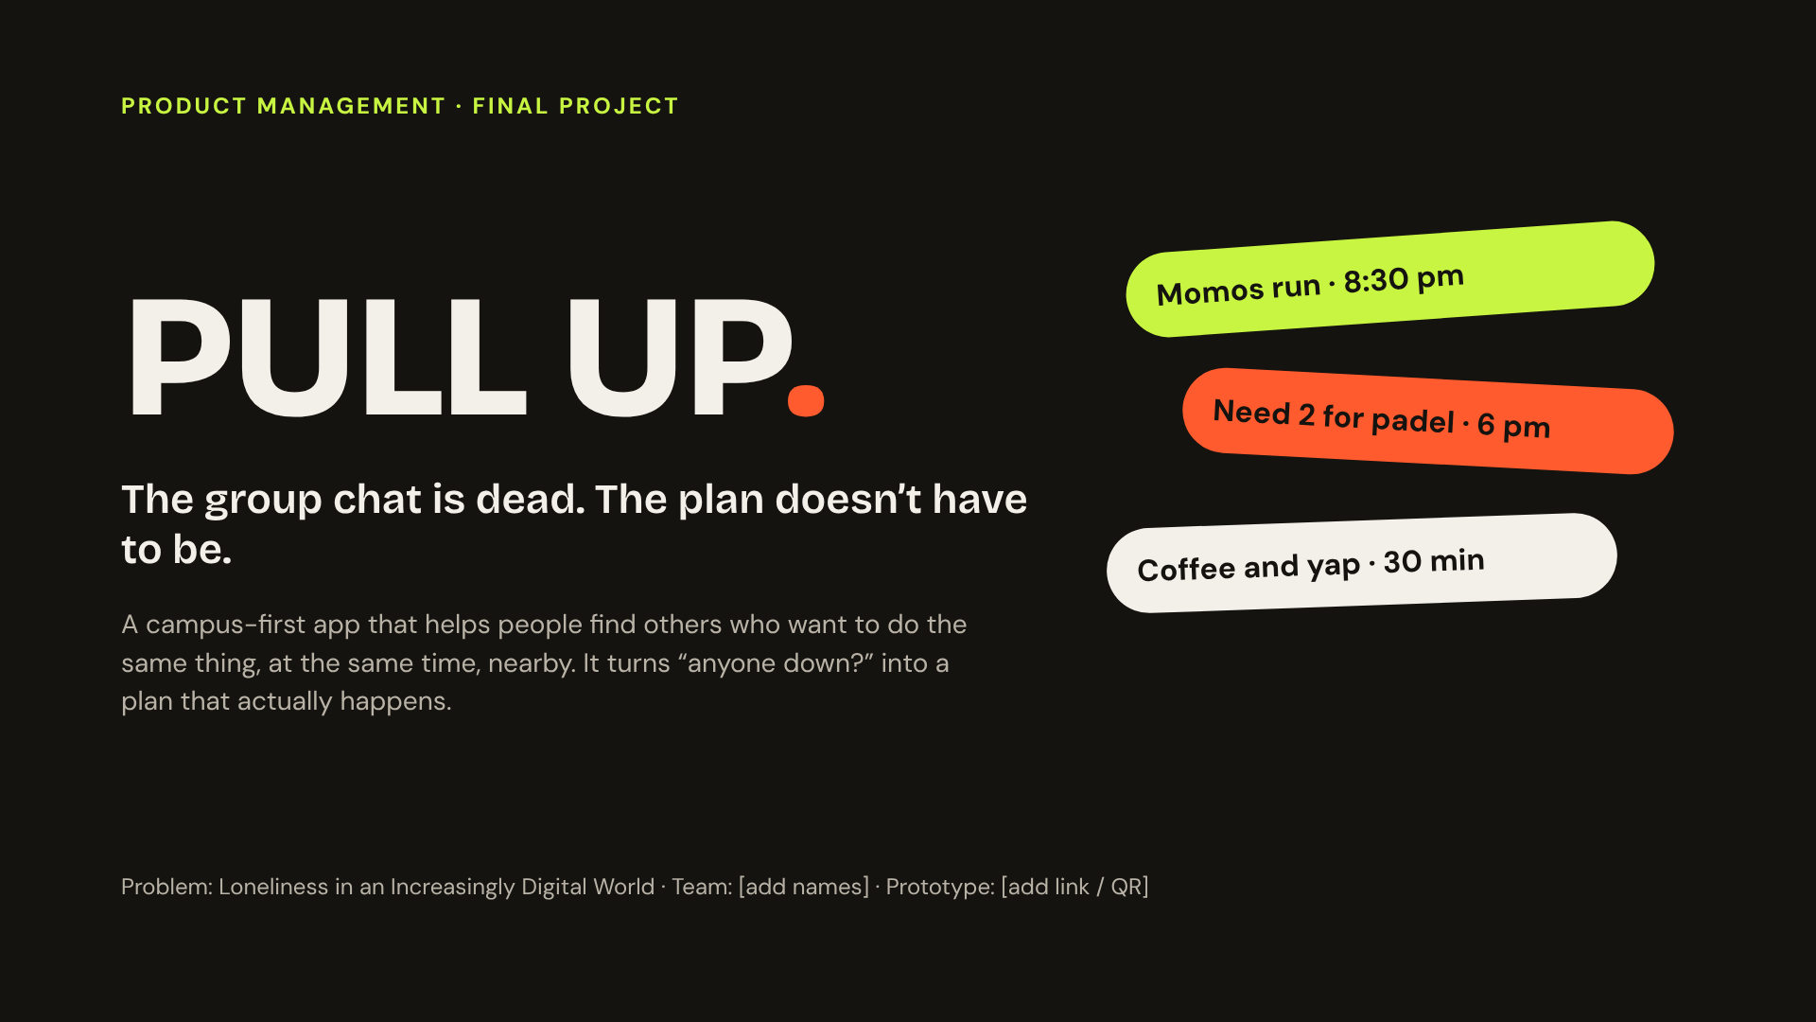
Notes:
Open with the scenario, not the stats. “It’s 7:30 on a Tuesday. You want momos. Your group chat is silent. Everyone says we should make plans, and nobody commits.” PULL UP. exists for that moment. We are not building a friendship app; we are building the shortest path from “I’m free” to “I’m there”.

Slide 2
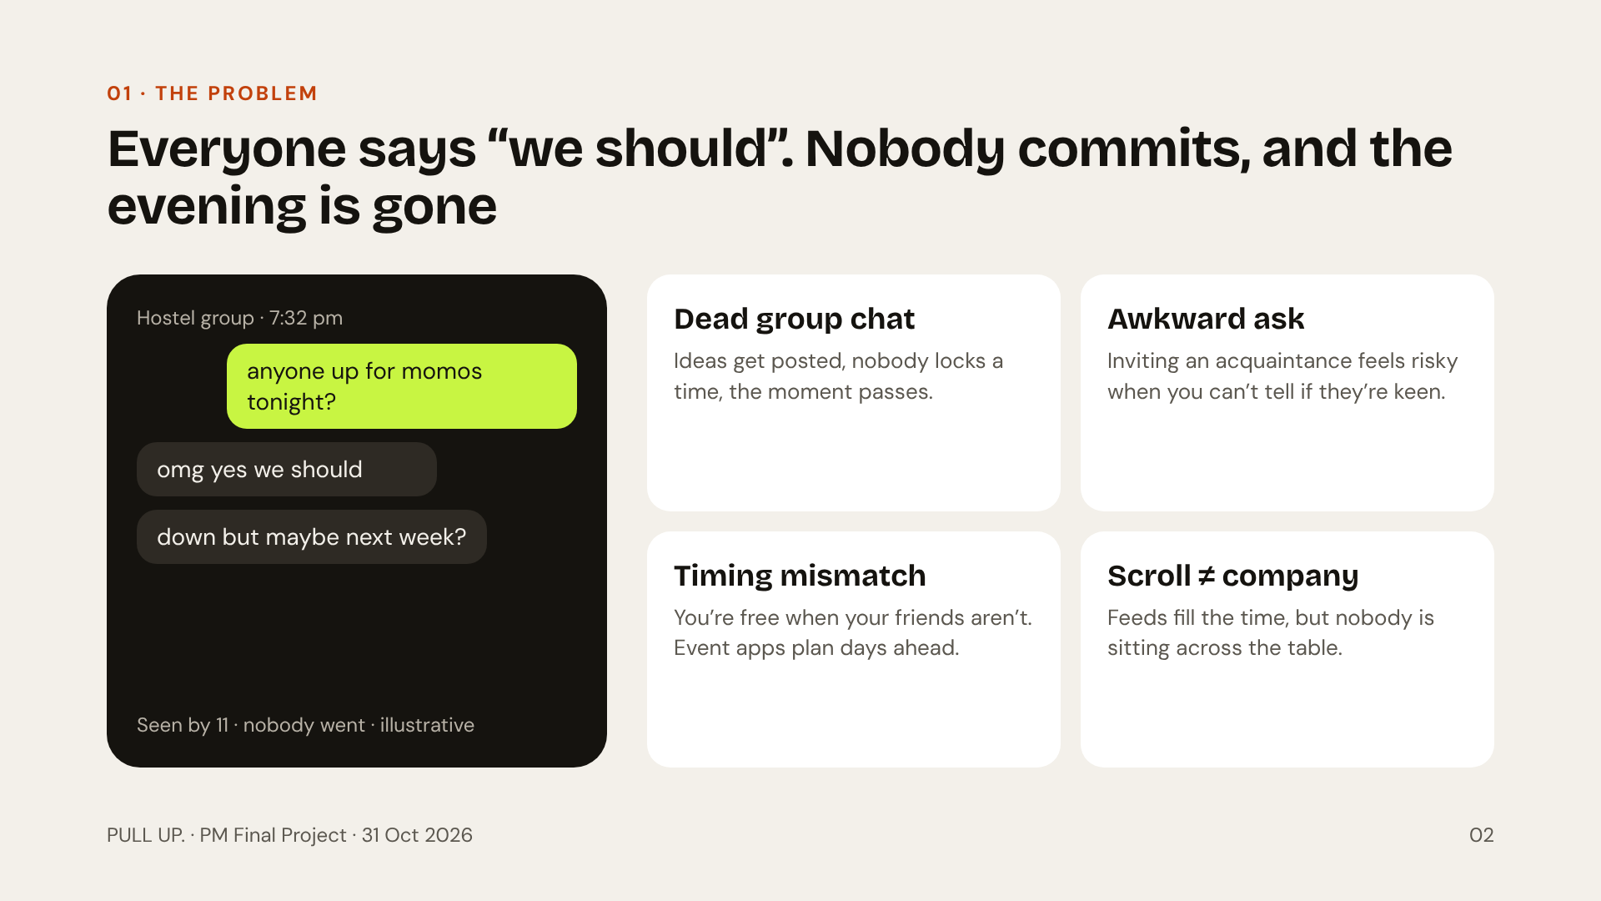
Notes:
The problem is not that people have no friends. It is that turning the wish for company into an actual meetup has too much friction. Four frictions: the dead group chat, the awkward ask, timing mismatch, and digital interaction that fills time without real connection. The chat on the left is illustrative, but everyone in this room has seen it.

Slide 3
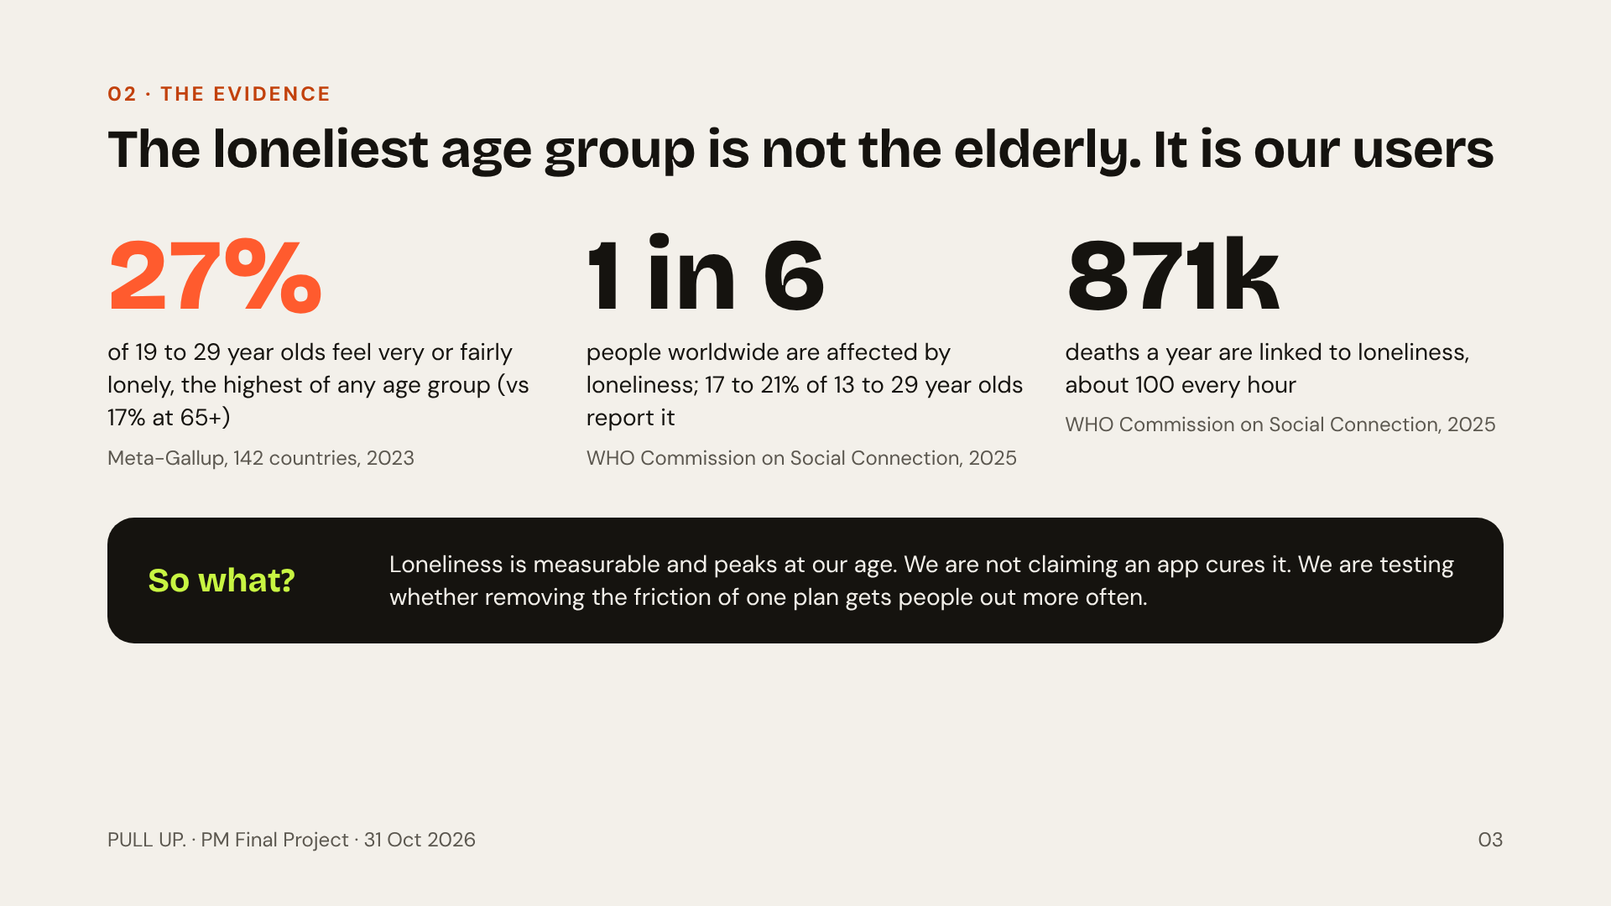
Notes:
All three numbers are sourced: Meta-Gallup Global State of Social Connections 2023 (27% of 19 to 29 year olds, 17% of 65+), and the WHO Commission on Social Connection report of 30 June 2025 (1 in 6 people affected, 17 to 21% of 13 to 29 year olds, about 871,000 deaths a year). The honest framing: loneliness is the context, but our product claim is narrower. We reduce the friction of making one plan happen.

Slide 4
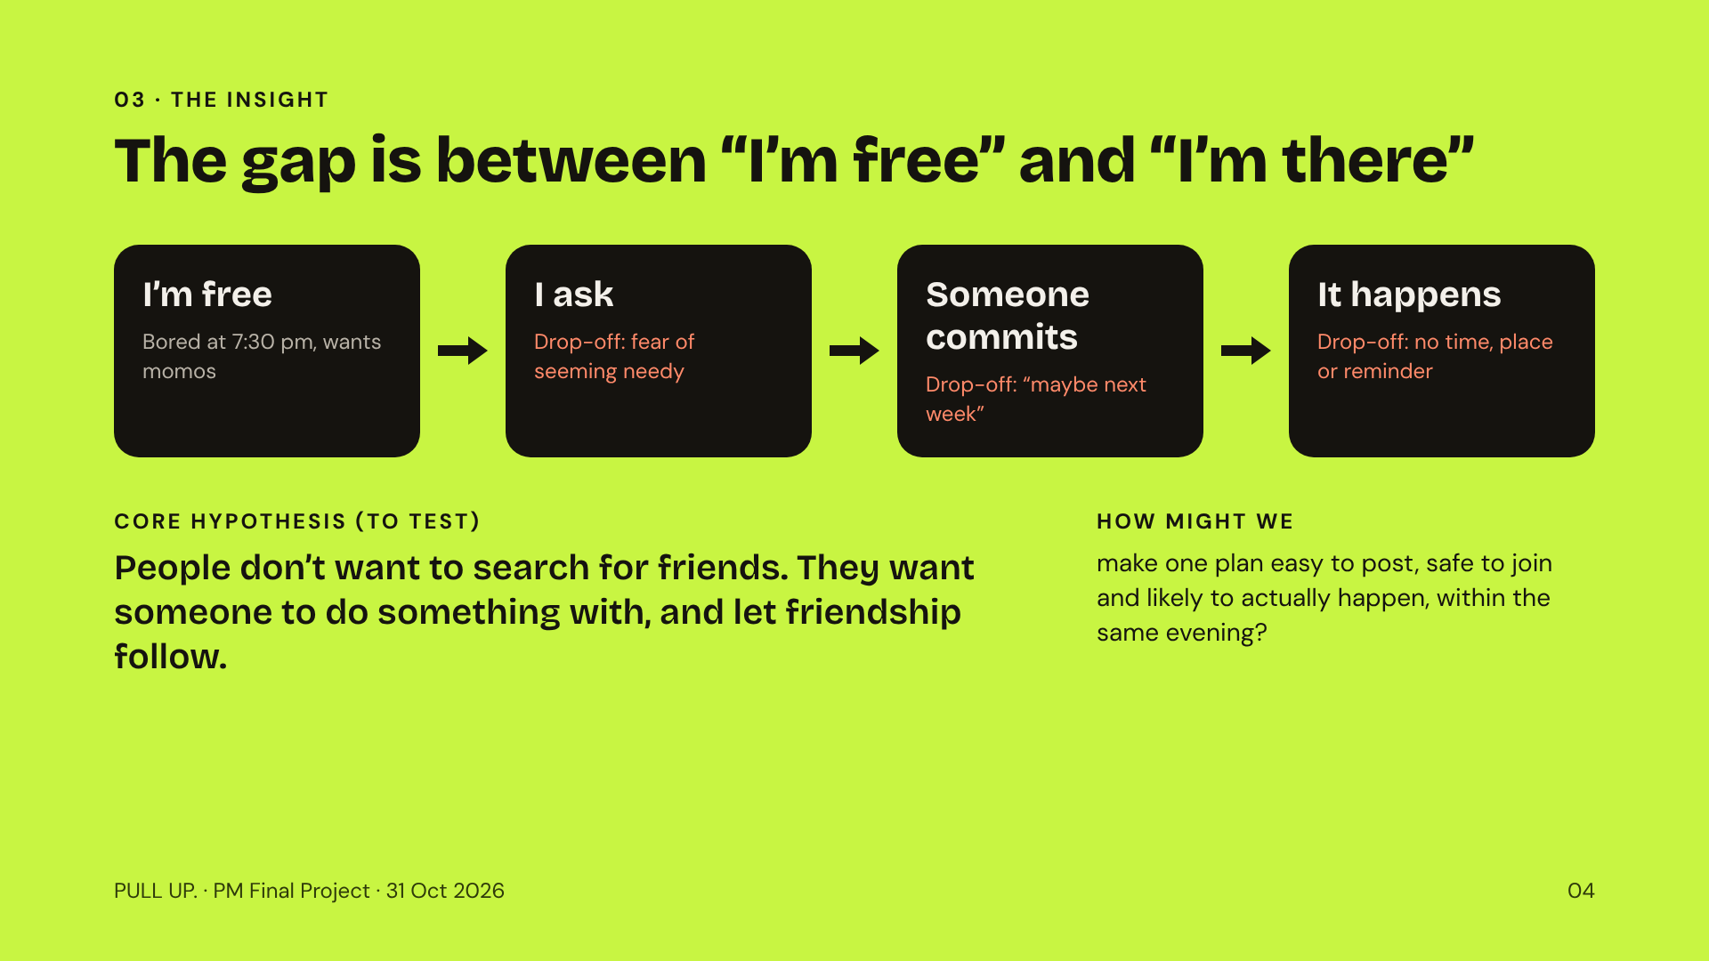
Notes:
This is the slide to remember. Every plan dies somewhere in this four-step funnel. Existing apps help with discovery or with chatting, but nobody owns the step from someone commits to it happens. Note that the core insight is stated as a hypothesis we will test, not as proven research.

Slide 5
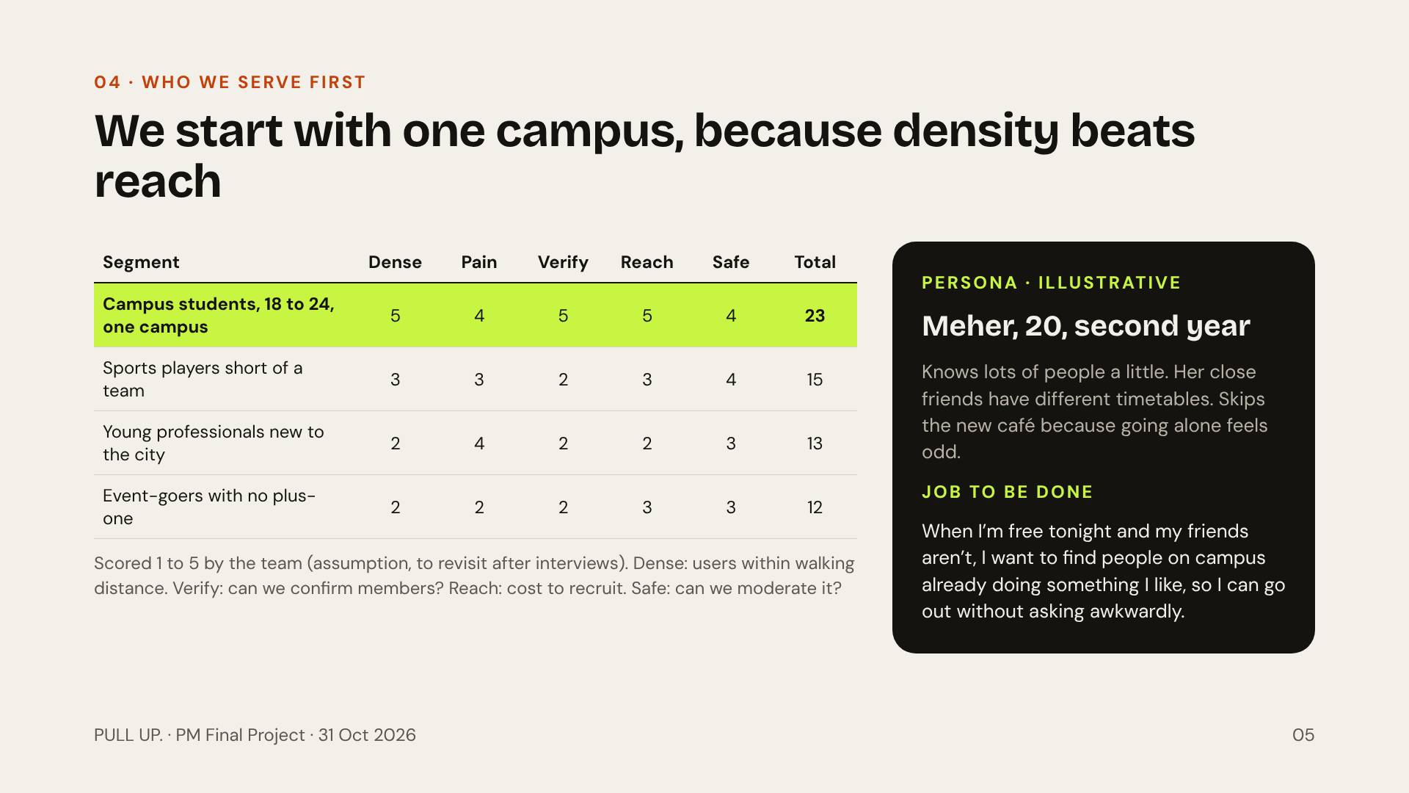
Notes:
The biggest mistake would be launching for everyone who is ever bored. A social app needs enough people free at the same time in the same place. One campus gives us density, shared locations, verifiable email and a safety environment we can actually moderate. Sports players scored second, but Playo already serves them well. The scores are our judgement and will be revisited after interviews.

Slide 6
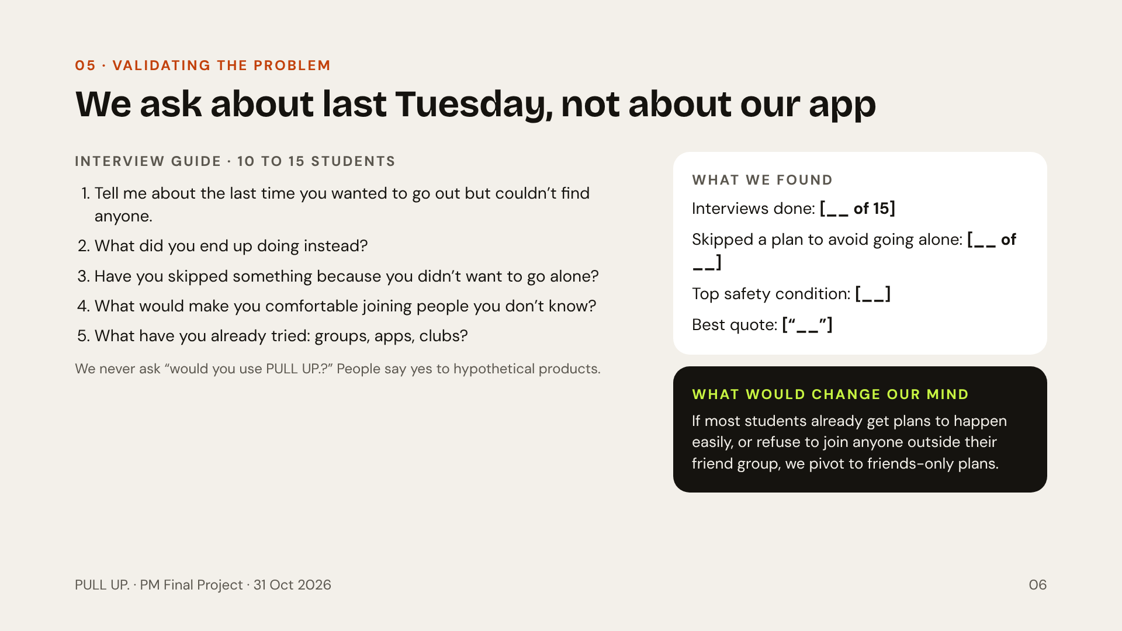
Notes:
Fill the right-hand card with what you actually heard before presenting. Do not invent numbers or quotes. The point of this slide is method: we ask about real past behaviour, not hypothetical intent. And we state up front what evidence would make us change direction, which is what separates product management from pitching.

Slide 7
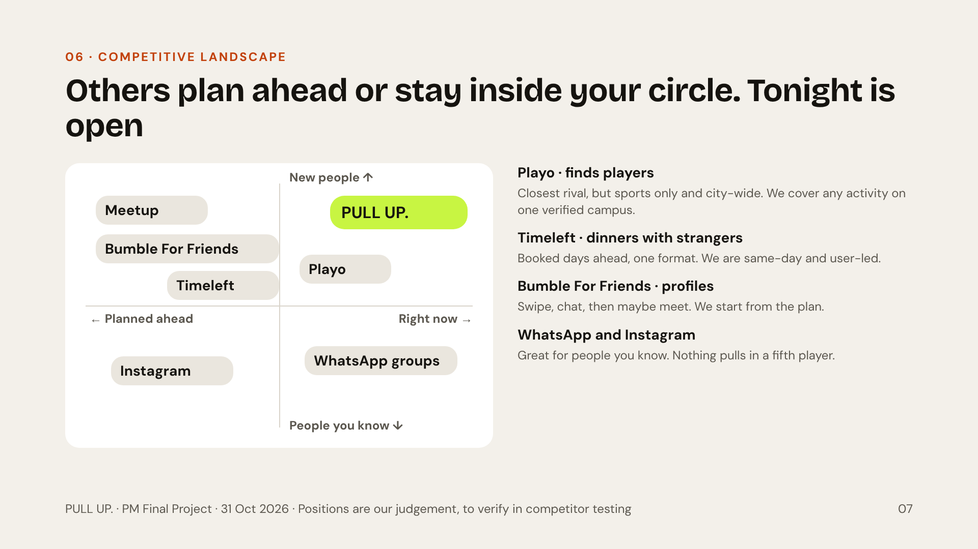
Notes:
Two axes that students actually decide on: is this planned ahead or happening now, and is it with people I already know or new people. Meetup and Timeleft are planned ahead. WhatsApp and Instagram are people you know. Playo is the honest closest competitor: it already lets you find players for a game. Our differentiation is narrower and testable: any activity, same day, inside one verified campus. These are positioning hypotheses, not a claim that nobody does this.

Slide 8
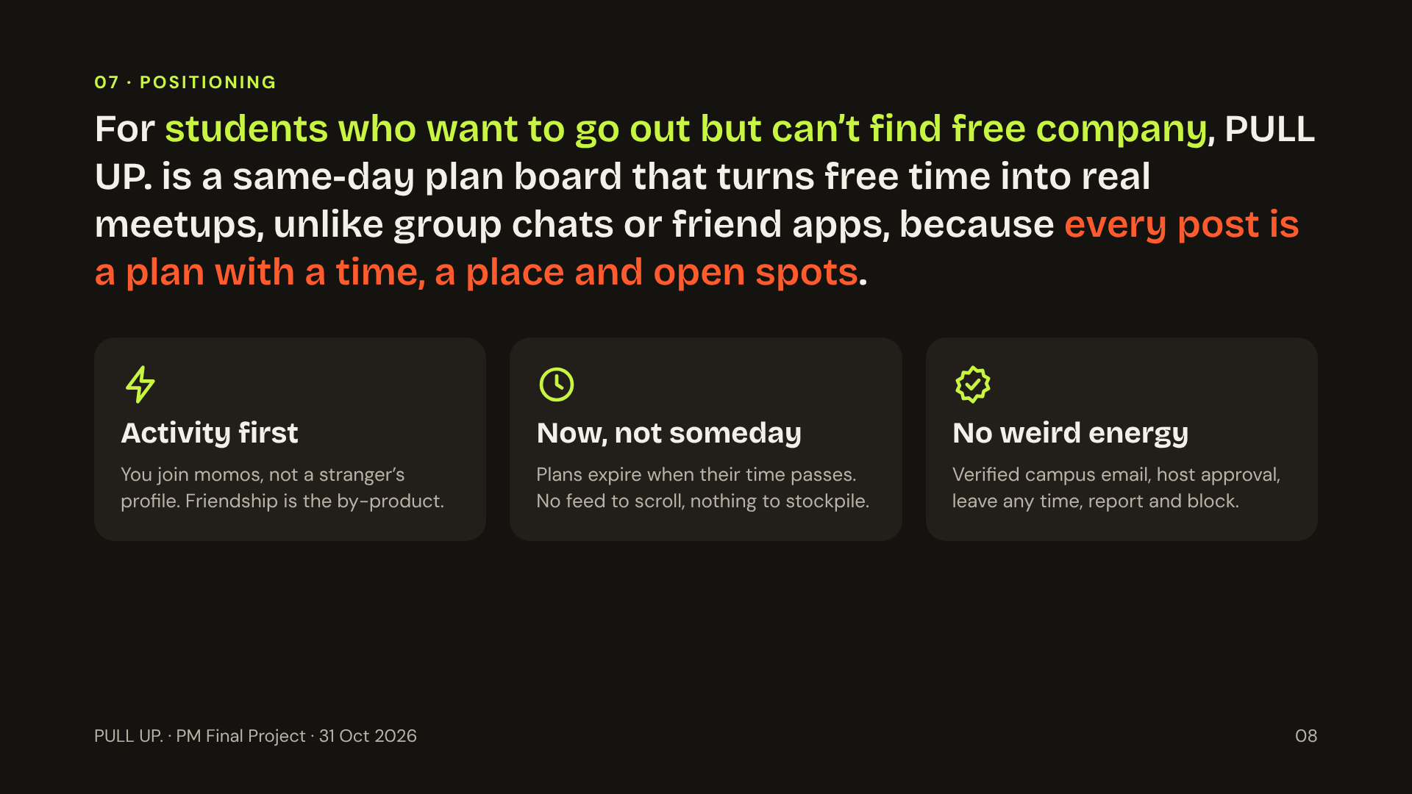
Notes:
Read the positioning statement out loud. Then the three product principles, which are how we decide what to build and what to refuse. Activity first: we never ask anyone to present themselves as lonely. Now, not someday: posts expire, so the board always shows what is actually possible tonight. No weird energy: safety is a release requirement, not a feature.

Slide 9
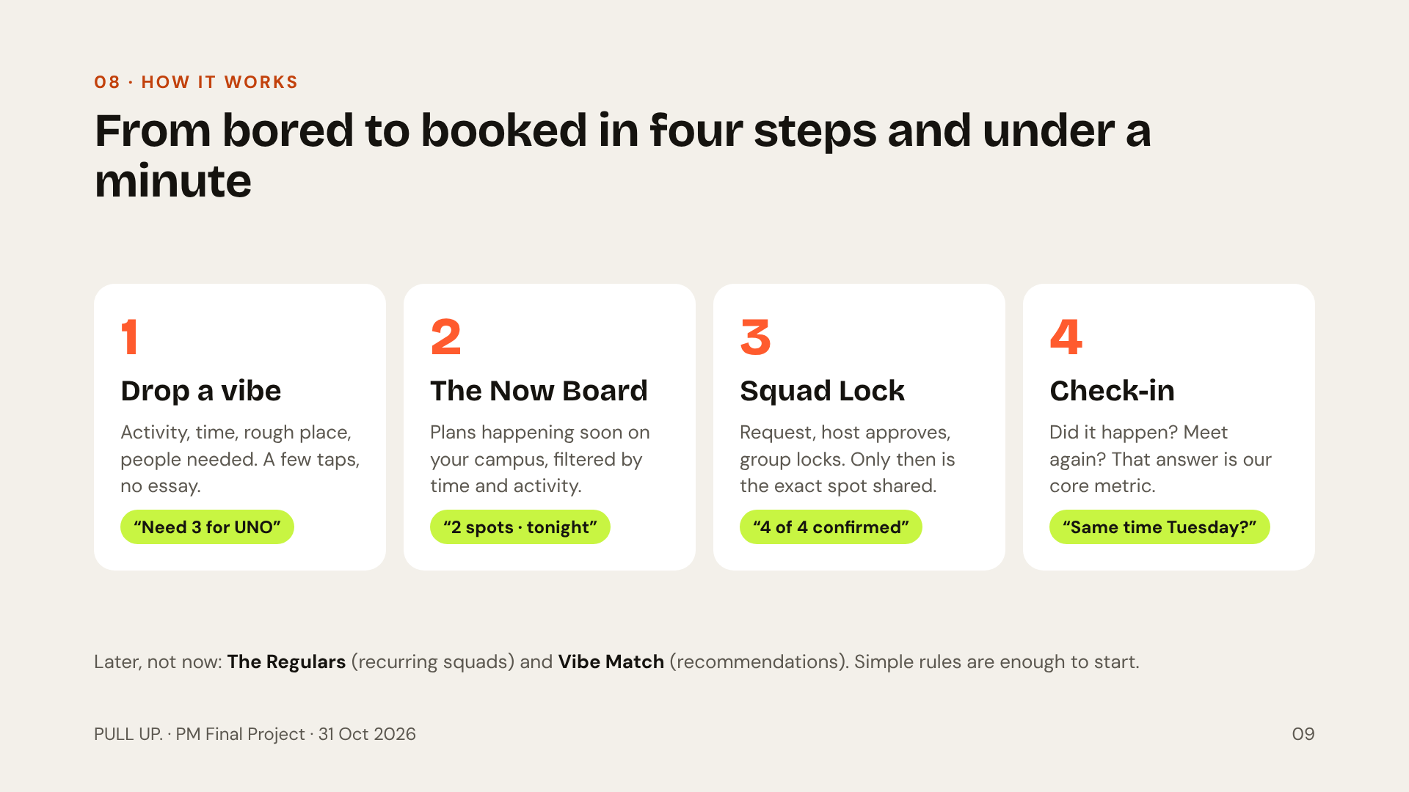
Notes:
Four signature features, each mapped to a drop-off in the funnel. Drop a vibe fixes the awkward ask, because you post an activity instead of inviting a person. The Now Board fixes timing. Squad Lock fixes “maybe next week” by turning interest into a confirmed group. The check-in closes the loop and gives us our north star data. The Regulars and Vibe Match wait until we have proven the core loop.

Slide 10
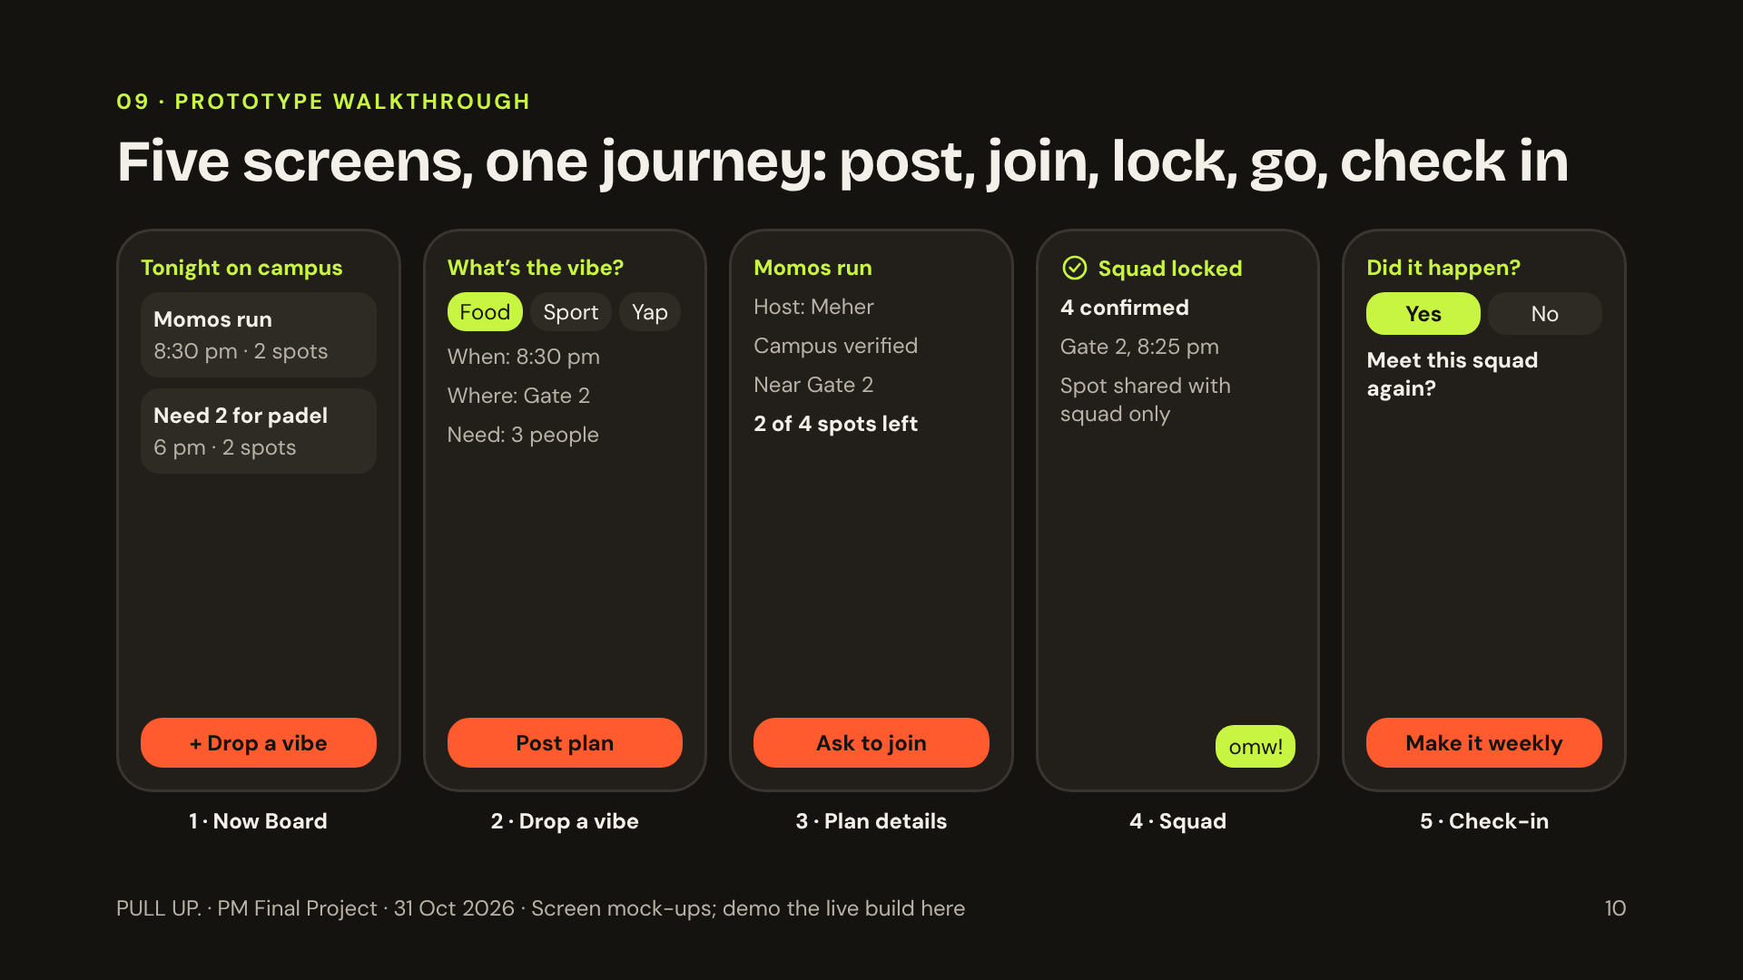
Notes:
Walk one journey end to end: Meher posts a momos run, Kabir sees it on the Now Board, asks to join, Meher approves, the squad locks and only then sees the exact meeting point. After the plan, both get the check-in. If you have the Lovable plus Supabase build working, switch to the live demo here. Only claim it works end to end if plans, requests, approvals and check-ins are really stored in the database.

Slide 11
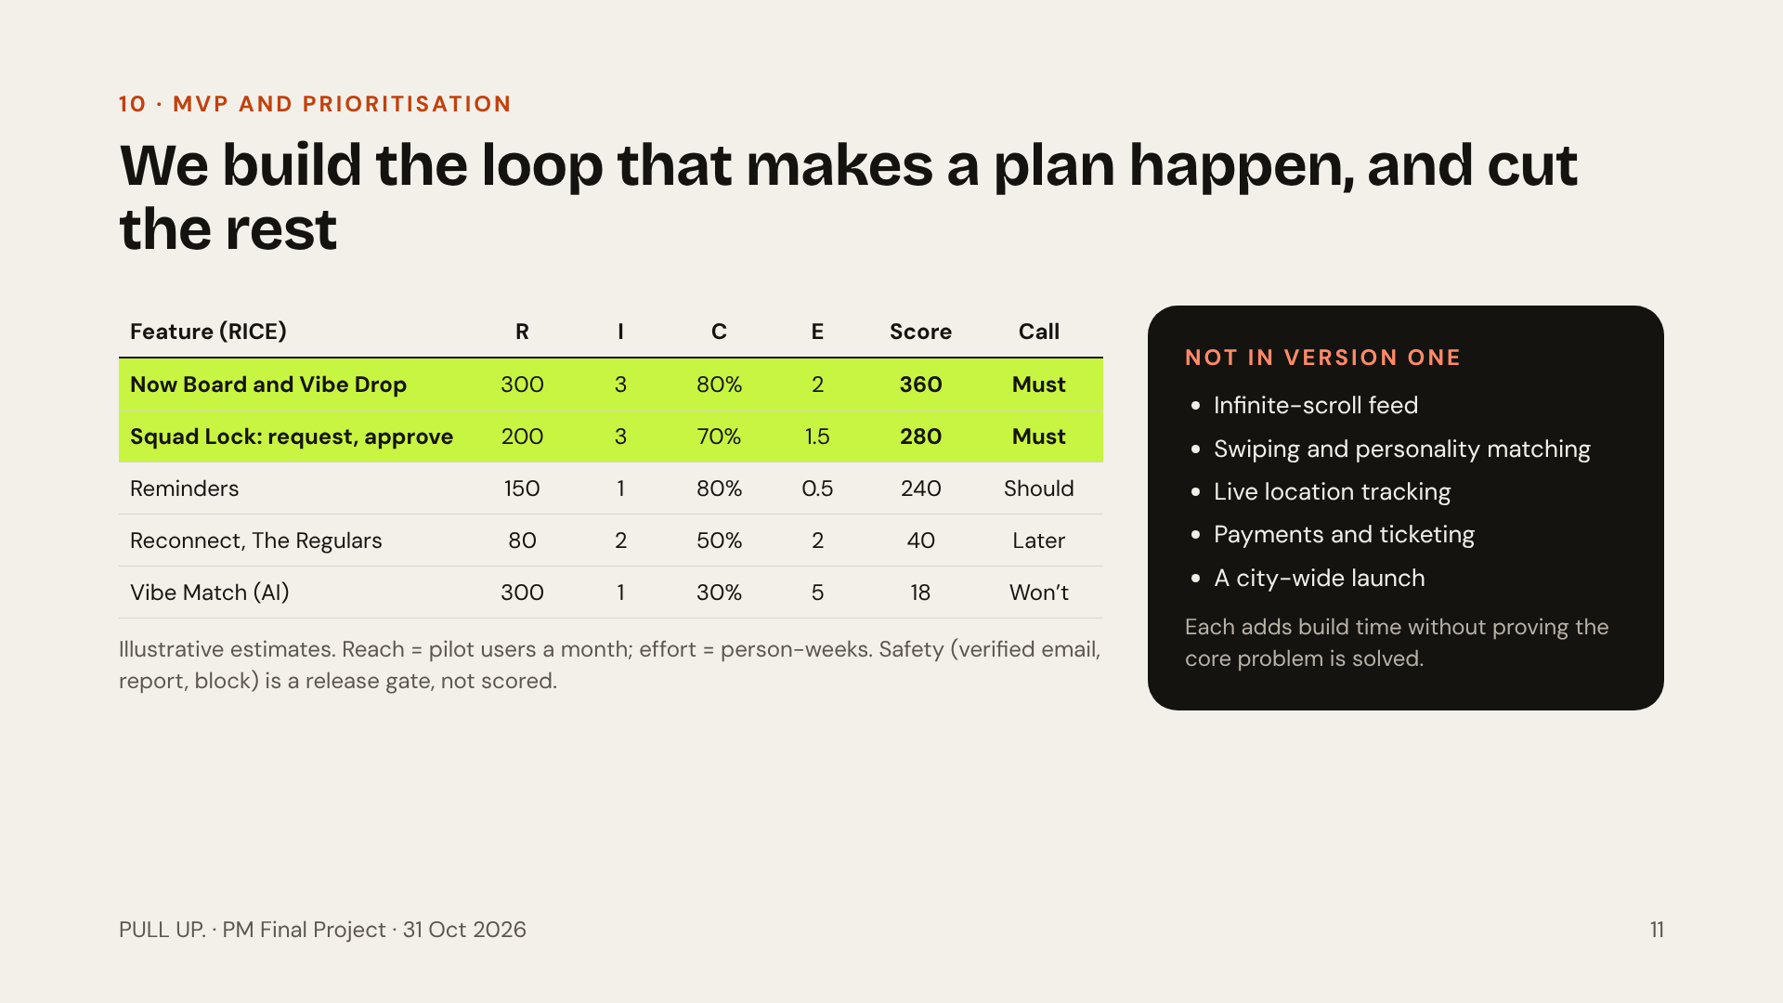
Notes:
RICE ranks the two features that create the loop at the top: the Now Board with Vibe Drop, and Squad Lock. Reminders are cheap and help show-up rates. AI matching scores lowest because we have low confidence and high effort, and with 30 pilot users simple filters work fine. Safety is not ranked at all: it ships regardless of score. Build stack: Lovable for the mobile web front end, Supabase for auth and data.

Slide 12
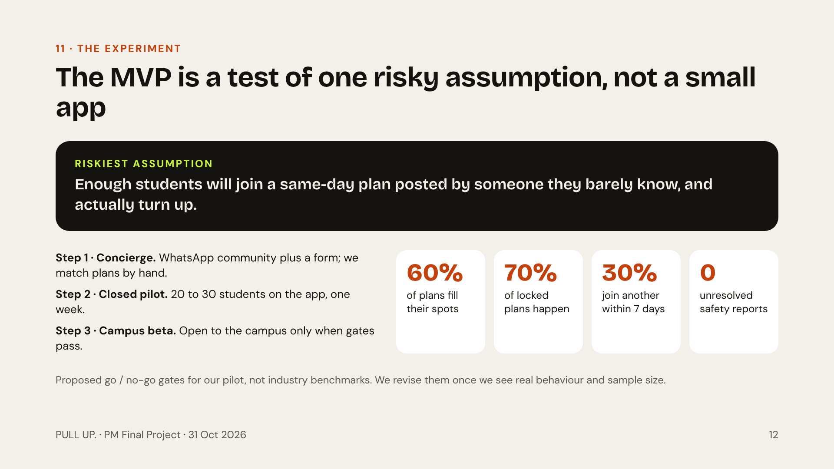
Notes:
If one thing kills PULL UP., it is this assumption: that people will join a near-stranger’s plan the same day and show up. So we test it in the cheapest way first, a concierge pilot run by hand over WhatsApp, before writing much code. The four gates decide whether we move to the next step. Zero unresolved safety reports is non-negotiable.

Slide 13
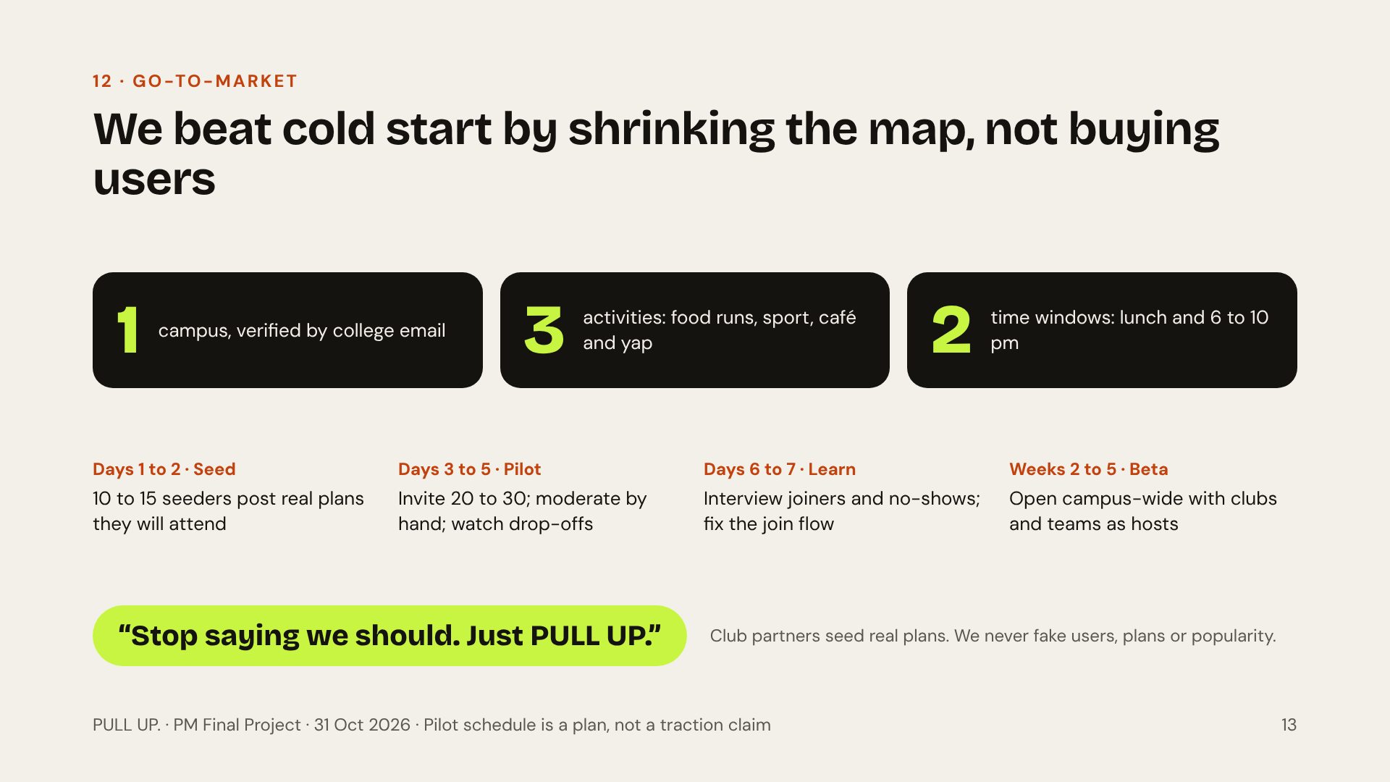
Notes:
A social app has the classic cold-start problem: nobody joins if no plans exist, and nobody posts if nobody is there. Our answer is to shrink the map until it feels full: one campus, three activity types, two time windows. A board with eight plans at 7 pm feels alive; a city with eight plans feels dead. Partner with student clubs and sports teams to post real plans. Never fabricate activity. Only report traction you actually measured.

Slide 14
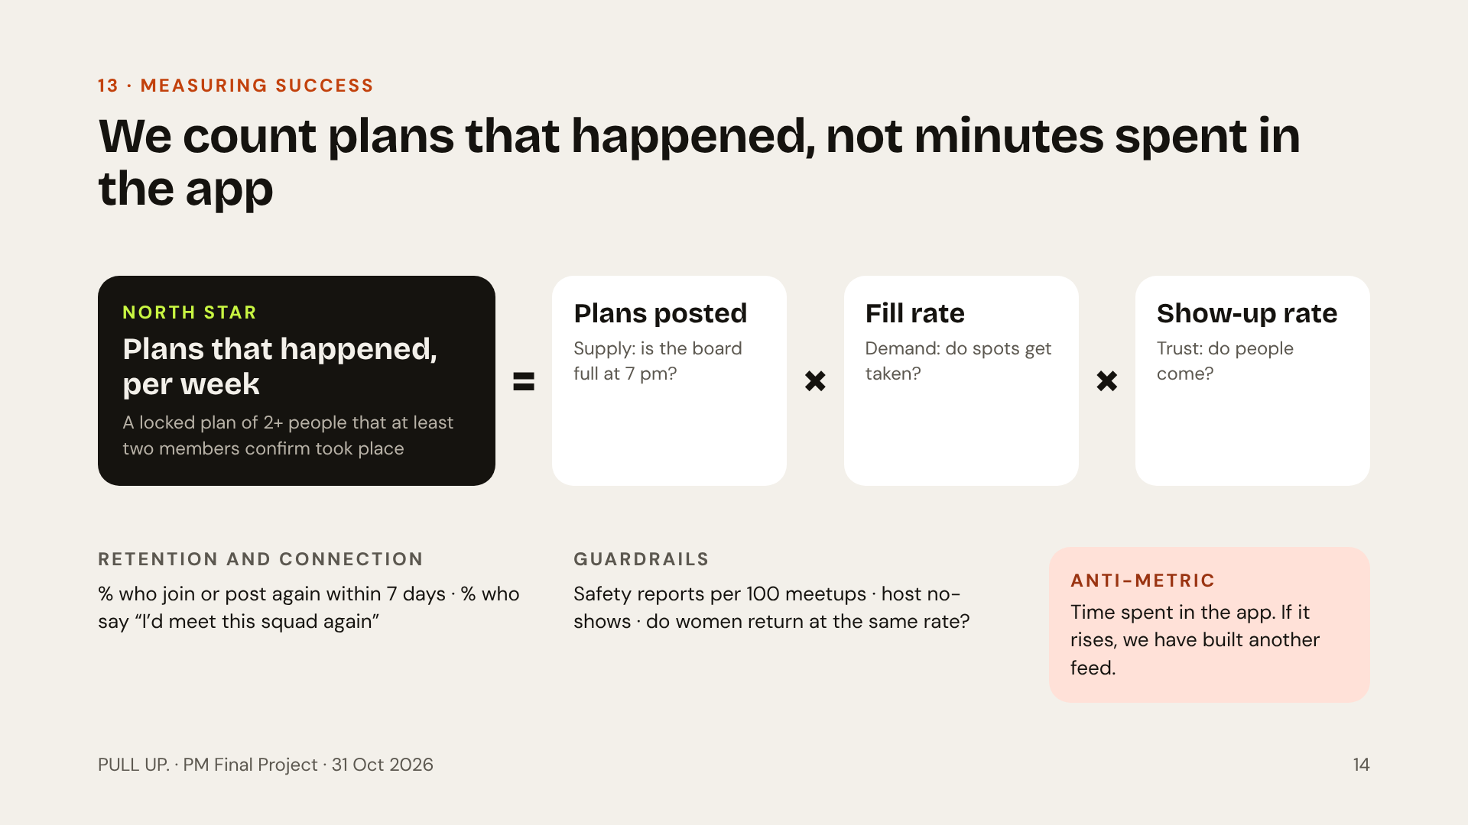
Notes:
Our north star is plans that happened per week, confirmed by at least two members in the check-in. It breaks into three levers we can work on separately: supply of plans, fill rate and show-up rate. If the north star drops, the driver tree tells us which lever broke. Guardrails stop us from growing in an unsafe way, and the anti-metric keeps us honest: time in app going up means we are becoming a feed, which is the opposite of the mission.

Slide 15
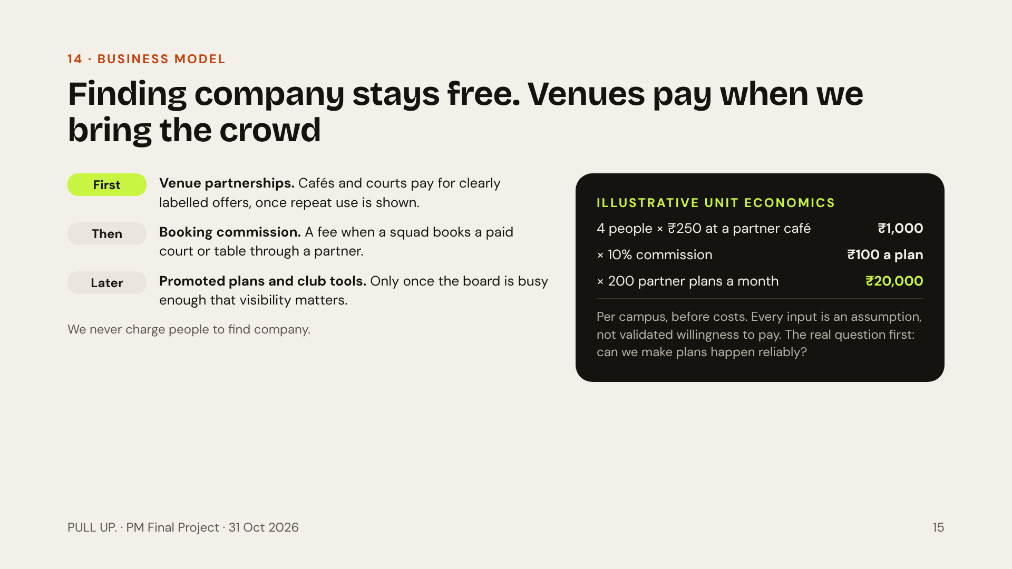
Notes:
Charging lonely people to find company is a bad business and a worse look, so discovery stays free. Revenue comes when we help people participate: venues want groups of four walking in at 8 pm on a weekday. The numbers on the right are a scenario to show the logic, not a forecast: four people spending 250 rupees, a 10% commission, 200 partner plans a month on one campus. The first business question is still whether PULL UP. reliably makes plans happen.

Slide 16
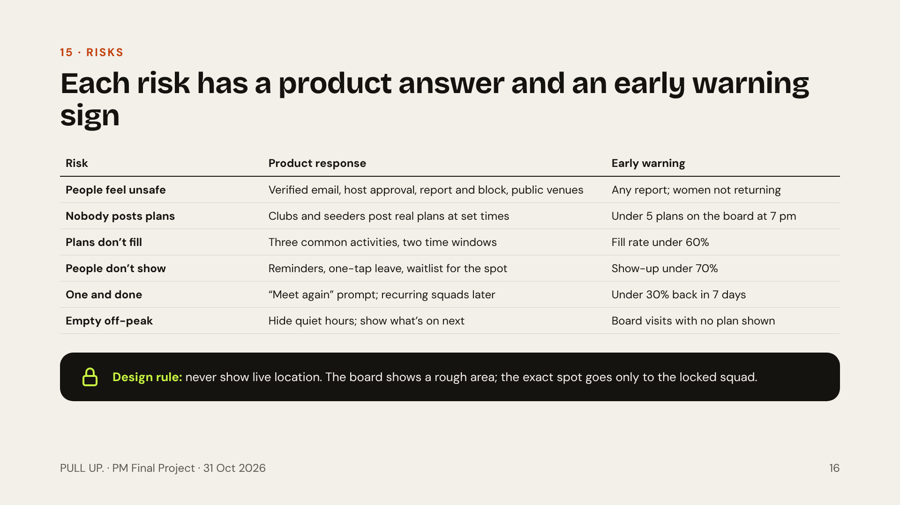
Notes:
Safety is first on this list on purpose. Meeting near-strangers is the scariest part of the idea, especially for women, so verification, host approval, report and block and public venues all ship in version one. Every other risk maps to a number on our dashboard, so we know early when something is breaking. The one design rule we will not break: no live location, ever.

Slide 17
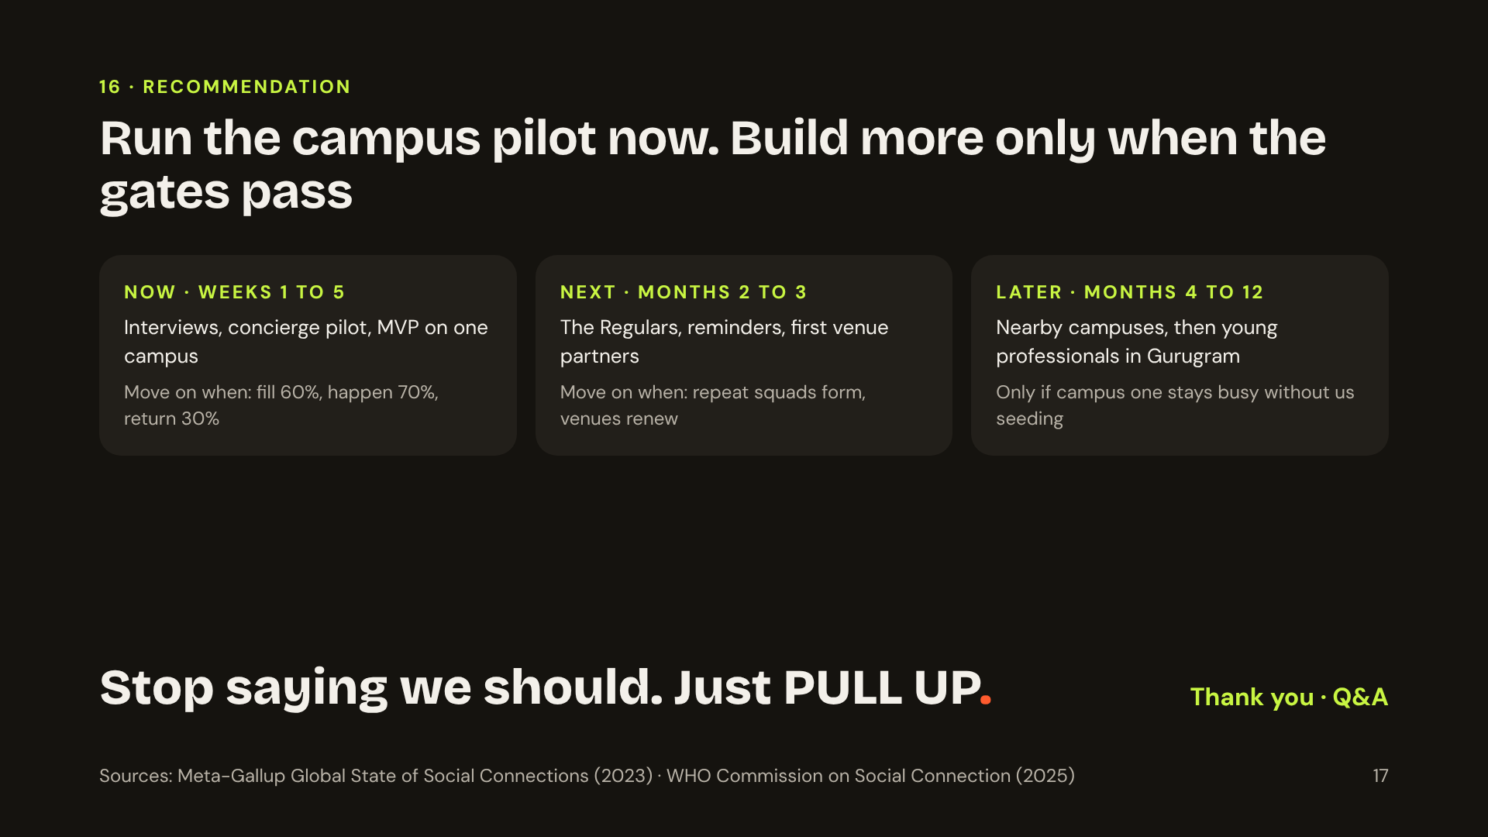
Notes:
Close on the decision, not the dream. Our recommendation is to run the campus pilot now and only invest in more features or more places when the numbers say plans are really happening. Biggest open question for Q and A: will people repeatedly meet near-strangers, and will enough of them be free at the same time? That is exactly what the pilot is designed to answer. End with the line: stop saying we should. Just PULL UP.

