Slide 1
EmpowHer
EmpowHER: Empowering Girls for Corporate Excellence Technical Curriculum - JAVA

Slide 2
Agenda Week 3
SPRING JDBC
Learn about the Spring JDBC and JdbcTemplate.
Learn about the in-memory database.
Learn to perform queries on the database such as SELECT, INSERT, UPDATE, and DELETE.
Master the concepts of DDL queries.
Learn about the RowMapper interface and related concepts.
Spring Data Java Persistent API
Learn about JPA, its annotations, and how to implement it.
Learn to manage entities using a repository.
Master the concepts of performing CRUD operations offered by the EntityManager.
Learn to write named queries.
Learn to connect to other databases.

Slide 3
Spring JDBC Overview
Spring Boot simplifies development and makes JDBC programming easy. It eliminates the need for establishing connection, handling expectations, and closing connections.
All the required boiler plate code is executed behind the scenes so the developer can concentrate on writing queries.

Slide 4
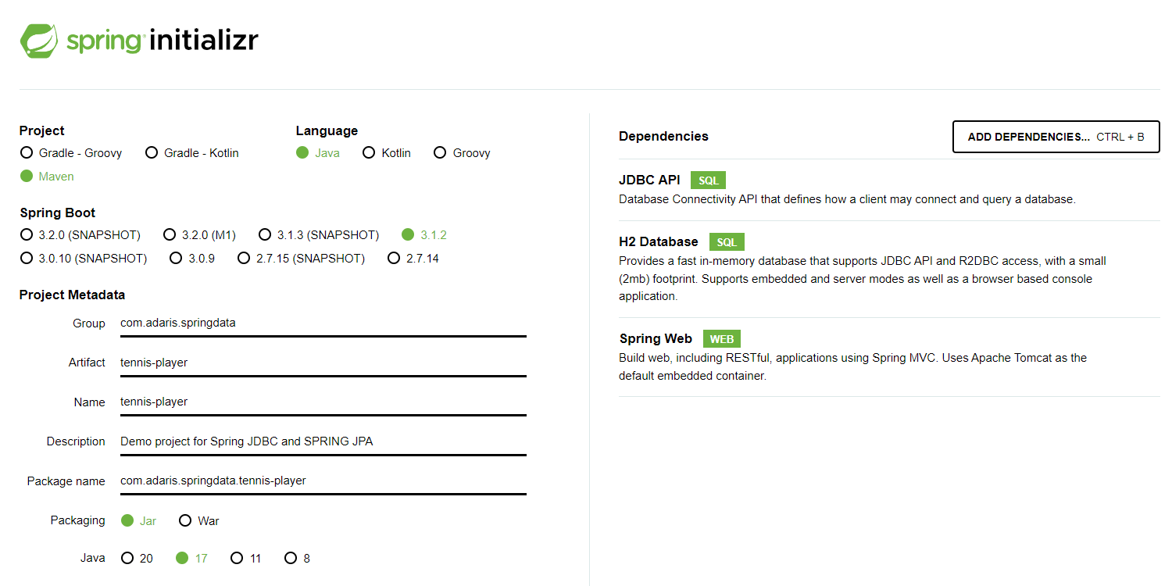
Creating a JDBC Starter Project
Spring JDBC makes talking to databases easy by eliminating the need for establishing a connection, handling expectations, and closing connections. Spring provides a template class called JdbcTemplate to interact with databases which offers a wide array of methods to perform storage and retrieval of data. The JdbcTemplate class hides all the boilerplate code for connection management and error handling whereby the developer can focus on the SQL query.
To set up a starter project for JDBC, go to Spring Initializr. The Group Id of the project is springdata and the Artifact Id is tennis-player. We will add the following dependencies:
JDBC API for querying the database
H2 Database that supports JDBC API access
Spring Web for the web console offered by H2

Slide 5
Setting up the H2 Database
Step 1
Configuring database
spring.datasource.url=jdbc:h2:mem:testdb
spring.h2.console.enabled=true
spring.h2.console.settings.web-allow-others=true
Step 2
Creating a table
CREATE TABLE Player (
ID INTEGER NOT NULL,
Name VARCHAR(255) NOT NULL,
Nationality VARCHAR(255) NOT NULL,
Birth_date TIMESTAMP,
Titles INTEGER,
PRIMARY KEY (ID)
);
Step 3
Inserting data
INSERT INTO Player (ID, Name,Nationality, Birth_date, Titles)
VALUES(1, 'Djokovic', 'Serbia', '1987-05-22', 81);
INSERT INTO Player (ID, Name,Nationality, Birth_date, Titles)
VALUES(2, 'Monfils', 'France', '1986-09-01', 10);
INSERT INTO Player (ID, Name,Nationality, Birth_date, Titles)
VALUES(3, 'Isner', 'USA', '1985-04-26', 15);

Slide 6
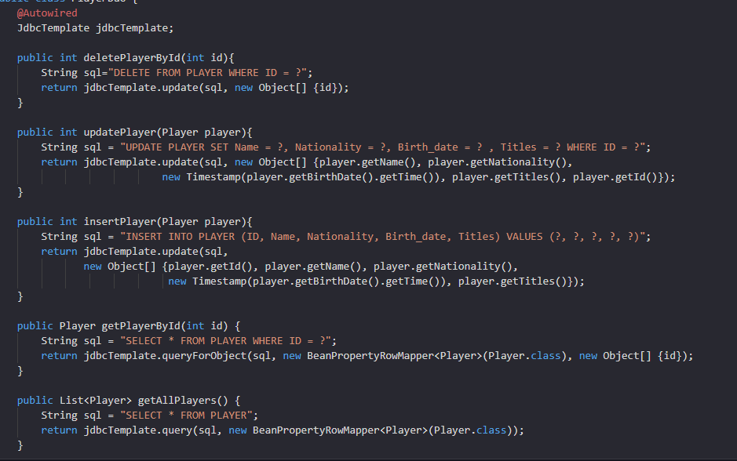
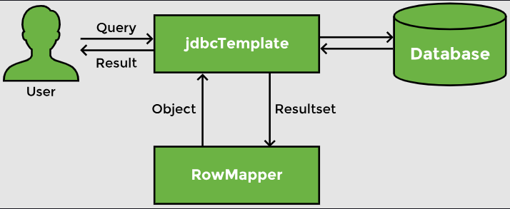
CRUD Operations
Spring data support makes interacting with databases easy. Since we are using Spring Boot, the connection part is automatically taken care of and the data source is automatically configured. Likewise, the connection is automatically closed. Spring provides JdbcTemplate, which makes it easy to write and execute a query. It also provides the BeanPropertyRowMapper which maps rows of a table to a bean.

Slide 7
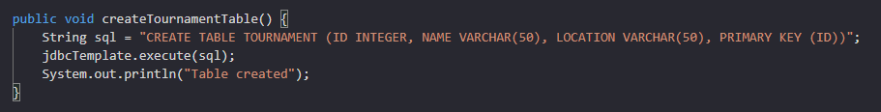
DDL Queries
Data Manipulation Language (DML) queries are the one where we manipulate the data in the table. In a rare scenario, we might want to create a table which is a Data Definition Language (DDL). In that case, we can use the execute method of the JdbcTemplate
we want to create a Tournament table to store details of a tennis tournament. We will create a method called createTournamentTable with a CREATE TABLE query.

Slide 8
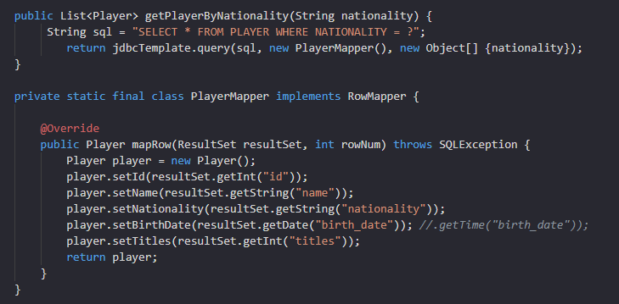
Custom RowMapper
The BeanPropertyRowMapper can be used to map the results of the query to our bean. If the database table has a different structure or column names, we need to define our custom mapping.
Define our own row mapper by implementing the RowMapper interface and providing the bean onto which the rows will be mapped.
Write custom implementation of mapRowMethod to initialize an object for each row
To use custom mapper, we can simply pass it in any method instead of the BeanPropertyRowMapper

Slide 9
Spring Data JPA Overview
Java Persistence API (JPA) is used to write, maintain, and manage hundreds of queries in large applications.
It is a simpler, cleaner, and less labor-intensive approach that helps developers to ease this task.
It eliminates the boilerplate code that has to be written to execute simple queries.
JPA helps to write more understandable and cleaner code and become more skilled and proficient as a Spring Boot developer.

Slide 10
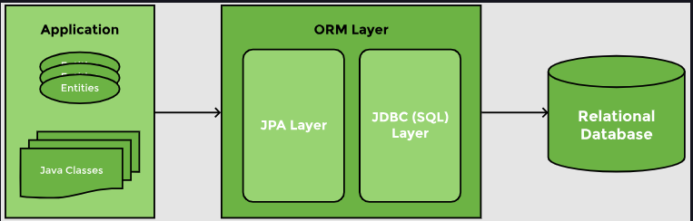
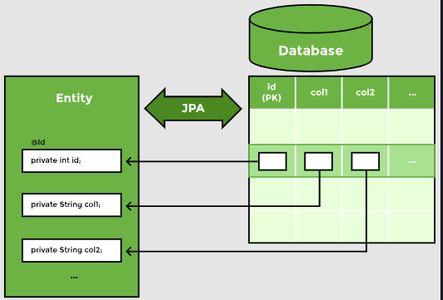
What is JPA?
Java Persistence API (JPA) is designed to ease writing and maintaining sql queries.
Using JPA, we can map a Java class or bean to a table. The members of the class map columns in the table. When this mapping is defined, JPA can write queries on its own. It takes the responsibility of creating and executing queries for CRUD operations.
There are numerous implementations of the JPA interface like Hibernate, EclipseLink, Apache OpenJPA, etc. Hibernate is by far the most popular implementation of JPA. It is a lightweight framework and can easily be integrated with Spring.
ORM maps Java objects to table rows
Class members are mapped to columns in a database table

Slide 11
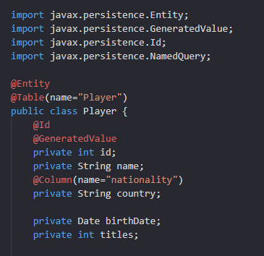
Defining an Entity
To use Spring Data JPA, add the starter JPA dependency, spring-boot-starter-data-jpa to the pom.xml
We will use the @Entity annotation to map this class to the Player table.
In case we want to map this class to a table with a different name, we can use the @Table annotation and provide the name of the table to which the bean maps to.
The @Id annotation is used to indicate the primary key
The @GeneratedValue annotation will automatically generate Id values.
@Column annotation mentions the name of the column that matches an attribute of the class

Slide 12
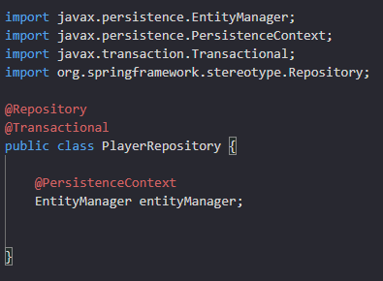
Creating a Repository
A repository class manages, stores, and retrieves entity data. It is created by marking it with the @Repository annotation.
Spring provides boilerplate code for transaction management, which can be integrated with JPA. This is done by using the @Transactional annotation on a method or class.
All operations on the entity, go through the EntityManager and are stored inside the PersistenceContext. EntityManager is the interface to the Persistence Context.

Slide 13
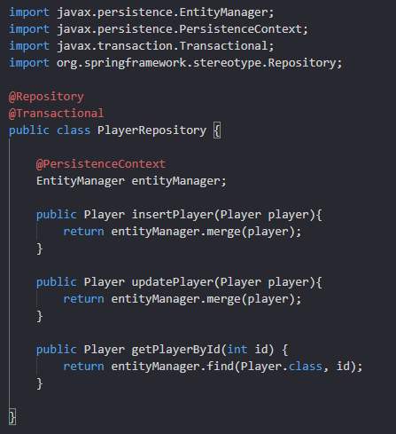
CRUD Operations
The EntityManager offers a merge method for both INSERT and UPDATE operations. merge checks if the primary key value is being passed to it or not. If it finds the primary key, it updates the corresponding record. If the primary key is not passed, it generates a value and inserts a new record in the table. The merge method returns a Entity object.
EntityManager offers a number of find methods.For example fine method can be used to return a player based on the primary key value.
merge and find methods creates the SQL query and maps values to it on its own. It also converts the row returned to a Player object.
To see the queries that Hibernate has generated, we can enable the show-sql property in the application.properties

Slide 14
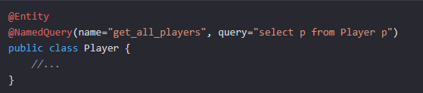
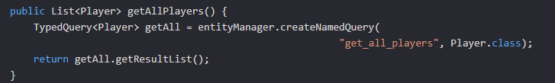
JPQL Named Query
To create a named query, we will use the @NamedQuery annotation on the Entity class. This annotation requires two parameters: the name of the query and the query itself.
In repository class,we will use the createNamedQuery method. We need to pass the name of the query and specify what the query will return.The createNamedQuery returns a TypedQuery. Then, we can use the getResultList method to return a list of Entities.

Slide 15
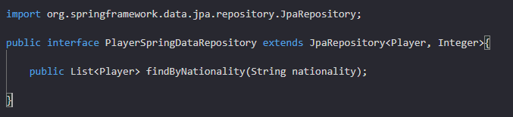
Spring Data JPA
Spring Data identified this duplication of code when writing repositories and created some predefined repositories. The developer provides the entity type and its primary key and Spring Data comes up with the CRUD methods for the entity. Spring Data JPA adds a layer of abstraction over the JPA provider.
The JpaRepository interface extends the Repository interface. It contains the API provided by CrudRespository as well as the PagingAndSortingRepository for CRUD operations along with pagination and sorting of records.
We will create an interface that extends the JpaRepository.We need to specify the entity that will be managed by this repository, as well as the primary key of the entity.Simply by extending the JpaRepository, we get all basic CRUD operations without having to write any implementation.

Slide 16
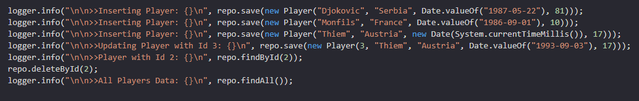
Spring Data JPA
To insert and update an object, Spring Data has a save method that works in the same manner as the merge method of the EntityManager.
Spring Data has a method called findById, which takes in the primary key and returns an object.
findAll method will returns all entity objects.
For deletion, Spring Data has a deleteById method that takes the primary key of the record to be deleted.
Spring Data can parse a method name and create a query from it. A method findByNationality even without any implementation, is converted to the following JPQL query using the JPA Criteria API:
select p from Player p where p.nationality = ?1
We can use keywords such as And, Or, GreaterThan, LessThan, Like, IsNull, Not etc., in the method name and OrderBy clause can be used to sort the results.

Slide 17

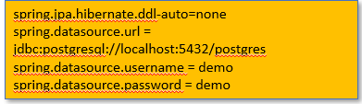
Connecting to Other Databases
In real-life applications, we might want to connect to Oracle, MySql, or postgresql server databases. Using Spring Boot, switching databases is very straightforward. We just need to perform following steps
Replace H2 dependency with dependency of Database we wish to connect to.
Update application.properties file with DB details. Since we already have a schema and do not want Hibernate to create it for us, we have set spring.jpa.hibernate.ddl-auto setting to none.
After making these changes, restart the application and Spring Boot will connect to the database of your choice.

Slide 18
Appendix
https://start.spring.io/

