Slide 1
Financial Management
System
CS 5393
Advanced Software Engineering Project
Group Members:
AAKRITI DHAKAL, AGNES JESIONOWSKA,
MANOJ KHANAL

Slide 2
Financial Management
System
Clarifies expectations, better interface design, test-as-contract
Automation today focuses on code-first, test-later
Lack of automation tools for TDD-style development
'Write TESTS first, then CODE'

Slide 3
Provides insights through dashboards, predictions, and AI-driven financial advice
AI-Powered Financial Management System
Financial Management
System
Students struggle to track finances, plan tuition, and understand spending patterns
Students struggle to track finances, plan tuition, and understand spending patterns

Slide 4
DEVELOPMENT CYCLE
Requirement Analysis
Deployment & Feedback
System Design
Testing &
Implementation
UI/UX
Design
Code
Implementation

Slide 5
TECH STACK
Frontend
React 18, Vite, Tailwind CSS for responsive UI and fast development
Backend
Java 17, Spring Boot 3 for REST APIs and business logic
Database
PostgreSQL for secure and scalable data storage
Authentication
JWT (stateless) + Spring Security for secure user access
API Communication
Axios for handling HTTP requests between frontend and backend
Data Visualization
Recharts for dashboard graphs and financial insights
AI Integration
OpenAI API for intelligent financial advice and recommendations

Slide 6
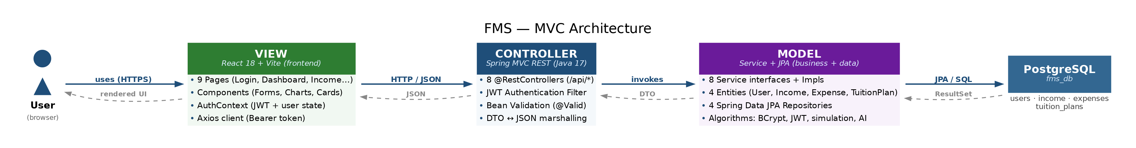
MVC ARCHITECTURE

Slide 7
CORE FEATURES
Create Account
Login
Manage Income
Register with BCrypt-hashed password + JWT
Authenticate, receive Bearer token
CRUD — scholarships, jobs, family support
Manage Expenses
Budget Dashboard
Tuition Planner
CRUD — housing, food, transport, etc.
Totals, net balance, 6-month chart
Gross/net tuition with scholarship offset
Expense Prediction
What-If Simulation
AI Financial Advisor
3-month moving-average forecast
Month-by-month cash flow projection
GPT-powered, grounded in user's real data

Slide 8
KEY ALGORITHMS
Dashboard Aggregation
Sums income/expense via BigDecimal across last 6 months using 12 indexed range queries (2 per month). O(n) in window size.
Expense Prediction
3-month moving average grouped by category. Requires ≥ 3 months; returns HTTP 422 if insufficient. Scale=2, HALF_UP.
What-If Simulation
Iterates m = 1..N: balance += (hypoIncome − hypoExpenses). Pure read-only — never persists. O(months).
Tuition Calculation
grossTuition = perCourse × N; netTuition = max(0, gross − scholarship). Floors at zero. Persists TuitionPlan.
AI Context Enrichment
Injects totals, 6-month history into system prompt before GPT call. Temperature = 0.4. 5-second SLA; 504 on timeout.

Slide 9
UML DIGRAMS
3 class diagrams + 5 statecharts covering all major workflows
Class Diagrams (3)
Statecharts (5)
S1 — Authentication
D1 — Domain Model
Landing → Register / Login → Session Active → Token Expired → Logout
JPA entities + DTO families Composition & dependency relationships
S2 — Income/Expense Lifecycle
No Record → Draft → Validating → Persisted → Edit → Delete
D2 — MVC Diagram
3-column View / Controller / Model Cross-package request flow arrows
S3 — Tuition Planning
Inputs → Validate → Calculate → Display Result → Adjust
S4 — What-If Simulation
D3 — Reverse Class Diagram
Baseline Load → Config → Simulate → Projection → Compare Scenarios
IDE-style — exact current source state TODO stubs & placeholder classes visible
S5 — AI Advisor Session
3-phase backend pipeline + external OpenAI call + 5 s SLA guard

Slide 10
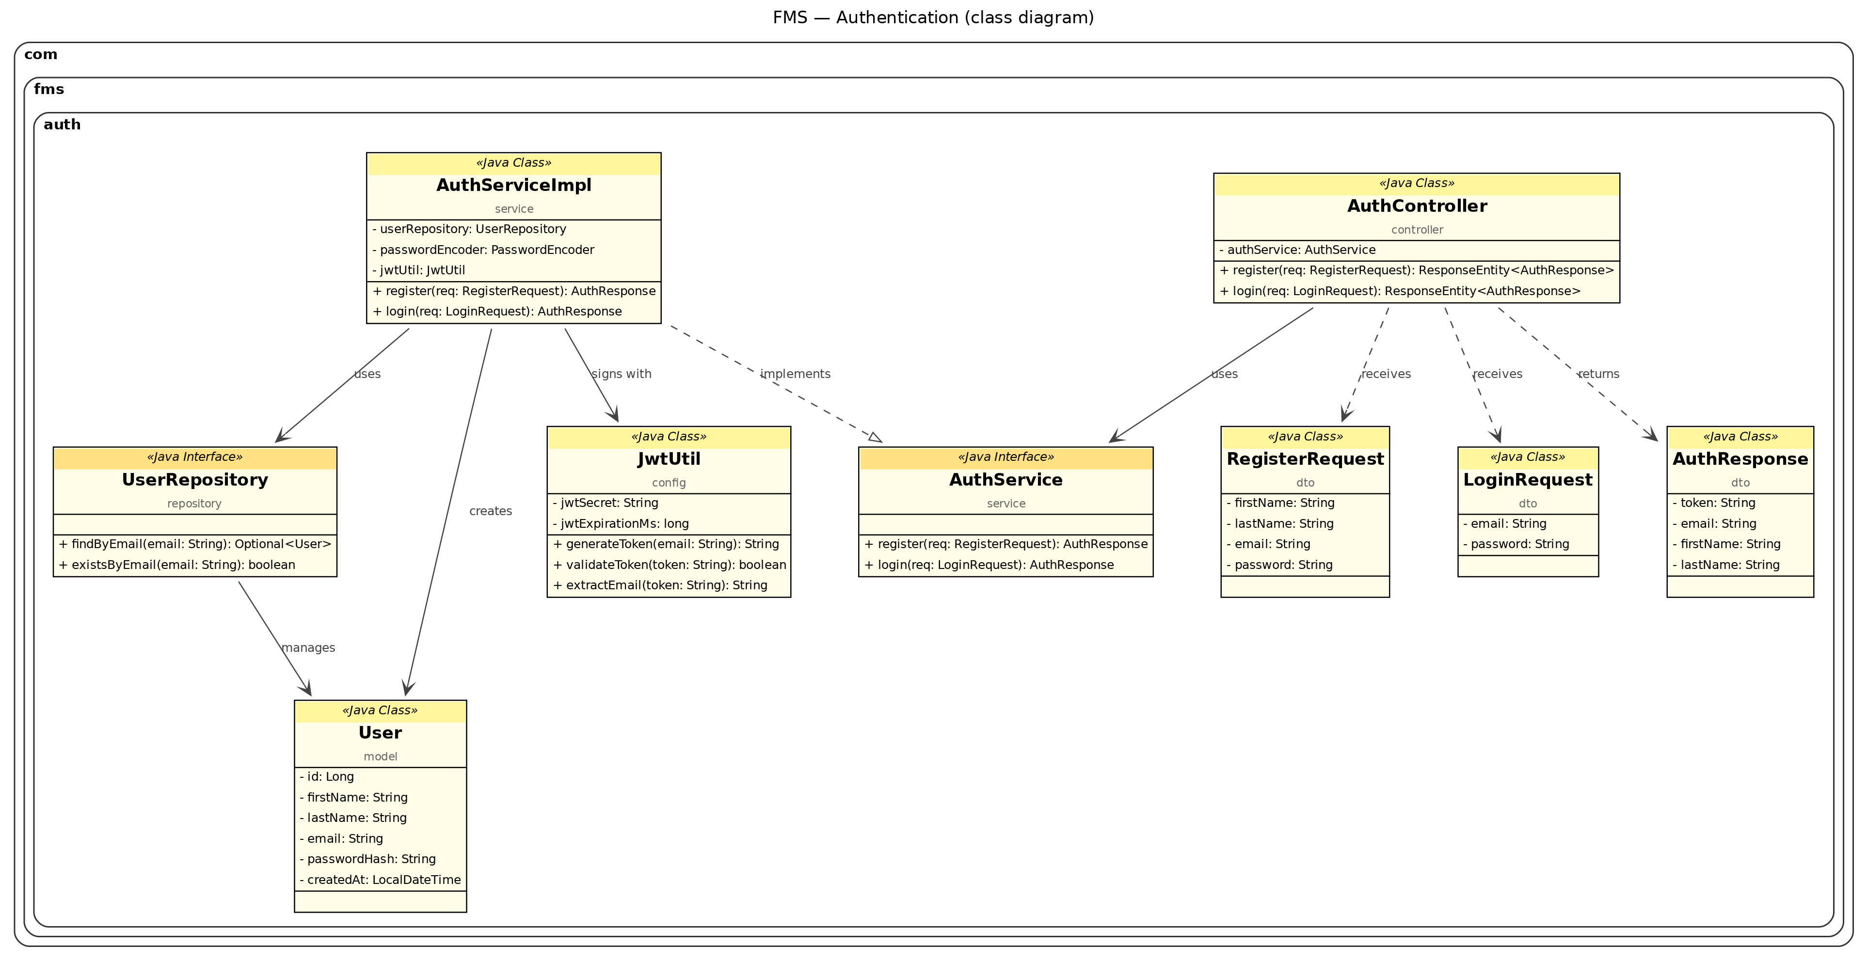
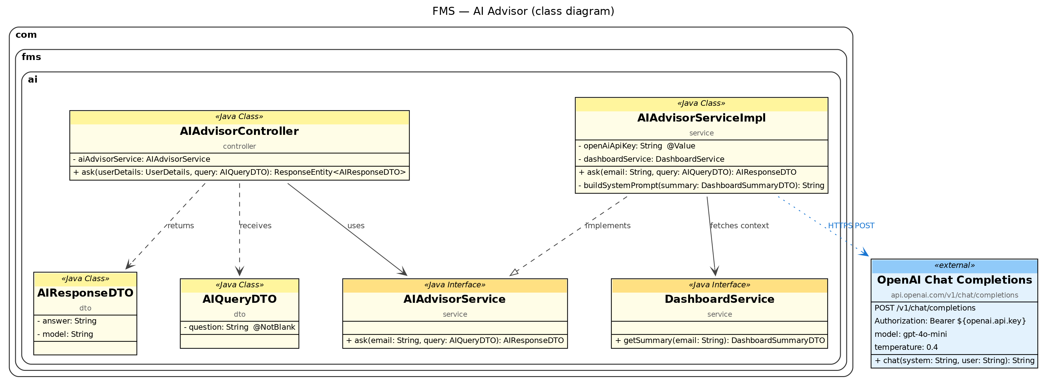
CLASS DIAGRAMS PREVIEWS

Slide 11
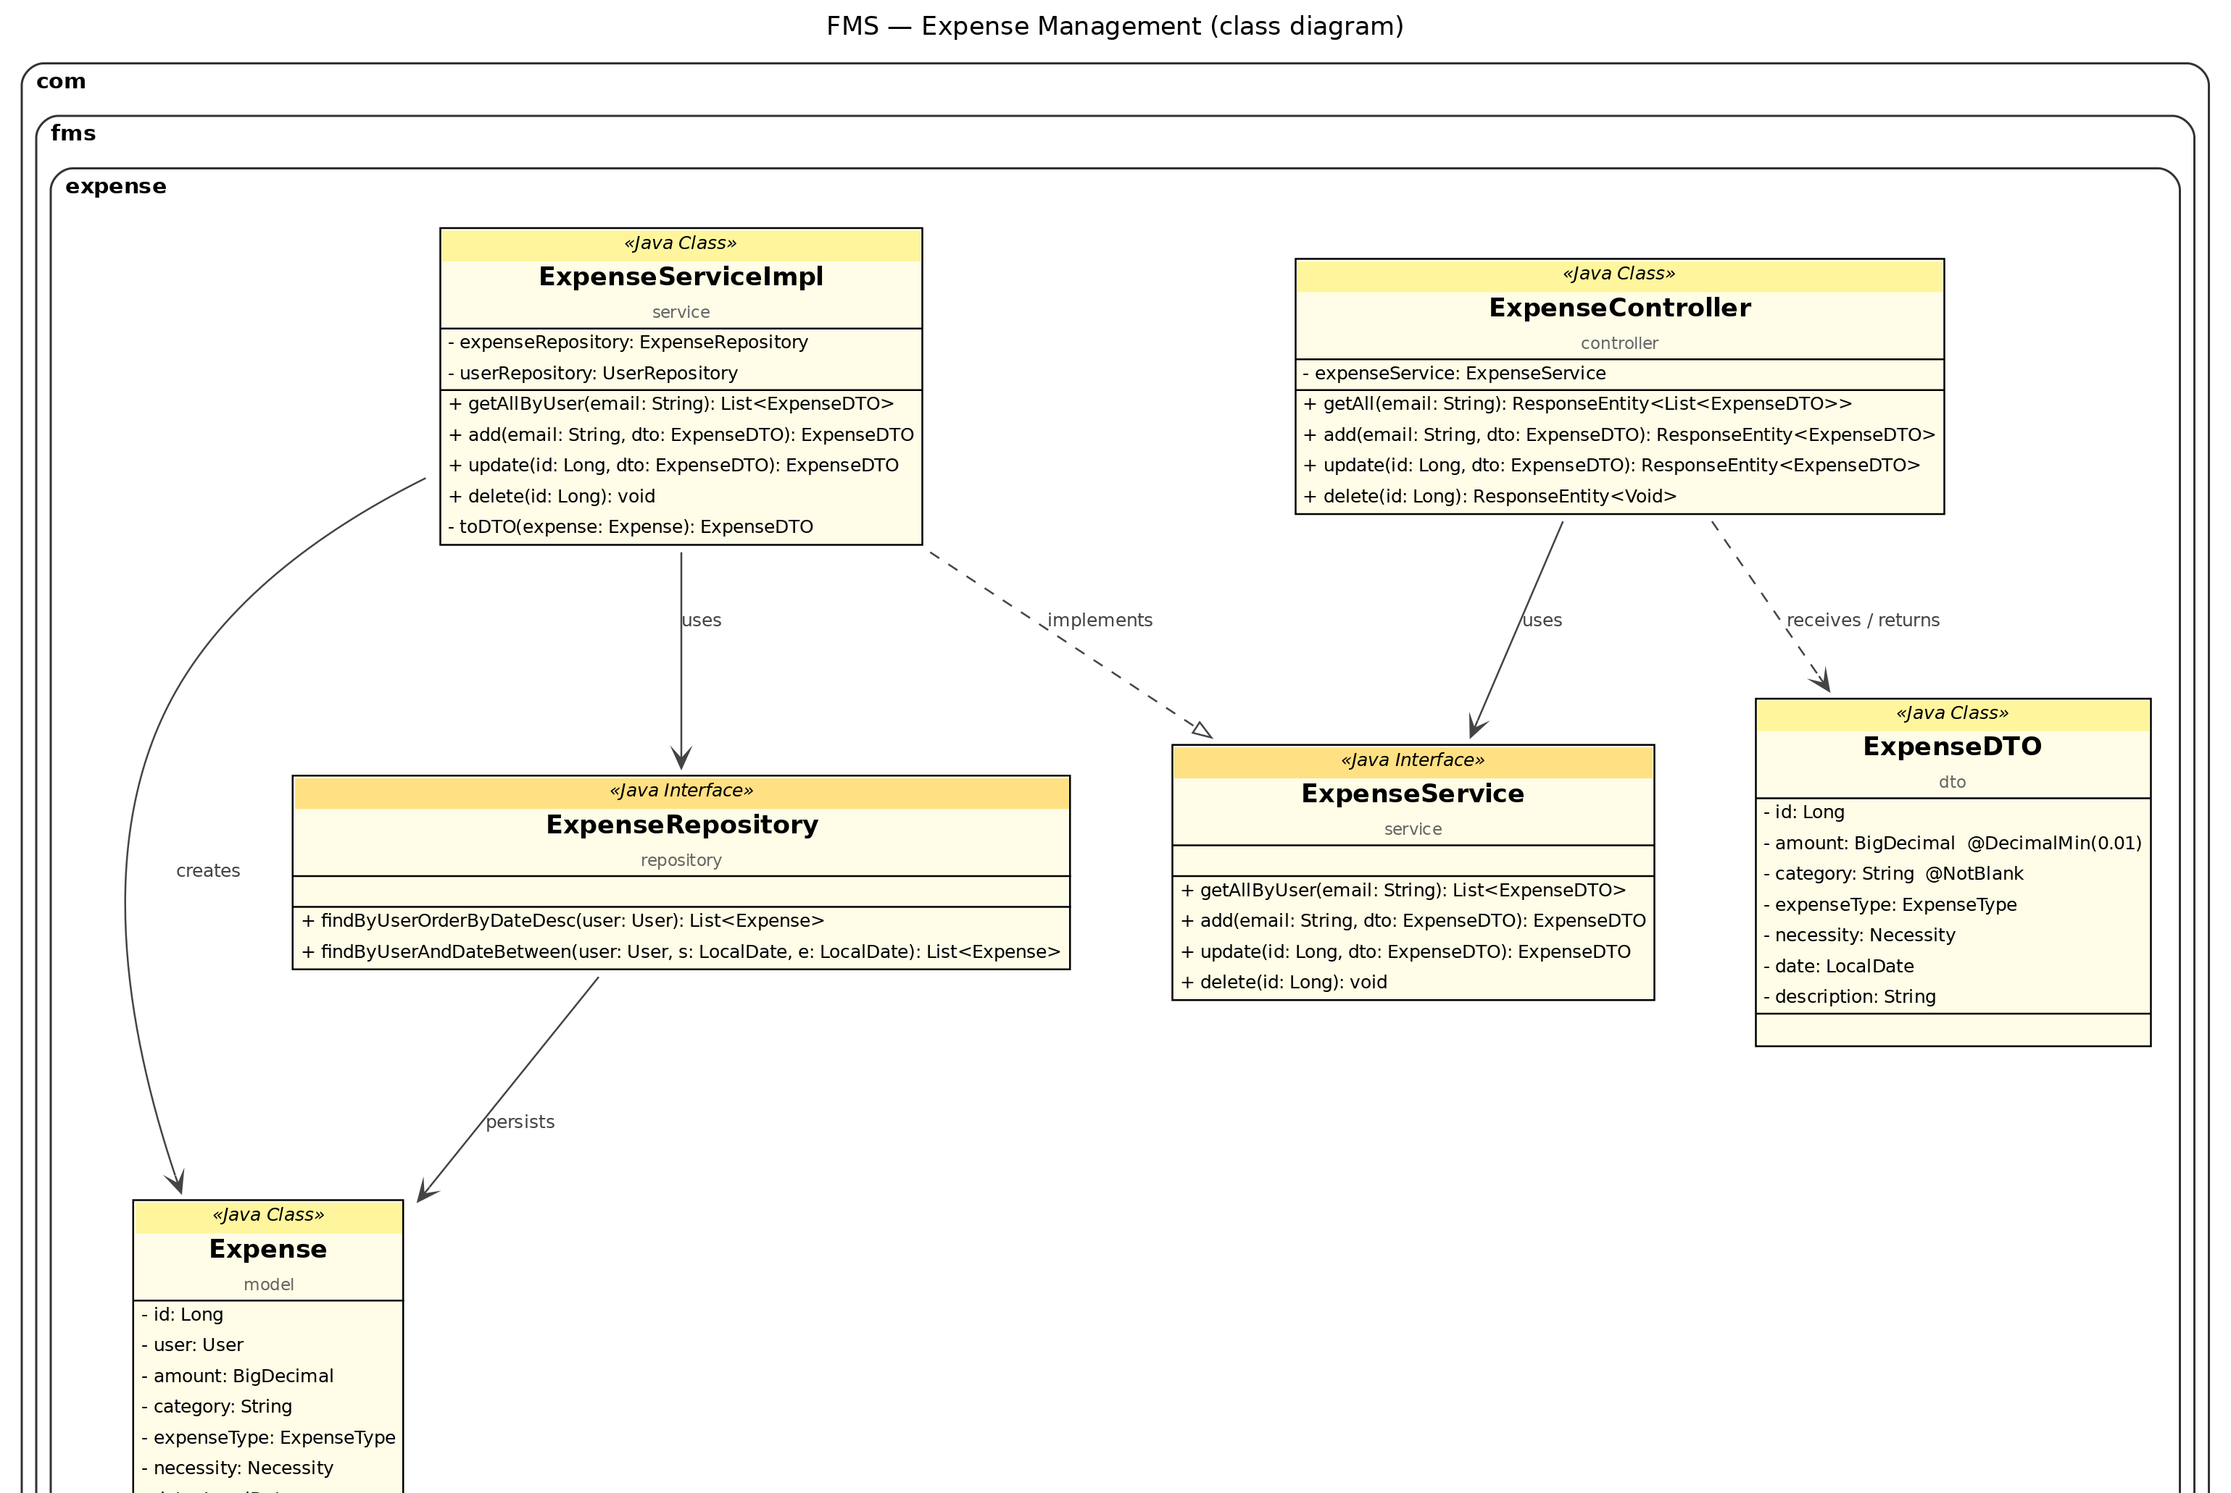
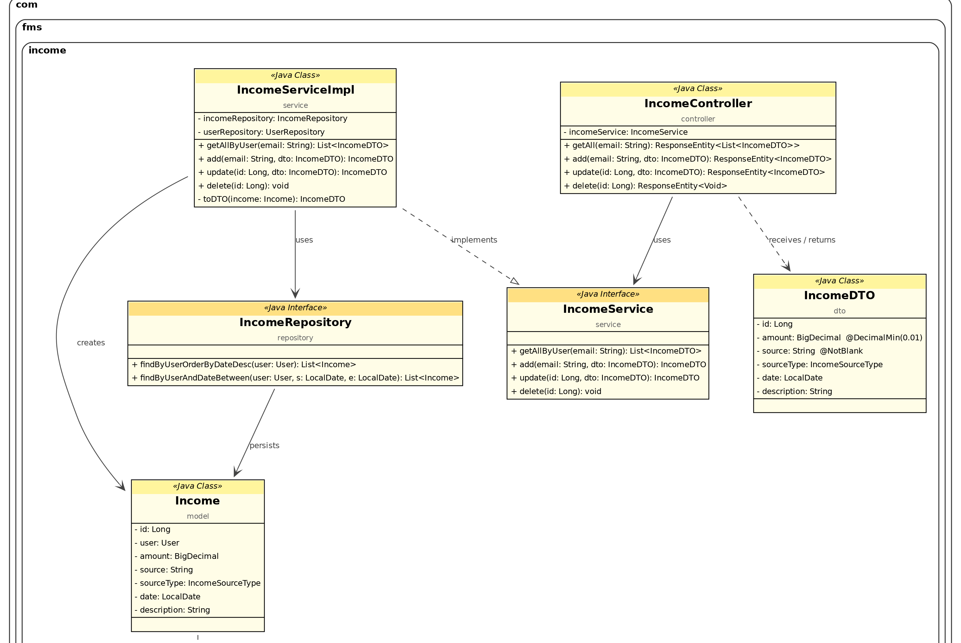
CLASS DIAGRAMS PREVIEWS

Slide 12
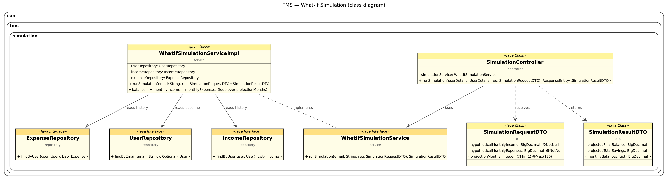
CLASS DIAGRAMS PREVIEWS

Slide 13
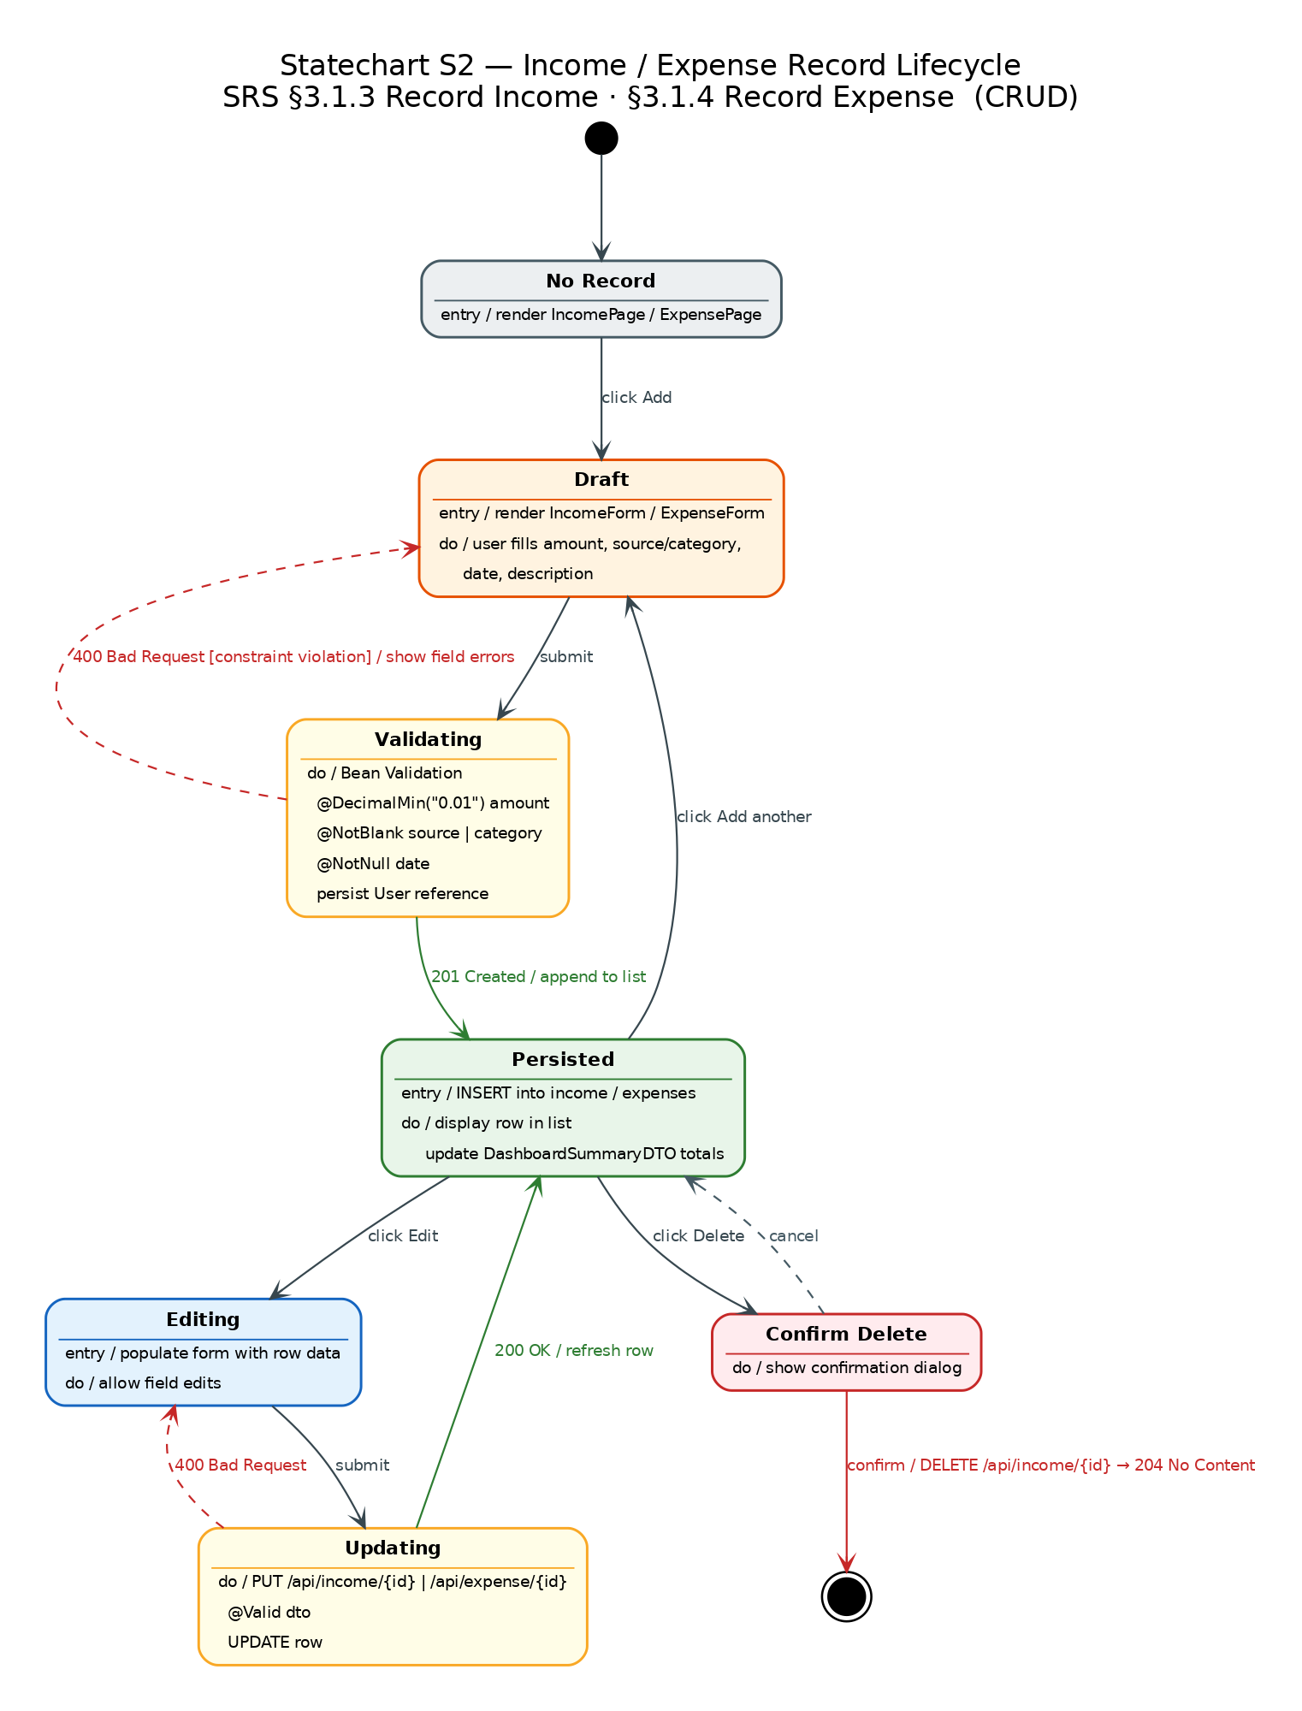
STATECHART
DIAGRAMS SAMPLES

Slide 14
DEMO:
System Walkthrough
Key Features in Action
BASELINE: ZERO-SHOT TEST GENERATION

Slide 15
TESTING STRATEGY
Test Classes
Coverage Matrix
UserEntityTest
Email, NotBlank validation via Validator
Happy path (200)
✓ all protected endpoints
IncomeEntityTest
Amount < 0.01 rejected, user reference required
401 — No token
✓ every non-auth endpoint
ExpenseEntityTest
Category NotBlank, date PastOrPresent
403 — Cross-user
✓ update & delete operations
AuthControllerTest
Register 200, duplicate 409, login 200, bad creds 401
IncomeControllerTest
GET with JWT 200, no JWT 401, cross-user DELETE 403
409 — Duplicate email
✓ AuthController.register
ExpenseControllerTest
Same matrix as Income
422 — Insufficient data
✓ PredictionService < 3 months
DashboardControllerTest
Totals correct, recentIncome size ≤ 5
400 — Bad Request
✓ all validation failures
TuitionControllerTest
Affordable=true/false branches, short-by-X message
BigDecimal precision
✓ HALF_UP, 2 decimal places
PredictionServiceTest
< 3 months → 422; ≥ 3 months → arithmetic mean to 2dp
WhatIfSimulationServiceTest
Surplus/deficit/break-even verdicts; timeline length check
Test naming convention
given_when_then style

Slide 16
PROMPT ENGINEERING
1
2
3
Sandwich Method
Attention Anchoring
Visual Emphasis
Critical requirement stated at top AND bottom of every prompt — prevents key constraints from getting lost mid-context.
MANDATORY, CRITICAL, DO NOT in capitals placed inline at the exact step they govern — the model cannot miss them.
Bold text, inline code, and fenced code blocks separate instructions from narrative filler, reducing ambiguity.
4
5
Clear Delimiters
Selective Context
### sub-headings and triple-backtick fences let the model parse sections unambiguously without guessing structure.
Each prompt carries ONLY the entity shapes, sibling filenames, and DTO names relevant to that one component.

Slide 17
SUMMARY & CONCLUSION
Built a full-stack Financial Management System for students
Implemented key features: income/expense tracking, dashboard, prediction, and AI advisor
Ensured secure, user-specific access using JWT authentication
Provides meaningful financial insights and supports better decision-making
Combines analytics, simulation, and AI for real-world usability
Designed with scalability, security, and future enhancements in mind

Slide 18
THANK YOU!
GROUP -2 MEMBERS
AAKRITI DHAKAL
AGNES JESIONOWSKA
MANOJ KHANAL

