Slide 1

Project Title - Seasonal Agriculture Performance Analysis
Name – Aakriti Sharma
College Name – Institute of Technology and Management
AICTE STU ID : STU6a4fe5f636f271783621110

Slide 2

PROBLEM STATEMENT
Agricultural activities are influenced by seasonal variations in environmental conditions, farming practices, resource availability and market conditions. As a result, agricultural performance may differ from one season to another. However, raw agricultural data does not clearly explain how agricultural performance changes across seasons or what patterns can be observed in different seasonal conditions. The problem is to analyze the given agricultural dataset and investigate seasonal differences in agricultural performance by identifying meaningful patterns, trends, relationships and variations within the available data.

Slide 3
Project Description
Analyzed a farm-level agricultural dataset of 4,000 records covering 3 seasons (Kharif, Rabi, Zaid), 8 Indian states, 8 crops, and 4 irrigation methods to study seasonal performance patterns.
Cleaned and prepared the dataset by handling missing values (median imputation by season) and verifying no duplicate records.
Performed univariate, bivariate, and multivariate analysis using Python, Pandas, and Seaborn to compare yield, cost, revenue, and profit across seasons.
Conducted 3 additional independent analyses on regional consistency, disease/pest risk, and water-use efficiency to explain seasonal performance gaps.
Identified that Zaid season showed the lowest yield and the only negative average profit among the three seasons, while Kharif consistently performed best across all 8 states.
Found that irrigation method significantly affects seasonal profitability — Drip irrigation remained profitable across all seasons, while Flood and Rainfed irrigation turned unprofitable in Zaid.
Delivered 9 documented insights and evidence-based recommendations, including targeted irrigation improvements for Zaid-season farms.

Slide 4

WHO ARE THE END USERS?
Farmers deciding which crop, season, or irrigation method to invest in for better returns.
Agricultural planners and government bodies developing season-specific agricultural policies.
Agribusiness and irrigation consultants identifying regions and seasons that need targeted support.
Researchers and students studying seasonal patterns in Indian agriculture for further analysis.
Financial institutions and insurers assessing seasonal risk for agricultural loans or crop insurance.

Slide 5

Technology Used
Python — core programming language for the entire analysis
Google Colab — development environment for writing and running the analysis
Pandas & NumPy — data cleaning, transformation, and numerical computation
Matplotlib & Seaborn — data visualization (univariate, bivariate, and multivariate plots)

Slide 6
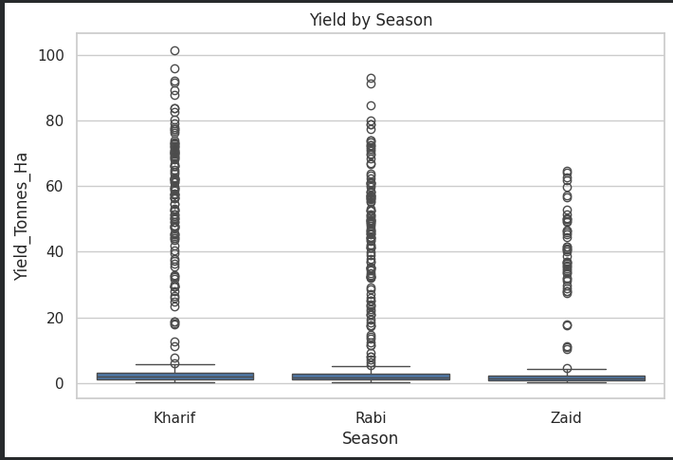
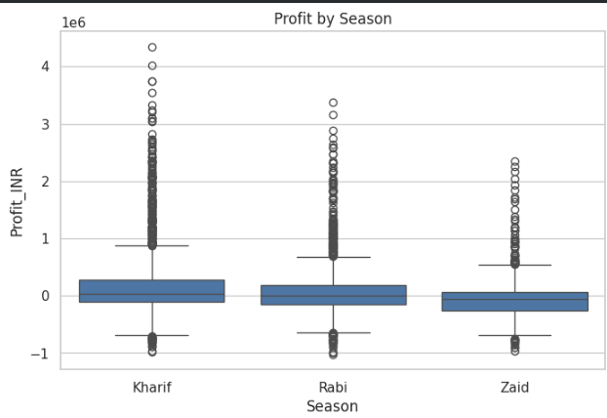
RESULTS : Seasonal Performance Comparison
Compared average Yield, Cost, Revenue, and Profit across Kharif, Rabi, and Zaid seasons.
Kharif recorded the highest performance: Yield 5.63 t/ha, Revenue ₹710,719, Profit ₹178,915.
Rabi showed moderate performance: Yield 5.04 t/ha, Profit ₹87,689.
Zaid was the weakest season: Yield 4.64 t/ha, and the only season with a negative average profit (-₹24,805), despite having the highest average cost

Slide 7
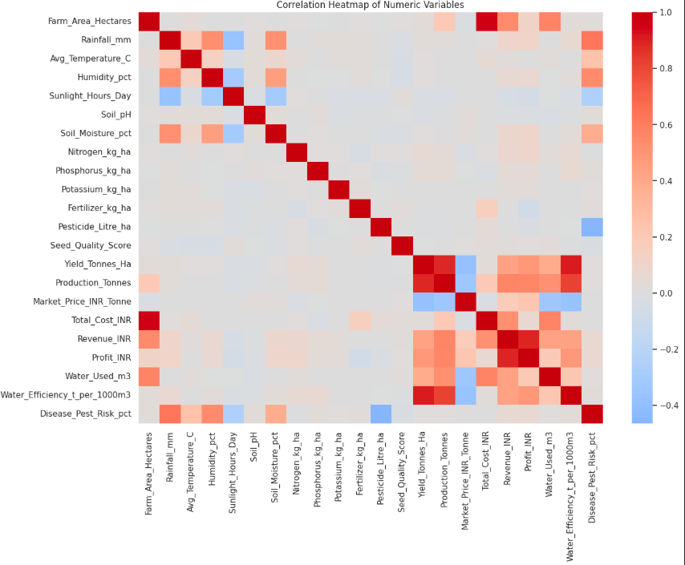
RESULTS : Correlation & Multivariate Analysis
Built a correlation heatmap across all numeric variables (environmental, input, and outcome variables).
Found expected clustering: cost- and revenue-related variables correlated together, while environmental variables (rainfall, temperature, humidity) formed a separate cluster.
Combined Rainfall, Yield, Season, and Cost in a single visualization, showing Kharif farms cluster in the higher-rainfall, higher-cost, higher-yield range.

Slide 8
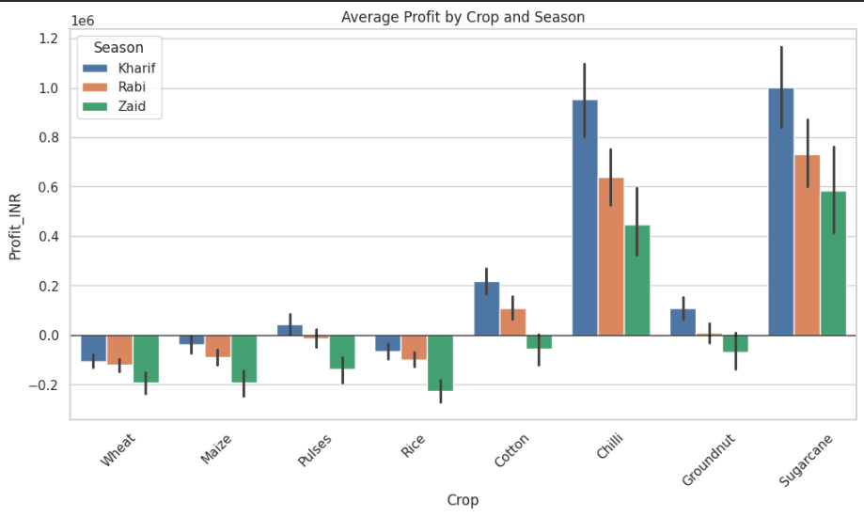
RESULTS : Crop & Season Profitability
Compared average profit by crop across all three seasons.
Chilli and Sugarcane were the most consistently profitable crops in every season.
Wheat, Maize, Pulses, and Rice ran close to breakeven or negative, especially in Zaid season.
Crop choice showed a stronger, more consistent link to profitability than season alone.

Slide 9

RESULTS : Irrigation Method Impact
Analyzed average profit by irrigation method within each season (Drip, Flood, Rainfed, Sprinkler).
Drip irrigation remained profitable across all three seasons.
Flood and Rainfed irrigation turned negative specifically in Zaid season (-₹69,787 and -₹79,467 respectively).
Identified irrigation method as a key, changeable factor behind Zaid's weaker performance.

Slide 10
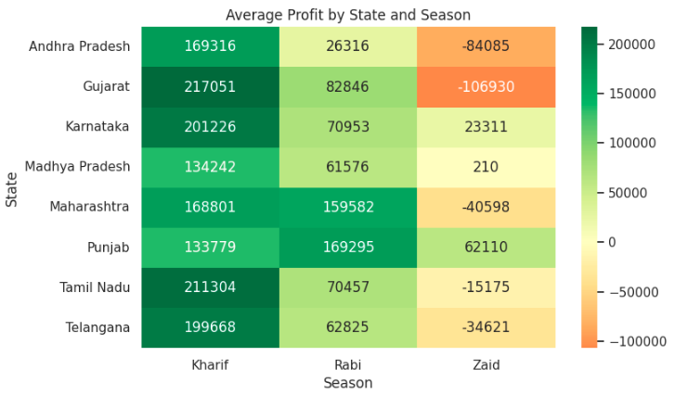
RESULTS :Regional, Risk & Water-Efficiency Findings
Regional analysis: Zaid was unprofitable in 5 of 8 states, most severely in Gujarat and Andhra Pradesh, but stayed positive in Karnataka and Punjab.

Slide 11
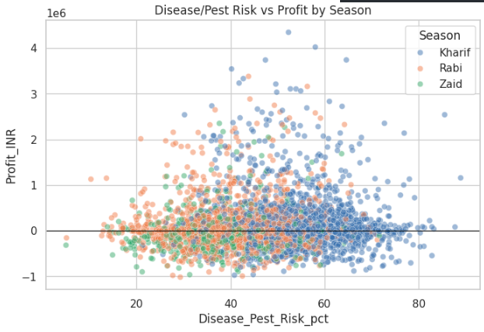
Risk analysis: Kharif had the highest disease/pest risk (54.47%) of all seasons, yet remained the most profitable ,ruling out pest risk as the cause of Zaid's underperformance.

Slide 12
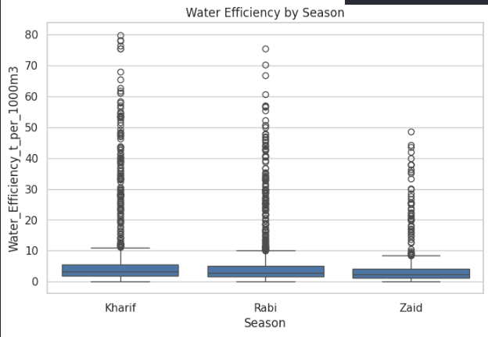
Water-efficiency analysis: Zaid used the most water (6,419.89 m³) but had the lowest water efficiency (4.41 t/1000m³), pointing to irrigation planning as the most actionable improvement area.

Slide 13
Future scope
Extend the dataset to multiple years to confirm whether these seasonal patterns hold consistently over time.
Study irrigation-conversion feasibility and cost for Zaid-season farms, especially in Gujarat and Andhra Pradesh.
Build a predictive model to estimate expected profit based on season, crop, and irrigation method.
Incorporate market price forecasting to strengthen revenue and profit predictions.
Extend the analysis to farm-size and soil-type factors to refine recommendations further.
Turn the analysis into an interactive dashboard for farmers and agricultural planners to use in real time.

Slide 14
GitHub Link
https://github.com/aakriti80043-create/Seasonal_Agriculture_Performance_Analysis.git

Slide 15

VOIS Course completion certificate - Course name- Data Visualization

Slide 16
Thank you
.
.

