Slide 1
Polymers
Dr. Jitendra Satam

Slide 2
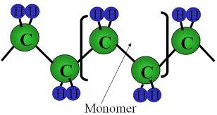
A polymers are macromolecule with high molecular mass compound ranging from 5000 to one million
Formed by combination of one or more low molecular weight compounds. The smallest unit from which polymer is obtained is called monomer.
The process by which polymers are obtained is called polymerization
For e.g. polyethylene is obtained by repeating ethylene unit as a result of polymerization.

Slide 3
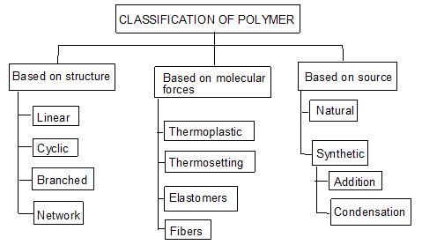

Slide 4
Classification based on source
Naturally occurring Polymers: These occur in plants and animals and are very essential for life e.g. starch, cellulose, amino acids, etc.
Synthetic polymers: These polymers are prepared in laboratory they are man made polymers e.g. plastics, synthetic rubbers, etc.
Semi synthetic polymers: These are derived from naturally occurring polymers by chemical modification. e.g. vulcanized rubber, Cuprammonium silk and Cuprammonium rayon, etc.

Slide 5
Classification based on Molecular forces
Polymers are classified into four categories based on magnitude of intermolecular forces
Elastomers: In these polymers, chain are held by weakest intermolecular forces which permits the polymers to be stretched. The polymer regains its original position when forces are released.
Fibers: In these polymers the inter molecular forces are strong due to hydrogen bonding, cross linking, cyclic structure
Thermoplastics: These are polymers for which inter molecular forces between elastomers and fibers. Due to this they can be easily molded by heating.
Thermosetting polymers: Thermosetting polymers undergo chemical changes and cross linking on heating and become permanently hard and infusible.

Slide 6
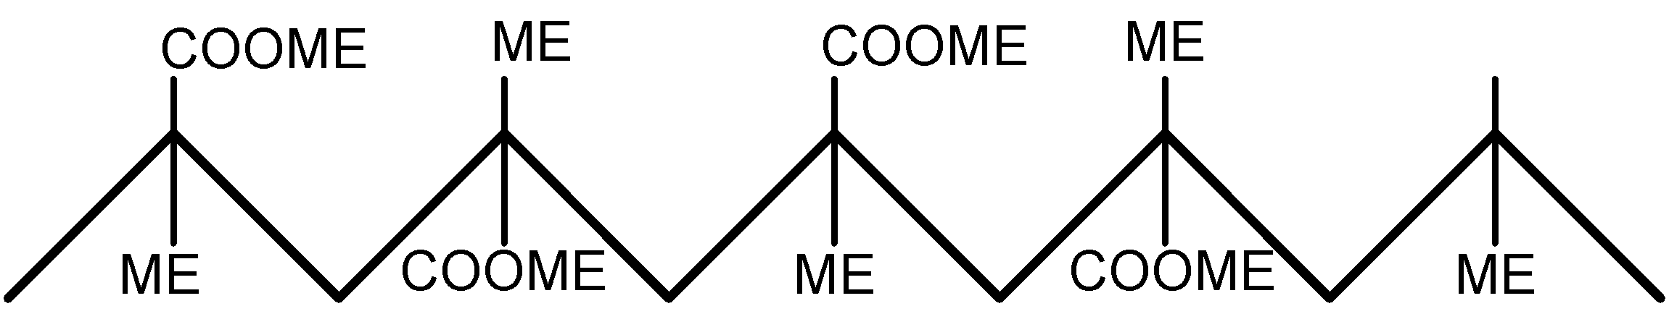
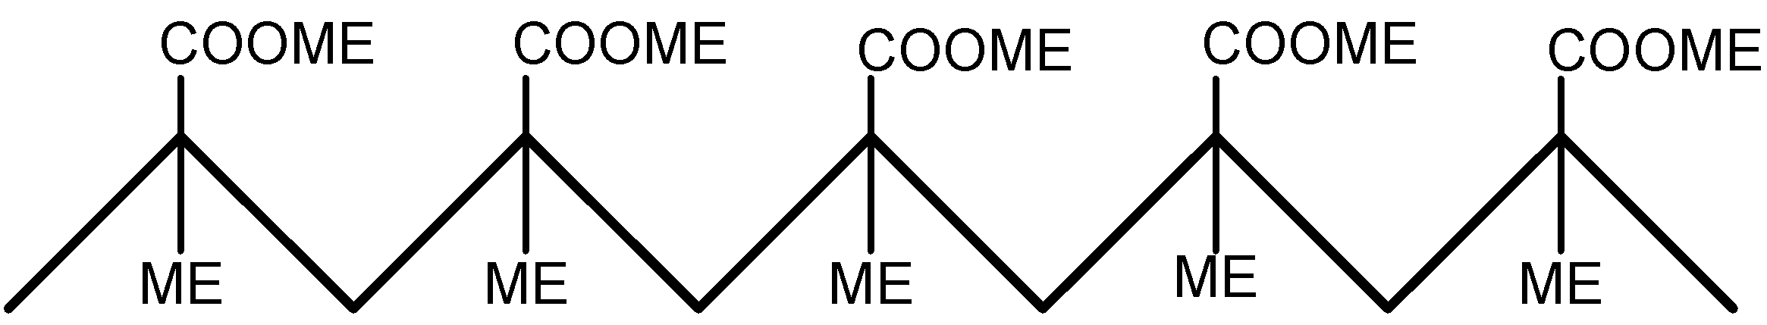
Classification based on Tacticity
Isotactic polymers: In isotactic, all the functional group lie on the same side of chain
Syndiotactic polymers: In syndiotatactic, functional group arrangement is alternate

Slide 7
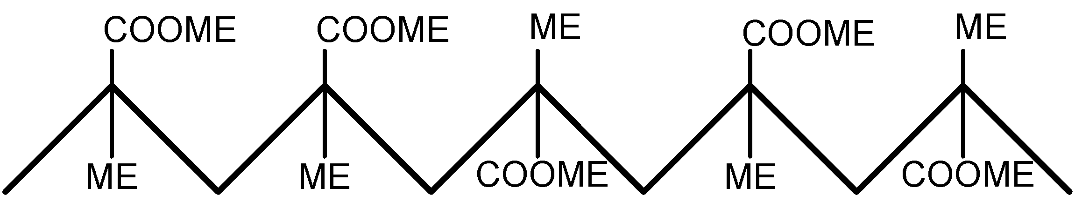
Atactic polymers: In atactic, functional group arrangement is random
Every other carbon in the chain is a stereo-center

Slide 8
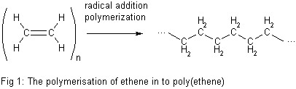
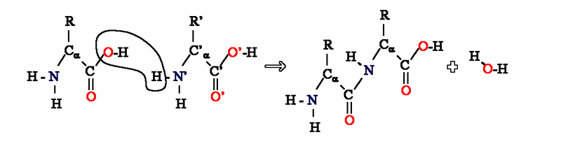
Classification based on Polymerization method
Addition Polymerization: A polymer formed by direct repeated addition of monomers is called addition polymerization. In this types of polymers monomers are unsaturated compounds or derivatives of alkenes.
Condensation Polymerization: Condensation polymerization involves condensation of two different monomers which are normally bi functional group. During the process there is loss of small molecule such as water

Slide 9
 | Condensation polymerisation |  | Additional polymerisation
(1) | It is also known as step growth | (1) | It is also known as chain growth
 | polymerisation |  | polymerization
(2) | It takes place in monomers having | (2) | It takes place only in monomers
 | reactive functional groups |  | having multiple bonds.
(3) | It takes place with elimination of | (3) | It takes place without elimination of
 | simple molecule like H₂O,NH₃,HCl |  | simple molecule.
 | etc.,
(4) | Repeat units of monomers are | (4) | Repeat units & monomers are same.
 | different
(5) | The polymer is formed in gradual | (5) | Reaction is fast and polymer is formed
 | steps |  | at once.
(6) | The molecular mass of polymer | (6) | There is very little change in the
 | increases throughout the reaction |  | molecular mass throughout the
 |  |  | reaction
(7) | Product obtained may be | (7) | Product obtained are thermoplastic
 | thermosetting/thermoplastic
(8) | E.g.:- Bakelite, polyester ,polyamides | (8) | E.g:-Polyethylene, PVC, poly styrene.
 | etc.,

Slide 10
Difference between thermoplastic & thermosetting resins:-
Thermoplastic resins (or) Polymers |  | Thermosetting resins
(1) | These are produced by addition polymerization | (1) | These are produced by condensation polymerization.
(2) | The resins are made of long chains attached by weak Vander Waal’s force of attraction | (2) | The resins have three dimensional network structure connected bonds.
(3) | On heating they soften and on cooling become stiff chemical nature won’t change | (3) | On heating they become stiff & hard. No change on cooling. Chemical nature changes.
(4) | They can be remoulded |  | They cannot be remoulded because once set means they are permanently set
(5) | Scrap (waste product) can be used | (5) | Scrap cannot be used
(6) | The resins are soft, weak and less brittle | (6) | The resins are usually hard, strong tough & more brittle
(7) | These are easily soluble in some organic substances E.g.:- PVC, polyethylene etc. | (7) | Resins are not soluble in organic Solvents E.g.:- Nylon, Bakelite etc.
(8) | Contain long chain polymer with no cross linkage. | (8) | They have 3D network structure.

Slide 11
Plastics
Plastic is a substance that can be easily moulded into a desired shape by the effect of mechanical force & heat.
In the manufacturing of plastic raw materials like coal, petroleum, cellulose, salt, sulphur, limestone, air, water etc. are used.
Plastics as engineering materials:-
Low fabrication cost, low thermal & electrical conductivities, high resistance to corrosion, Plastics are resistant to chemicals & solvents
Plastics reduce noise & vibrations in machines
Plastics are bad conductors of heat are useful for making handles used for hot objects, most plastics are inflammable.
Plastics are electrical insulators & find large scale use in the electrical industry.
Plastics are clear & transparent so they can be given beautiful colors.

Slide 12
Compounding of plastics
The process of mechanical mixing of various additives with polymers (resin) to impart some special properties to the plastics.
The additives gets incorporated with resins to give homogeneous mixture.
The principle Additives / Ingredients used in compounding are:
Resin or Binder
Fillers or extenders
Plasticizers
Pigments or Dyes
Activators, catalysts or accelerators
Lubricants
Stabilizers

Slide 13
1. Resin (Binder)
Resin is binder which holds the various constituents together
High molecular weight substances such as, synthetic resins, cellulose derivatives etc.
Binders influence the properties of plastics
They also decide the type of treatment during moulding operation
Eg. LDPE, HDPE, PP, PMMA, Phenol-Formaldehyde resin

Slide 14
2. Fillers or extender
Fillers reduce the cost of plastic without affecting its original properties
Imparts better tensile strength, hardness, finish, workability, opacity to the plastic
Highest % can be up to 50 %, which depends upon type of plastic
The fillers which increase mechanical strength are known as reinforce fillers
They also reduce shrinkage and brittleness
Eg. Organic fillers: wood powder, cotton pulp, carbon black, graphite, powdered rubber
Inorganic fillers: Asbestos, powdered mica, clays, talc, Zn & Pb oxides, Cd & Ba sulphides, carborundum.

Slide 15
3. Pigments / Dyes
Imparts desired color
Organic dyes and inorganic pigments
Eg. Azo dyes, chromate pigments

Slide 16
4. Catalysts or accelerators
Used for thermosets to increase the rate of cross-linking
Acidic or basic catalysts can be used
Just the small quantities are required
Eg. Benzoyl peroxide, hydrogen peroxide, metal oxides

Slide 17
5. Plasticizers
This increase the flexibility and mouldability and decrease brittleness of the materials.
It also lowers the temperature of moulding operation
Increase workability and flame proof-ness of plastics
Only used in thermo-softening plastics
When they mixed with the resin, they get uniformly distributed between the molecules and reduce intermolecular attraction between original polymer molecules. Thus the plastic becomes flexible.

Slide 18
5. Plasticizers
They can be added upto 10 %
Generally liquid plasticizers are used, hence the only disadvantage is, if they are not consistent they could ooze out from the finished product.
Examples
Cresyl diphenyl phosphate
Tricresyl phosphate
Triphenyl phosphate
Esters of oleic and stearic acids

Slide 19
6. Lubricants
Especially help during low or room temperature moulding
This gives the glossy finish to the final product
As lubricants get dispersed on the surface and occupies a layer between article and mould
This prevents sticking of an article to the mould and its easier separation from the mould
Eg. Soaps, waxes

Slide 20
7. Stabilizers
Improves thermal stability of the plastics
Generally helps in high temperature moulding operations, where some plastics decompose or gets decolorized
This could be prevented with the help of stabilizers
Eg.
Diethyl phthalate
Adipic acid esters

Slide 21
Molecular Mass of Polymer
The molecular mass of polymer is an important property of polymer because many important properties are influenced by molecular mass. Polymers with higher molecular mass are tougher and more resistant. Their viscosities and softening temperature are also higher. Thus polymers with desired molecular mass are often required for particular purposes.
Molecular mass of polymer is not a fixed or constant value like organic compound. Their molecular mass is controlled by polymerization reaction, which in turn depends upon availability of functional group, charge carrier, life time of charge carriers. Because of random nature of growth process, the product of polymerization process is mixture of chains of different length.
Hence polymers are poly disperse mixture of various molecular mass polymers. Therefore molecular mass of polymers is average molecular mass

Slide 22
Fabrication (Molding) of Plastics
Giving any desired shape to the plastics (granules or powders) by using mould under the application of heat and pressure. A proper method is to be selected depending on the shape and type of resin used. Methods involves partial melting of resinous mass by heating.
In case of thermo-plasts molten resin is introduced in die/mould and desired shape could be achieved by compression and further cooling.
In case of thermo-sets partially polymerized mass or raw materials are introduced in the die/mould, which further cured at high temperature in the mould itself to achieve desired shape.
Note:
In case of thermoplasts, curing is done at room temperature (low temperature), while in case of thermosets, curing is done at high temperature to obtain desired cross-linking

Slide 23
Four important types of fabrication Methods
Compression Molding : (Suitable for Thermosets / Thermoplasts)
Injection Molding : (Suitable for Thermoplasts)
Transfer Molding : (Suitable for Thermosets)
Extrusion Molding : (Suitable for Thermoplasts)

Slide 24
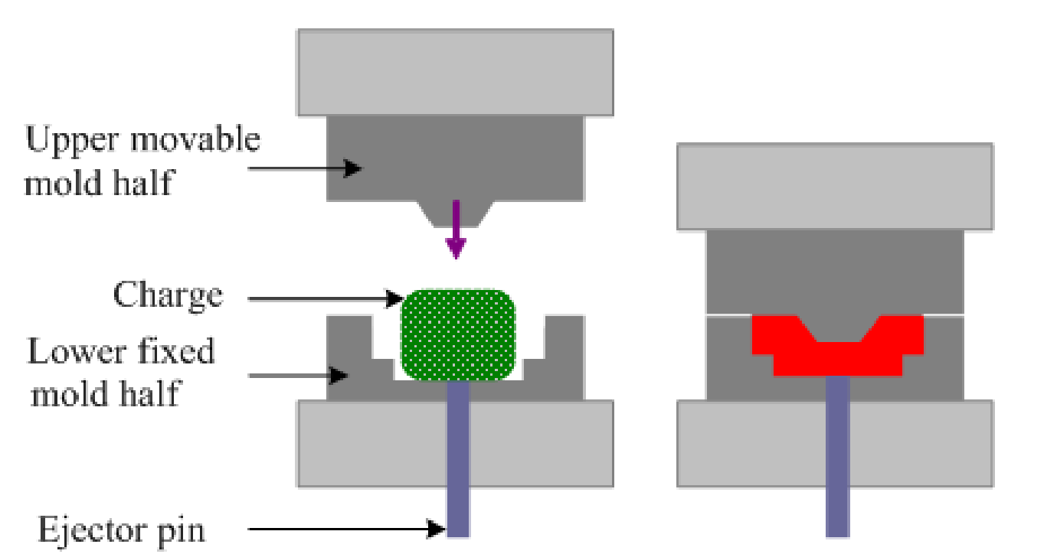
Compression Molding
Common and oldest method for molding thermosetting / thermoplastic materials
Compression of raw materials or soften resinous mass is done in the mould/die under heat and pressure
Predetermined quantity of raw materials is introduced carefully in the mould, further compressed by hydraulic pressure (2000 to 10000 psi)
Molten or soften resinous mass gets filled in the cavity of mould.
Curing is done by heating (Thermosetting) or by cooling (Thermoplastics)
Finally moulded article is separated from the mould by opening the mould apart.
Applications : Electric switch boxes, Ash trays, cabinets for radio, television, computers etc.

Slide 25
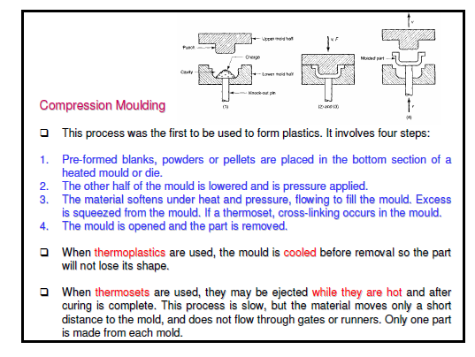

Slide 26
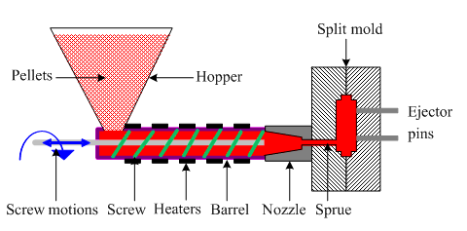
Injection Molding
Especially used for thermoplastic materials
Powder or granular resin is heated in a cylinder and injected at a controlled rate in a mould
Piston plunger or screw is used to force the material in mould.
Pressure upto 1758 kg/cm² (125 psi) is used
Once the article is formed mould is cooled and half mould is opened to remove the finished article.
Disadvantage of the method is formation of air bubbles or cavities in the articles
Applications: Smaller but large volume articles such as, pen caps, bottle caps, cups, containers, mechanical parts

Slide 27
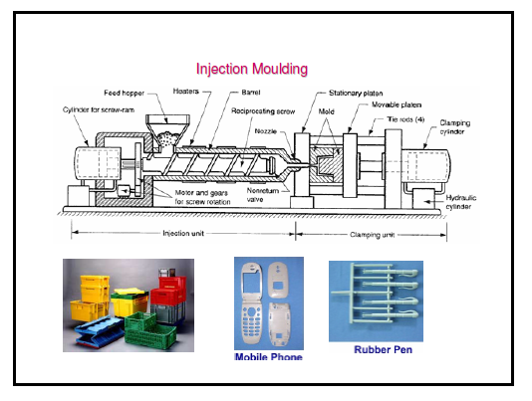

Slide 28
Transfer Molding
The method combines features of both Compression Molding (hydraulic pressing of molding materials - thermosets) and Injection Molding (ram-plunger and filling the mold through a sprue).
The method is used especially for molding thermosetting resins (thermosets)
Products with relatively intricate designs could be fabricated with this method
Powdered raw materials are heated at certain low temperature to soften and then introduced through an orifice or sprue in the mould
Then it is cured in the mould at high temperature for certain time
Finally the moulded article is removed by separation of mould
Advantages:
Articles with intricate shapes could be designed
Aerospace and automobile parts, car body, helmets
The articles produced are blister free
Fine wires and glass fibers can be inserted in the mould
Even thick pieces can be cured completely and uniformly

Slide 29
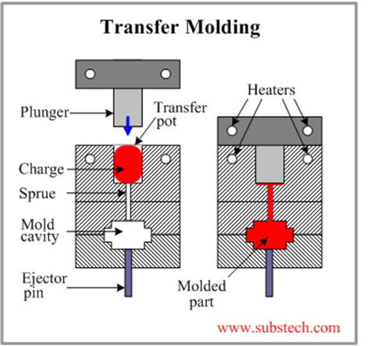
Transfer Molding

Slide 30
Extrusion Molding (Horizontal)
The method is used for the manufacturing of continuous type of thermoplastic articles with constant cross-section. Eg. Tubes, rods, strips, insulated electric cables
Dry powder or granules of thermoplastic materials are introduced through hopper and further melted by heating.
There are two types of extrusion moulding:
Vertical extruder moulding
Horizontal extruder moulding
Molten mass is pushed through the orifice of the die by using screw
Once the article leaves the orifice, it is allowed to pass through water for solidification
Proper temperature control of heating chamber and the speed of the screw are the major factors behind successful operation

Slide 31
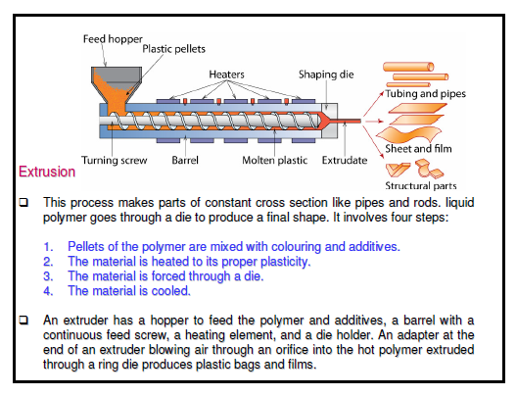
Extrusion Molding (Horizontal)

Slide 32
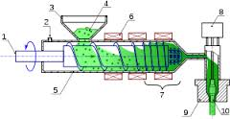
Extrusion Molding (Vertical)

Slide 33
Synthesis and Applications of Commercially important Polymers [Preparation, Properties and Uses]

Slide 34
Some Important Polymers
Poly Vinyl Acetate (PVAc): Y
Poly Methyl Methacrylate (PMMA):Y
Poly-Paraphenylene Terephthalamide (KEVLAR):Y
Polylactic acid: Y
PDMS: Y

Slide 35
1. Poly Vinyl Acetate (PVAc)
Polyvinyl acetate is a polymer produced through the combination of several units of monomeric vinyl acetate (CH₃COOCH=CH₂).
The number of units so combined is typically between 100 and 5,000.
This translates to an average molecular weight between 850 and 40,000.

Slide 36
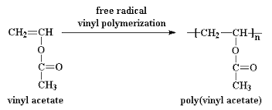
1. Poly Vinyl Acetate (PVAc)
Preparation:
Vinyl acetate Monomer is prepared by reacting acetylene with anhydrous acetic acid in the presence of a mercurous sulfate catalyst; poly vinyl acetate is prepared by free radical vinyl polymerization as follows:

Slide 37
1. Poly Vinyl Acetate (PVAc)
Properties:
Polyvinyl acetate is an amorphous polymer
The hardest of the polyvinyl esters, polyvinyl acetate offers good adhesion to most surfaces.
Unlike some other thermoplastics, it will not turn yellow.
Polyvinyl acetate does not cross-link, and it can be dissolved in many solvents other than water.
One slow-drying formulation combines 5 to 15 percent polyvinyl acetate with ethyl alcohol (ethanol).
A fast-drying counterpart combines the same amount of polyvinyl acetate with acetone (dimethyl ketone).

Slide 38
1. Poly Vinyl Acetate (PVAc)
USES:
Emulsified polyvinyl acetate is used in water-based adhesives, including pastes and glues.
One of the uses for emulsified polyvinyl acetate is in bookbinding, depending upon the necessary lifetime of the book, the polyvinyl acetate chosen will either be co-polymeric or homo-polymeric.
Polyvinyl acetate offers acceptable gap-filling capability.
It may be used as a resinous component of latex paints, offering compatibility with a wide-range of other paint chemicals.
Polyvinyl acetate may be used in the lamination of metal foils.
Non-emulsified, or waterless, polyvinyl acetate is useful as a thermosetting adhesive.

Slide 39
2. Poly Methyl Methacrylate (PMMA)
Poly-(methyl methacrylate) (PMMA), also known as acrylic or acrylic glass as well as by the trade names Crylux, Plexiglas, Acrylite, Lucite, and Perspex
It is a transparent thermoplastic often used in sheet form as a light-weight or shatter-resistant alternative to glass.
The same material can be used as a casting resin, in inks and coatings, and has many other uses.

Slide 40
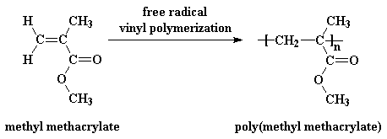
2. Poly Methyl Methacrylate (PMMA)
Preparation:
PMMA is routinely produced by emulsion polymerization, solution polymerization, and bulk polymerization.
It is generally prepared by radical initiation method.

Slide 41
2. Poly Methyl Methacrylate (PMMA)
Properties:
PMMA is a strong, tough, and lightweight material.
It has a density of 1.17–1.20 g/cm³, which is less than half that of glass.
It also has good impact strength, higher than both glass and polystyrene. [PMMA's impact strength is still significantly lower than polycarbonate]
PMMA transmits up to 92% of visible light (3 mm thickness), and gives a reflection of about 4% from each of its surfaces due to its refractive index (1.4905 at 589.3 nm).
It filters ultraviolet (UV) light at wavelengths below 300 nm.
PMMA swells and dissolves in many organic solvents; it also has poor resistance to many other chemicals due to its easily hydrolyzed ester

Slide 42
2. Poly Methyl Methacrylate (PMMA)
Uses:
Being transparent and durable, PMMA is a versatile material and has been used in a wide range of fields and applications such as rear-lights, appliances, and lenses for glasses.
PMMA is used for building windows, skylights, signs & displays, sanitary ware (bathtubs), LCD screens, furniture and many other applications.
It is also used for coating polymers based on MMA provides outstanding stability against environmental conditions with reduced emission of VOC.
Methacrylate polymers are used extensively in medical and dental applications where purity and stability are critical to performance.

Slide 43
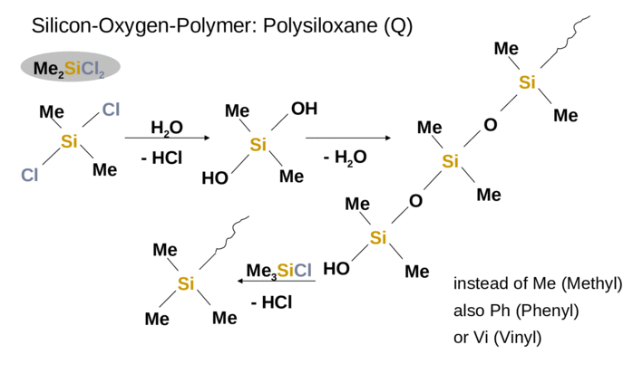
3-PDMS

Slide 44
Properties-
Good chemical resistance, low water absorption, good electrical properties, & available in flame retardant grade
Service temperature to about 260 °C to -50 °C
High molecular weight but not a solid, Ability to spread out on a wide variety of substrates
Silky, non-tacky, film forming
Lowest surface shear viscosity and low surface tension
Lubricating, antifoaming, waterproofing, release properties
High gas permeability, Excellent dielectric properties
Very good thermo-oxidative stability, Good chemical inertness and temperature resistance

Slide 45
Uses-
In the plumbing and automotive fields, silicone grease is often used as a lubricant. In plumbing, the grease is typically applied to O-rings in faucets and valves.
In the automotive field, silicone grease is typically used as a lubricant for brake components since it is stable at high temperatures, is not water-soluble
Biomedical applications, electronics applications, adhesives
3D-Printing applications, medicines, cosmetics, hair conditioners, contact lenses, mold release agent

Slide 46
4. Poly-Paraphenylene Terephthalamide (KEVLAR)
Poly-Paraphenylene Terephthalamide (KEVLAR):
Poly-paraphenylene terephthalamide (Kevlar) is a heat-resistant and strong synthetic fiber,
Preparation:
Kevlar is synthesized in solution from the monomers 1,4-phenylene-diamine (para-phenylenediamine) and terephthaloyl chloride in a condensation reaction yielding hydrochloric acid as a byproduct.

Slide 47
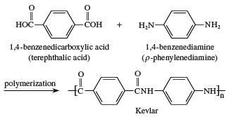
4. Poly-Paraphenylene Terephthalamide (KEVLAR)

Slide 48
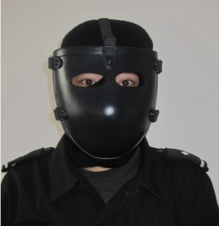
4. Poly-Paraphenylene Terephthalamide (KEVLAR)
Properties:
When Kevlar is spun, the resulting fiber has a tensile strength of about 3,620 MPa, and a relative density of 1.44.
Kevlar maintains its strength and resilience down to cryogenic temperatures (-196 °C); in fact, it is slightly stronger at low temperatures.
Kevlar's structure consists of relatively rigid molecules which makes them exceptionally strong
They are high tensile strength-to-weight ratio; by this measure it is 5 times stronger than steel.

Slide 49
4. Poly-Paraphenylene Terephthalamide (KEVLAR)
Uses:
Kevlar has many applications, ranging from bicycle tires and racing sails to bulletproof vests,
It is also used to make modern marching drumheads that withstand high impact.
Kevlar is a well-known component of personal armor such as combat helmets, ballistic face masks, and ballistic vests.
It is used for motorcycle safety clothing, especially in the areas featuring padding such as shoulders and elbows.
Kevlar is often used in the field of cryogenics for its low thermal conductivity and high strength relative to other materials for suspension purposes.

Slide 50
Conducting Polymers
Generally polymers are insulators because of the absence of free electrons.
But they can be made conductive in certain cases by the process called doping.
Two conditions for the polymer to become conducting are:
Polymers should possess conjugated double bonds
Polymer structure has to be disturbed either by adding or removing electrons by the process of doping.
There are 3 major classes of conducting polymers
Intrinsically conducting polymers
Doped conducting polymers
Extrinsically conducting polymers

Slide 51
1. Intrinsically conducting polymers
This belong to a class of organic materials consist of Conjugated pi-electrons in the backbone of their macromolecules which is responsible for high electrical conductivity.
In an electric field, conjugated pi-electrons of the polymer gets excited and can be transported through the solid polymer.
Overlapping of orbitals of conjugated pi-electrons over the entire backbone of the polymer results in the formation of valence bands and conduction bands. This induces conductivity in the presence of electric field.
For example:
Poly-acetylene, poly-aniline, poly-pyrolle and poly-thiophene etc.

Slide 52
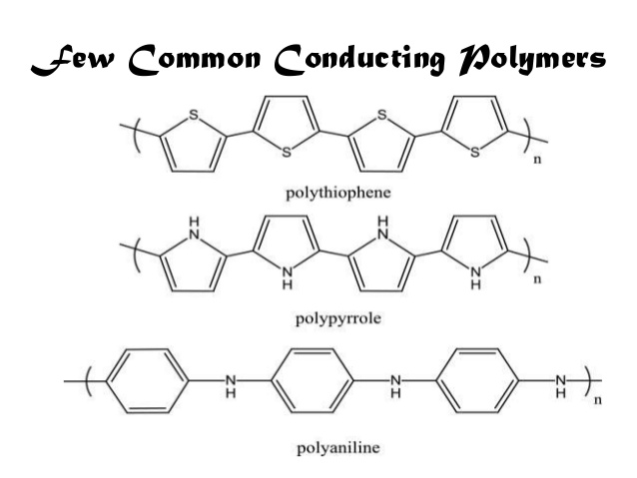


Polyacetylene

Slide 53
Due to their high electrical properties, ICPs are intensively investigated for application in electronics, microelectronics, optoelectronics mainly for areas in aerospace and automobile industries.
Among the most promising applications of the ICPs are corrosion protection, solid-state charge storage devices, electromagnetic screens, antistatic coatings and gas separation coatings.
However, poor mechanical properties, environmental sensitivity, moderate stability of electrical properties with temperature significantly limit the industrial applicability of ICPs.

Slide 54
2. (DCP) Doped conducting polymer
While the addition of a donor or an acceptor molecule to the polymer is called "doping ", the reaction that takes place is actually a redox reaction.
The first step is the formation of a cation (or anion), which is called a soliton or a polaron.
Pn ⇔ [Pn + A – ] (reduction oxidation)
As synthesized conductive polymers exhibit very low conductivities. It is not until an electron is removed from the valence band (p-doping) or added to the conduction band (n-doping, which is far less common) does a conducting polymer become highly conductive.
Doping (p or n) generates charge carriers which move in an electric field. Positive charges (holes) and negative charges (electrons) move to opposite electrodes. This movement of charge is what is actually responsible for electrical conductivity.

Slide 55
(DCP) Doped conducting polymer
This is obtained by exposing a polymer to a charge transfer agent in a gas phase or in solution.
Conductivity of ICPs can be increased by creating positive or negative charges on the polymer backbone by oxidation or reduction by the process of doping.
1. p-doping involves treating intrinsically conducting polymer with a Lewis acid thereby oxidation takes place and positive charges on the polymer backbone are created. Some common P-dopants are I₂, Br₂, AsF₅, PF₆ etc.

Slide 56
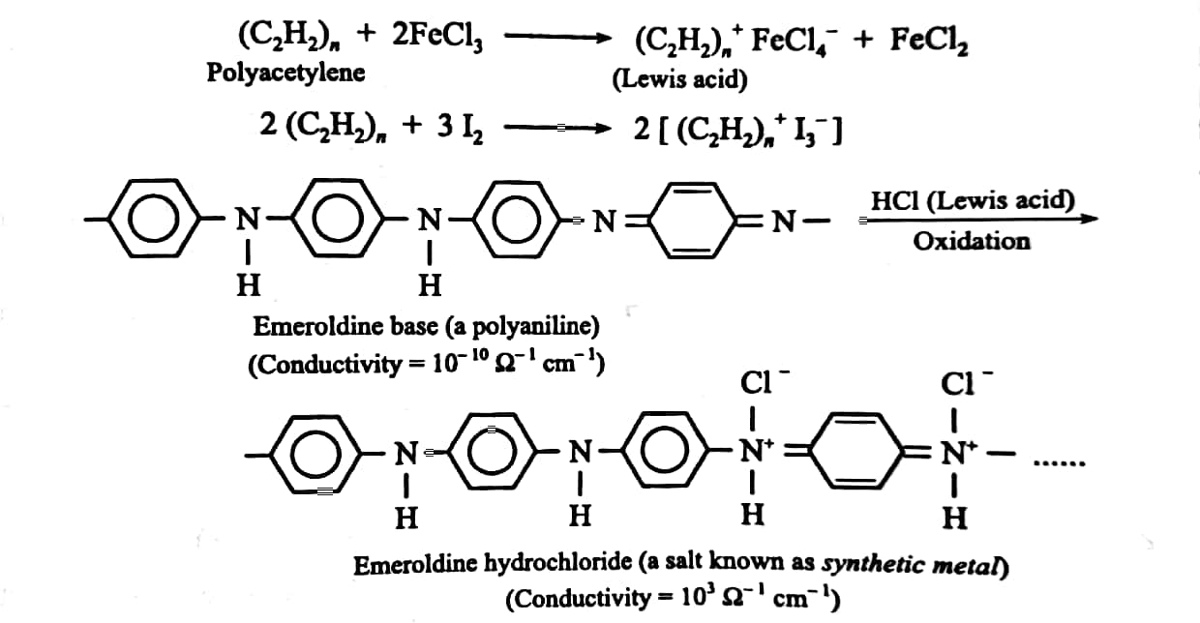

Slide 57
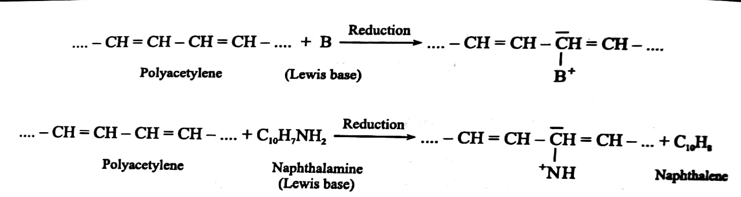
2. n-doping involves treating intrinsically conducting polymer with a Lewis base thereby reduction takes place and negative charges on the polymer backbone are created. Some common N-dopants are Li, Na, Ca etc.

Slide 58
3. Extrinsically Conducting Polymer
This type of conducting polymers possesses conductivity due to the presence of externally mixed conducting elements or compounds. These are of the following two types:
conductive element filled polymer: Such polymers contains non-conducting polymers (behaving as binder) holds the conducting elements or compounds (behaving as conducting filler) such as carbon black, metals, metal oxides, etc. Such polymers possesses good bulk conductivity, low cost, light weight, mechanically tough and easily processable.
Blended conducting polymer: such polymers are obtained by blending conventional polymers with conducting polymers either through physical or chemical process.

Slide 59
Applications of conducting polymers
In rechargeable light weight batteries
In optical display devices
In aircrafts and aerospace components
In diodes and transistors
In solar cells

Slide 60
Liquid-crystal polymers (LCPs)
An Austrian botanist named Friedrich Reinitzer studied a material called as cholesteryl benzoate which showed two distinct melting points. He noticed the change of crystal structure to hazy liquid by increase the temperature of solid sample.
Later on further heating, the hazy liquid converted to transparent liquid.
Reinitzer discovered a new phase of matter that is called as liquid crystal phase. Such materials show unique properties and have several new applications in modern technology.
Liquid-crystal polymers (LCPs) are a class of aromatic polymers. They are extremely unreactive and inert, and highly resistant to fire.
Liquid crystallinity in polymers may occur either by dissolving a polymer in a solvent (lyotropic liquid-crystal polymers) or by heating a polymer above its glass or melting transition point (thermotropic liquid-crystal polymers).

Slide 61
Liquid-crystal polymers (LCPs)
Liquid-crystal polymers are present in melted/liquid or solid form. In solid form the main example of lyotropic LCPs is the commercial aramid known as Kevlar. Chemical structure of this aramid consists of linearly substituted aromatic rings linked by amide groups. In a similar way, several series of thermotropic LCPs have been commercially produced by several companies. The orientation of molecules in liquid crystal state is intermediate liquid and solid phases. This intermediate state I called as mesogenic state or liquid crystal state. In such materials the properties of a material depend on the direction in which they are measured. The liquid crystalline structure has positional order, orientational order and bond orientational order.

Slide 62
Properties
1. Typically, LCPs have a high mechanical strength at high temperatures, extreme chemical resistance, inherent flame retardancy, and good weatherability.
2. Liquid-crystal polymers come in a variety of forms from sinterable high temperature to injection moldable compounds.
3. LCPs can be welded, though the lines created by welding are a weak point in the resulting product.
4. LCPs have a high coefficient of thermal expansion and are exceptionally inert.
6. They resist stress cracking in the presence of most chemicals at elevated temperatures, including aromatic or halogenated hydrocarbons, strong acids, bases, ketones, and other aggressive industrial substances.
7. Hydrolytic stability in boiling water is excellent. Environments that deteriorate the polymers are high-temperature steam, concentrated sulfuric acid, and boiling caustic materials.

Slide 63
Uses
Because of their various properties, LCPs are useful for electrical and mechanical parts, food containers, and any other applications requiring chemical inertness and high strength.
LCP is particularly good for microwave frequency electronics due to low relative dielectric constants, low dissipation factors, and commercial availability of laminates.
Packaging micro-electro-mechanical systems (MEMS) is another area that LCP has recently gained more attention.
The superior properties of LCPs make them especially suitable for automotive ignition system components, heater plug connectors, lamp sockets, transmission system components, pump components, coil forms and sunlight sensors and sensors for car safety belts.

Slide 64
N 3. Poly Carbonates (PC)
Polycarbonates (PC) are a group of thermoplastic polymers containing carbonate groups in their chemical structures. Polycarbonates used in engineering are strong, tough materials, and some grades are optically transparent. They are easily worked, molded, and thermoformed.
Preparation:
The main polycarbonate material is produced by the reaction of bisphenol-A (BPA) and phosgene COCl₂.
The first step of the synthesis involves treatment of bisphenol-A with sodium hydroxide, which deprotonates the hydroxyl groups of the bisphenol-A
The diphenoxide [Na₂(OC₆H₄)₂CMe₂] reacts with phosgene to give a chloroformate, which subsequently is attacked by another phenoxide. The net reaction from the diphenoxide is:

Slide 65
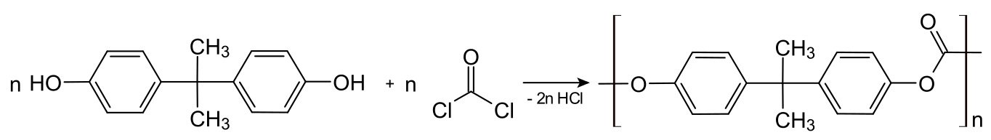
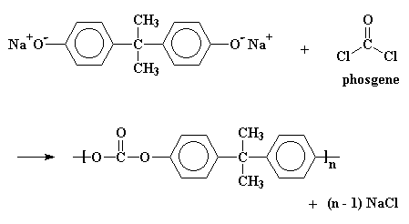
3. Poly Carbonates (PC)

Slide 66
3. Poly Carbonates (PC)
Properties:
Polycarbonate is a durable material. Although it has high impact-resistance, it has low scratch-resistance.
The characteristics of polycarbonate compare to those of polymethyl methacrylate (PMMA, acrylic), but polycarbonate is stronger and will hold up longer to extreme temperature.
Polycarbonate has a glass transition temperature of about 147 ⁰C (297 ⁰F; 420 K)
Unlike most thermoplastics, polycarbonate can undergo large plastic deformations without cracking or breaking.

Slide 67
3. Poly Carbonates (PC)
Uses:
ELECTRONICS: Polycarbonate is mainly used for electronic applications that capitalize on its collective safety features. Being a good electrical insulator and having heat-resistant and flame-retardant properties, it is used in various products associated with electrical and telecommunications hardware. It can also serve as a dielectric in high-stability capacitors
CONSTRUCTION: The second largest consumer of polycarbonates is the construction industry, e.g. for dome-lights, flat or curved glazing, and sound walls, which all use extruded flat solid or multiwall sheet, or corrugated sheet.
DATA STORAGE: A major application of polycarbonate is the production of Compact Discs, DVDs. These discs are produced by injection molding polycarbonate into a mold cavity that has on one side a metal stamper containing a negative image of the disc data, while the other mold side is a mirrored surface.
Due to its low weight and high impact resistance, polycarbonate is the dominant material for making automotive headlamp lenses.

Slide 68
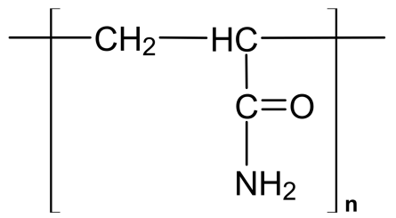
N 5. Polyacrylamide
Preparation:
Polyacrylamides are water-soluble synthetic linear polymers made of acrylamide or the combination of acrylamide and acrylic acid.
By chemical co-polymerization of acrylamide (AMD) monomers with a cross-linking reagent (usually N,N′-methylenebisacrylamide, Bis), a clear transparent gel is obtained.
The reaction is started with ammonium persulphate as catalyst.

Slide 69
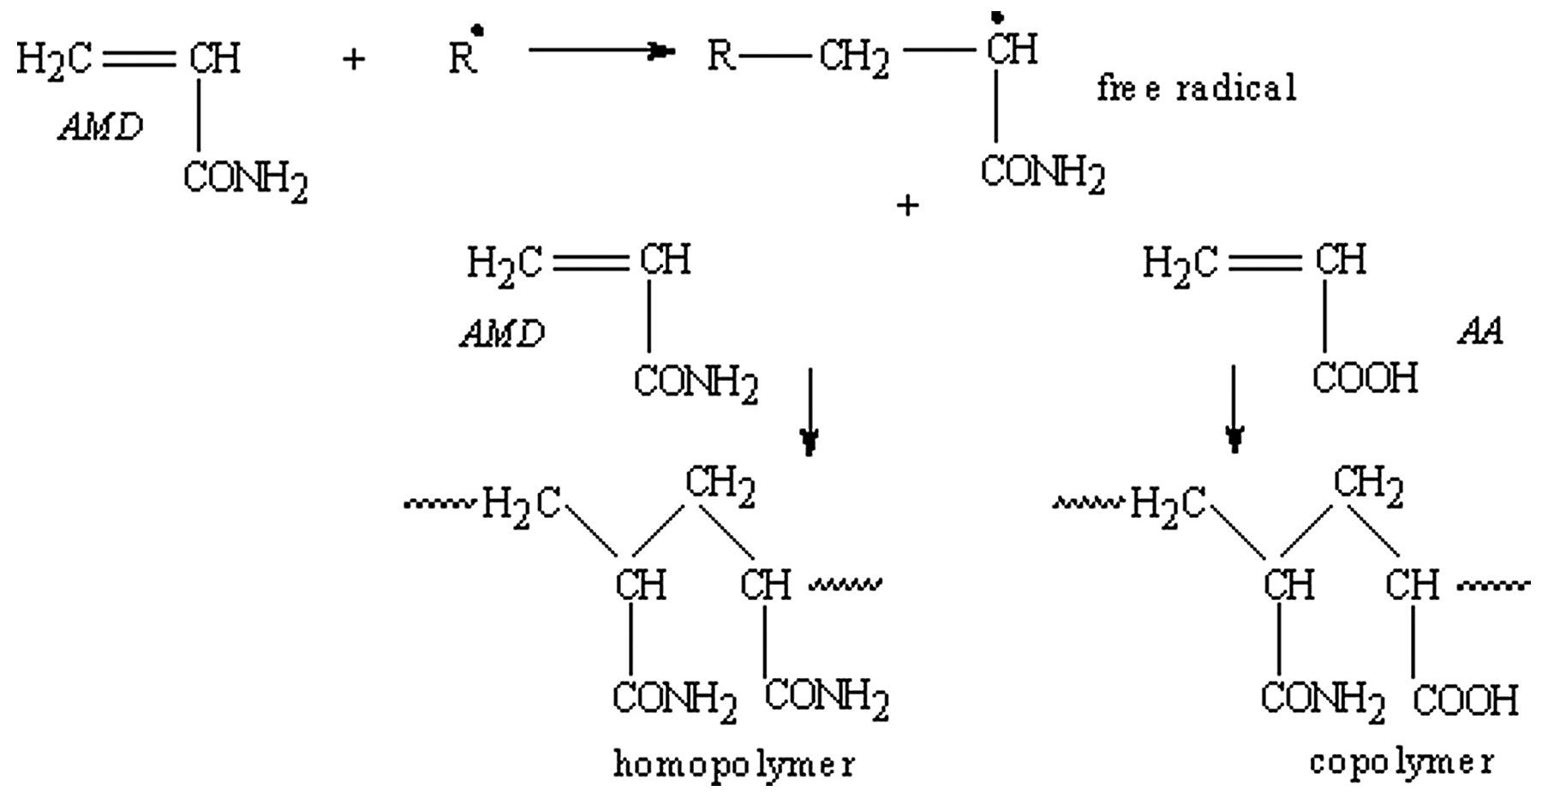
5. Polyacrylamide

Slide 70
5. Polyacrylamide
Properties:
Linear polyacrylamide is a water-soluble polymer.
It is typically non-ionic polymer
Due to hydrolysis of some amide groups they could convert into carboxylic groups giving polyacrylamide some weak ionic properties.

Slide 71
5. Polyacrylamide
Uses:
One of the largest uses for polyacrylamide is to flocculate solids in a liquid. This process applies to water treatment, and processes like paper making and screen printing.
Polyacrylamide can be supplied in a powder or liquid form, with the liquid form being subcategorized as solution and emulsion polymer. Even though these products are often called 'polyacrylamide', many are actually copolymers of acrylamide
Another common use of polyacrylamide and its derivatives is in subsurface applications such as Enhanced Oil Recovery

Slide 72
N 6. Poly Vinyl Alcohol (PVA)
Preparation:
Unlike most vinyl polymer, PVA is not prepared by polymerization of the corresponding monomer
Polyvinyl alcohol was first prepared in 1924 by hydrolyzing polyvinyl acetate in ethanol with potassium hydroxide.
Polyvinyl alcohol is produced commercially from polyvinyl acetate, usually by a continuous process. The acetate groups are hydrolyzed by ester interchange with methanol in the presence of anhydrous sodium methylate or aqueous sodium hydroxide. The physical characteristics and its specific functional uses depend on the degree of polymerization and the degree of hydrolysis. Polyvinyl alcohol is classified into two classes namely: partially hydrolyzed and fully hydrolyzed. Partially hydrolyzed PVA is used in the foods.

Slide 73
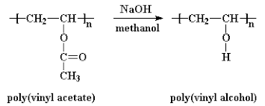
6. Poly Vinyl Alcohol (PVA)

Slide 74
6. Poly Vinyl Alcohol (PVA)
Properties
Polyvinyl alcohol, also known as PVOH, PVA, or PVAL, is a synthetic polymer that is soluble in water.
It is effective in film forming, emulsifying, and has an adhesive quality.
It has no odor and is not toxic, and is resistant to grease, oils, and solvents.
It is ductile but strong, flexible, and functions as a high oxygen and aroma barrier.

Slide 75
6. Poly Vinyl Alcohol (PVA)
Uses
Polyvinyl alcohol is often utilized as the raw material for the creation of other resins such as polyvinyl butyral (PVB) or polyvinyl formal (PVF). (PVB has an adhesive quality and is a water-resistant, plastic film, which is often used to laminate safety glass for vehicles. PVF is commonly used to insulate wires).
Polyvinyl alcohol is used for coating of medicinal tablets.
PVA is used in many industries, such as textile, paper industry, and food packaging industry because of its high chemical and thermal stability, and low manufacturing cost.
PVA is used in sizing agents that give greater strength to textile yarns and make paper more resistant to oils and greases.
It is also employed as a component of adhesives and emulsifiers, as a water-soluble protective film.

