Slide 1
REVIVE / UCS503P
PROJECT PROPOSAL
& PROTOTYPE
ReVive
Explainable Financial Anomaly Detection using a Corrupt-and-Repair Denoising Network
Software Engineering (UCS503P) | Project Proposal & Prototype Presentation

Slide 2
01
Four forces compound the review problem
SCALE
NO EXPLANATION
CLASS IMBALANCE
DETECTION LAG
Manual review breaks; thresholds miss subtle signals
A score alone cannot support a decision
Fraud is tiny; naive accuracy misleads
Batch review delays intervention
More volume → less context → weaker signals → slower action

Slide 3
02
Anomaly detection: from classical rules to structured learning
CLASSICAL
RECONSTRUCT & FORECAST
CORRUPT → CLEAN
STRUCTURE-AWARE
LOF · Isolation Forest · COPOD · MatrixProfile
No training; ReVive baselines
LSTM-AD · Donut · OmniAnomaly · SISVAE · USAD · STREAM-VAE
Error flags deviation
Denoising autoencoders · score matching · CSDI
ReVive’s lineage
Anomaly Transformer · GDN · TranAD
Powerful, computationally expensive
LOW SETUP
NEURAL COMPLEXITY
ReVive occupies the denoising lineage—minimal architecture, adapted here for explainable financial detection.

Slide 4
03
A minimal detector, extended into a usable system
NEW DOMAIN
Financial transactions beyond sensor benchmarks
EXPLAINABILITY
Feature + timestep attribution per flag
NEWLY PUBLISHED (2026)
MINIMAL DENOISING DETECTOR
Independent reimplementation · no official code
DEPLOYED SYSTEM
Ingest · detect · explain · triage · store · review
EXACT REBUILD
Verified 17,665-parameter configuration

Slide 5
04
One continuous path from raw file to reviewer action
DATA
INGESTION
PREPROCESS
& WINDOW
REVIVE
DETECTION
EXPLAINABILITY
MODULE
TRIAGE
LOGIC
STORAGE
(DB)
DASHBOARD
(UI)
Raw transactions
Clean windows
Repair score
Per-feature why
Severity
Alert record
Review & act
INGEST → REPAIR → EXPLAIN → TRIAGE → SURFACE

Slide 6
05
Use case diagram
ReVive: Financial Anomaly Detection System
View flagged anomalies
View state-of-art
comparison
USER /
ANALYST
«extend»
View explanation
for anomaly
Upload transaction data
ADMIN
«include»
Export alert report
Run anomaly detection
Configure triage
thresholds
User-facing review and admin control points; «include» and «extend» expose key dependencies.

Slide 7
06
Activity diagram: score, decide, explain
START
Upload transaction data
Preprocess & window data
Compute anomaly score (ReVive)
SCORE ABOVE THRESHOLD?
NO · Mark normal & log
YES · Explain → Triage
Create alert & store
DISPLAY ON DASHBOARD → END

Slide 8
07
Class diagram: modular by design
DashboardUI
chart_data: dict
render_timeline() · show_alert_detail()
APIController
routes: dict
predict() · get_alerts()
DataIngestor
file_path: str
load_csv() · validate_schema()
Preprocessor
window_size: int
clean_data() · normalize() · extract_windows()
ReVive (RepairModel)
hidden_dim · num_channels
forward(x) · train_step()
ScoringEngine
weights: dict
structural_score() · robust_standardize()
ExplainabilityModule
threshold: float
feature_attribution() · timestep_attribution()
TriageClassifier
thresholds: dict
classify(score): str
AlertRecord
id · timestamp · score
explanation · triage_level · save()
Requests move through ingestion → repair → scoring → explanation/triage → persistent alert records.

Slide 9
08
Level-1 data flow diagram
ReVive System (Level 1)
USER
1.0
INGEST DATA
2.0
PREPROCESS
3.0
DETECT ANOMALY
4.0
GENERATE EXPLANATION
5.0
DISPLAY DASHBOARD
raw transaction file cleaned + windowed data anomaly score alerts visual report
ALERT DATABASE
User input is transformed into an actionable, explained dashboard output.

Slide 10
09
Sequence diagram: the path of one prediction
USER
DASHBOARD
API
PREPROCESSOR
REVIVE
SCORING
EXPLAIN
TRIAGE
ALERT DB
upload file
POST /predict
preprocess(file)
windowed data
forward(windows)
repaired → structural_score
[above] attribution
classify score
save alert + explanation
results / flagged anomalies

Slide 11
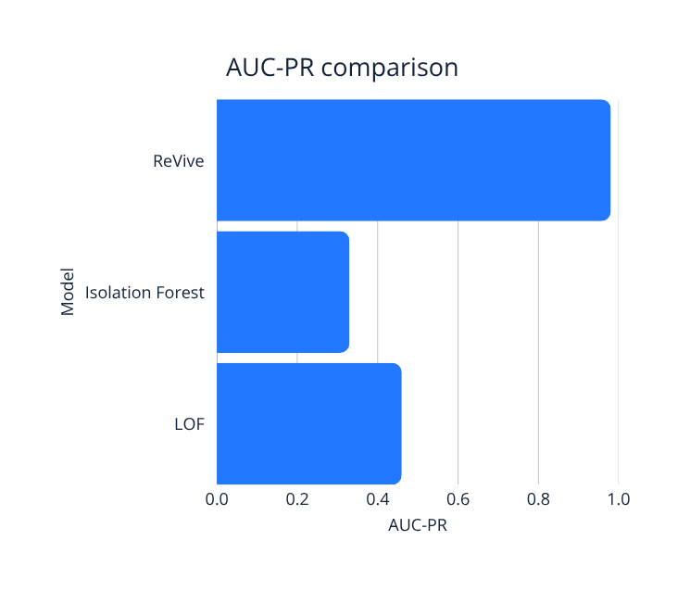
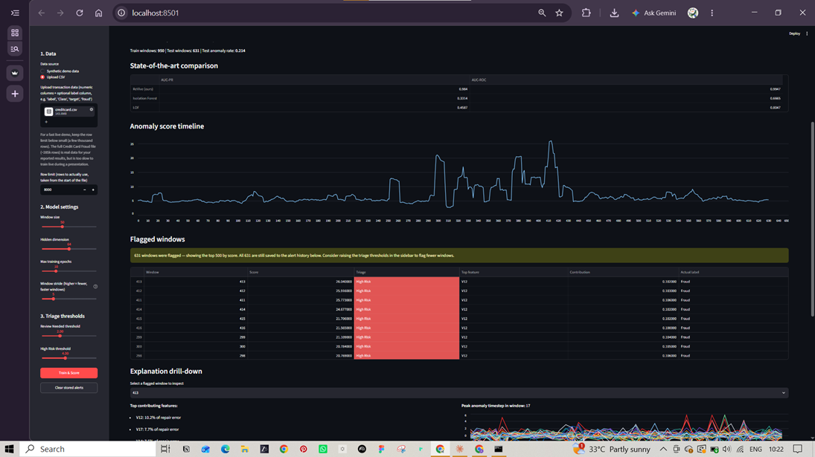
10
Prototype results: strong precision where it matters
ReVive achieves superior anomaly detection performance on real financial data, enabling real-time scoring and review.

Slide 12
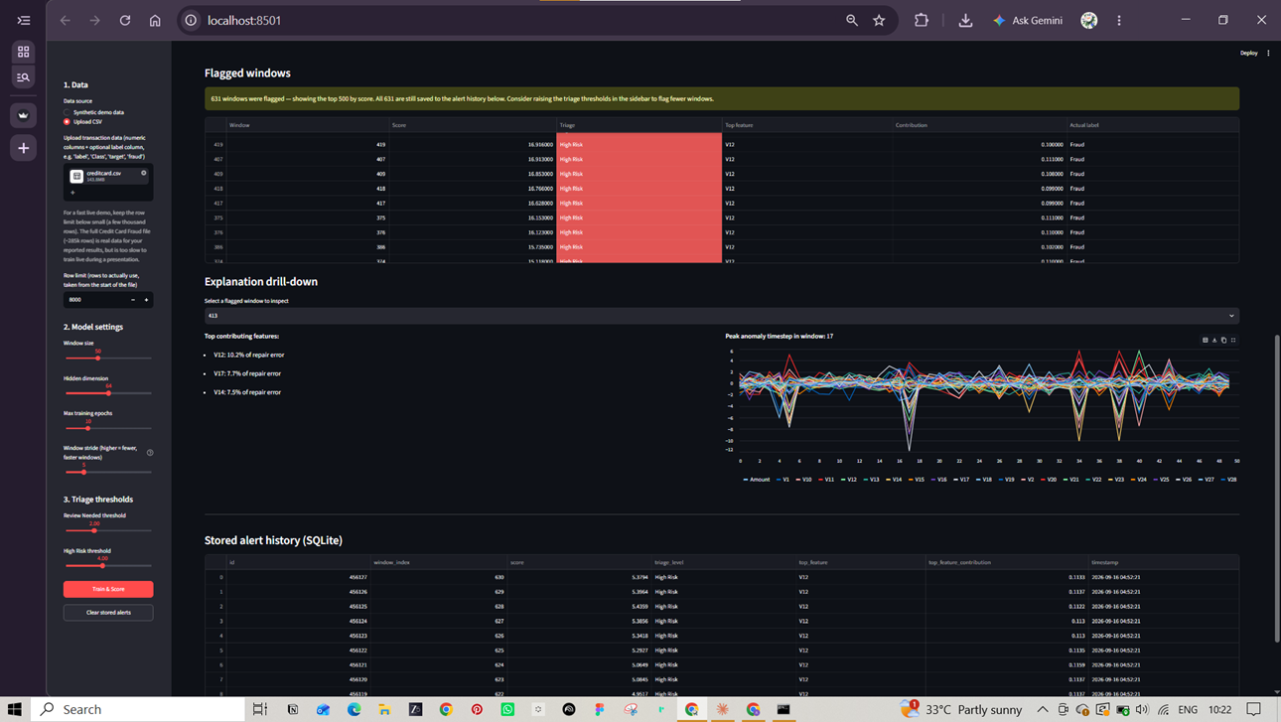
11
Why this anomaly? Move beyond one score.
PER-FEATURE ATTRIBUTION
Which inputs drove the flag
PEAK-TIMESTEP
Where deviation peaked in-window
ACTIONABLE CONTEXT
Feature + time insight, not an aggregate score

Slide 13
12
Known limitations—and what they mean in practice
FEATURE BLIND SPOTS
Only observed deviations; low-and-slow fraud may look normal.
Some subtle fraud may evade detection.
FALSE POSITIVES BY DESIGN
Unusual-but-legitimate behavior can score high.
Human triage is required; no auto-blocking.
TRAINING CONTAMINATION
History is mostly clean, not perfectly clean (~0.17% fraud).
Model purity is slightly reduced but manageable.
ANONYMIZED FEATURES
PCA-transformed columns limit semantic interpretation.
Explanations are less intuitive to humans.

Slide 14
13
Prototype → deployment-ready final system
01 CORRECTED BASELINE
IF + COPOD · normalized
03 INTEGRATION
Backend API + dashboard
05 FULL EVALUATION
Confidence intervals
02 EXPLAINABILITY
Full module evaluation
04 SELF-CLEANING
Retraining · stretch goal
Planned improvements enhance accuracy, usability, and deployment readiness.

Slide 15
ReVive
Thank You
Questions & Discussion
Explainable anomaly detection, repaired one window at a time.
Software Engineering • UCS503P

