Slide 1

SMART INDIA HACKATHON 2026
Problem Statement ID – S10
Problem Statement Title- Develop an intelligent hospital resource-optimization system that dynamically allocates appointments, beds, diagnostic facilities, and medical staff according to changing patient demand.
Theme- MedTech/ BioTech/ HealthTech
PS Category- Software
Team Name – Error404

Slide 2
IDEA TITLE
ERROR404
Idea/Solution
The software is a load-balancing grid for hospital capacity treating appointments, beds, diagnostic machines and staff as one shared pool across a network of hospitals.
A forecasting engine reads historical and seasonal patterns to predict patient demand per department, per hospital.
An optimization layer turns that prediction into a specific recommended action, reroute this booking, pre-hold this bed, batch these scans, add this shift before the threshold is crossed.
Innovation and Uniqueness
Looks forward, not backward : predicts demand instead of just reporting current occupancy.
Optimizes across hospitals, not within one : most existing tools (including e-Hospital/ORS) manage a single building but it bridges the gap between a full hospital and an empty one two kilometers away through a shared, interoperable data layer
Seasonal disease intelligence : recognizes recurring patterns like dengue season, flu or festival-related injury surges, and proactively recommends hospitals stock up on relevant staff, beds, and supplies before the surge hits.
One data layer, two use cases : the same live resource database that powers everyday scheduling also powers urgent cases: when a patient needs immediate care, the system instantly identifies the nearest hospital with genuinely available capacity and an on-duty specialist, rather than defaulting to "nearest by distance" alone
Problem Resolution
Existing hospital systems function largely as static ledgers, reflecting current status with no predictive capability
The software flags a likely spike in advance based on recurring demand patterns, giving staff time to act instead of react.
This directly prevents the core issue in the problem statement i.e., static resource allocation that can't keep up with changing patient demand.

Slide 3
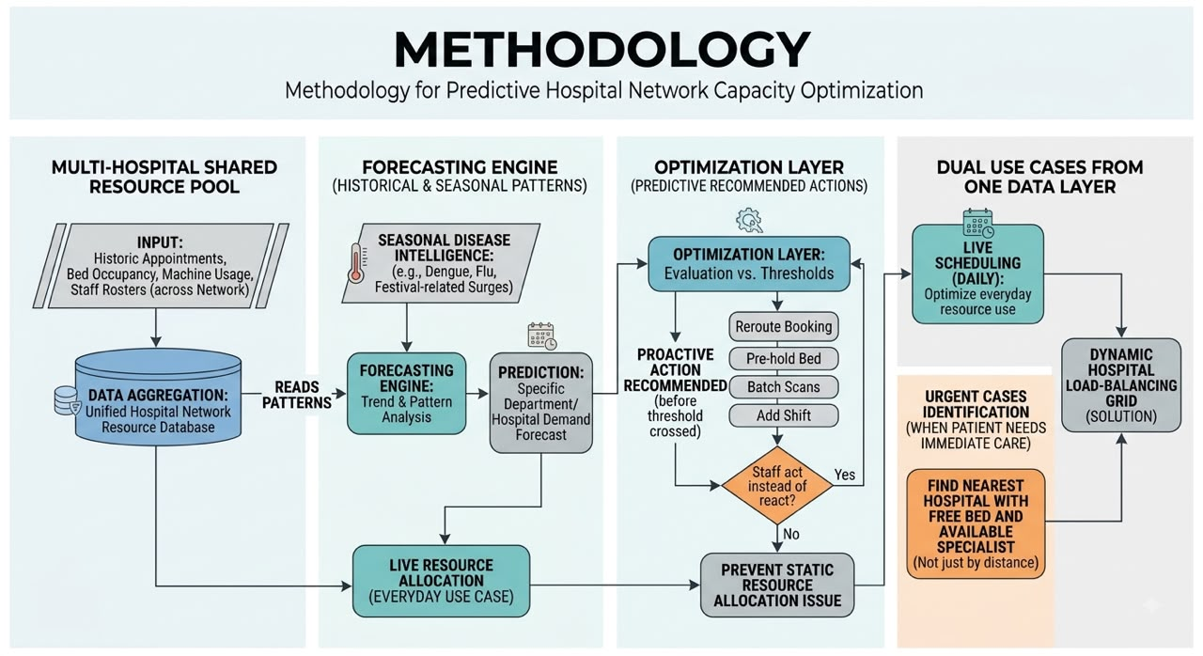
TECHNICAL APPROACH
ERROR404
Frontend: React or Flutter enables a consistent, cross-platform interface for both the patient-facing application and the hospital administrative dashboard
Backend: Node.js or Django, with PostgreSQL as the relational database, handling core business logic and data persistence
Forecasting/AI: Python, employing time-series forecasting models such as Prophet or ARIMA to predict demand patterns
Real-time synchronization: WebSockets or Firebase Cloud Messaging, ensuring bed, staff, and equipment status updates instantly across devices.
Integrations: ABDM (Ayushman Bharat Digital Mission) APIs for patient health records; Aadhaar-based authentication for identity verification.

Slide 4
FEASIBILITY AND VIABILITY
ERROR404
Feasibility
Built on mature proven existing technologies (Prophet/ARIMA, cloud backends, real-time sync) rather than experimental research.
Doesn't require replacing hospitals' existing systems instead use that data and work more efficiently.
It start with one district's government hospitals, since they already report to a common health authority and have a natural reason to share data.
Aligns with infrastructure, ABDM/NDHM, the government is already building reducing implementation overhead.
Potential challenges and strategies to overcome them
Data availability: Historical hospital data is often non-digitized or inconsistently formatted, complicating model training. The model needs to be prototyped using open-access datasets while formal data-sharing agreements with hospitals are negotiated.
Hospital reluctance to share data: Hospitals may be reluctant to share live resource data, for competitive (private) or bureaucratic (public) reasons. Roll out district-by-district under government sponsorship, using existing administrative hierarchies rather than requiring individual opt-in
Forecasting errors: Predictive models are inherently imperfect and could cause conflicts at the point of care if treated as certain. Treat predictions as ranges with buffer margins, not fixed promises.
Staff adoption: The system's real-time accuracy depends on staff consistently entering live updates, which is an adoption challenge, not just a technical one. Keep the interface minimal-friction (single-tap updates) paired with basic staff training.

Slide 5
IMPACT AND BENEFITS
ERROR404
Shorter wait times and better-matched hospital visits, with less risk of being turned away from an overcrowded facility.
Less scrambling during demand spikes, with better visibility to plan shifts and resources in advance.
Real-time, district-level visibility into hospital load, valuable during outbreaks and seasonal surges .
Improves equitable access to timely care, especially for migrants, rural patients, or the elderly unfamiliar with the local hospital network.
Reduces resource wastage through fewer idle machines and empty beds, and lowers overtime costs from better staff utilization.
Enables data-driven planning, letting authorities invest in infrastructure and staffing based on evidence, not guesswork .
Reduces unnecessary patient travel and equipment over-purchase through better utilization.

Slide 6
RESEARCH AND REFERENCES
ERROR404
https://www.nature.com/articles/s41598-025-86418-9
(bed occupancy forecasting)
https://link.springer.com/article/10.1186/s12911-026-03542-w
(Prophet model for bed forecasting)
https://www.ncbi.nlm.nih.gov/pmc/articles/PMC10709483
(ML + optimization for bed assignment)
https://www.nature.com/articles/s41598-026-43102-w
(AI-driven staff scheduling and workforce forecasting)
https://www.sciencedirect.com/science/article/abs/pii/S2211883723001004
(AI for patient/appointment scheduling)
https://abdm.gov.in
(government interoperability framework)

Slide 7
Live Prototype:
https://ai-care-flow-54.lovable.app/
GitHub Repository:
https://github.com/aakritisirohi/medi-grid-flow

