Slide 1

Predicting and Modernizing Income Status Using Qualitative and Quantitative Features from U.S. Census Data
By:
Paul Hill
Andrew Krupp

Slide 2
Introduction
The census collects granular, individual information on many economic, geographical, sociological, and anthropological descriptive features in attempt to profile the population
To use the collected census data, mathematical and statistical analysis are required to create meaningful models that can broaden the reach of the information.
Used a relatively clean and clearly defined sample of 48,000 individuals provided by the University of California, Irvine Machine Learning Repository
Performed feature engineering on data that could not be used in its current form
Employed simple financial mathematics to modernize the predictive model and render it relevant for modern use.

Slide 3
Background
Using census data collected by the United States Census Bureau, we will be attempting to predict the income status (that is, above or below $100,000/year) with reasonable accuracy.
Model creation was done through both binary Boolean variables and the creation of more precise categories derivative of the originals
We attempted to “modernize” the prediction by using current currency and inflation values
Created a more modern sample of data using surveying techniques to test if the model will be applicable to the modern day.
The data was collected independently, by sampling individuals and applying their features to the created predictive model.

Slide 4
Methodology
Feature | Data Type | Columns Created (if applicable)
Age | Integer | -
Work-class | Boolean | 8
Education | Boolean | 16
Education number | Integer | -
Marital Status | Boolean | 7
Occupation | Boolean | 14
Relationship | Boolean | 6
Race | Boolean | 5
Sex | Boolean | 2
Capital Gains | Integer | -
Capital Losses | Integer | -
Hours Worked | Integer | -
Country of Origin | Boolean | 41
Income (Above/Below $50,000) -1994 | Boolean | 1
Of the 15 features, 5 are quantitative and in integer form. The remaining 9 will need to be converted to a series of Boolean variables, made up of 0 for false and 1 for true, and an additional column added for each qualitative option the subjects have per feature.
$$f\left(a\right)=1+{\hat{X}}_{1}X_{1}+{\hat{X}}_{2}X_{2}+…+{\hat{X}}_{105}X_{105}$$

Slide 5
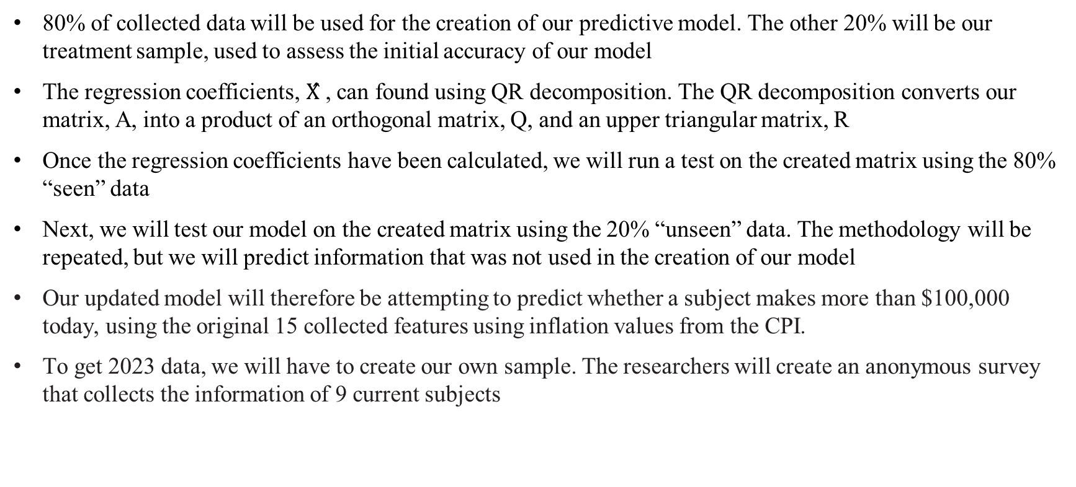
Methodology (cont.)
80% of collected data will be used for the creation of our predictive model. The other 20% will be our treatment sample, used to assess the initial accuracy of our model
The regression coefficients, $X̂$ , can found using QR decomposition. The QR decomposition converts our matrix, A, into a product of an orthogonal matrix, Q, and an upper triangular matrix, R
Once the regression coefficients have been calculated, we will run a test on the created matrix using the 80% “seen” data
Next, we will test our model on the created matrix using the 20% “unseen” data. The methodology will be repeated, but we will predict information that was not used in the creation of our model
Our updated model will therefore be attempting to predict whether a subject makes more than $100,000 today, using the original 15 collected features using inflation values from the CPI.
To get 2023 data, we will have to create our own sample. The researchers will create an anonymous survey that collects the information of 9 current subjects

Slide 6
Results
On seen data, the predictive model was able to predict over 84% of the data correctly, accurately assessing the income level of 21,883 subjects correctly
On unseen data however, the model was only approximately 57% accurate
In collected modern data, the model did not work. The engine predicted that every single subject makes more than $100,000, the equivalent of $50,000 in 1994.

Slide 7
Conclusions
This process showed that the model was significantly accurate on seen data, 84%, and only marginally better than random chance, 57%, on unseen data.
Based on these results, we conclude our model was harmed by over-fitting, and was created using too many independent variables
Due to the nature of the economic data, we cannot confidently omit any individual data or features of the sample. Forcing the model to overfit
Of the 9 collected subjects, only 2 claimed to exceed the income minimum. Despite this, our adjusted model indicated that all 9 subjects reflect the features to make greater than $100,000, overestimating the sample.

Slide 8
Conclusions (cont.)
Additional conclusions can still be drawn from the overfit model.
Young professionals, those with a college education under 25 (as reflected in the collected sample), were much wealthier on average in 1994.
This reflects the depreciating value of a bachelor’s degree, as the model predicts those in possession of such to be much wealthier.
We can also conclude it is increasingly difficult to establish wealth, as the gross over estimation reflects the model’s leniency to assume a higher income. In other words, reasonably wealthy individuals were much more common 30 years ago.
Future research should address over fitting, and work to create a more succinct model. Work should also be done to establish more specific dependent variables, predicting income to smaller intervals and not upon one minimum value

Slide 9
Acknowledgements and Backgrounds
Researcher Paul Hill is an undergraduate Finance student with a graduate focus on statistics, offering insight into the context of the economic nature of the data and assumptions being made.
Researcher Andrew Krupp is an undergraduate Software Engineer, with research experience in the field of data science and predictive modeling and will provide these learned skills to the project.
Special thanks to Dr. Alberto Condori, Ph.D. for the oversight, advisement, and support given throughout the project.

Slide 10
References
Becker, Barry. “Census Income Data Set.” Edited by Ronny Kohavi, UCI Machine Learning Repository: Census Income Data Set, 1 May 1996, https://archive.ics.uci.edu/ml/datasets/Census+Income
Bureau, US Census. “U.S. Census Bureau at a Glance.” Census.gov, 16 Dec. 2021, https://www.census.gov/about/what/census-at-a-glance.html
Federal Reserve Bank, Minneapolis. “Consumer Price Index, 1913.” Federal Reserve Bank of Minneapolis, https://www.minneapolisfed.org/about-us/monetary-policy/inflation-calculator/consumer-price-index-1913-
Pennsylvania State University. “3.2.2 - Binomial Random Variables: Stat 500.” PennState: Statistics Online Courses, Pennsylvania State University, https://online.stat.psu.edu/stat500/lesson/3/3.2/3.2.2
Yanovsky, Igor. “QR Decomposition with Gram-Schmidt - UCLA Mathematics.” UCLA Mathematics, https://www.math.ucla.edu/~yanovsky/Teaching/Math151B/handouts/GramSchmidt.pdf

