Slide 1
AgeLESS
Caring for you, well…At home.

Slide 2
Project Proposal
Immediate health reach for people especially above the age of 60 is critical.Due to their age and dependency on others this is becoming a concern.
In the world of Internet of things where we are trying to connect all devices, new and old, to each other in order to make daily life easier with the help of technology, requirement is to develop one such application/system for elderly people through which they can be assisted to get immediate health support.
Technology would enable them to remain connected to doctors and their dependents.
Alerts would be sent to dependents in case of any abnormalities recorded.

Slide 3
Objectives
To enable elderly people to be self-dependent in terms of their health.
Know their health statistics through regularly generated report
Ability to send the report/alert of abnormal condition to doctors And dependents.
Prompts to take appointment with a doctor(suggests list of doctors across networks)
Ability to send mail to doctor to book an appointment.
Enables to view changes in vital signs over a period of time through bar graph

Slide 4
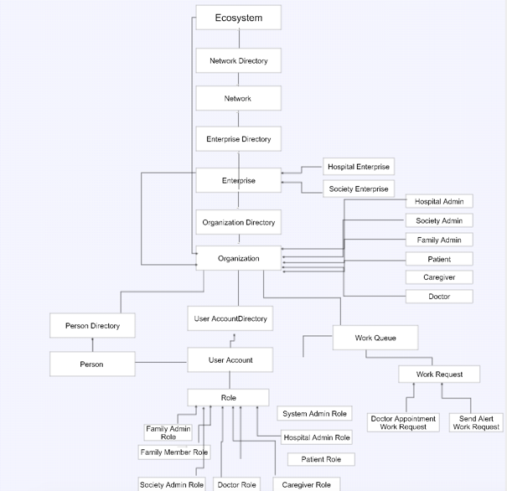
Object Model

Slide 5
Use Cases
Create networks in the ecosystem
Create Enterprises of type “HOSPITAL” and “SOCIETY”
Add system administrators for each Enterprise
Add different organizations in each network
Hospital Admin creates doctors,patients and assigns caregivers
Society admin creates Family admin and family members
Doctor can check the vital signs of patient generated through sensing devices
Doctor can see progress report of patient in the form of graph
Doctor can view and approve appointment requests from patient
Doctor can send alerts for abnormal condition to both patient and caregiver
Patient can check his vitals generated from devices and monitor his/her own health report.
Patient can request for appointment from doctor in case of abnormality in health.
Caregiver can see the report sent by doctor about patient’s abnormal health and take necessary action.

Slide 6
Roles
Patient
Doctor
Caregiver
Hospital Admin
Society Admin
Family Admin
Family Member
System Admin

Slide 7
EcoSystem extension to support IoT
Patient’s vital signs can be recorded through a number of sensors and devices available in the market like fitbit, wrist bands for heart rate, pulse rate and the like.Weight sensing shoes and blood sugar monitoring devices are already out by a number of companies as patents
Once the data from these devices is fed into this application, a patients health as a measure of time can be monitored via bar graphs
This application also enables automatic alerts to be sent to doctor in case an abnormal condition in patient’s health is encountered.
Allows the patients to independently check his vitals , see report and request for a appointment from a doctor across networks.

Slide 8
IoT Cause Effect Relationship
Enables automatic alerts to be sent to doctor in case an abnormal condition in patient’s health is encountered.
Allows the patients to independently check his vitals , see report and request for a appointment from a doctor across networks.

Slide 9
Validations
Multiple organizations of same type cannot be added in same enterprise
String , integer validations
Empty and null check validations
Person patient dependency validation
If a person exists then only a patient can be created
If person is a patient, he/she cannot be a caregiver

Slide 10
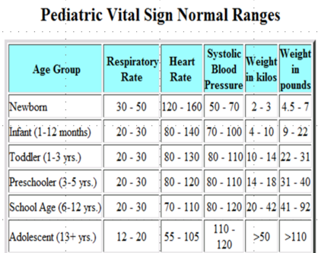
Referred Medical Ranges

Slide 11
Unique features
Vital signs of patient are visible to Patient as well as doctor as a measure of timestamp through clear bar graphs
A single Alert(work request) is sent by doctor to both patient and caregiver
-A patient can send an email in real time to take doctor’ appointment

Slide 12
Proposed Extensions
User should be able to have an appointment with doctor through video conferencing(using opencv jar) or any web camera accessing API
Family members who are healthy should b able to maintain their health via prescribed exercise routines
More work requests to be created for diet plans corresponding to health conditions monitored via BMI routine checks.

Slide 13
Stay Healthy :)

