Slide 1
Yelp Data Challenge
Aaksha Meghawat

Slide 2
Outline
Github Repo: https://github.com/aaksham/sensedatachallenge
Recommend Restaurants - Data Challenge 2
Predict Business Price Range - Data Challenge 1

Slide 3
ML System Framework (Aaksha)
Metrics
Data Ops
ML Model Dev
Accuracy vs. Latency
Design ML Tests
Sourcing / Extraction
Verification
Storage
Data Transformation
Feature Engineering
Modeling
Deployment
Inference (Online vs. Offline)
Serving Strategy (Server vs. Edge)
Data Science
Monitoring
Error Analysis
User Analytics
A/B Testing
Notes:
ML system design as a field hasn’t yet settled on design patterns like software engineering. So have my own framework for doing this. I like to think of a feature not just from the model perspective. This is my mental checklist for keeping the space in mind.
For example if we are launching a model where we are not reasonably sure of the user distribution, then its better to focus on a model which can be easily debugged.

Slide 4
Metrics
Data Ops
ML Model Dev
Accuracy vs. Latency
Design ML Tests
Sourcing / Extraction
Verification
Storage
Data Transformation
Feature Engineering
Modeling
Deployment
Inference (Online vs. Offline)
Serving Strategy (Server vs. Edge)
Data Science
Monitoring
Error Analysis
User Analytics
A/B Testing
Out of Scope
Notes:
ML system design as a field hasn’t yet settled on design patterns like software engineering. So have my own framework for doing this. I like to think of a feature not just from the model perspective. This is my mental checklist for keeping the space in mind.
For example if we are launching a model where we are not reasonably sure of the user distribution, then its better to focus on a model which can be easily debugged.

Slide 5
Recommend Restaurants - Data Challenge 2
Metrics
Data Ops
ML Model Dev
Deployment
Design (realistic) ML Tests
How to predict for new users? 2 Definitions:
UNSEEN USER: A user not seen in training but for whom some activity is available
NEVER_SEEN USER: A new user for whom no past record/activity is available
How to recommend restaurants reliably in “new” cities (w.r.t. past user activity)?
Accuracy
Hits@K (only possible for users with some activity in query city (seen or unseen))
Latency
Store featurized text vectors of user reviews

Slide 6
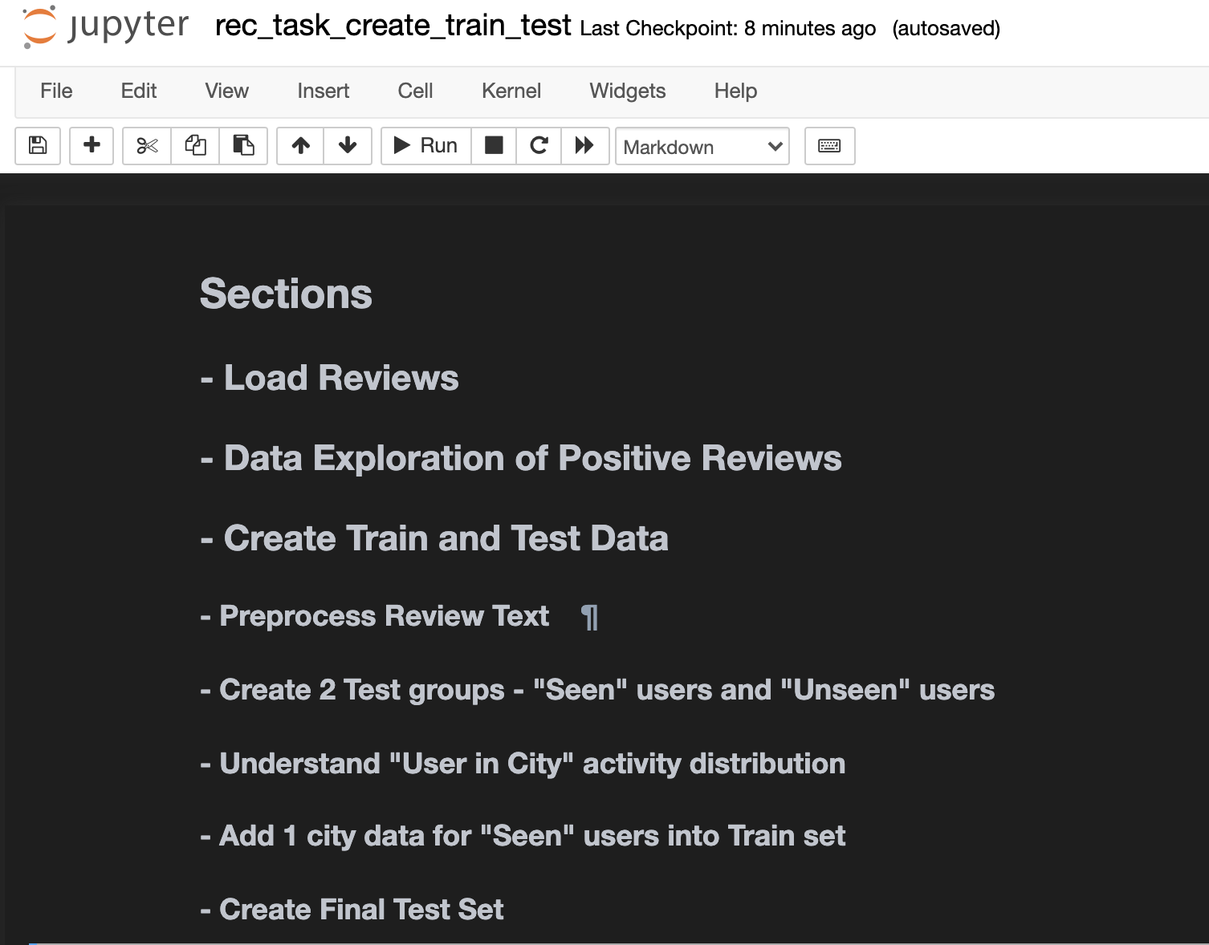
Recommend Restaurants - Data Challenge 2
Metrics
Data Ops
ML Model Dev
Deployment
Design (realistic) ML Tests
rec_task_create_train_test.ipynb

Slide 7
Recommend Restaurants - Data Challenge 2
Metrics
Data Ops
ML Model Dev
Deployment
ML Model Landscape
Content Based Filtering
Collaborative Filtering
Deep Learning Based approaches

Slide 8
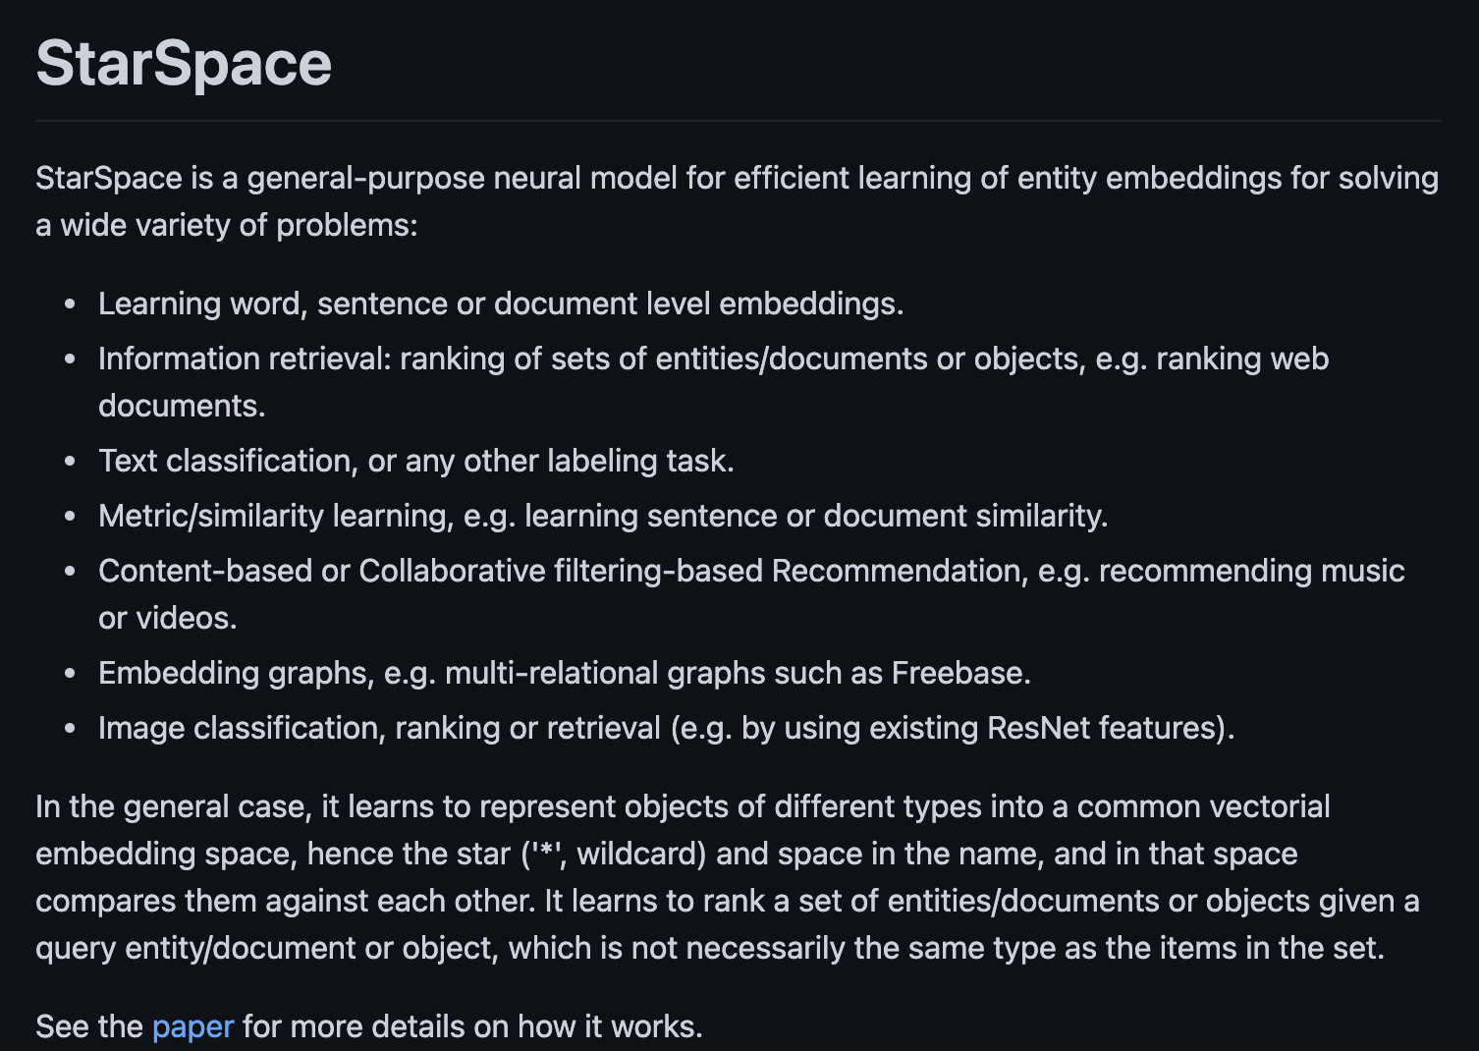
Recommend Restaurants - Data Challenge 2
Metrics
Data Ops
ML Model Dev
Deployment
StarSpace Embeddings: A Neural embeddings based recommendation system
https://github.com/facebookresearch/StarSpace

Slide 9
Recommend Restaurants - Data Challenge 2
Metrics
Data Ops
ML Model Dev
Deployment
StarSpace Embeddings
Environment Setup
Linux Based environment or Docker instance with atleast 16GB memory
Build StarSpace C++ binaries
Looking into hosting (my) docker image on the cloud
Training
Training data created in “Data Ops” step: rec_task_train_set_all.txt (1.39 GB)
docker run -it -p 8080:8080 --name sense-nlp -v $pwd:/root/sense aaksha/data-challenge
time starspace train -trainFile /root/sense/rec_task_train_set_all.txt -fileFormat labelDoc -trainMode 1 -adagrad true -ngrams 1 -epoch 10 -dim 50 -similarity cosine -minCount 2 -verbose true -negSearchLimit 10 -lr 0.05 -model /root/sense/embeddings/model
Training time: 20 mins.
Output: models/embeddings/model.tsv
Explore embeddings: explore_embeddings.ipynb

Slide 10
Recommend Restaurants - Data Challenge 2
Metrics
Data Ops
ML Model Dev
Deployment
StarSpace Embeddings – Main Advantages
Accuracy
Embed User Reviews & Restaurant Reviews in the same embedding space
Can recommend restaurants for users not seen in training
Can recommend Restaurants to new users with a single review post
Can recommend new restaurants to all users with a single review post
Customized embeddings for the domain and problem statement at hand
Performance
Compact model storage (due to vectorization)
Fast training due to c++ binaries

Slide 11
Recommend Restaurants - Data Challenge 2
Metrics
Data Ops
ML Model Dev
Deployment
For faster inference & model serving precompute user embeddings
create_user_trove.ipynb
Group positive reviews by user id (seen & unseen during training)
Positive review is defined as any review text with stars>=4
Prepocess User Review Text:
Remove weird symbols
Remove stopwords
Lemmatize words
Construct user vectors by using word embeddings estimated in previous step
User Vector is the mean of all the word embeddings present in the grouped user review text
Output: models/user_trove.pkl (574.7 mb)

Slide 12
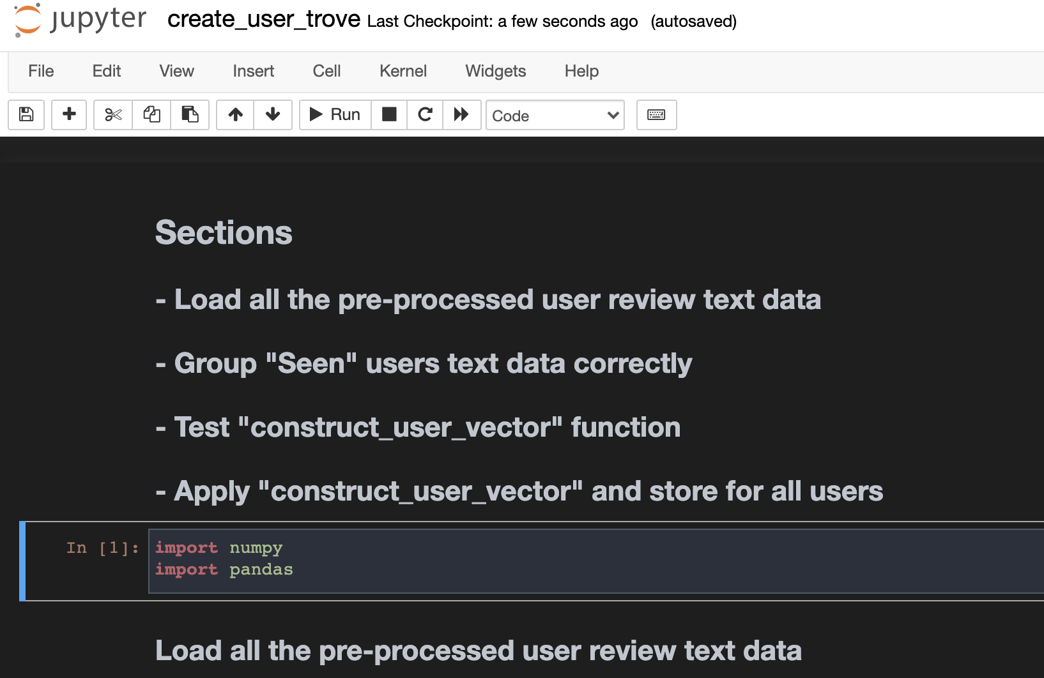
Recommend Restaurants - Data Challenge 2
Metrics
Data Ops
ML Model Dev
Deployment
For faster inference & model serving precompute user embeddings
create_user_trove.ipynb

Slide 13
Recommend Restaurants - Data Challenge 2
Metrics
Data Ops
ML Model Dev
Deployment
Similar to users, for faster inference & model serving precompute restaurant embeddings
create_restaurant_trove.ipynb
Special steps for restaurant review processing
Filter out businesses that are closed i.e. is_open=0
Filter out businesses which do not belong to the restaurant category
Select and group the 100 most recent (sort by date) & most “useful” (sort by useful column) reviews for every restaurant
This selection is based on data analysis in data challenge 1
Repeat text processing and vector construction as in previous step
Output: models/restaurant_trove.pkl (22.7 mb)

Slide 14
Recommend Restaurants - Data Challenge 2
Metrics
Data Ops
ML Model Dev
Deployment
Inference – recommend_csv.py, model_utils.py
Input format: example/{test_seen,test_unseen,test_never_seen}.csv
Example cmd – python3 recommend_csv.py –t example/test_seen.csv
Example cmd – python3 recommend_csv.py –t example/test_unseen.csv
Example cmd – python3 recommend_csv.py –t example/test_never_seen.csv
For every query user and city, the recommender does the following:
If the user vector exists (seen or unseen at training time), find all restaurants in the query city and return the top 10 restaurants with business review vectors closest in cosine similarity
If the user vector does not exist (never seen) and a sample review is given in the input, construct a user vector and repeat as above
If the user vector does not exist and no sample review is not given, return restaurants in query city with the highest stars
Output: ./output.csv

Slide 15
Predict business price range – Data challenge 1

Slide 16
Predict business price range – Data challenge 1
Metrics
Data Ops
ML Model Dev
Deployment
Mutliclass classification
Accuracy
F1 score
Average Precision score
ROC Curve
Micro Average
Macro Average
Test data and train data should not have any “business_id” in common

Slide 17
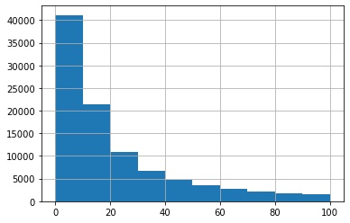
Predict business price range – Data challenge 1
Metrics
Data Ops
ML Model Dev
Deployment
Data exploration
biz_data_explore.ipynb
filter out all businesses with “NaN” attributes
Filter out all businesses with “NaN” or none price range
Understand target label distribution and skew
Understand review count distribution per business
No. of businesses vs. review count bucket. Based on this decided to consider the top 100 most recent and useful reviews
per business

Slide 18
Predict business price range – Data challenge 1
Metrics
Data Ops
ML Model Dev
Deployment
Feature design
reviews_data_explore.ipynb
Text processing - prep_text_data.ipynb
transform_data_final.ipynb
Group processed text by business_id
Create train & test sets: create_train_test_biz.ipynb, create_train_test_reviews.ipynb
Test data and train data should not have any “business_id” in common
70% business_ids for train, 10% for validation, 10% for test

Slide 19
Predict business price range – Data challenge 1
Metrics
Data Ops
ML Model Dev
Deployment
Feature Engineering (train_for_dc1.ipynb)
TFIDF vectorization of text (stored for future use in models/tfidf_vectorizer.joblib)
Model Training (train_for_dc1.ipynb)
Logistic Regression for multiclass classification
Stored for future use in models/overlogreg.joblib

Slide 20
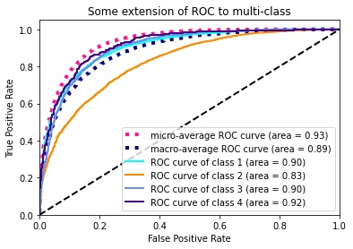
Predict business price range – Data challenge 1
Metrics
Data Ops
ML Model Dev
Deployment
performance (train_for_dc1.ipynb, test_for_dc1.ipynb)
Validation set: Accuracy-0.68, F1score-0.7,average precision-0.63
Test set: Accuracy-0.67, F1score-0.69,average precision-0.62

Slide 21
Github repo
https://github.com/aaksham/sensedatachallenge

