Slide 1
COMP590-154 Computer Architecture Lecture 3 - Microcoding
Amogh Akshintala
Department of Computer Sciences
University of North Carolina at Chapel Hill
https://aakshintala.com/comp590/

Slide 2
Last Time in Lecture 1 & 2
Computer Architecture >> ISAs and RTL
CS152 is about interaction of hardware and software, and design of appropriate abstraction layers
Technology and Applications shape Computer Architecture
History provides lessons for the future
First 130 years of CompArch, from Babbage to IBM 360
Move from calculators (no conditionals) to fully programmable machines
Rapid change started in WWII (mid-1940s), move from electro-mechanical to pure electronic processors
Cost of software development becomes a large constraint on architecture (need compatibility)
IBM 360 introduces notion of “family of machines” running same ISA but very different implementations
Six different machines released on same day (April 7, 1964)
“Future-proofing” for subsequent generations of machine

Slide 3
Instruction Set Architecture (ISA)
The contract between software and hardware
Typically described by giving all the programmer-visible state (registers + memory) plus the semantics of the instructions that operate on that state
IBM 360 was first line of machines to separate ISA from implementation (aka. microarchitecture)
Many implementations possible for a given ISA
E.g., the Soviets build code-compatible clones of the IBM360, as did Amdahl after he left IBM.
E.g.2., today you can buy AMD or Intel processors that run the x86-64 ISA.
E.g.3: many cellphones use the ARM ISA with implementations from many different companies including Apple, Qualcomm, Samsung, Huawei, etc.
We use Berkeley RISC-V as standard ISA in class
www.riscv.org

Slide 4
ISA to Microarchitecture Mapping
ISA often designed with particular microarchitectural style in mind, e.g.,
Accumulator ⇒ hardwired, unpipelined
CISC ⇒ microcoded
RISC ⇒ hardwired, pipelined
VLIW ⇒ fixed-latency in-order parallel pipelines
JVM ⇒ software interpretation
But can be implemented with any microarchitectural style
Intel Ivy Bridge: hardwired pipelined CISC (x86) machine (with some microcode support)
Spike: Software-interpreted RISC-V machine
ARM Jazelle: A hardware JVM processor
This lecture: a microcoded RISC-V machine

Slide 5
Why Learn Microprogramming?
To show how to build very small processors with complex ISAs
To help you understand where CISC* machines came from
Because still used in common machines (x86, IBM360, PowerPC)
As a gentle introduction into machine structures
To help understand how technology drove the move to RISC*
* “CISC”/”RISC” names much newer than style of machines they refer to.

Slide 6
Control versus Datapath
Processor designs can be split between datapath, where numbers are stored and arithmetic operations computed, and control, which sequences operations on datapath
Control
Biggest challenge for early computer designers was getting control circuitry correct
Maurice Wilkes invented the idea of microprogramming to design the control unit of a processor for EDSAC-II, 1958
Foreshadowed by Babbage’s “Barrel” and mechanisms in earlier programmable calculators
Datapath
Instruction
Control Lines
Condition?
Inst. Reg.
Registers
ALU
PC
Busy?
Address
Data
Main Memory

Slide 7
Microcoded CPU
Next State
µPC
Microcode ROM
(holds fixed µcode instructions)
Decoder
Condition
Opcode
Busy?
Control Lines
Datapath
Address
Data
Main Memory
(holds user program written in macroinstructions, e.g., x86, RISC-V)

Slide 8
Technology Influence
When microcode appeared in 1950s, different technologies for:
Logic: Vacuum Tubes
Main Memory: Magnetic cores
Read-Only Memory: Diode matrix, punched metal cards, …
Logic very expensive compared to ROM or RAM
ROM cheaper than RAM
ROM much faster than RAM

Slide 9
RISC-V ISA
New fifth-generation RISC design from UC Berkeley
Realistic & complete ISA, but open & small
Not over-architected for a certain implementation style
Both 32-bit (RV32) and 64-bit (RV64) address-space variants
Designed for multiprocessing
Efficient instruction encoding
Easy to subset/extend for education/research
RISC-V spec available on Foundation website and github
Increasing momentum with industry adoption

Slide 10
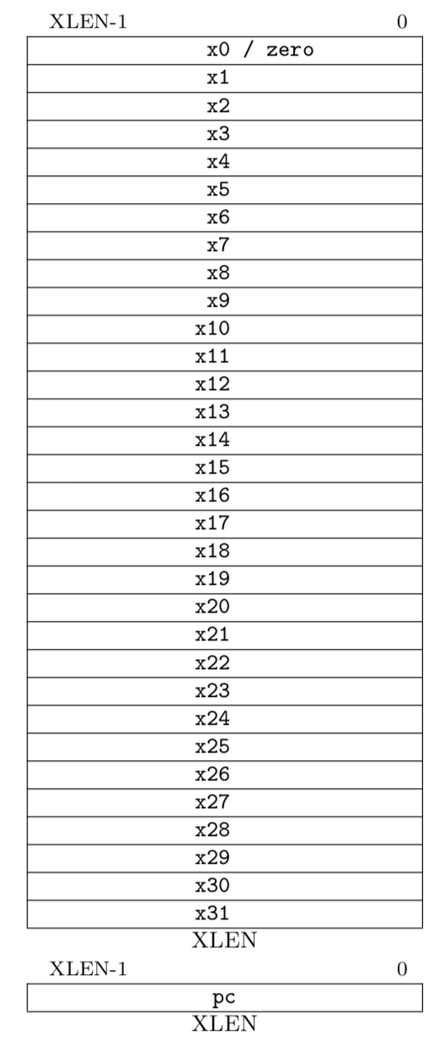
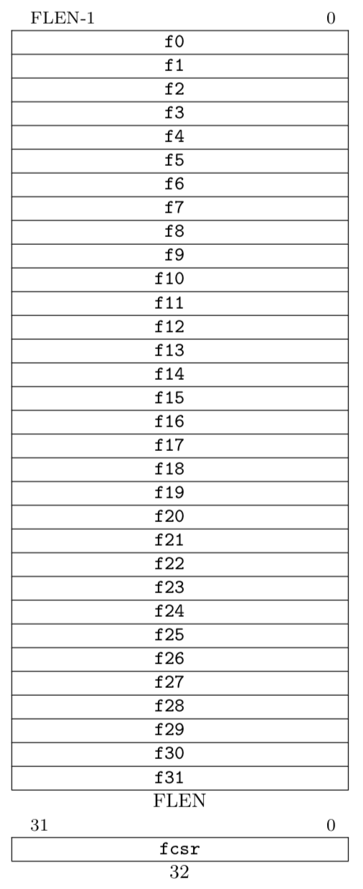
RV32 Processor State
Program counter (pc)
32x32-bit integer registers (x0-x31)
x0 always contains a 0
32 floating-point (FP) registers (f0-f31)
each can contain a single- or double-precision FP value (32-bit or 64-bit IEEE FP)
FP status register (fcsr), used for FP rounding mode & exception reporting

Slide 11
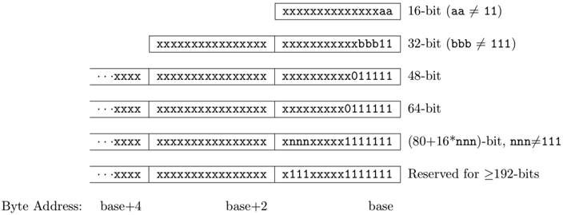
RISC-V Instruction Encoding
Can support variable-length instructions.
Base instruction set (RV32) always has fixed 32-bit instructions lowest two bits = 11₂
All branches and jumps have targets at 16-bit granularity (even in base ISA where all instructions are fixed 32 bits)

Slide 12
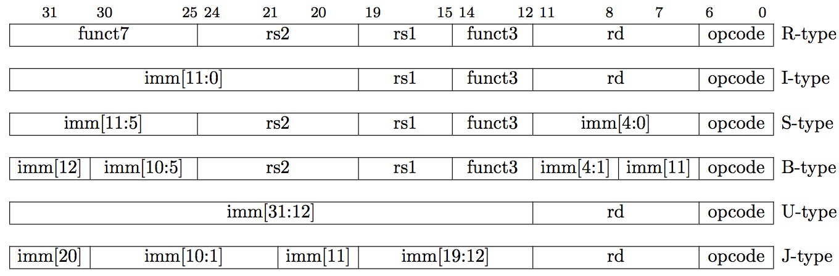
RISC-V Instruction Formats
7-bit opcode field (but low 2 bits =11₂)
Additional opcode bits/immediate
Destination Reg.
Reg. Source 2
Reg. Source 1

Slide 13
Single-Bus Datapath for Microcoded RISC-V
Opcode
Condition?
Busy?
32 (PC)
rs1
rs2
rd
RegW
MemW
InstLd
MALd
ImmSel
BLd
RegSel
ALUOp
Address
Main Memory
B
Register RAM
Registers
ALU
Immediate
PC
Mem. Address
Instruction Reg.
A
Data Out
In
ALd
ImmEn
RegEn
ALUEn
MemEn
Microinstructions written as register transfers:
MA:=PC means RegSel=PC; RegW=0; RegEn=1; MALd=1
B:=Reg[rs2] means RegSel=rs2; RegW=0; RegEn=1; BLd=1
Reg[rd]:=A+B means ALUop=Add; ALUEn=1; RegSel=rd; RegW=1

Slide 14
RISC-V Instruction Execution Phases
Instruction Fetch
Instruction Decode
Register Fetch
ALU Operations
Optional Memory Operations
Optional Register Writeback
Calculate Next Instruction Address

Slide 15
Microcode Sketches (1)
Instruction Fetch: MA,A:=PC
PC:=A+4
wait for memory
IR:=Mem
dispatch on opcode
ALU: A:=Reg[rs1]
B:=Reg[rs2]
Reg[rd]:=ALUOp(A,B)
goto instruction fetch
ALUI: A:=Reg[rs1]
B:=ImmI //Sign-extend 12b immediate
Reg[rd]:=ALUOp(A,B)
goto instruction fetch

Slide 16
Microcode Sketches (2)
LW: A:=Reg[rs1]
B:=ImmI //Sign-extend 12b immediate
MA:=A+B
wait for memory
Reg[rd]:=Mem
goto instruction fetch
JAL: Reg[rd]:=A // Store return address
A:=A-4 // Recover original PC
B:=ImmJ // Jump-style immediate
PC:=A+B
goto instruction fetch
Branch: A:=Reg[rs1]
B:=Reg[rs2]
if (!ALUOp(A,B)) goto instruction fetch //Not taken
A:=PC //Microcode fall through if branch taken
A:=A-4
B:=ImmB// Branch-style immediate
PC:=A+B
goto instruction fetch

Slide 17
Pure ROM Implementation
Opcode
Cond?
Busy?
µPC
Address
ROM
Data
Next µPC
Control Signals
How many address bits?
|µaddress| = |µPC|+|opcode|+ 1 + 1
How many data bits?
|data| = |µPC|+|control signals| = |µPC| + 18
Total ROM size = 2^{|µaddress|}x|data|

Slide 18
Pure ROM Contents
Address | Data
µPC Opcode Cond? Busy? | Control Lines Next µPC
fetch0 X X X | MA,A:=PC fetch1
fetch1 X X 1 | fetch1
fetch1 X X 0 | IR:=Mem fetch2
fetch2 ALU X X | PC:=A+4 ALU0
fetch2 ALUI X X | PC:=A+4 ALUI0
fetch2 LW X X | PC:=A+4 LW0
….
ALU0 X X X | A:=Reg[rs1] ALU1
ALU1 X X X | B:=Reg[rs2] ALU2
ALU2 X X X | Reg[rd]:=ALUOp(A,B) fetch0

Slide 19
Single-Bus Microcode RISC-V ROM Size
Instruction fetch sequence 3 common steps
~12 instruction groups
Each group takes ~5 steps (1 for dispatch)
Total steps 3+12*5 = 63, needs 6 bits for µPC
Opcode is 5 bits, ~18 control signals
Total size = 2⁽⁶⁺⁵⁺²⁾x(6+18)=2¹³x24 = ~25KiB!

Slide 20
Reducing Control Store Size
Reduce ROM height (#address bits)
Use external logic to combine input signals
Reduce #states by grouping opcodes
Reduce ROM width (#data bits)
Restrict µPC encoding (next,dispatch,wait on memory,…)
Encode control signals (vertical µcoding, nanocoding)

Slide 21
Single-Bus RISC-V Microcode Engine
Opcode
fetch0
Decode
µPC
+1
Cond?
µPC Jump Logic
Address
ROM
Busy?
Data
µPC jump
Control Signals
µPC jump = next | spin | fetch | dispatch | ftrue | ffalse

Slide 22
µPC Jump Types
next increments µPC
spin waits for memory
fetch jumps to start of instruction fetch
dispatch jumps to start of decoded opcode group
ftrue/ffalse jumps to fetch if Cond? true/false

Slide 23
Encoded ROM Contents
Address | Data
µPC | Control Lines Next µPC
fetch0 | MA,A:=PC next
fetch1 | IR:=Mem spin
fetch2 | PC:=A+4 dispatch
ALU0 | A:=Reg[rs1] next
ALU1 | B:=Reg[rs2] next
ALU2 | Reg[rd]:=ALUOp(A,B) fetch
Branch0 | A:=Reg[rs1] next
Branch1 | B:=Reg[rs2] next
Branch2 | A:=PC ffalse
Branch3 | A:=A-4 next
Branch4 | B:=ImmB next
Branch5 | PC:=A+B fetch

Slide 24
Implementing Complex Instructions
Memory-memory add: M[rd] = M[rs1] + M[rs2]
Address | Data
µPC | Control Lines Next µPC
MMA0 | MA:=Reg[rs1] next
MMA1 | A:=Mem spin
MMA2 | MA:=Reg[rs2] next
MMA3 | B:=Mem spin
MMA4 | MA:=Reg[rd] next
MMA5 | Mem:=ALUOp(A,B) spin
MMA6 | fetch
Complex instructions usually do not require datapath modifications, only extra space for control program
Very difficult to implement these instructions using a hardwired controller without substantial datapath modifications

Slide 25
Single-Bus Datapath for Microcoded RISC-V
Opcode
Condition?
Busy?
32 (PC)
rs1
rs2
rd
RegW
MemW
InstLd
MALd
ImmSel
BLd
RegSel
ALUOp
Address
Main Memory
B
Register RAM
Registers
ALU
Immediate
PC
Mem. Address
Instruction Reg.
A
Data Out
In
ALd
ImmEn
RegEn
ALUEn
MemEn
Datapath unchanged for complex instructions!

Slide 26
Horizontal vs Vertical µCode
Bits per µInstruction
# µInstructions
Horizontal µcode has wider µinstructions
Multiple parallel operations per µinstruction
Fewer microcode steps per macroinstruction
Sparser encoding ⇒ more bits
Vertical µcode has narrower µinstructions
Typically a single datapath operation per µinstruction
separate µinstruction for branches
More microcode steps per macroinstruction
More compact ⇒ less bits
Nanocoding
Tries to combine best of horizontal and vertical µcode

Slide 27
Nanocoding
Exploits recurring control signal patterns in µcode, e.g.,
ALU0 A ← Reg[rs1]
...
ALUI0 A ← Reg[rs1]
...
µcode
next-state
µPC (state)
µaddress
µcode ROM
nanoaddress
nanoinstruction ROM
data
Motorola 68000 had 17-bit µcode containing either 10-bit µjump or 9-bit nanoinstruction pointer
Nanoinstructions were 68 bits wide, decoded to give 196 control signals

Slide 28
Microprogramming in IBM 360
 | M30 | M40 | M50 | M65
Datapath width (bits) | 8 | 16 | 32 | 64
µinst width (bits) | 50 | 52 | 85 | 87
µcode size (K µinsts) | 4 | 4 | 2.75 | 2.75
µstore technology | CCROS | TCROS | BCROS | BCROS
µstore cycle (ns) | 750 | 625 | 500 | 200
memory cycle (ns) | 1500 | 2500 | 2000 | 750
Rental fee ($K/month) | 4 | 7 | 15 | 35
Only the fastest models (75 and 95) were hardwired

Slide 29
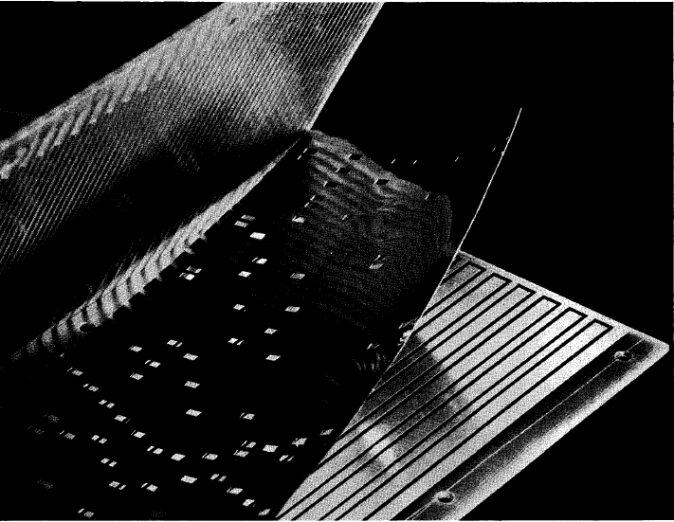
IBM Card-Capacitor Read-Only Storage
Punched Card with metal film
Fixed sensing plates
[ IBM Journal, January 1961]

Slide 30
Microcode Emulation
IBM initially miscalculated the importance of software compatibility with earlier models when introducing the 360 series
Honeywell stole some IBM 1401 customers by offering translation software (“Liberator”) for Honeywell H200 series machine
IBM retaliated with optional additional microcode for 360 series that could emulate IBM 1401 ISA, later extended for IBM 7000 series
one popular program on 1401 was a 650 simulator, so some customers ran many 650 programs on emulated 1401s
i.e., 650 simulated on 1401 emulated on 360

Slide 31
Microprogramming thrived in ‘60s and ‘70s
Significantly faster ROMs than DRAMs were available
For complex instruction sets, datapath and controller were cheaper and simpler
New instructions , e.g., floating point, could be supported without datapath modifications
Fixing bugs in the controller was easier
ISA compatibility across various models could be achieved easily and cheaply
Except for the cheapest and fastest machines, all computers were microprogrammed

Slide 32
Microprogramming: early 1980s
Evolution bred more complex micro-machines
Complex instruction sets led to need for subroutine and call stacks in µcode
Need for fixing bugs in control programs was in conflict with read-only nature of µROM
➔Writable Control Store (WCS) (B1700, QMachine, Intel i432, …)
With the advent of VLSI technology assumptions about ROM & RAM speed became invalid →more complexity
Better compilers made complex instructions less important.
Use of numerous micro-architectural innovations, e.g., pipelining, caches and buffers, made multiple-cycle execution of reg-reg instructions unattractive

Slide 33
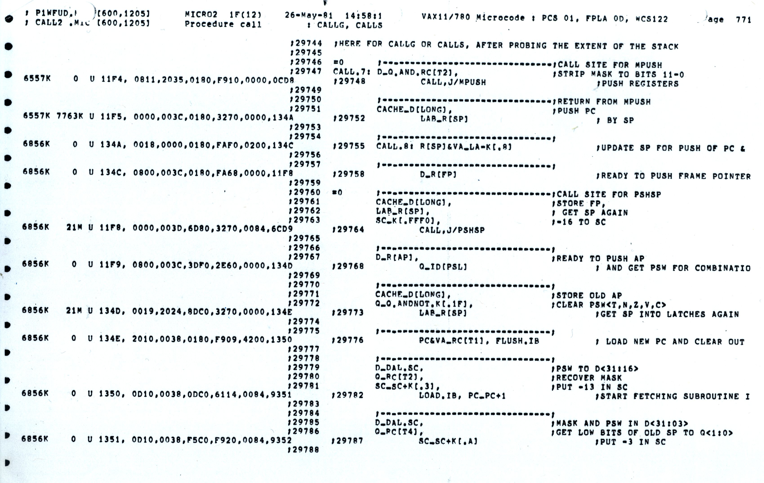
VAX 11-780 Microcode

Slide 34
Writable Control Store (WCS)
Implement control store in RAM not ROM
MOS SRAM memories now almost as fast as control store (core memories/DRAMs were 2-10x slower)
Bug-free microprograms difficult to write
User-WCS provided as option on several minicomputers
Allowed users to change microcode for each processor
User-WCS failed
Little or no programming tools support
Difficult to fit software into small space
Microcode control tailored to original ISA, less useful for others
Large WCS part of processor state - expensive context switches
Protection difficult if user can change microcode
Virtual memory required restartable microcode

Slide 35
Analyzing Microcoded Machines
John Cocke and group at IBM
Working on a simple pipelined processor, 801, and advanced compilers inside IBM
Ported experimental PL.8 compiler to IBM 370, and only used simple register-register and load/store instructions similar to 801
Code ran faster than other existing compilers that used all 370 instructions! (up to 6MIPS whereas 2MIPS considered good before)
Emer, Clark, at DEC
Measured VAX-11/780 using external hardware
Found it was actually a 0.5MIPS machine, although usually assumed to be a 1MIPS machine
Found 20% of VAX instructions responsible for 60% of microcode, but only account for 0.2% of execution time!
VAX8800
Control Store: 16K*147b RAM, Unified Cache: 64K*8b RAM
4.5x more microstore RAM than cache RAM!

Slide 36
“Iron Law” of Processor Performance
Time = Instructions Cycles Time
Program Program * Instruction * Cycle
Instructions per program depends on source code, compiler technology, and ISA
Cycles per instructions (CPI) depends on ISA and µarchitecture
Time per cycle depends upon the µarchitecture and base technology

Slide 37
CPI for Microcoded Machine
7 cycles
5 cycles
10 cycles
Inst 1
Inst 2
Inst 3
Time
Total clock cycles = 7+5+10 = 22
Total instructions = 3
CPI = 22/3 = 7.33
CPI is always an average over a large number of instructions.

Slide 38
IC Technology Changes Tradeoffs
Logic, RAM, ROM all implemented using MOS transistors
Semiconductor RAM ~ same speed as ROM

Slide 39
Reconsidering Microcode Machine (Nanocoded 68000 example)
RISC!
User PC
Exploits recurring control signal patterns in µcode, e.g.,
ALU0 A ← Reg[rs1]
...
ALUI0 A ← Reg[rs1]
...
µcode
next-state
µPC (state)
µaddress
Inst. Cache
µcode ROM
nanoaddress
Hardwired Decode
nanoinstruction ROM
data
Motorola 68000 had 17-bit µcode containing either 10-bit µjump or 9-bit nanoinstruction pointer
Nanoinstructions were 68 bits wide, decoded to give 196 control signals

Slide 40
From CISC to RISC
Use fast RAM to build fast instruction cache of user-visible instructions, not fixed hardware microroutines
Contents of fast instruction memory change to fit application needs
Use simple ISA to enable hardwired pipelined implementation
Most compiled code only used few CISC instructions
Simpler encoding allowed pipelined implementations
Further benefit with integration
In early ‘80s, finally fit 32-bit datapath + small caches on single chip
No chip crossings in common case allows faster operation

Slide 41
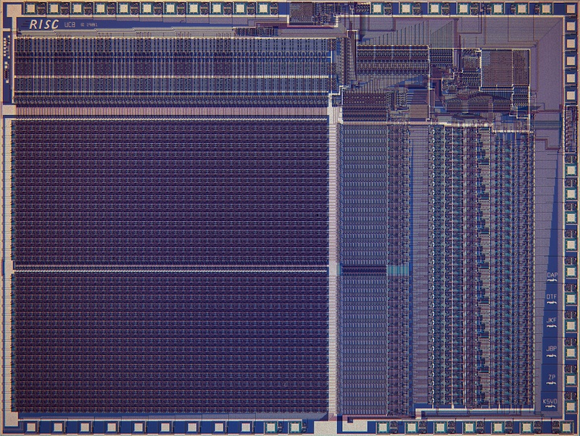
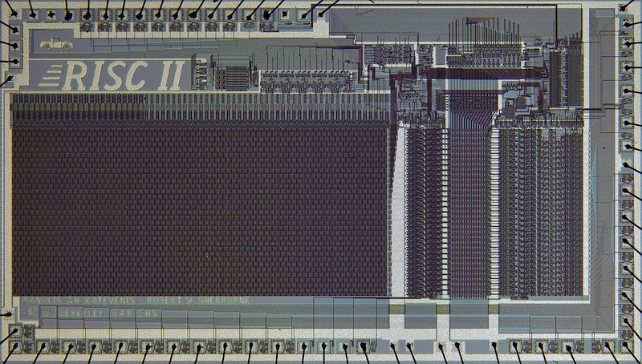
Berkeley RISC Chips
RISC-I (1982) Contains 44,420 transistors, fabbed in 5 µm NMOS, with a die area of 77 mm², ran at 1 MHz. This chip is probably the first VLSI RISC.
RISC-II (1983) contains 40,760 transistors, was fabbed in 3 µm NMOS, ran at 3 MHz, and the size is 60 mm².
Stanford built some too…

Slide 42
Microprogramming is far from extinct
Played a crucial role in micros of the Eighties
DEC uVAX, Motorola 68K series, Intel 286/386
Plays an assisting role in most modern micros
e.g., AMD Zen, Intel Sky Lake, Intel Atom, IBM PowerPC, …
Most instructions executed directly, i.e., with hard-wired control
Infrequently-used and/or complicated instructions invoke microcode
Patchable microcode common for post-fabrication bug fixes, e.g. Intel processors load µcode patches at bootup
Intel had to scramble to resurrect microcode tools and find original microcode engineers to patch Meltdown/Spectre security vulnerabilites

Slide 43
Acknowledgements
These slides contain material developed and copyright by:
Arvind (MIT)
Krste Asanovic (MIT/UCB)
Joel Emer (Intel/MIT)
James Hoe (CMU)
John Kubiatowicz (UCB)
David Patterson (UCB)
MIT material derived from course 6.823
UCB material derived from course CS252

