Slide 1
Review and Background

Slide 2
Amdahl’s Law
Speedup = time_{without enhancement} / time_{with enhancement}
An enhancement speeds up fraction f of a task by factor S
time_{new} = time_{orig}·( (1-f) + f/S )
S_{overall} = 1 / ( (1-f) + f/S )
time_{orig}
time_{orig}
time_{orig}
1
(1 - f)
f
(1 - f)
f
time_{new}
time_{new}
(1 - f)
f/S
(1 - f)
f/S
Notes:
Real life analogy: After driving through 60 minutes of traffic jam, how much time can you make up by speeding in the final mile?
Applications in Computer Architecture
RISC - Reduced Instruction Set Computer
Optimized to execute frequently used instructions quickly
Infrequently used instructions can take a long time, or even emulated by software
We should concentrate efforts on improving frequently occurring events or frequently used mechanisms

Slide 3
The Iron Law of Processor Performance
Total Work
In Program
CPI or 1/IPC
1/f (frequency)
Algorithms,
Compilers,
ISA Extensions
Microarchitecture
Microarchitecture,
Process Tech
We will concentrate on CPI, others are important too!

Slide 4
Performance
Latency (execution time): time to finish one task
Throughput (bandwidth): number of tasks/unit time
Throughput can exploit parallelism, latency can’t
Sometimes complimentary, often contradictory
Example: move people from A to B, 10 miles
Car: capacity = 5, speed = 60 miles/hour
Bus: capacity = 60, speed = 20 miles/hour
Latency: car = 10 min, bus = 30 min
Throughput: car = 15 PPH (count return trip), bus = 60 PPH
No right answer: pick metric for your goals

Slide 5
Performance Improvement
Processor A is X times faster than processor B if
Latency(P,A) = Latency(P,B) / X
Throughput(P,A) = Throughput(P,B) * X
Processor A is X% faster than processor B if
Latency(P,A) = Latency(P,B) / (1+X/100)
Throughput(P,A) = Throughput(P,B) * (1+X/100)
Car/bus example
Latency? Car is 3 times (200%) faster than bus
Throughput? Bus is 4 times (300%) faster than car

Slide 6
Partial Performance Metrics Pitfalls
Which processor would you buy?
Processor A: CPI = 2, clock = 2.8 GHz
Processor B: CPI = 1, clock = 1.8 GHz
Probably A, but B is faster (assuming same ISA/compiler)
Classic example
800 MHz Pentium III faster than 1 GHz Pentium 4
Same ISA and compiler

Slide 7
Averaging Performance Numbers (1/2)
Latency is additive, throughput is not
Latency(P1+P2,A) = Latency(P1,A) + Latency(P2,A)
Throughput(P1+P2,A) != Throughput(P1,A)+Throughput(P2,A)
Example:
180 miles @ 30 miles/hour + 180 miles @ 90 miles/hour
6 hours at 30 miles/hour + 2 hours at 90 miles/hour
Total latency is 6 + 2 = 8 hours
Total throughput is not 60 miles/hour
Total throughput is only 45 miles/hour! (360 miles / (6 + 2 hours))
Arithmetic mean is not always the answer!

Slide 8
Averaging Performance Numbers (2/2)
Arithmetic: times
proportional to time
e.g., latency
Harmonic: rates
inversely proportional to time
e.g., throughput
Geometric: ratios
unit-less quantities
e.g., speedups
Memorize these to avoid looking them up later

Slide 9
Parallelism: Work and Critical Path
Parallelism: number of independent tasks available
Work (T1): time on sequential system
Critical Path (T∞): time on infinitely-parallel system
Average Parallelism: P_{avg} = T1 / T∞
For a p-wide system: T_{p} ≥ max{ T1/p, T∞ } P_{avg} >> p ⇒ T_{p} ≈ T1/p
x = a + b;
y = b * 2
z =(x-y) * (x+y)
Can trade off frequency for parallelism

Slide 10
Locality Principle
Recent past is a good indication of near future
Temporal Locality: If you looked something up, it is very likely that you will look it up again soon
Spatial Locality: If you looked something up, it is very likely you will look up something nearby soon
Notes:
Real life analogy:
spatial locality - where you choose to sit in a room
temporal locality - will you be here again next week?
Examples in computer architecture:
Execution of program loops
spatial locality - after you execute an instruction, with very good probability, you will execute the next instruction
temporal locality - you are very likely to repeat the same instructions many times

Slide 11
Power vs. Energy (1/2)
Power: instantaneous rate of energy transfer
Expressed in Watts
In Architecture, implies conversion of electricity to heat
Power(Comp1+Comp2)=Power(Comp1)+Power(Comp2)
Energy: measure of using power for some time
Expressed in Joules
power * time (joules = watts * seconds)
Energy(OP1+OP2)=Energy(OP1)+Energy(OP2)

Slide 12
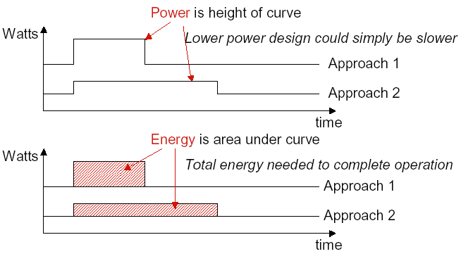
Power vs. Energy (2/2)
Does this example help or hurt?

Slide 13
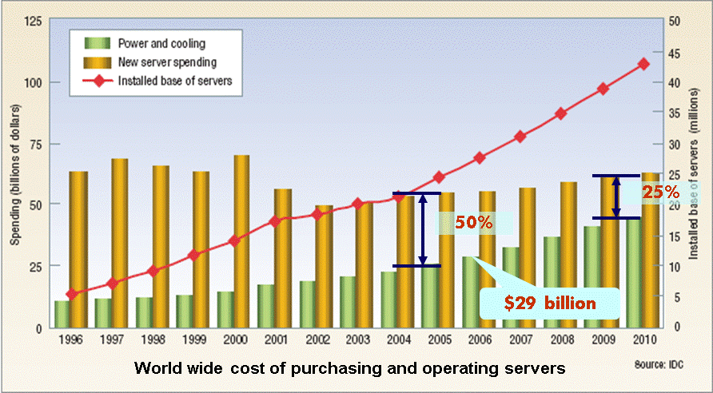
Why is energy important?
Because electricity consumption has costs
Impacts battery life for mobile
Impacts electricity costs for tethered
Delivering power for buildings, countries
Gets worse with larger data centers ($7M for 1000 racks)

Slide 14
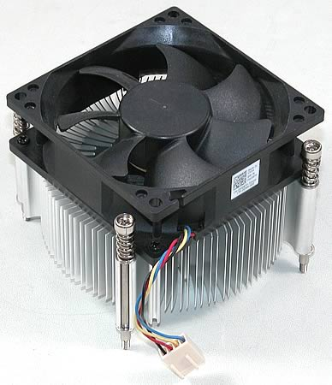
Why is power important?
Because power has a peak
All power “spent” is converted to heat
Must dissipate the heat
Need heat sinks and fans
What if fans not fast enough?
Chip powers off (if it’s smart enough)
Melts otherwise
Thermal failures even when fans OK
50% server reliability degradation for +10oC
50% decrease in hard disk lifetime for +15oC

Slide 15
Power
Dynamic power vs. Static power
Static: “leakage” power
Dynamic: “switching” power
Static power: steady, constant energy cost
Dynamic power: transitions from 0→1 and 1→0

Slide 16

Power: The Basics (1/2)
Dynamic Power
Related to switching activity of transistors (from 0→1 and 1→0)
Dynamic Power $∝CV_{dd}^{ 2}Af$
C: capacitance, function of transistor size and wire length
V_{dd}: Supply voltage
A: Activity factor (average fraction of transistors switching)
f: clock frequency
About 50-70% of processor power
Gate
Gate
Applied Voltage
+ + + + +
Current
Source
Drain
- - - - -
Current
Threshold Voltage
Source
Drain

Slide 17
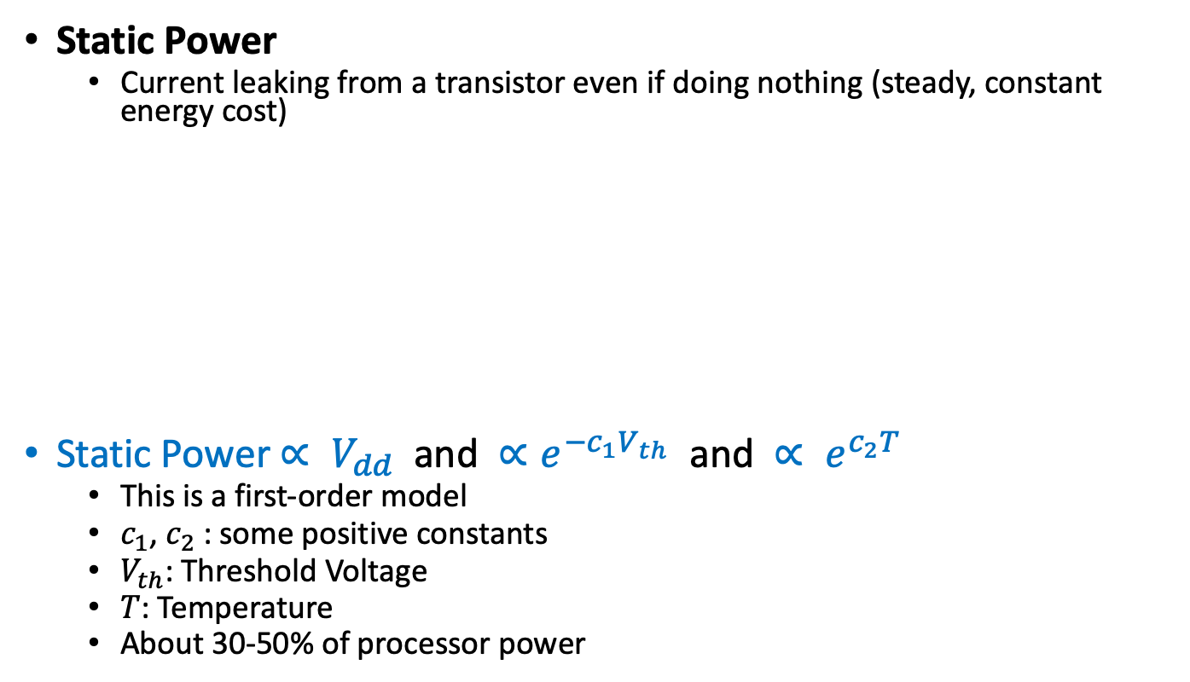
Power: The Basics (2/2)
Static Power
Current leaking from a transistor even if doing nothing (steady, constant energy cost)
Static Power $∝ V_{dd}$ and $∝e^{−c_{1}V_{th}}$ and $∝ e^{c_{2}T}$
This is a first-order model
$c_{1}$, $c_{2}$ : some positive constants
$V_{th}$: Threshold Voltage
$T$: Temperature
About 30-50% of processor power
Gate Leakage
Channel Leakage
Sub-threshold Conductance

Slide 18
Thermal Runaway
Leakage is an exponential function of temperature
⬆ Temp leads to ⬆ Leakage
Which burns more power
Which leads to ⬆ Temp, which leads to…
Positive feedback loop will melt your chip

Slide 19
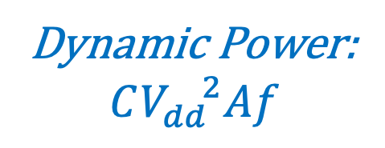
Why Power Became an Issue? (1/2)
Ideal scaling was great (aka Dennard scaling)
Every new semiconductor generation:
Transistor dimension: x 0.7
Transistor area: x 0.5
C and V_{dd}: x 0.7
Frequency: 1 / 0.7 = 1.4
Constant dynamic power density
In those good old days, leakage was not a big deal
Dynamic Power:
$$CV_{dd}^{ 2}Af$$
40% faster and 2x more transistors at same power

Slide 20
Why Power Became an Issue? (2/2)
Recent reality: V_{dd} does not decrease much
Switching speed is roughly proportional to V_{dd} - V_{th}
If too close to threshold voltage (V_{th}) → slow transistor
Fast transistor & low V_{dd} → low V_{th} → exponential leakage increase ✗
Dynamic power density keeps increasing
Leakage power has also become a big deal today
Due to lower Vth, smaller transistors, higher temperatures, etc.
Example: power consumption in Intel processors
Intel 80386 consumed ~ 2 W
3.3 GHz Intel Core i7 consumes ~ 130 W
Heat must be dissipated from 1.5 x 1.5 cm² chip
This is the limit of what can be cooled by air
Referred to as the Power Wall

Slide 21
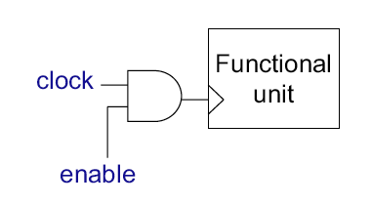
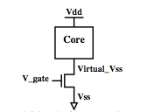
How to Reduce Power? (1/3)
Clock gating
Stop switching in unused components
Done automatically in most designs
Near instantaneous on/off behavior
Power gating
Turn off power to unused cores/caches
High latency for on/off
Saving SW state, flushing dirty cache lines, turning off clock tree
Carefully done to avoid voltage spikes or memory bottlenecks
Issue: Area & power consumption of power gate
Opportunity: use thermal headroom for other cores

Slide 22
How to Reduce Power? (2/3)
Reduce Voltage (V): quadratic effect on dyn. power
Negative (~linear) effect on frequency
Dynamic Voltage/Frequency Scaling (DVFS): set frequency to the lowest needed
Execution time = IC * CPI * f
Scale back V to lowest for that frequency
Lower voltage → slower transistors
Dyn. Power ≈ C * V² * F
Not Enough! Need Much More!

Slide 23
How to Reduce Power? (3/3)
Design for E & P efficiency rather than speed
New architectural designs:
Simplify the processor, shallow pipeline, less speculation
Efficient support for high concurrency (think GPUs)
Augment processing nodes with accelerators
New memory architectures and layouts
Data transfer minimization
…
New technologies:
Low supply voltage (V_{dd}) operation: Near-Threshold Voltage Computing
Non-volatile memory (Resistive memory, STTRAM, …)
3D die stacking
Efficient on-chip voltage conversion
Photonic interconnects
…

Slide 24
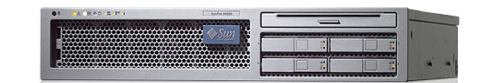
Processor Is Not Alone
SunFire T2000
< ¼ System Power
> ½ CPU Power
Need whole-system approaches to save energy

Slide 25
ISA: A contract between HW and SW
ISA: Instruction Set Architecture
A well-defined hardware/software interface
The “contract” between software and hardware
Functional definition of operations supported by hardware
Precise description of how to invoke all features
No guarantees regarding
How operations are implemented
Which operations are fast and which are slow (and when)
Which operations take more energy (and which take less)

Slide 26
Components of an ISA
Programmer-visible states
Program counter, general purpose registers, memory, control registers
Programmer-visible behaviors
What to do, when to do it
A binary encoding
if imem[rip]==“add rd, rs, rt”
then
rip ⇐ rip+1
gpr[rd]=gpr[rs]+grp[rt]
Example “register-transfer-level” description of an instruction
ISAs last forever, don’t add stuff you don’t need

Slide 27
RISC vs. CISC
Recall Iron Law:
(instructions/program) * (cycles/instruction) * (seconds/cycle)
CISC (Complex Instruction Set Computing)
Improve “instructions/program” with “complex” instructions
Easy for assembly-level programmers, good code density
RISC (Reduced Instruction Set Computing)
Improve “cycles/instruction” with many single-cycle instructions
Increases “instruction/program”, but hopefully not as much
Help from smart compiler
Perhaps improve clock cycle time (seconds/cycle)
via aggressive implementation allowed by simpler instructions
Today’s x86 chips translate CISC into ~RISC

Slide 28
Prototypical Processor Organization
Addr-gen.
Fetch
Decode
Issue
Execute
Memory
(Write-back)
+4
Instruction
Access
Register
File
Data
Access
PC
ALU

