Slide 1
CSE 502:
Computer Architecture
Memory Hierarchy & Caches

Slide 2
Motivation
Processor
Memory
Want memory to appear:
  As fast as CPU
  As large as required by all of the running applications

Slide 3
Storage Hierarchy
Make common case fast:
  Common: temporal & spatial locality
  Fast: smaller more expensive memory
Registers
Caches (SRAM)
Memory (DRAM)
[SSD? (Flash)]
Disk (Magnetic Media)
Controlled by Hardware
Bigger Transfers
Larger
Cheaper
More Bandwidth
Faster
Controlled by Software (OS)
  What is S(tatic)RAM vs D(dynamic)RAM?

Slide 4
Caches
An automatically managed hierarchy
Break memory into blocks (several bytes)
and transfer data to/from cache in blocks
  spatial locality
Keep recently accessed blocks
  temporal locality
Core
$
Memory

Slide 5
Cache Terminology
block (cache line): minimum unit that may be cached
frame: cache storage location to hold one block
hit: block is found in the cache
miss: block is not found in the cache
miss ratio: fraction of references that miss
hit time: time to access the cache
miss penalty: time to replace block on a miss

Slide 6
Cache Example
Address sequence from core:
(assume 8-byte lines)
Core
0x10000
Miss
0x10000 (…data…)
0x10004
Hit
0x10008 (…data…)
0x10120
Miss
Miss
0x10120 (…data…)
0x10008
0x10124
Hit
0x10004
Hit
Memory
  Final miss ratio is 50%

Slide 7
Average Memory Access Time (1/2)
Very powerful tool to estimate performance
If …
cache hit is 10 cycles (core to L1 and back)
memory access is 100 cycles (core to mem and back)
Then …
at 50% miss ratio, avg. access: 0.5×10+0.5×100 = 55
at 10% miss ratio, avg. access: 0.9×10+0.1×100 = 19
at 1% miss ratio, avg. access: 0.99×10+0.01×100 ≈ 11

Slide 8
Average Memory Access Time (2/2)
Generalizes nicely to any-depth hierarchy
If …
L1 cache hit is 5 cycles (core to L1 and back)
L2 cache hit is 20 cycles (core to L2 and back)
memory access is 100 cycles (core to mem and back)
Then …
at 20% miss ratio in L1 and 40% miss ratio in L2 …
avg. access: 0.8×5+0.2×(0.6×20+0.4×100) ≈ 14

Slide 9
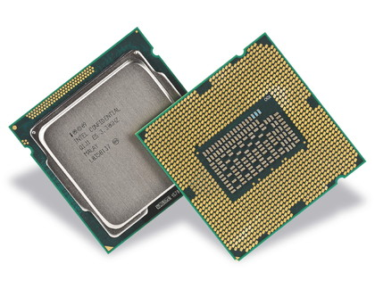
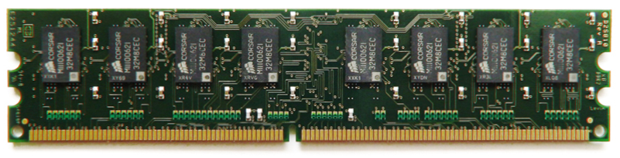
Memory Organization (1/3)
Processor
Registers
I-TLB
L1 I-Cache
L1 D-Cache
D-TLB
L2 Cache
L3 Cache (LLC)
Main Memory (DRAM)
  L1 is split, L2 (here) and LLC unified

Slide 10
Memory Organization (2/3)
L1 and L2 are private
L3 is shared
Processor
Core 0
Core 1
Registers
Registers
I-TLB
L1 I-Cache
L1 D-Cache
D-TLB
I-TLB
L1 I-Cache
L1 D-Cache
D-TLB
L2 Cache
L2 Cache
L3 Cache (LLC)
Main Memory (DRAM)
  Multi-core replicates the top of the hierarchy

Slide 11
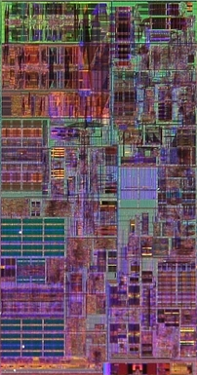
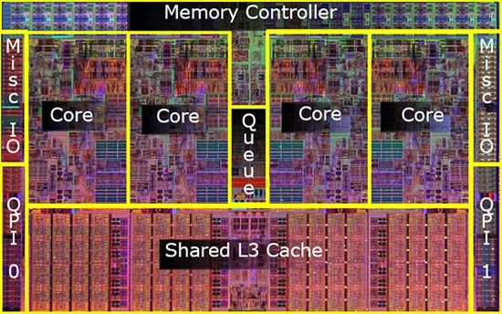
Memory Organization (3/3)
32K
L1-D
Intel Nehalem
(3.3GHz, 4 cores, 2 threads per core)
256K
L2
32K
L1-I

Slide 12
SRAM Overview
1
1
0
1
0
1
“6T SRAM” cell
2 access gates
2T per inverter
b
b
Chained inverters maintain a stable state
Access gates provide access to the cell
Writing to cell involves over-powering storage inverters
Notes:
Should definitely be review for the ECE crowd.

Slide 13
8-bit SRAM Array
wordline
bitlines

Slide 14
8×8-bit SRAM Array
wordlines
bitlines

Slide 15
Fully-Associative Cache
Keep blocks in cache frames
  data
  state (e.g., valid)
  address tag
63
address
0
tag[63:6] | block offset[5:0]
state
tag
=
data
state
tag
=
data
state
tag
=
data
state
tag
=
data
multiplexor
hit?
  What happens when the cache runs out of space?

Slide 16
The 3 C’s of Cache Misses
Compulsory: Never accessed before
Capacity: Accessed long ago and already replaced
Conflict: Neither compulsory nor capacity (later today)
Coherence: (To appear in multi-core lecture)

Slide 17
Cache Size
Cache size is data capacity (don’t count tag and state)
  Bigger can exploit temporal locality better
  Not always better
Too large a cache
  Smaller is faster → bigger is slower
  Access time may hurt critical path
Too small a cache
  Limited temporal locality
  Useful data constantly replaced
hit rate
working set
size
capacity

Slide 18
Block Size
Block size is the data that is
  Associated with an address tag
  Not necessarily the unit of transfer between hierarchies
Too small a block
  Don’t exploit spatial locality well
  Excessive tag overhead
Too large a block
  Useless data transferred
  Too few total blocks
    Useful data frequently replaced
hit rate
block size

Slide 19
8×8-bit SRAM Array
wordline
1-of-8 decoder
bitlines

Slide 20
64×1-bit SRAM Array
wordline
1-of-8 decoder
bitlines
column
mux
1-of-8 decoder

Slide 21
Direct-Mapped Cache
Use middle bits as index
Only one tag comparison
tag[63:16] | index[15:6] | block offset[5:0]
data
state
tag
data
state
tag
data
state
tag
decoder
data
state
tag
multiplexor
tag match
(hit?)
=
  Why take index bits out of the middle?

Slide 22
Cache Conflicts
What if two blocks alias on a frame?
  Same index, but different tags
  Address sequence:
  0xDEADBEEF 11011110101011011011111011101111
  0xFEEDBEEF 11111110111011011011111011101111
  0xDEADBEEF 11011110101011011011111011101111
0xDEADBEEF experiences a Conflict miss
  Not Compulsory (seen it before)
  Not Capacity (lots of other indexes available in cache)
tag
index
block offset

Slide 23
Associativity (1/2)
Where does block index 12 (b’1100) go?
Block
Set/Block
Set
0
0
0
1
0
1
1
2
0
2
3
1
1
3
4
0
4
5
2
1
5
6
0
6
7
3
1
7
Fully-associative
block goes in any frame
(all frames in 1 set)
Set-associative
block goes in any frame in one set
(frames grouped in sets)
Direct-mapped
block goes in exactly one frame
(1 frame per set)

Slide 24
Associativity (2/2)
Larger associativity
  lower miss rate (fewer conflicts)
  higher power consumption
Smaller associativity
  lower cost
  faster hit time
hit rate
~5
for L1-D
associativity

Slide 25
N-Way Set-Associative Cache
tag[63:15] | index[14:6] | block offset[5:0]
way
data
state
tag
data
state
tag
set
data
state
tag
data
state
tag
data
state
tag
data
state
tag
decoder
decoder
data
state
tag
data
state
tag
multiplexor
multiplexor
=
=
multiplexor
hit?
  Note the additional bit(s) moved from index to tag

Slide 26
Associative Block Replacement
Which block in a set to replace on a miss?
Ideal replacement (Belady’s Algorithm)
  Replace block accessed farthest in the future
  Trick question: How do you implement it?
Least Recently Used (LRU)
  Optimized for temporal locality (expensive for >2-way)
Not Most Recently Used (NMRU)
  Track MRU, random select among the rest
Random
  Nearly as good as LRU, sometimes better (when?)
Pseudo-LRU
  Used in caches with high associativity
  Examples: Tree-PLRU, Bit-PLRU

Slide 27
Victim Cache (1/2)
Associativity is expensive
  Performance from extra muxes
  Power from reading and checking more tags and data
Conflicts are expensive
  Performance from extra mises
Observation: Conflicts don’t occur in all sets

Slide 28
Victim Cache (2/2)
Access
Sequence:
4-way Set-Associative
L1 Cache
4-way Set-Associative
L1 Cache
+
Fully-Associative
Victim Cache
B
C
C
A
E
D
A
E
B
A
C
B
D
D
A
B
C
C
A
B
C
D
E
J
K
L
M
A
L
B
N
X
Y
Z
X
Y
Z
J
J
N
K
L
M
J
N
K
J
L
K
M
C
M
J
K
L
L
K
P
Q
R
P
Q
R
L
D
Every access is a miss!
ABCDE and JKLMN
do not “fit” in a 4-way
set associative cache
Victim cache provides
a “fifth way” so long as
only four sets overflow
into it at the same time
M
Can even provide 6th
or 7th … ways
  Provide “extra” associativity, but not for all sets
Notes:
Typically need some sort of “cast out” buffer for evictees anyway… a dirty line in a writeback cache needs to be written back to the next-level cache, and this might not be able to happen right away (e.g., bus busy, next-level cache busy, etc.). Victim cache and writeback buffer can be combined into one structure.

Slide 29
Parallel vs Serial Caches
Tag and Data usually separate (tag is smaller & faster)
  State bits stored along with tags
    Valid bit, “LRU” bit(s), …
Parallel access to Tag and Data
reduces latency (good for L1)
Serial access to Tag and Data
reduces power (good for L2+)
enable
=
=
=
=
=
=
=
=
valid?
valid?
hit?
data
hit?
data

Slide 30
Way-Prediction and Partial Tagging
Sometimes even parallel tag and data is too slow
  Usually happens in high-associativity L1 caches
If you can’t wait… guess
Way Prediction
Guess based on history, PC, etc…
Partial Tagging
Use part of tag to pre-select mux
prediction
=
=
=
=
=
=
=
=
valid?
valid?
=
=
=
=
=
0
=0
hit?
correct?
data
hit?
correct?
data
  Guess and verify, extra cycle(s) if not correct

Slide 31
Physically-Indexed Caches
8KB pages & 512 cache sets
  13-bit page offset
  9-bit cache index
Core requests are VAs
Cache index is PA[14:6]
  PA[12:6] == VA[12:6]
  VA passes through TLB
  D-TLB on critical path
  PA[14:13] from TLB
Cache tag is PA[63:15]
If index size < page size
  Can use VA for index
tag[63:15] | index[14:6] | block offset[5:0]
virtual page[63:13] | page offset[12:0]
Virtual Address
D-TLB
/ physical index[6:0]
(lower-bits of index from VA)
physical
index[8:0]
/
/
physical
index[8:7]
(lower-bit of physical page number)
/
physical tag
(higher-bits of physical page number)
=
=
=
=
  Simple, but slow. Can we do better?

Slide 32
Virtually-Indexed Caches
Core requests are VAs
Cache index is VA[14:6]
Cache tag is PA[63:13]
  Why not PA[63:15]?
Why not tag with VA?
  VA does not uniquely identify memory location
  Cache flush on ctxt switch
tag[63:15] | index[14:6] | block offset[5:0]
virtual page[63:13] | page offset[12:0]
/ virtual index[8:0]
Virtual Address
D-TLB
/
physical tag
=
=
=
=

Slide 33
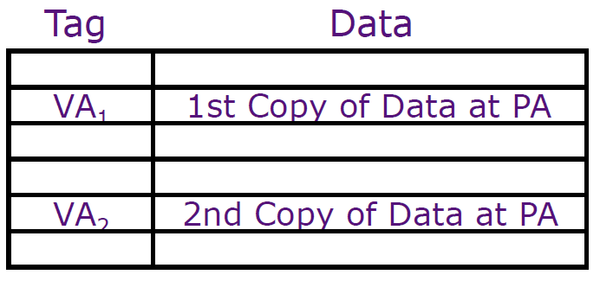
Virtually-Indexed Caches
Main problem: Virtual aliases
  Different virtual addresses for the same physical location
  Different virtual addrs → map to different sets in the cache
Solution: ensure they don’t exist by invalidating all aliases when a miss happens
  If page offset is p bits, block offset is b bits and index is m bits, an alias might exist in any of 2^{m-(p-b)} sets.
  Search all those sets and remove aliases (alias = same physical tag)
tag | m | b
page number | p
p - b
Same in VA₁ and VA₂
m - (p - b)
Different in VA₁ and VA₂
  Fast, but complicated

Slide 34
Multiple Accesses per Cycle
Need high-bandwidth access to caches
  Core can make multiple access requests per cycle
  Multiple cores can access LLC at the same time
Must either delay some requests, or…
  Design SRAM with multiple ports
    Big and power-hungry
  Split SRAM into multiple banks
    Can result in delays, but usually not

Slide 35
Multi-Ported SRAMs
Wordline₂
Wordline₁
b₂
b₁
b₁
b₂
Wordlines = 1 per port
Bitlines = 2 per port
Area = O(ports²)
Notes:
Lots of other techniques *not* discussed here such as sub-banking, hierarchical wordlines/bitlines, etc.

Slide 36
Multi-Porting vs Banking
Decoder
Decoder
Decoder
Decoder
SRAM
Array
Decoder
SRAM
Array
Decoder
SRAM
Array
S
S
Decoder
SRAM
Array
Decoder
SRAM
Array
Sense
Sense
Sense
Sense
Column
Muxing
S
S
4 ports
Big (and slow)
Guarantees concurrent access
4 banks, 1 port each
Each bank small (and fast)
Conflicts (delays) possible
  How to decide which bank to go to?

Slide 37
Bank Conflicts
Banks are address interleaved
  For block size b cache with N banks…
  Bank = (Address / b) % N
    Looks more complicated than is: just low-order bits of index
  Modern processors perform hashed cache indexing
    May randomize bank and index
Banking can provide high bandwidth
  But only if all accesses are to different banks
  For 4 banks, 2 accesses, chance of conflict is 25%
tag | index | offset
no banking
tag | index | bank | offset
w/ banking

Slide 38
Write Policies
Writes are more interesting
  On reads, tag and data can be accessed in parallel
  On writes, needs two steps
  Is access time important for writes?
Choices of Write Policies
  On write hits, update memory?
    Yes: write-through (higher bandwidth)
    No: write-back (uses Dirty bits to identify blocks to write back)
  On write misses, allocate a cache block frame?
    Yes: write-allocate
    No: no-write-allocate

Slide 39
Inclusion
Core often accesses blocks not present on chip
  Should block be allocated in L3, L2, and L1?
    Called Inclusive caches
    Waste of space
    Requires forced evict (e.g., force evict from L1 on evict from L2+)
  Only allocate blocks in L1
    Called Non-inclusive caches (why not “exclusive”?)
    Must write back clean lines
Some processors combine both
  L3 is inclusive of L1 and L2
  L2 is non-inclusive of L1 (like a large victim cache)

Slide 40
Parity & ECC
Cosmic radiation can strike at any time
  Especially at high altitude
  Or during solar flares
What can be done?
  Parity
    1 bit to indicate if sum is odd/even (detects single-bit errors)
  Error Correcting Codes (ECC)
    8 bit code per 64-bit word
    Generally SECDED (Single-Error-Correct, Double-Error-Detect)
Detecting errors on clean cache lines is harmless
  Pretend it’s a cache miss and go to memory
0 1
0 1
1 0
0 1
1 0
0 1
1 0
0 1
0 1

