Slide 1
Flight Price Prediction Using Streamlit
Group: Aakash Singhal
NU ID : 002761944

Slide 2
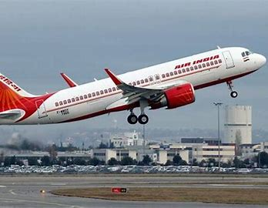
Basic Idea:
Problem: Predicting Flight Price from Labelled Dataset available in csv format.
Objective: To develop Machine Learning Model that would predict based on input features
Approach: Data Preprocessing, Exploratory Data Analysis, Feature Engineering, Running ML models
Notes:
Meagan
Today, we're tackling the challenge of condensing lengthy podcasts into digestible summaries.
Podcasts offer valuable insights, but their length can be overwhelming for listeners seeking concise information.
Our objective is to streamline the podcast consumption experience by automating the summarization process.
Our goal is to automate the summarization of podcasts, making it easier for listeners to access key information without listening to the entire episode.
By generating highlights from podcasts, we aim to provide listeners with a quick overview of the episode's main points and topics.
Automating this process saves time for listeners and helps them discover relevant content more efficiently.
We start by transcribing audio podcasts into text transcripts using automatic speech recognition (ASR) technology.
TF-IDF helps us identify significant words and phrases in the text
By combining transcription with NLP techniques, we can efficiently summarize podcasts and generate highlights that capture the essence of the episodes.

Slide 3


Data Preprocessing and Cleaning:
Download the Dataset:
Getting to know the data. Its type, input features depending on categorical or numerical,
Processing the data:
Processing data into required format for running models. Such as number of stops and the time format.
The duration of flight is expressed in Hours and Minutes. Converting the data to minutes to make interpretable for the model
.
BEFORE
AFTER
Notes:
Meagan
Data Loading: We start by loading the podcast datasets ('final_df_raw.csv') using Pandas.
Audio Data Download: Utilizing download_audio function, we fetch audio content from specific URLs, handling any download errors gracefully.
Text Tokenization: Textual preprocessing is performed using NLTK. The tokenize_text function tokenizes, removes punctuation, stopwords, and applies stemming.
Tokenization Process: We iterate through each transcript in the dataset, tokenize it, and append the tokens to a list.
Integration with Dataset: Tokenized transcripts are added back to the original dataset under 'tokenized_transcript' column.
Dataset Saving: The updated dataset, now containing tokenized transcripts, is saved to 'all_podcast_with_tokens.csv'.
Quick note on challenges:
There were some challenges faced with preprocessing in specific removing the time stamps from the podcasts data. Since most of the time stamps were set up in a different orientation within each section of the podcasts and there was a stamp every minute or so the removal process for all time stamps posed a challenge. Most were removed using code specifications on the formatting but some still remained.
Ideally all time stamps being removed would be best but with the short project window the removal was not ideal.

Slide 4
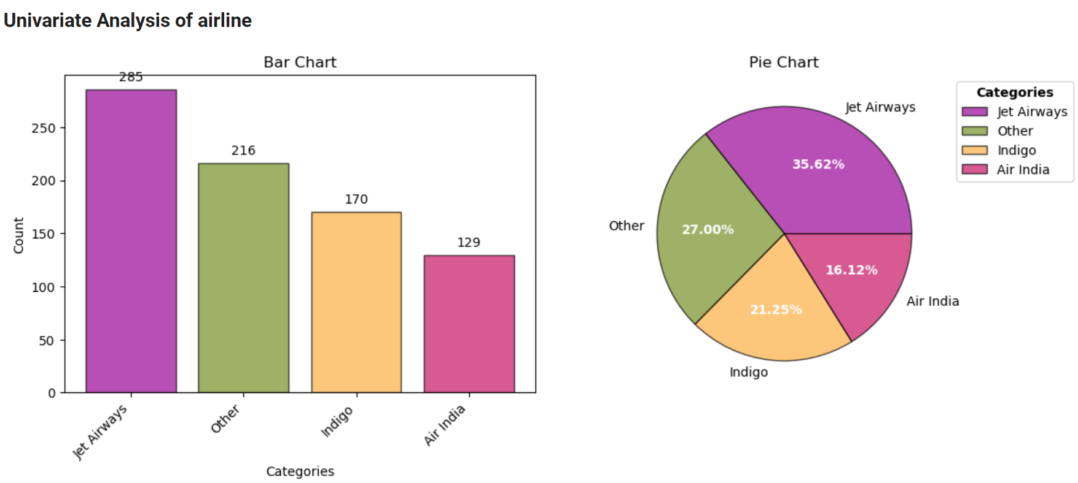
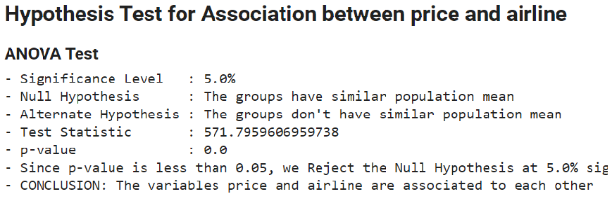
EDA (Exploratory Data Analysis)
Creating the helper function to analyze the peatures such as univariate analyses, bivariate analysis, Histogram to check the frequency of airline. Here the airlines having less frequency is grouped in other to ease the computation
Bivariate Analysis to check how the two input features are related to each other whether linearly positive or negative
Ran hypothesis testing to get the result. Performed ANOVA and Kruskal –Wallis Test to check how the association of airline and the target price
Performed various Multivariate plots and analysis to check how more than two input features behaves with respect to target and with each other
Notes:
Marin

Slide 5
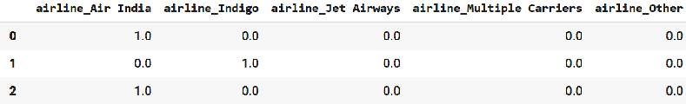
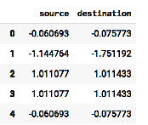
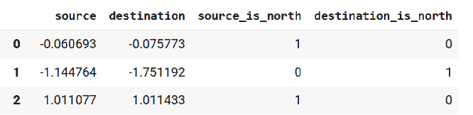
Feature Engineering
This steps involves manipulating with the features to get the good features so that we could run the models easily.It involves the encoding of the categorical variables
The first was done on airline . Performed one hot encoding and those having less frequency is paired in other category.
For the source and destination the encoding is done as mean encoder and then applied the Power Transformer to obtain gaussian distribution.
The cities where the flight is divided into north and south zone to check whether flight is moving within northern region or from northern to southern.
Notes:
Marin

Slide 6
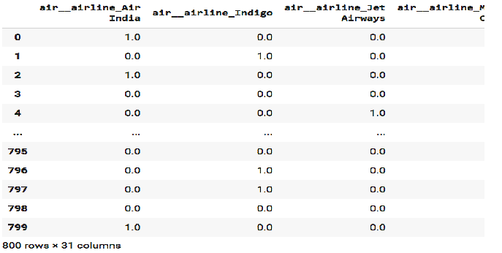
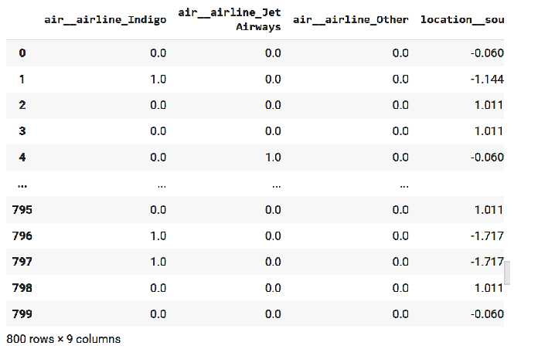
Total Feature engineering has been done . Post that total 31 columns has been made.
Post that the random regressor is been implied as it works feature filtering technique. Post applying the Random Forest Regressor the size of the column was reduced from 31 to 9.
Shown below is the illustration as how I would be running my ML models on these datasets.
BEFORE
AFTER
Notes:
Marin

Slide 7
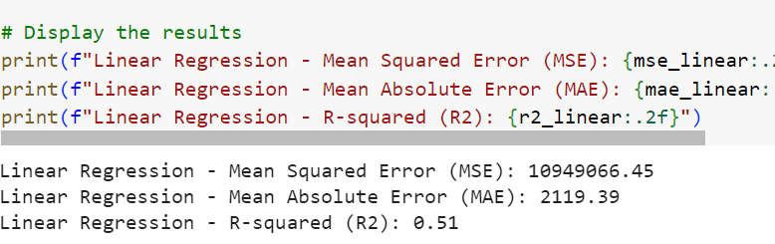
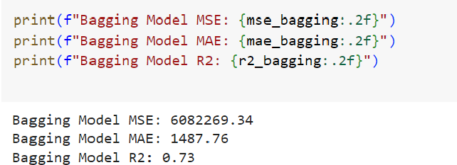
Training
Post Feature Engineering on the dataset to apply ML models.
Firstly I have applied the Linear Regression on the dataset. Library are used from sklearn. The loss functions considered are MSE(Mean Squared Error),MAE(Mean Absolute Error) and the R2 score.
SECONDLY I have applied the Bagging ensemble learning with decision as base estimator.
Notes:
Parth

Slide 8
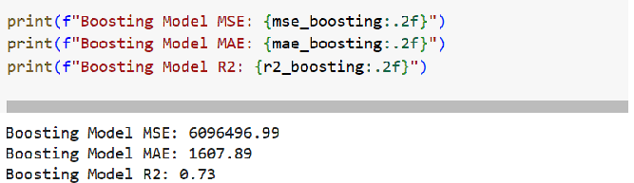
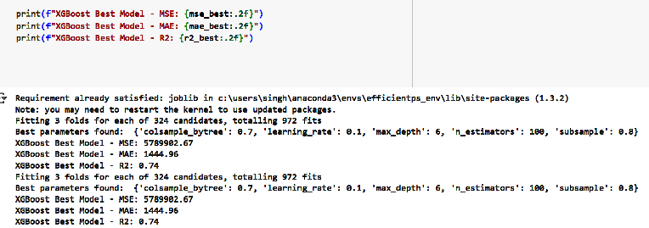
Boosting : I have boosting algorithms in which there will be many models in sequential manner. One model will improve after learning from mistakes from its previous models.
XGBoost: This is the Extreme gradient boost algorithms which is much faster and efficient as it involves parallel operations. They handle missing values too. Following below is the result for the Xgboost. I have applied the grid search to check as which hyperparameter will give the best result.
Notes:
Parth

Slide 9
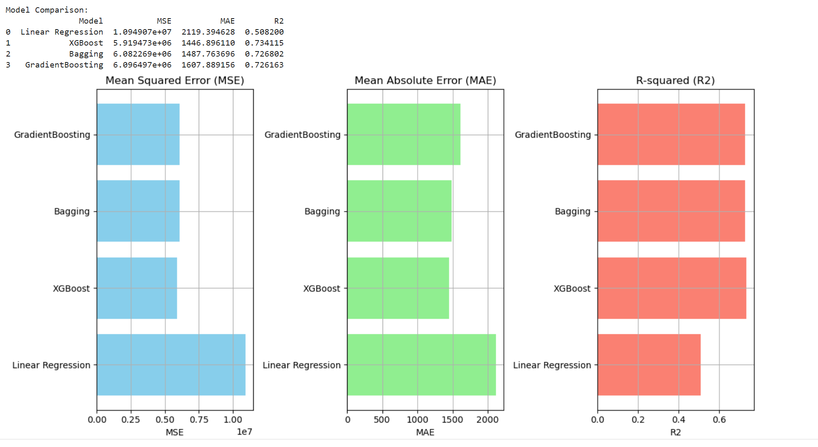
Summary
The post application of all the ML models. The models been compared as which performs the best giving the best result.
The model has been deployed on Streamlit app in local server which gives us the prediction of the pricing.
As mentioned in the below result XGBoost performs the best result with the R2 score of 0.74.
Notes:
Aakash

