Slide 1
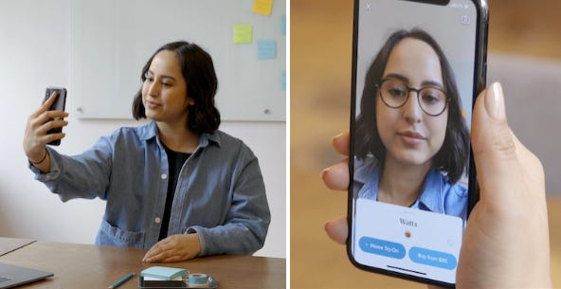
VAST
Virtual AI smart Try on

Slide 2
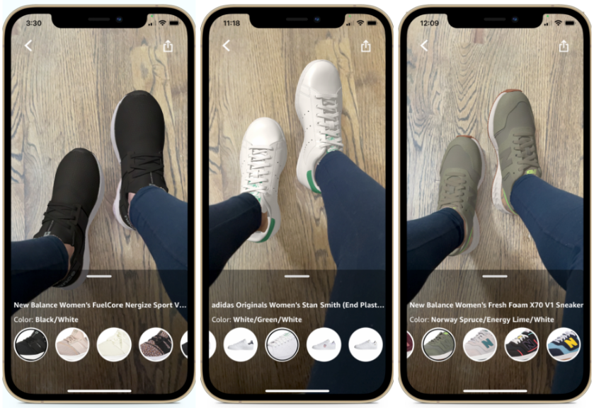

Introduction
We propose to develop a smart adaptation system that uses artificial intelligence (AI) and
augmented reality (AR) to help people try on different items of clothing, jewelry , Glasses,
and accessories and so on virtually. Our app will allow users to see how they would
look in different items without having to leave their home or try on dozens of items at a store.
2

Slide 3
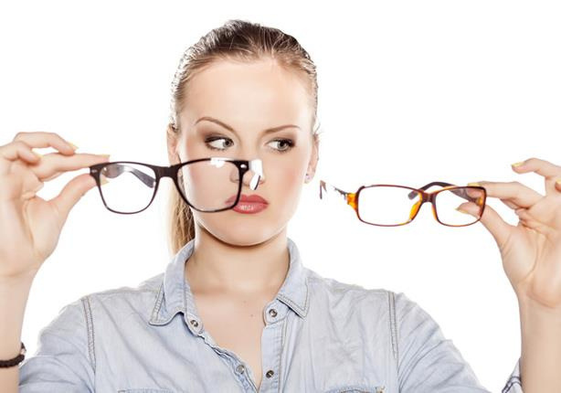
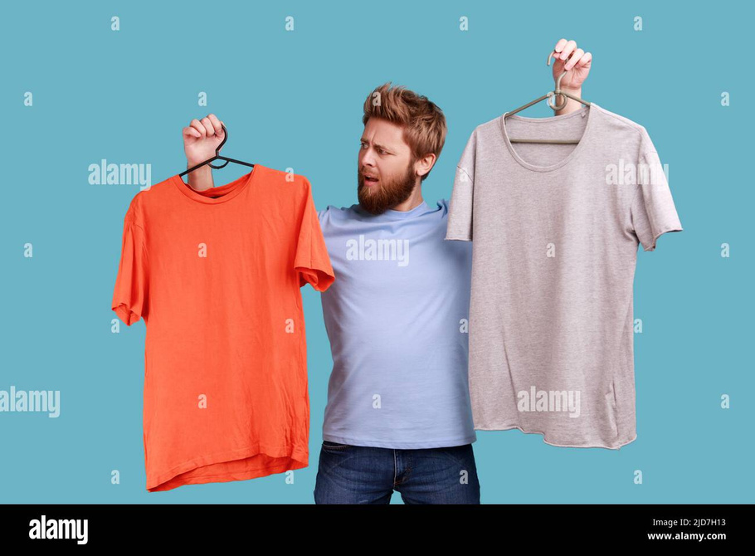
PROBLEM
Finding the perfect wearable items can be a time-consuming and frustrating process. It can be difficult to find the right size, style, and fit, especially without trying the items on.

Slide 4

Solution
Our app will solve this problem by allowing users to virtually try on different wearable items before they buy them. Users will be able to see how the items look on their bodies from all angles, and they will be able to try on different colors and styles to find the perfect match. This will save users time and money, and it will help them to find wearable items that they love.
We will first apply our smart adaptation system using AI and AR to glasses. We believe that glasses are the ideal first product category for our solution because they are relatively simple to model and render in AR. Additionally, glasses are a high-volume product category with a large potential customer base.
With our App, you can do just that! Using artificial intelligence (AI) and augmented reality (AR), our app allows you to see how you would look in different pairs of glasses, simply by pointing your phone at your face.
No more trying on dozens of pairs of glasses at the store, only to find that none of them look good on you.
With our app, you can try on as many pairs as you want, in the comfort of your own home. And because our app uses AR, you can see how the glasses would look in different lighting conditions and from different angles.
Once we have successfully developed and launched our AI-powered AR glasses try-on app, we will expand the solution to other wearable items, such as clothing, jewelry, and accessories.
4

Slide 5
Benefits
Accessibility
Reduced returns
Convenience
Personalization
Our app saves customers Time and effort by allowing them to try on
glasses from anywhere, anytime.
Our app makes it possible for people to try on glasses
from anywhere in Egypt, including rural areas were
there may not be an eyewear store nearby.
Our app can help customers find the perfect pair of glasses for
their face shape and style
Our app can help to reduce the number of returns that eyewear stores receive by allowing
customers to try on glasses virtually before they buy them. This can save stores money and improve the customer experience.

Slide 6
Business Model Canvas
Key Partners
Key Activities
Value Proposition
Customer Relationship
Customer Segment
Informative
Content :Offers
3. Social Proof: Showcase positive customer reviews and testimonials on our app store listing or social media
4. Multiple Payment Options
5. Order Tracking and Customer Support
1.App Development
2.Markiting
3. Customer Support
4.
1.Saves Customers Time and efforts
2. Improved decision-making
3. Enhanced accessibility
1. Eyewear Retailers
2. shipping companies
3. Fashion Influencers
people who are
interested in
wearables items
Key Resources
Channels
1.Mobile App
2. Social media
3. Collaborations: Partner with eyewear retailers or influencers
Social Media Platforms
Items Data
Development Tools
Cost Structure
Revenue Streams
1. Stores Ads
2. Ads
3. Subscription fees
1.Development Costs
2. Customer Support
Designs
Marketing
Data Storage
Notes:
6

Slide 7

Competitors
There are currently no Virtual Ai smart try
on apps available in Egypt
Global Competitors
3DLook
Eyecatcher
Visage Tech
Modiface
PerfectCorp
Virtualitics
Amazon AR
Nike Virtual View
Snapchat AR Lens

Slide 8

Expected result
Accurate glasses placement: The virtual try-on feature should accurately place the glasses frames on the user's face, taking into account facial landmarks and features.
Realistic rendering: The glass frames should be rendered realistically, considering lighting conditions, reflections, and shadows.
Real-time performance: The virtual try-on feature should provide real-time feedback, allowing users to interact with the glasses frames seamlessly.

Slide 9
Tools
Programming Environment: A suitable programming environment like Visual Studio Code
Computer Vision Libraries: Libraries like OpenCV and Mediapipe for facial landmark detection, object tracking, and image processing tasks.
UX/UI Design Tools: Figma, Sketch, or Adobe XD for prototyping and designing the user interface
Asp.net core web Api
Entity framework
SQL server
postman

Slide 10
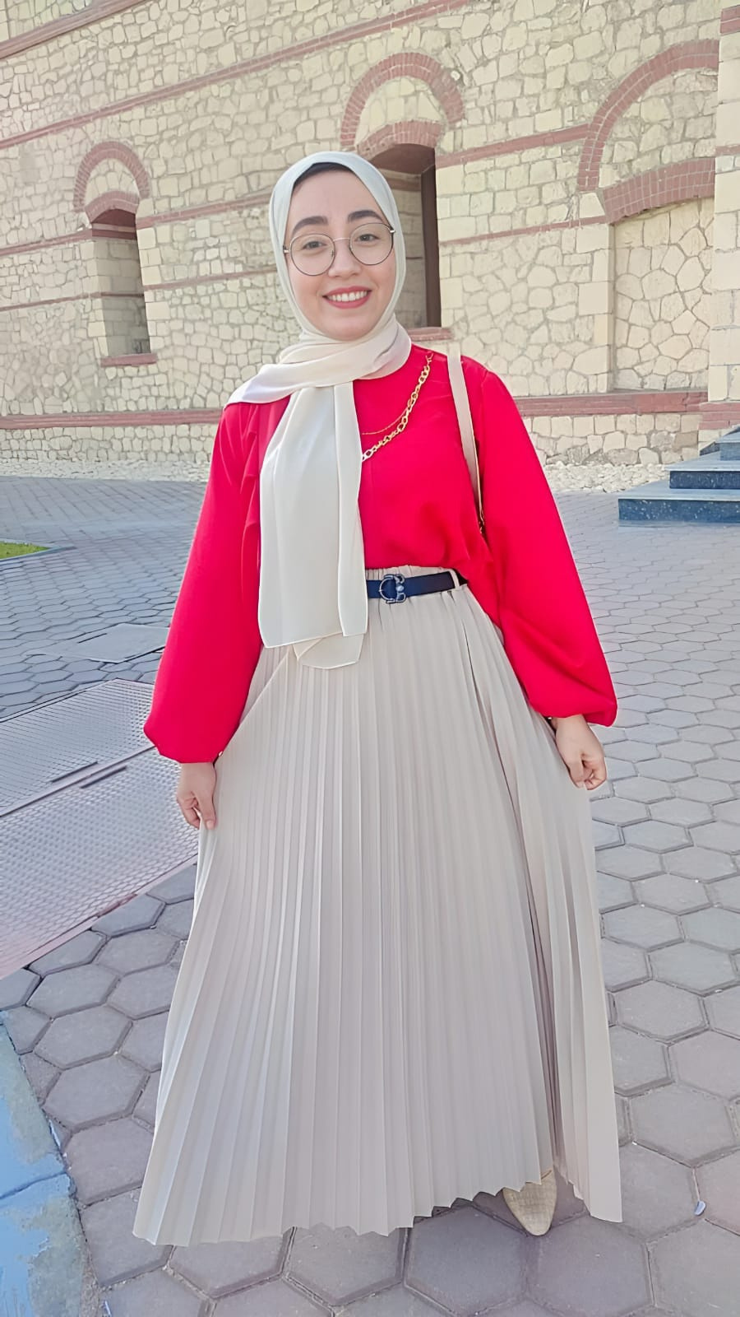
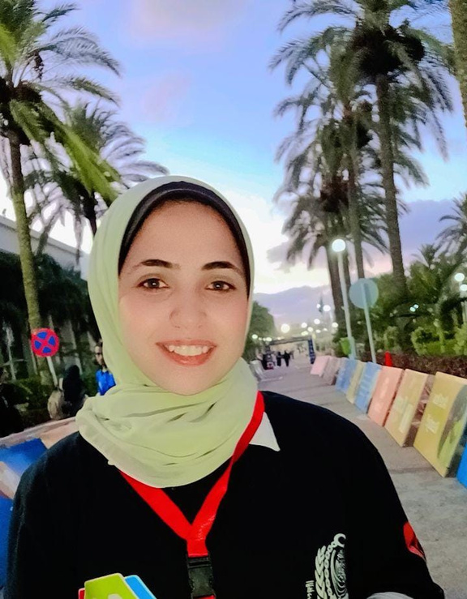
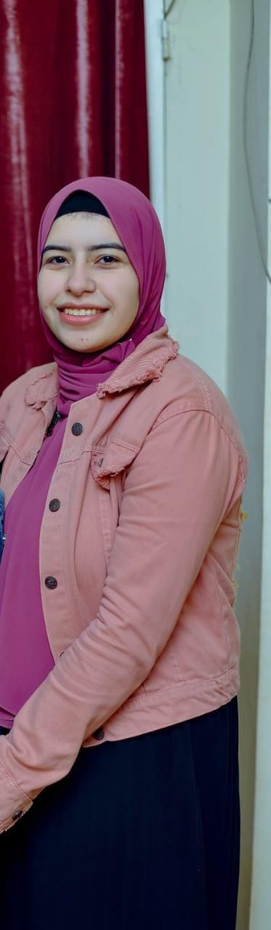


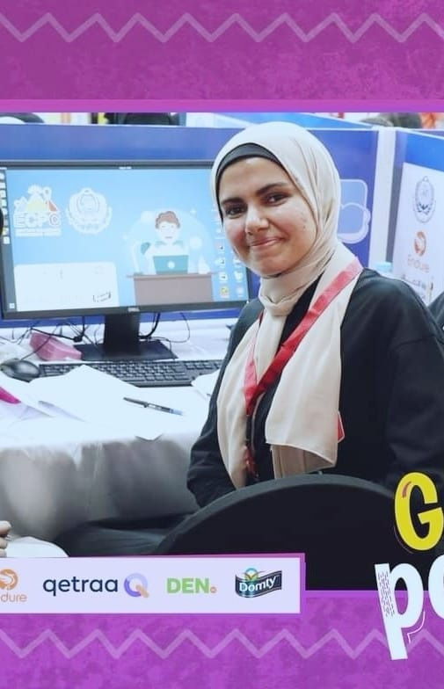
Our Team
SHROUK ADEL
ESRAA ABDELALIM
REHAM ABDELHAMEED
ALAA SAIED
KARIMA MAHER
AYA AHMED
ML Engineer
ML Engineer
Android developer
Android developer
Backend developer
Backend developer

Slide 11
Thank you

