Slide 1
CSYE 7230 Software Engineering
Abdulkareem Alali

Slide 2
Syllabus and Plan
aalali.github.io/sef24-csye7230

Slide 3
Software Engineering
We know that computers and software automate many tasks
Hardware quality is important?
What about Software Quality?
“Software entities are more complex for their size than perhaps any other human construct because no two parts are alike (at least above the statement level).
If they are, we make the two similar parts into a subroutine — open or closed. In this respect, software systems differ profoundly from computers, buildings, or automobiles, where repeated elements abound.”
(No Silver Bullet, Brooks 1995, p 82) . (read the paper)
Notes:
If we would treat constructing software (writing code) as we would constructing a building, we would have a quality software .. AA

Slide 4
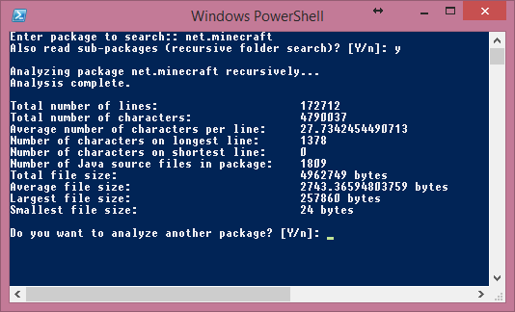
Large Software?
How many lines of code was used to make Minecraft?
By putting the 1.9.4 (2016) source through the java decompiler, recursively count the lines, decompiled jar yields 603,343 LOC .
Minecraft Forge Decompile 1.7.5 (2014) there is 172,712 lines, no comments .
Video game Doom, Quake?
Doom 3 has 601k, Quake III has 229k and Quake II has 136k .
.

Slide 5
Large Software?
How many lines of code are in Android, Windows, Firefox, Chrome?
Windows 3.1 ∼ 3 million lines of code
Google Chrome has about ∼ 5 million LOC
Firefox ∼ 10 MLOC
Android ∼ 12 MLOC
Windows 7 ∼ 40 MLOC, a little less than Windows XP and ∼10 MLOC less than Windows Vista .
Windows 10 ∼ 50–60 MLOC .
Windows 11 ∼ 60–100 MLOC .

Slide 6
Large Software?
IEEE Spectrum article by Robert Charette entitled: “This Car Runs on Code,” 2009:
First car to incorporate embedded software was the 1977 General Motors Oldsmobile Toronado which had an electronic control unit (ECU) that managed electronic spark timing .
By 1981, GM had deployed about 50,000 lines of engine control software code. Others soon followed the trend.
Volt has ~ 10 million lines of code
New Mercedes-Benz E-Class has more LOC than an Airbus A380 .
A modern high-end car features around 100 million lines of code, and this number is planned to grow to 200-300 millions in the near future .

Slide 7
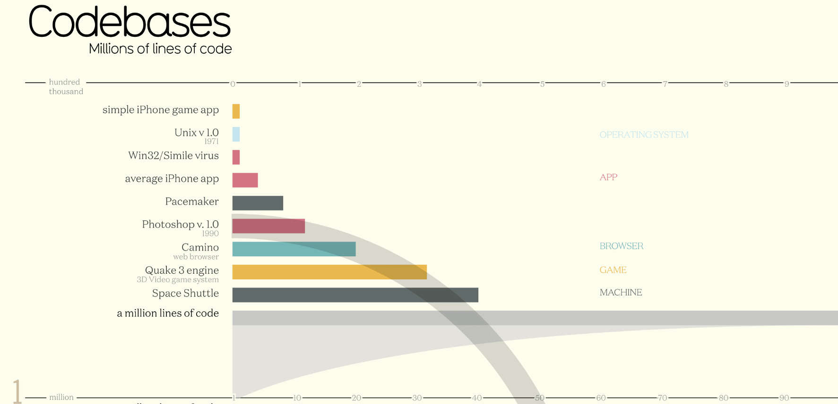
.

Slide 8
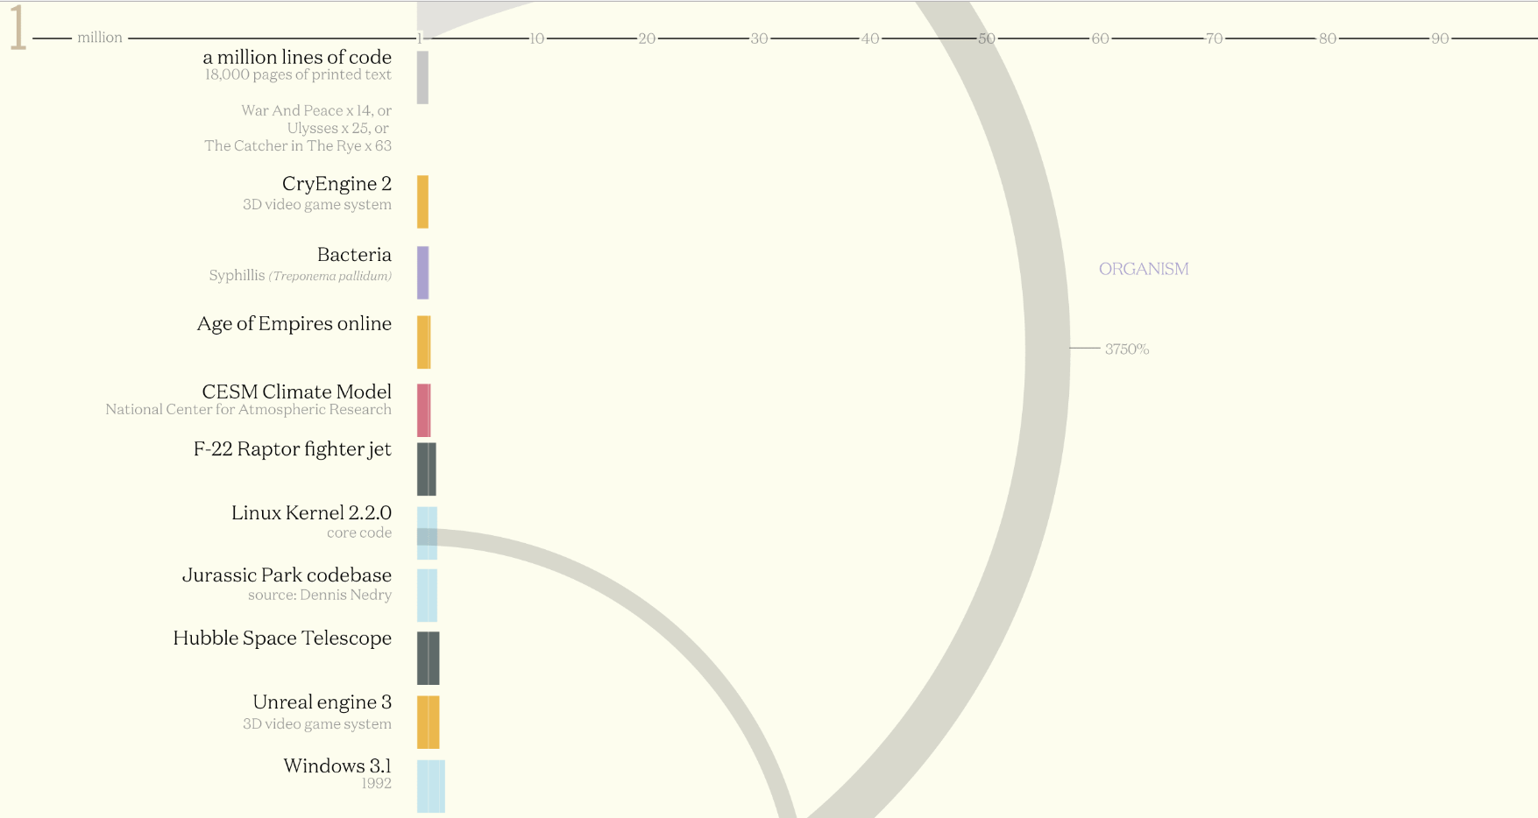
.
.

Slide 9
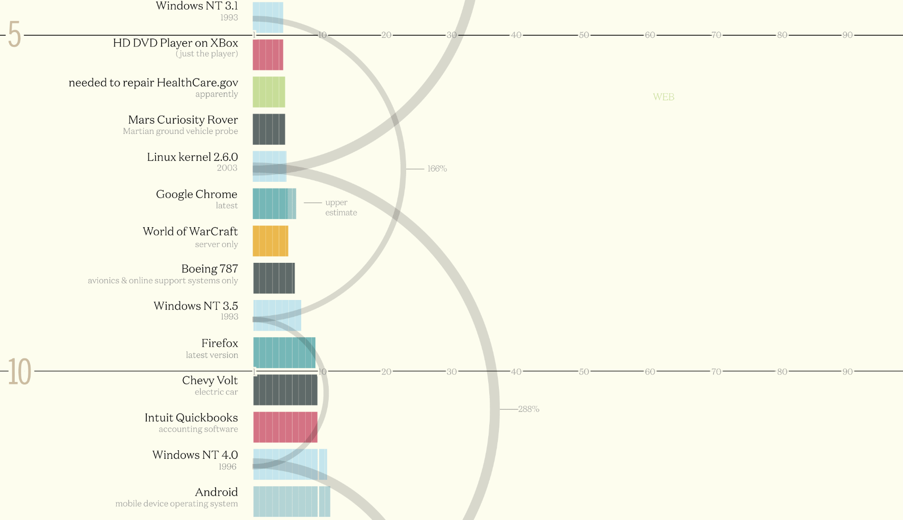
.
.

Slide 10
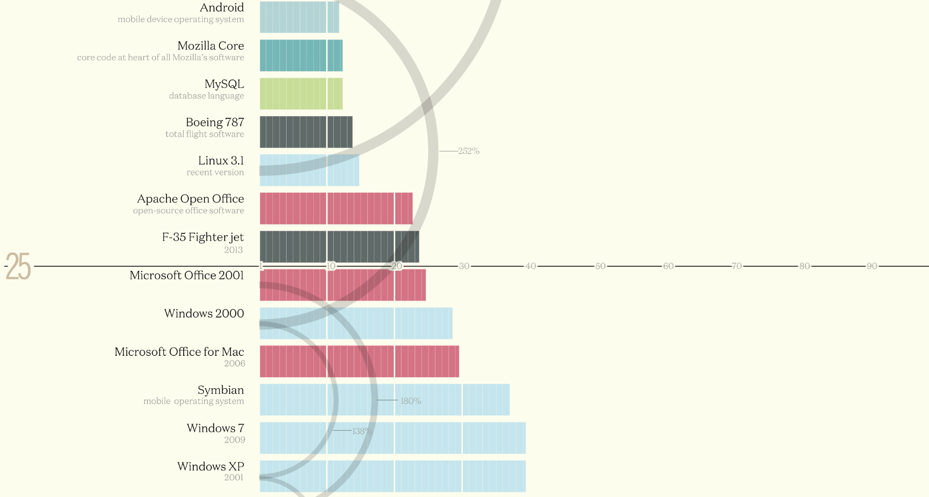
.

Slide 11
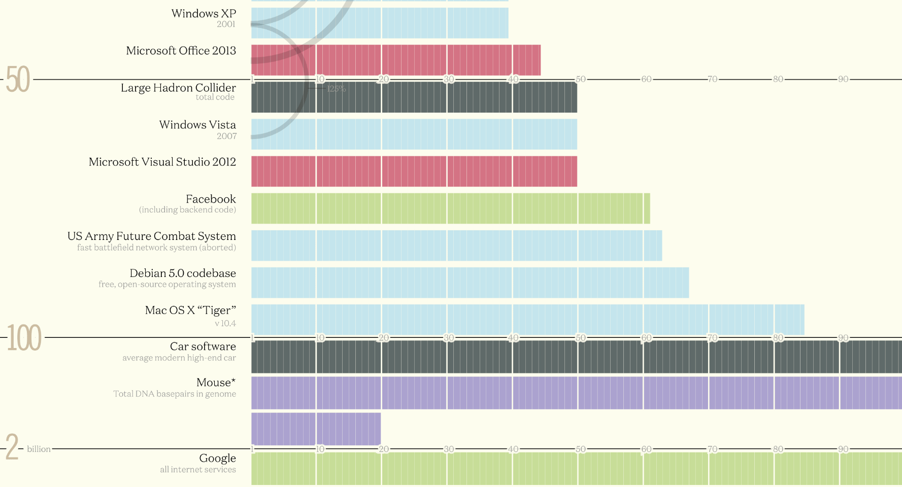
.

Slide 12
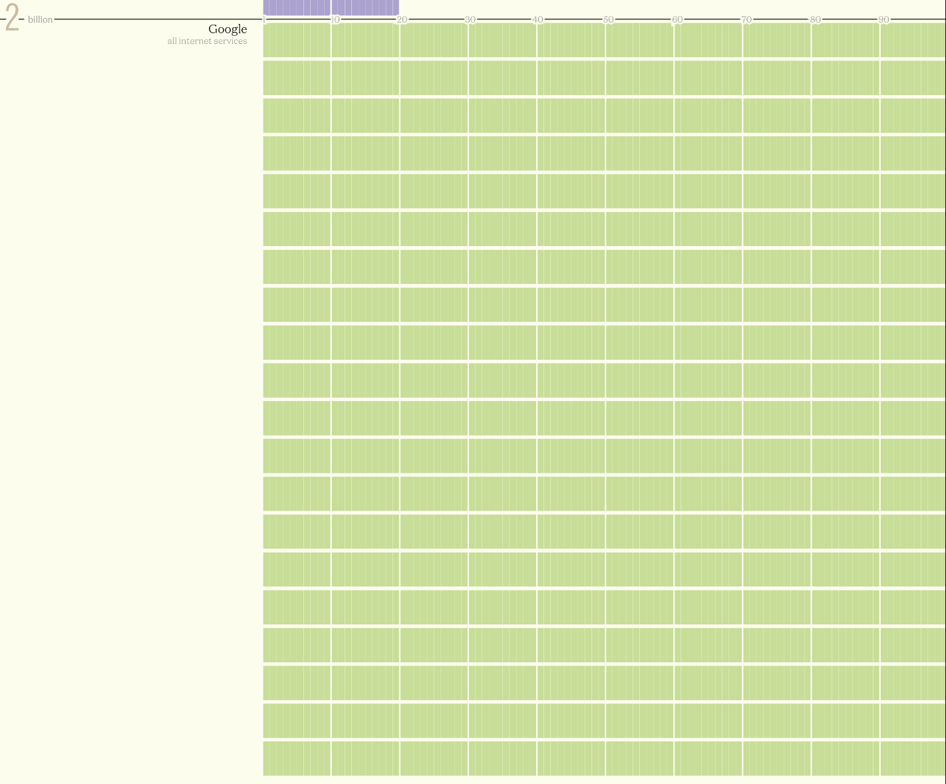
.

Slide 13
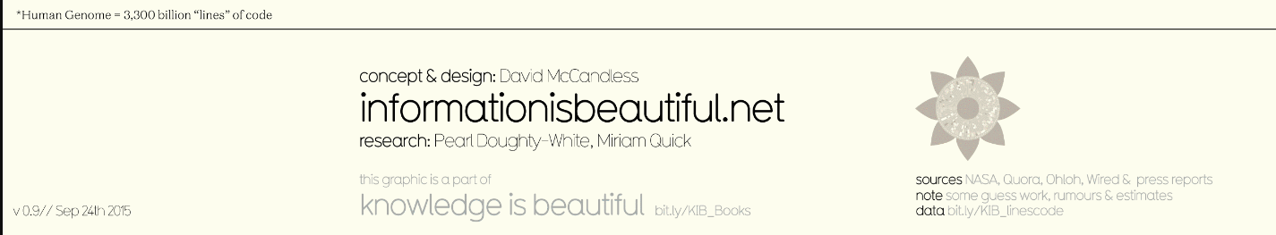
.
Information is Beautiful
Book by David McCandless .
The mouse genome is contained in 20 chromosome pairs and the current results suggest that it is about 120 billion base pairs in size (DNA nucleobases A, G, C, and T)
The human genome is 3,300 billion base pairs spread out over 23 pairs of chromosomes . .
How could we compare LOC to base pairs?

Slide 14
What's Involved in Large-Scale Software Development?
Assume you and a few friends are going to undertake a substantial software project.
What are the things that need to be done?
How would you start?
What other considerations would you have?

Slide 15
Large Projects Need Planning
On small programming projects there is often a single programmer who knows, or thinks he/she knows, what needs to be done
The focus is on implementation
Large-scale projects require more planning and this is what software engineering is about!
Unfortunately there is no known approach that, if followed, will guarantee success

Slide 16
General Problems - The Nature of Software
50% of all software projects fail
Never delivered/completed
Do not meet requirements or user needs
Excessive failures (bugs)
Excessively over budget or late
Quality and reliability of many software systems can not be formally assessed

Slide 17
Software Production Problems .
Complexity
Interacting parts in a software system. Functions or objects, and invoked as needed rather than being replicated
Software parts have several different kinds of interactions, including serial and concurrent invocations, state transitions, data couplings, and interfaces to databases and external systems

Slide 18
Software Production Problems .
Conformity
Lack of conformity can cause problems when an existing software component cannot be reused as planned because it does not conform to the needs of the product under development
Lack of conformity might not be discovered until late in a project
This requires an unplanned allocation of resources (usually) and can delay project completion

Slide 19
Software Production Problems .
Changeability
Software can “easily” be changed, but a bridge is almost impossible to move
However, this does not mean that software is easy to change, side effects!

Slide 20
Software Production Problems .
Invisibility
Software is very hard to visualize
Effects of executing software on a digital computer are observable, software itself cannot be seen, tasted, smelled, touched, or heard. My code isn’t a living tree? Maybe a virtual tree?
Due to no physical presence, software engineers must use different representations at different levels of abstraction in an attempt to visualize. A diamond as a service?

Slide 21
Software Production Problems .
Brook’s “No Silver Bullet” [IEEE Computer 9(4), 1987]
Software is very difficult to develop, and most likely will not get easier
Reuse is one solution suggested
Brooks insists that there is no one silver bullet -- "there is no single development, in either technology or management technique, which by itself promises even one order of magnitude [tenfold] improvement within a decade in productivity, in reliability, in simplicity."

Slide 22
Software Crisis . .
“Software Crisis” NATO Software Engineering Conference in 1968 at Garmisch, Germany
“The major cause of the software crisis is that the machines have become several orders of magnitude more powerful!
To put it quite bluntly: as long as there were no machines, programming was no problem at all; when we had a few weak computers, programming became a mild problem, and now we have gigantic computers, programming has become an equally gigantic problem.”
—Edsger Dijkstra, The Humble Programmer (EWD340), Communications of the ACM, 1972 ACM Turing Award Lecture

Slide 23
History’s Worst Software Bugs .
1993 – Intel Pentium floating point divide
Pentium chip to make mistakes when dividing floating-point numbers that occur within a specific range
For example, dividing 4195835.0/3145727.0 yields 1.33374 instead of 1.33382, an error of 0.006 percent
Although the bug affects few users, it becomes a public relations nightmare
With an estimated 3 million to 5 million defective chips in circulation, at first Intel only offers to replace Pentium chips for consumers who can prove that they need high accuracy;
eventually the company relents and agrees to replace the chips for anyone who complains. The bug ultimately costs Intel $475 million

Slide 24
History’s Worst Software Bugs .
1993 – CrowdStrike and Windows
~25% of Fortune 500 companies experienced disruptions due to the CrowdStrike outage
Airlines, Healthcare, and Banking most impacted
Estimated Financial Loss due to the CrowdStrike outage: $5.4 billion for the Fortune 500, excluding Microsoft

Slide 25
Software Development .
Better quality of the software development process has given rise to the discipline of
Software Engineering,
which aims to apply the systematic approach exemplified in the engineering paradigm to the process of software development

Slide 26
Software Engineering
(1) The application of a systematic, disciplined, quantifiable approach to the development, operation, and maintenance of software; that is the application of engineering to software. (2) The study of approaches as in (1). (IEEE/Pressman)
Software engineering is the application of engineering to the design, development, implementation, testing and maintenance of software in a systematic method .
We need discipline but we also need Adaptability and Agility

Slide 27

What is Software Engineering? .

Slide 28
Software Engineering is a Layered Technology (Pressman)

Slide 29

Software Development Overview
Software Engineering is a layered technology. Any engineering approach must rest on an organizational commitment to Quality.
The bedrock that supports software engineering is a Quality focus. (Pressman)

Slide 30
Software Development Overview
Quality Focus: Focus on certain aspects of quality
Process: A sequence of activities, people, and systems involved in achieving some desired result
Glue that holds technology layers together and enables timely development of software
Management control of software projects
Technical methods are applied to construct a product:
Milestones are established,
Quality is ensured,
And change is properly managed

Slide 31
Software Development Overview
Methods: software engineering methods provide the technical how to for building software.
Requirement gathering, analysis, design, coding, testing, and support/maintenance (~80%).
Tools: Tools provide support for the methods and process
Automated or semi-automated support for the process and the methods

Slide 32
Process
Software development life-cycle is the phases a software product goes through between when it is conceived and when it is no longer available for use

Slide 33
Methods
Software Development Methodology (SDM)
Requirements
Requirements are determined
Use cases are done
A high-level functional specification is created
Analysis
Conceptual classes are identified
Estimations for time, risk analysis

Slide 34
Methods
Software Development Methodology (SDM)
Design
Abstractions of the system is created
System Architecture is defined
Objects will be determined (some of this in analysis also)
Interfaces are defined
Data structures may be chosen
Algorithms may be chosen

Slide 35
Methods
Implementation
If design is done well, implementation is straight-forward
Testing
Testing should be continuous and on-going
Release
Software is released to customers

Slide 36
Methods
Maintenance (80-90% cost) .
Modifies the software for the following purposes:
Adaptive - modify to accommodate changes in the external environment
Corrective - fix errors
Perfective - add additional functionality
Preventive - make changes to facilitate easier correction, adaptation, and enhancement

Slide 37
Process and Methods
Systems Development Life Cycle (SDLC) and Software Development Methodology (SDM)
The divisions are not necessarily clear-cut and they affect each other
There is usually feedback from latter stages to earlier stages
Some things, like documentation, are done in most or all stages

Slide 38
SDLC Stages
Software cannot be developed by going through the stages of the software life-cycle
Why?
It is very hard to determine all the requirements initially.
Requirements, what the client wants, often change as the development progresses.
Unforeseen issues arise.
...
Problems discovered late are costly to fix because earlier stages are impacted and other things must then be changed

Slide 39
The Process

Slide 40
Software Development Process Models or SDLC
There are a number of process models
For example the Waterfall Model or linear sequential model process is essentially the steps of the software development life-cycle. This approach does not work, maybe, or does it? . . .
Usual development processes run iteratively and incrementally through the software development life-cycle phases rather than linearly

Slide 41
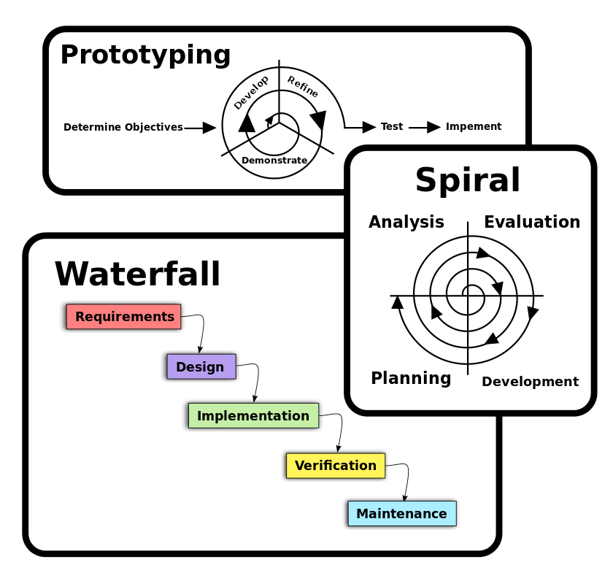
Software Development Process Models .
Waterfall
Prototyping
Iterative and Incremental development
Spiral development
Rapid application development
Extreme programming
Agile methodology
…

Slide 42
History of SDLC .
A "sponsor" or "maintenance" organization distributes an official set of documents that describe the process. Examples:
1970s: Structured programming since 1969
1980s Structured systems analysis and design method (SSADM) from 1980 onwards Information Requirement Analysis/Soft systems methodology
1990s Object-oriented programming (OOP) developed in the early 1960s, OOP Dominated programming approach during mid-1990s Spiral development 1988 Rapid application development (RAD), since 1991 Dynamic systems development method (DSDM), since 1994 Scrum, since 1995 Team software process, since 1998 Rational Unified Process (RUP), maintained by IBM since 1998 Extreme programming, since 1999
2000s Agile Unified Process (AUP) maintained since 2005 by Scott Ambler
It is notable that since DSDM in 1994, 22 years ago, yet many organizations, especially governments, still struggle on with pre-agile processes (often waterfall or similar).

Slide 43
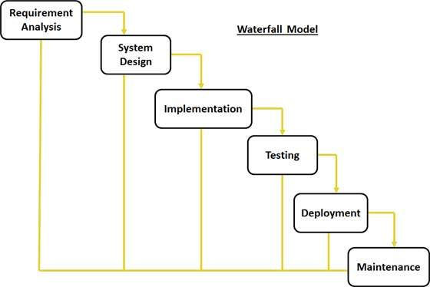
Waterfall Model Design .

Slide 44
Waterfall Model Design .
Requirement Gathering and Analysis
ALL possible requirements of the system to be developed are captured in this phase and documented in a requirement specification doc
System Design
The requirement specifications from first phase are studied in this phase and system design is prepared

Slide 45
Waterfall Model Design .
Implementation
With inputs from system design, the system is first developed in small programs called units, which are integrated in the next phase. Each unit is developed and tested
Integration and Testing
All the units developed in the implementation phase are integrated into a system after testing of each unit. Post integration the entire system is tested for any faults and failures

Slide 46
Waterfall Model Design .
Deployment of System
Once the functional and non functional testing is done, the product is deployed in the customer environment or released into the market
Maintenance
There are some issues which come up in the client environment. To fix those issues patches are released. Also to enhance the product some better versions are released

Slide 47
Waterfall Model Application
Requirements are very well documented, clear and fixed
Product definition is stable
No ambiguous requirements
Resources with required expertise are available
The project is, usually, short

Slide 48
Waterfall Model Pros.
Simple and easy to understand and use, easy to manage
Phases are processed and completed one at a time
Works well for smaller projects where requirements are very well understood
Clearly defined stages, Easy to arrange tasks
Process and results are well documented

Slide 49
Waterfall Model Cons.
No working software is produced until late during the life cycle
Not suitable for the projects where requirements are at a moderate to high risk of changing
It is difficult to measure progress within stages
Integration is done as a big-bang at the very end

Slide 50
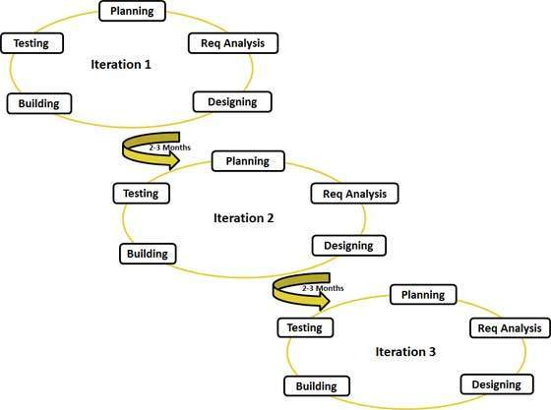
Agile Model .

Slide 51
Agile Model .
Individuals and Interactions
self-organization and motivation are important
Working software
Working software is considered the best means of communication with the customer to understand their requirement, instead of just depending on documentation

Slide 52
Agile Model .
Customer Collaboration
As the requirements cannot be gathered completely in the beginning of the project
Continuous customer interaction is very important to get proper product requirements
Responding to Change
Agile development is focused on quick responses to change

Slide 53
Popular Agile Model Methods .
Rational Unified Process (1994),
Scrum (1995),
Crystal Clear,
Extreme Programming (1996),
Adaptive Software Development,
Feature Driven Development, and
Dynamic Systems Development Method (DSDM) (1995).

Slide 54
Agile Model Pros .
Is a very realistic approach to software development
Promotes teamwork and flexibility to developers
Functionality can be developed rapidly and demonstrated
Suitable for fixed or changing requirements and delivers early partial working solutions
Enables concurrent development
Delivery within an overall planned context

Slide 55
Agile Model Cons .
Agile leader and management practice is a must
Strict delivery management for functionality to be delivered, and adjustments to meet the deadlines
Depends heavily on customer interaction, so if customer is not clear, team can be driven in the wrong direction
There is very high individual dependency and transfer of technology to new team members may be quite challenging due to lack of documentation

Slide 56
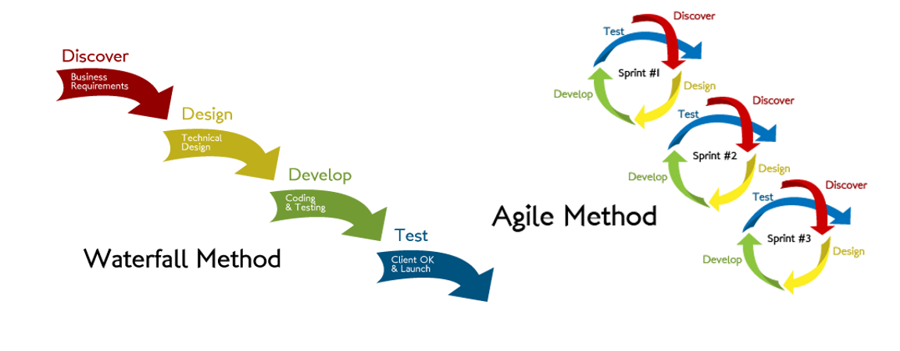
Agile Vs Traditional SDLC .

Slide 57
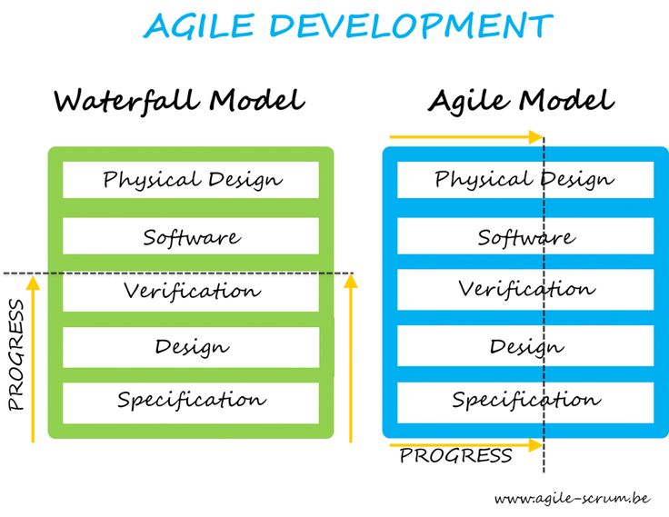
Agile Vs Traditional SDLC .

Slide 58
Agile Vs Traditional SDLC .
Agile is Adaptive, waterfall model is a Predictive approach
Predictive teams waterfall like models have a complete forecast of the exact tasks and features to be delivered
Agile has no detailed planning and clarity on future tasks only in respect of what features need to be developed (%)

Slide 59
Agile vs. Traditional SDLC .
Agile team adapts to the changing product requirements dynamically
Tested very frequently, through the iterations, minimizing the risk of any major failures in future
Customer interaction is the backbone of Agile methodology, and open communication with minimum documentation
The agile teams often located in the same geographical location

Slide 60
Summary
Development of large-scale software is a complicated task
There are many aspects to the development of all substantial software systems
The software development life-cycle states the things that need to be done in a process but they can't just be done as a sequence, 1, 2, 3, ... .

Slide 61
References
http://www.phonearena.com/news/Lines-of-code-How-our-favorite-apps-stack-up-against-the-rest-of-tech_id49281
https://www.quora.com/How-many-lines-of-code-are-there-in-Minecraft
http://www.minecraftforum.net/forums/mapping-and-modding/minecraft-mods/mods-discussion/1377756-how-many-lines-of-code-is-in-minecraft#c14
https://en.wikipedia.org/wiki/Software_development
https://en.wikipedia.org/wiki/Software_crisis
https://en.wikipedia.org/wiki/Software_engineering
http://sebokwiki.org/wiki/The_Nature_of_Software
Software Engineering: A Practitioner's Approach, 8/e

