Slide 1
CS 63016 & CS 73016 Big Data Analytics
Chapter 3: Indexing Big Data (2)
Xiang Lian
Department of Computer Science
Kent State University
Email: xlian@kent.edu
Homepage: http://www.cs.kent.edu/~xlian/
Notes:
The slides of this Big Data course used some public slides/materials on the Web. I would like to acknowledge these resources, and please let me know if I failed to cite them.

Slide 2
Objectives
In this chapter, you will:
Get familiar with many indexing mechanisms:
B⁺-tree, extensible hashing, bitmap
Grid file
Z-order, Hilbert curve
Bitmap index
Quadtree
k-d tree
R-tree, R⁺-tree, R*-tree
X-tree
SS-tree, SR-tree
M-tree
Embedding-based index
Inverted index
Locality sensitive hashing
Similarity search over indexes
Distributed indexes

Slide 3
Outline
Introduction
Indexing Mechanisms
Similarity Search Over Indexes
Indexing for High-Dimensional Data
Permutation-Based Indexing

Slide 4
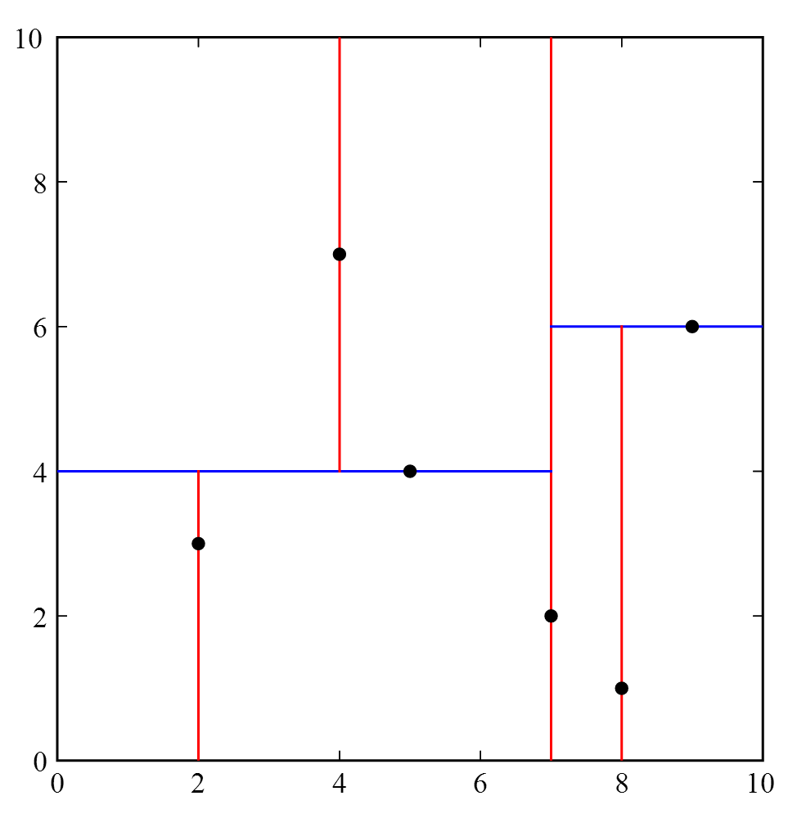
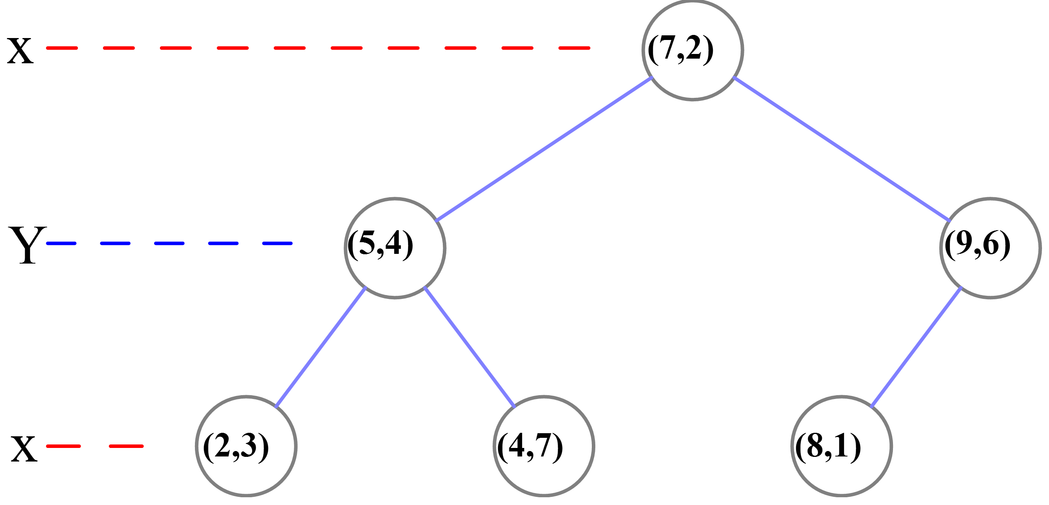
k-d Tree
k-d tree (short for k-dimensional tree)
A space partitioning data structure, binary tree
Each non-leaf node is split by a hyperplane on a selected dimension
Y
(5,4)
(2,3)
(7,2)
X
k-d tree decomposition for the point set: {(2,3), (5,4), (9,6), (4,7), (8,1), (7,2)}
Notes:
https://en.wikipedia.org/wiki/K-d_tree

Slide 5
Insert (55, 62) into the Following 2-D Tree
55 > 53, move right
X
53, 14
62 > 51, move right
Y
27, 28
65, 51
X
30, 11
31, 85
70, 3
99, 90
55 < 99, move left
Y
29, 16
40, 26
7, 39
32, 29
82, 64
38, 23
55,62
73, 75
15, 61
62 < 64, move left
Null pointer, attach
https://www.csee.umbc.edu/courses/undergraduate/341/fall07/Lectures/KDTree/KDTrees.ppt
Notes:
https://www.csee.umbc.edu/courses/undergraduate/341/fall07/Lectures/KDTree/KDTrees.ppt

Slide 6
3-D Example
X < 20
20,12,30
X > 20
15,18,27
40,12,39
Y < 18
Y > 18
Y < 12
Y > 12
17,16,22
19,19,37
22,10,33
25,24,10
Z < 22
Z < 33
Z > 33
16,15,20
24,9,30
50,11,40
X < 16
X > 16
12,14,20
18,16,18
A
B
C
D
What property (or properties) do the nodes in the subtrees labeled A, B, C, and D have?
Notes:
https://www.csee.umbc.edu/courses/undergraduate/341/fall07/Lectures/KDTree/KDTrees.ppt
How about k-D-Btree? http://repository.cmu.edu/cgi/viewcontent.cgi?article=3451&context=compsci
The K-D-B-Tree : a search structure for large multidimensional dynamic indexes

Slide 7
R-Tree Family
Multidimensional Tree Index
Space partitioning
E.g., Quadtree, k-d tree
Data partitioning
E.g., R-tree, R⁺-tree, R*-tree, SR-tree

Slide 8
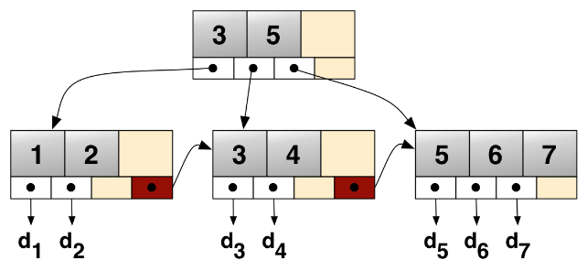
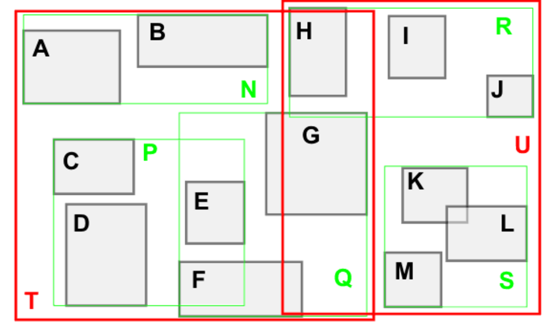
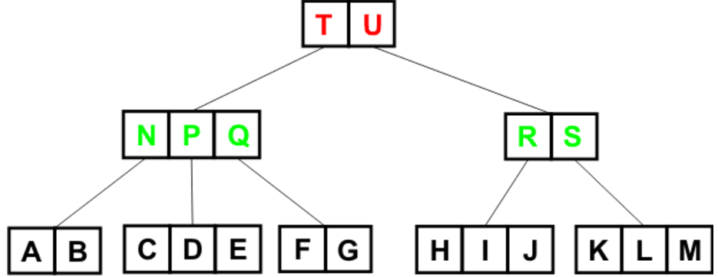
R-Tree
A number of spatial objects (e.g., points, lines, rectangles, polygons, or irregular shapes)
The R-tree index extends the idea of B⁺-tree index
From 1-dimensional data to d-dimensional data (d ≥ 1)
A. Guttman. R-trees: a dynamic index structure for spatial searching. In SIGMOD, 1984.
Notes:
A. Guttman. R-trees: a dynamic index structure for spatial searching. In SIGMOD, 1984.
http://cglab.ca/~cdillaba/comp5409_project/R_Trees.html
https://en.wikipedia.org/wiki/B%2B_tree

Slide 9
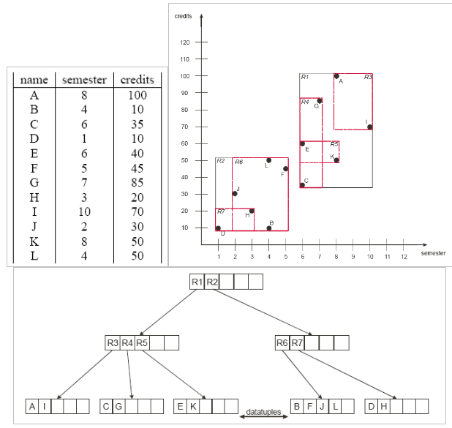
Example of R-Tree in 2D Space
Notes:
http://sysnet.ucsd.edu/~cfleizac/cse262/R-Trees.ppt

Slide 10
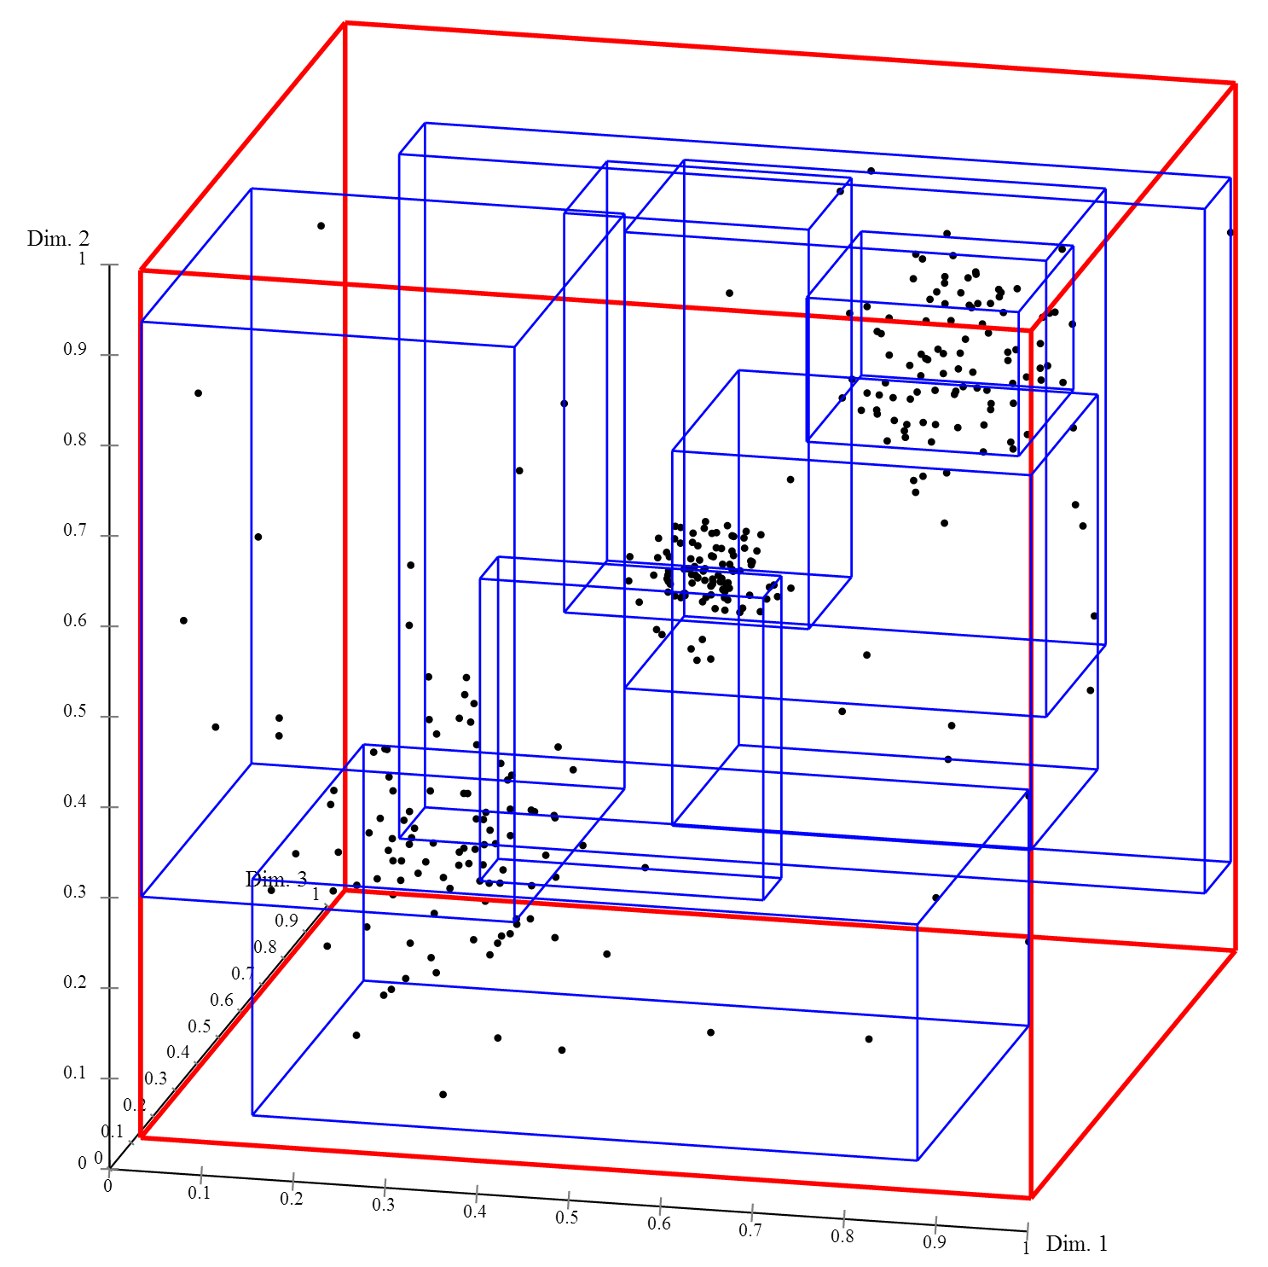
R-Tree in the Multidimensional Space
3D R-Tree:
https://en.wikipedia.org/wiki/R-tree

Slide 11
R-Tree Data Structure
Minimum Bounding Rectangle (MBR)
Use a smallest rectangle (or hyperrectangle in the multidimensional space) to bound objects/nodes
X₂
x_{2max}
MBR
(x_{1min}, x_{1max}; x_{2min}, x_{2max})
x_{2min}
X₁
x_{1min}
x_{1max}

Slide 12
R-Tree Data Structure (cont'd)
In a d-dimensional space, an MBR in the R-tree is in the form of:
(x_{1min}, x_{1max}; x_{2min}, x_{2max}; ...; x_{dmin}, x_{dmax})

Slide 13
R-Tree Data Structure (cont'd)
R-tree is a height-balanced multi-way external memory tree over n multidimensional data objects (height: log_{F}(n))
Non-leaf node (or intermediate node): contains a number of entries (MBRs) that minimally bound their child nodes, as well as pointers pointing to child nodes
Leaf node: contains spatial objects
node fanout: F ∈ [m, M],
where m ≤ M/2

Slide 14
R-Tree Data Structure (cont'd)
In a d-dimensional space
Given 2 MBRs, E₁ = (x_{1min}, x_{1max}; x_{2min}, x_{2max}; ...; x_{dmin}, x_{dmax}) and E₂ = (y_{1min}, y_{1max}; y_{2min}, y_{2max}; ...; y_{dmin}, y_{dmax})
What is the MBR, E, that bounds both E₁ and E₂?
E = ?
X₁

Slide 15
R-Tree Construction
Bulk loading: bottom-up R-tree construction (e.g., sorting objects by Hilbert curve and grouping them)
Node capacity, M = 4
P1
P3
P4
P2
Notes:
http://infolab.usc.edu/csci587/Fall2016/slides/session3-spatial-index-rtree.pdf
Bulk loading of R-tree
http://ftp.informatik.rwth-aachen.de/Publications/CEUR-WS/Vol-74/files/FORUM_18.pdf

Slide 16
R-Tree Construction (cont'd)
Insert objects, o, one by one (similar to B⁺-tree)
Find a leaf node, E, to be inserted
Insert the new object o into the chosen leaf node E
Full node?
Notes:
A. Guttman. R-trees: a dynamic index structure for spatial searching. In SIGMOD, 1984.

Slide 17
Incremental Insert Algorithm for the R-Tree
Invoke ChooseLeaf to select a leaf node, E, to place the new object o
If node E has room for another entry, add o to node E; otherwise, invoke SplitNode to obtain two split nodes E₁ and E₂ containing o and old entries
Invoke AdjustTree to propagate changes upwards
If the node split causes the root to split, then create a new root whose children are the two split nodes (i.e., the height of the tree is larger)
Notes:
A. Guttman. R-trees: a dynamic index structure for spatial searching. In SIGMOD, 1984.

Slide 18
ChooseLeaf Algorithm
Find a leaf node, E, to insert a new object o
Decide the branch to descend
Select a branch such that the insertion causes the least enlargement of the rectangle, or MBR (intuition?)
In the case of ties, choose the branch with the MBR of the smallest area (intuition?)

Slide 19
Illustration of R-Tree Object Insertion: ChooseLeaf
E₁
E₁
E₁
E₂
E₂
A new object o to be inserted

Slide 20
R-Tree Object Insertion: SplitNode
Insert the new object into the chosen leaf node
In the case of full node?
How to split the node
A new object o to be inserted
Maximum fanout M = 4

Slide 21
SplitNode Heuristics
Exhaustive Algorithm
Generate all possible groupings and choose the best one with the minimum area
Time complexity: in the worse case, O(2^{M-1}) possible groupings (M can be as large as 50)
Notes:
A. Guttman. R-trees: a dynamic index structure for spatial searching. In SIGMOD, 1984.

Slide 22
SplitNode Heuristics (cont'd)
A Quadratic-Cost Algorithm
Pick two of (M+1) entries as the first two elements of two split groups
These two entries have the largest wasted area, given by the area of MBR covering these two entries minus the areas of two entries themselves
The remaining entries are then assigned to one of two groups one at a time, each time with the minimum enlarged area (resolve ties by selecting the one with the smallest area)
Time complexity: O(M²)
o₁
o₂
Notes:
A. Guttman. R-trees: a dynamic index structure for spatial searching. In SIGMOD, 1984.

Slide 23
SplitNode Heuristics (cont'd)
A Linear-Cost Algorithm
Linear seed pickup
Find extreme rectangles/objects for all dimensions (i.e., the ones with the highest low side, and with the lowest high side)
Normalize the shape of the rectangle by dividing by the width of rectangle along each dimension
Select the most extreme pair, i.e., with the greatest normalized separation along any dimension (intuitive?)
The remaining entries are then assigned to one of two groups one at a time (the same as the Quadratic Algorithm)
Time complexity: O(M)
X
Notes:
A. Guttman. R-trees: a dynamic index structure for spatial searching. In SIGMOD, 1984.

Slide 24
Object Deletion for the R-Tree
Find the location of an object o in a leaf node E
Delete the object o in the leaf node E
If the leaf node E has less than m objects, then handle the underflow of the leaf node
Delete the leaf node E from the R-tree
Re-insert objects in E by Insert Algorithm

Slide 25
Search in the R-Tree
Range query
Point query
NN, ...
Query Point
Query Range

Slide 26
Drawbacks of R-Tree
The constructed R-tree for the same set of objects is not unique
Depending on the order of object insertions/deletions
For the range query, we need to check multiple MBRs
Why?
Solutions?
Notes:
http://infolab.usc.edu/csci587/Fall2016/slides/session3-spatial-index-rtree.pdf

Slide 27
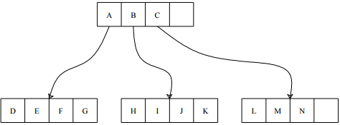
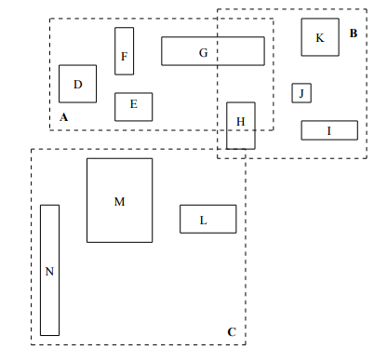
Drawbacks of R-Tree (cont'd)
To tackle the drawbacks of R-tree
Coverage
Overlap
R-tree:
range queries
T. Sellis, N. Roussopoulos, and C. Faloutsos. The R⁺-Tree: A dynamic index for multi-dimensional objects. In VLDB, 1987.
Notes:
T. Sellis, N. Roussopoulos, and C. Faloutsos. The R⁺-Tree: A dynamic index for multi-dimensional objects. In VLDB, 1987.

Slide 28
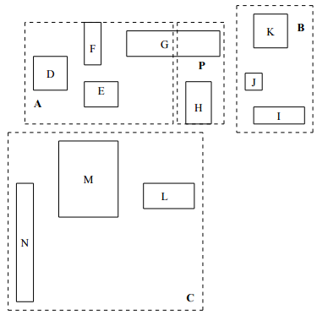
R⁺-Tree (cont'd)
Goal:
Minimize both coverage and overlap
R-tree
R⁺-tree
Notes:
T. Sellis, N. Roussopoulos, and C. Faloutsos. The R⁺-Tree: A dynamic index for multi-dimensional objects. In VLDB, 1987.

Slide 29
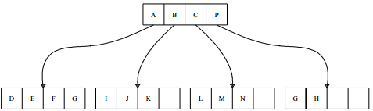
Differences of R⁺-Tree from R-Tree
R⁺-tree nodes are not guaranteed to be at least half filled
The entries of any internal node do not overlap
An object ID may be stored in more than one leaf node
https://en.wikipedia.org/wiki/R%2B_tree
Notes:
https://en.wikipedia.org/wiki/R%2B_tree

Slide 30
Advantages and Disadvantage of R⁺-Tree
Advantages
For range queries, we do not need to access overlapping nodes
For point queries, only a single path from root to a leaf node needs to be accessed
Disadvantages
Space cost: objects may be stored in multiple leaf nodes → the height of R⁺-tree may increase
Construction and maintenance are more complex than R-trees
Notes:
https://en.wikipedia.org/wiki/R%2B_tree#Advantages

Slide 31
R⁺-Tree Insert
To insert an object with non-zero area
Object may be broken to multiple sub-rectangles, and inserted into more than one leaf node
If leaf nodes are full (i.e., overflowing), then nodes are split and splits are propagated to parent

Slide 32
R⁺-Tree Node Split
Split nodes
Divide the total space occupied by N rectangles (2D example) by a line parallel to either x-axis (x_cut) or y-axis (y_cut)
The selection of x_ or y_cut is based on:
Nearest neighbor
Minimal total x- and y- displacement
Minimal total space coverage accrued by the two sub-regions
Minimal number of rectangle splits

Slide 33
R*-Tree
R-tree aims to minimize the areas of the index nodes (e.g., while splitting nodes)
R*-tree further optimized the R-tree index
Criteria
Area covered by an index MBR node
Overlap among index MBR nodes
Margin (perimeter) of an index MBR node
Storage utilization
Essentially: coverage and overlap
N. Beckmann, H.-P. Kriegel, R. Schneider, and B. Seeger. The R*-tree: an efficient and robust access method for points and rectangles. In SIGMOD, 1990.
Notes:
https://en.wikipedia.org/wiki/R*_tree
http://infolab.usc.edu/csci587/Fall2016/slides/session3-spatial-index-rtree.pdf

Slide 34
Insert in R*-Tree
ChooseSubtree
If the node is a leaf node, choose a branch using the following criteria (in order):
Least overlap enlargement
Least area enlargement
Smaller area
Else
Least area enlargement
Smaller area
Notes:
N. Beckmann, H.-P. Kriegel, R. Schneider, and B. Seeger. The R*-tree: an efficient and robust access method for points and rectangles. In SIGMOD, 1990.

Slide 35
Handling Overflow Nodes
Split nodes
ChooseSplitAxis: Choose axis to split
ChooseSplitIndex: Partition entries into 2 groups along the selected axis
ChooseSplitAxis
For each axis, sort entries by lower/upper values of MBRs and divide them into two groups
Compute the sum, S, of all margin values (i.e., perimeters) of different partitions
Select the axis with the smallest S value
ChooseSplitIndex
For the selected axis, choose the partitioning with the minimal overlapping values
Notes:
http://infolab.usc.edu/csci587/Fall2016/slides/session3-spatial-index-rtree.pdf

Slide 36
Forced Reinsert in R*-Tree
Forced reinsertion
Reinsert nodes, instead of splitting nodes
By reinsert, we may avoid the splitting of nodes
Producing more well-clustered groups of entries in nodes
Reducing node coverage

Slide 37

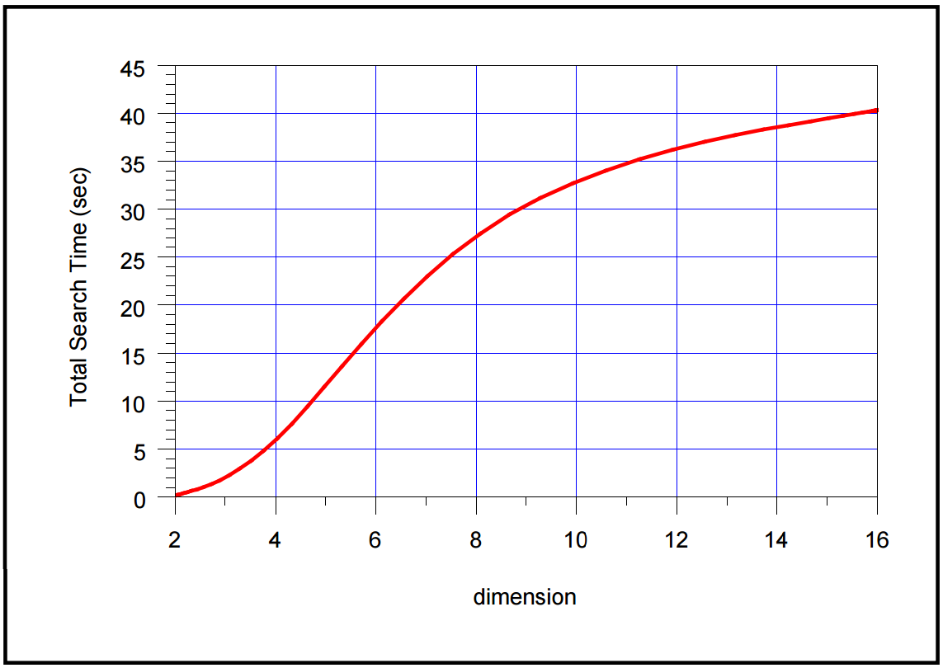
Disadvantage of R-Tree Family
Dimensionality Curse
When the dimensionality, d, of the R-tree index (and its variants) is high (e.g., >16), the performance of R-tree degrades dramatically, which may be even worse than the linear scan method on the entire data set
The reasons are
In high dimensional space, there are many overlapping MBRs in the R-tree
The node capacity becomes smaller for high dimensional objects, which makes the tree higher
The performance of R-tree on the number of dimensions over real data
Source: S. Berchtold, D. A. Keim, and H.-P. Kriegel. The X-tree: An Index Structure for High-Dimensional Data. In VLDB, 1996.
Notes:
https://en.wikipedia.org/wiki/Curse_of_dimensionality
S. Berchtold, D. A. Keim, and H.-P. Kriegel. The X-tree: An Index Structure for High-Dimensional Data. In VLDB, 1996.

Slide 38
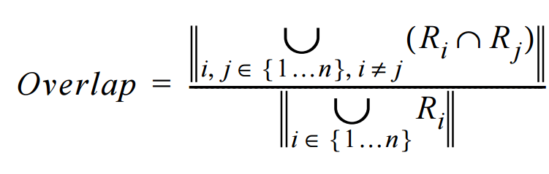
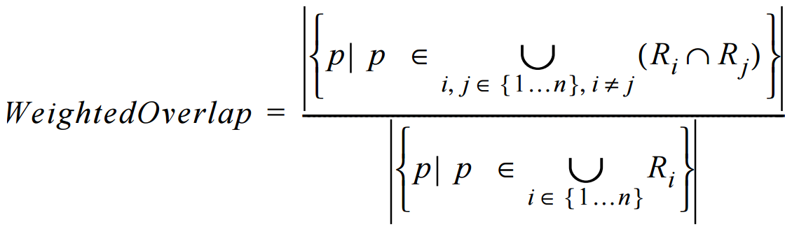
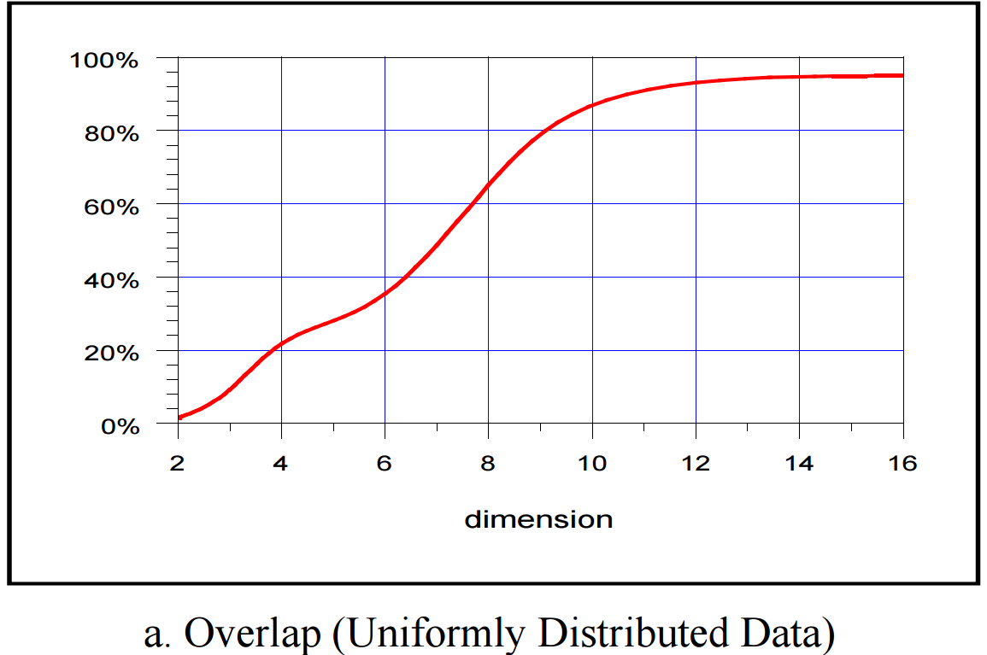
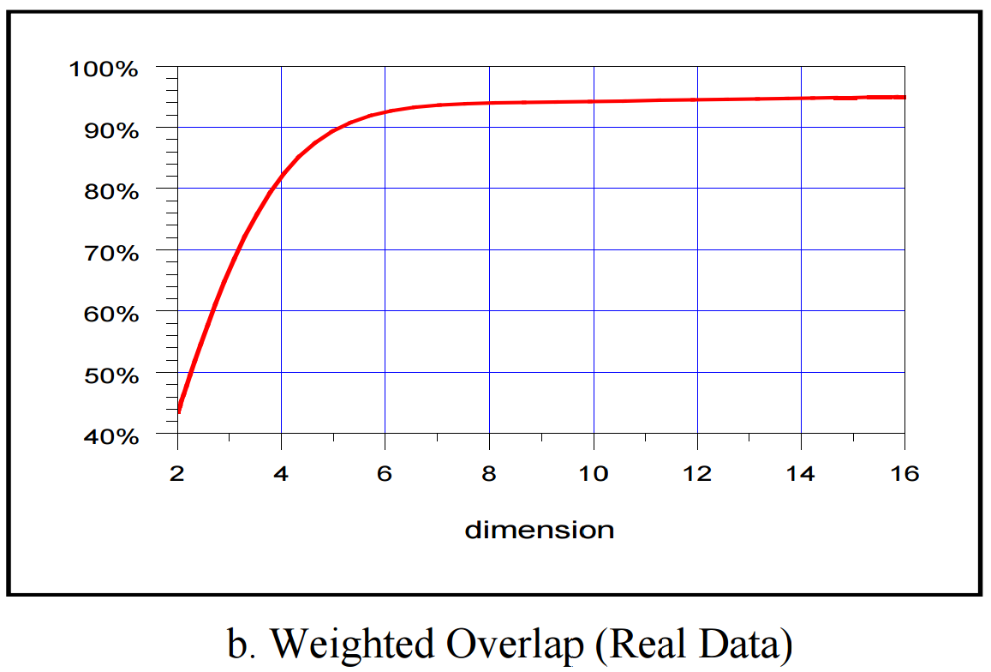
The Effect of Overlaps in the R*-Tree for High Dimensional Data
Given n MBRs {R₁, …, R_{n}}, the overlap is defined as the percentage of space covered by more than one MBR
The weighted overlap is given by the percentage of data objects that fall in the overlapping portion of the space
Notes:
S. Berchtold, D. A. Keim, and H.-P. Kriegel. The X-tree: An Index Structure for High-Dimensional Data. In VLDB, 1996.

Slide 39
X-Tree
X-tree (eXtended node tree) : A variant of R*-tree to improve the performance of the tree index over high dimensional data
The overlap-free split
The supernode mechanism
S. Berchtold, D. A. Keim, and H.-P. Kriegel. The X-tree: An Index Structure for High-Dimensional Data. In VLDB, 1996.
Notes:
S. Berchtold, D. A. Keim, and H.-P. Kriegel. The X-tree: An Index Structure for High-Dimensional Data. In VLDB, 1996.

Slide 40
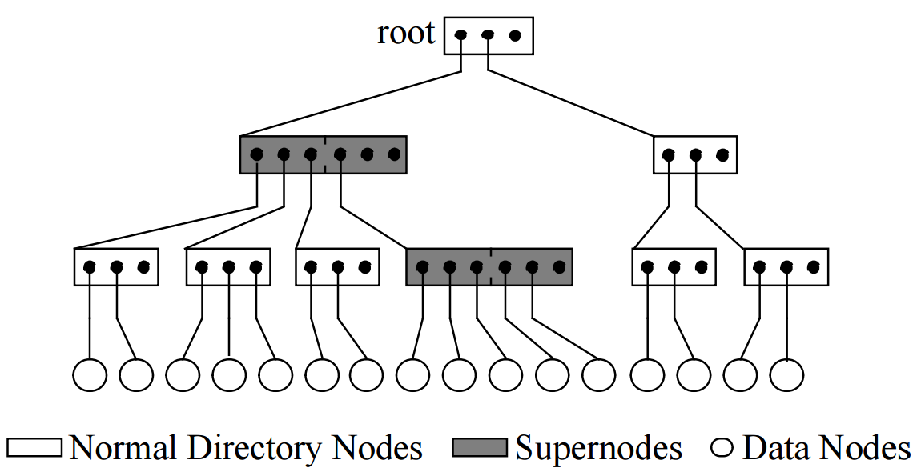
X-Tree Structure
X-Tree structure
Data nodes
Normal directory nodes
Supernodes (with larger node sizes where necessary)
During insertions, supernodes are created to avoid overlap due to splits in the directory
Notes:
S. Berchtold, D. A. Keim, and H.-P. Kriegel. The X-tree: An Index Structure for High-Dimensional Data. In VLDB, 1996.

Slide 41

X-Tree Structure (cont'd)
Split an X-tree node
Find an overlap-minimal split of a directory node
Partition MBRs in the node into two subsets such that the overlap of MBRs of two subsets is minimal
Always possible for point data (i.e., overlap-free; Overlap = 0)
May not be possible for MBR objects
supernode
Notes:
S. Berchtold, D. A. Keim, and H.-P. Kriegel. The X-tree: An Index Structure for High-Dimensional Data. In VLDB, 1996.

Slide 42
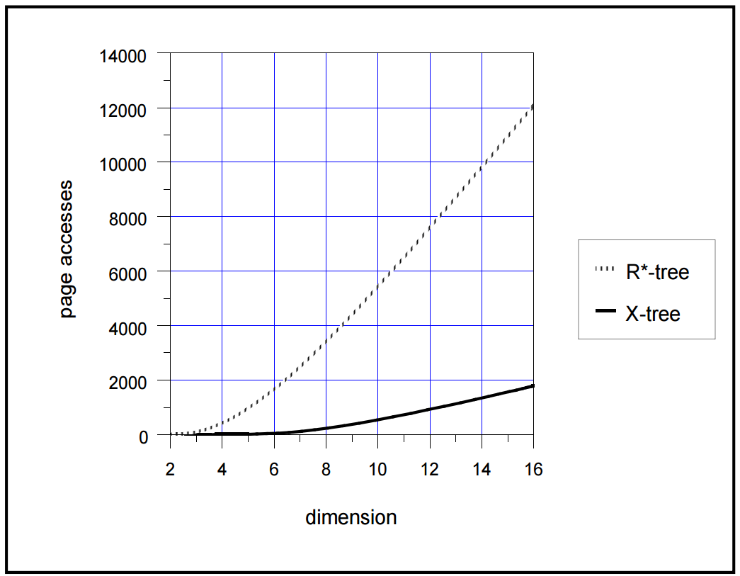
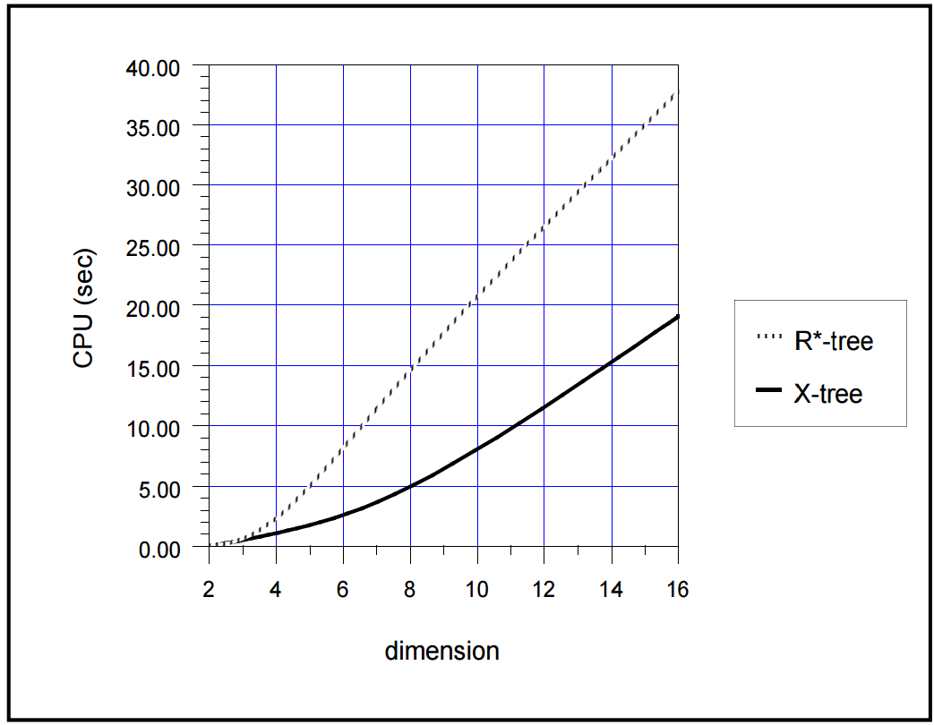
Performance Comparisons Between R*-Tree and X-Tree
Real Point Data (70 MBytes)
Notes:
S. Berchtold, D. A. Keim, and H.-P. Kriegel. The X-tree: An Index Structure for High-Dimensional Data. In VLDB, 1996.

Slide 43

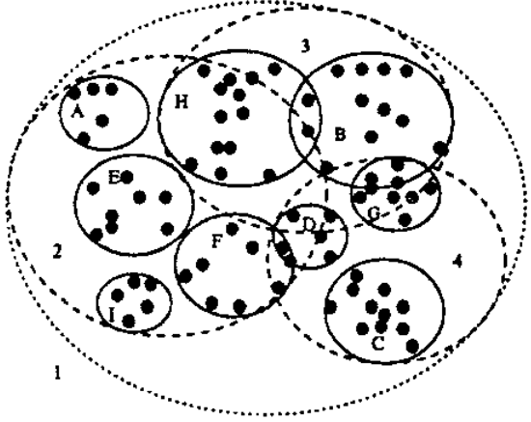
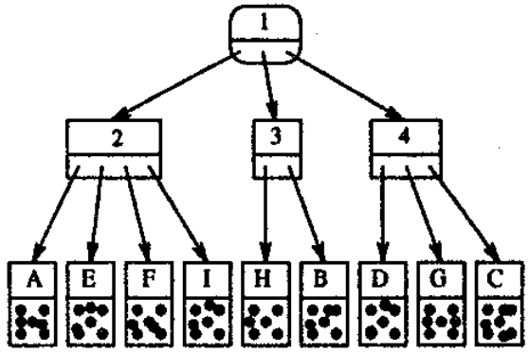
SS-Tree
The SS-tree is a height-balanced tree, where each node is a sphere
The distance between two objects is given by a weighted Euclidean distance
D. A. White and R. Jain. Similarity Indexing with the SS-tree. In ICDE, 1996.
Notes:
http://www.cs.uml.edu/~cchen/580-S06/reading/WJ96.pdf
D. A. White and R. Jain. Similarity Indexing with the SS-tree. In ICDE, 1996.

Slide 44
SS-Tree (cont'd)
Each node in SS-tree is represented by a sphere, centered at a centroid of underlying objects and with a radius r

Slide 45
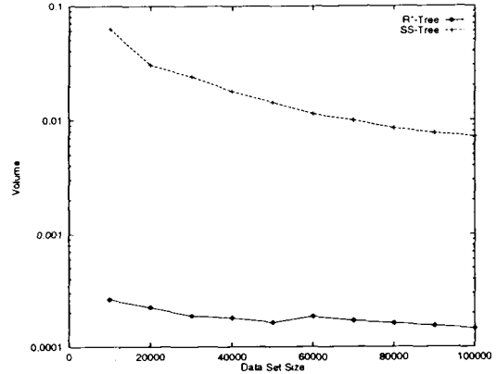
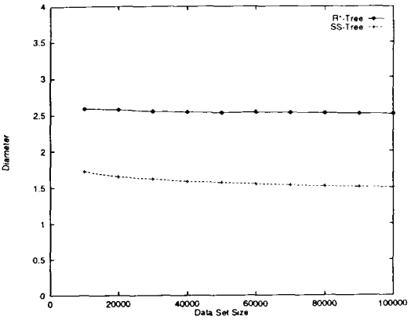
SS-Tree vs. R*-Tree
SS-Tree (bounding spheres)
volume
diameter
R*-Tree (MBRs)
data size
data size
The diameter of regions has more influence on the performance of nearest neighbor (NN) queries than their volumes
Notes:
N. Katayama and S. Satoh. The SR-tree: an index structure for high-dimensional nearest neighbor queries. In SIGMOD, 1997.

Slide 46
SR-Tree
Sphere/Rectangle-tree (SR-tree)
range queries
N. Katayama and S. Satoh. The SR-tree: an index structure for high-dimensional nearest neighbor queries. In SIGMOD, 1997.
Notes:
https://pdfs.semanticscholar.org/20b5/fc20821968a2e990183ee4613c591951597c.pdf

Slide 47
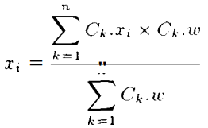
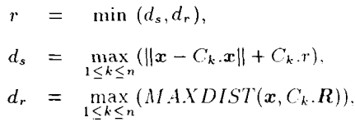
SR-Tree (cont'd)
Insert Algorithm – similar to the SS-tree
Update both bounding rectangles and spheres
The bounding sphere
Centroid of points, x(x₁, x₂, …, x_{d})
Radius r

Slide 48
SR-Tree (cont'd)
Deletion
If the deletion causes no underflow, then simply delete this entry
Otherwise, the underflowing leaf node is removed, and entries in the leaf node are re-inserted into the SR-tree

Slide 49
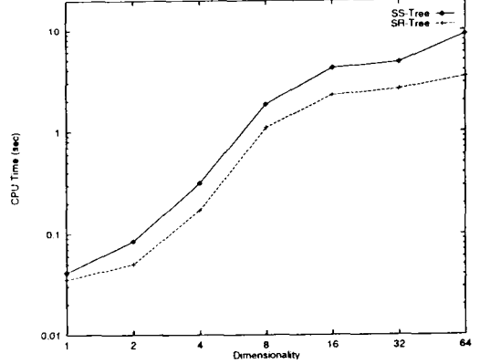
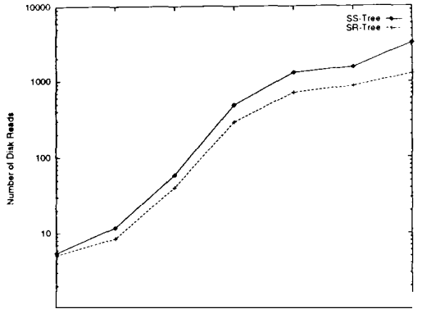
Performance of SR-Tree vs. SS-Tree
Cluster data set

Slide 50

M-Tree (cont'd)
M-tree: A height-balanced tree index in metric spaces
Properties in metric spaces
Symmetry: dist(x, y) = dist(y, x)
Non-negativity: dist(x, y) > 0 (x ≠ y) and dist(x, x) = 0
Triangle inequality: dist(x, y) + dist(y, z) ≥ dist(x, z)
Euclidean distance is one type of metric-space distances
dist(p, q) =
P. Ciaccia, M. Patella, and P. Zezula. M-tree An Efficient Access Method for Similarity Search in Metric Spaces. In VLDB, 1997.
Notes:
P. Ciaccia, M. Patella, and P. Zezula. M-tree An Efficient Access Method for Similarity Search in Metric Spaces. In VLDB, 1997.

Slide 51
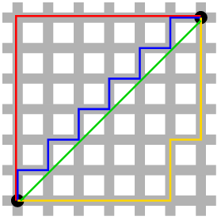


Metric Spaces
L_{p}-norm distance
L₁-norm (Manhattan distance)
L₂-norm (Euclidean distance)
L∞-norm
Edit distance
Given two strings a and b, the edit distance, dist(a, b), is the minimum-weight series of edit operations that transforms a into b
Insertion, deletion, substitution
The shortest path distance in graphs
Notes:
http://repository.cmu.edu/cgi/viewcontent.cgi?article=1551&context=compsci
https://en.wikipedia.org/wiki/Edit_distance

Slide 52


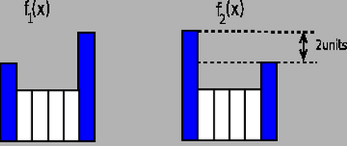
Metric Spaces (cont'd)
Jaccard distance between two sets, A and B
Hausdorff distance
The maximum distance of a set to the nearest point in the other set
Earth mover's distance
The distance between two probability distributions
Notes:
https://en.wikipedia.org/wiki/Jaccard_index
https://en.wikipedia.org/wiki/Hausdorff_distance
http://cgm.cs.mcgill.ca/~godfried/teaching/cg-projects/98/normand/main.html#whatis
http://vellum.cz/~mikc/oss-projects/CarRecognition/doc/dp/node29.html

Slide 53
Hamming Distance
The Hamming distance between two strings of equal length is the number of positions at which the corresponding symbols are different
"karolin" and "kathrin" is 3
"karolin" and "kerstin" is 3
1011101 and 1001001 is 2
2173896 and 2233796 is 3
It follows the triangle inequality
Notes:
https://en.wikipedia.org/wiki/Hamming_distance

Slide 54
Basic Idea of M-Tree
Reduce the number of distance computations
r(O_{r})
O_{r}
Q

Slide 55
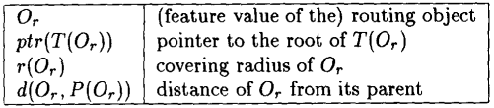
M-Tree Data Structure
Leaf nodes
Store data objects
Non-leaf nodes
Routing objects, O_{r}
Covering radii, r(O_{r})
Distances, d(O_{r}, P(O_{r})), from O_{r} to its parent P(O_{r})
Pointers pointing to subtrees, ptr(T(O_{r}))
d(O_{r}, P(O_{r}))
P(O_{r})
O_{r}
r(O_{r})

Slide 56
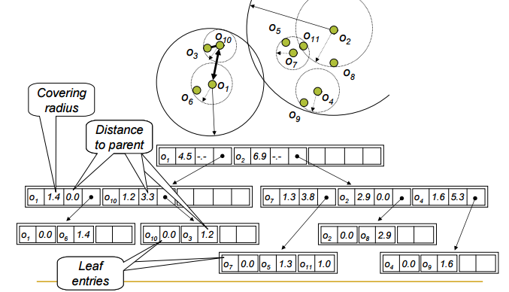
An Example of M-Tree
A metric index
http://www.nmis.isti.cnr.it/amato/similarity-search-book/SAC-07-tutorial.pdf
Notes:
http://www.nmis.isti.cnr.it/amato/similarity-search-book/SAC-07-tutorial.pdf

Slide 57
Insert Algorithm for M-Tree
Insert a new object O_{n}
Starting from root, find a branch to descend such that:
d(O_{r}, O_{n}) ≤ r(O_{r});
In the case of multiple branches satisfying the inequality, select the one with O_{r} having the closest distance to O_{n}
If no routing objects satisfying d(O_{r}, O_{n}) ≤ r(O_{r}) exist, the choice is to minimize the increase of the covering radius d(O_{r}, O_{n}) - r(O_{r})
When inserting O_{n} into a full leaf node, we split the overflow node into two nodes

Slide 58
Split Policies for M-Tree
Goals
Minimizing "volume"
Minimizing "overlap"
Policies
m_RAD – minimize (sum of) RADii, r(O_{p1}) + r(O_{p2}),
mM_RAD – minimize the maximum of the two radii, max{r(O_{p1}), r(O_{p2})}
M_LB_DIST – minimize the Maximum Lower Bound on DISTance (i.e., O_{p2} is the farthest object from O_{p1})
RANDOM – randomly select routing objects
SAMPLING – select routing objects from s sample objects (s>1)

Slide 59
Distribution of Entries Between Two Split Nodes
Balanced distribution:
Compute d(O_{j}, O_{p1}) and d(O_{j}, O_{p2}) for all O_{j} ∈ N. Repeat until N is empty:
Assign to N₁ the nearest neighbor of O_{p1} in N and remove it from N;
Assign to N₂ the nearest neighbor of O_{p2} in N and remove it from N.

Slide 60
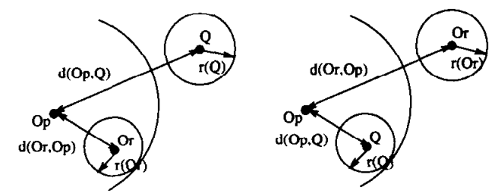
Range Queries Over M-Tree
Given a query object Q, and a query radius r(Q), a range query is to find all objects O_{j} such that d(O_{j}, Q) ≤ r(Q)
Pruning strategies
Q
r(Q)
O_{r}
r(O_{r})
If d(O_{r}, Q) > r(Q) + r(O_{r}), then objects in node O_{r} can be safely pruned
If |d(O_{p}, Q)-d(O_{r}, O_{p})|>r(Q)+r(O_{r}), then d(O_{r}, Q) > r(Q) + r(O_{r}).
Notes:
http://www.nmis.isti.cnr.it/amato/similarity-search-book/SAC-07-tutorial.pdf

Slide 61
OMNI Family
All-purpose access methods for similarity search in metric spaces
Basic idea
Select a set, F, of objects as foci (or called pivots or reference points), f₁, f₂, …, f_{l}
Compute distances, d(f_{k}, o_{i}), of all other objects, o_{i}, from this set F
Convert each object to a new l-dimensional data space, and conduct the search in the new space
R.F.S. Filho, A. Traina, C. Traina, and C. Faloutsos. Similarity search without tears: the OMNI-family of all-purpose access methods. In ICDE, 2001.

Slide 62
Example of OMNI
Object o_{i} is converted to a 2D data point in the embedded space (d(f₁, o_{i}), d(f₂, o_{i}))
d(f₁, o_{i})
f₁
o_{i}
d(f₂, o_{i})
f₂

Slide 63
OMNI - Terms
Omni-foci base
A set, F, of foci f₁, f₂, …, f_{l}
Omni-coordinates
Converted coordinates, d(f_{k}, o_{i}), of objects in the embedded space
Minimum Bounding Omni Region (mbOr)
Each focus defines a metric subspace "ring"
The mbOr is a bit like "minimum bounding rectangle" of a set, A, of objects in the embedded space

Slide 64
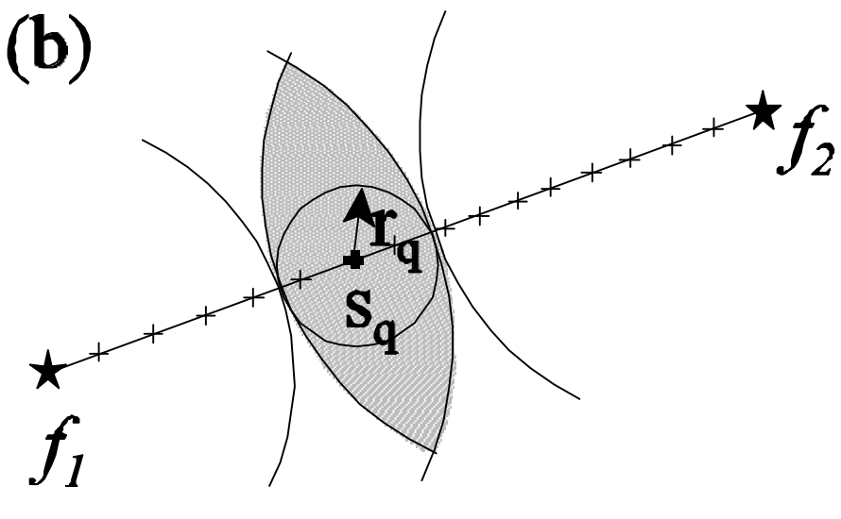
OMNI – Example of Minimum Bounding Omni Region
Minimum Bounding Omni Region (mbOr)
The intersection of the metric intervals, I_{i}, on the i-th dimension of the embedded space (w.r.t. focus f_{i})
I_{i}=[min_{∀oj ∈ A} {d(o_{j}, f_{i})}, max_{∀oj ∈ A} {d(o_{j}, f_{i})}]
a region containing a set, A, of objects

Slide 65
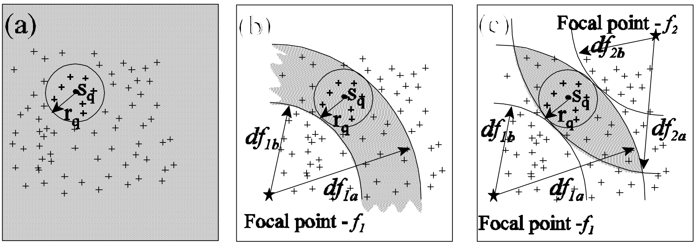
Range Queries over OMNI
Given a query point S_{q}, and a query radius r_{q}
Retrieve all objects with r_{q} distances from S_{q}
The triangle inequality in metric spaces!

Slide 66
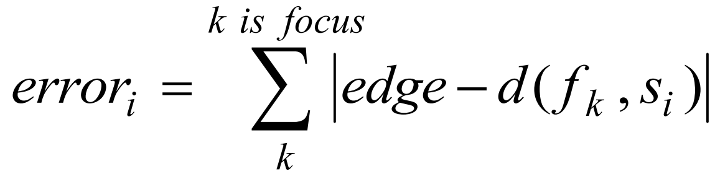
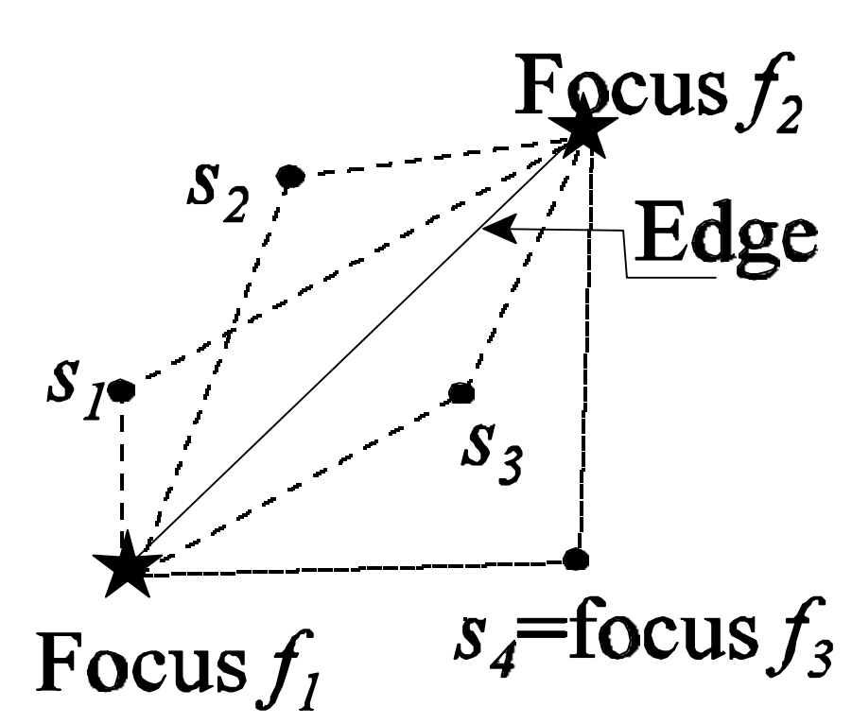

Research Problems with OMNI
How to select foci?
HF-algorithm (finding foci near hull of the data set)
Randomly choose an object s₁
Find the farthest object f₁ from s₁ and set it as the first focus
Find the farthest object f₂ from f₁ and set it as the second focus
The next focus will be the one, s_{i}, that has the most similar distances to the previously chosen foci
Formally, minimizing

Slide 67
Members of OMNI-Family
Omni-Sequential
The entire data set is read sequentially
OmniB-tree
Use one focus, and index 1-dimensional embedded objects using B⁺-tree
OmniR-tree
Use l foci, and index l-dimensional transformed objects using R-tree (or its variants like R*-tree)

Slide 68
Inverted Index
An inverted file is a word-oriented mechanism for indexing a text collection in order to speed up the searching task
The structure of inverted file:
Vocabulary is a set of all distinct words in the text
Occurrences are lists containing all information necessary for each word of the vocabulary (text position, frequency, documents where the word appears, etc.)
Notes:
https://en.wikipedia.org/wiki/Inverted_index
cecs.wright.edu/~tkprasad/courses/cs499/L03InvertedIndex.ppt
www.csdl.tamu.edu/~shipman/courses/cpsc315/slides/inverted-index.ppt

Slide 69
An Example of the Inverted Index
Text:
Inverted file
1 6 12 16 18 25 29 36 40 45 54 58 66 70
That house has a garden. The garden has many flowers. The flowers are beautiful
Vocabulary
Occurrences
beautiful
flowers
garden
house
70
45, 58
18, 29
6
Notes:
www.csdl.tamu.edu/~shipman/courses/cpsc315/slides/inverted-index.ppt

Slide 70
Inverted Files with TF-IDF
The term frequency (tf)
The inverse document frequency (idf)
Vocabulary entry
Posting file entry
t
idf_{t}
doc₁
tf_{t,1}
doc₂
tf_{t,2}
…
idf_{t} : inverse document frequency of term t
doc_{i} : i-th document that contains term t
tf_{t,i} : term frequency of term t in document i
Notes:
www.csdl.tamu.edu/~shipman/courses/cpsc315/slides/inverted-index.ppt
V. Hristidis and Y. Papakonstantinou. Discover: Keyword search in relational databases. In VLDB, 2002.

Slide 71
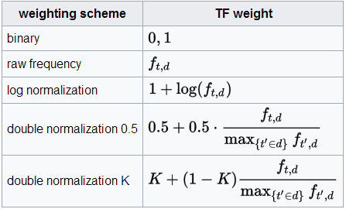
Inverted Files with TF-IDF (cont'd)
Term frequency, tf(t, d)
The number of times that term t occurs in document d
Notes:
https://en.wikipedia.org/wiki/Tf–idf

Slide 72

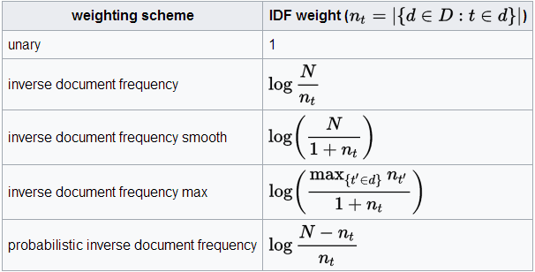
Inverted Files with TF-IDF (cont'd)
Inverse document frequency, idf(t, D)
Notes:
https://en.wikipedia.org/wiki/Tf–idf

Slide 73

Inverted Files with TF-IDF (cont'd)
Term frequency - Inverse document frequency
Reflect how important a word is to a document in a collection or corpus
Higher tf-idf measure indicates more importance of term t
Notes:
https://en.wikipedia.org/wiki/Tf–idf

Slide 74
Score for a Document
Given a query document q, and a data document d
Notes:
https://web.stanford.edu/class/cs276/handouts/lecture6-tfidf.ppt

Slide 75
Searching
The search algorithm on an inverted index follows three steps:
Vocabulary search: the words present in the query are located in the vocabulary
Retrieval occurrences: the lists of the occurrences of all query words found are retrieved
Manipulation of occurrences: the occurrences are processed to solve the query
Notes:
www.csdl.tamu.edu/~shipman/courses/cpsc315/slides/inverted-index.ppt

Slide 76
Searching (cont'd)
Searching inverted files starts with vocabulary
Store the vocabulary in a separate file
Structures used to store the vocabulary include
Hashing: O(1) lookup, does not support range queries
Tries: O(c) lookup, c = length (word)
B-trees: O(log v) lookup
An alternative is simply storing the words in lexicographical order
cheaper in space and very competitive with O(log v) cost
Notes:
www.csdl.tamu.edu/~shipman/courses/cpsc315/slides/inverted-index.ppt

Slide 77
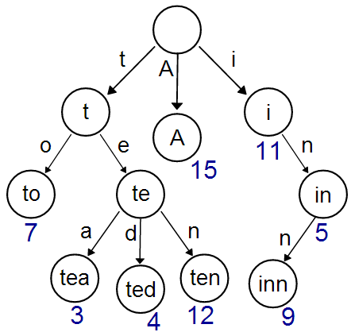
Trie
Trie (or prefix tree)
An index for string data
https://en.wikipedia.org/wiki/Trie

Slide 78
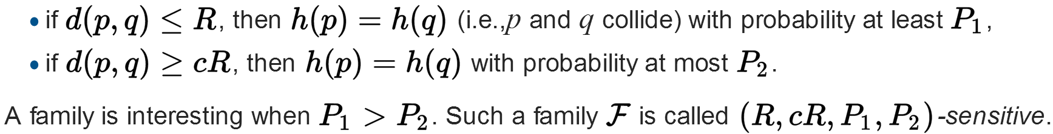
Locality Sensitive Hashing
Locality Sensitive Hashing (LSH)
Hash high dimensional objects into buckets
Similar objects are mapped into the same bucket with high probabilities
Dissimilar objects are mapped into the same bucket with low probabilities
Given two objects p and q, a distance function d(., .), an approximation factor c > 1, and a hash function h(.)
Notes:
https://en.wikipedia.org/wiki/Locality-sensitive_hashing

Slide 79
Applications of LSH
Near duplicate detection
Documents
Texts
Web pages
Papers
Clustering

Slide 80
Examples of LSH
Hamming similarity
Given two n-bit vectors x and y
HS(x, y) = #{i : x_{i} = y_{i} } / n
If x and y do not have any bit of the same values, then HS(x, y) = 0
If x and y are identical, HS(x, y) = 1
x = 01001, y = 10011, HS(x, y) = 2/5
The normalized Hamming distance between x and y is: 1- HS(x, y)
Sampling hash
H = {h₁, …, h_{n}}, where h_{i}(x) = x_{i}
The i-th hash function h_{i}(x) outputs the i-th bit of x
Sampling hash functions form an LSH for hamming similarity
Pr[h(x) = h(y)] = Pr_{i}[h_{i}(x) = h_{i}(y)] = HS(x, y)
(R, cR, p₁, p₂) – sensitive: p₁= 1-R/n, p₂=1-cR/n
Notes:
https://users.soe.ucsc.edu/~niejiazhong/slides/kumar.pdf

Slide 81
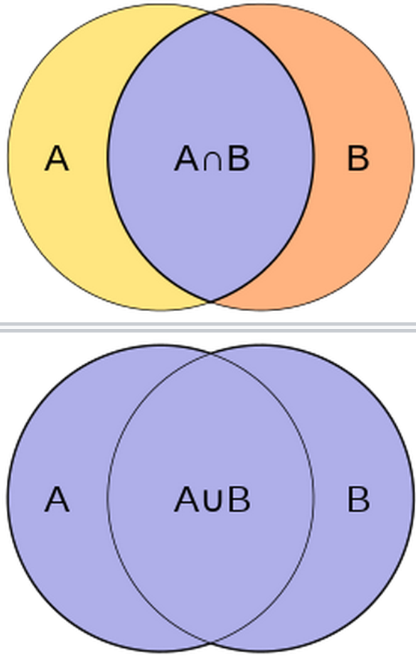
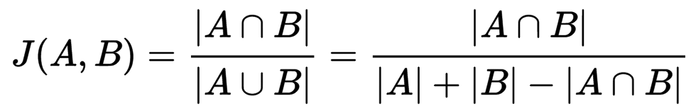
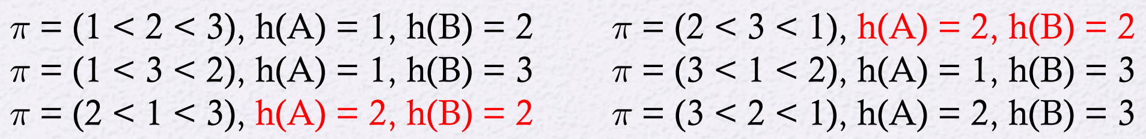
Examples of LSH (cont'd)
Jaccard similarity (Jaccard index)
Given two sets, A and B
MinHash
Let π be a permutation on the domain of sets S
For subset A ⊆ S, let h(A) = min_{a∈A}{π(a)}
A = {1, 2}, B = {2, 3}
Pr[h(A) = h(B)] = |A∩B| / |A ∪ B| = J(A, B)
Notes:
https://en.wikipedia.org/wiki/Jaccard_index
https://users.soe.ucsc.edu/~niejiazhong/slides/kumar.pdf

Slide 82
LSH Algorithms for Nearest Neighbor Search
Selecting k hashing functions h₁(), ..., h_{k}()
For each object o in the database
Hash this object o to k buckets w.r.t. k hashing functions, respectively
Given a query object q
Search k buckets where q is hashed into (with k hashing functions, respectively)
The process is stopped when a point within distance cR from q is found
Notes:
https://en.wikipedia.org/wiki/Locality-sensitive_hashing#LSH_algorithm_for_nearest_neighbor_search

Slide 83
Reading Materials
(Quadtree) H. Samet and R. E. Webber. Storing a collection of polygons using quadtrees. In ACM Trans. Graph, 1985. https://pdfs.semanticscholar.org/65ee/4429b5509173f12309539e809ac533e84690.pdf
(K-D-B-tree) J. T. Robinson. The K-D-B-Tree: a search structure for large multidimensional dynamic indexes. In SIGMOD, 1981. http://repository.cmu.edu/cgi/viewcontent.cgi?article=3451&context=compsci
(K-D-tree) R. A. Brown. Building a Balanced k-d Tree in O(kn log n) Time. In Journal of Computer Graphics Techniques (JCGT), vol. 4, no. 1, 50-68, 2015. http://jcgt.org/published/0004/01/03/paper.pdf
(R-tree) A. Guttman. R-trees: a dynamic index structure for spatial searching. In SIGMOD, 1984. http://www-db.deis.unibo.it/courses/SI-LS/papers/Gut84.pdf
(R⁺-tree) T. Sellis, N. Roussopoulos, and C. Faloutsos. The R⁺-Tree: A dynamic index for multi-dimensional objects. In VLDB, 1987. http://citeseerx.ist.psu.edu/viewdoc/summary?doi=10.1.1.45.3272
(R*-tree) N. Beckmann, H.-P. Kriegel, R. Schneider, and B. Seeger. The R*-tree: an efficient and robust access method for points and rectangles. In SIGMOD, 1990. https://www.cs.umd.edu/class/fall2002/cmsc818s/Readings/rstar-tree.pdf
(X-tree) S. Berchtold, D. A. Keim, and H.-P. Kriegel. The X-tree: An Index Structure for High-Dimensional Data. In VLDB, 1996. https://pdfs.semanticscholar.org/83f6/d2b79b68af1115db013907df78b96dd82ea7.pdf
(Locality Sensitive Hashing) A. Gionis, P. Indyk, and R. Motwani. Similarity Search in High Dimensions via Hashing. In VLDB, 1999. http://www.vldb.org/conf/1999/P49.pdf

Slide 84
Reading Materials (cont'd)
(SS-tree) D. A. White and R. Jain. Similarity Indexing with the SS-tree. In ICDE, 1996. http://www.cs.uml.edu/~cchen/580-S06/reading/WJ96.pdf
(SR-tree) N. Katayama and S. Satoh. The SR-tree: an index structure for high-dimensional nearest neighbor queries. In SIGMOD, 1997. https://pdfs.semanticscholar.org/20b5/fc20821968a2e990183ee4613c591951597c.pdf
(M-tree) P. Ciaccia, M. Patella, and P. Zezula. M-tree An Efficient Access Method for Similarity Search in Metric Spaces. In VLDB, 1997. http://www.vldb.org/conf/1997/P426.PDF
(OMNI-family) R.F.S. Filho, A. Traina, C. Traina, and C. Faloutsos. Similarity search without tears: the OMNI-family of all-purpose access methods. In ICDE, 2001. http://ieeexplore.ieee.org/document/914877/?reload=true
(High-Dimensional Indexing) C. Faloutsos, M. Ranganathan, and Y. Manolopoulos. Fast subsequence matching in time-series databases. In SIGMOD, 1994. http://dl.acm.org/citation.cfm?id=191925
H. Samet. Foundations of Multidimensional and Metric Data Structures. The Morgan Kaufmann Series in Computer Graphics and Geometric Modeling, ISBN: 0123694469, 2005. http://dl.acm.org/citation.cfm?id=1076819
(Similarity Search) http://www.nmis.isti.cnr.it/amato/similarity-search-book/SAC-07-tutorial.pdf

Slide 85
Exercises
Install Apache Hadoop on your machine
http://hadoop.apache.org/
Read tutorials of Amazon AWS
https://aws.amazon.com/

