Slide 1
CS 63016 & CS 73016 Big Data Analytics
Chapter 6: Queries Over Big Data (2)
Xiang Lian
Department of Computer Science
Kent State University
Email: xlian@kent.edu
Homepage: http://www.cs.kent.edu/~xlian/
Notes:
The slides of this Big Data course used some public slides/materials on the Web. I would like to acknowledge these resources, and please let me know if I failed to cite them.

Slide 2
Queries Over Big Data
Range Query
Nearest Neighbor (NN) Query
k-Nearest Neighbor (kNN) Query
Group Nearest Neighbor (GNN) Query
Reverse Nearest Neighbor (RNN) Query
Top-k Query
Skyline Query
Top-k Dominating Query
Reverse Skyline Query
Inverse Ranking Query
Aggregate Queries
Keyword Search Query
Graph Queries

Slide 3
Static Skyline Problem
Point o(o₁,o₂, …, o_{d}) dominates point p(p₁,p₂, …, p_{d}), iff
o_{i} ≤ p_{i} for all 1≤ i ≤ d;
o_{j} < p_{j}, for some 1≤ j ≤ d
Point o is a skyline point if o is not dominated by other points
static
skyline points

Slide 4
Dynamic Skyline
Skyline with dynamic attributes
Dynamic dominance
|o_{i} - u_{i}| ≤ |p_{i} - u_{i}|, for all 1 ≤ i ≤ d
|o_{j} - u_{j}| < |p_{j} - u_{j}|, for some j
To obtain all the objects in the database that are not dynamically dominated by other objects with respect to query object u
|o₁ – u₁|
o
|o₂ – u₂|
p
dominating
regions
E. Dellis and B. Seeger. Efficient Computation of Reverse Skyline Queries. In VLDB, 2007.
Notes:
Given a query object u, we say object o dynamically dominates object p with respect to u (denoted as o <_{u} p), if it holds that: 1) |o_{i} - u_{i}| ≤ |p_{i} - u_{i}|, for all dimensions 1 ≤ i ≤ d, and 2) there exists at least one dimension j, such that |o_{j} - u_{j}| < |p_{j} - u_{j}|
Given a query object u, a dynamic skyline query obtains all the objects in the database that are not dynamically dominated by other objects with respect to u
E. Dellis and B. Seeger. Efficient Computation of Reverse Skyline Queries. In VLDB, 2007.

Slide 5
Reverse Skyline Query
dynamic skyline
of point b
Given a query point q, a reverse skyline query obtains all the objects u such that the dynamic skyline points of u include query point q
b is a reverse
skyline of q
E. Dellis and B. Seeger. Efficient Computation of Reverse Skyline Queries. In VLDB, 2007.

Slide 6
Motivation Example of Reverse Skyline Query
In a laptop market, each model corresponds to a 2D point in a price and performance space
Those customers who are interested in f, are very likely to be interested in a and c
If a company wants to produce a new model, …
new model q
f
a model that customers prefer
E. Dellis and B. Seeger. Efficient Computation of Reverse Skyline Queries. In VLDB, 2007.

Slide 7
Problem Definition of Reverse Skyline Query
Let P be a d-dimensional data set
Given a query point q, a reverse skyline query (RSQ) according to the query point q retrieves all points p₁ ∈ P where q is in the dynamic skyline of p₁.
Formally, a point p₁ ∈ P is a reverse skyline point of q ∈ P, iff ¬∃ p₂ ∈ P such that:
(a) for all i ∈ {1, . . . , d}: |p₂^{i} − p₁^{i}| ≤ |q^{i} − p₁^{i}| and
(b) for at least one j ∈ {1, . . . , d}: | p₂^{j} − p₁^{j}| < | q^{j} − p₁^{j}|

Slide 8
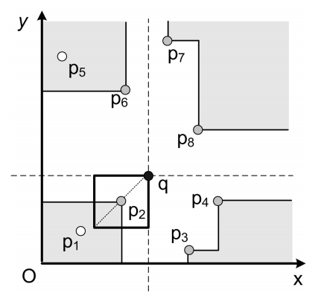
Global Skyline Points
A point p₁ ∈ P globally dominates p₂ ∈ P with regard to the query point q if:
(1) for all i ∈ {1, . . . , d}: (p₁^{i} −q^{i})(p₂^{i} −q^{i}) > 0,
(2) for all i ∈ {1, . . . , d}: |p₁^{i} −q^{i} | ≤ |p₂^{i} −q^{i}|, and
(3) for at least one j ∈ {1, . . . , d}: | p₁^{j} −q^{j} | < |p₂^{j} −q^{j}|
The global skyline of a point q, GSL(q), contains those points which are not globally dominated by another point according to q
The global skyline set, GSL(q), is a superset of reverse skyline answers of query point q!!

Slide 9
Top-k Queries
monotonic preference function
f(o) = o.height + o.weight
For newborn babies, large values of weight and height would indicate their good health
Given a monotonic preference function f(.) that outputs the score of a baby, we can rank babies sorted on scores
In literature, the problem of retrieving k babies with the highest scores is called top-k query
Notes:
Let me first give an example of top-k query.
Assume we have a number of newborn babies. Each baby has his/her own height and weight, which is represented by a point in this data space.
Intuitively, if a baby has large values of weight and height, then it indicates a good health of this baby. The top-k problem would specify a preference function, for example, to compute the summation of weight and height. Then, each baby has a score based on this preference function. In our example, baby a has the largest score, baby b has the second largest score, and so on. The top-k problem is to retrieve k babies who have the scores, that is, k healthiest babies.

Slide 10
Inverse Ranking Queries [Li, 2007]
monotonic preference function
f(o) = o.height + o.weight
For a newborn baby, we may be interested in his/her health compared with other babies, for example, in terms of height and weight
Given a query baby q and a preference function f(.), an inverse ranking problem is to obtain the rank of baby q among other babies, in order to infer q's health
query baby q
C. Li. Enabling data retrieval: by ranking and beyond. In Ph.D. Dissertation, University of Illinois at Urbana-Champaign, 2007.
Notes:
In contrast, for the inverse ranking query, instead of finding babies with the highest scores in the existing database, we are given a query baby q, and we want to determine the health of this query baby compared with other babies. In other words, we want to obtain the rank of this query baby in this database. In this example, we can see that the rank of this query baby is 3.

Slide 11
Inverse Ranking Queries (cont'd)
monotonic preference function
f(o) = o.credit + o.salary
Credit Card Application
The information of customers includes the credit history and salary
To determine the credit line of a new customer among his/her peers
query customer q
Notes:
The inverse ranking query has many other applications, for example, in the credit card application. Each customer has his/her information including the credit history and salary. Similarly, assume we have a preference function which sums up credit and salary of each customer.
Now given a new customer q, the credit card company may want to determine the credit line of this customer by comparing his/her score with those of other customers.

Slide 12
Problem Definition of Inverse Ranking Query
Inverse Ranking Queries
A spatial database, D
A query object, q
A monotonic preference function, f(·)
An inverse ranking query computes the rank of a given query object q in the database D

Slide 13
Reducing the Search Space
R⁺
Classify MBRs/objects into 3 categories
R⁺ – a set of MBRs/objects o with scores f(o) definitely larger than f(q)
R₀ – a set of MBRs/objects o that might have scores f(o) equal to f(q)
R⁻ – a set of MBRs/objects o with scores f(o) definitely smaller than f(q)
R₀
query point q
R⁻

Slide 14
Pruning Idea
R⁺
Indexing
Aggregate R-tree (aR-tree)
Aggregate: COUNT
While traversing aR-tree
Obtain the size, |R⁺|, of set R⁺
Retrieve all the MBRs /objects in the set R₀
R₀
query point q
R⁻

Slide 15
Aggregate Queries
Range aggregate queries
COUNT
SUM
MIN/MAX
AVG
Medium
Quantile

Slide 16
Examples of Aggregate Queries
Range COUNT query
query range

Slide 17
Solutions
aR-tree
Histogram
Sampling
…

Slide 18
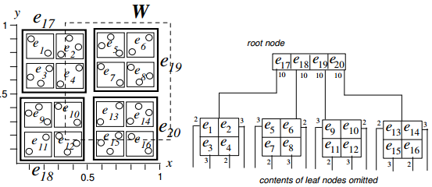
Recall: Aggregate R-Tree
I. Lazaridis and S. Mehrotra. Progressive Approximate Aggregate Queries with a Multi-Resolution Tree Structure. In SIGMOD, 2001.

Slide 19
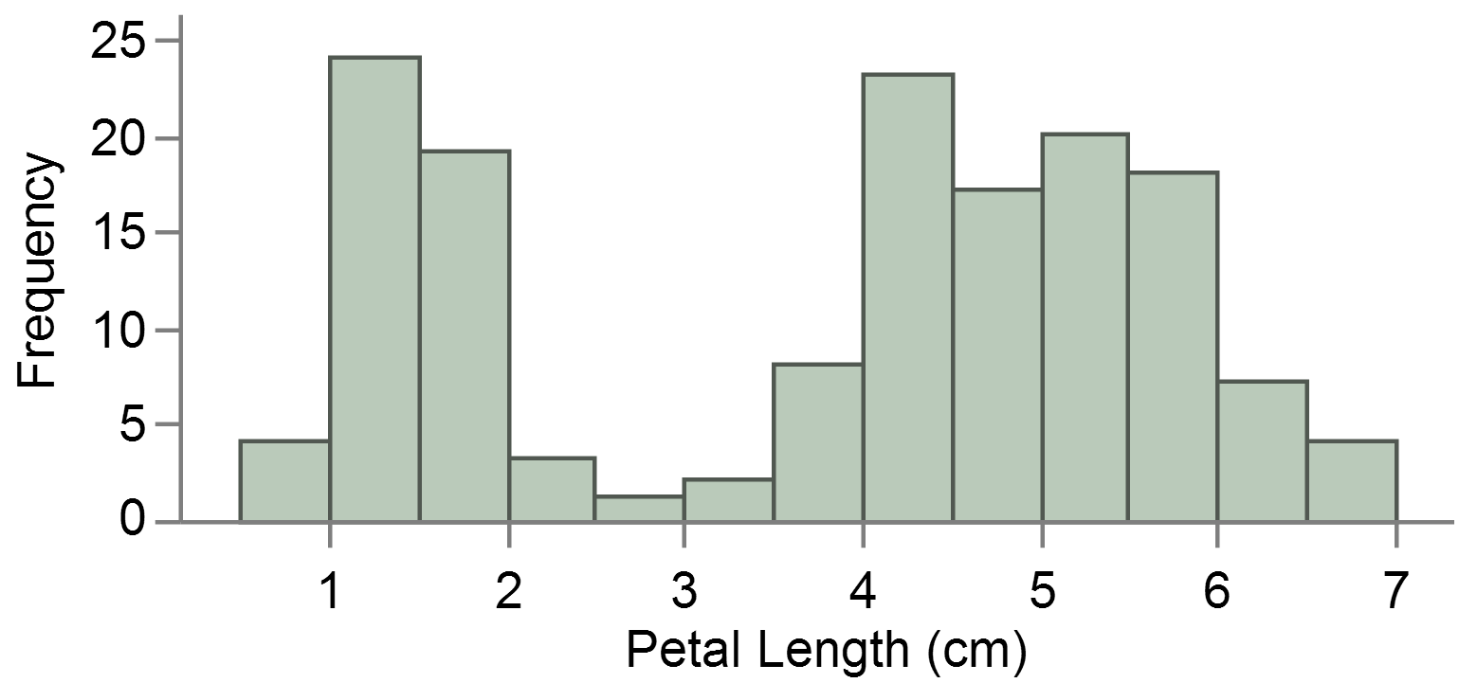
Histogram
1-dimensional data
Histogram for d-dimensional data

Slide 20
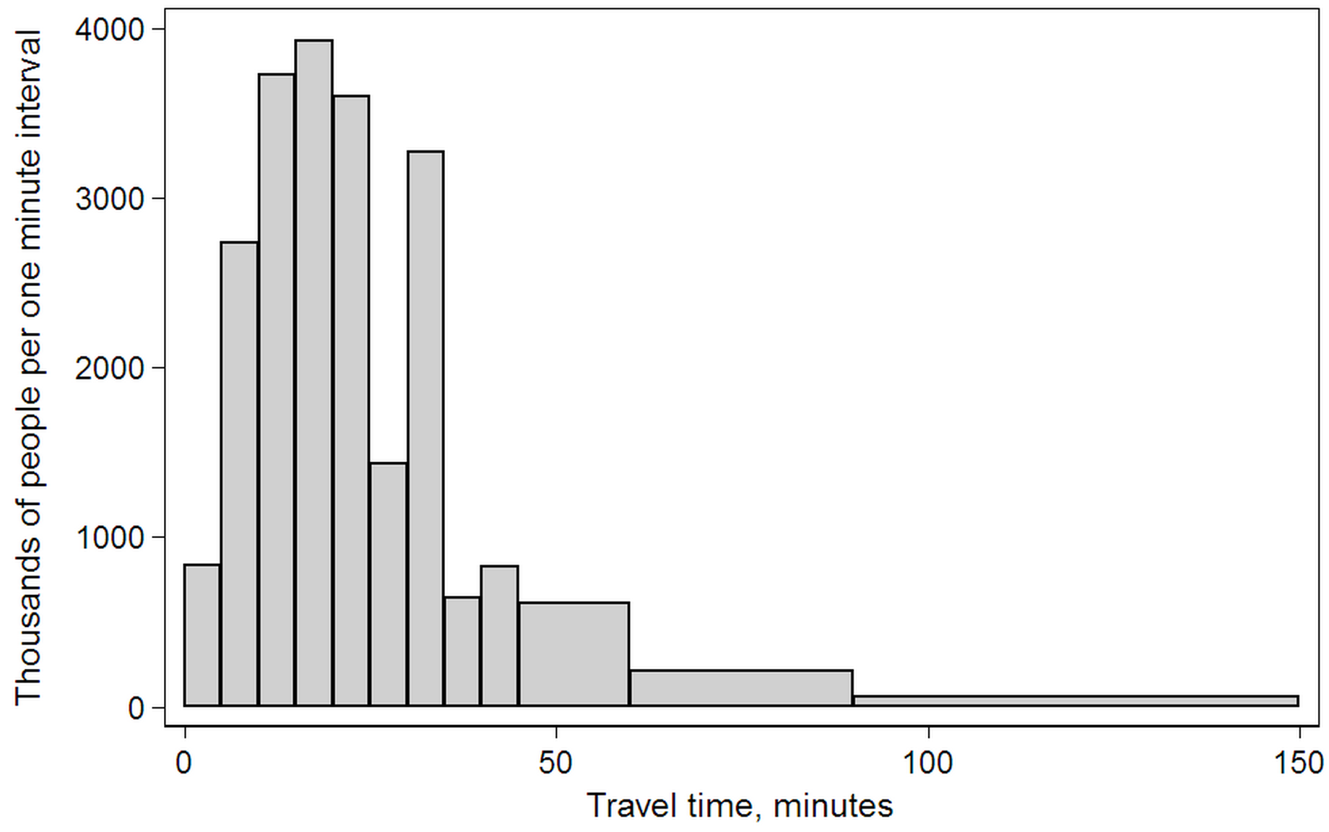
Categories of Histograms
Equi-width histogram
Equi-depth histogram

Slide 21
Random Sampling
COUNT estimation from samples
10 objects, 3 random samples
1 sample in the query range
The estimated COUNT = 10 * (1/3) = 3.333…
query range
samples

Slide 22
Other Methods: Haar Wavelet Coefficients
Hierarchical decomposition structure ( a.k.a. Error Tree )
Conceptual tool to “visualize” coefficient supports & data reconstruction
2.75
Reconstruct data values d(i)
d(i) = (+/-1) * (coefficient on path)
Range sum calculation d(l:h)
d(l:h) = simple linear combination of coefficients on paths to l, h
Only O(logN) terms
+
+
-1.25
-
0.5
0
+
-
+
-
0
-1
-1
0
+
-
+
-
+
-
+
-
Original data
2 2 0 2 3 5 4 4
3 = 2.75 - (-1.25) + 0 + (-1)
6 = 4*2.75 + 4*(-1.25)
M. Garofalakis and P. B. Gibbons. Wavelet Synopses with Error Guarantees. In SIGMOD, 2002.
Notes:
www.softnet.tuc.gr/~minos/Talks/uw-wavelets.ppt
https://pdfs.semanticscholar.org/9000/d59b60bb3acac9ffe256c26e8152de3b645a.pdf

Slide 23
Keyword Search Query
Given a set of query keywords, find relevant documents or other data that contain these query keywords
Advantages of the keyword search query
Ease to use: only need to specify a few query keywords
No need to know the detailed schema of the data
Good for non-experts without any domain knowledge

Slide 24

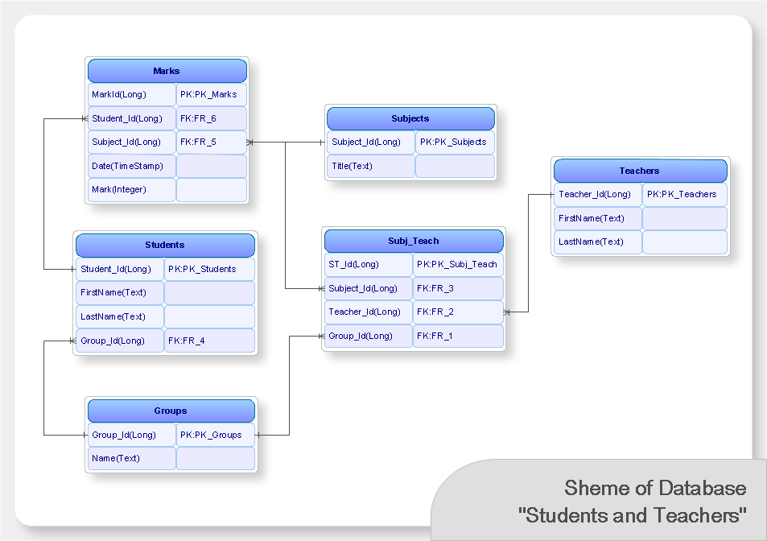




Traditional Data Access Methods
Text documents:
Unstructured
Accessed by keywords
Limited search quality
Large user population
Databases / XML data
Structured, with rich meta-data
Accessed by query languages
High search quality
Small user population that masters DB
https://web.njit.edu/~ychen/keyword_sigmod09_tutorial.ppt
Notes:
https://web.njit.edu/~ychen/keyword_sigmod09_tutorial.ppt

Slide 25


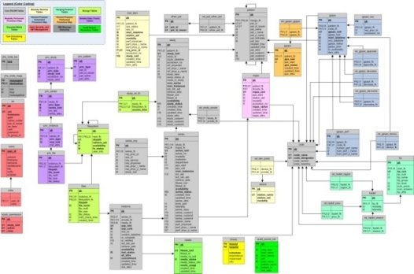
The Challenges of Accessing Structured Data
Query languages: long learning curves
Schemas: Complex, evolving, or even unavailable
What about filling in query forms?
Limited access pattern
Hard to design and maintain forms on dynamic and heterogeneous data!
select paper.title from conference c, paper p, author a1, author a2, write w1, write w2 where c.cid = p.cid AND p.pid = w1.pid AND p.pid = w2.pid AND w1.aid = a1.aid AND w2.aid = a2.aid AND a1.name = “John” AND a2.name = “Mary” AND c.name = SIGMOD
The usability of DB is severely limited unless easier ways to access databases are developed ^{[Jagadish, SIGMOD 07]}.
Notes:
Jagadish, H. V., Chapman, A., Elkiss, A., Jayapandian, M., Li, Y., Nandi, A., and Yu, C. (2007). Making database systems usable. In SIGMOD, pages 13-24.

Slide 26
Keyword Search on Graph Representation of Data
Keyword search on relational, XML, HTML, etc. data
BANKS, Discover, DBXplorer, XRank, BLINKS, etc.
Need to find a (closely) connected set of nodes that together match all given keywords
Focus of our work
Search algorithms to find connections between nodes
Notes:
research.cs.wisc.edu/dibook/slides/Chapter_16.ppt

Slide 27
Graph Data Model
Data modeled as a directed weighted graph: BANKS [ICDE’02]
Can model relational, XML, HTML, etc. data
E.g., DBLP database
Node = tuple
Edge = foreign key reference
BANKS: Keyword search…
Multi-Query Optimization
paper
writes
Soumen
Sudarshan
Prasan Roy
author
Notes:
Talk about RDF and other data too

Slide 28
Graph Data Model (2)
E.g., XML data
<proceedings>
<paper id=“1”>
<title>Databases</title>
</paper>
<paper id=“2”>
<title>Keyword Search</title>
<cite ref=“1”>Databases</cite>
</paper>
</proceedings>
proceedings
paper (@id = 1)
paper (@id = 2)
title
cite
title

Slide 29
Response Model
Response: Minimal, rooted tree connecting keyword nodes
Undirected: Discover, DBXplorer
Directed: BANKS
paper
Multi-Query Optimization
E.g., Sudarshan Roy
writes
writes
author
author
Sudarshan
Prasan Roy

Slide 30
Response Ranking
Edge Score = E_{A}
Smaller tree => higher score
E.g., BANKS: E_{A} = 1/ (S edge weights)
Node Score = N_{A}
Measure of authority of nodes in tree
E.g., BANKS: N_{A} = S (leaf and root node authorities)
Overall score = f (E_{A}, N_{A})
E.g., BANKS: f (E_{A}, N_{A}) = E_{A} . N_{A}^{l}

Slide 31
Finding Answer Trees
BANKS: Backward Expanding Search
Intuition: travel backwards from keyword nodes till you hit a common node
paper
MultiQuery Optimization
Query: sudarshan roy
writes
Sudarshan
Prasan Roy
authors
A. Hulgeri and C. Nakhe. Keyword Searching and Browsing in Databases using BANKS. In ICDE, 2002.

Slide 32
Backward Search: Algorithm
Algorithm
Run concurrent single source shortest path iterators from each node matching a keyword
Traverse the graph edges in reverse direction
Output next nearest node on each get-next() call
Do best-first search across iterators
Output node if in the intersection of sets of nodes reached from each keyword

Slide 33
Backward Search: Limitations
Wasteful exploration of graph:
Frequently occurring keywords
"Hub" nodes in the graph (high in-degree)
“Shashank Sudarshan Database”
…
Database
Schema Legend
…
author
writes
Shashank
Sudarshan
paper

Slide 34
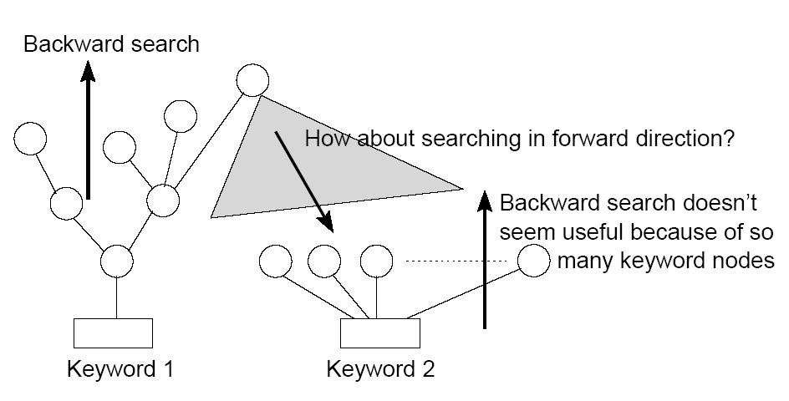
Bidirectional Search: Motivation
V. Kacholia, S. Pandit, S. Chakrabarti, S. Sudarshan, R. Desai, and H. Karambelkar. Bidirectional expansion for keyword search on graph databases. In VLDB, 2005.
Notes:
http://www.vldb2005.org/program/paper/wed/p505-kacholia.pdf

Slide 35
Bidir Search: Intuition
First cut solution:
Don’t go backward if keyword matches many nodes
Don’t go backward if node points to a hub
Instead explore forward from other keywords
“Shashank Sudarshan Database”
…
…
Schema Legend
Database
author
…
writes
paper
Shashank
Sudarshan

Slide 36
Bidir Search: Issues
What should threshold for not expanding be?
Solution: prioritize expansion of nodes based on spreading activation
To penalize frequent keywords and bushy tree
V. Kacholia, S. Pandit, S. Chakrabarti, S. Sudarshan, R. Desai, and H. Karambelkar. Bidirectional expansion for keyword search on graph databases. In VLDB, 2005.

Slide 37
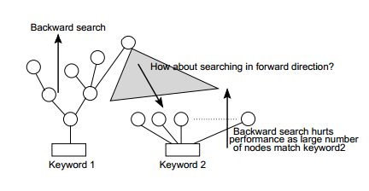
Bidirectional Search
Backward Search: All the single source shortest path iterators from query keywords merged into a single iterator, called the incoming iterator.
Forward Search: An outgoing iterator runs concurrently, which follows forwarding edges starting from all the nodes explored by the incoming iterator.
Prioritize: Spreading activation to prioritize the search, which chooses incoming iterator or outgoing iterator to be called next.
Requirement for Bidirectional Search
37
Notes:
http://eecs.wsu.edu/~yinghui/mat/papers/Emerging%20graph%20queries%20in%20linked%20data-ICDE12.pptx

Slide 38
BLINKS
BLINKS
Propose a cost-balanced strategy for controlling expansion across clusters, with a provable bound on its worst-case performance
Use bi-level indexing to support forward jumps in search
More …
Dynamic Programming [Ding et. al., ICDE ’07]
External Memory [Dalvi et. al, VLDB ‘08]
H. He, H. Wang, J. Yang, and P. S. Yu. BLINKS: ranked keyword searches on graphs. In SIGMOD, 2007. http://db.cs.duke.edu/papers/2007-SIGMOD-hwyy-kwgraph.pdf
Notes:
http://eecs.wsu.edu/~yinghui/mat/papers/Emerging%20graph%20queries%20in%20linked%20data-ICDE12.pptx
BLINKS [He et. al., SIGMOD ‘07]
Dynamic Programming [Ding et. al., ICDE ’07]
External Memory [Dalvi et. al, VLDB ‘08]

Slide 39
Graph Queries
Emerging Graph Queries:
Keyword Search
Graph Search
Graph Pattern Matching
Graph Pattern Mining
Anomaly Detection
Graph Skyline
Graph OLAP
Ranking and Expert Finding
Graph Aggregation

Slide 40
Graph Search Queries
Variants
Containment Query
Similarity Query
Matching Query
Graph matching query
Subgraph matching query

Slide 41
Graph Search Queries (cont'd)
Retrieves all graphs from a graph database, such that they contain a given query graph (exact and approximate).
Containment Query
Similarity Query
Matching Query
Q
G₁
G₂
Arijit Khan, Yinghui Wu, Xifeng Yan. Emerging Graph Queries in Linked Data.
Notes:
Arijit Khan, Yinghui Wu, Xifeng Yan. Emerging Graph Queries in Linked Data.

Slide 42
Graph Search Queries (cont'd)
Retrieves all graphs from a graph database, that are similar to the query graph (exact and approximate).
Containment Query
Similarity Query
Graph edit distance
Other ranking scores …
Matching Query
Q
G₁
G₂
Arijit Khan, Yinghui Wu, Xifeng Yan. Emerging Graph Queries in Linked Data.

Slide 43
Graph Search Queries (cont'd)
Find all occurrences of a query graph in a large target network (exact and approximate).
Containment Query
Similarity Query
Matching Query
Q
G
Arijit Khan, Yinghui Wu, Xifeng Yan. Emerging Graph Queries in Linked Data.

Slide 44
Reading Materials
(Reverse Skyline Query) E. Dellis and B. Seeger. Efficient Computation of Reverse Skyline Queries. In VLDB, 2007.
(Inverse Ranking Query) C. Li. Enabling data retrieval: by ranking and beyond. In Ph.D. Dissertation, University of Illinois at Urbana-Champaign, 2007.
(Aggregate Query) I. Lazaridis and S. Mehrotra. Progressive Approximate Aggregate Queries with a Multi-Resolution Tree Structure. In SIGMOD, 2001.
(Histogram) M. Muralikrishna and D. J. DeWitt. Equi-depth multidimensional histograms. In SIGMOD, 1988.
(Sampling) R. J. Lipton, J. F. Naughton, and D. A. Schneider. Practical Selectivity Estimation through Adaptive Sampling. In SIGMOD, 1990.
(Wavelet) M. Garofalakis and P. B. Gibbons. Wavelet Synopses with Error Guarantees. In SIGMOD, 2002.
(Keyword Search; BANK) A. Hulgeri and C. Nakhe. Keyword Searching and Browsing in Databases using BANKS. In ICDE, 2002.
(Keyword Search; BANK) V. Kacholia, S. Pandit, S. Chakrabarti, S. Sudarshan, R. Desai, and H. Karambelkar. Bidirectional expansion for keyword search on graph databases. In VLDB, 2005.
(Keyword Search; BLINKS) H. He, H. Wang, J. Yang, and P. S. Yu. BLINKS: ranked keyword searches on graphs. In SIGMOD, 2007. http://db.cs.duke.edu/papers/2007-SIGMOD-hwyy-kwgraph.pdf

