Slide 1
Previous lecture review
Out of basic scheduling techniques none is a clear
winner:
  FCFS - simple but unfair
  RR - more overhead than FCFS may not be fair
  SJF - optimal, but high overhead, starvation possible
  SRF - optimal, even higher overhead, starvation possible
combined techniques:
  priority scheduling
  multiple feedback scheduling
all are incorporated in modern OS scheduler design

Slide 2
Lecture 8: Scheduling in modern OS
non-preemptive kernel to avoid kernel data corruption
classical Unix (SVR3, 4.3BSD) scheduler design
real-time requirements
SVR4 scheduling improvements
Solaris scheduling improvements
multiprocessor scheduling

Slide 3
Non-Preemptive Kernel
to prevent data structures (especially kernel structures) corruption by simultaneous access by different processes/threads we need to ensure mutual exclusion of access
classical approach
  make kernel non-preemptive - process in kernel mode cannot be suspended when it is in the middle of a shared structure modification
  disable interrupts when vital structures are modified (see Nachos lecture) - interrupt handler cannot corrupt shared structures modified by kernel
problems:
  can be unfair/does not scale
  cannot be used for real-time scheduling
  cannot be used for multiprocessor systems

Slide 4
Classical Unix CPU Scheduling
(System V release 3(SVR3), 4.3BSD)
policy:
  multiple queues (32), each with a priority value - 0-127 (low value = high priority):
    Kernel processes (or user processes in kernel mode) the lower values (0-49) - kernel processes are not preemptive!
    User processes have higher value (50-127)
  choose the process from the occupied queue with the highest priority, and run that process preemptively, using a timer (time slice typically around 100ms)
    Round-robin scheduling in each queue
  move processes between queues
    Keep track of clock ticks (60/second)
    add the number of clock ticks to the process on CPU (decreasing its priority) – process decay
    increase priority of processes spending time in ready queue
  users can decrease (but not increase!) priority

Slide 5
Analysis of classical UNIX CPU scheduling
advantages:
  simple (relatively) and effective
  ok for general purpose, single processor, small sized systems
disadvantages:
  re-computing priorities every second is inefficient in large systems
  no response time guarantee
  priority inversion - a high priority process has to wait for a lower priority process which is in kernel space (non-preemptive kernel) - some kernel code paths take several ms
  applications do not have adequate control over priority (only superuser can increase)

Slide 6
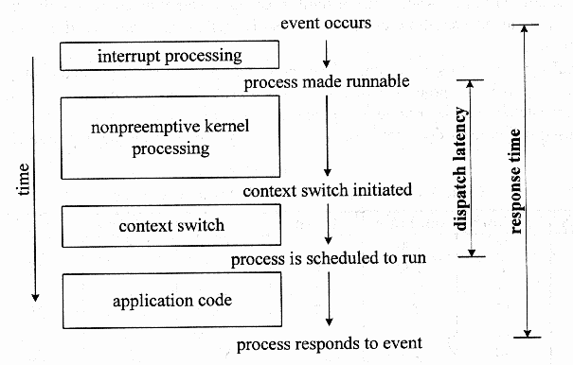
Real-time scheduling
Soft real-time capabilities are needed for quality of service sensitive applications - video, audio, multimedia, virtual reality
require bounded dispatch latency, and response time
Reproduced from “Unix Internals” by Uresh Vahalia
dispatch latency - time from the moment the process becomes runnable to the moment it begins to run
response time = interrupt processing + dispatch latency +
real-time process execution

Slide 7
System V release 4 (SVR4) scheduling
Scheduling classes (in the order of priority):
  real-time - fixed priority and time slices
  system - kernel
  time-sharing (default) - RR scheduling, dynamic priorities, lower priority processes are given larger time slices (to offset overall I/O favoring)
possibility of adding other classes (dynamic loading of scheduler implementations)
on-event priority recompilation - priority changes on specific events
  priority reduced when process uses up time slice
  priority upped if process blocks
kernel preemptive in preemption points - points defined where it is safe to preempt the kernel

Slide 8
Analysis of SVR4 scheduling
Advantages
  flexible, allows real-time, scalable
  modifiable (allows to add classes)
  efficient priority computation
  more balanced scheduling between I/O and CPU bound processes
Problems
  switching time sharing -> real-time is not allowed - hand tuning required and not always possible
  kernel is not completely preemptible
  no multiprocessor support

Slide 9
Solaris Scheduling
fully preemptive kernel, shared kernel structures are protected by explicit synchronization mechanisms
kernel is multithreaded, interrupts are implemented as threads - no need to change interrupt level
symmetric multiprocessor scheduling
priority inheritance or priority lending (solves priority inversion problem) - when a higher priority thread is needs a resources used by a lower priority thread - the higher priority thread lends it’s priority to the lower priority thread; must be transitive!
Does not have hard real-time capabilities

Slide 10
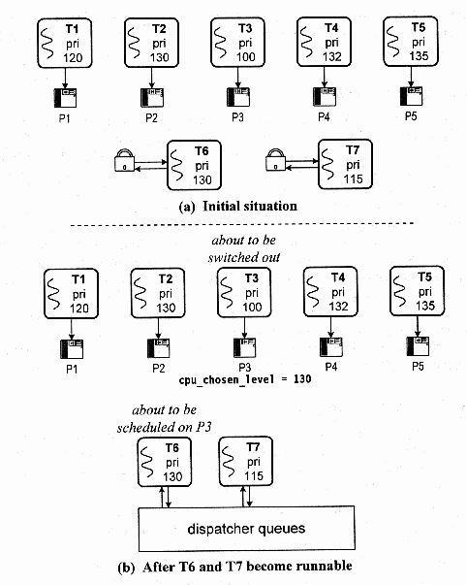
Multiprocessor scheduling in Solaris
one run queue
processors
communicate through cross-processor interrupts
example of multiprocessor scheduling (greater number - higher priority):
1. T6, T7 blocked
2. P1 unblocks T6, calls scheduler to find proc. to run it on,
3. scheduler selects T3, and sends it cross-processor interrupt
4. P2 unblocks T7, calls scheduler to find proc to run
5. P2 needs to know that T6 is scheduled on P3!
Reproduced from “Unix Internals” by Uresh Vahalia

Slide 11


Processor Affinity
Multicore Processors
process migration between processes, although necessary, invalidates processor cache
  processor affinity – OS tries to schedule processes on the same processors
multicore processors particularly vulnerable to memory stall
  to mitigate it – several (typically two) programmable threads per core that are switched in hardware when blocked

