Slide 1
Advanced Memory
Management Techniques
static vs. dynamic kernel memory allocation
resource map allocation
power-of-two free list allocation
buddy method allocation
lazy buddy method allocation

Slide 2
What Is There to Manage?
a number of tasks require arbitrary allocation/deallocation
  user programs – heaps
  kernel
    process structures (PCBs/TCBs, etc.)
    I/O device management
    network buffers and other communication structures
pages are usually to big for such requests
the kernel subsystem that deals with arbitrary kernel memory management is called Kernel Memory Allocator (KMA)
first Unix kernels allocated the these structures statically; what’s wrong with this approach?
  can overflow
  inflexible (cannot be adjusted to concrete system’s needs)
  conservative allocation leads to wasting memory
need dynamic kernel memory allocation

Slide 3
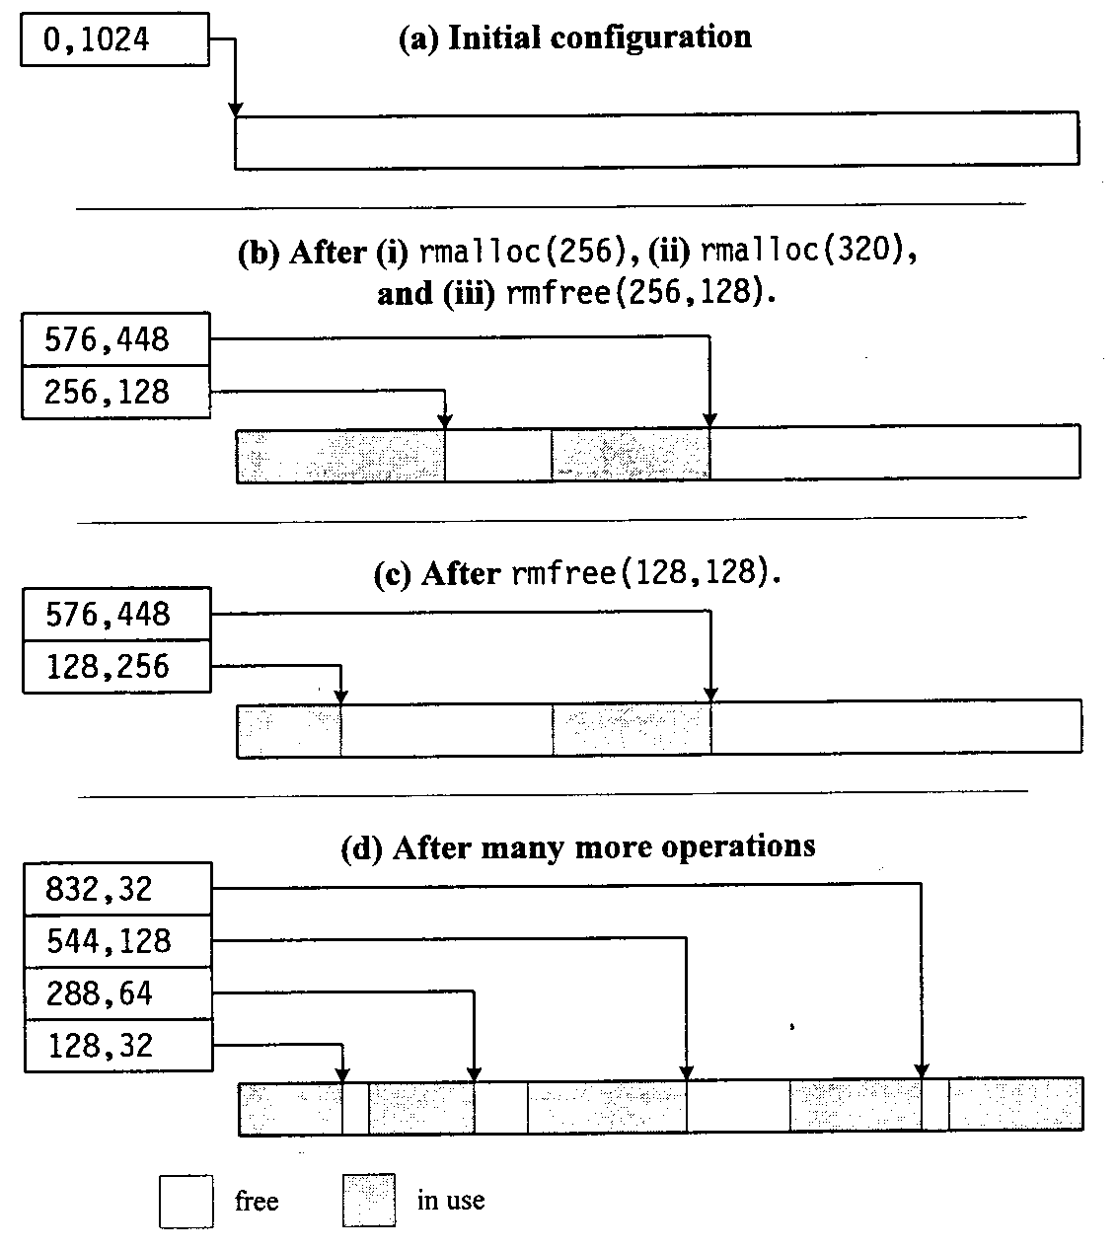
Resource Map Implementation of FF, BF and WF
the simplest dynamic memory allocation KMA
uses resource map: a list of <base,size> where
  base - start of free segment
  size - size of free segment
KMA can use either of
  first fit
  best fit
  worst fit
Unix uses FF for
kernel buffers

Slide 4
Analysis of Resource Map KMA
advantages:
  easy to implement
  can allocate precise memory regions, clients can release parts of memory
  adjacent free memory regions can be coalesced (joined) with extra work
disadvantages:
  the memory space gets fragmented
  linear search for available memory space
  resource map increases with fragmentation. what’s wrong with that?
    more kernel resource are used for the map
    search time increases
  to coalesce adjacent regions map needs to be sorted - expensive
  hard to remove memory from the memory-mapped region

Slide 5
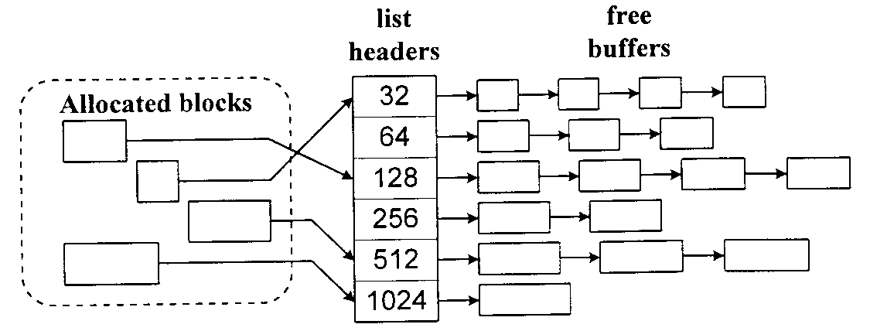
Power-of-two free list KMA
set of free buffer lists - each a power of two a.i.
32, 64, 128 … bytes
each buffer has a one word (4 bytes) pointer
  when the buffer is free - the pointer shows the next free buffer
  when the buffer is used - it points to the size of the buffer
the memory allocation requests are rounded up to the next power of 2
when allocated - the buffer is removed from the list
when freed - the buffer is returned to the appropriate free buffer list
when list is empty KMA either allocates a larger buffer or delays request
used in Unix
to implement
heaps
Notes:
Used by unix to implement malloc() and free() in user-level C-library

Slide 6
Analysis of Power-of-Two KMA
Advantages:
  simple and fast (bounded worst-case performance) - no linear searches
Disadvantages:
  cannot release parts of buffers
  space is wasted on rounding to the next power of two
    (what type of fragmentation is that?)
  a word is wasted on the header - big problem for the memory requests that are power-of-two
  cannot coalesce adjacent free buffers

Slide 7
Buddy KMA
combines buffer coalescing with power-of-two allocator
small buffers are created by (repeatedly) halving a large buffer
when buffer is split the halves are called buddies
  maintains the bitmap for the minimum possible buffer; 1 - allocated
  2 - free
  maintains a list of buffer sized (powers of two)
example, initially we have a block of 1024bytes
  allocate(256) - block is split into buddies of size 512
  bytes - A and A’
  A is split into B
  and B’ - size 256
  B allocated

Slide 8
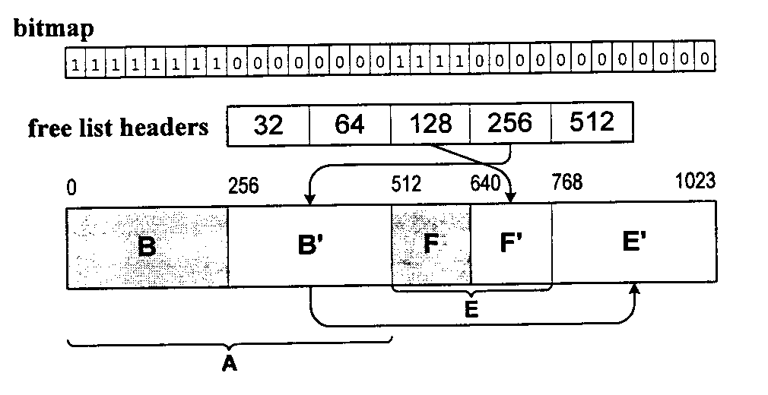
Buddy KMA(cont)
Allocate(128) - finds 128-free list empty; gets B’ from 256-list and splits it into C and C’ - size 128; allocates C
allocate(64) - finds 64-list empty, gets C’ from 128-list; splits it into D and D’ - size 64, allocates D (see picture on previous page)
allocate(128) - removes A’; splits it into E and E’;
splits E into F and F’, allocates F
release(C, 128) - see picture on top
release(D, 64) - coalesce D, D’ to get C’, coalesce C’ and C to get B’

Slide 9
Analysis of buddy KMA
advantages:
  coalescence possible
  possible dynamic modification of allocation region
disadvantages:
  performance - coalescing every time possibly to split up again; coalescing is recursive!
  no partial release

Slide 10
Lazy buddy KMA
coalescence delay - time it takes to check if the
buddy is free and coalesce
buddy KMA - each release operation - at least one coalescence delay
if we allocate and deallocate same-size buffers – inefficient
solution: coalesce only as necessary
  operation is fast when we don’t coalesce
  operation is extremely slow if we coalesce
middle approach:
  we free the buffer making it available for reuse but not for coalescing (not marked in bitmap)
  coalescing is done depending on the number of available buffers of certain class:
    many (lazy state) - no coalescing necessary
    borderline (reclaiming state) - coalescing is needed
    few (accelerated state) - KMA must coalesce fast

Slide 11
Previous lecture review
efficient memory management is needed in various areas
user process space
  internal - inside a process
      in stack segment
      in heap segment
  external - between user processes
kernel memory management

