Slide 1
Discussed Earlier
segmentation - the process address space is divided into logical pieces called segments. The following are the example of types of segments
  code
  bss (statically allocated data)
  heap
  stack
process may have several segments of the same type!
segments are used for different purposes, some of them may grow, OS can distinguish types of segments and treat them differently, example:
  allowing code segments to be shared between processes
  prohibiting writing into code segments

Slide 2
Paging (Outline)
definition
page table description
memory protection and sharing
TLBs
page table organization
  multilevel
  hashed
  inverted
memory management organization example:
Pentium/Linux

Slide 3
Paging Definition
each process is divided into a number of small,
fixed-size partitions called pages
physical memory is divided into a large number of small, fixed-size partitions called frames
page size = frame size
  usually 512 bytes to 16K bytes (lately tends to be 4K)
the whole process is still loaded into memory, but the pages of a process do not have to be loaded into a contiguous set of frames
virtual (logical) address consists of page number and offset from beginning of the page

Slide 4


Page Table
page table – per process data
structure that provides mapping
from page to frame
address space -
the set of all possible addresses
logical address space –
continuous
physical address space –
fragmented
to obtain physical memory
address the page number part
of it is translated to frame
number

Slide 5

Protection in Page Tables
process may not use the whole page table
unused portions of the page table are protected by
valid/invalid bit
the address space for the process is 0 through 12,287 (6 - 2K pages)
even though the page
table contains additional unused
page references they are
marked as invalid
attempt to address these pages
will result in a trap with “memory
protection violation”
alternatively
page-table base register (PTBR)
points to the page table
page-table length register (PRLR)
indicates size of the page table

Slide 6
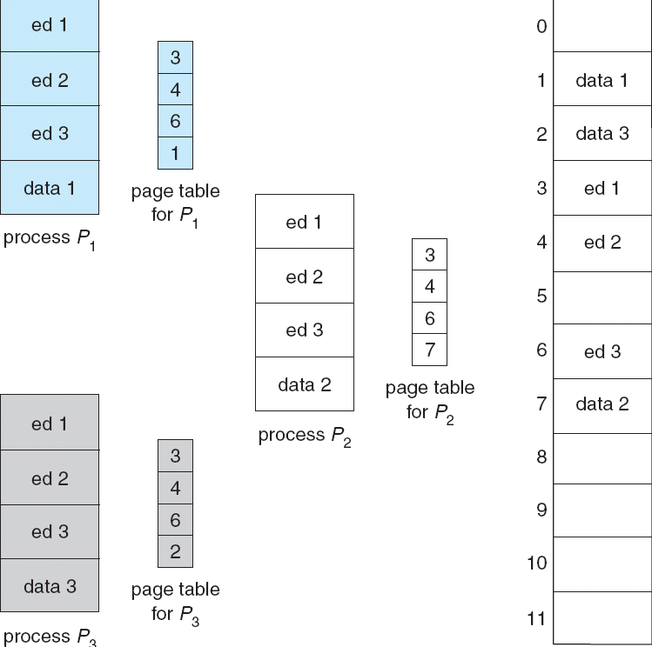
Sharing Pages
paging provides easy way
of reusing the code
if multiple processes are
executing the same
program (ex: text editor)
the pages containing
the code for the editor can
be shared
the code has to be
reentrant (not self-modifying)
and write protected – usually
every page has a
read-only bit
how can shared memory be
implemented using the same
technique?

Slide 7

TLBs
page table resides in
memory; getting data/code
requires more than one
memory lookup
solution: translation
lookaside buffers (TLB) –
associative cache that holds
page and frame numbers
on page access, page # is
first looked in TLBs if
found (cache hit) can
immediately access page
if not found (cache miss)
have to look up the frame in the page table
program with good code locality of reference benefits from TLBs
what happens on context switch?
  old way: flush TLBs (destroying all info they hold)
  new way: each TLB entry stores address-space identifier (ASID) – identifies process, if wrong process – cache miss

Slide 8


Multilevel Page Table
address space of modern computer
system is 2³² to 2⁶⁴ size of page table
is potentially large
  ex: 2³² address space 4K pages (2¹²),
  4-byte page entry – 1 M page entries,
  4MB of space
how to search? trivial if allocation is
continuous (such allocation is difficult
with large page sizes)
page the page table (multilevel page
table)
may
have up
to three
levels

Slide 9

Hashed Page Table
multilevel page table potentially requires multiple
memory lookups for single memory access
inefficient for large address spaces (2⁶⁴)
hashed page table – hashes logical page number. In case of hash collision, page references are linked
Notes:
why 64 bit architecture cannot be done with hierarchical paging – offset 10^12, inner page 10^10, outer 10^10. second outer is 10^32 – 16GB of space for paging

Slide 10

Inverted Page Table
(direct) page table may itself consume significant amount of
memory
  may be inefficient especially for architectures with large virtual address space (64-bit)
instead, store one (global) page table for all processes
one entry for each frame
search table to find
the frame that logical
page refers to
need to keep PID
to know if page access
is from correct process
linear search inefficient
use additional hash
table
difficulty implementing
shared pages
  why?

Slide 11

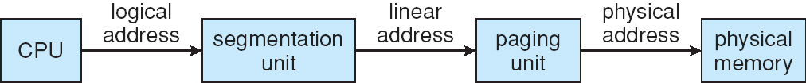
Intel Pentium Segmentation
supports both segmentation and paging
MMU consist of segmentation and paging units
CPU produces logical address
segmentation unit translates it into linear address
paging unit provides physical address
two descriptor (segment) tables
  local (LDT) – specific to
  process
  global (GDT) – shared among
  processes
each entry in descriptor table
contains segment
base/limit/protection info
CPU has specialized registers
to hold descriptor info – if stored
on registers, no memory access needed

Slide 12
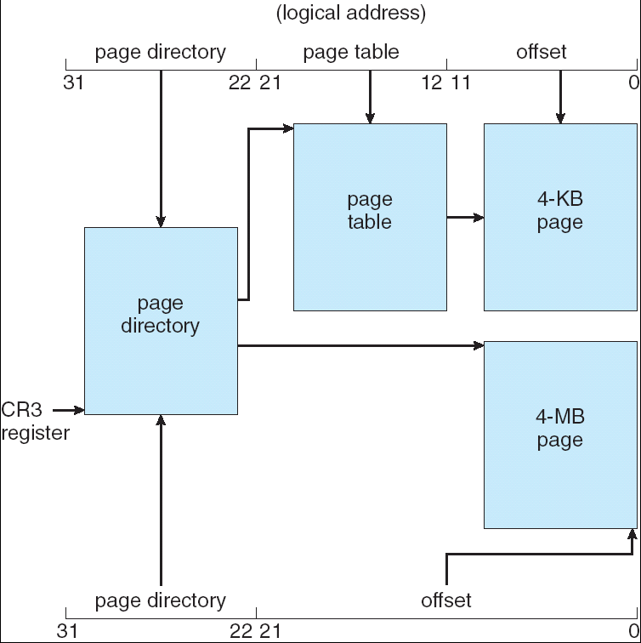

Intel Pentium Paging
paging unit translates from
linear to physical address
supports 4KB and 4MB pages
4KB pages
  linear address consists of
  20-bit page number and
  12-bit page offset
  two level page table
    page directory – outer
    table, higher 10 bits of
    page number
    page table – inner table,
    lower 10 bits of page
    number
4MB pages
  only page directory is used
  higher 10 bits
  lower 22 bits – page offset

Slide 13
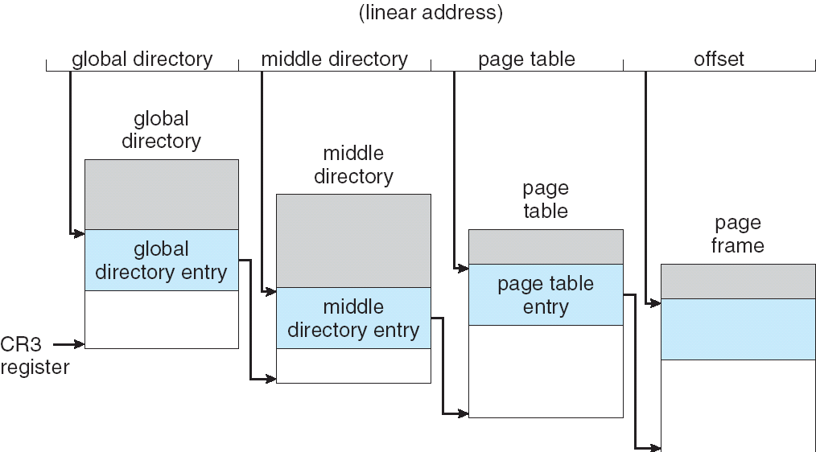
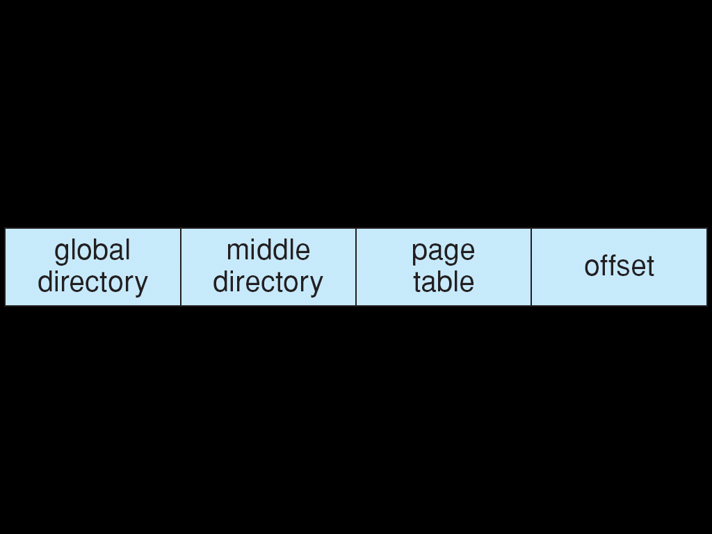
Memory Management in Linux
Linux – OS designed to be
portable across
architectures
  does not use some of
  Pentium specifics
uses only six segments
  in GDT – kernel code, kernel data, user code, user data
    note that user code and data are in GDT – protection is designed on page-level
  in LDT – task state segment (TSS), default segment – effectively PCB
uses only two protection modes – user and kernel (Pentium supports four)
uses three-level page table (to accommodate 64-bit architectures)
  on Pentium the size of middle directory is 0

