Slide 1
Previously Discussed
segmentation - the process address space is divided into logical pieces called segments. The following are the example of types of segments
  code
  bss (statically allocated data)
  heap
  stack
process may have several segments of the same type!
segments are used for different purposes, some of them may grow, OS can distinguish types of segments and treat them differently, example:
  allowing code segments to be shared between processes
  prohibiting writing into code segments

Slide 2
Virtual Memory
definition
page table organization for virtual memory
handling page faults
copy-on-write
page replacement strategies
  FIFO
  optimal
  Least Recently Used
implementing LRU
  recently used bit
  second chance algorithm
frame allocation
thrashing
working set

Slide 3
Demand Paging and Segmentation
virtual memory – the technique that allows to execute
processes that may not be completely in physical memory
can be implemented using:
  demand segmentation – only the segments that are currently in use are brought into memory
  demand paging – only the necessary pages are brought in
virtual memory is transparent to user processes
demand paging
  while not in use the pages are stored on a disk – backing store
  the page table indicates whether the page is in memory or in backing store
  if a process requests a page that is not in memory
    a page fault trap is generated and control is passed to OS
    the faulted process is suspended (another process may be started while it waits) and a request to fetch the page is generated
    when page is in memory the page table is updated and the instruction that caused page fault is re-executed

Slide 4
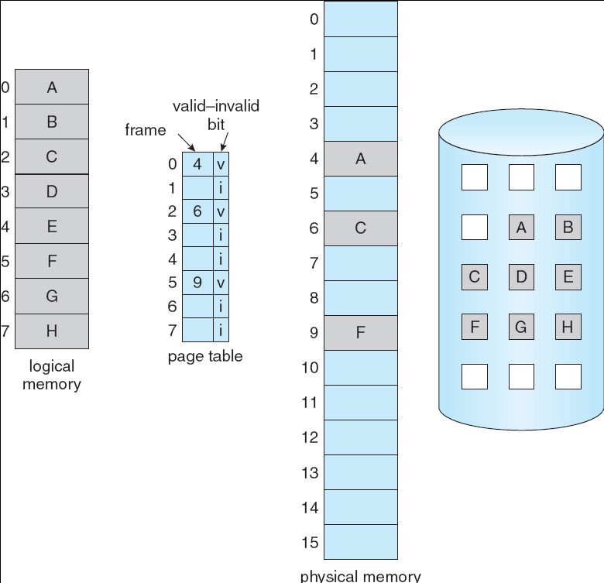
Page Table Organization
page table entry includes valid (present) bit to indicate
if program attempts to access a page that
is not in physical memory, page fault
occurs
  page fault – an exception that
  causes a trap to the OS
unlike interrupts, a page fault can
occur any time there’s a memory
reference
  even in the middle of an
  instruction (how? and why not
  with interrupts?)
  however, handling a page fault
  should be invisible to user
  process
Notes:
So, with demand paging, we’ll bring pages into main memory on demand
How does that work?
There must be hardware support for this
MMU notices this problem during translation, tells CPU, which tells OS
Like swapping in, but only one page, not entire process
If no page is free, have to replace an existing page — more on that later
at the point it faulted
May be more than one memory reference per instruction in a CISC machine
Think of a 3-address CISC: ADD a, b, c
Why not with interrupts?
Interrupts are only checked at end of fetch/decode cycle
Still true for LOAD/STORE?
Yes, one to fetch instruction, one to access memory operand

Slide 5

Handling Page Faults
to handle a page fault the OS
looks at another table to decide:
  invalid reference ⇒ abort
  just not in memory
gets an empty frame
pages in the page into frame
updates page table
resets validation bit
restarts the instruction that
caused the page fault
Notes:
Now that the page is in place, the instruction can continue
How does that work?
Called precise interrupts — very hard to implement
So any machine with a modern memory architecture has this built in

Slide 6
Restarting Faulting Instruction
the OS has to recover enough of the machine state at
the time of the fault to restart the execution of the instruction afterwards
problems
  the PC is usually incremented at the beginning of the instruction cycle, if no special action is taken, faulting process will execute the next instruction, that is, the faulting instruction is skipped
  if instruction may affect several memory locations (consider IBM 360/370 instruction that moves a block up to 256 bytes from one memory location to another)
hardware support:
  test for faults before executing instruction (IBM 370)
  instruction completion — continue where you left off (Intel 386…)
  restart instruction, undoing (if necessary) whatever the instruction has already done (PDP-11, MIPS R3000, DEC Alpha, most modern architectures)
Notes:
Leave some of this on disk is physical memory space is tight
Spacial locality — will stay in same area
Temporal locality — need now, will need again soon
(Caching also takes advantage of this)

Slide 7
Performance of Demand Paging
effective access time for demand-paged memory:
  eacc = (1–p)(macc) + (p)(pfault)
where:
  p = probability that page fault will occur
  macc = memory access time,
  pfault = time needed to service page fault
with typical numbers:
  eacc = (1–p)(100) + (p)(25,000,000) = 100 + (p)(24,999,900)
  if p is 1 in 1000,
  eacc = 25,099.9 ns (250 times slower!)
  to keep overhead under 10%,
  110 > 100 + (p)(24,999,900)
    p must be less than 0.0000004
    less than 1 in 2,500,000 memory accesses must page fault!
Notes:
Macc = 10 to 100ns
Pfault = 25ms = 25,000,000 ns (mainly due to disk I/O)
Servicing a page fault requires:
Trap PS
Save register and process state
Determine that interrupt was a page fault
Find page on disk
Read page from disk (wait until I/O is finished)
If CPU did something else in meantime, save that process’s state
Determine that interrupt was from disk (I/O finished)
Update page table
Wait for process to run again
Restore user registers, process state, and page table

Slide 8
Copy-on-Write
copy-on-write – technique to speed up process creation
recall that after fork() child process obtains a copy of parent’s
address space
  process creation is expensive if straightforward implementation
instead, let parent and child share pages and mark them as copy-on-write
when attempt is made to write to the page – create independent copy
  this can be done by marking the page as read-only and handing page copying on access-violation exception
note that this way parent and child will automatically share code as well as read-only sections of data
Notes:
Leave some of this on disk is physical memory space is tight
Spacial locality — will stay in same area
Temporal locality — need now, will need again soon
(Caching also takes advantage of this)

Slide 9
Page Replacement
what happens if a process requests a page and there are no
free frames?
to (partially) remedy the situation a clean/dirty bit is associated with every in-memory page
  if the page has been modified – it is dirty and has to be written to disk
  if the page has not been modified - (it is the same as it’s copy in the backing store) - it can be just discarded and replaced
What if we still need to select a page to replace? The OS has to evict (remove) a page from memory to backing store
page replacement strategies
  FIFO - simplest to implement, performance is not always good
  Optimal - replace the page that will not be used for the longest period of time - cannot be implemented (requires future knowledge)
  LRU - replace the least recently used page

Slide 10
Page Replacement Strategies
FIFO
A
B
C
A
B
D
A
D
B
C
B
frame 1
Assumptions: 4 pages, 3 frames
Page references: ABCABDADBCA
frame 2
frame 3
Optimal
A
B
C
A
B
D
A
D
B
C
B
frame 1
frame 2
frame 3
LRU
A
B
C
A
B
D
A
D
B
C
B
frame 1
frame 2
frame 3

Slide 11
Implementing LRU
a perfect implementation would be something like this:
  associate a clock register with every page in physical
  memory
  update the clock value at every access
  during replacement, scan through all the pages and find the one with the lowest value in its clock register
  what’s wrong with all this implementation?
simple approximations:
  not-recently-used (NRU)
    use an R (reference) bit, and set it whenever a page is referenced
    clear the R bit periodically, such as every clock interrupt
    choose any page with a clear R bit to evict
    there is overhead on clearing the bits and the picture may not be good enough - additional bits may be needed

Slide 12

Second-Chance Replacement (Clock)
use an R (reference) bit as
before
on a page fault, circle around
the “clock” of all pages in the
user memory pool
start after the page
examined last time
if the R bit for the page is set,
clear it
if the R bit for the page is
clear, replace that page and set the bit
can it loop forever? what does it mean if the “hand” is moving slowly?
…if the hand is moving quickly

Slide 13
Frame Allocation
how many frames does each process get (M frames, N
processes)?
  at least 2 frames (one for instruction, one for data), maybe more…
  maximum is number in physical memory
allocation algorithms:
  equal allocation - each gets M / N frames
  proportional allocation - number depends on size and priority
which pool of frames is used for replacement?
  local replacement - process can only reuse its own frames
    predictable
  global replacement - process can reuse any frame (even if used by another process)
    processes may be able to grow dynamically

Slide 14

Thrashing
if memory gets overcommitted, between the times the
process accesses the CPU, most of the process’ pages
get paged out
thus most of the page accesses result in page faults
thus most of the time is spent use waiting for pages to be brought in
  the CPU is being idle
this wasted activity due to frequent paging is called thrashing

Slide 15

Memory Reference Locality and Working Set
blah

Slide 16

Working Set
working set— the collection of pages that a process is
working with, and which must be resident in main memory, to avoid thrashing
  implementation - choose time T, pages that were accessed during time T constitute a working set, the rest can be discarded, scan periodically to update working set
    unix: T - about one second; scans - every several milliseconds

Slide 17
Page replacement cheatsheet
FIFO
A
B
C
A
B
D
A
D
B
C
A
frame 1
A
D
C
frame 2
B
A
frame 3
C
B
7 page faults
Optimal
A
B
C
A
B
D
A
D
B
C
A
frame 1
A
frame 2
B
C
frame 3
C
D
A
5 page faults
LRU
A
B
C
A
B
D
A
D
B
C
B
frame 1
A
C
frame 2
B
frame 3
C
D
A
6 page faults

