Slide 1
Lecture 15: File System Interface
file system interface
  reasons for delegating storage management to OS
  file definition and operations on a file
  file access patterns
  directories
file system structures
  i-nodes
  on-disk file system structures
  in-memory file system structures
disk space allocation methods
  continuous
  chained (linked)
  indexed
  multilevel indexed

Slide 2

Why Manage
Secondary
Storage
use of raw disk is
inconvenient to the
users
use of raw disk by multiple users is inefficient
applications
daemons
servers
OS provides an interface to conveniently access the disk
OS manages this interface efficiently
system
calls
create( )
open( )
close( )
device-
independent
interface
delete( )
rename( )
read( )
write( )
link( )
tracks
sectors
blocks
device
interface
seek( )
readblock( )
writeblock( )
disk
other hardware

Slide 3
What Is a File?
a file is a named collection of data:
what is stored in a file?
  c++ source code, object files, executable files, shell scripts, PostScript…
  Macintosh OS explicitly supports file types — TEXT, PICT, etc.
  Windows uses file naming conventions — “.exe” and “.com” for executables, etc.
  UNIX looks at contents to determine type:
    Shell scripts — start with “#!”
    PostScript — starts with “%!PS-Adobe…”
    Executables — starts with magic number
for ease of reference files are grouped into a directory

Slide 4
File Operations
create(name)
  constructs an entry on disk to represent the newly created file
  adds a file entry to a directory
  allocates disk space for the file
fileid = open(name, mode)
  allocates a unique identifier called the fileid (identifier) (returned to the user) to use by the program to refer to the file
  sets the mode (r, w, rw) to control concurrent access to the file
close(fileId)
delete(name)
  deletes the file from the disk and removes its name from the directory

Slide 5
Common File Access Patterns
sequential access
  data is processed in order, one byte at a time, always
  going forward
  most accesses are of this form
  example: compiler reading a source file
direct / random access
  can access any byte in the file directly, without accessing any of its predecessors
  example: accessing database record 12
keyed access
  can access a byte based on a key value
  example: database search, dictionary
  OS usually does not support keyed access
    user program must determine the address from the key, then use random access (provided by the OS) into the file

Slide 6
File Operations (cont.)
read(fileId, from, size, bufAddress)
  random access read
  reads size bytes from file fileId, starting at position from, into the buffer specified by bufAddress
read(fileId, size, bufAddress)
  sequential access read
  reads size bytes from file fileId, starting at the current file position fp, into the buffer specified by bufAddress, and then increments fp by size
write — similar to Read

Slide 7
Directories and Naming
directories of named files
  user and OS must have some way to refer to files stored on the disk
  OS needs to use numbers (index into an array of inodes) (efficient, etc.)
  user wants to use textual names (readable, mnemonic, etc.)
simple naming
  one name space for the entire disk
    every name must be unique
  implementation:
    store directory on disk
    directory contains <name, index> pairs
  used by early mainframes, early MacOS, and MS DOS

Slide 8

Directories and
Naming (cont.)
user-based naming
  one name space for
  each user
    every name in that
    user’s directory
    must be unique,
    but two different
    users can use the
    same name for a file in their directory
  used by TOPS-10 (DEC mainframe from the early 1980s)
multilevel naming
  tree-structured name space
  implementation:
    store directories on disk, just like files
    each directory contains <name, index> pairs in no particular order
      the file pointed to by a directory can be another directory
        names have “/” separating levels
  used in UNIX

Slide 9

Unix Directories
multilevel naming - unambiguous but cumbersome:
this file’s name is: /home/mikhail/public_html/classes/os.s07/Slides/l15files.ppt
OS maintains current working directory as part of process state thus a program may refer to files relative to current working directory
each directory has two special entries:
  . - refers to the directory itself
  .. - refers to parent directory (root
  directory has .. pointing to itself)
each file can be listed in several different
directories. Each reference is called
hard-link; file continues to exist as long
as there is at least one hard-link
  hence Unix directory structure
  is more complex than just tree

Slide 10
I-nodes
every file is described by an i-node (UNIX term –
stands for index node), which may contain (varies with OS):
  type
  access permissions — read, write, etc.
  link count — number of directories that contain this file
  owner, group
  size
  access times — when created, last accessed, last modified
  blocks where file is located on disk
not included:
  name of file

Slide 11
Unix File System
an i-node represents a file
  all i-nodes are stored on the disk in a fixed-size array called the ilist
    the size of the ilist array is determined when the disk is initialized
    the index of a file descriptor in the array is called its inode number, or inumber
  i-nodes for active files are also cached in memory in the active inode table
a UNIX disk may be divided into partitions, each of which contains:
  blocks for storing directories and files
  blocks for storing the ilist
    i-nodes corresponding to files
  some special blocks
    boot block — code for booting the system
    super block - size of disk, number of free blocks, list of free blocks, size of ilist, number of free inodes in ilist, etc.

Slide 12
Unix file system (cont.)
high level view
disk drive
partition
partition
bootb.
superb.
ilist
directory blocks and file data blocks
inode
inode
inode
inode
inode
Note that in practice the picture is more complicated because the directory structure is added:
  a directory is a file that contains the list of file names and inodes

Slide 13
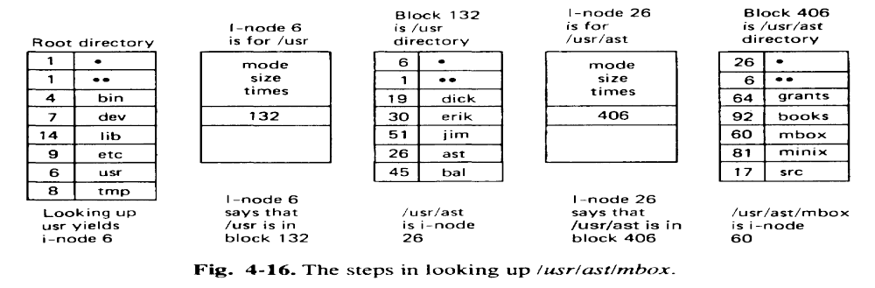
Working With Directories (Lookup)
a directory is a table of entries:
  2 bytes — inumber
  14 bytes — file name (improved in BSD 4.2 and later)
search to find the file begins with either root, or the current working directory
  Inode 2 points to the root directory (“ / ”)
  example above shows lookup of
  /usr/ast/mbox
Notes:
Inode 2 contains the root directory
Recall that directories are stored in blocks on the disk, but inodes are stored in the ilist
File descriptor for mbox points to all the blocks that make up that file

Slide 14
File Descriptors,
File Tables
Open
OS
File Table
open file table
(one, belongs to OS)
  lists all open files
  each entry contains:
    a file descriptor (sometimes also called
    i-node - don’t confuse with i-node on the
    disk!)
    open count — number of
    processes that have the file open
per-process file table (many)
  list all open files for that process
  each entry contains:
    pointer to entry in open file table
    current position (offset) in file
count
file descrip.
Per-Process
count
file descrip.
File Table
position
Per-Process
File Table
position
position

Slide 15

Continuous Allocation
OS keeps an ordered list of free blocks
allocates contiguous groups of
blocks when it creates a file
i-node must store start
block and length of file
used in IBM 370, some write-only disks
have to use usual dynamic allocation
techniques (first-fit, best-fit, etc.)
advantages:
  simple
  efficient sequential access, reasonably efficient random access
  small number of seeks (head movement), most may be on same track
  good for storing data on CDROM
disadvantages:
  may have difficulty changing file size (size is specified when file is created)
  problems with external fragmentation
compaction - relocation of files so that there is no free space between them

Slide 16

Chained (Linked) Allocation
OS keeps an ordered list of free blocks
file descriptor stores pointer to first block
each block stores pointer to next block
used in DEC TOPS-10, Xerox Alto
advantages:
  no external fragmentation
  any free space is as good as any other
  can easily change file size
  (no need to declare in advance)
disadvantages:
  reasonable, but not great, for sequential access (one seek each time)
  inefficient random access — have to follow many links
  lost space due to lots of pointers (small, but adds up)
  lots of seeks to find a block
  not very robust — lose a block, lose rest of file
compaction can be used so that blocks of one file are located continuously on the disk - optimizes disk access.

Slide 17

Linked Allocation
Variant: FAT
file allocation table (FAT) a variant of
linked list allocation
used in MS-DOS, OS/2, Windows
the beginning of each partition contains
the indexing table FAT
directory entry has the number of the
first block
FAT
  has an entry for each block
  the FAT entry indexed by the first block has the number of the second block and so on
  last block’s FAT entry has reserved EOF symbol
  unused blocks have \0 entry

Slide 18

Indexed Allocation
OS keeps a list of free blocks
  OS allocates an array (called the
  index block) to hold pointers to all the
  blocks used by the file
  allocates blocks only on demand
used in DEC VMS
advantages:
  can easily grow up to maximum size
  both sequential and random accesses
  are easy
disadvantages:
  limit on maximum file size
  lots of seeks since data is not contiguous
  wasted space for pointers (need a whole block even for one pointer)

Slide 19
Multilevel indexed allocation
used in UNIX (numbers below are for traditional UNIX,
BSD UNIX 4.1)
each i-node contains 13 block pointers
  first 10 pointers point to data blocks (each 512 bytes long) of a file
    if the file is bigger than 10 blocks (5,120 bytes), the 11th pointer points to a single indirect block, which contains 128 pointers to 128 more data blocks (can support files up to 70,656 bytes)
      if the file is bigger than that, the 12th pointer points to a double indirect block, which contains 128 pointers to 128 more single indirect blocks (can support files up to 8,459,264 bytes)
        if the file is bigger than that, the 13th pointer points to a triple indirect block, which contains 128 pointers to 128 more double indirect blocks
  max file size is 1,082,201,087 bytes

Slide 20
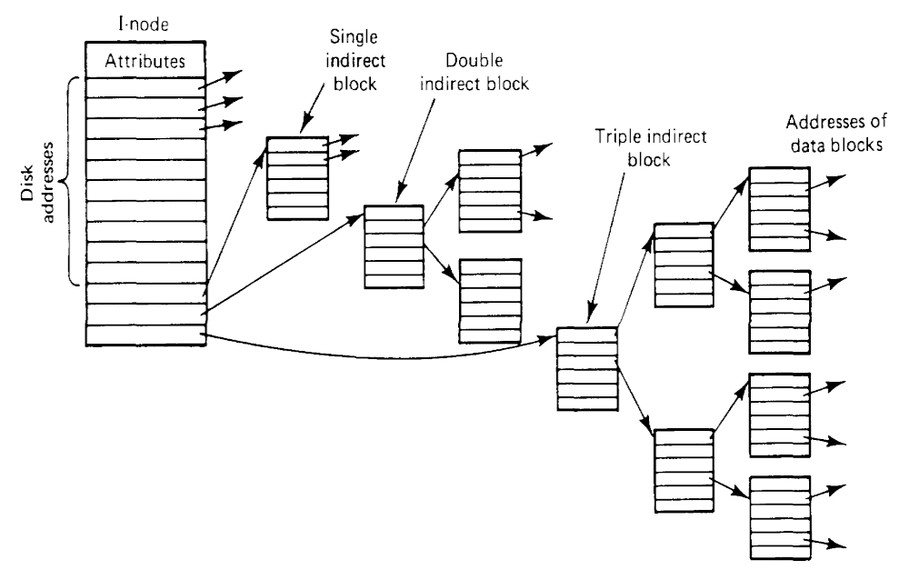
Multilevel Indexed Allocation (cont.)
advantages:
  simple to implement
  supports incremental file growth
  works well for small files
disadvantages:
  inefficient access to very large files
  data gets spread around - more seeks

Slide 21
Unix File System “The Big Picture”
disk drive
partition
partition
bootb.
superb.
ilist
directory blocks and file data blocks
dir’s inode
dir. attributes
File’s inode
inode
inode
inode
inode
inode
File attributes
pointer
inode #
name
dir’s
block
block #
...
block #
inode #
name
...
1st indirect
block #
block
block
block
block
directory and file
data blocks
1st indi-
rect block
block #
...
block
block
block #

Slide 22
Why OS manages secondary storage? (cont.)
Important to the user:
  Persistence — data stays around between power cycles and crashes
  Ease of use — can easily find, examine, modify, etc. data
  Efficiency — uses disk space well
  Speed — can get to data quickly
  Protection — others can’t corrupt (or sometimes even see) my data
OS provides:
  File system with directories and naming — allows user to specify directories and names instead of location on disk
  Disk management — keeps track of where files are located on the disk, accesses those files quickly
  Protection — no unauthorized access

