Slide 1
File System Implementation and
Disk Management
disk configuration and typical access times
selecting disk geometry
evolution of UNIX file system
improving disk performance
  using caching
  using head scheduling

Slide 2
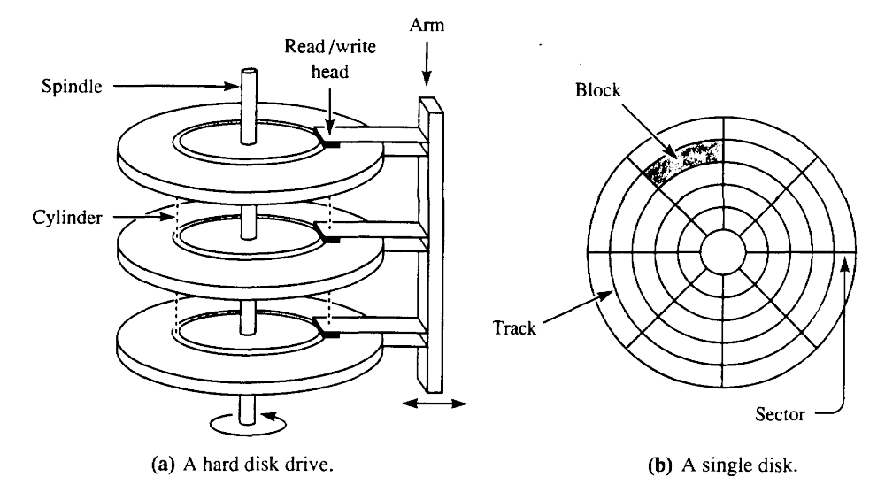
On previous lecture
seek time —
time required to
position heads
over the track /
cylinder
  typically
  10 ms to cross entire disk
rotational delay — time required for sector to rotate underneath the head
  120 rotations / second = 8 ms / rotation

Slide 3
Disk Access Times
typically on a disk:
  32-64 sectors per track
  1K bytes per sector
data transfer rate is number of bytes rotating under the head per second
  1 KB / sector * 32 sectors / rotation * 120 rotations / second =
  4 MB / s
disk I/O time = seek + rotational delay + transfer
  If head is at a random place on the disk
    avg. seek time is 5 ms
    avg. rotational delay is 4 ms
    data transfer rate for a 1KB is 0.25 ms
    i/o time = 9.25 ms for 1KB
    real transfer rate is roughly 100 KB / s
  in contrast, memory access may be 20 MB / s (200 times faster)

Slide 4
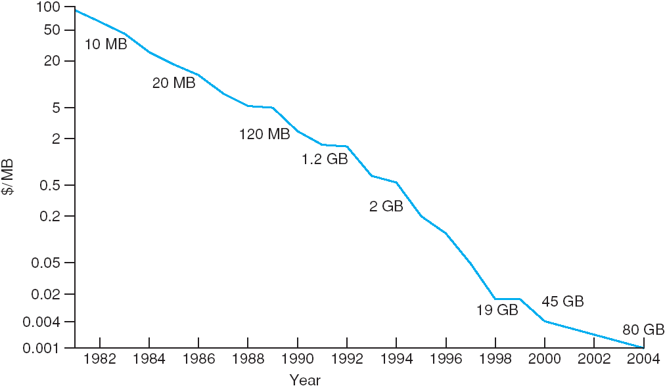
Disk Hardware (cont.)
typical disk today
(Compaq 40GB Ultra ATA 100
7200RPM hard disk = $369):
  16383 cylinders, 16 heads,
  63 sectors/track
  16 platters *
  16383 tracks/platter *
  63 sectors/track *
  4048 bytes/sector *
    1/1024^3 GB/byte = 63GB unformatted
  7200 rpm spindle speed, 8 ms average seek time, 100 MBps data transfer rate
trends in disk technology
  disks get smaller, for similar capacity – faster data transfer, lighter weight
  disk are storing data more dense – faster data transfer
  density improving faster than mechanical limitations (seek time, rotational delay)
  disks are getting cheaper (factor of 2 per year since 1991)
Notes:
Let’s look at some typical numbers
Bytes/sector is a guess
One way to improve density is to get the head closer to the disk
Can’t touch disk — would scrape off magnetic coating
As it gets closer, there’s no room for an air molecule
Solution — disk pack filled with an inert gas
(CDROM has “spiral” track:
Constant linear velocity, reads at same speed on all tracks => spins at changing rate
Hybrid CDROM: constant angular velocity, reads data faster on outer tracsks => spins at changing rate Example: 12x/24x)

Slide 5
Selecting Sector Size (cont.)
using big sectors sounds like a good idea, but
  most files are small, maybe one block
  big blocks cause internal fragmentation
some measurements from a file system at UC Berkeley:
  Organization Space used Waste
  data only 775.2 0%
  +inodes, 512B block 828.7 6.9%
  +inodes, 1KB block 866.5 11.8%
  +inodes, 2KB block 948.5 22.4%
  +inodes, 4KB block 1128.3 45.6%

Slide 6
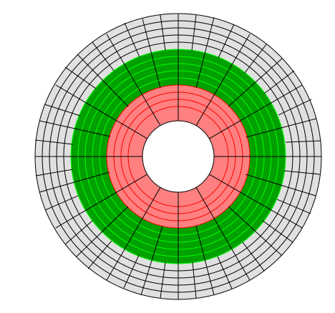
Storing Data on Circular Media
sectors on the inner tracks have shorter length.
problem
cannot read/write faster than in outer track (outer
tracks may move faster under read/write head
solutions
constant angular velocity (CAV) – different speed on different tracks, simpler motor mechanism – used on most modern hard drives
  observation: most of waste happens on the outer tracks, partial-CAV
  (p-CAV or CAV/CLV) - two zones, inner – CAV, outer – CLV
  – used for some CD-ROM/DVD drives
constant linear velocity (CLV) – changes disk speed rotation with each track – complicated rotation mechanism, imprecise change
  variant zone-CLV (Z-CLV) - breaks cylinders into zones, changes speed by zone
problem
cannot write denser than in inner tracks – potentially sparse data on outer track
solution
constant bit recoding – same number of sectors on all cylinders
zone bit recording (ZBR) – break cylinders into zones, change number of sectors per zone. If CAV, the data transfer rate is higher on outer cylinders – may be a benefit (store metadata there)
  most modern disks are ZBR

Slide 7
Recall The File System Organization
disk drive
partition
partition
bootb.
superb.
ilist
directory blocks and file data blocks
dir’s inode
dir. attributes
File’s inode
inode
inode
inode
inode
inode
File attributes
pointer
inode #
name
dir’s
block
block #
...
block #
inode #
name
...
1st indirect
block #
block
block
block
block
Directory and file
data blocks
1st indi-
rect block
block #
...
block
block
block #

Slide 8
Traditional Unix File System
in traditional UNIX (System V FS), and Berkeley
BSD 3.0 UNIX
  disk lock size was 512 bytes
  i-list follows superblock, has limited size determined at formatting (limits the number of files on system
  directory contains fixed size records 16 bytes each (first two - i-node number, the rest - file name)
  free blocks maintained in a linked list, superblock contains pointer to first
problems with System V FS:
  one superblock - becomes corrupted - filesystem unusable
  all I-nodes at the beginning of disk - reading files requires accessing I-nodes - random disk access pattern
  files blocks are allocated at random
  practical measurements: when file system was first created
    free list was ordered, and they - transfer rates up to 175 KB / s
    after a few weeks data and free blocks got so randomized - to 30 KB / s; less than 4% of the maximum transfer rate!
  14 character names insufficient

Slide 9
Unix Fast-File System
in Berkeley BSD 4.2 UNIX:
  see “A Fast File System for UNIX” on class home page for details
  introduced cylinder group – a set of adjacent cylinders
    each cylinder group has a copy of super block, bit map of free blocks, ilist, and blocks for storing directories and files
  the OS tries to put related information together into the same cylinder group
    try to put all i-nodes in a directory in the same cylinder group
    try to put i-node and file blocks in the same cylinder group
    try to put blocks for one file contiguously in the same cylinder group: bitmap of free blocks makes this easy
  however, OS tries to spread the load between cylinder groups (otherwise all disk – one cylinder group)
    for long files, redirect each megabyte to a new cylinder group
    puts directory and its subdirectories in different groups)
Notes:
Try to put directory and subidrectory on different cylinder groups to spread allocation (disk will be one big cylinder group otherwise)

Slide 10
Unix FFS (cont.)
block size was changed to 4096 bytes
  reduced fragmentation as follows:
    each disk block can be used in its entirety, or can be broken up into 2, 4, or 8 fragments
    for most of the blocks in the file, use the full block
    For the last block in the file, use as small a fragment as possible
    can get as many as 8 very small files in one disk block
  this change resulted in
    only as much fragmentation as a 1KB block size (w/ 4 fragments)
    data transfer rates that were 47% of the maximum rate
other improvements:
  bit map instead of unordered free list - each bit corresponds to a fragment
  variable length file names, symbolic links
  file locking, disk quotas
Notes:
Long file names - each entry contains two parts - fixed -inode number, size of the filename in the entry, variable - filename followed by \0, when deleting a filename FFS merges the released space with previous entry, directory is allocated in 512 - byte chunk, an entry cannot span a chunk
symbolic links - inode identifies that the file is a symbolic link and data - pathname to the file it refers to

Slide 11
File System Recovery
disk drive
partition
partition
bootb.
superb.
ilist
directory blocks and file data blocks
dir’s inode
dir. attributes
File’s inode
inode
inode
inode
inode
inode
is it possible to restore a
filesystem if the following
structures are corrupted?
superblock
ilist
directory listing
individual inode
free list
most OSes check consistency
of a filesystem either automatically
(on boot) or on demand
pointer
File attributes
inode #
name
dir’s
block
block #
...
block #
inode #
name
...
1st indirect
block #
block
block
block
block
Directory and file
data blocks
1st indi-
rect block
block #
...
block
block
block #

Slide 12
Efficient Block Management
OS keeps track of free blocks on the disk using a bit map
  bit map – an array of bits
    1 – the block is free,
    0 – the block is allocated to a file
  For a 1.2 GB drive, there are about 307,000 4KB blocks, so a bit map takes up 38.4 KB (usually kept in memory)
  modern comp. architectures provide instructions for quick bitmap manipulation – one instruction returns the offset of the first zero
efficient to allocate related blocks closer to each other
  problematic if disk is nearly full
    solution — keep some space (about 5-10% of the disk) in reserve, and don’t tell users; never let disk get more than 90% full
    spread the load to make sure that disk fills up uniformly across cylinders

Slide 13
Extent-Based Allocation, Journaling
extent-based allocation
  rather than refer to individual data blocks the index blocks specifies the beginning of an extent of continuously allocated blocks and the number of blocks in the extent
    advantages - faster disk access, fewer indirections (combines the advantages of continuous and indexed allocation)
    disadvantages – extra effort to select extend size, possible since modern FS keep free lists as bits
journaling (in NTFS (Windows NT/XP) and UFS in modern Unices)
  updating data entails multiple operations in several places:
    slow, not robust in case of a crash
  metadata (directories, pointers, free list, etc.) needs to be updated
  improvement: synchronously write changes to a file (called log or journal) and then asynchronously to all needed places on disk
    advantage: sequential synchronous write instead of distributed asynchronous one

Slide 14
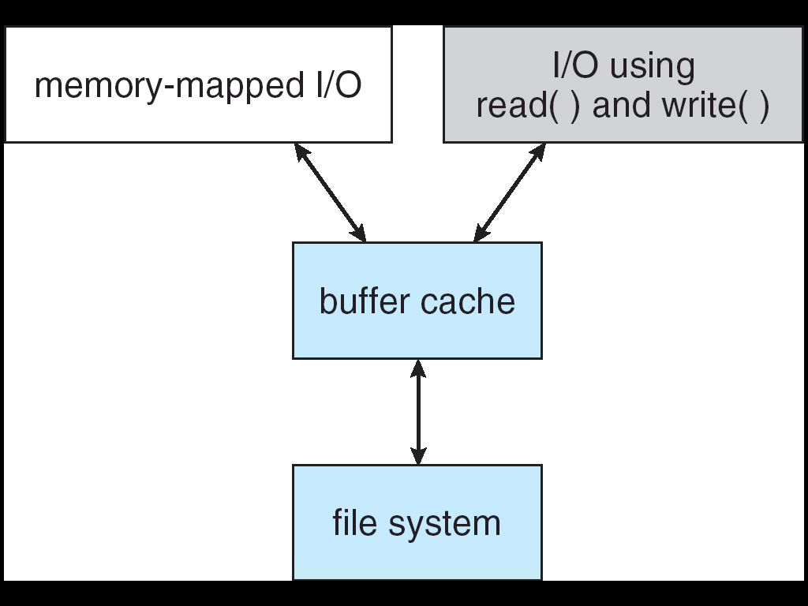
Unified Buffer Cache
OS caches disk blocks to improve performance
  when OS reads a file from disk, it copies
  those blocks into the cache
  before OS reads a file from disk, it first
  checks the cache to see if any of the blocks
  are there (if so, uses cached copy)
page cache (Solaris, new Linux, XP)
  storing files info as pages is more efficient than as blocks – can apply virtual memory techniques, if so – no reason to differentiate
  unified buffer cache – combined (process and file I/O) paging
  what page replacement to use?
    a variant of LRU seems good
    optimization for files for sequential access
      free behind – discards page as soon as it is read
      read ahead – pages are read in advance
Notes:
Replacement policies for the blocks:
Same options as paging
FIFO, LRU using clock / second chance
Easy to implement exact LRU
OS just records time along with everything else it has to update when a block is read
But — sequential access degrades LRU
Solution: free-behind policy for large sequentially-accessed files — as block is read, remove previous one from cache

Slide 15
Disk Head Scheduling
permute the order of the disk requests
  from the order that they arrive in
  into an order that reduces the distance of seeks
examples:
  head just moved from lower-numbered track to get to track 30
  request queue: 61, 40, 18, 78
algorithms:
  first-come first-served (FCFS)
  shortest seek time first (SSTF)
  SCAN (0 to 100, 100 to 0, …)
  C-SCAN (0 to 100, 0 to 100, …)
  LOOK (lowest-highest, highest-lowest)
  C-LOOK (lowest-highest, lowest-highest)

Slide 16
Disk Head Scheduling (cont.)
FCFS - handle in the order of arrival
0 10 20 30 40 50 60 70 80 90 100
advantages: simple, fair
disadvantages: can use disk inefficiently (if one process is using file on outer track, and another process is using file on inner track, will be many long seeks)

Slide 17
Disk Head Scheduling (cont.)
SSTF - select the request that requires the smallest seek
from current track
0 10 20 30 40 50 60 70 80 90 100
advantages: reduces arm movement, uses the disk rather efficiently
disadvantages:
  fairness: disk can stay in one area for a long time (result = starvation)

Slide 18
Disk Head Scheduling (cont.)
SCAN (elevator algorithm) - Move the head 0 to 100, 100
to 0, picking up requests as it goes
0 10 20 30 40 50 60 70 80 90 100
advantages: better fairness (no starvation)
problems
  request on edge of disk just behind in direction traveling can wait a long time to be serviced (twice disk length)
  even request in middle waits long time

Slide 19
Disk Head Scheduling (cont.)
LOOK (variant of SCAN) - don’t go to edges if there are no
requests there
0 10 20 30 40 50 60 70 80 90 100
advantages: less wasted movement than SCAN

Slide 20
Disk Head Scheduling (cont.)
C-SCAN -Move the head 0 to 100, picking up requests as
it goes, then big seek to 0
0 10 20 30 40 50 60 70 80 90 100
advantage: fairer than SCAN

Slide 21
Disk Head Scheduling (cont.)
C-LOOK -same as C-SCAN, don’t go to edge if not
necessary
0 10 20 30 40 50 60 70 80 90 100

Slide 22
Summary: improving disk performance
Keep some structures in memory
  Active inodes, file tables
Efficient free space management
  Bitmaps
Careful allocation of disk blocks
  Contiguous allocation where possible
  Direct / indirect blocks
  Good choice of block size
  Cylinder groups
  Keep some disk space in reserve
Disk management
  Cache of disk blocks
  Disk scheduling

Slide 23
Disk management
Disk formatting
  Physical formatting — dividing disk into sectors: header, data area, trailer
  Most disks are preformatted, although special utilities can reformat them
  After formatting, must partition the disk, then write the data structures for the file system (logical formatting)
Boot block contains the “bootstrap” program for the computer
  System also contains a ROM with a bootstrap loader that loads this program
Disk system should ignore bad blocks
  When disk is formatted, a scan detects bad blocks and tells disk system not to assign those blocks to files
  blocks may go bad as disk is used
Notes:
Header/trailer - sector number and ECC - error correcting code - checksum
IDE disks - bad block handing by OS
SCSI disks - bad block handling by disc controller - sector sparing, sector forwarding - certain blocks are set aside by controller (not visible to OS), when block goes bad - the controller automatically forwards the request to a different block

Slide 24
Disk management (cont.)
Disk reliability RAIDs
  Data normally assumed to be persistent
  Disk striping — data broken into blocks, successive blocks stored on separate drives
  Mirroring — keep a “shadow” or “mirror” copy of the entire disk
  Stable storage — data is never lost during an update — maintain two physical blocks for each logical block, and both must be same for a write to be successful
  RAID5 - use parity disk
Notes:
Swap space management
Swap space in normal file system
Swap space in separate partition
One big file — don’t need whole file system, directories, etc.
Only need manager to allocate/deallocate blocks (optimized for speed)

Slide 25
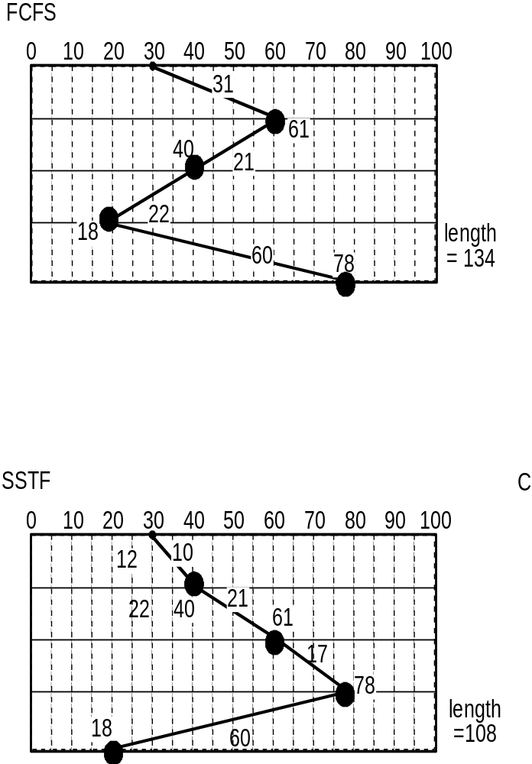
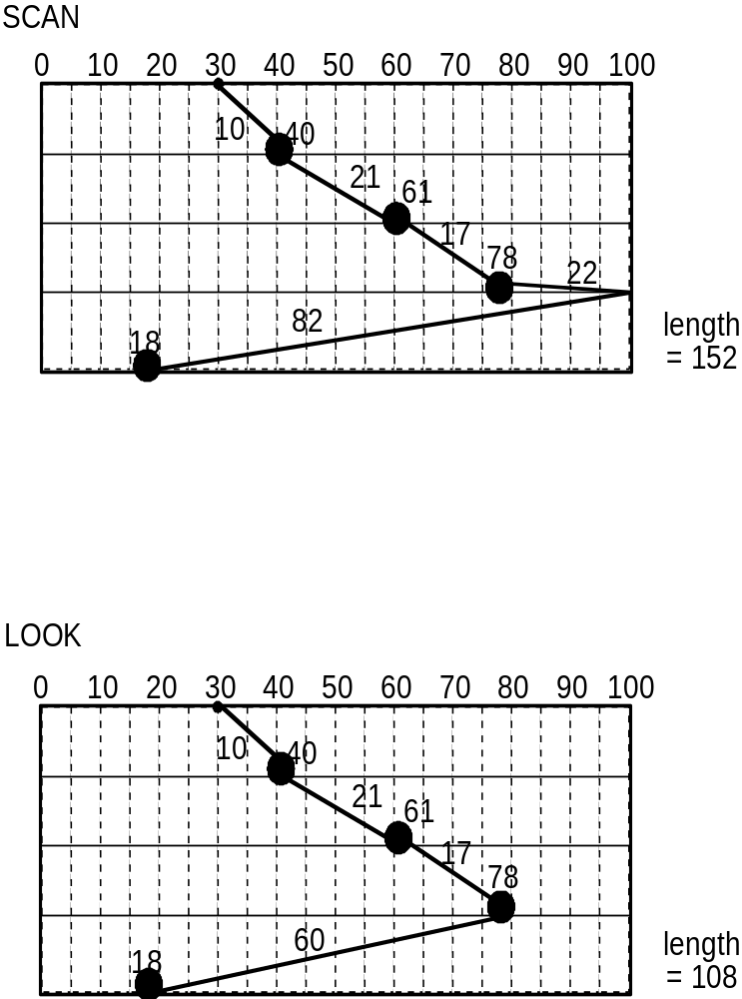

Slide 26
