Slide 1
Lecture 18: RAID
I/O bottleneck
JBOD and SLED
striping and mirroring
“classic” RAID levels: 1 – 5
additional RAID levels: 6, 0+1, 10
RAID usage

Slide 2
Impending I/O crisis
CPU speed is growing exponentially
Memory size is growing exponentially
I/0 performance is increasing only slowly
computer systems will become I/O dominated
  Amdahl law - the system is only as fast as it’s slowest component

Slide 3
Can we get more disks?
Can we get more disks and access them in parallel - disk array?
Advantage: disk access speeds up
problem: mean time between failures MTBF decreases!
  MTBF(disk array) = MTBF(disk) / # of disks
idea - controlled redundancy of the information in disk array improves the MTBF as well as keeping disk access fast:
  RAID - Redundant Array of Inexpensive Disks
  JOBD - Just a Bunch of Disks
  SLED - Single Large Expensive Drive

Slide 4
RAID uses striping and mirroring
Disks are divided into independent reliability groups
Striping - information is written in stripes, each stripe spans multiple drives.
  Can be
    bit interleaving - every bit belongs to a different portion of the logical “volume”
    sector interleaving - every sector belongs to a different portion of the logical volume
  advantage: reads and writes can be done in parallel
  disadvantage: one disk fails - the information is lost
mirroring - information is copied into two different disks
  advantage: reads can be done in parallel, fault-tolerant
  disadvantage: have to get 2X disks
depending on the combination of the two techniques RAID is classified into 5 levels

Slide 5
RAID levels 0, 1 and 2
0 – bit-interleaving striping
  ok performance
  low MTBF
1 - mirroring only
  excellent reliability
  high cost (must purchase 2X disks) -50% overhead
  reads are slightly better (can read from either copy)
  have to do two writes, can’t proceed until they complete
2 - use striping (with bit interleaving) and error correction code (ECC)
  hamming ECC ensures that the error can be corrected, 20-40% overhead
  reliable
  performance is bad for small I/0 - have to read the whole stripe
  can’t do I/O in parallel

Slide 6
RAID levels 3 and 4
disk controllers can recognize if the disk has failed!
3
  only one parity disk per reliability group (4-10% overhead)
  bit interleaving
  reliability and performance is slightly better than 2 since we use fewer disks
4
  use sector interleaving
  large writes can go in parallel
  independent / large reads can go in parallel
  problem: parity disk is a bottleneck!

Slide 7

Comparison of RAID levels 2, 3 and 4

Slide 8
RAID level 5
5 - stripe and parity across all disks - no singe disk is a bottleneck

Slide 9
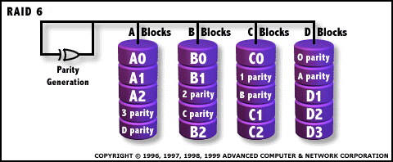
Raid level 6
two independent sets of parities (2-dimentional parity)
  one - similar to RAID 5
  two – across all disks for fault tolerance
eval
  can sustain 2 simultaneous disk crashes
  second parity slows down writes, needs extra disk, expensive electronics to calculate parity

Slide 10
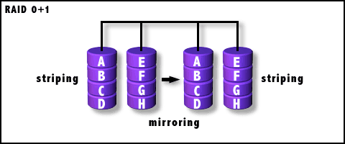
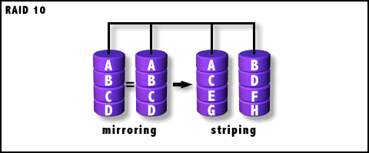
RAID Levels 0+1 and 10
0+1 – stripe then mirror
  fault tolerance – can
  withstand single
  failure
  performance – as
  good as mirroring and striping
10 – mirror than stripe
  better fault tolerance than 0+1 (why?)
  same performance as 0+1
both techniques are
expensive since
2X disks are needed

Slide 11
RAID applications
Hot spare is maintained - if a “working” disk fails then the information is rewritten to hot spare
RAID can be implemented in hardware or software
  software RAID - OS calculates checksums and does writes to raids,
    does not need special hardware
    slow
    not very fault-tolerant - OS crashes - RAID may go with it
  hardware RAID - there is a separate CPU on the RAID; RAID’s CPU talks to the disks, calculates checksums and supplies the computer with “ready” data
    faster
    fault-tolerant
    expensive?
Most hardware RAIDs have “on-board” RAM to use as cache

