Slide 1
The X-Tree
An Index Structure for High Dimensional Data
Stefan Berchtold, Daniel A Keim, Hans Peter Kriegel
Institute of Computer Science
Munich, Germany

Slide 2
Outline
Introduction
Problems of R-tree based structures
X-tree Structure
X-tree Algorithms
Overall-Minimal Split
Performance Evaluation

Slide 3
Introduction
Objective - To index point and spatial data in high-dimensional space
    Dimensions - few tens to hundreds
    Hyper-rectangles
    Fields - CAD, Molecular biology
Improves upon R*-tree
Approach
  ‘Minimal Overlap Split’
  Directory structure organization - ‘Supernodes’
Performance is better than R* tree and TV tree by 2 orders of magnitude

Slide 4
Previous work
(on High Dimensional Data)
Reduce dimensionality - two basic approaches:
Data is highly clustered and correlated
  Occupy only some space
  Algorithms to transform to lower dimension
  Index using traditional multi-dimensional index structures
  Eg: SS Tree
Small number of dimensions contain most of the information
  Eg: TV Tree
BUT…reduced dimensions may still be too high

Slide 5
Problem with R* tree
Why R*-Trees ?
  Handles both point and spatial data
  Spatial data is not transformed to point data
Performance deteriorates rapidly with dimension.
After detailed evaluations, found that
Overlap in directory increases rapidly with growing dimensionality.
Dimension=5, Overlap=90%
Overlap ↑Query Performance ↓

Slide 6
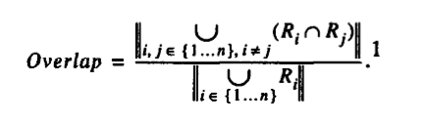

Defining Overlap
Intuitively - Percentage of volume covered by more than one directory hyper-rectangle
Overlap
  R-tree node contains n hyper-rectangles {R₁, R₂, … R_{n}}
  Overlap directly corresponds to query performance (only if query objects are uniformly distributed)
  Query distribution estimated by data distribution
    In high dimensional data queries and data are clustered

Slide 7
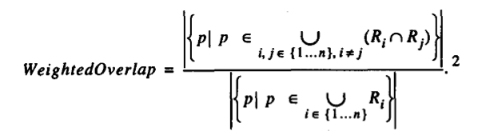
Defining Overlap (contd)
Weighted Overlap
  More accurate
  Percentage of data objects in overlapping space

Slide 8
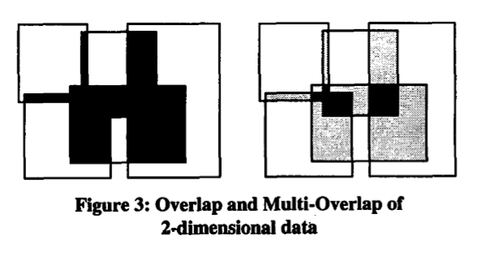
Defining Overlap (contd)
Multi Overlap - How many R_{i}’s in the overlapping space ?

Slide 9
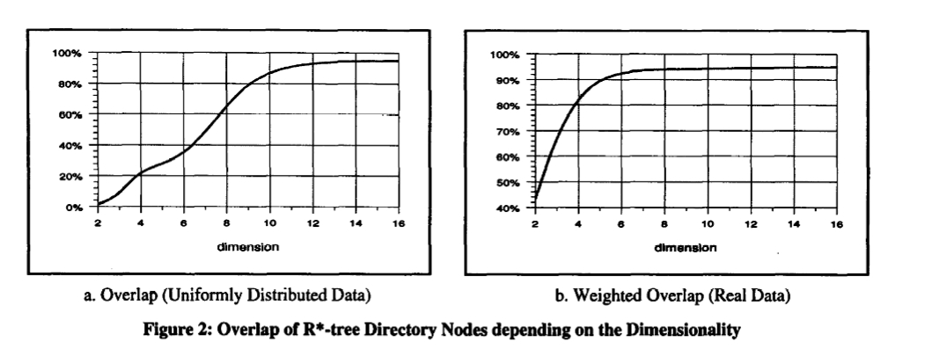
Overlap in R* Tree
Dimensionality ↑, Overlap ↑
So multiple paths need to be searched for each query

Slide 10
X-Tree - eXtended node tree
Goal - Efficient query processing of high dimensional point and spatial data
General Approach
  Avoid overlaps when splitting
  Create supernode - extendible variable size directory node
Solution - Dynamically organize directory to be hybrid
  Directory Structure Organizations
    Low dimension (no/low overlap) - Hierarchical
    High dimension (high overlap) - Linear
    Cheaper to linear scan than traverse multiple paths

Slide 11
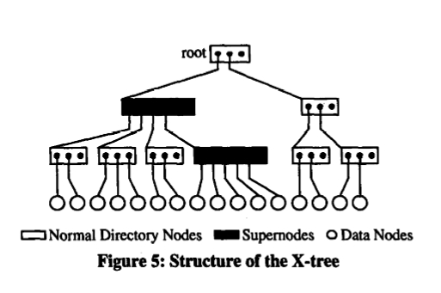
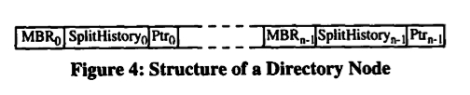
X-Tree Structure
Three types of nodes
  Directory
  Supernode
  Data node
Split history
  Minimal Overlap Splits

Slide 12


X Tree
Storing supernodes
Memory / Replace nodes using priority function
Storage utilization
    (Uniformly dist. data)
    Normal Directory nodes - 66%
    Supernode - 88% (m=5)
Extreme Cases of X tree
  No supernode -> R-Tree
    Completely hierarchical
    Low dimension, non-overlapping data
  One large root supernode
    Linear directory
    High dimension, highly overlapping data

Slide 13
Algorithm

Slide 14
Insert Algorithm
Determines a combination of hierarchical and linear structure
Tries to find a topological (or) overlap-minimal split using R* Tree - heuristics
If no splits are obtained, current directory node is extended to become a super node of twice the standard block-size
If the current super node is full, additional block is added to the super node.

Slide 15
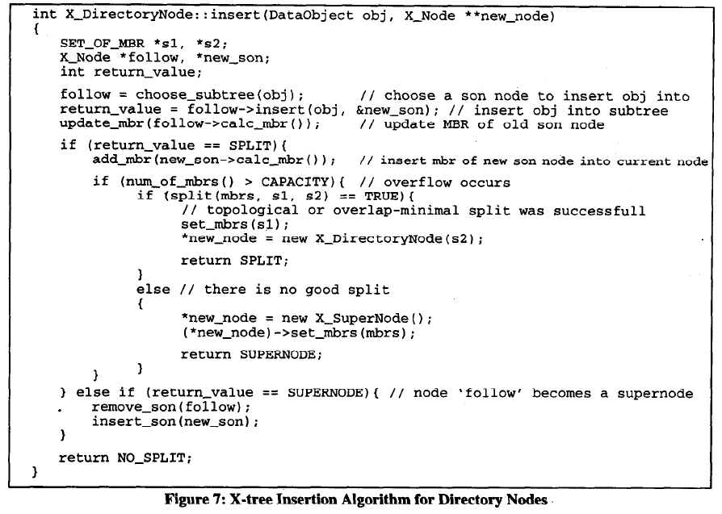
Insert Algorithm

Slide 16
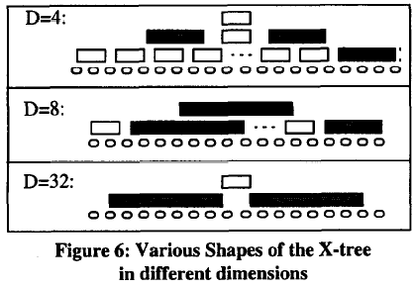
X-Trees in different dimensions

Slide 17
Split Algorithm
Addition of an MBR to a node may result in an overflow and cause a split
Criteria to split a node:
  Find a split based on topological and geometrical properties of the MBR
  If the above step results in a greater overlap, try to use overlap-minimal split
  If the above step results in under-filled nodes, do not perform a split, and return false

Slide 18
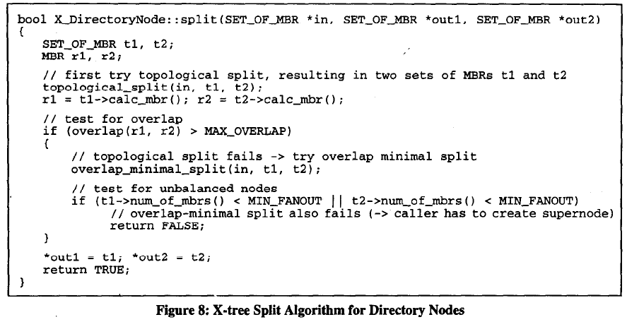

Slide 19

Parameters
MIN_FANOUT – Similar to value used in other index structures (35% - 45% Approx.)
MAX_OVERLAP – System constant
  Balance between reading a supernode of twice block size and reading 2 blocks with a probability MaxO and one block with a probability (1-MaxO) (For T_{IO} = 2ms, T_{Tr}=4ms, T_{CPU}=1ms, MaxO = 20%)

Slide 20
Delete and Update
Update operation is a combination of delete and insert
If there is an underflow in the supernodes due to deletion, they are merged to form a single directory node.
Hence, the structure is dynamic.

Slide 21
Overlap Minimal Split

Slide 22
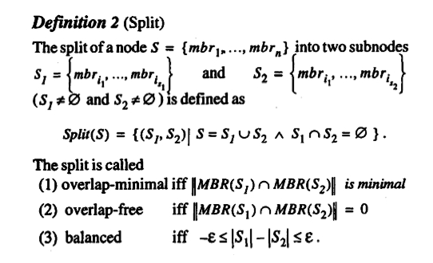
Determining the Overlap Minimal Split
Partition MBRs (S) in directory node into two subsets (S₁, S₂) such that the MBRs of both subset overlap minimally
Point-data
  Overlap free is possible
  Balanced cannot be guaranteed

Slide 23


Lemma 1
For uniformly distributed point data, an overlap free split is possible iff there is a dimension according to which all MBRs in the node have been previously split

Slide 24
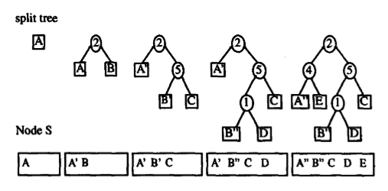
Split History
  To determine dimension
  according to which all
  MBRs in S have been split
    Storage requirement is a few bits
  Split produces 2 MBRs from 1
    Represent as a binary tree ‘Split tree’
    Leaf node - corresponds to MBR in S
    Internal Node - Old non-existent MBRs, labeled with split axis used
  Characteristics
    Left subtree MBR has lower coordinates in the split dimension (Disjoint)
    Path - which dimensions has this MBR been split by?
    Root node - split dimension common to all MBRs

Slide 25
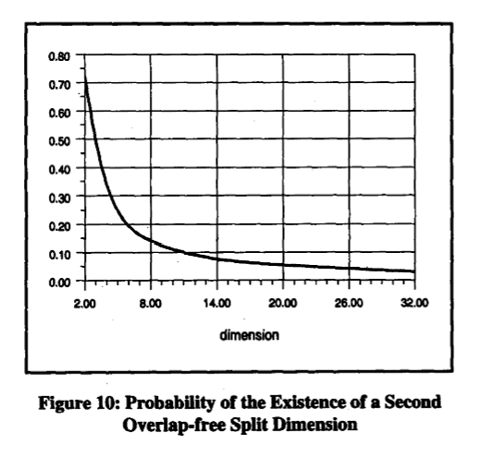
Lemma 2
For point data, an overlap free split always exists
Probability of second
overlap free split axis
Probability that a
split algorithm chooses the
right split axis coincidentally
is very low.
Eg: R* tree
  Random choice
  Criteria different

Slide 26
Performance Evaluation

Slide 27
Performance Evaluation
X-Tree vs TV-Tree / R*-Tree
  Faster Insertion rates into the X-tree (10.45 times faster than R*-Tree, about 170 insertions per sec for 150 MB index containing 16-Dimensional point data)
  High speed up of search time for point queries increase with increase in dimension (attributed to the fact that due to high overlap in high dimensions R*-tree accesses most of the directory pages)
  (* All results were carried out on HP735 workstation with 64MB main memory, 10GB index space on disk)

Slide 28
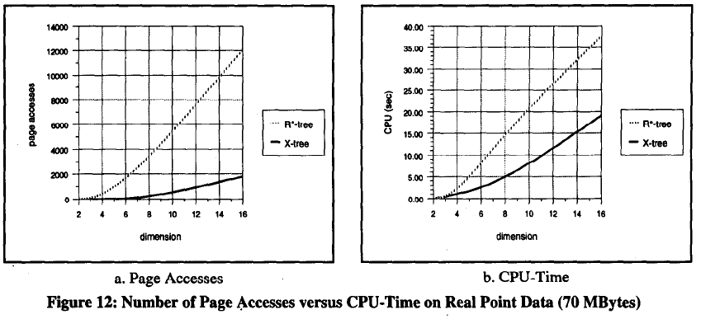
Number of Page Accesses, CPU Time

Slide 29
Number of Page Accesses, CPU Time
X-Tree outperforms the TV-Tree and R*-Tree up to orders of magnitude for point and nearest neighbor queries on both synthetic and real data.
Since, the nearest neighbor queries require sorting on the min-max distance, the CPU-time is much higher, but, better than that of an R-Tree.
Since, extended spatial objects, induce some overlap in the X-Tree as well, the speed-up for X-tree over the R*-Tree is lower than for point data (factor of about 8 for D=16)

Slide 30
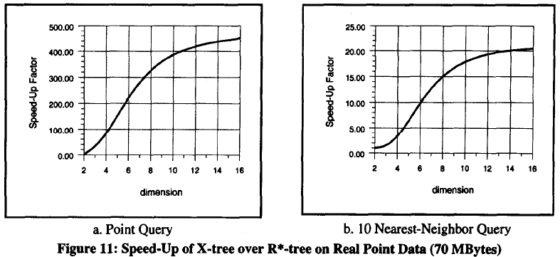
Performance - Speed up on Real Point Data

Slide 31
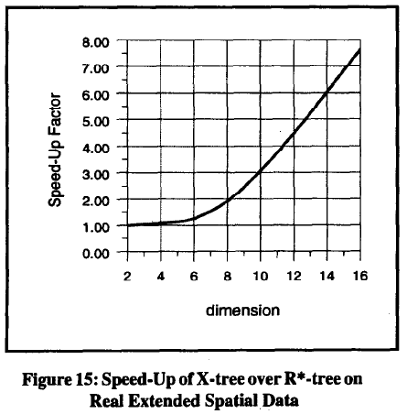
Performance - Speed up on Real Spatial Data

Slide 32
Conclusions
R-Tree based index structures do not behave well in high dimensional spaces.
X-Tree, with the concept of supernodes and overlap minimal split (Directory nodes extended over block size to avoid degeneration of the index) provides higher speed up for point and nearest neighbor queries.
As the total search time of X-Tree grows logarithmically with the database size, it scales well for very large database sizes.

Slide 33
Questions?

