Slide 1
Asynchronous
Processing in Web Development

Slide 2
Synchronous Processing

Slide 3
Synchronous Processing
Before showing Asynchronous Processing,
We want to review a simpler and more typical situation in programming processing which is Synchronous processing.

Slide 4

Let’s think in the next process :
makeCoffee
boilWater
brewCoffee
Enjoy

Slide 5

In JavaScript, we can prepare coffee in the next program:
function boilWater() {
console.log("Boiling water...");
return "Hot water";
}
function brewCoffee(water) {
console.log(`Brewing coffee with ${water}`);
return "Coffee";
}
function makeCoffee() {
const water = boilWater();
const coffee = brewCoffee(water);
console.log(`Enjoy your ${coffee}`);
}
makeCoffee();

Slide 6
The sequence of execution is the next:
function boilWater() {
console.log("Boiling water...");
return "Hot water";
}
function brewCoffee(water) {
console.log(`Brewing coffee with ${water}`);
return "Coffee";
}
function makeCoffee() {
const water = boilWater();
const coffee = brewCoffee(water);
console.log(`Enjoy your ${coffee}`);
}
makeCoffee();

Slide 7
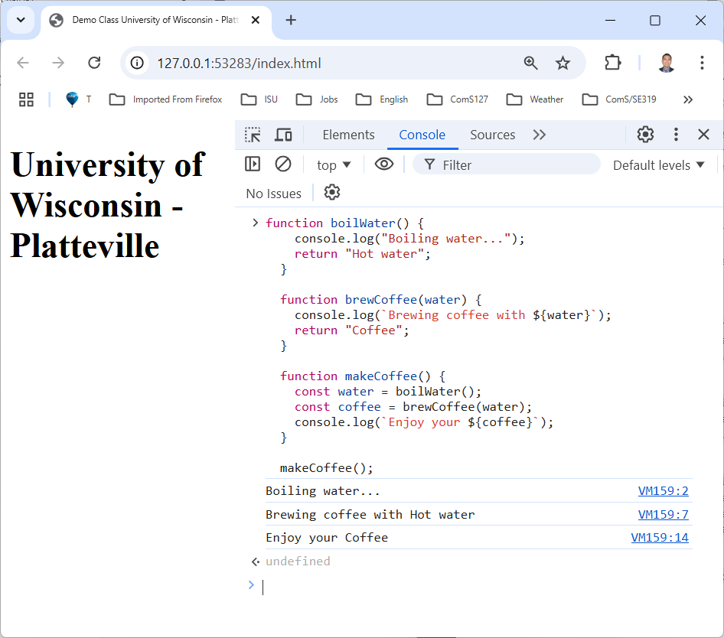
Try the code in a browser:
Analyze output:
liveserver
python –m http.server 8888

Slide 8
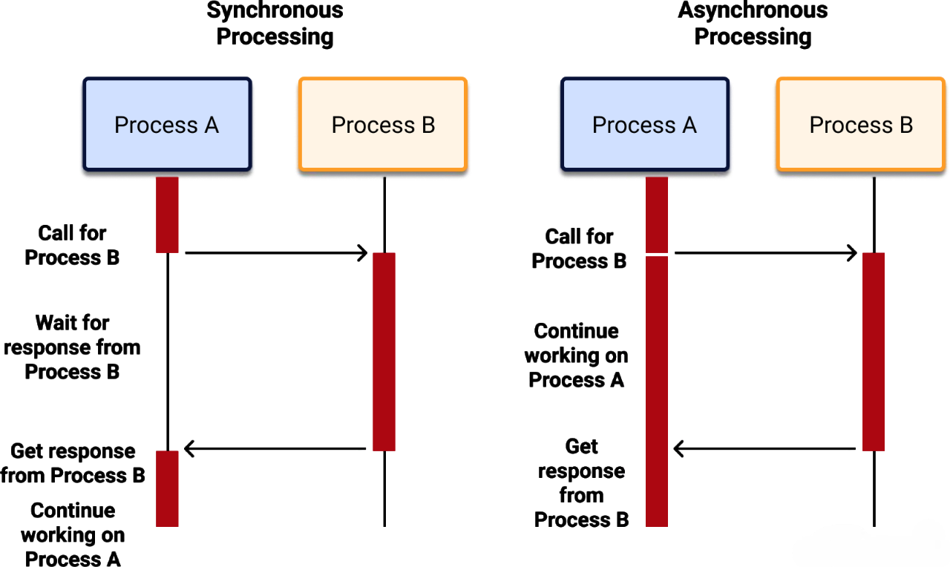

Slide 9
In our program there are several parts of code waiting their turn…
function boilWater() {
console.log("Boiling water...");
return "Hot water";
}
function brewCoffee(water) {
console.log(`Brewing coffee with ${water}`);
return "Coffee";
}
function makeCoffee() {
const water = boilWater();
const coffee = brewCoffee(water);
console.log(`Enjoy your ${coffee}`);
}
makeCoffee();
2
1
brewCoffee(water) waits to boilWater() to complete.
console.log() waits to brewCofee() to complete

Slide 10
makeCoffee
boilWater
brewCoffee
Here, it is very evident that brewCoffee() waits for boilWater()
time
enjoy

Slide 11

Is synchronous processing good or bad?

Slide 12
It is neither bad nor good,
It is necessary when operations depend on the result of the previous step

Slide 13
In Synchronous processing :
What happens if one of the functions takes too long? How would it affect the program?

Slide 14
Asynchronous Processing

Slide 15
In Asynchronous processing we can continue the execution of other processes
(non blocking processing)

Slide 16
Observe what is happening with Process A while Process B is running.
They can run simultaneously

Slide 17
Let’s simulate two processes that can be executed without dependency on each other:
makeToast
(5 seconds)
makeBreakfast
End
fryEggs
(2 seconds)
You can cook Eggs and Toast simultaneously

Slide 18
With the help of setTimeout we can simulate delay in execution :
1
console.log("Start");
setTimeout(() => {
console.log("This runs after 5 seconds");
}, 5000);
console.log("End");
2
3

Slide 19
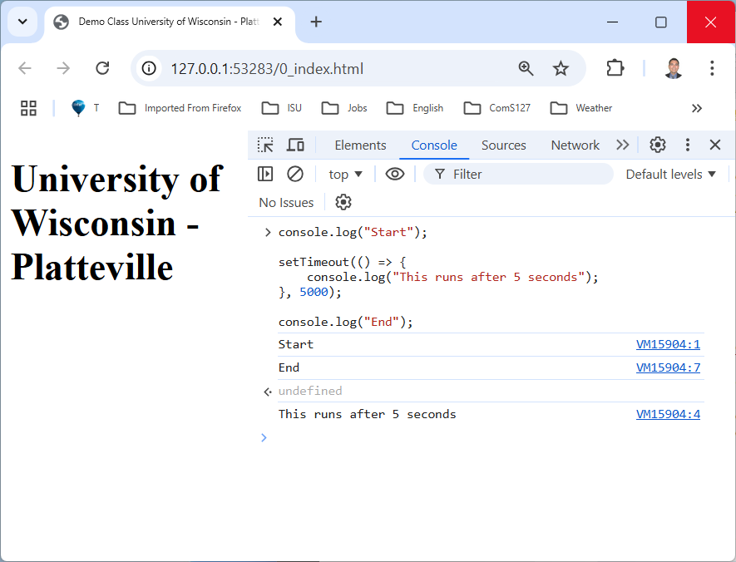
Try code in a browser:
1
2
3
setTimeout causes a 5 secs delay in execution :
liveserver
python –m http.server 8888

Slide 20
Simulate two processes running simultaneously using setTimeout() :
function makeToast() {
setTimeout(() => console.log("Toast is ready!"), 5000);
}
5 seconds
function fryEggs() {
setTimeout(() => console.log("Eggs are ready!"), 2000);
}
2 seconds

Slide 21
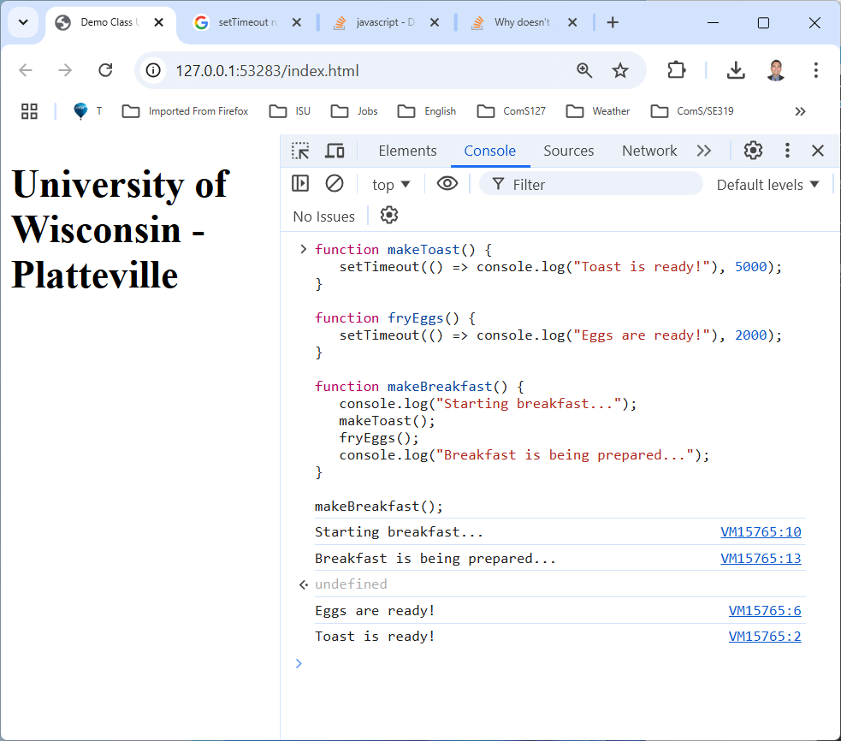
Try code in a browser:
5 seconds
2 seconds
Observe that
“breakfast is being prepared…“
is shown quickly ...
and
“fryEggs()“
finishes first.

Slide 22
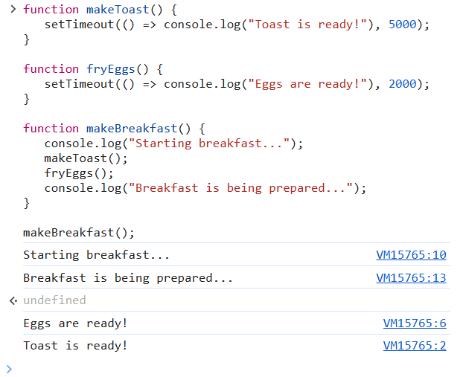

Here, preparing Eggs and Toast simultaneously is not a problem …
It is delicious !
5 seconds
2 seconds

Slide 23
Situation in Asynchronous Processing
There are situations where some processes must wait one intermediate result, but we can continue the execution of other processes
(non blocking processing)

Slide 24
Scenario :
If you need to download a large volume of data from a server, which can take a considerable amount of time, it would be inefficient for your program or function to freeze while waiting for the data to be fetched.
Instead, it is common practice to run the fetching operation in the background.

Slide 25
Hypothetical situation :
If processA() is in charge of loading the data from an external source,
and processB() in charge of executing on the data (filter, sort, select, etc),
but processB() is executed before processA() completes,
an could happen.
err

Slide 26

Consider our previous synchronous example preparing coffee,
This time, execute the processes boilWater() and brewCoffee() Asynchronously :
boilWater
(5 secs)
Enjoy ?
makeCoffee
brewCoffee
(2 secs)
Why not Enjoying ?

Slide 27
makeCoffee
boilWater
(5 secs)
brewCoffee
(2 secs)
Now, brewCoffee() finishes before boilWater()and the coffee is not enjoyed.
enjoy
undefined
time
The output

Slide 28
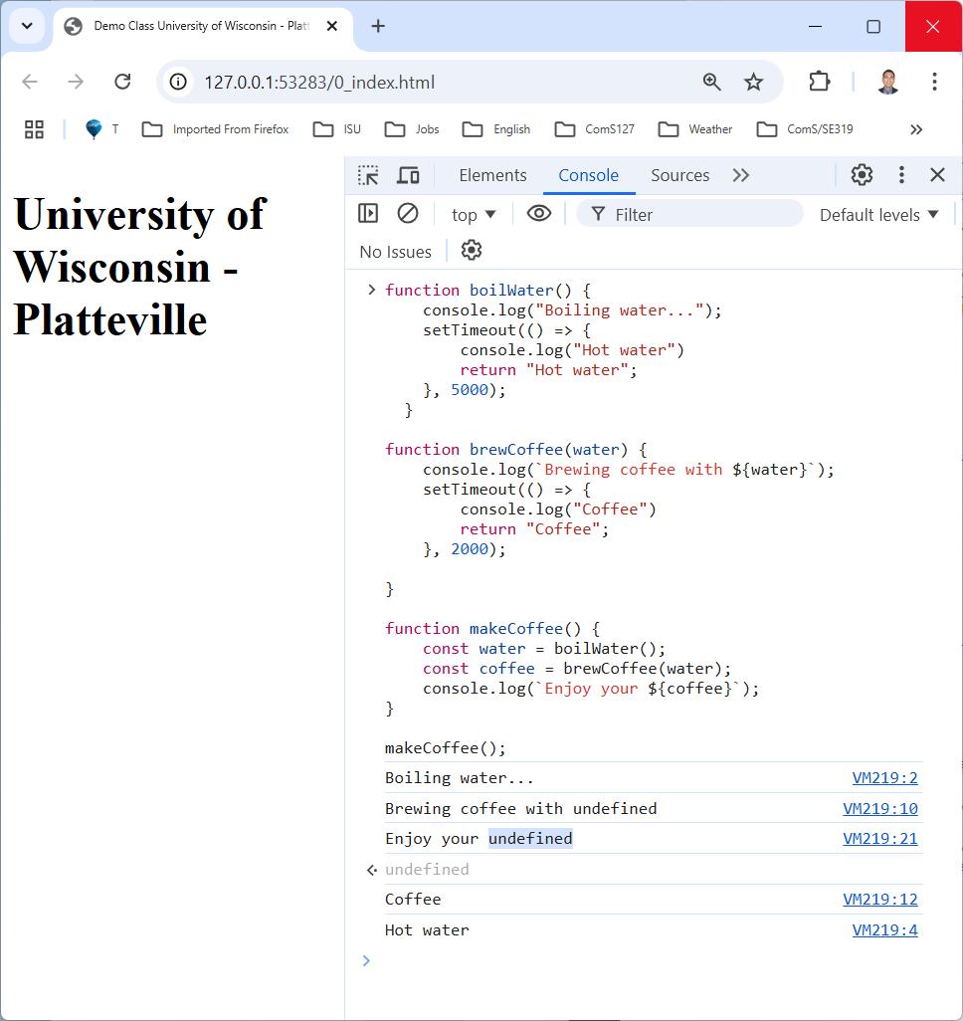


Try code in a browser:
“Enjoy your Coffee“
is shown quickly immediately ...
brewCoffee(water) executes
without waiting “Hot water”
Not what we want
boilerWater() takes longer than brewCoffee()

Slide 29
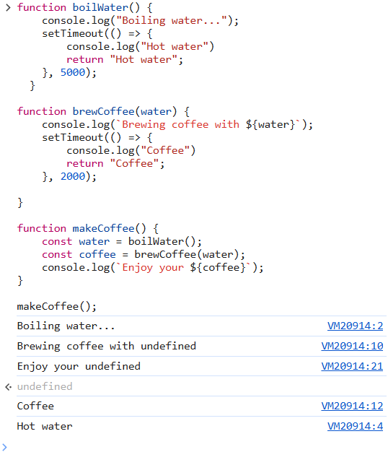


Why is water undefined ?
err
Same with coffee?

Slide 30
Solution
async / await
Let’s make brewCoffee() wait for boilWater() to finish

Slide 31
makeCoffee
boilWater
(5 secs)
brewCoffee
(2 secs)
Let’s make brewCoffee() wait for boilWater() to finish.
(5 secs)
time
(2 secs)
enjoy

Slide 32
Let’s make brewCoffee() wait for boilWater() to finish by using async / await :
async function makeCoffee() {
console.log("Starting coffee...");
const water = await boilWater();
const coffee = await brewCoffee(water);
console.log(`Enjoy your ${coffee}`);
}

Slide 33
With the help of promise we can handle asynchronous processing in regular functions:
Some statements are inherently promises :
fetch("https://fakestoreapi.com/products")
.then(response => response.json())
.then(data => console.log(data));
async function boilWater() {
console.log("Boiling water...");
return new Promise((resolve) =>
setTimeout(() => {
console.log("Hot water");
resolve("Hot water");;
}, 5000)
);
}
Promise()
setTimeout()

Slide 34
Promise
A promise may produce a value some time in the future.
That is, instead of immediately returning the final value, the asynchronous method returns a promise to supply the value at some point in the future.

Slide 35
Complete solution using Promise-based setTimeout and async/await:
async function boilWater() {
console.log("Boiling water...");
return new Promise((resolve) =>
setTimeout(() => {
console.log("Hot water");
resolve("Hot water");;
}, 5000)
);
}
async function brewCoffee(water) {
console.log(`Brewing coffee with ${water}`);
return new Promise((resolve) =>
setTimeout(() => {
console.log("Coffee");
resolve("Coffee");
}, 2000)
);
}
async function makeCoffee() {
console.log("Starting coffee...");
const water = await boilWater();
const coffee = await brewCoffee(water);
console.log(`Enjoy your ${coffee}`);
}
makeCoffee();

Slide 36

Try code in a browser:
“Enjoy your Coffee“
is shown after boilWater() ←5 secs
and
brewCoffee() ← 2 secs

Slide 37
Asynchronous processing
fetch

Slide 38
So far :
We have use setTimeout to simulate processing delay.
Then, we add Promise to use async/await and have control over asynchronous processing.
Fetch :
It is a built-in function that allows you to make network requests to retrieve data from a server or API.
It is considered a promise-based function.
And it executes asynchronously.

Slide 39


If we use fetch incorrectly, we may have error:
function fetchData(){
fetch("./data.json")
.then(response=>response.json())
.then(data => console.log(data));
for (const person of data)
console.log(person.firstName);
}
fetchData();
[
{
"firstName":"Abraham",
"lastName" : "Aldaco"
},
{
"firstName":"John",
"lastName" : "Doe"
},
{
"firstName":"Clark",
"lastName" : "Kent"
}
]
err

Slide 40

function fetchData(){
fetch("./data.json")
.then(response=>response.json())
.then(data => console.log(data));
for (const person of data)
console.log(person.firstName);
}
fetchData();
Why is data not defined ?
err

Slide 41

Explanation of the error :
function fetchData(){
fetch("./data.json")
.then(response=>response.json())
.then(data => console.log(data));
for (const person of data)
console.log(person.firstName);
}
fetchData();
fetch and console.log work fine.
execution
But the for statement is executed without waiting for the fetch to finish.
err

Slide 42
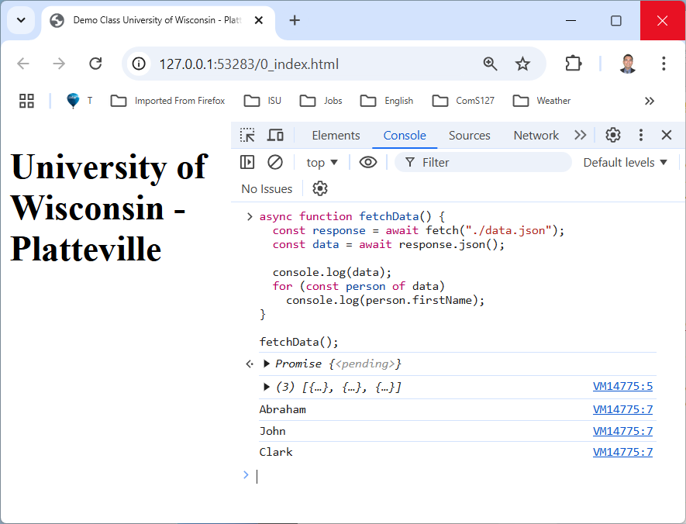


Solving the issue adding async/await:
async function fetchData(){
const response = await fetch("./data.json");
const data = await response.json();
console.log(data);
for (const person of data)
console.log(person.firstName);
}
fetchData();
execution

Slide 43
Assignment :
Convert to async/await the next code
using Promise and setTimeout:

Slide 44


// Function to calculate the area of a rectangle
function calculateArea(length, width) {
return length * width;
}
// Function to calculate the cost of flooring based on area
function calculateFlooringCost(area, costPerSquareUnit) {
return area * costPerSquareUnit;
}
function flooringCost() {
const length = 10; // Length of the room
const width = 15; // Width of the room
const costPerSquareUnit = 5; // Cost per square unit
// Step 1: Calculate the area
const area = calculateArea(length, width);
console.log(`Area of the room: ${area} square units`);
// Step 2: Calculate the flooring cost based on the area
const totalCost = calculateFlooringCost(area, costPerSquareUnit);
console.log(`Total flooring cost: $${totalCost}`);
}
flooringCost();
Assignment

Slide 45

Thanks !
Questions ?

Slide 46
Backup

Slide 47
Code
https://github.com/aaldacog/uwp

Slide 48
Promise
A Promise is an object representing the eventual completion or failure of an Asynchronous operation.
Reference:
https://www.mitrais.com/news-updates/asynchronous-in-javascript/
https://developer.mozilla.org/en-US/docs/Web/JavaScript/Guide/Using_promises

Slide 49
Promise
A promise is an object that may produce a single value some time in the future:
either a resolved value, or a reason that it’s not resolved (e.g., a network error occurred).
if the promise succeed
if the promise fails

Slide 50
Promise
instead of immediately returning the final value, the asynchronous method returns a promise to supply the value at some point in the future.

Slide 51
1
Let’s to execute a resolve promise :
new Promise(function(resolve, reject) {
// the function is executed automatically when the promise is constructed
// after 1 second signal that the job is done with the result "done“
setTimeout(() => resolve("done"), 1000);
});
The Promise executed successfully.
And the result value is ‘done’’
Reference:
https://javascript.info/promise-basics

Slide 52
Servers :
liveserver
python –m http.server 8888

