Slide 1
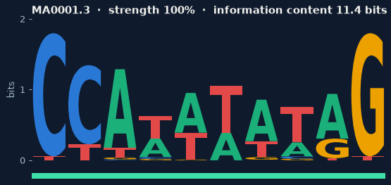
MotifBench
C
C
A
T
A
T
A
T
A
G
Classic vs modern motif discovery under varying motif strength, background models and pseudocounts
Aaleen Fatima · Laiba Amjad · Mariyam Pasha
CS4054 Bioinformatics · FAST-NUCES Lahore · November 2026
Notes:
Welcome. MotifBench is a controlled benchmark that asks how far the textbook motif-finding algorithms fall behind a modern tool, and why. Each of us will present the part we built: Laiba the data and pipeline, Aaleen the algorithms, Mariyam the evaluation and results.

Slide 2
Finding a hidden pattern in DNA
Transcription factors bind short DNA patterns called motifs. Each copy is slightly different, and all are buried in long stretches of unrelated DNA.
A motif is a probability matrix
GTTACGCCATATATAGTTCAGA
AACCATAAATAGGCTTTGACCG
TTGATCCCATATATGGAACGTT
Input: 50 sequences × 500 bp. Output: where the motif is, and what it looks like.
Letter height = how much information each position carries (0–2 bits).
Notes:
A motif is described by a 4 by k probability matrix, shown here as a sequence logo. The task: given 50 sequences of 500 base pairs, each with one hidden copy, find the copies and recover the matrix.

Slide 3
Three questions
1
2
3
Reliability
Gap
Explanation
At what motif strength does each classic algorithm become reliable?
How far behind STREME, a modern tool from the MEME Suite, are they?
How much of that gap comes down to two cheap fixes: pseudocounts and the background model?
Greedy · Randomized · Gibbs (Compeau & Pevzner, Ch. 2) vs STREME (Bailey, 2021)
Notes:
These three questions come straight from our proposal and structure the rest of the talk.

Slide 4
Building the benchmark
A
C
G
T
Data and pipeline · Laiba Amjad
Notes:
Laiba presents the datasets and the experiment pipeline.

Slide 5
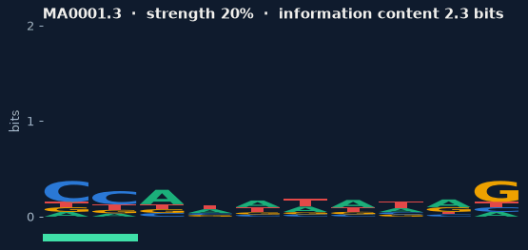
Planting real motifs at controlled strength
8
7
3
1,770
JASPAR 2026 motifs
strength levels
DNA backgrounds
datasets
Strength: blend with uniform, P′ = (1−α)P + α·0.25, keeping 20–100 % of the original information content
Backgrounds: uniform · AT-rich (35/15/15/35) · Markov with CpG depletion
Real sites: JASPAR binding sites (TFAP2A, PAX5, CREB1) in synthetic flanks, 90 datasets
20 % strength
100 % strength
Non-uniform backgrounds matter: on uniform DNA a uniform and an estimated background model are the same, so the background variable could show nothing.
Notes:
Each synthetic dataset is 50 sequences of 500 base pairs with one planted site per sequence. Strength is controlled by blending the JASPAR matrix with the uniform distribution, choosing alpha by bisection so the motif keeps a target fraction of its information content. 8 motifs, 7 strengths, 3 backgrounds and 10 replicates give 1,680 synthetic datasets, plus 90 real binding-site datasets.

Slide 6
26,550 runs, one evaluation for all
1,770
12
+3
1
datasets
classic configs
references
evaluate()
FASTA + truth in JSON
3 algorithms × pseudocounts × background
STREME, true-motif ceiling, random chance
same metrics for every run → one CSV row
STREME run locally with default settings (max width raised to 20); its top-ranked motif is used, never the closest one.
Reproducible: every row stores its seed; the run configuration and code commit are saved; ~43 CPU-hours in total.
Notes:
Every dataset gets 15 runs: 12 classic configurations, STREME, and two baselines that bracket the results: scanning with the true motif (the ceiling) and random sites (chance). All go through the same evaluation function.

Slide 7
The hunters and their two switches
G
C
A
T
Algorithms · Aaleen Fatima
Notes:
Aaleen presents the three algorithms and the two switches we vary.

Slide 8
Three classic search strategies
G
Greedy
R
Randomized
G
Gibbs
Seeds with every k-mer of sequence 1, then adds each next sequence's best-scoring k-mer.
Random start, then profile → best k-mers until the score stops improving.
Drops one sequence's k-mer and resamples it in proportion to how well it fits the rest.
Deterministic · ~2 s / dataset
200 restarts · ~4 s / dataset
40 restarts × 2,000 steps · ~15 s
All three: NumPy-vectorised, told the true width k, scored by log-odds Σ log( P[b, j] / bg[b] )
Notes:
All three follow Compeau and Pevzner. To include a background model we replaced the textbook consensus score with a log-odds score. Search budgets were fixed so the comparison is fair.

Slide 9
Two switches we turn on and off
T
Pseudocounts
G
Background model
off: P = c / n
uniform: bg = 0.25 per base
on: P = (c + 1) / (n + 4)
shuffled: bg from a shuffled copy of the input
Without them, one unseen base gives probability 0, so the whole window scores −∞.
Shuffling keeps the base composition, so this is the input's own A/C/G/T frequencies.
Notes:
These are the two experimental switches. Zero probabilities without pseudocounts are handled explicitly rather than crashing. The background estimate has its own random generator so uniform and shuffled runs are paired.

Slide 10
Scoring the hunters fairly
T
G
C
A
Evaluation and analysis · Mariyam Pasha
Notes:
Mariyam presents the evaluation and the results.

Slide 11
Four metrics, all shift- and strand-aware
Site recovery
Pearson r
A
C
share of planted sites found (≥ 50 % overlap) — main metric
found vs true matrix at the best offset and strand
Hamming distance
Profile entropy
G
T
found vs true consensus, as a fraction of width
how specific the found motif is, vs the true one
Fair to STREME: it picks its own width and may report the opposite strand, so every metric slides the found motif along the true one on both strands; its sites come from scanning with its own matrix.
Statistics: paired Wilcoxon signed-rank tests on the same datasets, rank-biserial effect size r, Holm correction.
Notes:
Every metric handles shifted motifs, the reverse strand and different widths, which matters most for STREME. A method that reports nothing scores zero, so failures count. Comparisons are paired on the same datasets, which removes the large variation between strong and weak motifs.

Slide 12
What 26,550 runs say
C
C
A
T
Results

Slide 13
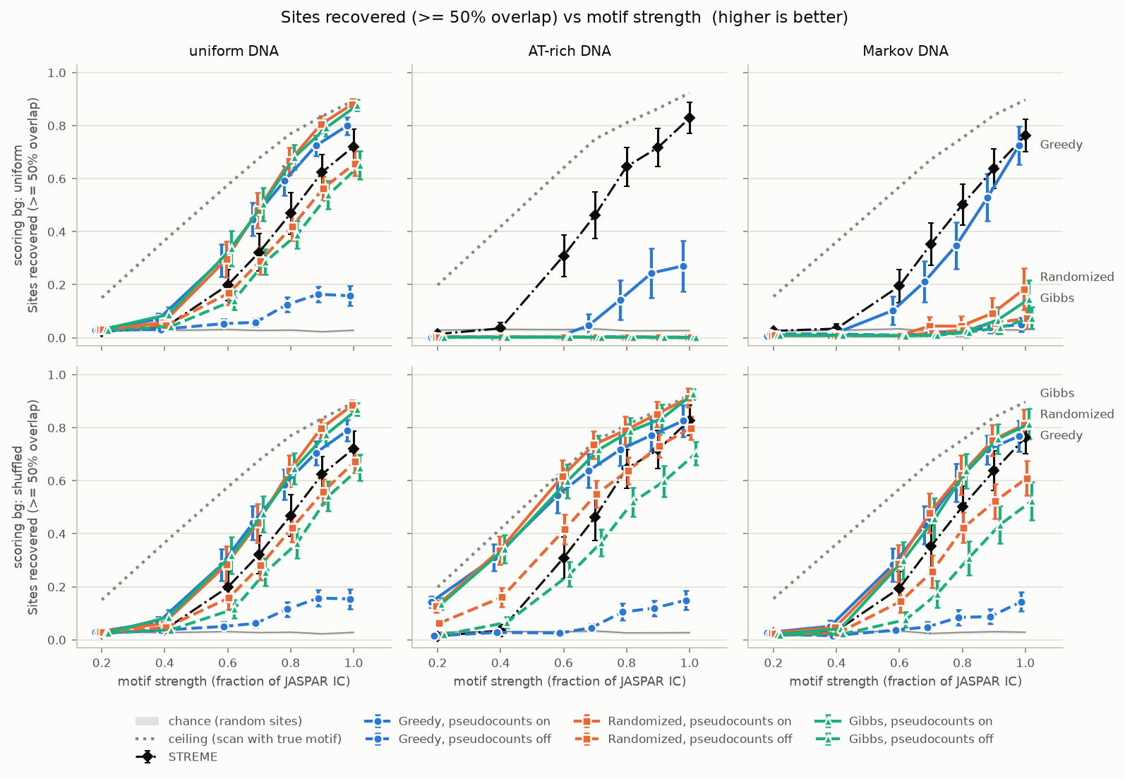
The whole story in one figure
Uniform DNA: top and bottom rows match, as expected
AT-rich & Markov DNA: with a uniform background (top) the algorithms find almost nothing
Dashed blue: Greedy without pseudocounts collapses everywhere
Black: STREME; grey dotted: the true-motif ceiling
Notes:
Columns show how the DNA was generated, rows what background the algorithm assumed. Solid lines are pseudocounts on, dashed off. Each point averages 8 motifs times 10 replicates, with 95 percent confidence intervals.

Slide 14
The background model is the biggest factor
+0.55
Randomized site recovery on AT-rich DNA (r = 1.00)
With bg = 0.25 every A or T looks like evidence, so the search converges to junk like AAATAAAAAT. Estimating the background from the input cancels that bias.
Markov DNA: +0.30 to +0.32 · uniform DNA: no difference
Notes:
On AT-rich DNA, Randomized and Gibbs drop to 0.2 percent site recovery with a uniform background, and rise to about 50 percent with a shuffled one. The shuffled background wins on 1,053 of 1,120 paired datasets for Randomized. Holm-corrected p below 1e-160.

Slide 15
Pseudocounts help everyone and rescue Greedy
+0.31
Greedy site recovery with pseudocounts (r = 0.89)
Greedy builds its first profiles from one or two sequences. Without pseudocounts almost every next window scores −∞ and the first one is taken by default; the error then propagates.
Real binding sites: Greedy +0.54
Notes:
All three algorithms improve significantly; Holm-corrected p below 1e-250. Gibbs +0.14, Randomized +0.10.

Slide 16
Both fixes close the whole gap to STREME
Real binding sites
Gibbs 0.88 · Randomized 0.88
Greedy 0.79 · STREME 0.80
Gibbs and Randomized beat STREME (p < 1e-5)
Caveat
The classic algorithms were told the true motif width; STREME had to find it. "Beats STREME" holds under that condition.
Notes:
Textbook settings recover 4 to 11 percent of sites against STREME's 38. Both fixes take them to about 50 percent. The gap is closed entirely by two one-line changes. Be clear about the width caveat.

Slide 17
When can you trust them?
Method | Uniform DNA | AT-rich DNA | Markov DNA
True motif (ceiling) | 0.6 | 0.6 | 0.6
Gibbs, both fixes | 0.8 | 0.6 | 0.8
Randomized, both fixes | 0.8 | 0.6 | 0.8
Greedy, both fixes | 0.8 | 0.6 | 0.8
STREME | 0.9 | 0.8 | 0.8
Textbook settings | 0.9 or never | never | never
60 %
of the information content before even the true motif finds half the sites
Below that, failures are a limit of the data, not of the algorithms. High-information motifs (Ar, TBXT: ~19 bits) are far easier than low ones (AGL3, Runx1: ~11 bits).
Lowest strength (fraction of JASPAR information content) at which mean site recovery reaches 50 %
Notes:
With both fixes, Randomized and Gibbs reach 50 percent recovery at 60 to 80 percent strength and 80 percent at 90 to 100 percent. The ceiling row is the important context.

Slide 18
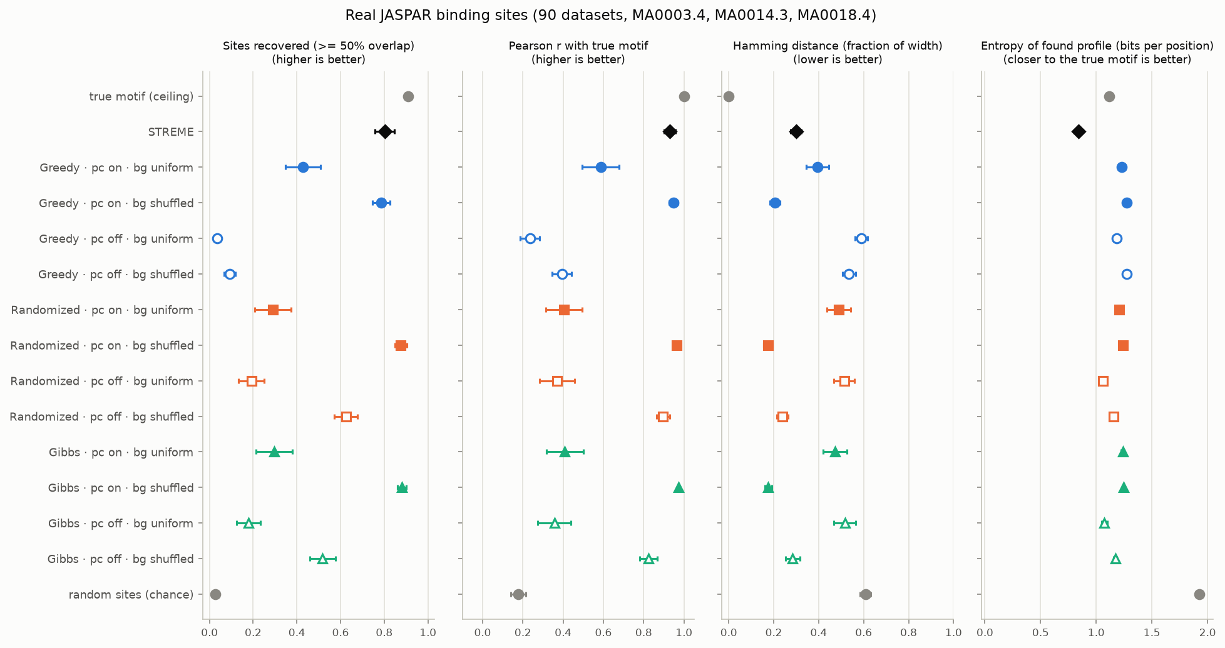
The same story on real binding sites
90 datasets of real JASPAR sites (TFAP2A, PAX5, CREB1). Filled = pseudocounts on, hollow = off. The shuffled background wins on 60 of 60 paired AT-rich datasets for Randomized and Gibbs.
Notes:
Every conclusion repeats on real binding sites, usually more strongly.

Slide 19
Two findings we did not expect
T
Over-confident motifs
G
Search or scoring?
1.1–1.5 vs 1.8
88 %
58 %
bits per position: found vs true motif at 20 % strength
Randomized runs that already beat the planted sites' score
for Gibbs: its search is not saturated
At weak strength the searches lock onto chance patterns that look more conserved than the real motif. Treat a sharp motif from weak data with suspicion.
More search would barely help Randomized; its errors come from the scoring model. Gibbs is still search-limited, so its results are a lower bound.
Notes:
From the entropy metric and from the budget study, which reran Randomized and Gibbs on 12 datasets with growing budgets.

Slide 20
Takeaways
A
C
G
T
A
Estimate the background from the data decisive on non-uniform DNA, free on uniform DNA
C
Always use pseudocounts essential for Greedy, helpful for all
G
Prefer Randomized or Gibbs with both fixes they match or beat STREME (given the width)
T
Distrust motifs from weak data below ~60 % of the information content, nothing finds the sites
Notes:
The gap between textbook and modern motif finding is mostly about two modelling choices, not the search algorithms themselves.

Slide 21
Thank you · Questions?
C
C
A
T
A
T
A
T
A
G
github.com/aaleenfatima/MotifBench
Limitations
8 motifs · synthetic flanks for real sites · one site per sequence · width given to the classic algorithms · STREME untuned · Gibbs budget not saturated
Notes:
Code, data, results, figures and the analysis notebook are all in the repository.

