Slide 1
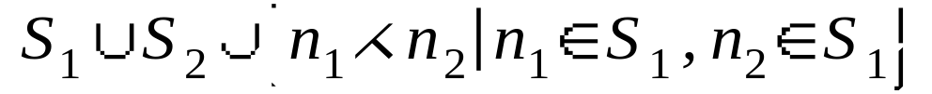
Separating Axis Theorem
…for Convex bodies
No intersection if ∃ a separating axis
Axis on which the projections do not overlap
Separating plane is the plane with s.a. as normal
Let S₁ = {set of 1’s normals}
Let S₂ = {set of 2’s normals}
If s.a. exists, it is in:
NOT a Separating axis
Separating axis

Slide 2
Spatial Subdivision
Collision detection for n objects is O(n²)
Array: O(n²) time, O(n) space
Why test pairs of objects that are far apart?

Slide 3
Grid
Store a pointer to an object in every cell overlapped by its bounding box.
An object can only collide with objects in the same cells
k x k Grid: O(n/k²) time, O(n+k²) space (small objects, good luck)

Slide 4
kd-Tree
Recursively divide space with axis-aligned splitting planes
Forms a binary tree where node = plane
An object is stored at the highest node that cuts its bounding box
O(n) space
O(n lg n) time time to find all objects overlapping a bounding box for collision detection (if you’re lucky)

Slide 5
BSP-Tree
The planes aren’t axis aligned
Same performance as kd-tree

Slide 6
Stable Simulation using
Brown University CS224
  Nonconvex Rigid Bodies with Stacking
  Guendelman, Bridson & Fedkiw SIGGRAPH ’03
Morgan McGuire

Slide 7
Algorithm
Find external forces
Resolve collisions
Compute new velocities
Resolve contact
Compute new positions

Slide 8
Timeline
v = x’ = velocity
Old
x₀
v₀
t₀
New
x₁
v₁
t₁
Computation order: Red, Green, Blue
Δt
Δt
Δt
Predicted
(assume no collisions)
x_{p}
v_{p}
Prediction changes after each collision is resolved.

Slide 9
1. Compute External Forces
F_{net}= F_{gravity} + F_{wind} + F_{buoyant}+…
No contact based forces (F_{friction}, F_{normal})
Use old positions and velocities

Slide 10
2. Collisions
Predict velocity and position
v_{p} = v₀ + F_{net}Δt / m
x_{p} = x₀ + v_{p}Δt
For every predicted collision between objects A and B,
  Go back to old values
  Compute impulse j_{col} from v₀ values
  Apply j_{col} to v₀ values
  (Leave x₀ values unchanged)
Repeat the entire process many times (randomize the iteration order for each pass)

Slide 11
3. Compute New Velocities
Forward Euler integration
  Assume constant acceleration over Δt
Officially move velocity from t₀ to t₁
v₁ = v₀ + F_{net}Δt / m
Position has still not changed

Slide 12
4. Contact [Collisions]
Process contact as inelastic collisions (ε=0)
Use predicted positions and new velocities
Detect the deepest interpenetration pair
Compute contact impulse using ε=0
Apply impulses to the v₁ values
Repeat many times

Slide 13
5. Update Positions
Officially update positions
x₁ = x₀ + v₁Δt
(Velocity was already updated)

Slide 14
Example: Objects at Rest

Slide 15
Initial Conditions
Object A: Immobile block
  m_{A} = ∞
  v_{A} is always 0
  x_{A} is always 0
Object B: Sphere
  radius = 1
  m_{B} = 1
  x₀ = 1 (only look at y-axis)
  v₀ = 0
Let Δt = 1 for simplicity
Let ε = 1
B
A

Slide 16
Step 1: Forces
F = m_{B}(-g) = -g
Ignore the forces on A (it is immobile)
B
F_{g}
A

Slide 17
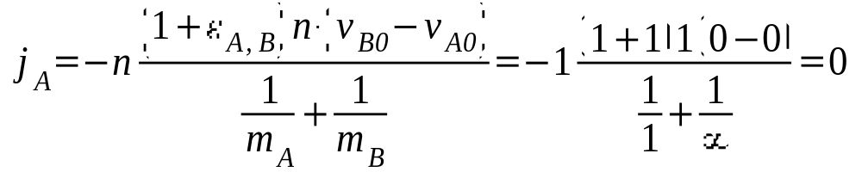
Step 2: Collisions
Predict Positions
  v_{p} = v₀ + F Δt / m_{B} = 0 + (-g)(1)/(1) = -g
  x_{p} = x₀ + v_{p} Δt = 1 + (-g)(1) = 1-g
Detect Collisions
  Sphere interpenetrates at x_{c} = -g, n = 1
Apply Impulses
v₀ := v₀ + j_{A} / m_{B} = 0 + 0/1
B
n
X
A

Slide 18
Step 3: Velocities
v₁= v₀ + FΔt/m_{B} = 0 + (-g)(1)/(1) = -g
B
v₁
A

Slide 19
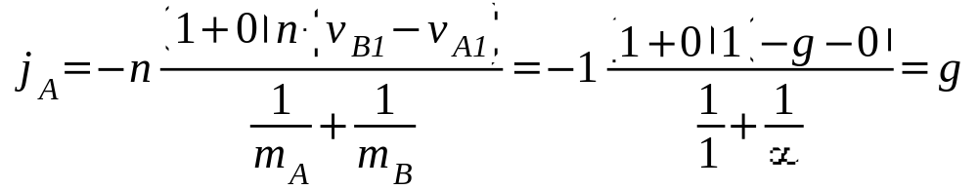
Step 4: Contact
Predict Positions
  x_{p} = x₀ + v₁ Δt = 1 + (-g)(1) = 1-g
Detect Collisions
  Sphere interpenetrates at x_{c} = -g, n = 1
Compute Impulses
v₁ := v₁ + j_{A} / m_{B} = -g + g/1 = 0
B
n
X
A

Slide 20
Step 5: Positions
x₁ = x₀ + v₁Δt = 1 + (0)1 = 1
(we are back to the initial conditions!)
B
A

Slide 21
Example: Collision

Slide 22
Initial Conditions
Object A: Immobile block
  m_{A} = ∞
  v_{A} is always 0
  x_{A} is always 0
Object B: Sphere
  radius = 1
  m_{B} = 1
  x₀ = 3g (only look at y-axis)
  v₀ = -2g
Let Δt = 1 for simplicity
Let ε = 1
B
3g
3g-1
v₀
A

Slide 23
Step 1: Forces
F = m_{B}(-g) = -g
Ignore the forces on A (it is immobile)
B
F_{g}
A

Slide 24
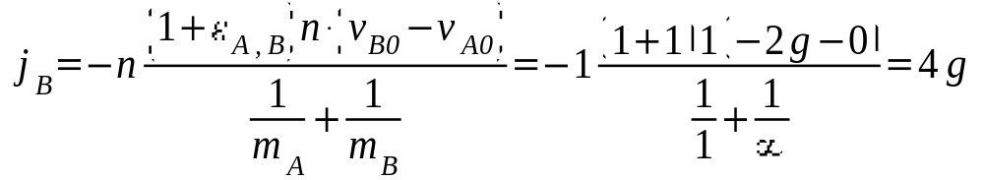
Step 2: Collisions
B
Predict Positions
  v_{p} = v₀ + F Δt / m_{B} = -2g + -g = -3g
  x_{p} = x₀ + v_{p} Δt = 3g + -3g = 0
Detect Collisions
  Sphere interpenetrates at x_{c} = -1, n = 1
Apply Impulses
v₀ := v₀ + j_{B} / m_{B} = -2g + 4g/1 = 2g
n
A
X

Slide 25
Step 3: Velocities
v₁= v₀ + FΔt/m_{B} = 2g + -g= g
v₁
B
A

Slide 26
Step 4: Contact
Predict Positions
  x_{p} = x₀ + v₁ Δt = 3g + g = 4g
Detect Collisions
  None!
v₁
B
A

Slide 27
Step 5: Positions
x₁ = x₀ + v₁Δt = 2g + g = g
(Sphere has bounced and is moving upward)
v₁
B
A

Slide 28
Example: Stacking

Slide 29
Initial Conditions
Object A: Sphere
  x_{A0} = 3, v_{A0} = 0, m_{A}=1
Object B: Sphere
  x_{B0} = 1, v_{B0} = 0, m_{B}=1
Object C: Immobile block
A
B
C

Slide 30
Step 1: Compute Forces
F_{A} = -m_{A}g
F_{B} = -m_{B}g
F_{C}= irrelevant (immobile)
A
B
C

Slide 31
Step 2: Collisions
Predict Positions
  v_{Ap} = v_{A0} + F_{A}Δt / m_{A} = -g
  x_{Ap} = x_{A0} + v_{Ap} Δt = 3 – g
  v_{Bp} = v_{B0} + F_{B}Δt / m_{A} = -g
  x_{Bp} = x_{B0} + v_{Bp} Δt = 1 – g
Detect Collisions
  B collides with C
Apply Impulses
(j=0 since v_{B0}=0)
A
B
j_{col}
C

Slide 32
Step 3: Velocities
  v_{A1} = v_{A0} + F_{A}Δt / m_{A} = -g
  v_{B1} = v_{B0} + F_{B}Δt / m_{A} = -g
A
v_{A1}
B
v_{B1}
C

Slide 33
Step 4: Contact (1st pass)
Predict Positions
  x_{Ap} = x_{A0} + v_{A1} Δt = 3 – g
  x_{Bp} = x_{B0} + v_{B1} Δt = 1 – g
Detect Collisions
  B collides with C
Apply Impulses
v_{B1} := v_{B1}+ j_{col}/m_{B} = 0
A
B
j_{col}
C
X

Slide 34
Step 4: Contact (2nd pass)
Predict Positions
  x_{Ap} = x_{A0} + v_{A1} Δt = 3 – g
  x_{Bp} = x_{B0} + v_{B1} Δt = 1
Detect Collisions
  A collides with B
Apply Impulses
v_{A1} := v_{A1}+ j_{col}/m_{A} = 0
v_{B1} := v_{B1}+ j_{col}/m_{A} = -g
j_{col}
A
X
B
-j_{col}
C

Slide 35
Step 4: Contact (3rd pass)
Predict Positions
  x_{Ap} = x_{A0} + v_{A1} Δt = 3
  x_{Bp} = x_{B0} + v_{B1} Δt = 1-g
Detect Collisions
  B collides with C
Apply Impulses
v_{B1} := v_{B1}+ j_{col}/m_{A} = 0
A
B
j_{col}
C
X

Slide 36
Step 4: Contact (4th pass)
Predict Positions
  x_{Ap} = x_{A0} + v_{A1} Δt = 3
  x_{Bp} = x_{B0} + v_{B1} Δt = 1
Detect Collisions
  None!
A
B
C

Slide 37
Step 5: Positions
  x_{A1} = x_{A0} + v_{A1}Δt = 1
  x_{B1} = x_{B0} + v_{B1}Δt = 3
  … back to the initial conditions!
A
B
C

