Slide 1
Everything you ever wanted to know about collision detection
(and as much about collision response as I can figure out by Wednesday)
By Ryan Schmidt, ryansc@cpsc.ucalgary.ca

Slide 2
Where to find this on the Interweb
http://www.cpsc.ucalgary.ca/~ryansc
Lots of links to software, web articles, and a bunch of papers in PDF format
You can also email me, ryansc@cpsc.ucalgary.ca - I’ll try to help you if I can.

Slide 3
What you need to know
Basic geometry
  vectors, points, homogenous coordinates, affine transformations, dot product, cross product, vector projections, normals, planes
math helps…
  Linear algebra, calculus, differential equations

Slide 4
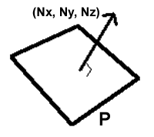


Calculating Plane Equations
A 3D Plane is defined by a normal and a distance along that normal
Plane Equation:
Find d:
For test point (x,y,z), if plane equation
  > 0: point on ‘front’ side (in direction of normal),
  < 0: on ‘back’ side
  = 0: directly on plane
2D Line ‘Normal’: negate rise and run, find d using the same method

Slide 5
So where do ya start….?
First you have to detect collisions
  With discrete timesteps, every frame you check to see if objects are intersecting (overlapping)
Testing if your model’s actual volume overlaps another’s is too slow
Use bounding volumes (BV’s) to approximate each object’s real volume

Slide 6
Bounding Volumes?
Convex-ness is important*
spheres, cylinders, boxes, polyhedra, etc.
Really you are only going to use spheres, boxes, and polyhedra (…and probably not polyhedra)
Spheres are mostly used for fast culling
For boxes and polyhedra, most intersection tests start with point inside-outside tests
  That’s why convexity matters. There is no general inside-outside test for a 3D concave polyhedron.
* 40 Helens agree…

Slide 7


2D Point Inside-Outside Tests
Convex Polygon Test
  Test point has to be on same side of all edges
Concave Polygon Tests
  360 degree angle summation
  Compute angles between test point and each vertex, inside if they sum to 360
  Slow, dot product and acos for each angle!

Slide 8
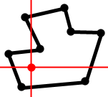
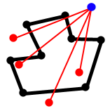
More Concave Polygon Tests
Quadrant Method (see Gamasutra article)
  Translate poly so test point is origin
  Walk around polygon edges, find axis crossings
  +1 for CW crossing, -1 for CCW crossing,
  Diagonal crossings are +2/-2
  Keep running total, point inside if final total is +4/-4
Edge Cross Test (see Graphics Gems IV)
  Take line from test point to a point outside polygon
  Count polygon edge crossings
  Even # of crossings, point is outside
  Odd # of crossings, point is inside
These two are about the same speed

Slide 9
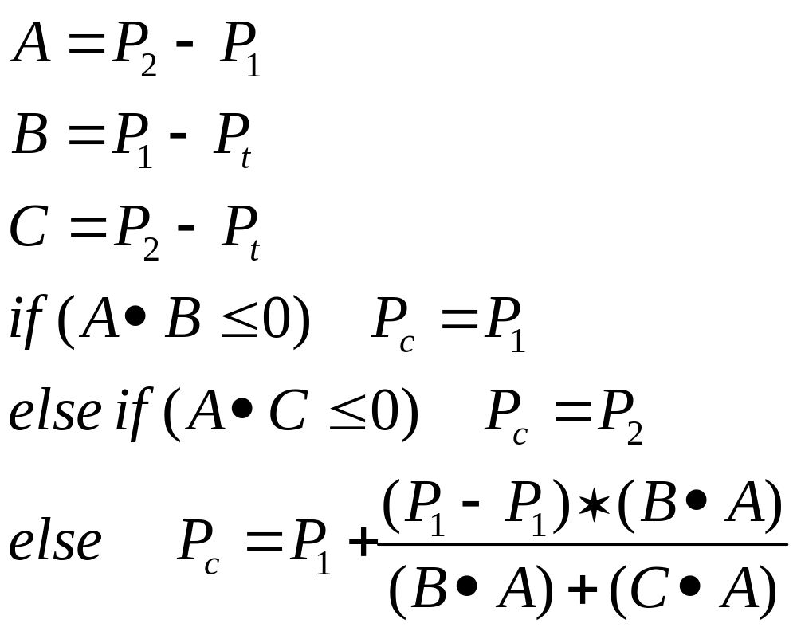
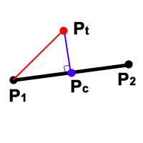
Closest point on a line
Handy for all sorts of things…

Slide 10
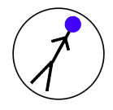
Spheres as Bounding Volumes
Simplest 3D Bounding Volume
  Center point and radius
Point in/out test:
  Calculate distance between test point and center point
  If distance <= radius, point is inside
  You can save a square root by calculating the squared distance and comparing with the squared radius !!!
  (this makes things a lot faster)
It is ALWAYS worth it to do a sphere test before any more complicated test. ALWAYS. I said ALWAYS.

Slide 11
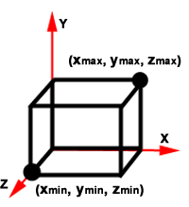
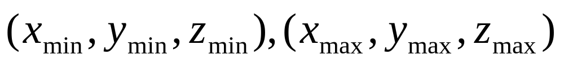
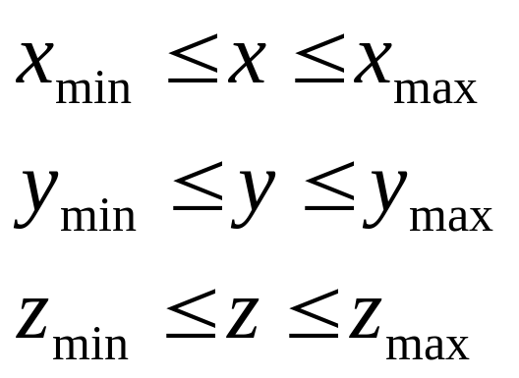
Axis-Aligned Bounding Boxes
Specified as two points:
Normals are easy to calculate
Simple point-inside test:

Slide 12
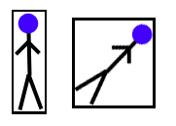
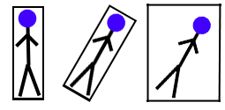
Problems With AABB’s
Not very efficient
Rotation can be complicated
  Must rotate all 8 points of box
  Other option is to rotate model and rebuild AABB, but this is not efficient

Slide 13
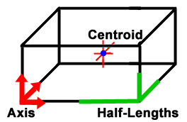

Oriented Bounding Boxes
Center point, 3 normalized
axis, 3 edge half-lengths
Can store as 8 points,
sometimes more efficient
  Can become not-a-box after transformations
Axis are the 3 face normals
Better at bounding than spheres and AABB’s

Slide 14
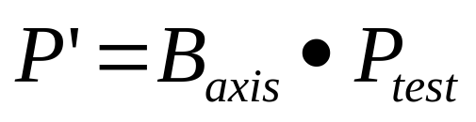
OBB Point Inside/Outside Tests
Plane Equations Test
  Plug test point into plane equation for all 6 faces
  If all test results have the same sign, the point is inside (which sign depends on normal orientation, but really doesn’t matter)
Smart Plane Equations Test
  Each pair of opposing faces has same normal, only d changes
  Test point against d intervals – down to 3 plane tests
Possibly Clever Change-of-Basis Test*
  Transform point into OBB basis (use the OBB axis)
  Now do AABB test on point (!)
  Change of basis:
* This just occurred to me while I was writing,
So it might not actually work

Slide 15

k-DOP’s
k-Discrete Oriented Polytype
Set of k/2 infinite ‘slabs’
  A slab is a normal and a d-interval
Intersection of all slabs forms a convex polyhedra
OBB and AABB are 6-DOP’s
Same intersection tests as OBB
  There is an even faster test if all
  your objects have the same k and
  same slab normals
Better bounds than OBB

Slide 16

Plane Intersection Tests
Planes are good for all sorts of things
  Boundaries between level areas, ‘finish lines’, track walls, powerups, etc
Basis of BSP (Binary Space Partition) Trees
  Used heavily in game engines like Quake(1, 2,… )
  They PARTITION space in half
  In half…that’s why they’re binary…punk*
* Sorry, I had to fill up the rest of this slide somehow, and
just making the font bigger makes me feel like a fraud…

Slide 17
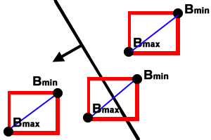
AABB/Plane Test
An AABB has 4 diagonals
Find the diagonal most
closely aligned with
the plane normal
Check if the diagonal crosses the plane
You can be clever again…
  If Bmin is on the positive side, then Bmax is guaranteed to be positive as well

Slide 18
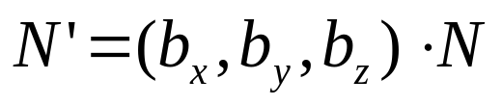
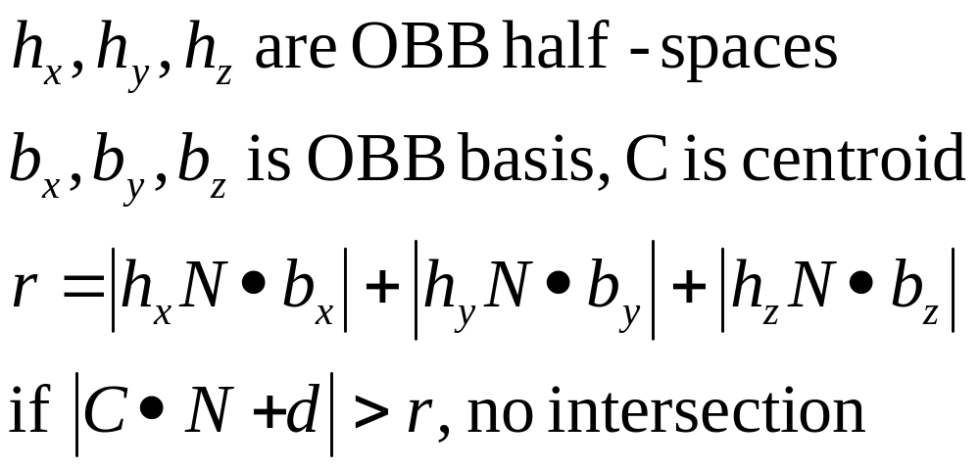
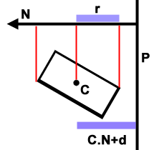
OBB/Plane Test
Method 1: transform the plane normal into the basis of the OBB and do the AABB test on N`
Method 2: project OBB axis onto plane normal

Slide 19
Other Plane-ish Tests
Plane-Plane
  Planes are infinite. They intersect unless they are parallel.
  You can build an arbitrary polyhedra using a bunch of planes (just make sure it is closed….)
Triangle-Triangle
  Many, many different ways to do this
  Use your napster machine to find code

Slide 20
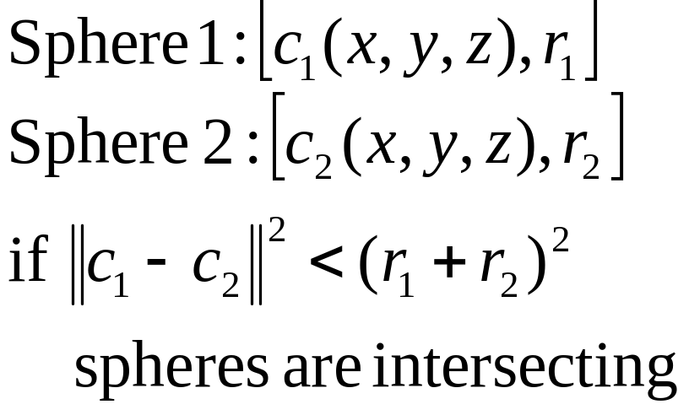
Bounding Volume Intersection Tests
Mostly based on point in/out tests
Simplest Test: Sphere/Sphere test

Slide 21
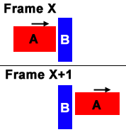
A fundamental problem
If timestep is large and A is
moving quickly, it can pass
through B in one frame
No collision is detected
Can solve by doing CD in
4 dimensions (4th is time)
  This is complicated
Can contain box over time and test that

Slide 22
Separating Axis Theorem
For any two arbitrary, convex, disjoint polyhedra A and B, there exists a separating axis where the projections of the polyhedra for intervals on the axis and the projections are disjoint
Lemma: if A and B are disjoint they can be separated by an axis that is orthogonal to either:
  a face of A
  a face of B
  an edge from each polyhedron

Slide 23
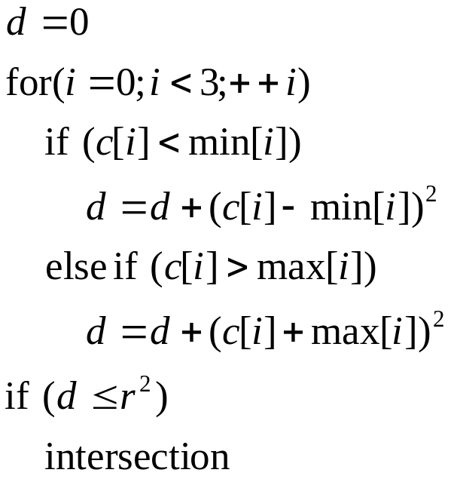
Sphere/AABB Intersection
Algorithm:
For OBB, transform sphere center into OBB basis and apply AABB test

Slide 24
AABB/AABB Test
Each AABB defines 3 intervals in x,y,z axis
If any of these intervals overlap, the AABB’s are intersecting

Slide 25
OBB/OBB – Separating Axis Theorem Test
Test 15 axis with with SAT
  3 faces of A, 3 faces of B
  9 edge combinations between A and B
See OBBTree paper for derivation of tests and possible optimizations (on web)
Most efficient OBB/OBB test
  it has no degenerate conditions. This matters.
Not so good for doing dynamics
  the test doesn’t tell us which points/edges are intersecting

Slide 26
OBB/OBB – Geometric Test
To check if A is intersecting B:
  Check if any vertex of A is inside B
  Check if any edge of A intersects a face of B
Repeat tests with B against A
Face/Face tests
  It is possible for two boxes to intersect but fail the vertex/box and edge/face tests.
  Catch this by testing face centroids against boxes
  Very unlikely to happen, usually ignored

Slide 27
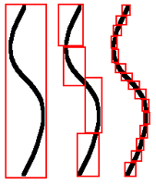
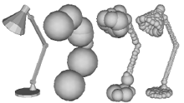
Heirarchical Bounding Volumes
Sphere Trees, AABB Trees, OBB Trees
  Gran Turismo used Sphere Trees
Trees are built automagically
  Usually precomputed, fitting is expensive
Accurate bounding of concave objects
  Down to polygon level if necessary
  Still very fast
See papers on-line
Approximating Polyhedra with _x000b_Spheres for Time-Critical Collision _x000b_Detection, Philip M. Hubbard

Slide 28
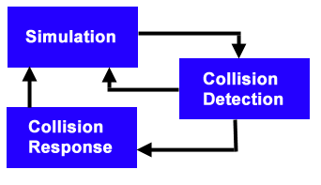
Dynamic Simulation Architecture
Collision Detection
is generally the
bottleneck in any
dynamic simulation
system
Lots of ways to speed up collision-detection

Slide 29
Reducing Collision Tests
Testing each object with all others is O(N²)
At minimum, do bounding sphere tests first
Reduce to O(N+k) with sweep-and-prune
  See SIGGRAPH 97 Physically Based Modelling Course Notes
Spatial Subdivision is fast too
  Updating after movement can be complicated
  AABB is easiest to sort and maintain
  Not necessary to subdivide all 3 dimensions

Slide 30
Other neat tricks
Raycasting
  Fast heuristic for ‘pass-through’ problem
  Sometimes useful in AI
    Like for avoiding other cars
Caching
  Exploit frame coherency, cache the last vertex/edge/face that failed and test it first
  ‘hits’ most of the time, large gains can be seen

Slide 31
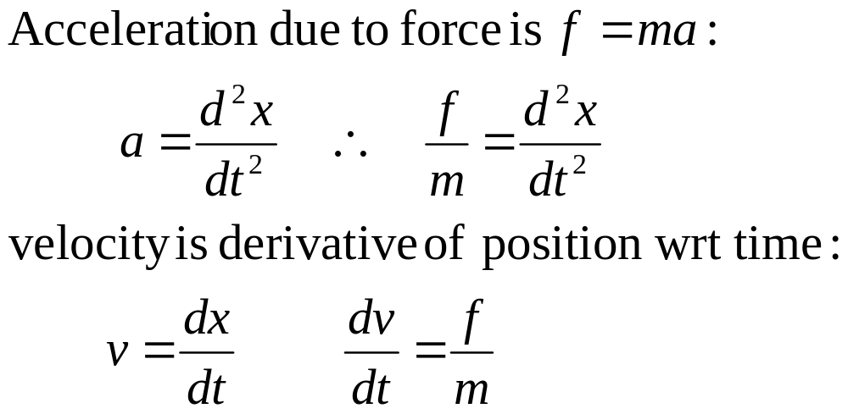
Dynamic Particle Simulation
Simplest type of dynamics system
Based on basic linear ODE:

Slide 32
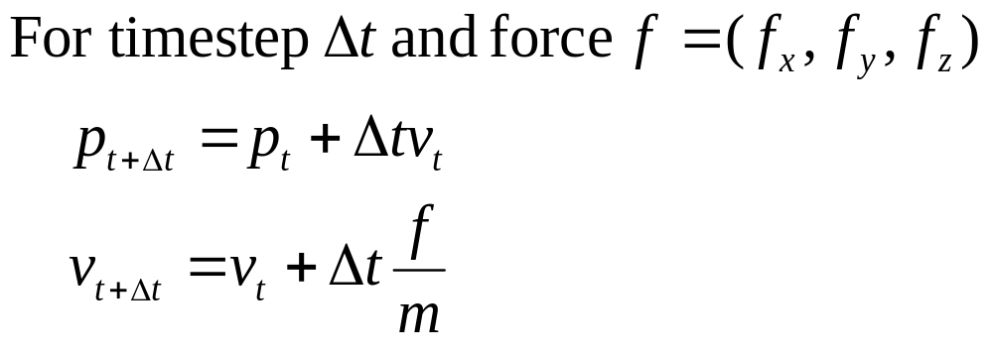
Particle Movement
Particle Definition:
  Position x(x,y,z)
  Velocity v(x,y,z)
  Mass m

Slide 33
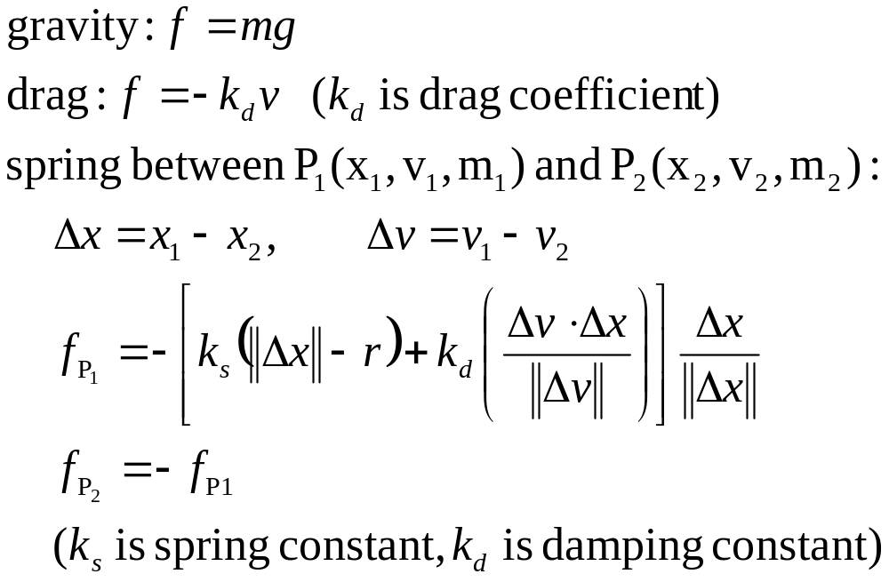
Example Forces

Slide 34
Using Particle Dynamics
Each timestep:
  Update position (add velocity)
  Calculate forces on particle
  Update velocity (add force over mass)
Model has no rotational velocity
  You can hack this in by rotating the velocity vector each frame
  Causes problems with collision response

Slide 35
Particle Collision System
Assumption: using OBBs
Do geometric test for colliding boxes
  Test all vertices and edges
  Save intersections
Calculate intersection point and time-of-intersection for each intersection
Move object back largest timestep
Apply collision response to intersection point

Slide 36
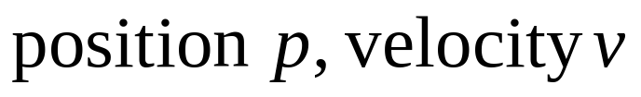
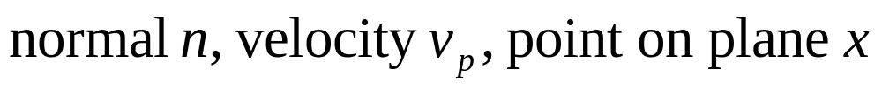

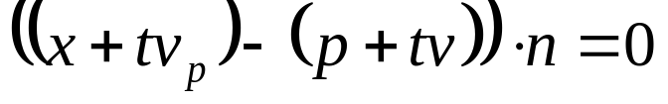
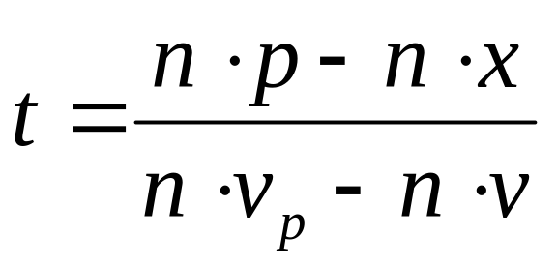
Closed-form expression for point/plane collision time
Point:
Plane:
Point on plane if
With linear velocity normal is constant:
now solve for t:
Notes:
If the plane isn’t moving, just set vp to 0
It may be possible for (n.vp – n.v) to degenerate to 0. In that case, I think you have to use binary subdivision
Now if you calculate (p+tv), you get the collision point on the face (!)

Slide 37
Problems with point/plane time
Have to test point with 3 faces (why?)
Time can be infinity / very large
  Ignore times that are too big
  Heuristic: throw away if larger than last timestep
If the rotation hack was applied, can return a time larger than last timestep
  This is why the rotation hack is bad
  Can always use subdivision in this case
    Have to use subdivision for edges as well, unless you can come up with a closed-form edge collision time (which shouldn’t be too hard, just sub (p_{i}+tv_{i}) into line-intersection test)

Slide 38
Binary Search for collision time
Move OBB back to before current timestep
Run simulator for half the last timestep
Test point / edge to see if they are still colliding
Rinse and repeat to desired accuracy
  3 or 4 iterations is probably enough
Notes:
If this is too much work for ya, you can just move the point back to where it was last frame and use
that as the collision point. But that sucks.

Slide 39
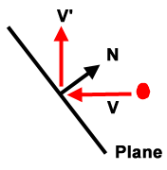
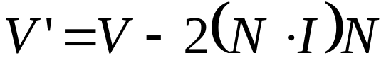
Particle Collision Response
Basic method: vector reflection
Need a vector to reflect around
  Face normal for point/face
  Cross product for edge/edge
  Negate vector to reflect other object
Vector Reflection:
Can make collision elastic by multiplying reflected vector by elasticity constant
You can hack in momentum-transfer by swapping the magnitude of each object’s pre-collision velocity vector
This and the elastic collision constant make a reasonable collision response system

Slide 40
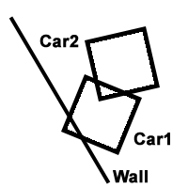
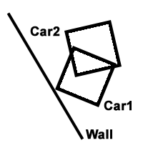
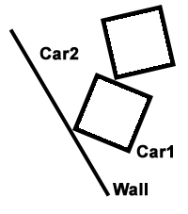
Multiple Collisions
This is a significant problem
For racing games, resolve dynamic/static
object collisions first (walls, buildings, etc)
Then lock resolved objects and resolve any
collisions with them, etc, etc
This will screw with your collision-time
finding algorithms
  Car2 may have to move back past where it
  started last frame
The correct way to handle this is with articulated
figures, which require linear systems of equations
and are rather complicated (see Moore88)

Slide 41
Rigid Body Dynamics
Now working with volumes instead of points
  Typically OBB’s, easy to integrate over volume
Rotational/Angular velocity is part of the system
A lot more complicated than the linear system
SIGGRAPH 97 Physically Based Modelling course notes walk through the math and code for a Rigid Body Dynamics system. Far more useful than what I will skim over in these slides.

Slide 42
Center of Mass
Also called the Centroid
System is easiest to build if we place objects in local coordinate system
  Want centroid at origin (0,0,0)
x(t) is translation of origin in world coords
R(t) rotates local reference frame (axis) into world axis
  3x3 rotation matrix

Slide 43
Linear Velocity and Momentum
Linear velocity v(t) is just like particle velocity
Linear momentum P(t) is velocity of mass of rigid body
P(t) = Mv(t)
More useful for solving motion equations

Slide 44
Force and Torque
Force F(t) acts on the centroid, just like force for a particle
Torque T(t) acts on a particle in the rigid body volume
Force affects linear velocity, Torque affects angular velocity

Slide 45
Angular Velocity and Momentum
Angular Velocity w(t) defines an axis object rotates around, magnitude is rotation speed
Angular momentum L(t) is related to w(t) by inertia tensor I(t)
L(t) = I(t)w(t)
Angular Momentum is again more useful for solving dynamics equations

Slide 46
Inertia Tensor
Relates angular velocity and angular momentum
3x3 matrix I(t), entries are derived by integrating over object’s volume
  OBB is easy to integrate over
Can be computed as I(t) = R(t)I_{body}R(t)^{T}, where I_{body} can be pre-computed
Note: I(t)⁻¹ = R(t)I_{body}⁻¹ R(t)^{T}
This is the most complicated part…

Slide 47
So how do we simulate motion?
Rigid body is represented by:
  Position x(t)
  Rotation R(t)
  Linear Momentum P(t)
  Angular Momentum L(t)
New Position:
  x`(t) = x(t) + v(t), where v(t) = P(t)/Mass
  R`(t) = w(t)*R(t), where w(t) = I(t)⁻¹L(t)
  P`(t) = P(t) + F(t)
  L`(t) = L(t) + T(t)
Calculating F(t), T(t), and I_{body} are complicated, see the online SIGGRAPH 97 course notes
Notes:
Note: the * operator is defined in the SIGGRAPH 97 Physically Based Modelling Course Notes

Slide 48
Rigid Body Collision Resolution
Similar to particle collision resolution
Finding collision point / time is difficult
  No closed forms, have to use binary search
Online SIGGRAPH 97 Course Notes have full explanation and code for how to calculate collision impulses
  Rigid Body Simulation II – Nonpenetration Constraints
Also describe resting contact collision, which is much more difficult

Slide 49
Helpful Books
Real Time Rendering, chapters 10-11
  Lots of these notes derived from this book
Graphics Gems series
  Lots of errors, find errata on internet
Numerical Recipes in C
  The mathematical computing bible
Game Programming Gems
  Not much on CD, but lots of neat tricks
Lex & Yacc (published by O’reilly)
  Not about CD, but useful for reading data files

Slide 50
What your mom never told you about PC hardware
Cache Memory
  Linear memory access at all costs!
  Wasting cycles and space to get linear access is often faster. It is worth it to do some profiling.
  DO NOT USE LINKED LISTS. They are bad.
  STL vector<T> class is great, so is STL string
    vector<T> is basically a dynamically-sized array
    vector.begin() returns a pointer to front of array
Conditionals are Evil
  Branch prediction makes conditionals dangerous
  They can trash the pipeline, minimize them if possible

Slide 51
What your mom never told you about C/C++ compilers
Compilers only inline code in headers
  The inline keyword is only a hint
  If the code isn’t in a header, inlining is impossible
Inlining can be an insane speedup
Avoid the temptation to be too OO
  Simple objects should have simple classes
    Eg: writing your own templated, dynamically resizable vector class with a bunch of overloaded operators is probably not going to be worth it in the end.

Slide 52
What your mom never told you about Numerical Computing
Lots of algorithms have degenerate conditions
  Learn to use isinf(), isnan(), finite()
Testing for X = 0 is dangerous
  If X != 0, but is really small, many algorithms will still degenerate
  Often better to test fabs(X) < (small number)
Avoid sqrt(), pow() – they are slow

