Slide 1
Fast Proximity Queries for Interactive Walkthroughs
Ming C. Lin
University of North Carolina at Chapel Hill
http://www.cs.unc.edu/~geom/collide.html
Presented by Dave Luebke for CS 551/651-2

Slide 2
Proximity Queries
Collision
A procedure to compute the geometric contact (and distance) between objects.

Slide 3
Theme
Use of coherence, locality, hierarchy
and incremental computations
t = 0
t = 1

Slide 4
Other Applications
Rapid Prototyping -- tolerance verification
Dynamic simulation -- contact force calculation
Computer Animation -- motion control
Motion Planning -- distance computation
Haptic Rendering -- restoring force computation
Simulation-Based Design -- interference detection

Slide 5
Goals
Efficiency
  real-time (interactive) for pairwise & n-body
Accuracy
  exact, not approximation
Practical
  should work on “real-world” models
  relatively easy to implement
  general yet robust

Slide 6
Problem Domain Specifications
Model Representations
  polyhedra (convex vs. non-convex vs. soups)
  CSG, Implicit Rep, Parametric Rep
Type of Queries
  collision detection
  distance computation
  penetration depth
  estimated time to collision
Simulation Environments
  pairwise vs. n-body
  static vs. dynamic
  rigid vs. deformable

Slide 7
Problem Complexity
Given an environment consisted of m objects and each has no more than n polygons, the problem has the following complexity using brute-force methods:
    N-Body: O(m²)
    Pairwise: O(n²)

Slide 8
Organization
Multi-Body Environments
  Sweep & Prune
  Scheduling Scheme
Pairwise Proximity Queries
  Convex Objects (Lin&Canny, SWIFT)
  General Models (OBBTree, SSV)
Data Management

Slide 9
System Architecture
Transform
Sweep & Prune
Overlap
Simulation
Exact
Collision
Detection
Analysis &
Response
Parameters
Collision

Slide 10
Sweep and Prune
Compute the axis-aligned bounding box (fixed vs. dynamic) for each object
Dimension Reduction by projecting boxes onto each x, y, z- axis
Sort the endpoints and find overlapping intervals
Possible collision -- only if projected intervals overlap in all 3 dimensions

Slide 11
Dimension Reduction
T = 1
e₃
e₂
b₃
e₁
b₂
b₁
b₁
b₂
e₁
e₂
b₃
e₃
T = 2
e₂
e₁
b₂
e₃
b₁
b₃
b₁
b₂
e₁
e₂
b₃
e₃

Slide 12
Dimension Reduction
T = 1
b₁
b₂
e₁
e₂
b₃
e₃
X-axis
b₁
b₂
e₁
b₃
e₂
e₃
Y-axis
T = 2
b₁
b₂
e₁
e₂
b₃
e₃
X-axis
b₃
b₁
e₃
b₂
e₁
e₂
Y-axis
T = 1
T = 2
1
2
3
1
2
3
1
X Y
1
X Y
Y
2
Y
2
3
3

Slide 13
Updating Bounding Boxes
Coherence (greedy walk)
Convexity properties (geometric properties of convex polytopes)
Nearly constant time, if the motion is relatively “small”

Slide 14
Use of Sorting Methods
Initial sort -- quick sort runs in O(m log m) just as in any ordinary situation
Updating -- insertion sort runs in O(m) due to coherence. We sort an almost sorted list from last stimulation step. In fact, we look for “swap” of positions in all 3 dimension.

Slide 15
Scheduling Scheme
When the velocity and acceleration of all objects are known, use the scheduling scheme to prioritize “critical events” to be processed (using heap)
  Each object pair is tagged with the estimated time to next collision.
  All object pairs are sorted accordingly.
  The heap is updated when a collision occurs.

Slide 16
Deriving Bounds
a_{max}: an upper bound on relative acceleration between any two points on any pair of objects.
a_{lin}: relative absolute linear
α: relative rotational accelerations
ω: relative rotational velocities
r: vector difference btw CoM of two bodies
d: initial separation for two given objects
        a_{max} = | a_{lin} + α x r + ω x ω x r |
        v_{i} = | v_{lin} + ω x r |

Slide 17
Bounding Time to Collision
Given the bound on maximum relative acceleration (including rotational and linear) a_{max} and initial relative velocity (including rotational & linear) v_{i} with separation d between two objects,
t_{c} = [ (v_{i}² + 2 a_{max} d ) ^{1/2} - v_{i} ] / a_{max}

Slide 18
Basic Steps
Maintain a queue of all object pairs sorted by approximated time to collision
At each step, only update the closest feature pair at the head of priority queue (as a heap)
If collision occurs, handle collision
Re-compute time-to-collision for the affected feature pairs and reinsert them into the queue

Slide 19
Organization
Literature Survey
Multi-Body Environments
  Sweep & Prune
  Scheduling Scheme
Pairwise Proximity Queries
  Convex Objects (Lin&Canny, SWIFT)
  General Models (OBBTree, SSV)
Data Management

Slide 20
Tracking Closest Features
Lin & Canny [1991]: expected O(1) time performance, independent of complexity
v

Slide 21
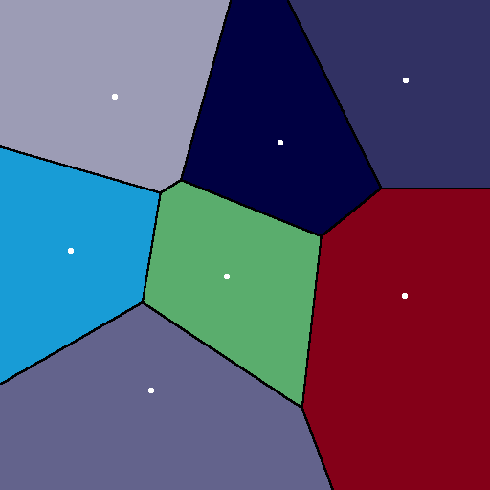
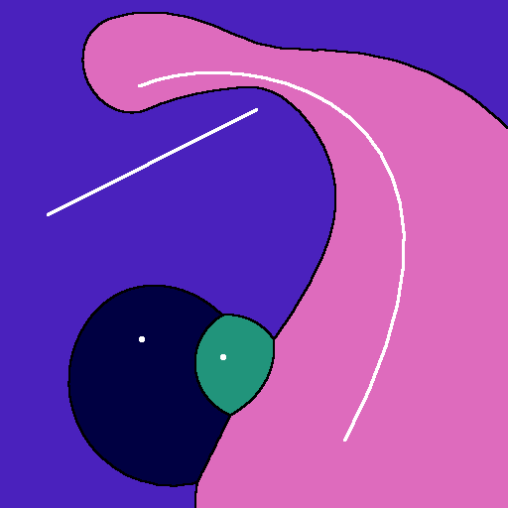
Voronoi Regions
Given a collection of geometric primitives, it is a subdivision of space into cells such that all points in a cell are closer to one primitive than to any other
Voronoi Site
Voronoi Region

Slide 22
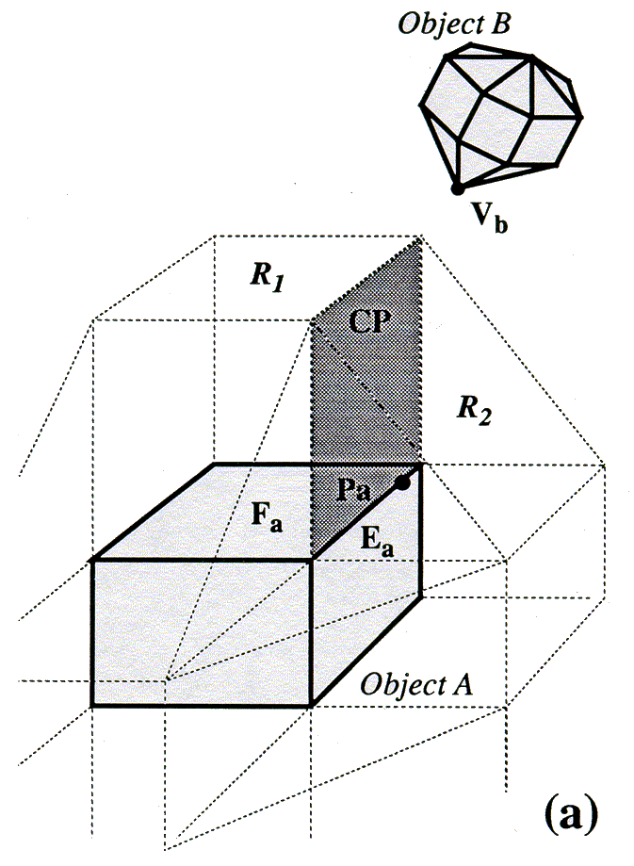
Closest Feature Tracking Using Voronoi Regions

Slide 23
Basic Algorithm
Given one feature from each polyhedron, find the nearest points of the two features.
If each nearest point is in the Voronoi region of the other feature, closest features have been found.
Else, walk to one or both of their neighbors or some other feature.

Slide 24
Running Time Analysis
Distance strictly decreases with each change of feature pair, and no pair of features can be selected twice.
Convergence to closest pair typically much better for dynamic environments:
  O(1) achievable in simulations with coherence
  Closer to sub-linear time performance even without coherence

Slide 25
I-Collide Collision Detection System
Routines:
  N-body overlap tests (sweep and prune)
  Distance calculation btwn convex polytopes
Public domain system
2500+ researchers have ftp’ed the code
A mailing list of many hundreds of users

Slide 26
I-Collide System Demonstrations
Architectural Walkthrough
Dynamic Simulator (Impulse)
Multi-Body Simulators

Slide 27
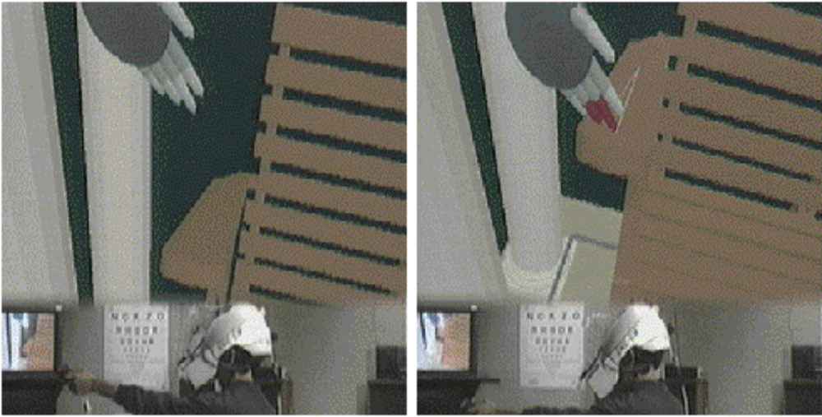
Architectural Walkthrough

Slide 28
System Demonstration
Video

Slide 29
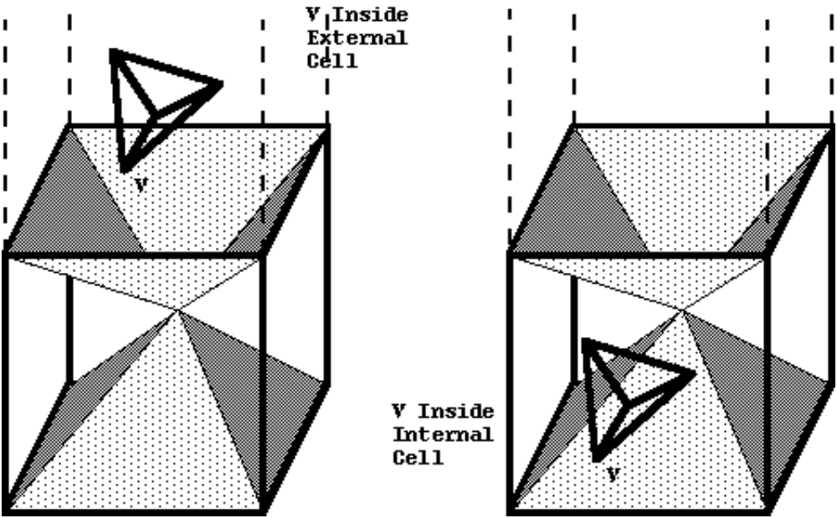
Penetration Detection

Slide 30
Accelerated Proximity Queries based on Multi-Level Marching
Improved closest feature-tracking based on Voronoi regions
Use of normal tables to jump start and avoid local minima problem
Take advantages of level-of-details (multi-resolution) representations

Slide 31
Implementation: SWIFT
Progressive Refinement Framework
Faster (2x to 10x ) than any public domain packages for convex objects
Insensitive to level of motion coherence
Will be available at:
http://www.cs.unc.edu/~geom/SWIFT

Slide 32
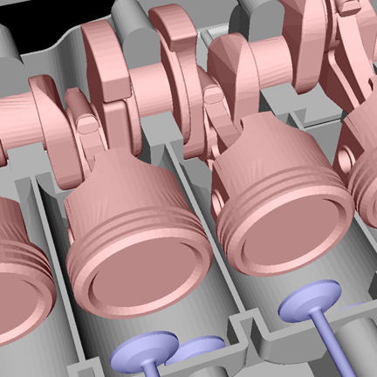
Motivation
Parallel close
proximity:
piston against
combustion
chamber wall
Engine model courtesy of Engineering Animation Inc

Slide 33
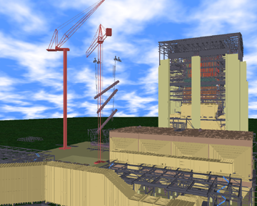
Motivation
Model Courtesy of ABB Engineering, Inc.
A Coal-fired Powerplant Model: 15,432,126 triangles

Slide 34
BVH-Based Collision Detection
Model Hierarchy:
  each node has a simple volume that bounds a set of triangles
  children contain volumes that each bound a different portion of the parent’s triangles
  The leaves of the hierarchy usually contain individual triangles
A binary bounding volume hierarchy:

Slide 35
BVH-Based Collision Detection

Slide 36
Higher Order Bounding Volume Hierarchies
OBBTree: Tree of Oriented Bounding Boxes (OBBs)
SSV: Tree of Swept Sphere Volumes

Slide 37
OBBTREES: Organization
Building an OBBTree
Tree Traversal
OBB Overlap Test
Performance

Slide 38
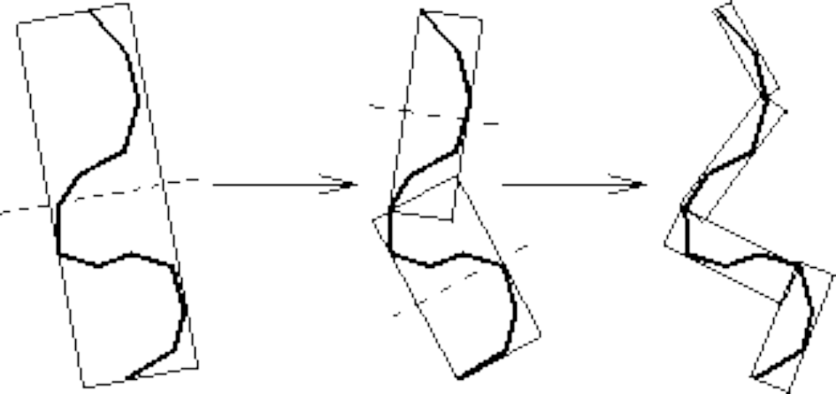
Building an OBB Tree
Recursive top-down construction:
partition and refit

Slide 39
Building an OBB Tree
Given some polygons,
consider their vertices...

Slide 40
Building an OBB Tree
Project onto the line
Consider variance of
distribution on the line

Slide 41
Building an OBB Tree
Given by eigenvectors
of covariance matrix
(summarizing the 1st
& 2nd order statistics)
of coordinates
of original points

Slide 42
Building an OBB Tree
Choose bounding box
oriented this way

Slide 43
Building an OBB Tree
… and sample them uniformly

Slide 44
Building an OBB Tree: Summary
OBB Fitting algorithm:
Statistics-based
Use of convex hull
Uniform sampling distributions
O(n log n) fitting time for single BV
O(n log² n) fitting time for entire tree

Slide 45
OBBTREES: Organization
Building an OBBTree
Tree Traversal
OBB Overlap Test
Performance

Slide 46
Tree Traversal
Disjoint bounding volumes:
No possible collision

Slide 47
Tree Traversal
Overlapping bounding volumes:
  split one box into children
  test children against other box

Slide 48
Tree Traversal
First child: no overlap

Slide 49
Tree Traversal
Second child overlaps:
  split larger box
  continue tests

Slide 50
Tree Traversal

Slide 51
Tree Traversal

Slide 52
Tree Traversal
Hierarchy of tests

Slide 53
OBBTREES: Organization
Building an OBBTree
Tree Traversal
OBB Overlap Test
Performance

Slide 54
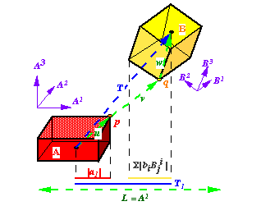
Separating Axis Theorem
L is a separating axis for OBBs A & B, since A & B become disjoint intervals under projection onto L

Slide 55
Separating Axis Theorem
Two polytopes A and B are disjoint iff there
exists a separating axis which is:
perpendicular to a face from either
or
perpedicular to an edge from each

Slide 56
Implications of Theorem
Given two generic polytopes, each with E edges and F faces, number of candidate axes to test is:
2F + E²
OBBs have only E = 3 distinct edge directions, and only F = 3 distinct face normals. OBBs need at most 15 axis tests.
Because edge directions and normals each form orthogonal frames, the axis tests are rather simple.

Slide 57
OBB Overlap Test
L
s
h
a
h
b
L is a separating axis iff:
s
>
h
+
h
a
b

Slide 58
OBB Overlap Test
Project boxes onto axis. If intervals don’t overlap, it is a separating axis.
A separating axis exists if and only if boxes are disjoint.
2D OBBs: 4 axes to test
3D OBBs: 15 axes to test

Slide 59
OBB Overlap Test
Typical axis test for 3-space.
Up to 15 tests required.
s = fabs(T2 * R11 - T1 * R21);
ha = a1 * Rf21 + a2 * Rf11;
hb = b0 * Rf02 + b2 * Rf00;
if (s > (ha + hb)) return 0;

Slide 60
OBB Overlap Test
Strengths of this overlap test:
  80 to 234 arithmetic operations per box overlap test
  No special cases for parallel/coincident faces, edges, or vertices
  No special cases for degenerate boxes
  No conditioning problems
  Good candidate for micro-coding

Slide 61
OBB Overlap Test:
SIMD Implementation
[Jointly with Intel]
Decompose into 5 sets of axis tests
  Each set implemented using Katmai SIMD instruction sets
  About 2.5 times speedup in practice

Slide 62
OBBTREES: Organization
Building an OBBTree
Tree Traversal
OBB Overlap Test
Performance

Slide 63
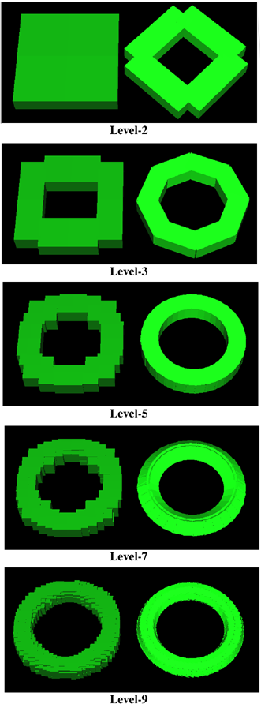
AABB’s vs. OBB’s
Approximation
of a Torus

Slide 64
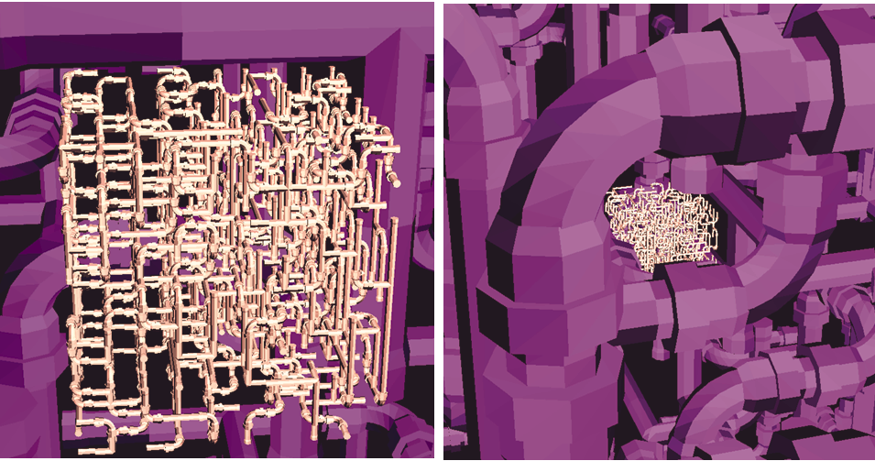
Dynamic Simulation
Interactive Collision Detection on 2 complex Pipelines: 140K polygons each; 4.2ms on SGI RE/90M Hz

Slide 65
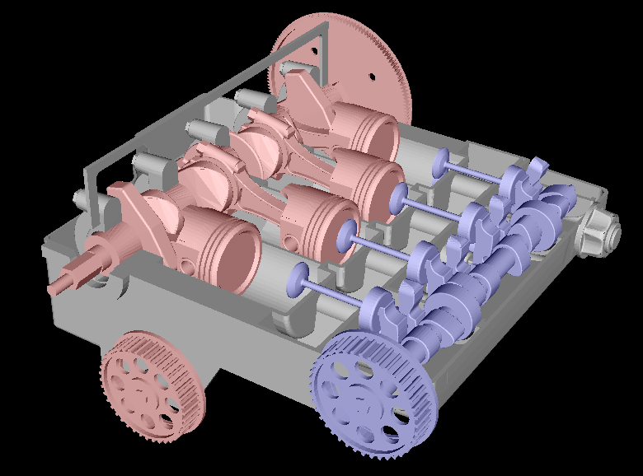
Engineering Animation
Interference Detection of Engine Model: Fixed part: 84,454 triangles; Moving parts: 256,606 triangles

Slide 66
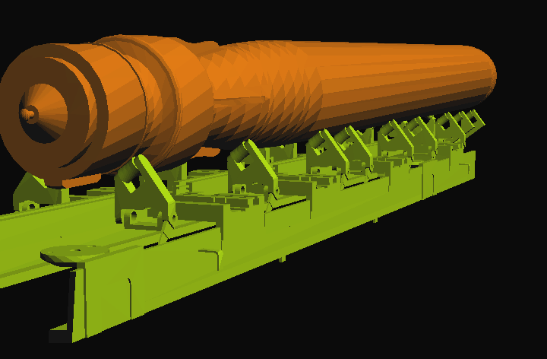
Simulation-Based Design
Interactive Interference Detection: A Torpedo (4780 polygons) on Pivot Structure (44921 polygons)

Slide 67
System Demonstration
Video

Slide 68
Implementation: RAPID
Available at: http://www.cs.unc.edu/~geom/OBB
Part of V-COLLIDE: http://www.cs.unc.edu/~geom/V_COLLIDE
More than 3000 users have ftp’ed the code
Used for virtual prototyping, dynamic simulation, robotics and computer animation

Slide 69
Technology Transfer
Virtual Protptyping & VEs: Division, MSC Working Knowledge, Prosolvia, Ford, AmandaSoft, Lockheed-Martin
Computer Animation: Jack/Transom Tech.
Medical Applications: ADAC Lab
Interactive Gaming: Intel, OZ.com, Blaxxun etc.

Slide 70
Swept Sphere Volumes
PSS LSS RSS

Slide 71
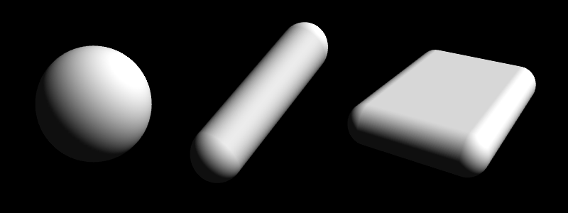
Swept Sphere Volumes (S-topes)
PSS LSS RSS

Slide 72
SSV Fitting
Use OBB’s code based upon Principle Component Analysis
For PSS, use the largest dimension as the radius
For LSS, use the two largest dimensions as the length and radius
For RSS, use all three dimensions

Slide 73
Overlap Test
One routine that can perform overlap tests between all possible combination of CORE primitives of SSV(s).
The routine is a specialized test based on Voronoi regions and OBB overlap test.
It is faster than GJK.

Slide 74
Hybrid BVH’s based on SSV
Use a simpler BV when it prunes search equally well - benefit from lower cost of BV overlap tests
Overlap test (based on Lin-Canny & OBB overlap test) between all pairs of BV’s in a BV family is unified
Complications
  deciding which BV to use either dynamically or statically

Slide 75
PQP: Implementation
Library written in C++
Good for any proximity query
5-20x speed-up in distance computation over prior methods
Available at http://www.cs.unc.edu/~geom/SSV/

Slide 76
PQP: Technology Transfer
Released in July’99
More than 250 active users
Strong interest from Sony
Optimized for PS2 applications: only 1-2 routines need optimization

Slide 77
Organization
Multi-Body Environments
  Sweep & Prune
  Scheduling Scheme
Pairwise Proximity Queries
  Convex Objects (Lin&Canny, SWIFT)
  General Models (OBBTree, SSV)
Data Management

Slide 78
System Architecture
Processing Large Geometric Databases for Massive Models
Encode the proximity relationship with “overlap graphs” to
partition massive 3D dataset into smaller, manageable datasets
Localized Sub-graphs
Scene
Graph
Partition
& Refine
Graphs
Overlap
Graph
Proximity
Queries
Database

Slide 79
Localized Sub-graphs
Reduce frequency of disk accessing
Runtime ordering & traversal
Localize region of contacts
Allow modification on the fly
Prefetch geometry

Slide 80
2D Objects
A simple environment consisting of polygons

Slide 81
Object Bounding Boxes
Each object is bounded by a AABB.

Slide 82
Object Nodes
Each node corresponds to an object.

Slide 83
Overlap Graph
Each edge corresponds to a potential overlap & each node has a weight proportional to object memory requirement (polygon # & hierarchies)

Slide 84
Computing Connected Components
Identify cacheable components
Object decomposition
Find high-valence nodes
Multi-level graph partitioning
…Repeat on the resulting cut graph till decomposing the overlap graph into localized subgraphs, such that the weight of each subgraph < memory cache size

Slide 85
Algorithmic Choices
Types of Bounding Volumes (e.g. spheres, AABBS, OBBs, etc.)
On-the-fly Hierarchy Construction & Lazy Evaluation

Slide 86
IMMPACT: Implementation
Written in C++ & OpenGL
Built on top of PQP (UNC-CH)
Use of METIS (University of Minnesota)
Real-time interaction with CAD models
[Eurographics’99]

Slide 87
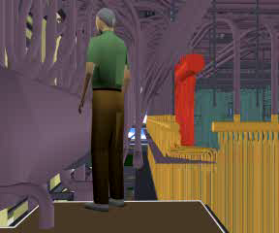
IMMPACT: Demonstration
Real-time Interaction with PowerPlant (15 million triangles)

Slide 88
Technology Transfer & Feedback
7 Collision Detection & Proximity Systems
More than 4500 downloads
More than 40 commercial licenses
The Collide Inc. handles licensing
Useful feedback from our users

Slide 89
Collaborators
Dinesh Manocha
John Canny (Berkeley)
Jonathan Cohen (Johns Hopkins)
Stephen Ehmann
Stefan Gottschalk (NVidia)
Eric Larsen (Sony R&D America)
Brian Mirtich (MERL)
Amol Pattekar (Yahoo)
Krish Ponamgi
Andy Wilson
Intel MGL Research Group
Sony PS2 R&D Group

Slide 90
Acknowledgments
Army Research Office
Honda
Intel
National Science Foundation
Office of Naval Research
Sloan Foundation

