Slide 1
CS 593
Natural Language Processing
Fall 2025
Instructor: Jonathan Rusert

Slide 2
Introductions - Me
Academics
University of Minnesota, Duluth
B.S. Computer Science, Mathematics
M.S. Computer Science
University of Iowa
PhD Computer Science
Purdue Fort Wayne
Visiting Professor 2022
Assistant Professor 2023

Slide 3
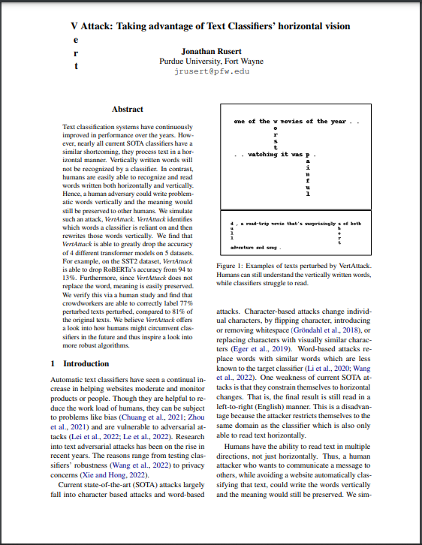
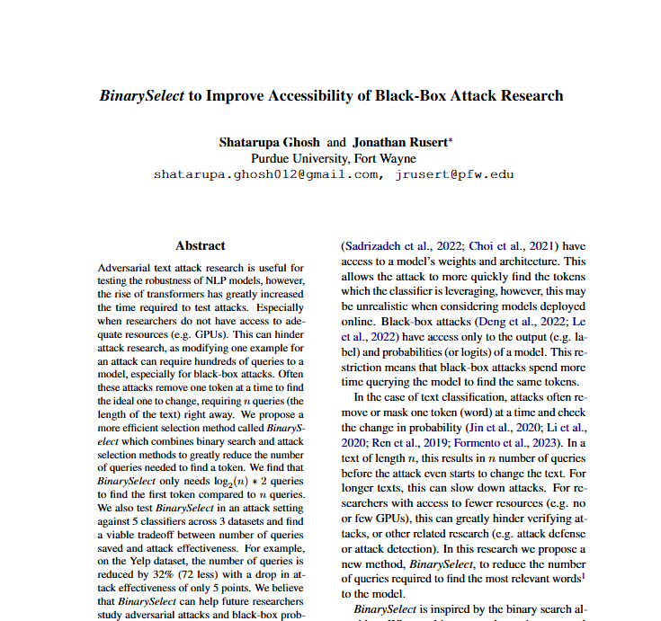
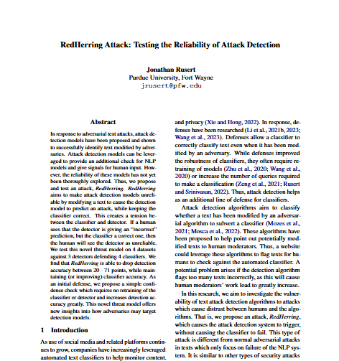
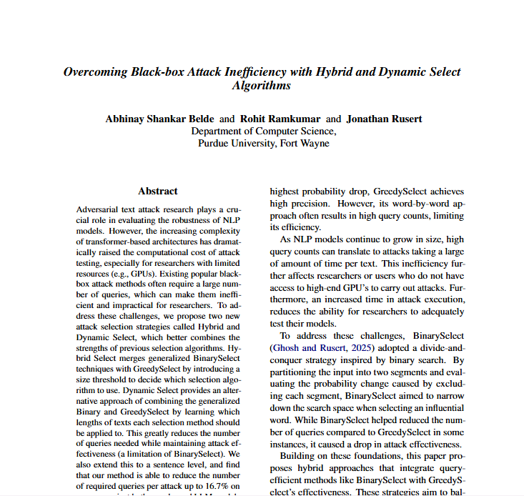
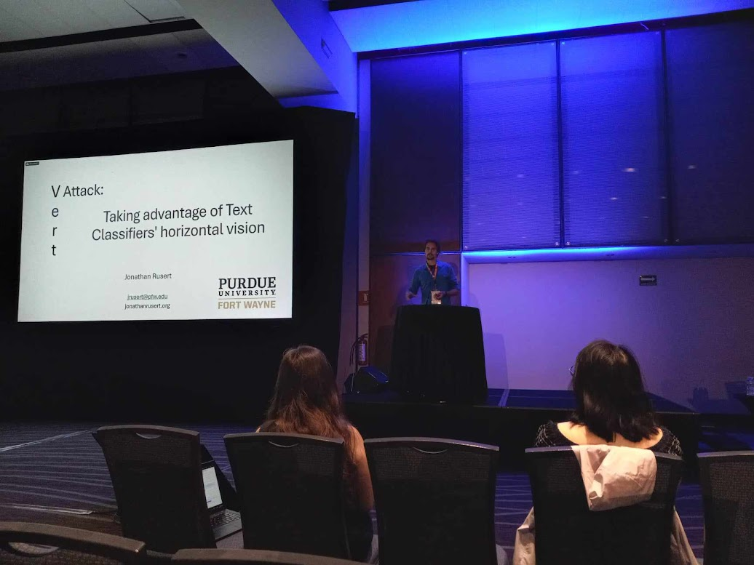
Introductions - Me
Research
Natural Language Processing, Obfuscation, Text Classification, Adversarial Attacks, Privacy
NAACL 2024
Mexico City

Slide 4
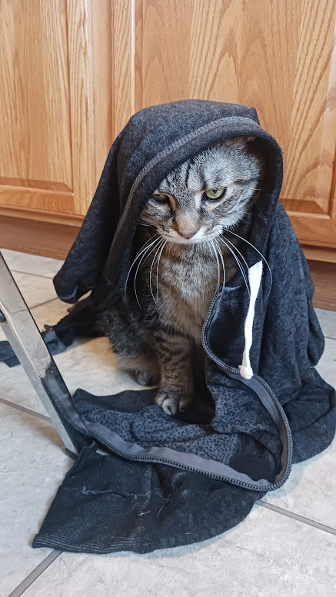
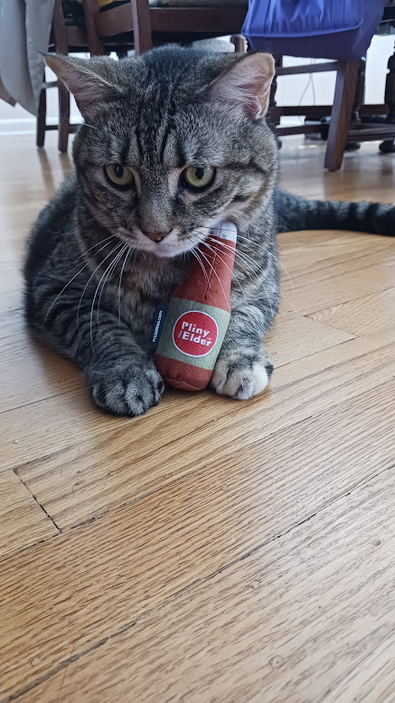
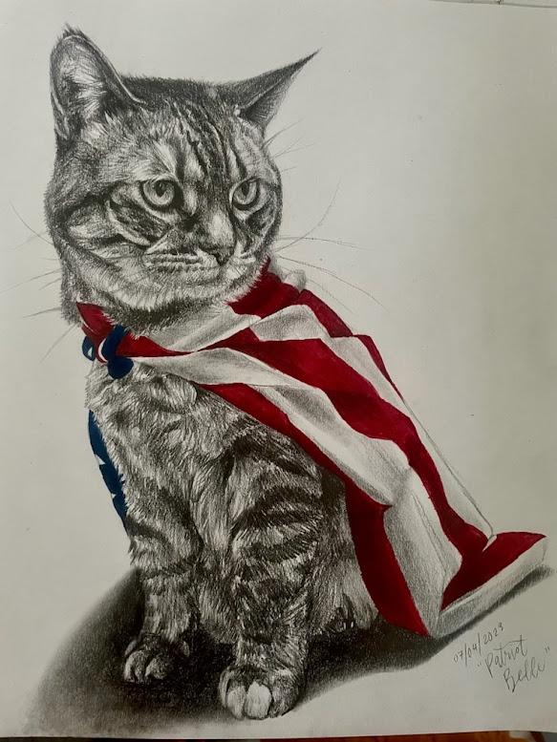
Introductions - Cat
Belle

Slide 5
Introductions
What is your name (first and last)?

Slide 6
Class Information
Lecture:
Instructor: Jonathan Rusert
Office: ET 125K
Office Hours: M 3 – 4, T 12 – 1, W 1 – 3 PM or by appointment
Email: jrusert@pfw.edu
Course Website: purdue.brightspace.com

Slide 7
Course Goals
Become familiar Natural Language Processing (NLP) and its problems
Q&A
Classification
NLG
Transformers
…
Think through ways of addressing of basic and more difficult NLP problems

Slide 8
Why Study NLP?

Slide 9
Why Study NLP?
Conversational Agents (Alexa, Siri, Google)
Automatic Classification
Obfuscation
Defending against Adversarial Attacks
Fairness and Bias
Natural Language Generation
GPT
LLMs
- Many areas of research (https://www.2022.aclweb.org/papers)

Slide 10
Student Goals
External:
Develop ways to approach NLP problems
Strengthen ability to examine and analyze text
Internal:
Improve algorithmic thinking
Obtain self-sense of accomplishment

Slide 11

Textbook
https://web.stanford.edu/~jurafsky/slp3/

Slide 12
Grading
Item | Percentage | Points
Homework | 30 | (6 at 50) = 300
Quizzes | 24 | (3 at 80) = 240
Final Project | 40 | 400
Attendance/Class Participation | 6 | 60
Total | 100 | 1000

Slide 13
Grading
A 90 - 100
B 80 - 89
C 70 - 79
D 60 - 69
F Below 60

Slide 14
Class Policies
No late assignments accepted*
* homeworks considered late when the grader starts grading the assignment
(guaranteed grader won't start grading before the due date)
Email or contact about special circumstances (e.g. extended sickness, accident, etc.)

Slide 15
Class Policies
Homework done individually
Come to office hours if stuck
Academic Integrity Code in Purdue University Fort Wayne student manual
Cheating
Plagiarism
Class participation
Late Arrival/Attendance

Slide 16
Class Policies
Read assigned chapters and paper(s) before class
Bring questions ready to discuss
Class time
Focus on complicated aspects
Work through examples
Answer questions
Don’t be afraid to ask questions

Slide 17
Class Policies
Be considerate of others
Help to create a positive learning environment for yourself and others
Cell phones off/silenced, no extra conversations, etc.
Participate in discussions
Ask questions
What if …?
Why is it that …?
Could you explain this notion one more time?

Slide 18
What to Expect
Combination of introduction NLP concepts
Textbook and homeworks, examples in class
And examination of State-of-the-art solutions
Recently published research papers

Slide 19
How to achieve a satisfactory grade
Access textbook
Read Research Papers and participate in discussions
Attend class
Understand class slides and examples
Rework through after class if difficulty during
Understand HW problems and solutions
Form study group
Discuss concepts from readings
Explain concepts to others
Ask me
Don’t wait until the last minute!
Review materials frequently

Slide 20
I am here to help!
You are here to learn, not already have all the answers
No shame in asking questions
In class
Office Hours
Each semester students struggle and refuse to ask for help
The earlier you ask, the better you will be prepared for the rest of the course
I want to help, but cannot force you to learn
My office hours are specifically set to help my students
If there are none that work for you, email me to set up other times

Slide 21
Q & A

