Slide 1
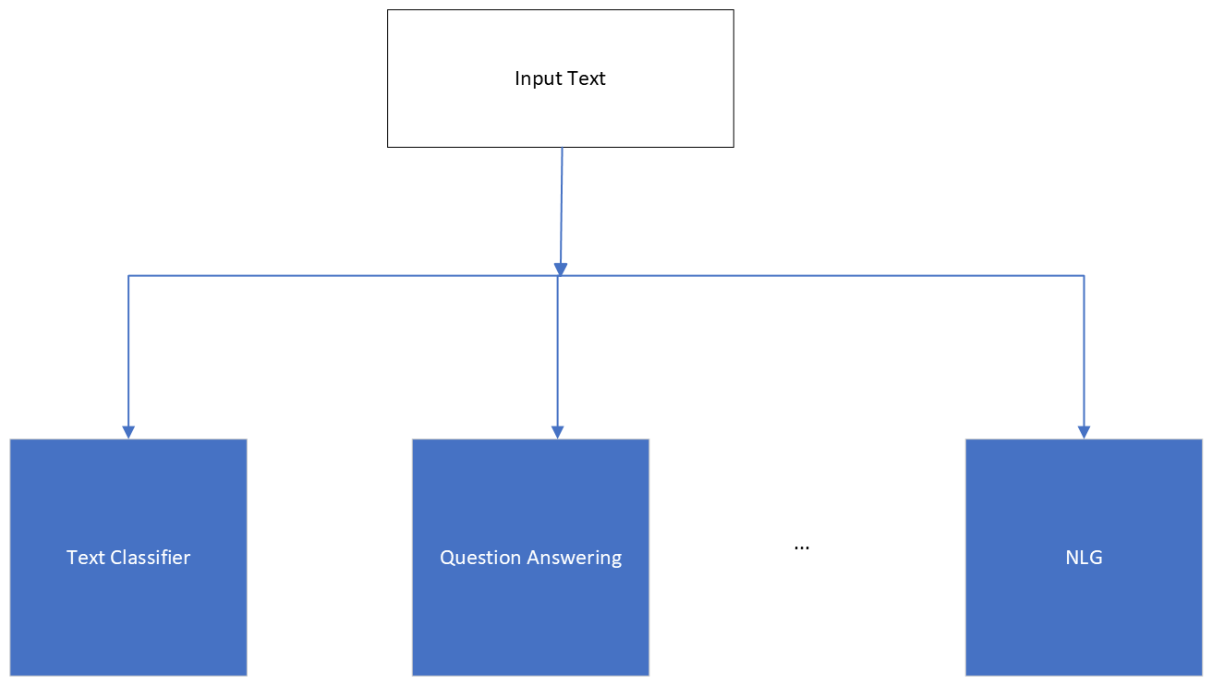
Basic Text Processing
Word tokenization
Notes:
In the next few lectures we'll introduce text normalization, the process of turning a text into standard formatting of words or sentences. We'll start by thinking about how to break up a text into word tokens.

Slide 2
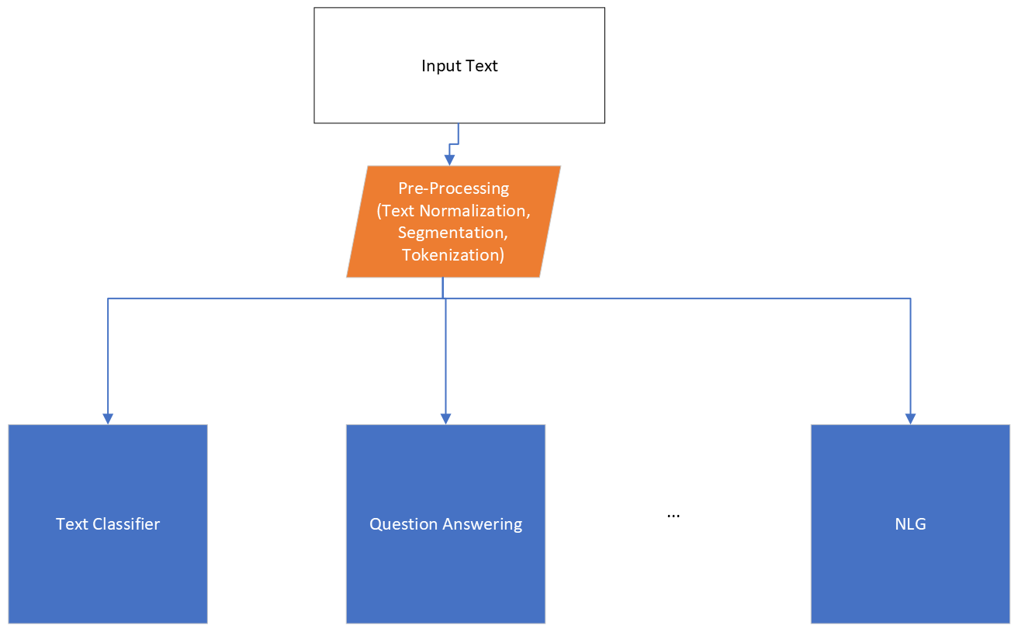
Basic Text Processing
Word tokenization
Notes:
In the next few lectures we'll introduce text normalization, the process of turning a text into standard formatting of words or sentences. We'll start by thinking about how to break up a text into word tokens.

Slide 3
Basic Text Processing
Words and Corpora
Notes:
Let's continue our study of basic text processing methods. In this lecture we'll talk about some basic properties of words. How many words are there? And what are the properties of corpora, that's the plural of corpus, meaning bodies of text?

Slide 4
How many words in a sentence?
"I do uh main- mainly business data processing"
Fragments, filled pauses
"Seuss’s cat in the hat is different from other cats!"
Lemma: same stem, part of speech, rough word sense
cat and cats = same lemma
Wordform: the full inflected surface form
cat and cats = different wordforms
Notes:
Let's start by asking how many words are in just one sentence? Here's a sentence: "I do uh main- mainly business data processing". How many words are in that sentence? It's a complicated question. Is "uh" a word? What about the cutoff "main" the first time I started to say "mainly". We call things like "main" here a fragment, and we call "uh" and "um" filled pauses. So for certain applications, like speech applications, we might want to be counting these. Or how about "cat" and "cats" in this Dr. Seuss sentence? It will help to introduce the distinction between "lemma" and "wordform". Two words are the same lemma if they have the same stem, the same part of speech, the same sense. Whereas wordform is the exact surface form of the word, with all its inflections or endings. So if we're counting lemmas, "cat" and "cats" count as the same lemma. If we're counting wordforms, "cat" and "cats" are different.

Slide 5
How many words in a sentence?
they lay back on the San Francisco grass and looked at the stars and their
Type: an element of the vocabulary.
Token: an instance of that type in running text.
How many?
15 tokens (or 14)
13 types (or 12) (or 11?)
Notes:
Let's look at a part of another sentence. How many words are in this sentence? Pause the video and count for yourself. Again, it depends how you count. We could count word types, the number of unique words that occur in the sentence. By that count we only count "the" once, even though it appears twice. Word tokens we're counting every word token on the page, so the two "the"s count twice. And what about San Francisco? One word or two? And how about "they and their". Different wordforms, same lemma. Again, it depends on our goals, and it's important to make that clear whenever you report word counts

Slide 6
How many words in a corpus?
N = number of tokens
V = vocabulary = set of types, |V| is size of vocabulary
Heaps Law = Herdan's Law = where often .67 < β < .75
i.e., vocabulary size grows with > square root of the number of word tokens
 | Tokens = N | Types = |V|
Switchboard phone conversations | 2.4 million | 20 thousand
Shakespeare | 884,000 | 31 thousand
COCA | 440 million | 2 million
Google N-grams | 1 trillion | 13+ million
Notes:
In general, we'll refer to the number of tokens with capital N. And we'll use capital V to mean the vocabulary, the set of all words. So the cardinality of V is the size of vocabulary, the number of word types. although sometimes for simplification, we'll just use capital V to mean the vocabulary size when it's not ambiguous. There's a relationship between these two in running text, called Heaps Law or Herdan's Law, which is that the size of the vocabulary grows with spmething over the square root of the number of word tokens. So a large corpus of N words tokens, you can expect to see N to the .7 word types. Here are the numbers for some common corpora,… The switchboard corpus of phone conversations has 2.4 million word tokens. And there's 20,000 word types in those 2.4
millions words. Shakespeare has just under a million word tokens. Shakespeare is
quite a small corpus. He wrote, 800,000 words in his lifetime. And in that less
than a million words, he actually used 31,000 distinct words. So he had a very,
very broad vocabulary famously. And if you look at a very huge corpus, the Google
N-grams corpus that has a trillion different tokens, a very large number of
words, there's. Thirteen million types, so how many words are there in English? Well,
if you look at conversation, 20,000 different words. If you look at
Shakespeare, 30,000 words. And if you combine the two, probably somewhere, not
quite the sum of the two, but some larger number. But if you look at the Google
engrams, we have thirteen million. And of course, some of those are probably urls,
and. And email addresses, but even if you eliminate all of those, the number of
words in a language is very large, maybe there's a million words of English.

Slide 7
Corpora
Words don't appear out of nowhere!
A text is produced by
a specific writer(s),
at a specific time,
in a specific variety,
of a specific language,
for a specific function.
Notes:
Where did these corpora come from? …. These characteristics of a text influence properties of the text.

Slide 8
Corpora vary along dimension like
Language: 7097 languages in the world
Variety, like African American Language varieties.
AAE Twitter posts might include forms like "iont" (I don't)
Code switching, e.g., Spanish/English, Hindi/English:
S/E: Por primera vez veo a @username actually being hateful! It was beautiful:)
[For the first time I get to see @username actually being hateful! it was beautiful:) ]
H/E: dost tha or ra- hega ... dont wory ... but dherya rakhe
[“he was and will remain a friend ... don’t worry ... but have faith”]
Genre: newswire, fiction, scientific articles, Wikipedia
Author Demographics: writer's age, gender, ethnicity, SES
Notes:
For example, what language is the text in? As we'll see when we get to talking about word tokenization, what counts as a word can be different in different languages.

Slide 9
Corpus datasheets
Gebru et al (2020), Bender and Friedman (2018)
Motivation:
Why was the corpus collected?
By whom?
Who funded it?
Situation: In what situation was the text written?
Collection process: If it is a subsample how was it sampled? Was there consent? Pre-processing?
+Annotation process, language variety, demographics, etc.
Notes:
You'll need to make sure you consider all those properties of a text when you are using it for processing purposes. And there are even more properties of corpora that it's important to consider. Who collected this corpus?
Whenever you build a corpus, you should be documenting these decisions in a datasheet for the corpus.

Slide 10
Basic Text Processing
Words and Corpora
Notes:
In summary, when you study text in corpora it's important to be explicit about what you mean by word (type or token, lemma or wordform) and what are the properties of the corpora; their genre, their language variety, who wrote them and how they were collected.

Slide 11
Basic Text Processing
Word tokenization
Notes:
In the next few lectures we'll introduce text normalization, the process of turning a text into standard formatting of words or sentences. We'll start by thinking about how to break up a text into word tokens.

Slide 12
Basic Text Processing
Word tokenization
Notes:
In the next few lectures we'll introduce text normalization, the process of turning a text into standard formatting of words or sentences. We'll start by thinking about how to break up a text into word tokens.

Slide 13
Text Normalization
Every NLP task requires text normalization:
Tokenizing (segmenting) words
Normalizing word formats
Segmenting sentences

Slide 14
Space-based tokenization
A very simple way to tokenize
For languages that use space characters between words
Arabic, Cyrillic, Greek, Latin, etc., based writing systems
Segment off a token between instances of spaces
Unix tools for space-based tokenization
The "tr" command
Inspired by Ken Church's UNIX for Poets
Given a text file, output the word tokens and their frequencies
Notes:
Let's now introduce some simple Unix tools for text processing, starting with the UNIX "tr" command for space-based word tokenization. Our goal will be to take a text file and output word tokens and their frequencies.

Slide 15
Simple Tokenization in UNIX
(Inspired by Ken Church’s UNIX for Poets.)
Given a text file, output the word tokens and their frequencies
tr -sc ’A-Za-z’ ’\n’ < shakes.txt
| sort
| uniq –c
1945 A
72 AARON
19 ABBESS
5 ABBOT
... ...
Change all non-alpha to newlines
Sort in alphabetical order
Merge and count each type
25 Aaron
6 Abate
1 Abates
5 Abbess
6 Abbey
3 Abbot
.... …

Slide 16
The first step: tokenizing
tr -sc ’A-Za-z’ ’\n’ < shakes.txt | head
THE
SONNETS
by
William
Shakespeare
From
fairest
creatures
We
...

Slide 17
The second step: sorting
tr -sc ’A-Za-z’ ’\n’ < shakes.txt | sort | head
A
A
A
A
A
A
A
A
A
...

Slide 18
More counting
Merging upper and lower case
tr ‘A-Z’ ‘a-z’ < shakes.txt | tr –sc ‘A-Za-z’ ‘\n’ | sort | uniq –c
Sorting the counts
tr ‘A-Z’ ‘a-z’ < shakes.txt | tr –sc ‘A-Za-z’ ‘\n’ | sort | uniq –c | sort –n –r
23243 the
22225 i
18618 and
16339 to
15687 of
12780 a
12163 you
10839 my
10005 in
8954 d
What happened here?

Slide 19
Issues in Tokenization
Can't just blindly remove punctuation:
m.p.h., Ph.D., AT&T, cap’n
prices ($45.55)
dates (01/02/06)
URLs (http://www.stanford.edu)
hashtags (#nlproc)
email addresses (someone@cs.colorado.edu)
Clitic: a word that doesn't stand on its own
"are" in we're, French "je" in j'ai, "le" in l'honneur
When should multiword expressions (MWE) be words?
New York, rock ’n’ roll
Notes:
Of course, tokenization in most real situations isn't as simple as I've suggested with the simple UNIX tools.

Slide 20
Tokenization in NLTK
Bird, Loper and Klein (2009), Natural Language Processing with Python. O’Reilly
Notes:
So most standard tokenization programs for English or languages with similar writing systems need to deal with each of these issues. Here's a simple python tokenizer in the Natural Language Toolkit that has little regular expressions for dealing with hypthens, and currency, and whatnot

Slide 21
Tokenization in languages without spaces
Many languages (like Chinese, Japanese, Thai) don't use spaces to separate words!
How do we decide where the token boundaries should be?
Notes:
But wait, what about all the languages that don't have spaces!

Slide 22
Word tokenization in Chinese
Chinese words are composed of characters called "hanzi" (or sometimes just "zi")
Each one represents a meaning unit called a morpheme.
Each word has on average 2.4 of them.
But deciding what counts as a word is complex and not agreed upon.

Slide 23
How to do word tokenization in Chinese?
姚明进入总决赛 “Yao Ming reaches the finals”
3 words?
姚明 进入 总决赛
YaoMing reaches finals
5 words?
姚 明 进入 总 决赛
Yao Ming reaches overall finals
7 characters? (don't use words at all):
姚 明 进 入 总 决 赛
Yao Ming enter enter overall decision game

Slide 24
How to do word tokenization in Chinese?
姚明进入总决赛 “Yao Ming reaches the finals”
3 words?
姚明 进入 总决赛
YaoMing reaches finals
5 words?
姚 明 进入 总 决赛
Yao Ming reaches overall finals
7 characters? (don't use words at all):
姚 明 进 入 总 决 赛
Yao Ming enter enter overall decision game

Slide 25
How to do word tokenization in Chinese?
姚明进入总决赛 “Yao Ming reaches the finals”
3 words?
姚明 进入 总决赛
YaoMing reaches finals
5 words?
姚 明 进入 总 决赛
Yao Ming reaches overall finals
7 characters? (don't use words at all):
姚 明 进 入 总 决 赛
Yao Ming enter enter overall decision game

Slide 26
How to do word tokenization in Chinese?
姚明进入总决赛 “Yao Ming reaches the finals”
3 words?
姚明 进入 总决赛
YaoMing reaches finals
5 words?
姚 明 进入 总 决赛
Yao Ming reaches overall finals
7 characters? (don't use words at all):
姚 明 进 入 总 决 赛
Yao Ming enter enter overall decision game

Slide 27
Word tokenization / segmentation
So in Chinese it's common to just treat each character (zi) as a token.
So the segmentation step is very simple
In other languages (like Thai and Japanese), more complex word segmentation is required.
The standard algorithms are neural sequence models trained by supervised machine learning.

Slide 28
Basic Text Processing
Word tokenization
Notes:
Word tokenization is an important step in text normalization. Here we introduced some common baseline methods, space-based and character-based tokenization.

Slide 29
Basic Text Processing
Word Normalization and other issues
Notes:
Now let's discuss how to put all words in a standard format, a process called Word Normalization. We'll also talk about sentence segmentation, the process of breaking up your text corpus into larger units like sentences.

Slide 30
Word Normalization
Putting words/tokens in a standard format
U.S.A. or USA
uhhuh or uh-huh
Fed or fed
am, is, be, are

Slide 31
Case folding
Applications like IR: reduce all letters to lower case
Since users tend to use lower case
Possible exception: upper case in mid-sentence?
e.g., General Motors
Fed vs. fed
SAIL vs. sail
For sentiment analysis, MT, Information extraction
Case is helpful (US versus us is important)

Slide 32
Lemmatization
Represent all words as their lemma, their shared root
= dictionary headword form:
am, are, is → be
car, cars, car's, cars' → car
Spanish quiero (‘I want’), quieres (‘you want’)
→ querer ‘want'
He is reading detective stories
→ He be read detective story

Slide 33
Lemmatization is done by Morphological Parsing
Morphemes:
The small meaningful units that make up words
Stems: The core meaning-bearing units
Affixes: Parts that adhere to stems, often with grammatical functions
Morphological Parsers:
Parse cats into two morphemes cat and s
Parse Spanish amaren (‘if in the future they would love’) into morpheme amar ‘to love’, and the morphological features 3PL and future subjunctive.

Slide 34
Stemming
Reduce terms to stems, chopping off affixes crudely
This was not the map we found in Billy Bones’s chest, but an accurate copy, complete in all things-names and heights and soundings-with the single exception of the red crosses and the written notes.
Thi wa not the map we found in Billi Bone s chest but an accur copi complet in all thing name and height and sound with the singl except of the red cross and the written note
.

Slide 35
Porter Stemmer
Based on a series of rewrite rules run in series
A cascade, in which output of each pass fed to next pass
Some sample rules:

Slide 36
Dealing with complex morphology is necessary for many languages
e.g., the Turkish word:
Uygarlastiramadiklarimizdanmissinizcasina
`(behaving) as if you are among those whom we could not civilize’
Uygar `civilized’ + las `become’
+ tir `cause’ + ama `not able’
+ dik `past’ + lar ‘plural’
+ imiz ‘p1pl’ + dan ‘abl’
+ mis ‘past’ + siniz ‘2pl’ + casina ‘as if’

Slide 37
Sentence Segmentation
!, ? mostly unambiguous but period “.” is very ambiguous
Sentence boundary
Abbreviations like Inc. or Dr.
Numbers like .02% or 4.3
Common algorithm: Tokenize first: use rules or ML to classify a period as either (a) part of the word or (b) a sentence-boundary.
An abbreviation dictionary can help
Sentence segmentation can then often be done by rules based on this tokenization.

Slide 38
Basic Text Processing
Word Normalization and other issues
Notes:
Normalizing words, and segmenting off sentences or other larger discourse units, are important initial steps in text processing.

Slide 39
Basic Text Processing
Byte Pair Encoding
Notes:
In this lecture, we introduce the Byte Pair Encoding or BPE algorithm that uses corpus statistics to decide how to segment a text into tokens.

Slide 40
Another option for text tokenization
Instead of
white-space segmentation
single-character segmentation
Use the data to tell us how to tokenize.
Subword tokenization (because tokens can be parts of words as well as whole words)

Slide 41
Subword tokenization
Three common algorithms:
Byte-Pair Encoding (BPE) (Sennrich et al., 2016)
Unigram language modeling tokenization (Kudo, 2018)
WordPiece (Schuster and Nakajima, 2012)
All have 2 parts:
A token learner that takes a raw training corpus and induces a vocabulary (a set of tokens).
A token segmenter that takes a raw test sentence and tokenizes it according to that vocabulary

Slide 42
Byte Pair Encoding (BPE) token learner
Let vocabulary be the set of all individual characters
= {A, B, C, D,…, a, b, c, d….}
Repeat:
Choose the two symbols that are most frequently adjacent in the training corpus (say 'A', 'B')
Add a new merged symbol 'AB' to the vocabulary
Replace every adjacent 'A' 'B' in the corpus with 'AB'.
Until k merges have been done.

Slide 43
BPE token learner algorithm

Slide 44
Byte Pair Encoding (BPE) Addendum
Most subword algorithms are run inside space-separated tokens.
So we commonly first add a special end-of-word symbol '__' before space in training corpus
Next, separate into letters.

Slide 45
BPE token learner
Original (very fascinating🙄) corpus:
low low low low low lowest lowest newer newer newer newer newer newer wider wider wider new new
Add end-of-word tokens, resulting in this vocabulary:
representation

Slide 46
BPE token learner
Merge e r to er

Slide 47
BPE
Merge er _ to er_

Slide 48
BPE
Merge n e to ne

Slide 49
BPE
The next merges are:

Slide 50
BPE token segmenter algorithm
On the test data, run each merge learned from the training data:
Greedily
In the order we learned them
(test frequencies don't play a role)
So: merge every e r to er, then merge er _ to er_, etc.
Result:
Test set "n e w e r _" would be tokenized as a full word
Test set "l o w e r _" would be two tokens: "low er_"

Slide 51
Properties of BPE tokens
Usually include frequent words
And frequent subwords
Which are often morphemes like -est or –er
A morpheme is the smallest meaning-bearing unit of a language
unlikeliest has 3 morphemes un-, likely, and -est

Slide 52
Basic Text Processing
Byte Pair Encoding
Notes:
The Byte Pair Encoding algorithm we've described is one of a set of corpus-based tokenizers that together are now extremely commonly used throughout NLP

Slide 53
Basic Text Processing
Regular Expressions

Slide 54
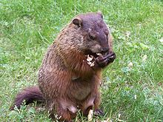
Regular expressions
A formal language for specifying text strings
How can we search for any of these?
woodchuck
woodchucks
Woodchuck
Woodchucks

Slide 55
Regular Expressions: Disjunctions
Letters inside square brackets []
Ranges [A-Z]
Pattern | Matches
[wW]oodchuck | Woodchuck, woodchuck
[1234567890] | Any digit
Pattern | Matches
[A-Z] | An upper case letter | Drenched Blossoms
[a-z] | A lower case letter | my beans were impatient
[0-9] | A single digit | Chapter 1: Down the Rabbit Hole

Slide 56
Regular Expressions: Negation in Disjunction
Negations [^Ss]
Carat means negation only when first in []
Pattern | Matches
[^A-Z] | Not an upper case letter | Oyfn pripetchik
[^Ss] | Neither ‘S’ nor ‘s’ | I have no exquisite reason”
[^e^] | Neither e nor ^ | Look here
a^b | The pattern a carat b | Look up a^b now

Slide 57
Regular Expressions: More Disjunction
Woodchuck is another name for groundhog!
The pipe | for disjunction
Pattern | Matches
groundhog|woodchuck | woodchuck
yours|mine | yours
a|b|c | = [abc]
[gG]roundhog|[Ww]oodchuck | Woodchuck

Slide 58
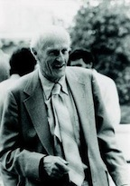
Regular Expressions: ? *+.
Pattern | Matches
colou?r | Optional previous char | color colour
oo*h! | 0 or more of previous char | oh! ooh! oooh! ooooh!
o+h! | 1 or more of previous char | oh! ooh! oooh! ooooh!
baa+ |  | baa baaa baaaa baaaaa
beg.n |  | begin begun begun beg3n
Stephen C Kleene
Kleene *, Kleene +

Slide 59
Regular Expressions: Anchors ^ $
Pattern | Matches
^[A-Z] | Palo Alto
^[^A-Za-z] | 1 “Hello”
\.$ | The end.
.$ | The end? The end!

Slide 60
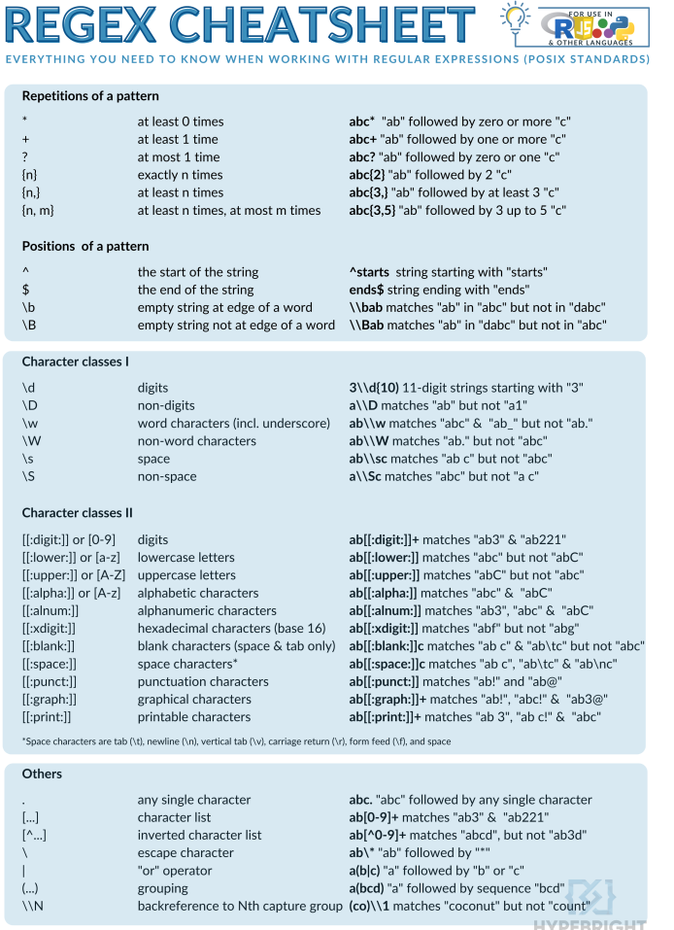
More Regex

Slide 61
Example
Find me all instances of the word “the” in a text.
the
Misses capitalized examples
[tT]he
Incorrectly returns other or theology
[^a-zA-Z][tT]he[^a-zA-Z]

Slide 62
Errors
The process we just went through was based on fixing two kinds of errors:
Matching strings that we should not have matched (there, then, other)
False positives (Type I errors)
Not matching things that we should have matched (The)
False negatives (Type II errors)

Slide 63
Errors cont.
In NLP we are always dealing with these kinds of errors.
Reducing the error rate for an application often involves two antagonistic efforts:
Increasing accuracy or precision (minimizing false positives)
Increasing coverage or recall (minimizing false negatives).

Slide 64
Summary
Regular expressions play a surprisingly large role
Sophisticated sequences of regular expressions are often the first model for any text processing text
For hard tasks, we use machine learning classifiers
But regular expressions are still used for pre-processing, or as features in the classifiers
Can be very useful in capturing generalizations

Slide 65
Basic Text Processing
Regular Expressions

Slide 66
Basic Text Processing
More Regular Expressions: Substitutions and ELIZA
Notes:
Regular expression play a very powerful role when they are used to change strings, substituting one string for another. And this power to easily model string substitutions turns out to play a role in one of the earliest NLP systems, the pioneering 1966 chatbot ELIZA.

Slide 67
Substitutions
Substitution in Python and UNIX commands:
s/regexp1/pattern/
e.g.:
s/colour/color/
Notes:
The syntax for substitutions is simple. For example the python "S" command can be used to change a string matched by a regex to the substitute, another string.

Slide 68
Capture Groups
Say we want to put angles around all numbers:
the 35 boxes → the <35> boxes
Use parens () to "capture" a pattern into a numbered register (1, 2, 3…)
Use \1 to refer to the contents of the register
s/([0-9]+)/<\1>/
(note on regex101 \1 = $1 for substitution)
Notes:
It is often useful to be able to refer to a particular subpart of the string matching the first pattern. For that, we can use "capture groups", a way of storing part of the pattern into a "register" so we can refer to it later in the substitution string.

Slide 69
Capture groups: multiple registers
/the (.*)er they (.*), the \1er we \2/
Matches
the faster they ran, the faster we ran
But not
the faster they ran, the faster we ate
Notes:
In very complex patterns, we'll want to use more than one register; here's an example where we first capture two strings, and then refer to them both in order.

Slide 70
But suppose we don't want to capture?
Parentheses have a double function: grouping terms, and capturing
Non-capturing groups: add a ?: after paren:
/(?:some|a few) (people|cats) like some \1/
matches
some cats like some cats
but not
some cats like some some
Notes:
Here's a problem: parenthesis are used to specify capture groups. But they are also how we group terms, for example for disjunctions, like an expression for a string matching "people" or "cats". How do we specify that we are using the capture groups just for grouping and not for capturing? We simply add a "question mark colon" after the open paren.

Slide 71
Lookahead assertions
(?= pattern) is true if pattern matches, but is zero-width; doesn't advance character pointer
(?! pattern) true if a pattern does not match
How to match, at the beginning of a line, any single word that doesn’t start with “Volcano”:
/ˆ(?!Volcano)[A-Za-z]+/
Notes:
Finally, there will be times when we need to predict the future: look ahead in the text to see if some pattern matches, but not advance the match cursor, so that we can then deal with the pattern if it occurs.
These "lookahead assertions" make use of the (? syntax that we just introduced for non-capture groups. The operator (?= pattern) is true if the pattern occurs, but is zero-width, meaning the match pointer doesn’t advance. And the negative lookahead, ?! pattern only returns true if a pattern does not match, but again is zero-width. Negative lookahead is commonly used when we are parsing some complex pattern but want to rule out a special case. For example this last pattern here matches, at the beginning of a line, any single word that doesn’t start with “Volcano”.

Slide 72
Simple Application: ELIZA
Early NLP system that imitated a Rogerian psychotherapist
Joseph Weizenbaum, 1966.
Uses pattern matching to match, e.g.,:
“I need X”
and translates them into, e.g.
“What would it mean to you if you got X?
Notes:
Substitutions and capture groups are very useful in implementing simple chat-bots like ELIZA. ELIZA , one of the most important historical NLP systems, was created by pioneering AI researcher Joseph Weizenbaum in 1966, and simulates a Rogerian psychologist, a kind of therapist who emphasizes mirroring back what they hear. ELIZA is a surprisingly simple program that uses pattern matching to recognize phrases like “I need X” and translate them into suitable outputs like “What would it mean to you if you got X?”. This simple technique succeeds in this domain because ELIZA doesn’t actually need to know anything to mimic a Rogerian psychotherapist. This is one of the few dialogue genres where listeners can act as if they know nothing of the world.

Slide 73
Simple Application: ELIZA
Men are all alike. IN WHAT WAY
They're always bugging us about something or other. CAN YOU THINK OF A SPECIFIC EXAMPLE
Well, my boyfriend made me come here. YOUR BOYFRIEND MADE YOU COME HERE
He says I'm depressed much of the time. I AM SORRY TO HEAR YOU ARE DEPRESSED
Notes:
Here's some fragments from a sample conversation with ELIZA in 1966. Eliza’s mimicry of human conversation was remarkably successful: many people who interacted with ELIZA came to believe that it really understood them and their problems, and in very prescient early work, Weizenbaum pointed out the ethical issues in this attribution of human qualities to an artificial agent. We'll return to this issue in the dialogue lectures.

Slide 74
How ELIZA works
s/.* I’M (depressed|sad) .*/I AM SORRY TO HEAR YOU ARE \1/
s/.* I AM (depressed|sad) .*/WHY DO YOU THINK YOU ARE \1/
s/.* all .*/IN WHAT WAY?/
s/.* always .*/CAN YOU THINK OF A SPECIFIC EXAMPLE?/
Notes:
ELIZA consists mainly of a series of substitution patterns, with some control for deciding what pattern to select, and some higher-level dialogue structure that we'll come back to. Here we can see examples of capture groups for capturing the adjectives the user writes to describes themselves, and simple patterns for asking more details when the user uses generic statements containing "all" or "always".

Slide 75
Basic Text Processing
More Regular Expressions: Substitutions and ELIZA
Notes:
You'll find regular expression substitutions, and more powerful tools like lookahead, to be useful in all sorts of applications. And later on we'll be returning to ELIZA and the general issue of building agents that can interact conversationally.

