Slide 1

Final Project NLP
Fall 2025

Slide 2
Contents
Grade Breakdown
Proposal
Project Update 1
Project Update 2
Final Paper
Final Presentation
Other details
Final Project

Slide 3
Final Project
The final project is a semester long project which allows you to explore a problem talked about in class more in depth or explore a problem that is not covered in class but is related.
It will be worked on for up to 10 weeks of the semester, so it should involve a substantial enough idea.
For example, if it is simpler than one of the homeworks examined, then it is not enough
Title of class is "Natural Language Processing"
Final project should involve an NLP idea or NLP problem (if it does not involve text in a major way, then probably not NLP).
Final project should make use of AI, either to evaluate or use or both.

Slide 4
Final Project – Additional Details
Again, your goal is to address an NLP problem.
There are no requirements for deployable tools or browser extensions.
You can still add these, but be careful that they do not take away from addressing the question.
The project will more closely model some of the research papers we'll be looking at throughout the semester (although no requirement for novel research).
You need not (and should not simply) re-implement other research papers.
You can start with other research papers, but you'll want to explore different models or datasets or questions. Or extend the ideas.

Slide 5
Other Details
Number of students per project?
Up to 3
Students can choose their own groups
I will open a discussion board for students to find other members on brightspace
Students should be contributing equally to project
Evaluation at end of project
Concerns during semester should be brought to professor ASAP
Projects must:
Involve NLP ideas/methodologies (if there is no text, then probably not going to work!!!)
NOT be regular sentiment analysis (we investigate during class, there are more interesting classification topics)

Slide 6
Other Details
How do I come up with ideas for the project?
SemEval projects
https://semeval.github.io/SemEval2026/
https://semeval.github.io/SemEval2024/tasks
https://semeval.github.io/SemEval2023/tasks
Look to NLP research for inspirations
https://aclanthology.org/
https://aclanthology.org/events/acl-2022/#2022-acl-long
https://aclanthology.org/events/naacl-2022/#2022-naacl-main
Scholar.google.com
Discuss with group or professor

Slide 7
Questions to consider
What datasets are available to help me accomplish my goal?
Often there is not enough time to collect enough original data so it is recommended to find some starting datasets.
How will I evaluate that my goal was achieved?
This will differ based on different NLP tasks. For example, classification might use accuracy and F1 while generation might use BERT-score. In all cases you should know what the evaluation metrics are actually evaluating.
Do all group members have enough to work on?
If you have two or three group members, than one NLP model is not going to be enough equal work throughout the semester. You may decide to add in multiple models or variations or address multiple NLP related tasks at once.

Slide 8
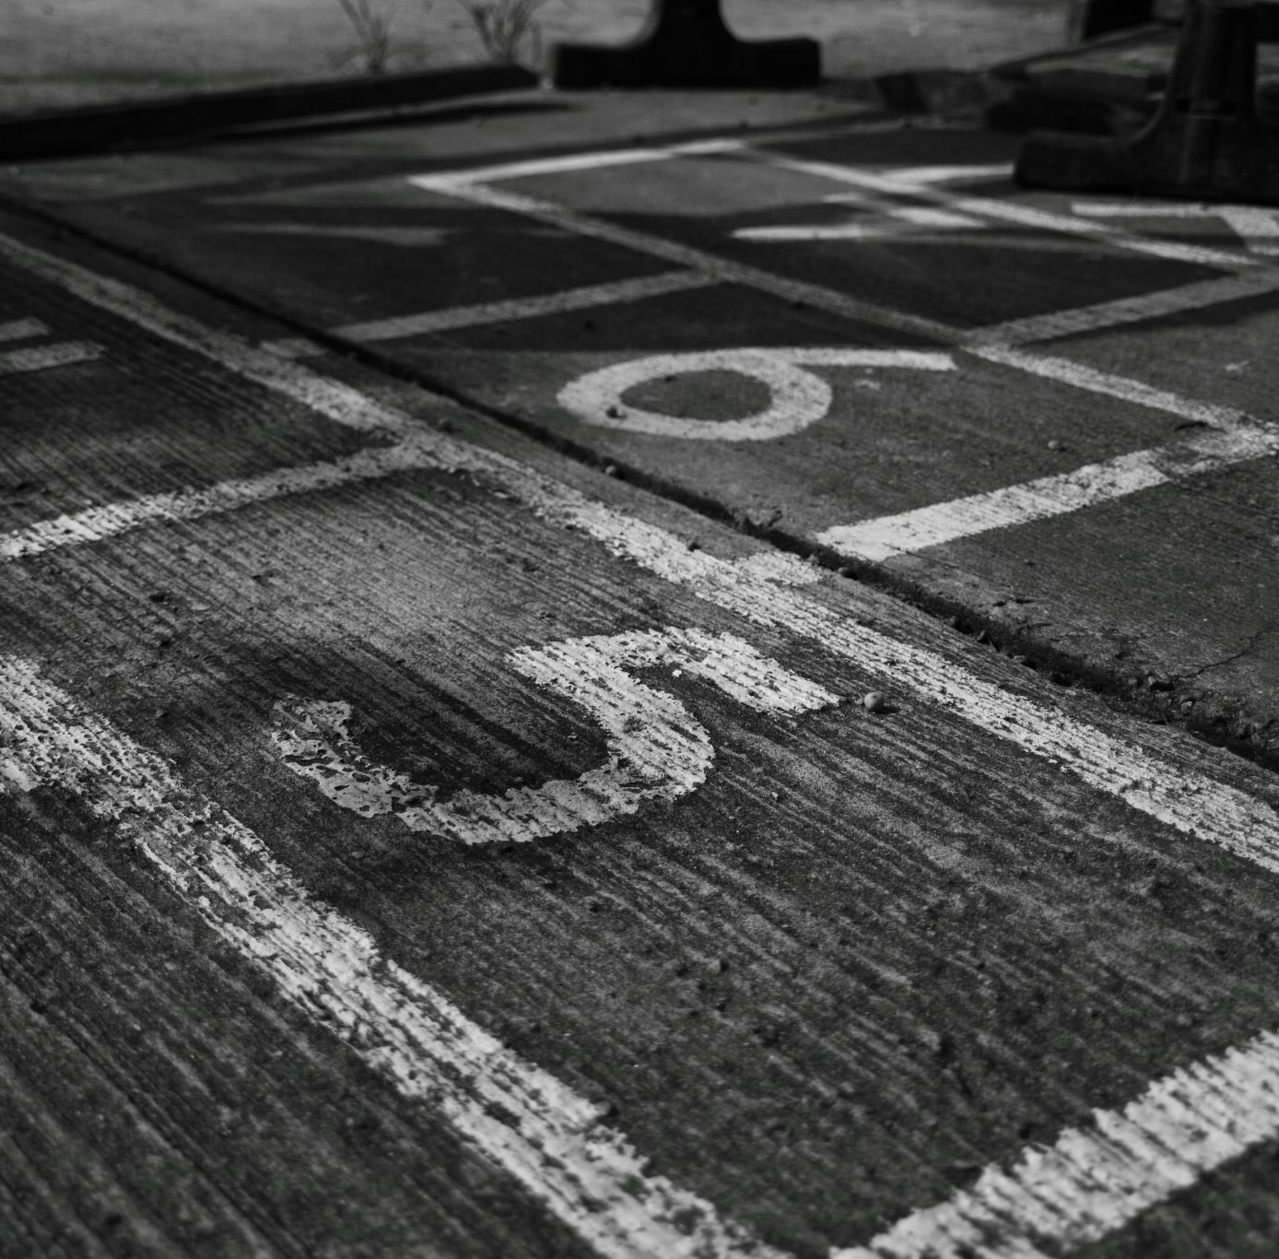
Grade Breakdown
Project Total | 40% (points)
Project Idea(s) | 2% (20)
Proposal | 8% (80)
Update 1 | 5% (50)
Update 2 | 5% (50)
Final Paper | 15% (150)
Presentation | 5% (50)

Slide 9
Project Idea(s)(Due Week 4)
Must submit simple document which details group members and possible ideas for your final project
Give a few details for each idea beyond a generic wording:
e.g. "Text Classification" is too general
Do not have to have them fully realized
I will be providing feedback to help you in what is realistic for your time in this semester
No Sentiment Analysis allowed

Slide 10
Proposal (Week 6)
Paper describing problem to work on
Should include motivation
Problem statement (not the same as motivation)
Model/Algorithm to address problem (may be initial thoughts, but should expand on the idea)
Datasets that might be used (may add additional later)
Measurement of success (accuracy, F1)
Possible future additional analysis that can be done (will become more clear throughout the project) (Do not confuse this with results!)

Slide 11
Proposal (Week 6)
(Up to) 3 page paper
Must use ACL formatting
https://aclrollingreview.org/authorchecklist
https://github.com/acl-org/acl-style-files/tree/master/latex
https://www.overleaf.com/latex/templates/association-for-computational-linguistics-acl-conference/jvxskxpnznfj
Overleaf.com can be a great tool for writing, especially with multiple group members
References are not required, but you'll need them in your final paper so it doesn't hurt to start to get familiar with them

Slide 12
Project Update 1 (Due Week 10)
Include initial draft of Related Work section
Include initial draft of Methodology (include the methods used so far)
Include in a Results section:
Describe current results
Describe upcoming results
Describe analysis done
Describe upcoming analysis
Describe problems encountered which may have changed the project direction
Same formatting as proposal (ACL formatting)
Include github link which stores code and results

Slide 13
Project Update 2 (Due Week 13)
Include initial draft of Introduction
Include more complete draft of Related Work section
Include more complete draft of Methodology (include the methods used so far)
Include initial draft of Experiments/Experimental Setup
Include in a Results section:
Describe current results
Describe upcoming results
Describe analysis done
Describe upcoming analysis
+ progress since last update
Ideas that were tried that didn't work out
Next steps/analysis
Same formatting as proposal (ACL formatting)

Slide 14
Final Presentation (Week 16 and Finals Week)
~20 minute in class presentations (15 minutes presenting, 5 minutes questions)
Describes problem, motivation, method, experiments, results, analysis, etc.
May not have time to describe everything in final paper, but should touch on all the most important details
Every team member should participate
Hand in slides the evening before your presentation

Slide 15
Final Paper (Due Week 16)
(up to) 5 page paper
Treated as a research paper (those we have been reading throughout the semester)
Include (at least) abstract, introduction, (slight) related work, methodology, experiments/experimental setup, results, additional analysis, conclusion
Should include citations (see examples on brightspace for how to use citations on overleaf)
See other research papers for ways of presenting the research

Slide 16
Final Paper (Due Week 16)
Must use ACL formatting
https://aclrollingreview.org/authorchecklist
https://www.overleaf.com/latex/templates/association-for-computational-linguistics-acl-conference/jvxskxpnznfj
Must include github link with code/artifacts created/used for the project
5 pages max, does not include references
Should be well written
It's not enough just to include the required sections
Overleaf.com can be a great tool for writing, especially with multiple group members

Slide 17
Final Project Rubric | Points | Needs Improvement (0-25%) | Satisfactory (25-50%) | Good (50-75%) | Excellent (75-100%)
Writing | 10 | Frequent errors, unclear writing. | Noticeable errors, somewhat clear. | Minor errors, mostly clear and concise. | Clear, concise, and error-free writing.
Abstract, Introduction, Related Work | 30 | Incomplete or unclear. Abstract is vague. Introduction lacks context. Related work is insufficient or irrelevant. | Adequate but lacks depth. Abstract is basic. Introduction is somewhat clear. Related work is somewhat relevant. | Clear and relevant. Abstract summarizes key points. Introduction provides context. Related work is relevant and well-cited. | Comprehensive and insightful. Abstract summarizes well. Introduction sets context. Related work is thorough and well-cited.
Methodology, Experiments | 50 | Incomplete or unclear methodology. Experiments are poorly documented. | Basic methodology and experiments. Lacks detail and clarity. | Clear methodology and experiments. Some details may be missing. | Detailed and well-structured methodology. Experiments are thorough and well-documented.
Results, Additional Analysis, Conclusion | 50 | Results are unclear or missing. Analysis is poor. Conclusion is unsupported. | Results are presented but lack clarity. Analysis is basic. Conclusion is weak. | Results are clear. Analysis is relevant. Conclusion is supported by data. | Results are clearly presented and analyzed. Conclusion is insightful and well-supported.
Paper Format/Citations | 10 | Frequent formatting or citation errors. | Noticeable formatting or citation errors. | Minor formatting or citation errors. | Perfect formatting and citation style.
Total | 150

Slide 18
Other Details
How do I write the final paper?
Start adding details early on
Motivation, Methodology, datasets
Continue to add/improve old writing
Waiting until the last minute will result in a poorly written paper
All members should contribute, waiting until the last minute won't allow this either
Ask other groups to proofread your paper
Grammar, missing/unclear details, etc.
Get familiar with overleaf/latex

