Slide 1
Vector Semantics & Embeddings
Word2vec
Notes:
Let's now introduce the important word2vec embeddings.

Slide 2
Sparse versus dense vectors
tf-idf (or PMI) vectors are
long (length |V|= 20,000 to 50,000)
sparse (most elements are zero)
Alternative: learn vectors which are
short (length 50-1000)
dense (most elements are non-zero)
Notes:
In the previous lectures we saw how to represent a word as a sparse, long vector with dimensions corresponding to words in the vocabulary or documents in a collection. We now introduce a more powerful word representation: embeddings, short dense vectors. Unlike the vectors we’ve seen so far, embeddings are short, with number of dimensions d ranging from 50-1000, rather than the much larger vocabulary size |V | or number of documents D we’ve seen. These d dimensions don’t have a clear interpretation. And the vectors are dense: instead of vector entries being sparse, mostly-zero counts or functions of counts, the values will be real-valued numbers that can be negative.

Slide 3
Sparse versus dense vectors
Why dense vectors?
Short vectors may be easier to use as features in machine learning (fewer weights to tune)
Dense vectors may generalize better than explicit counts
Dense vectors may do better at capturing synonymy:
car and automobile are synonyms; but are distinct dimensions
a word with car as a neighbor and a word with automobile as a neighbor should be similar, but aren't
In practice, they work better
Notes:
It turns out that dense vectors work better in every NLP task than sparse vectors. While we don’t completely understand all the reasons for this, we have some intu- itions. Representing words as 700-dimensional dense vectors requires our classifiers to learn far fewer weights than if we represented words as 50,000-dimensional vec- tors, and the smaller parameter space possibly helps with generalization and avoid- ing overfitting. Dense vectors may also do a better job of capturing synonymy. For example, in a sparse vector representation, dimensions for synonyms like car and automobile dimension are distinct and unrelated; sparse vectors may thus fail to capture the similarity between a word with car as a neighbor and a word with automobile as a neighbo

Slide 4
Common methods for getting short dense vectors
“Neural Language Model”-inspired models
Word2vec (skipgram, CBOW), GloVe
Singular Value Decomposition (SVD)
A special case of this is called LSA – Latent Semantic Analysis
Alternative to these "static embeddings":
Contextual Embeddings (ELMo, BERT)
Compute distinct embeddings for a word in its context
Separate embeddings for each token of a word
Notes:
In this section we introduce one method for computing embeddings: skip-gram with negative sampling, sometimes called SGNS. The skip-gram algorithm is one of two algorithms in a software package called word2vec, and so sometimes the al- gorithm is loosely referred to as word2vec. The word2vec methods are fast, efficient to train, and easily available online with code and pretrained embeddings. Word2vec embeddings are static embeddings, meaning that the method learns one fixed embedding for each word in the vocabulary. An lternative to these static embeddings are more recent methods for learning dynamic contextual em-beddings like the popular BERT representations, in which the vector for each word is different in different contexts.

Slide 5
Simple static embeddings you can download!
Word2vec (Mikolov et al)
https://code.google.com/archive/p/word2vec/
GloVe (Pennington, Socher, Manning)
http://nlp.stanford.edu/projects/glove/

Slide 6
Word2vec
Popular embedding method
Very fast to train
Code available on the web
Idea: predict rather than count
Word2vec provides various options. We'll do:
skip-gram with negative sampling (SGNS)

Slide 7
Word2vec
Instead of counting how often each word w occurs near "apricot"
Train a classifier on a binary prediction task:
Is w likely to show up near "apricot"?
We don’t actually care about this task
But we'll take the learned classifier weights as the word embeddings
Big idea: self-supervision:
A word c that occurs near apricot in the corpus counts as the gold "correct answer" for supervised learning
No need for human labels
Bengio et al. (2003); Collobert et al. (2011)
Notes:
The intuition of word2vec is that instead of counting how often each word w oc- curs near, say, apricot, we’ll instead train a classifier on a binary prediction task: “Is word w likely to show up near apricot?” We don’t actually care about this prediction task; instead we’ll take the learned classifier weights as the word embeddings. The revolutionary intuition here is that we can just use running text as implicitly supervised training data for such a classifier; a word c that occurs near the target word apricot acts as gold ‘correct answer’ to the question “Is word c likely to show up near apricot?” This method, often called self-supervision, avoids the need for any sort of hand-labeled supervision signal. This idea was first proposed in the task of neural language modeling, when Bengio et al. (2003) and Collobert et al. (2011) showed that a neural language model (a neural network that learned to predict the next word from prior words) could just use the next word in running text as its supervision signal, and could be used to learn an embedding representation for each word as part of doing this prediction task. word2vec is a much simpler model than the neural network language model, in two ways. First, word2vec simplifies the task (making it binary classification instead of word pre- diction). Second, word2vec simplifies the architecture (training a logistic regression classifier instead of a multi-layer neural network with hidden layers that demand more sophisticated training algorithms)

Slide 8
Approach: predict if candidate word c is a "neighbor"
Treat the target word t and a neighboring context word c as positive examples.
Randomly sample other words in the lexicon to get negative examples
Use logistic regression to train a classifier to distinguish those two cases
Use the learned weights as the embeddings
Notes:
The intuition of skip-gram is:

Slide 9
Skip-Gram Training Data
Assume a +/- 2 word window, given training sentence:
…lemon, a [tablespoon of apricot jam, a] pinch…
c1 c2 c3 c4
[target]
Notes:
Let’s start by thinking about the classification task, and then turn to how to train. Imagine a sentence like the following, with a target word apricot, and assume we’re using a window of ±2 context words:

Slide 10
Skip-Gram Classifier
(assuming a +/- 2 word window)
…lemon, a [tablespoon of apricot jam, a] pinch…
c1 c2 [target] c3 c4
Goal: train a classifier that is given a candidate (word, context) pair
(apricot, jam)
(apricot, aardvark)
…
And assigns each pair a probability:
P(+|w, c)
P(−|w, c) = 1 − P(+|w, c)
Notes:
Our goal is to train a classifier such that, given a tuple (w,c) of a target word w paired with a candidate context word c (for example (apricot, jam), or perhaps (apricot, aardvark)) it will return the probability that c is a real context word (true for jam, false for aardvark):
The probability that word c is not a real context word for w is just 1 minus

Slide 11
Similarity is computed from dot product
Remember: two vectors are similar if they have a high dot product
Cosine is just a normalized dot product
So:
Similarity(w,c) ∝ w ∙ c
We’ll need to normalize to get a probability
(cosine isn't a probability either)
Notes:
he intuition of the skip- gram model is to base this probability on embedding similarity: a word is likely to occur near the target if its embedding is similar to the target embedding. To compute similarity between these dense embeddings, we rely on the intuition that two vectors are similar if they have a high dot product (after all, cosine is just a normalized dot product). In other words: Similarity(w,c) ∝ w ∙ c

Slide 12
Turning dot products into probabilities
Sim(w,c) ≈ w ∙ c
To turn this into a probability
We'll use the sigmoid from logistic regression:
Notes:
The dot product c · w is not a probability, it’s just a number ranging from −∞ to ∞ (since the elements in word2vec embeddings can be negative, the dot product can be negative). To turn the dot product into a probability, we’ll use the logistic or sigmoid function σ (x) from logistic regression
We model the probability that word c is a real context word for target word w as:
to make it a probability we’ll also need the total probability of the two possible events (c is a context word, and c isn’t a context word) to sum to 1. We thus estimate the probability that word c is not a real context word for w as:

Slide 13
How Skip-Gram Classifier computes P(+|w, c)
This is for one context word, but we have lots of context words.
We'll assume independence and just multiply them:
Notes:
This equation gives us the probability for one word, but there are many context words in the window. Skip-gram makes the simplifying assumption that all context words are independent, allowing us to just multiply their probabilities:

Slide 14
Skip-gram classifier: summary
A probabilistic classifier, given
a test target word w
its context window of L words c_{1:L}
Estimates probability that w occurs in this window based on similarity of w (embeddings) to c_{1:L} (embeddings).
To compute this, we just need embeddings for all the words.
Notes:
In summary, skip-gram trains a probabilistic classifier that, given a test target word w and its context window of L words c1:L, assigns a probability based on how similar this context window is to the target word. The probability is based on applying the logistic (sigmoid) function to the dot product of the embeddings of the target word with each context word. To compute this probability, we just need embeddings for each target word and context word in the vocabulary.

Slide 15
These embeddings we'll need: a set for w, a set for c
Notes:
Here's the intuition of parameters we’ll need. Skip-gram actually stores two embeddings for each word, one for the word as a target, and one for the word considered as context. Thus the parameters we need to learn are two matrices W and C, each containing an embedding for every one of the |V | words in the vocbulary

Slide 16
Vector Semantics & Embeddings
Word2vec
Notes:
We've seen how the skipgram classifier functions. In the next section we'll turn to learning its weights, which is the goal of building the classifier

Slide 17
Vector Semantics & Embeddings
Word2vec: Learning the embeddings
Notes:
Let's see how word2vec uses sigmoids and gradient descent to learn embeddings

Slide 18
Skip-Gram Training data
…lemon, a [tablespoon of apricot jam, a] pinch…
c1 c2 [target] c3 c4
Notes:
Skip-gram learns embeddings by starting with random embedding vectors and then iteratively shifting the embedding of each word w to be more like the embeddings of words that occur nearby in texts, and less like the embeddings of words that don’t occur nearby. Let’s start by considering a single piece of training data
This example has a target word w (apricot), and 4 context words in the L = ±2 window, resulting in 4 positive training instances (on the left below):

Slide 19
Skip-Gram Training data
…lemon, a [tablespoon of apricot jam, a] pinch…
c1 c2 [target] c3 c4
For each positive example we'll grab k negative examples, sampling by frequency
Notes:
For training a binary classifier we also need negative examples. In fact skip- gram with negative sampling (SGNS) uses more negative examples than positive examples (with the ratio between them set by a parameter k). So for each of these (w,cpos) training instances we’ll create k negative samples, each consisting of the target w plus a ‘noise word’ cneg. A noise word is a random word from the lexicon, constrained not to be the target word w.

Slide 20
Skip-Gram Training data
…lemon, a [tablespoon of apricot jam, a] pinch…
c1 c2 [target] c3 c4
Notes:
Here's the setting where k = 2, so we’ll have 2 negative examples in the negative training set − for each positive example w,cpos. The noise words are chosen according to their weighted unigram frequency.

Slide 21
Word2vec: how to learn vectors
Given the set of positive and negative training instances, and an initial set of embedding vectors
The goal of learning is to adjust those word vectors such that we:
Maximize the similarity of the target word, context word pairs (w , c_{pos}) drawn from the positive data
Minimize the similarity of the (w , c_{neg}) pairs drawn from the negative data.
Notes:
Given the set of positive and negative training instances, and an initial set of embeddings, the goal of the learning algorithm is to adjust those embeddings to
• Maximize the similarity of the target word, context word pairs (w,cpos) drawn from the positive examples
• Minimize the similarity of the (w,cneg) pairs from the negative examples.

Slide 22
Loss function for one w with c_{pos} , c_{neg1} ...c_{negk}
Maximize the similarity of the target with the actual context words, and minimize the similarity of the target with the k negative sampled non-neighbor words.
Notes:
If we consider one word/context pair (w, cpos ) with its k noise words cneg1 ...cnegk , our goal is to maximize the similarity of the target with the actual context words, andn minimize the similarity of the target with the k negative sampled non-neighbor words. We can express these two goals as the following loss function L to be minimized (hence the −); here the first term expresses that we want the classifier to assign the real context word cpos a high probability of being a neighbor, and the second term expresses that we want to assign each of the noise words cnegi a high probability of being a non-neighbor, all multiplied because we assume independence:
If we substitute in our sigmoid of the dot product estimate for P, we want to maximize the dot product of the word with the actual context words, and minimize the dot products of the word with the k negative sampled non- neighbor words.
􏰼

Slide 23
Learning the classifier
How to learn?
Stochastic gradient descent!
We’ll adjust the word weights to
make the positive pairs more likely
and the negative pairs less likely,
over the entire training set.
Notes:
We minimize this loss function using stochastic gradient descent.

Slide 24
Intuition of one step of gradient descent
Notes:
Let's look at the intuition of one step of gradient descent. The skip-gram model tries to shift embeddings so the target embeddings (here for apricot) are closer to (have a higher dot product with) context embeddings for nearby words (here jam) and further from (lower dot product with) context embeddings for noise words that don’t occur nearby (here Tolstoy and matrix).

Slide 25
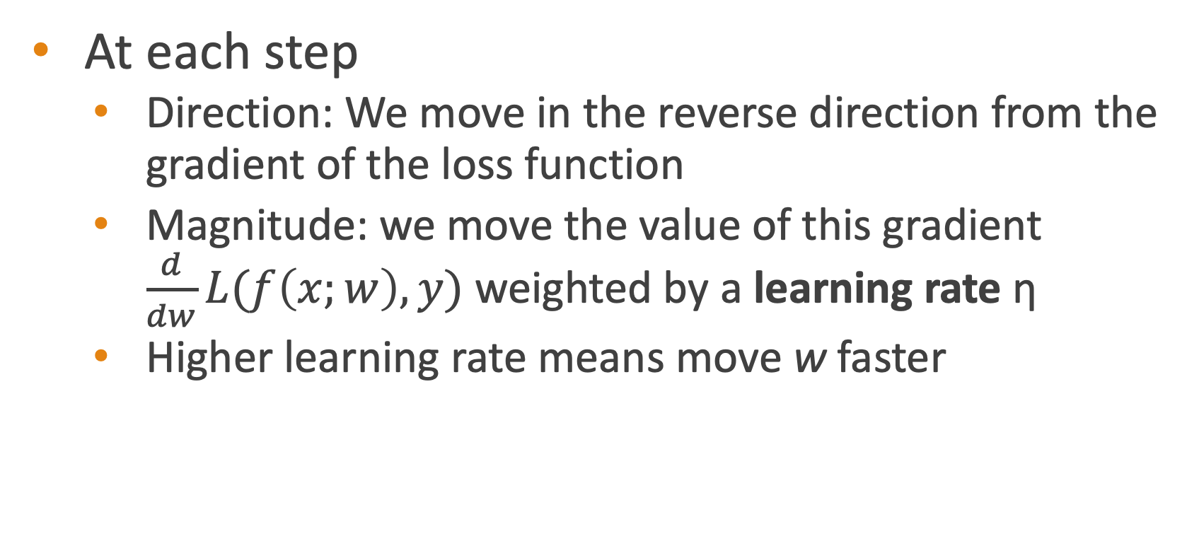
Reminder: gradient descent
At each step
Direction: We move in the reverse direction from the gradient of the loss function
Magnitude: we move the value of this gradient $\frac{d}{dw}L(f\left(x;w\right),y)$ weighted by a learning rate η
Higher learning rate means move w faster

Slide 26
The derivatives of the loss function
Notes:
To get the gradient, we need to take the derivative of this equation with respect to the different embeddings. We'll need a derivate for the C embeddings and for the W embeddings. And we'll want a different derivative for the weights for the positive context examples and the nevative context examples, since we want to move them in opposite directions. It turns out the derivatives are the following elegant functions.

Slide 27
Update equation in SGD
Start with randomly initialized C and W matrices, then incrementally do updates
Notes:
The update equations going from time step t to t + 1 in stochastic gradient descent are thus:
Just as in logistic regression, then, the learning algorithm starts with randomly initialized W and C matrices, and then walks through the training corpus using gradient descent to move W and C so as to maximize the objective we saw earlier by making the updates here.

Slide 28
Two sets of embeddings
SGNS learns two sets of embeddings
Target embeddings matrix W
Context embedding matrix C
It's common to just add them together, representing word i as the vector w_{i} + c_{i}
Notes:
As we've just seen, the skip-gram model learns two separate embeddings for each word i: the target embedding w and the context embedding c , stored in two matrices, the target matrix W and the context matrix C. Ibut if we just need one vector to represent a word, what should we use? t’s common to just add them together, representing word i with the vector wi + ci .

Slide 29
Summary: How to learn word2vec (skip-gram) embeddings
Start with V random d-dimensional vectors as initial embeddings
Train a classifier based on embedding similarity
Take a corpus and take pairs of words that co-occur as positive examples
Take pairs of words that don't co-occur as negative examples
Train the classifier to distinguish these by slowly adjusting all the embeddings to improve the classifier performance
Throw away the classifier code and keep the embeddings.

Slide 30
Vector Semantics & Embeddings
Word2vec: Learning the embeddings
Notes:
We've seen how to learn word2vec embeddings, one of the most popular static embedding method

Slide 31
Vector Semantics & Embeddings
Properties of Embeddings
Notes:
Let's talk about various properties and parameters of embeddings

Slide 32
The kinds of neighbors depend on window size
Small windows (C= +/- 2) : nearest words are syntactically similar words in same taxonomy
Hogwarts nearest neighbors are other fictional schools
Sunnydale, Evernight, Blandings
Large windows (C= +/- 5) : nearest words are related words in same semantic field
Hogwarts nearest neighbors are Harry Potter world:
Dumbledore, half-blood, Malfoy
Notes:
One parameter of vector semantic models that is relevant to both sparse tf-idf vectors and dense word2vec vectors is the size of the context window used to collect counts. This is generally between 1 and 10 words on each side of the target word (for a total context of 2-20 words).
The choice depends on the goals of the representation. Shorter context windows tend to lead to representations that are a bit more syntactic, since the information is coming from immediately nearby words. When the vectors are computed from short context windows, the most similar words to a target word w tend to be semantically similar words with the same parts of speech. When vectors are computed from long context windows, the highest cosine words to a target word w tend to be words that are topically related but not similar. For example Levy and Goldberg (2014a) showed that using skip-gram with a window of ±2, the most similar words to the word Hogwarts (from the Harry Potter series) were names of other fictional schools: Sunnydale (from Buffy the Vampire Slayer) or Evernight (from a vampire series). With a window of ±5, the most similar words to Hogwarts were other words topically related to the Harry Potter series: Dumbledore, Malfoy, and half-blood.

Slide 33
Analogical relations
The classic parallelogram model of analogical reasoning (Rumelhart and Abrahamson 1973)
To solve: "apple is to tree as grape is to _____"
Add tree – apple to grape to get vine
Notes:
Another semantic property of embeddings is their ability to capture relational meanings. In an important early vector space model of cognition, Rumelhart and Abrahamson (1973) proposed the parallelogram model for solving simple analogy problems of the form a is to b as a* is to what?. In such problems, a system given a problem like apple:tree::grape:?, i.e., apple is to tree as grape is to , and must fill in the word vine.
In the parallelogram model, the vector from the word apple ito the word tree (= apple − tree)
is added to the vector for grape (grape); the nearest word to that point is returned

Slide 34
Analogical relations via parallelogram
The parallelogram method can solve analogies with both sparse and dense embeddings (Turney and Littman 2005, Mikolov et al. 2013b)
king – man + woman is close to queen
Paris – France + Italy is close to Rome
For a problem a:a*::b:b*, the parallelogram method is:
Notes:
For a a:b::a*:b* problem, meaning the algorithm is given a, b, and a* and must find b*, the parallelogram method is thus: EQUATION
with the distance function defined either as cosine or as Euclidean distance.

Slide 35
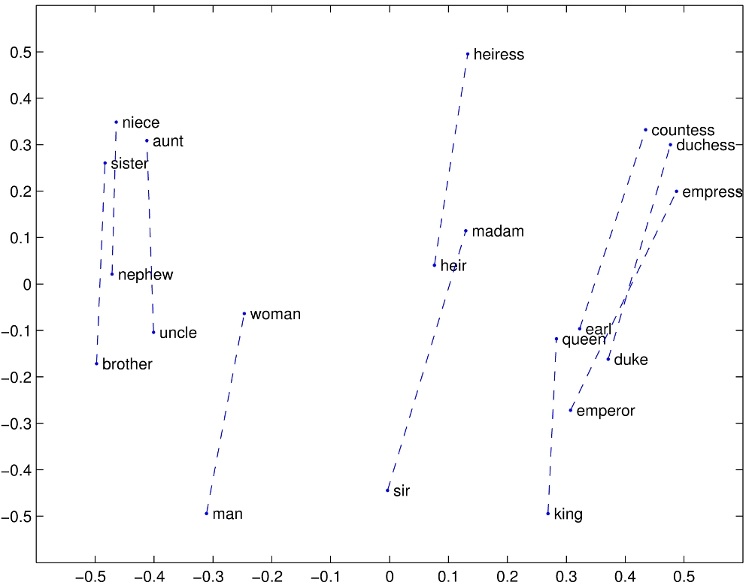
Structure in GloVE Embedding space

Slide 36
Caveats with the parallelogram method
It only seems to work for frequent words, small distances and certain relations (relating countries to capitals, or parts of speech), but not others. (Linzen 2016, Gladkova et al. 2016, Ethayarajh et al. 2019a)
Understanding analogy is an open area of research (Peterson et al. 2020)

Slide 37
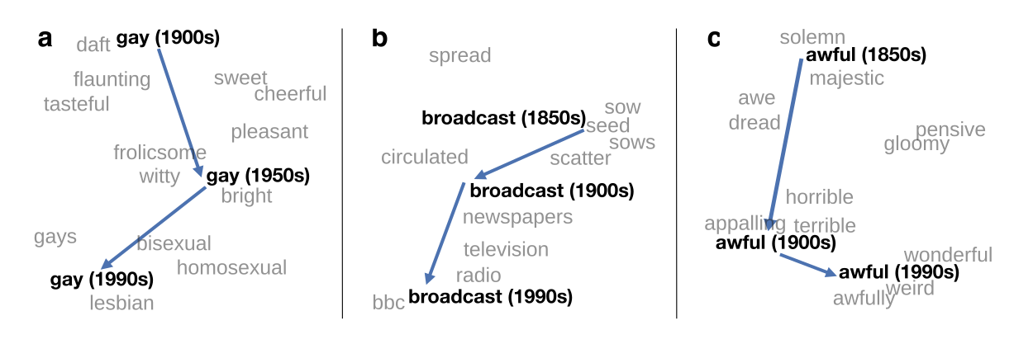
Embeddings as a window onto historical semantics
Train embeddings on different decades of historical text to see meanings shift
~30 million books, 1850-1990, Google Books data
William L. Hamilton, Jure Leskovec, and Dan Jurafsky. 2016. Diachronic Word Embeddings Reveal Statistical Laws of Semantic Change. Proceedings of ACL.
Notes:
Embeddings can also be a useful tool for studying how meaning changes over time, by computing multiple embedding spaces, each from texts written in a particular time period. For example these figures shows a visualization of changes in meaning in English words over the last two centuries, computed by building separate embedding spaces for each decade from historical corpora like Google N-grams and the Corpus of Historical American English.

Slide 38
Embeddings reflect cultural bias!
Bolukbasi, Tolga, Kai-Wei Chang, James Y. Zou, Venkatesh Saligrama, and Adam T. Kalai. "Man is to computer programmer as woman is to homemaker? debiasing word embeddings." In NeurIPS, pp. 4349-4357. 2016.
Ask “Paris : France :: Tokyo : x”
x = Japan
Ask “father : doctor :: mother : x”
x = nurse
Ask “man : computer programmer :: woman : x”
x = homemaker
Algorithms that use embeddings as part of e.g., hiring searches for programmers, might lead to bias in hiring
Notes:
In addition to their ability to learn word meaning from text, embeddings, alas, also reproduce the implicit biases and stereotypes that were latent in the text. As the prior section just showed, embeddings can roughly model relational similar- ity: ‘queen’ as the closest word to ‘king’ - ‘man’ + ‘woman’ implies the analogy man:woman::king:queen. But these same embedding analogies also exhibit gender stereotypes. For example the embeddings suggest the analogy ‘father’ is to ‘doctor’ as ‘mother’ is to ‘nurse’, and the closest occupation to ‘man’ - ‘computer programmer’ + ‘woman’ in word2vec embeddings trained on news text is ‘homemaker'
This could result in what Crawford calls an allocational harm, when a system allo- cates resources (jobs or credit) unfairly to different groups. For example algorithms that use embeddings as part of a search for hiring potential programmers or doctors might thus incorrectly downweight documents with women’s names.

Slide 39
Historical embedding as a tool to study cultural biases
Garg, N., Schiebinger, L., Jurafsky, D., and Zou, J. (2018). Word embeddings quantify 100 years of gender and ethnic stereotypes. Proceedings of the National Academy of Sciences 115(16), E3635–E3644.
Compute a gender or ethnic bias for each adjective: e.g., how much closer the adjective is to "woman" synonyms than "man" synonyms, or names of particular ethnicities
Embeddings for competence adjective (smart, wise, brilliant, resourceful, thoughtful, logical) are biased toward men, a bias slowly decreasing 1960-1990
Embeddings for dehumanizing adjectives (barbaric, monstrous, bizarre) were biased toward Asians in the 1930s, bias decreasing over the 20th century.
These match the results of old surveys done in the 1930s
Notes:
Historical embeddings are also being used to measure biases in the past. Garg et al. (2018) used embeddings from historical texts to measure the association be- tween embeddings for adjectives and embeddings for names of various ethnici- ties or genders. embeddings for adjectives related to competence (‘smart’, ‘wise’, ‘thoughtful’, ‘resourceful’) had a higher cosine with male than fe- male words, and showed that this bias has been slowly decreasing since 1960, and that Historical embeddings also repli- cated old surveys of ethnic stereotypes; Embeddings for Chinese names were biased twoare dehumanizing adjectives like ‘barbaric’ in the 1930s, matching the results of old surveys done in the 1930s, but this bias decreased in both text and surveys over the 20th century.

Slide 40
Vector Semantics & Embeddings
Properties of Embeddings
Notes:
We've seen various properties of embeddings, include how they reflect cultural biases in the text they are trained on.

Slide 41

Contextual Word Embeddings
Borrowed from:
COS 598C Advanced Topics in Computer Science: Deep Learning for Natural Language Processing

Slide 42
Overview
•
(McCann et al, NIPS’2017) Learned in translation: contextualized word vectors
•
(Peters et al, NAACL’2018) Deep contextualized word representations

Slide 43
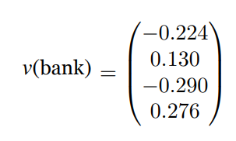
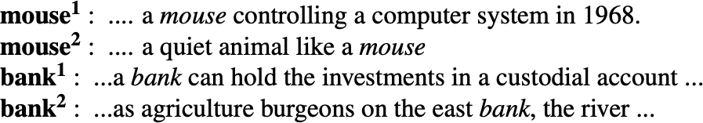
Limitations of word2vec
•
One vector for each word type
•
Polysemous words, e.g., bank, mouse
•
Words don’t appear in isolation. The word use (e.g., syntax and semantics) depends on its context. Why not learn the representations for each word in its context?

Slide 44

Contextualized word embeddings
Build a vector for each word conditioned on its context!
= representation for each token is a function of the entire input sentence
Contextualized word embeddings
the
movie was terribly exciting !
g : (w₁, w₂, …, w_{n}) ⟶ x₁, …, x_{n} ∈ ℝ^{d}

Slide 45

Contextualized word embeddings
Compute contextual vector:
c_{k} = f (w_{k} | w₁, w₂,. .., w_{n}) R^{d}
f (play | Elmo and Cookie Monster play a game)
6=
f (play | The Broadway play premiered yesterday)

Slide 46
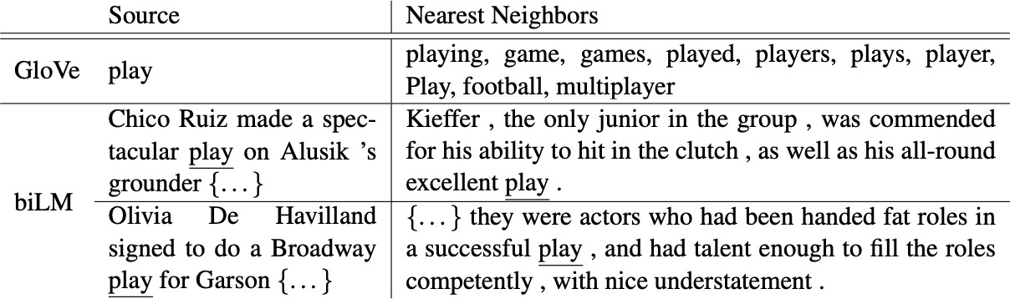
Contextualized word embeddings
(Peters et al, 2018): Deep contextualized word representations

Slide 47
Noah Smith. 2019.
Contextual Word Representations: A Contextual Introduction
“With hindsight, we can now see that by representing word types independent of context, we were solving a problem that was harder than it needed to be. Because words mean different things in different contexts, we were requiring that type representations capture all of the possibilities. Moving to word token vectors simplifies things, asking the word token representation to capture only what a word means in this context. For the same reasons that the collection of contexts a word type is found in provide clues about its meaning(s), a particular token’s context provides clues about its specific meaning.”

Slide 48
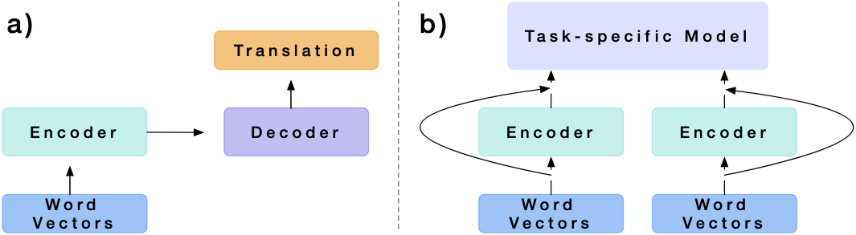
CoVe
Key idea:
Train a standard sequence-to-sequence (with attention) model for English-to-German translation.
Take the encoder directly as contextualized word embeddings.

Slide 49
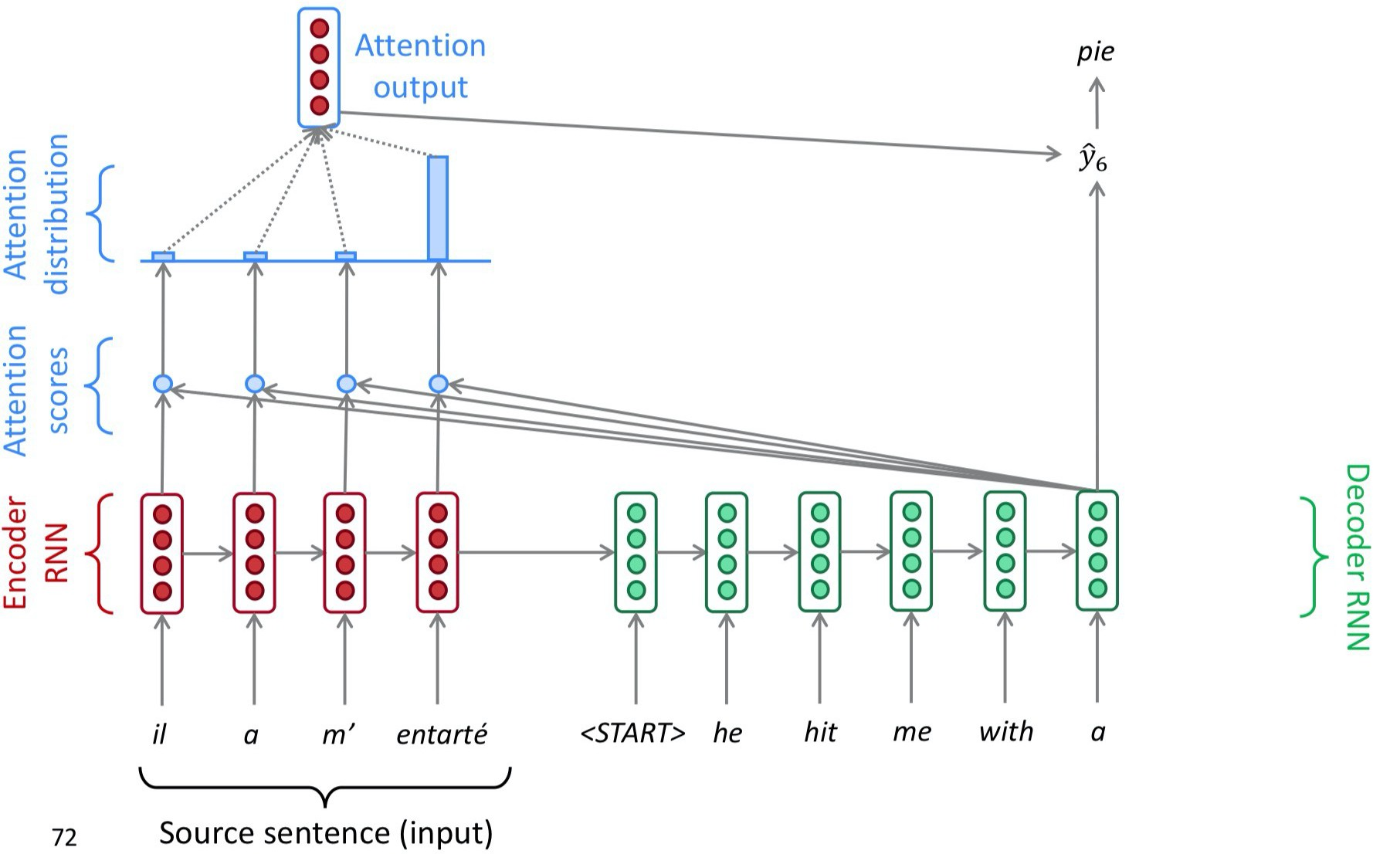
Sequence-to-sequence with attention
(slide credit: Abigail See)

Slide 50
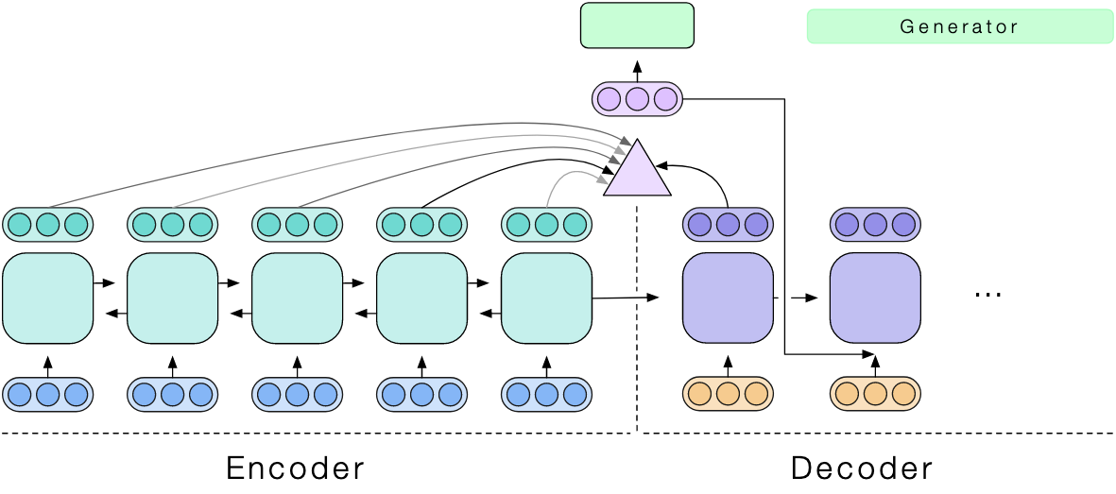
CoVe
Bidirectional encoder!

Slide 51
Training details
Machine Translation datasets
•
•
•
Small: 30,000 sentence pairs (Flickr captions) Medium: 209,772 (TED presentations)
Large: 7M (Web crawl data, news, European Parliament proceedings…)
Encoder: two-layer bidirectional LSTMs
Decoder: two-layer unidirectional LSTMs

Slide 52
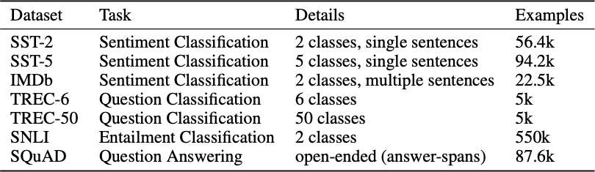
Evaluation

Slide 53
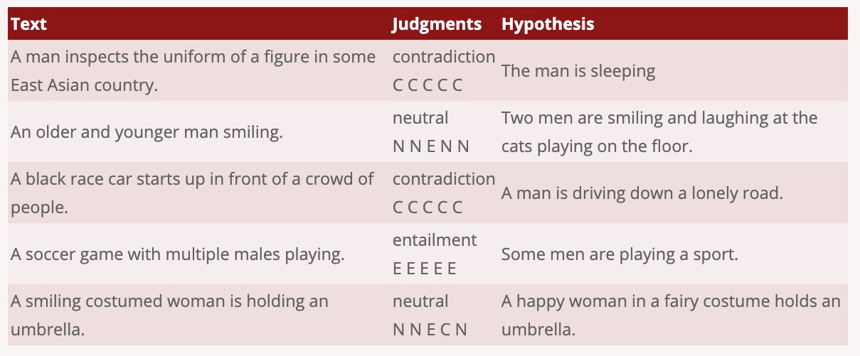
Evaluation: SNLI

Slide 54
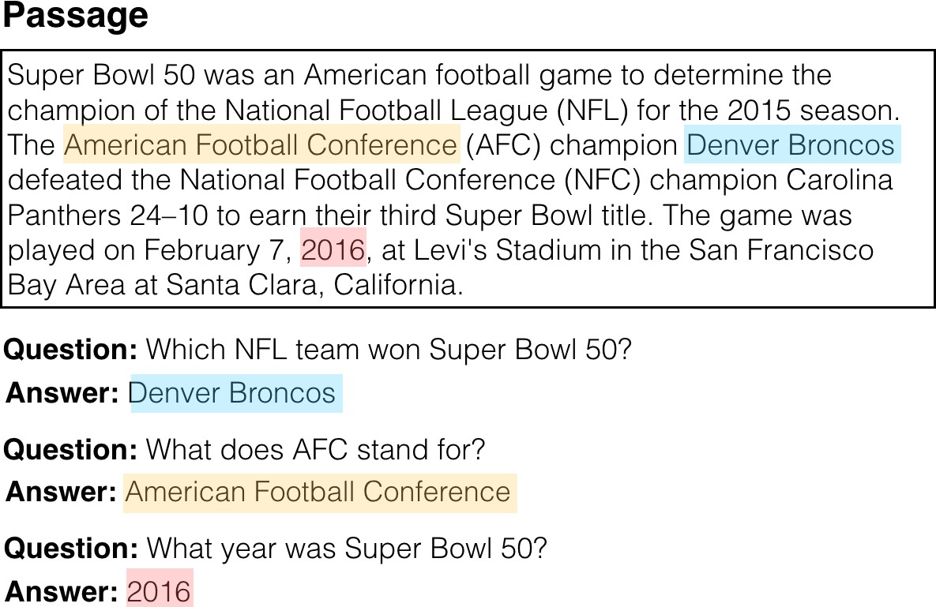
Evaluation: SQuAD

Slide 55
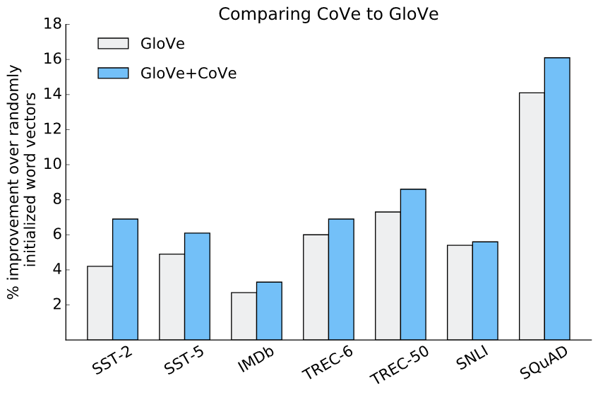
Evaluation

Slide 56
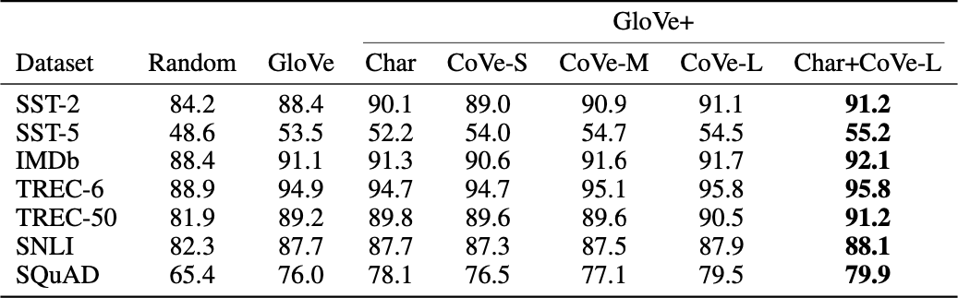
Evaluation

Slide 57
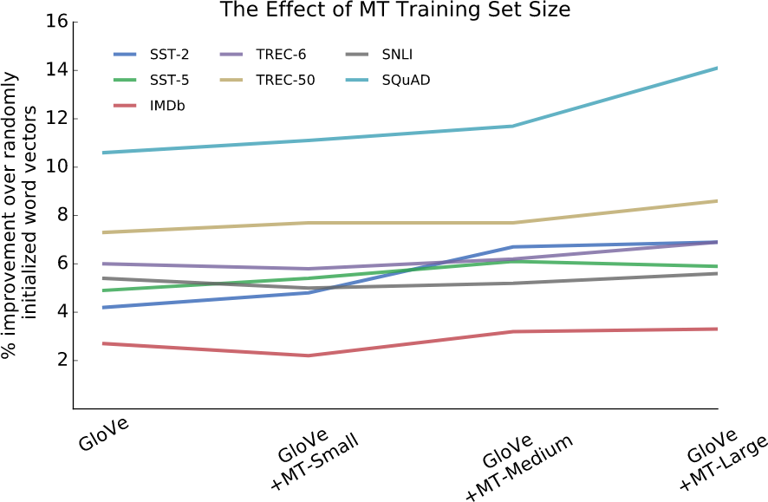
More MT —> Better CoVe

Slide 58

ELMo
Key idea:
Train a forward LSTM-based LM and a backward LSTM-based LM on some large corpus
Use the hidden states of the LSTMs for each token to compute a vector representation of each word

Slide 59
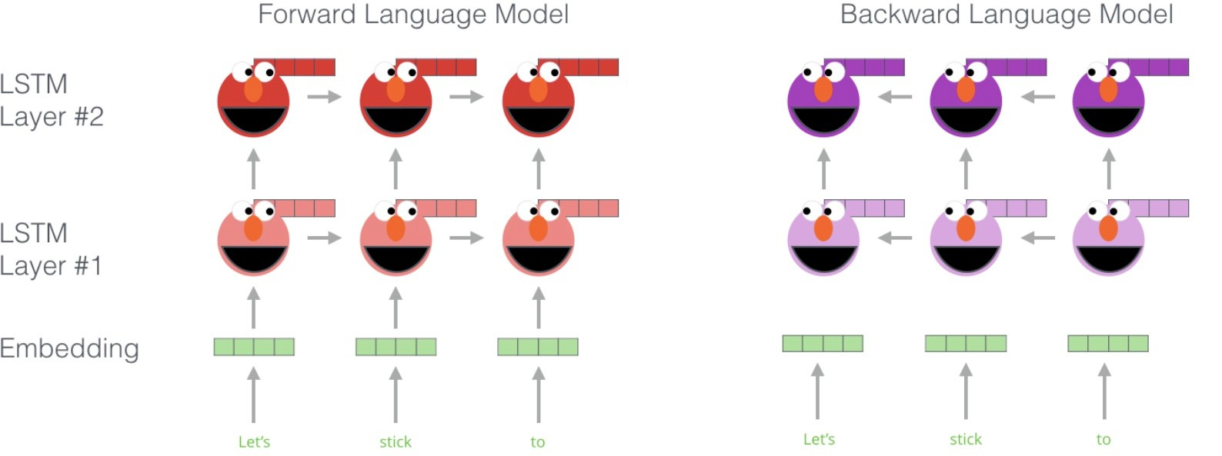
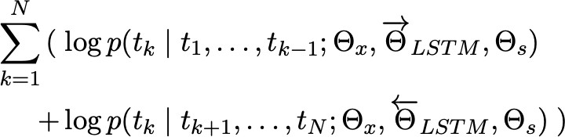
ELMo
# words in the sentence
softmax
input

Slide 60
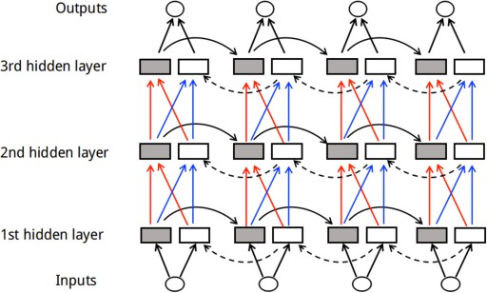
ELMo != bidirectional LSTMs
•
Essentially two LSTMs in different directions

Slide 61
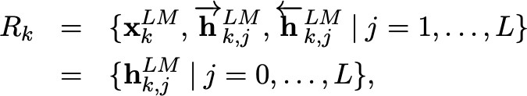
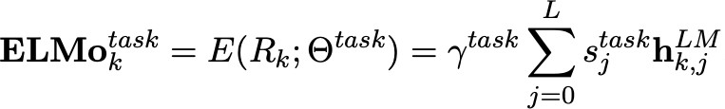
How to use ELMo?
# of layers
h^{LM} = x^{LM}, h^{LM} = [ h ^{LM}; h ^{LM}]
k,0 k k,j k,j k,j
γ^{task}: allows the task model to scale the entire ELMo vector
s^{task}: softmax-normalized weights across layers
j

Slide 62

How to use ELMo?
•
Plug ELMo into any (neural) NLP model: freeze all the LMs weights and change the input representation to:
•
Could also insert ELMo into higher layers (will discuss soon)

Slide 63
Training details
Forward and backward LMs: 2 layers each
Character embeddings to replace word embeddings
Recommended reading: Character-Aware Neural Language Models
2048 char n-gram filters and 2 highway layers, 512 dim projection
No-pretrained word embeddings!
User 4096 dim hidden/cell LSTM states with 512 dim projections to next input
A residual connection from the first to second layer
Trained 10 epochs on 1B Word Benchmark

Slide 64

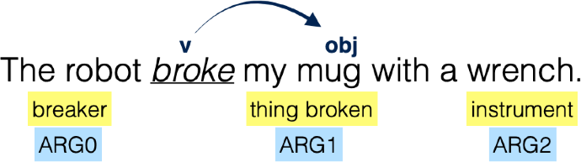
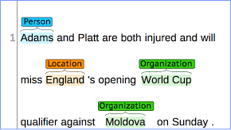

Evaluation
•
•
•
•
•
•
SQuAD: question answering SNLI: textual entailment
SRL: semantic role labeling Coref: coreference resolution
NER: named entity recognition SST-5: sentiment analysis
Barack Obama nominated Hillary Rodham Clinton as his secretary of state on Monday. He chose her because she had foreign affairs experience as a former First Lady.

Slide 65
Baseline models
•
•
•
•
•
SQuAD: (Clark and Gardner, 2017)
Textual entailment: (Chen et al, 2017)
Semantic role labeling: (He et al, 2017)
Coreference resolution: (Lee et al, 2017)
Named entity recognition: pre-trained word embeddings, a character-based CNN representation, two biLSTM layers and a conditional random field (CRF) loss
Sentiment analysis: (McCann et al, 2017)
•

Slide 66
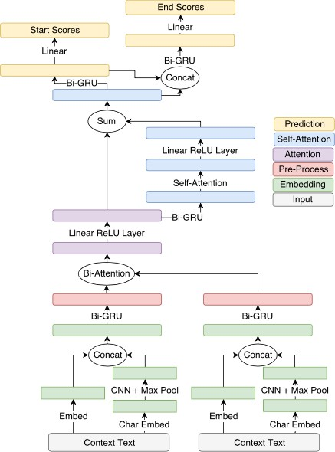
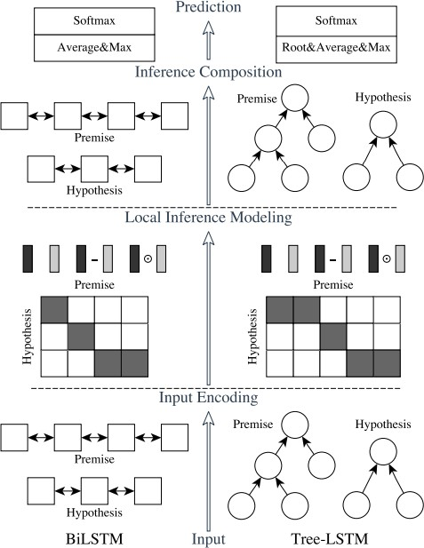
Baseline models
(Clark and Gardner, 2017)
(Chen et al, 2017)

Slide 67
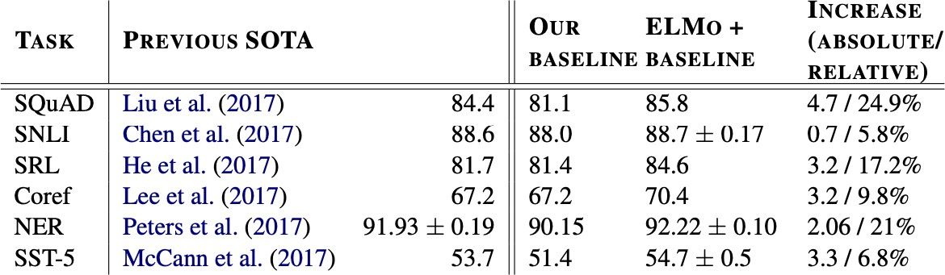
Experimental results
•
•
SQuAD: “The increase of 4.7% with ELMo is also significantly larger then the 1.8% improvement from adding CoVe to a baseline model”
SST-5: “Replacing CoVe with ELMo results in a 1.0% absolute accuracy”

Slide 68
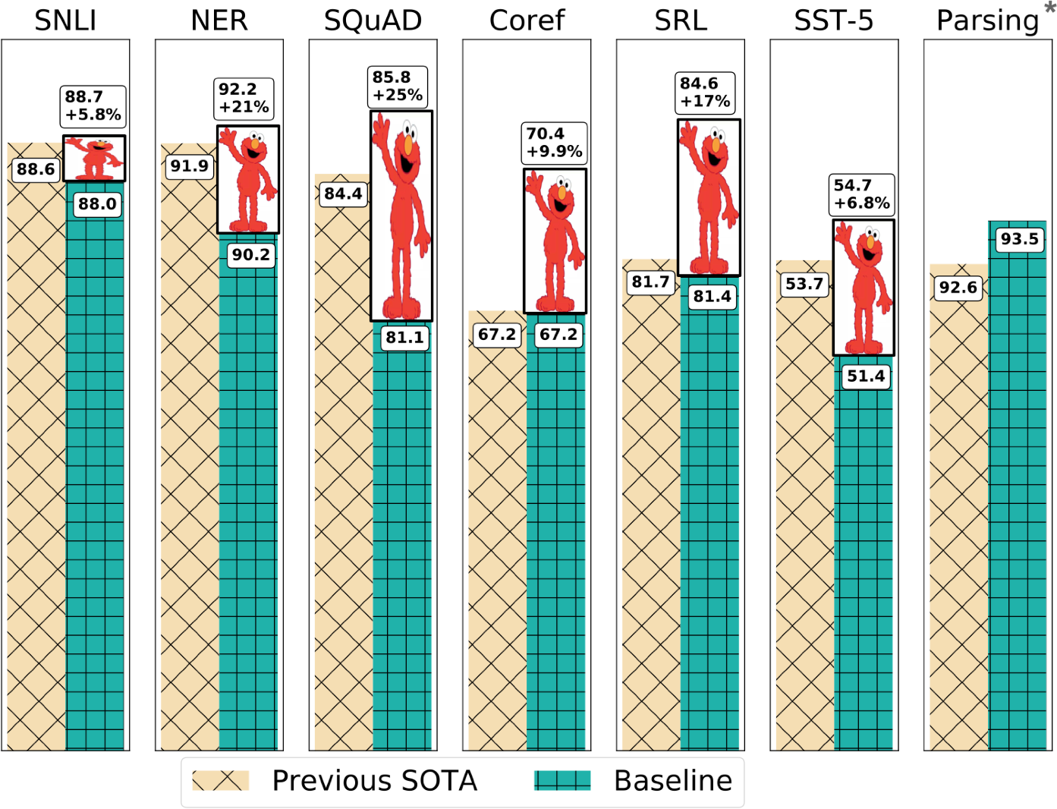
Experimental results

Slide 69
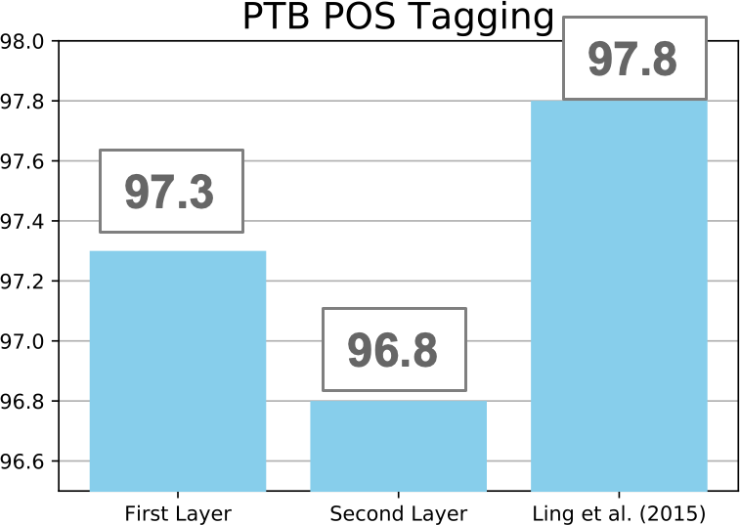
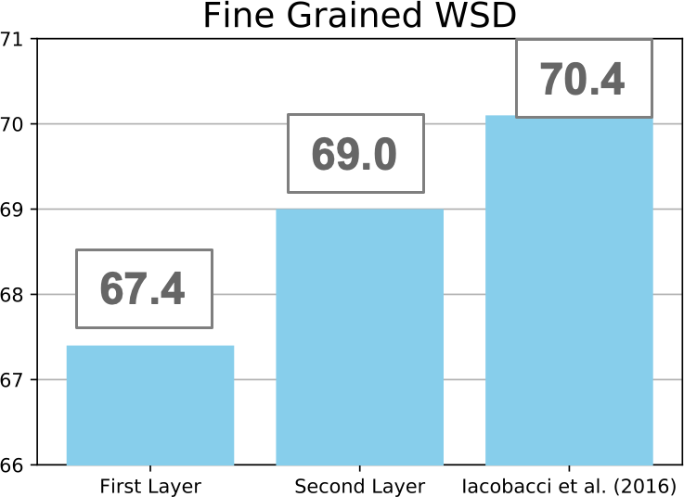
What information is captured by ELMo representations?
First Layer > Second Layer Second Layer > First Layer
syntactic information is better represented at lower layers while semantic information is captured a higher layers

Slide 70
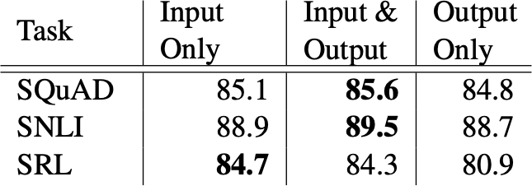
Where to include ELMo?

Slide 71
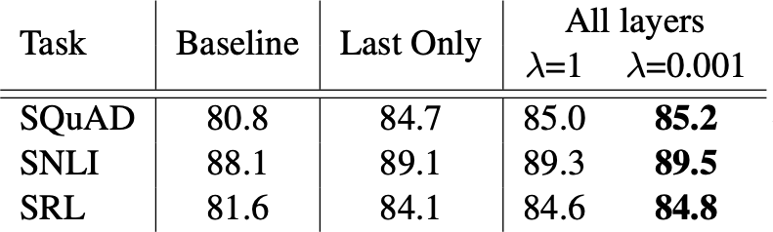
Using all layers > last layer
Reg. Parameter

Slide 72
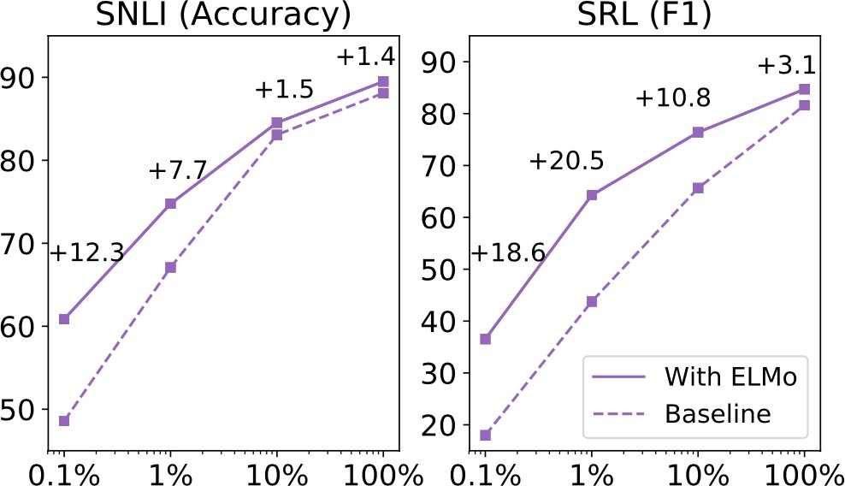
Sample Efficiency

Slide 73
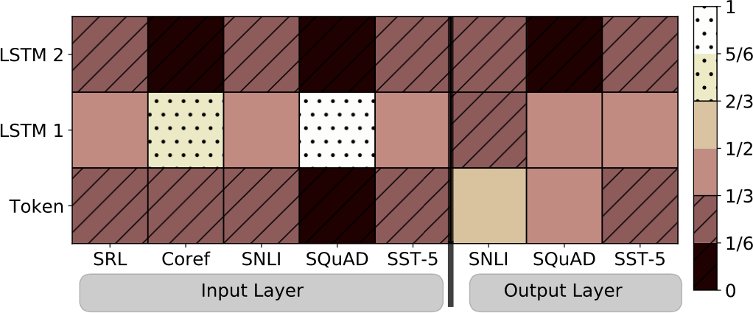
Visualization of softmax normalized weights

Slide 74
Discussion: CoVe vs ELMo
•
•
•
•
Data dependence: monolingual data vs parallel data Training efficiency: ELMo slightly better than CoVe
Objectives: predicting each word in the sentence vs “translating source sentence as a whole”
Directionality: bidirectional encoder vs forward + backward LMs

Slide 75
Limitations of ELMo/CoVe
•
•
•
Task-specific architectures: Contextualized word embeddings are used as an augmentation to static word embeddings
Trained on single sentences
Training corpus is much smaller than those used for training word2vec/GloVe vectors

