Slide 1
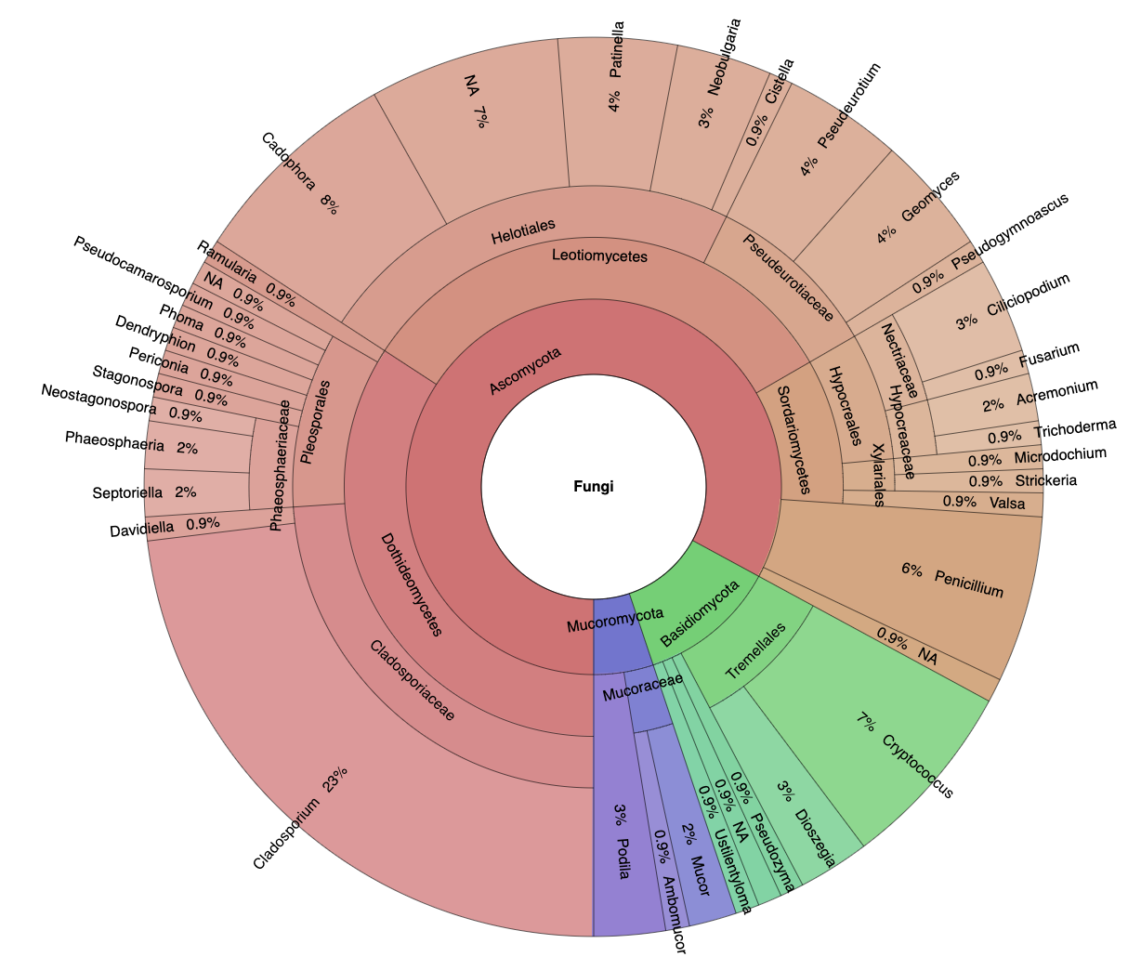
n = 2
n = 2
n = 1
n = 3
n = 3
n = 1
n = 1
Tested for Bd inhibition in vitro
(n = number of isolates)
Bd-inhibitive in vitro
(n = number of isolates)
n = 1
n = 5
n = 2

Slide 2
