Slide 1
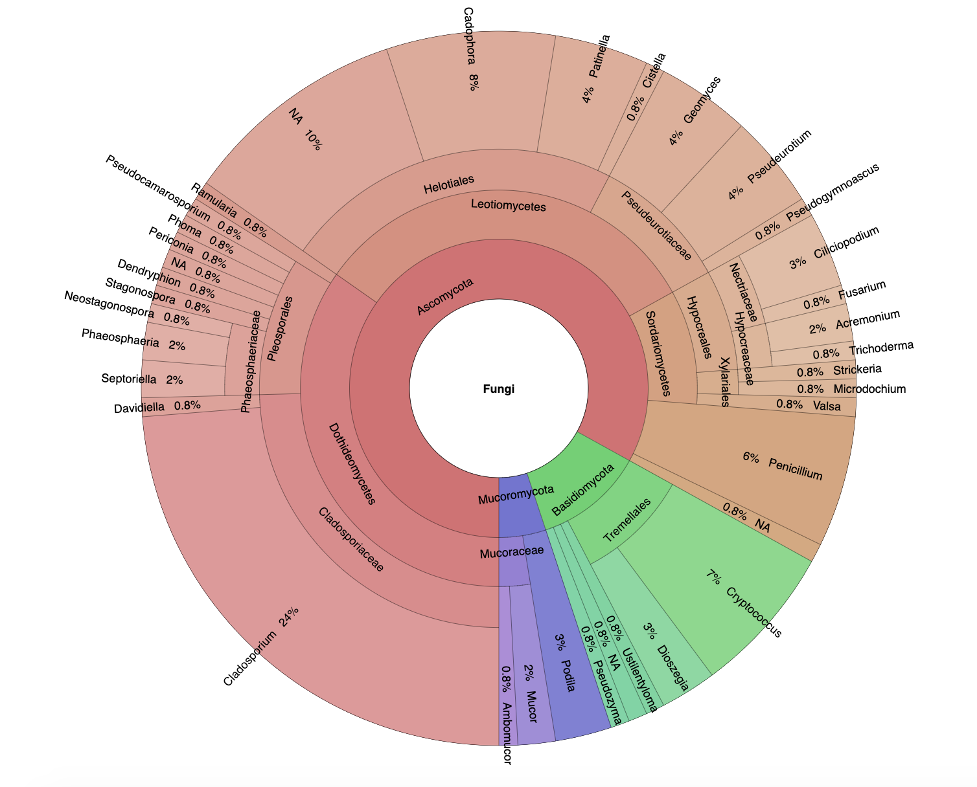
n = 1
n = 3
n = 1
n = 2
n = 3
n = 3
Tested for Bd inhibition in vitro (n = number of isolates)
n = 1
Bd-inhibitive in vitro (n = number of isolates)
n = 5
n = 2

