Slide 1
Team Bitantics:
Crash Course in Cryptocurrencies
Blake, Kelly, Tony and April
January 26, 2021

Slide 2
Research
Questions:
How many different cryptocurrencies are out in the market?
What is the relationship between cryptocurrencies?
What similarities and differences can we draw between cryptocurrencies and other asset classes?
What fiat currencies are accepted for buying/selling cryptocurrencies? How often is one fiat currency used compared to another?
Is crypto a viable asset class? Who are the winners and laggards?

Slide 3
Data Exploration & Cleanup
Data Sources
Coinbase REST API
Cryptocurrency historical data (volume)
Data capped by rate limits and amount of data returned
CoinMarketCap
Cryptocurrency historical prices
Investing.com
Global indices data using investpy Python package

Slide 4
Data Analysis
Kelly: Trading Activity (Volume) Trends
April: Compare cryptocurrencies within asset class (BTC vs ETH etc)
Blake: Compare cryptocurrencies with S&P, Nasdaq and other top global indices
Tony: Compare cryptocurrencies with US GDP

Slide 5
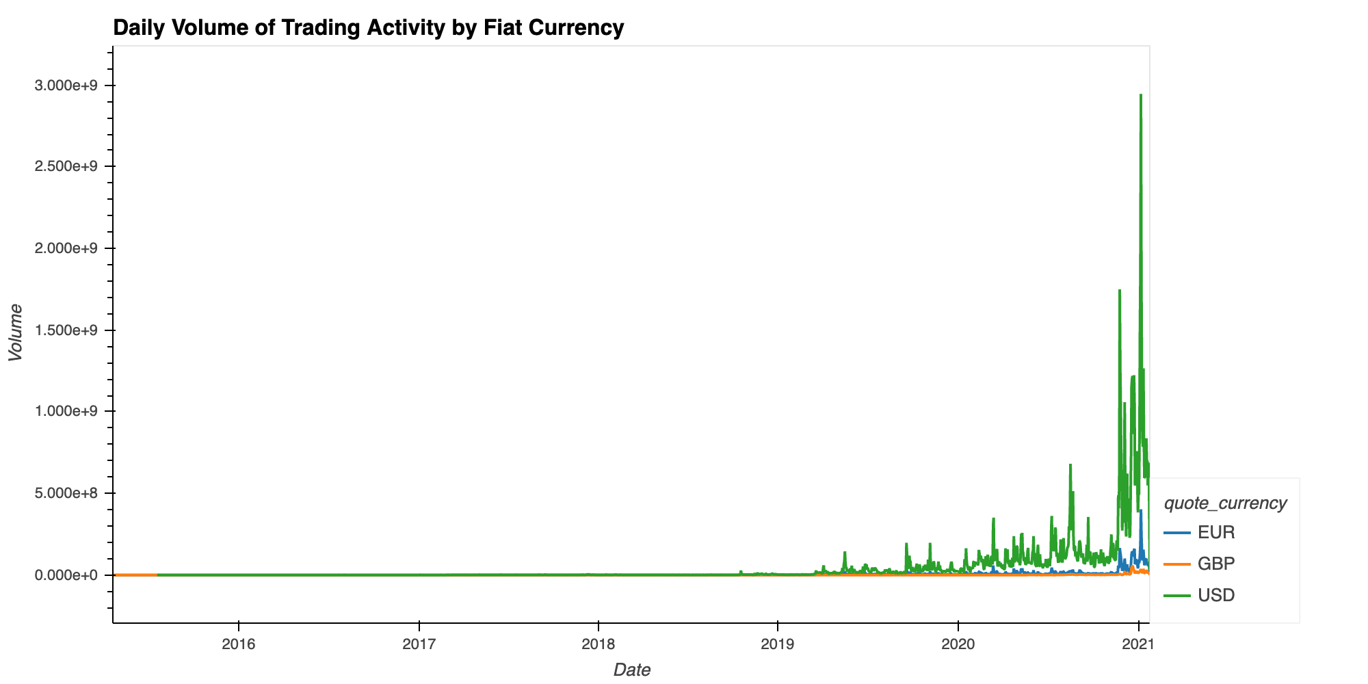
Part 1:
Analysis: Volume of Trading Activity
Trends of Top 3 Supported Fiat Currencies
Daily Volume of Trading Activity
USD
Data collected from Coinbase API.
Coinbase started in 2012 and has 43 cryptocurrencies available for trade.
Accepted fiat currencies: USD, GBP, EUR, AUD, CAD, SGD. RUB accepted at some exchanges.
Higher trading activity starting in 2019.
Notes:
References:
Supported cryptocurrencies. https://help.coinbase.com/en/coinbase/getting-started/general-crypto-education/supported-cryptocurrencies
Coinbase API. https://docs.pro.coinbase.com/#get-historic-rates

Slide 6
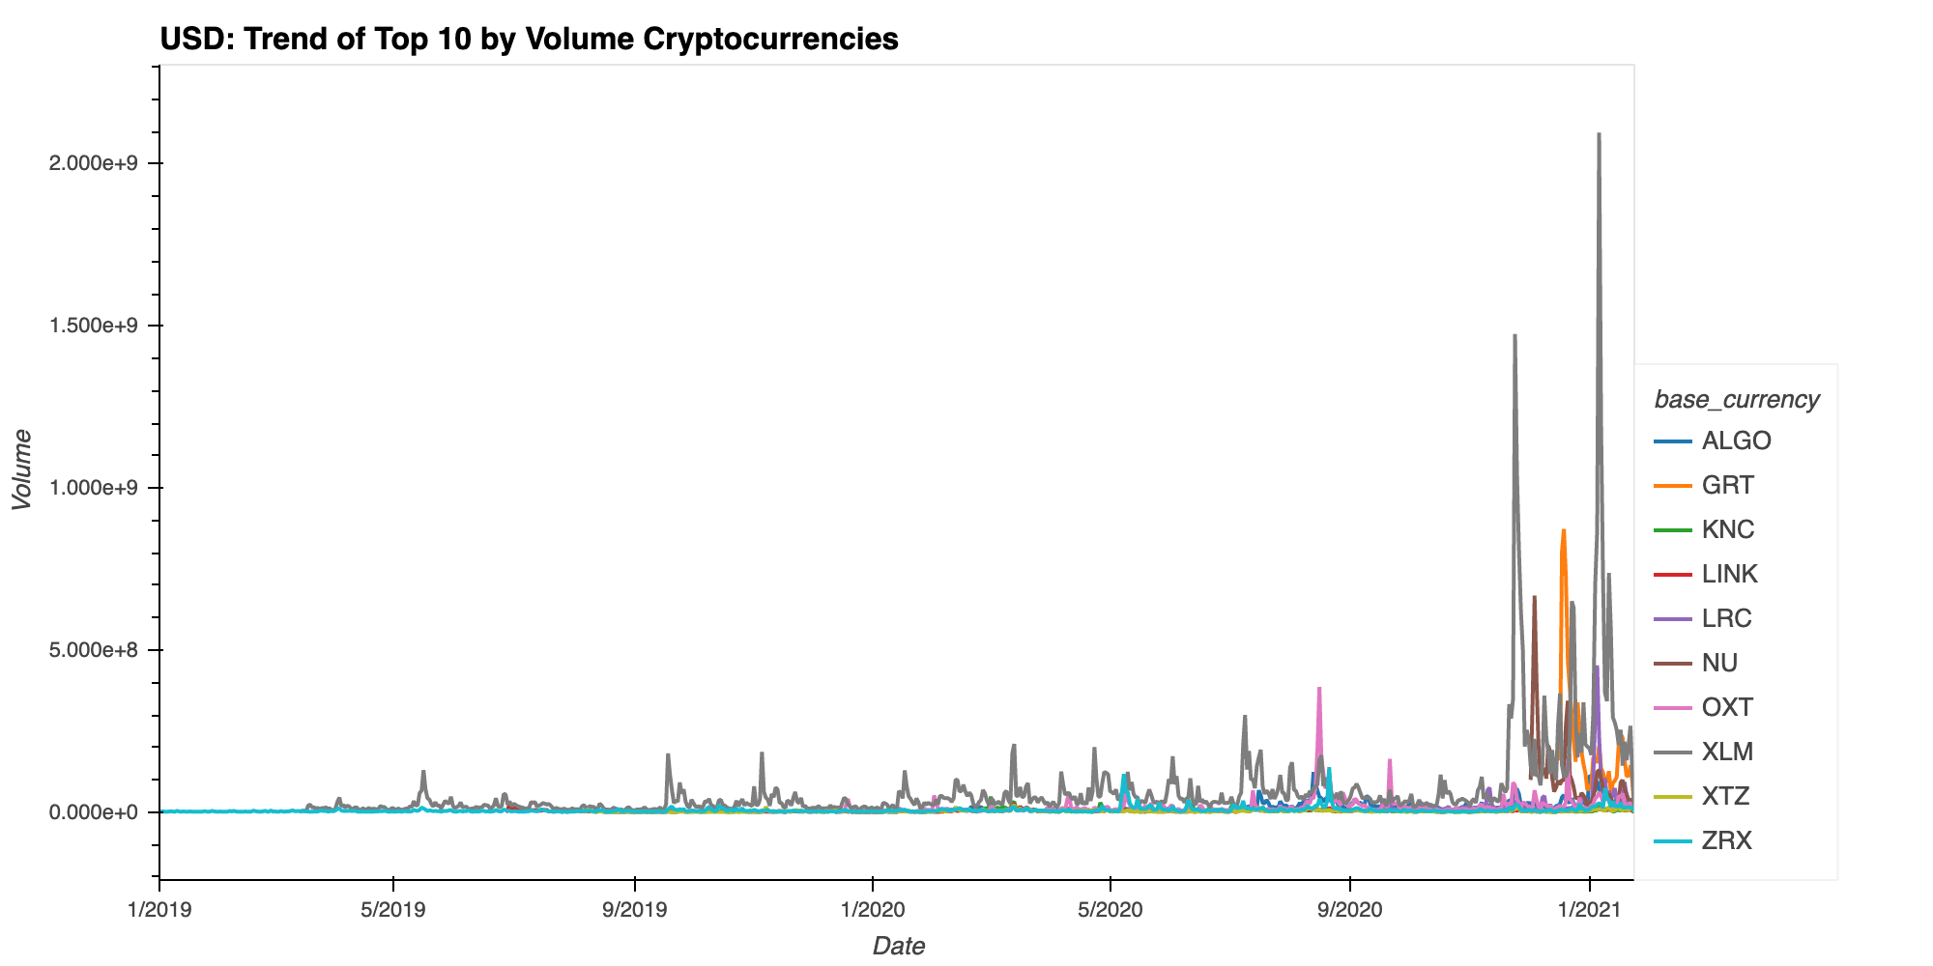
Part 1:
Analysis: Volume of Trading Activity
Which cryptocurrency dominates the USD trading activity?
USD: Top 10 Cryptocurrency Volumes
XLM
Dominated by XLM (Stellar Lumens)
Stellar network was launched in 2015
Trade any kind of currency (cryptocurrency-adjacent, not meant to replace existing financial system)
Lumen is the native digital currency
Wirex launched 26 fiat-backed stablecoins on Stellar network, Visa card
Notes:
Wirex Visa card allowed users to convert and spend cryptocurrencies
References:
Intro to Steller. https://www.stellar.org/learn/intro-to-stellar
FCA Regulated Payment Platform Launches 26 Fiat-Backed Cryptocurrencies On The Stellar Network. https://www.forbes.com/sites/rachelwolfson/2019/04/25/fca-regulated-payment-platform-launches-26-fiat-backed-stablecoins-on-the-stellar-network/?sh=67a3f86252c7

Slide 7
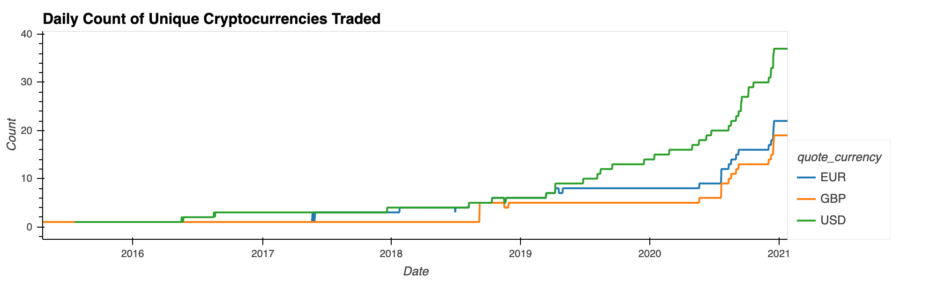
Part 1:
Analysis: Volume of Trading Activity
How many different cryptocurrencies are traded daily?
Daily Count of Unique Cryptocurrencies Traded
USD leads in number of cryptocurrencies being bought/sold
Top 3 by Volume
XLM: Stellar Lumens
GRT: The Graph (Ethereum token)
OXT: Orchid (Ethereum token)
NU: NuCypher (Ethereum token)
ALGO: Algorand
USD | XLM, GRT, OXT
EUR | XLM, GRT, NU
GBP | GRT, NU, ALGO
Notes:
Ethereum tokens are digital assets built on top of Ethereum blockchain
The Graph - indexing protocol for querying networks, build and publish APIs
Orchid - decentralized VPN, users can buy bandwidth
NuCypher - data privacy and key management for decentralized applications and protocols
References:
A beginner’s guide to Ethereum tokens. https://blog.coinbase.com/a-beginners-guide-to-ethereum-tokens-fbd5611fe30b

Slide 8
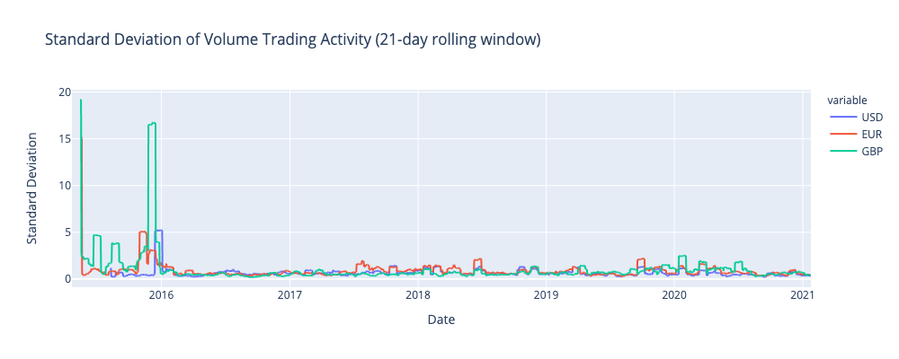
Part 1:
Analysis: Volume of Trading Activity
Volatility in Volume of Trading Activity
21-day Rolling Window Standard Deviation
What happened in 2015?
Ross Ulbricht found guilty of running online black market site Silk Road
Silk Road recovered bitcoins auctioned off in November
Recession in Greece, banks temporarily shut down
Hong Kong-based Bitfinex exchange suffered a crash in 30 minutes to bring BTC value down 14%
Stock market downturn
Notes:
References:
Bitcoin history. https://en.bitcoinwiki.org/wiki/Bitcoin_history#Bitcoin_in_2016
Greeks are rushing to Bitcoin. https://money.cnn.com/2015/06/29/technology/greece-bitcoin/index.html
Greece shuts banks in bid to prevent collapse. https://money.cnn.com/2015/06/28/news/economy/greece-banks-ecb/?iid=EL
From Worst to First: Bitcoin’s Price Ends 2015 on Top. https://www.coindesk.com/bitcoin-price-in-2015-doom-and-gloom-give-way-to-positive-years-end
2015-2016 stock market selloff. https://en.wikipedia.org/wiki/2015%E2%80%932016_stock_market_selloff

Slide 9
Part 2:
Analysis:
Compare Cryptos w/in Asset Class
Top 10 Cryptocurrencies
by Market Cap
CoinMarketCap (31Dec2020)
Crypto | Closing Price (USD)
Bitcoin-BTC | 29374.15
Ethereum-ETH | 730.37
Bitcoin Cash-BCH | 343.05
Bitcoin-BSV | 163.12
Monero-XMR | 136.05
Litecoin-LTC | 126.23
Counos-CCXX | 89.10
Dash-DASH | 88.24
Kusama-KSM | 71.96
Zcash-ZEC | 63.99
Notes:
4k+ different cryptos available to trade on CoinMarketCap

Slide 10
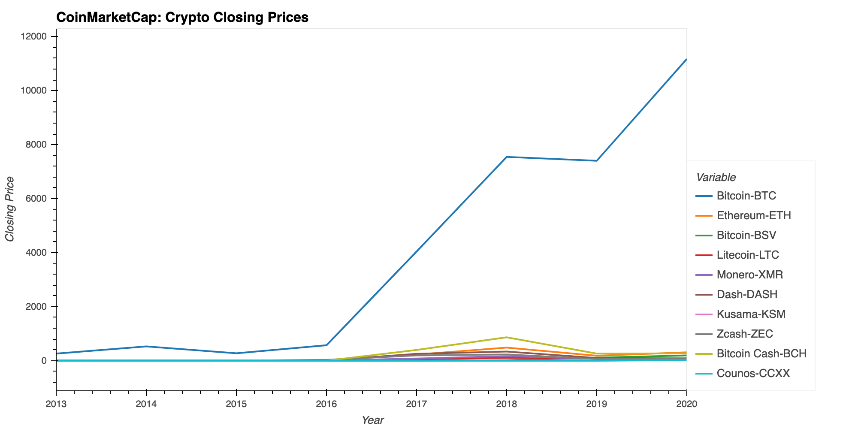
Part 2:
Analysis:
Compare Cryptos w/in Asset Class
Average Closing
Price per crypto from
Jan 2013 - Dec 2020
Bitcoin is king w/ an average closing price of $11,180 in 2020 vs Kusama closing w/ an average of $17.36

Slide 11
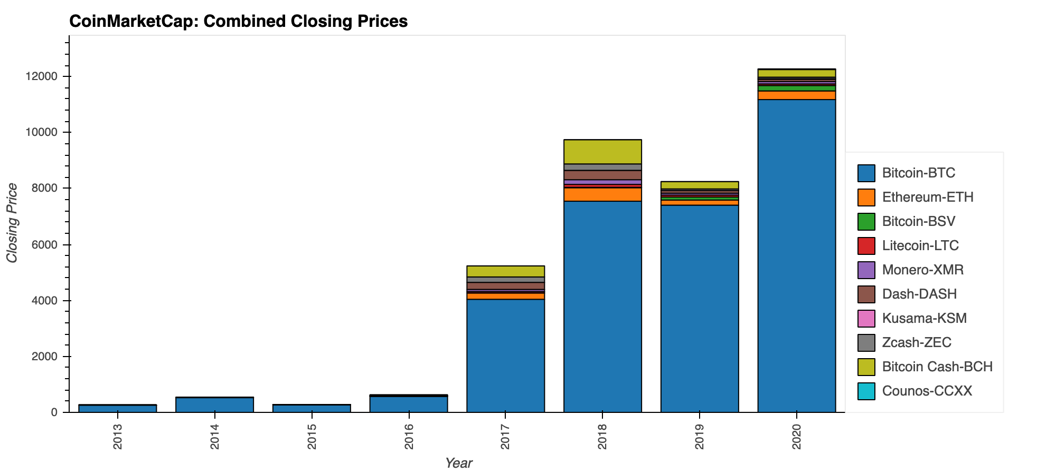
Part 2:
Analysis:
Compare Cryptos w/in Asset Class
Average Total
Closing Price
Combined by Year
The average total closing prices for the ten cryptocurrencies in 2020 is $12,300 vs $270 in 2013
Notes:
Earliest Data Available Closing Price (USD) Crypto
4/28/2013 144.54 BTC
4/28/2013 4.38 LTC
2/14/2014 0.31 DASH
5/21/2014 2.10 XMR
8/7/2015 0.75 ETH
10/29/2016 574.82 ZEC
7/23/2017 440.70 BCH
11/9/2018 87.06 BSV
12/12/2019 1.75 KSM
4/20/2020 20.38 CCXX

Slide 12
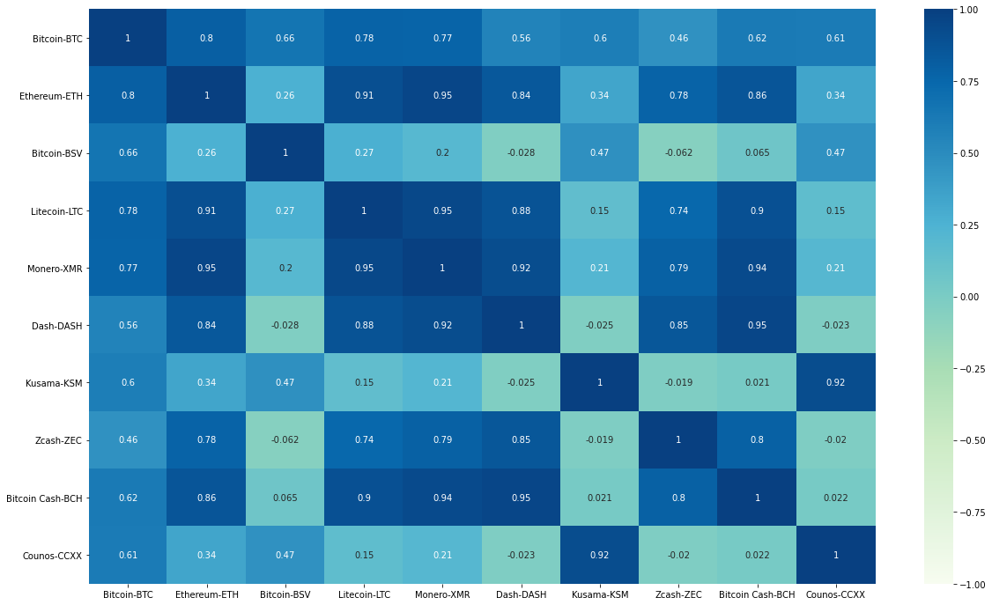
Part 2:
Analysis:
Compare Cryptos w/in Asset Class
What is the correlation
between the ten cryptocurrencies?
Correlation Plot
Bitcoin and Ethereum are closely correlated (0.8)
Bitcoin SV and Zcash are least correlated (-0.062)

Slide 13
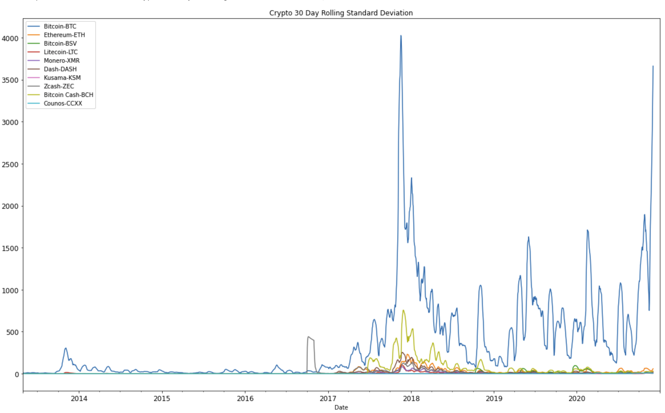
Part 2:
Analysis:
Compare Cryptos w/in Asset Class
Risk over time:
30 Day Rolling Standard Deviation
BTC
CCXX
Bitcoin is the most volatile among the 10 cryptos illustrated by the spikes above
Counos is the least risky shown (almost) flat-lining
Notes:
Future analysis to include profit/loss based on $XX initial investment per coin or across the top 10 cryptos

Slide 14
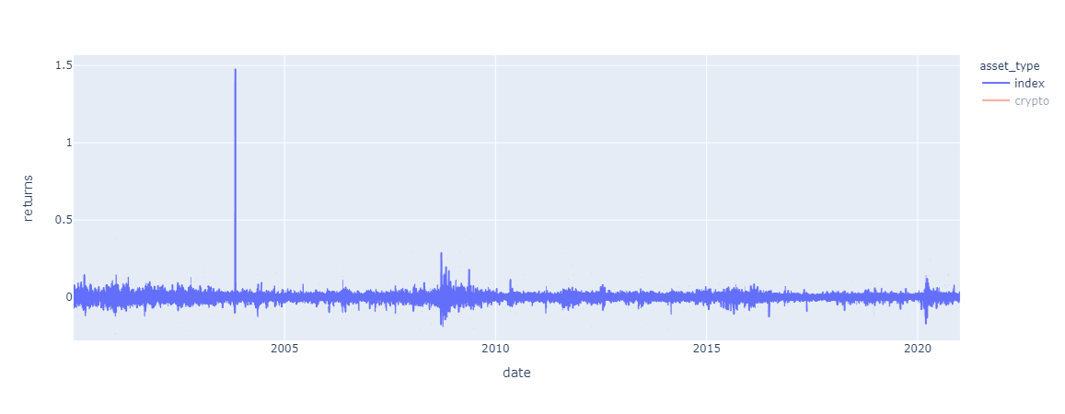
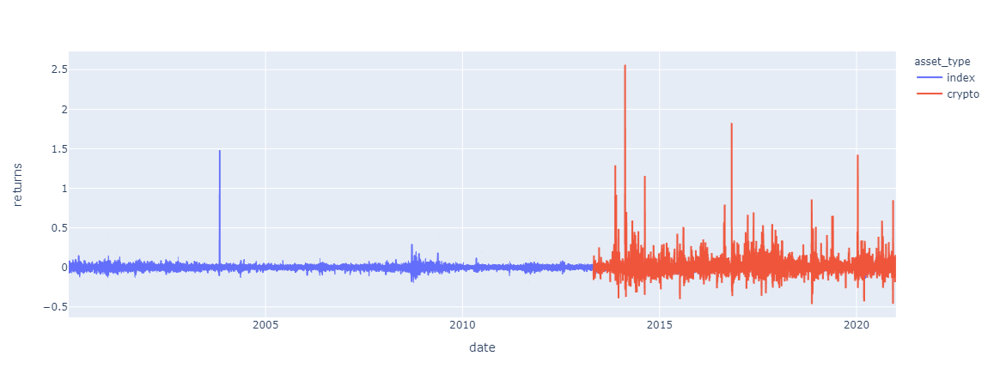
Part 3:
Global Indices vs. Cryptocurrencies
Do cryptocurrencies behave similar to global indices?
Top 30 Global Indices daily returns since 2000
...adding top cryptocurrencies changes the norm
Historical global trends are obvious
….dot com bubble
...2008 financial crisis
...2016 recession
...2020 pandemic
Cryptocurrencies don’t follow this pattern. Similar to the Italian FTSE index in Nov. 2003
Notes:
Wirex Visa card allowed users to convert and spend cryptocurrencies
References:
Intro to Steller. https://www.stellar.org/learn/intro-to-stellar
FCA Regulated Payment Platform Launches 26 Fiat-Backed Cryptocurrencies On The Stellar Network. https://www.forbes.com/sites/rachelwolfson/2019/04/25/fca-regulated-payment-platform-launches-26-fiat-backed-stablecoins-on-the-stellar-network/?sh=67a3f86252c7

Slide 15
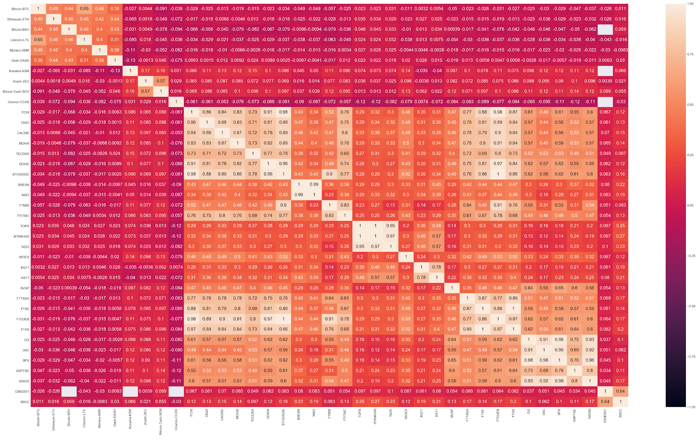
Intra-crypto correlation is high, whereas correlation of global indices to top cryptocurrencies is inguishinable and needs a different lens
Intra-Crypto
Crypto vs. Index
Intra-indices
SPX (S&P 500)
DJI (Dow Jones)

Slide 16
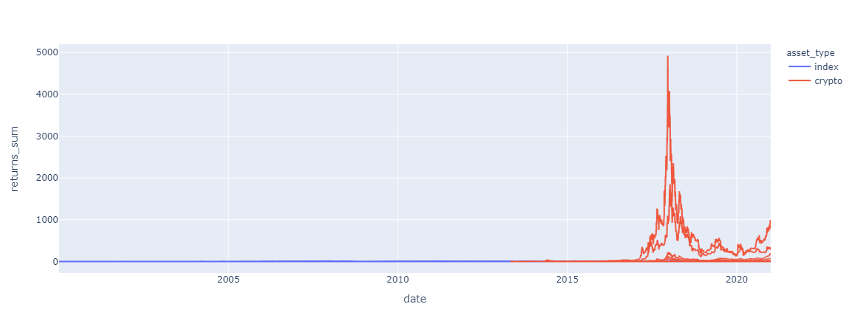
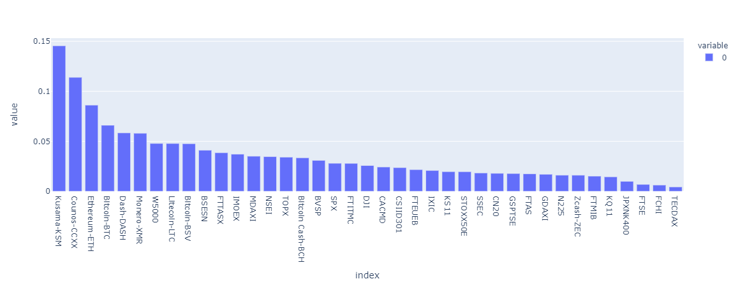
Part 3:
Global Indices vs. Cryptocurrencies
As seen in cumulative returns...
...crypto needs a different lens across assets
If we focus on cumulative returns...it's easy to get fixated on cryptocurrencies as show by DASH and Ethereum performance heading into Dec of 2017, but not without risk
According to a Sharpe ratio calculation, not surprisingly, crypto leads the way, but global indices such as the W5000 (US), BSESN (India), IMOEX (Russia), for example, are still attractive investments per returns and risk taken, beating Bitcoin and Litecoin.
Notes:
Wirex Visa card allowed users to convert and spend cryptocurrencies
References:
Intro to Steller. https://www.stellar.org/learn/intro-to-stellar
FCA Regulated Payment Platform Launches 26 Fiat-Backed Cryptocurrencies On The Stellar Network. https://www.forbes.com/sites/rachelwolfson/2019/04/25/fca-regulated-payment-platform-launches-26-fiat-backed-stablecoins-on-the-stellar-network/?sh=67a3f86252c7

Slide 17
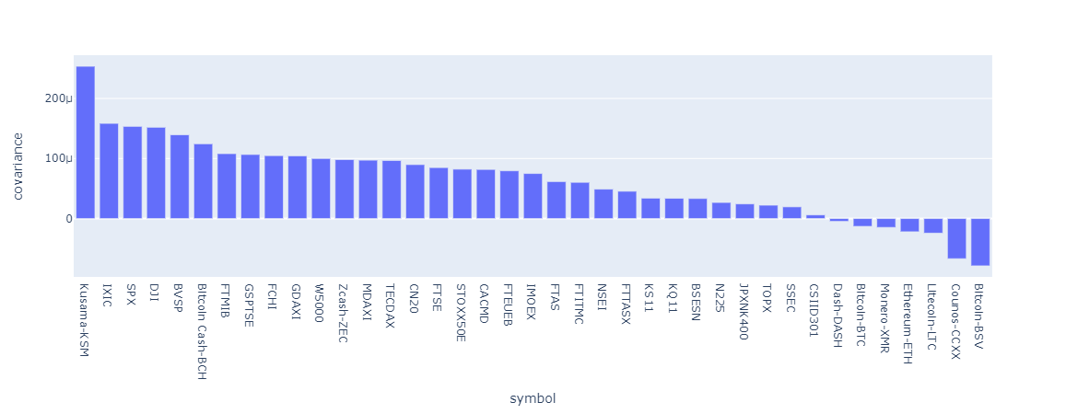
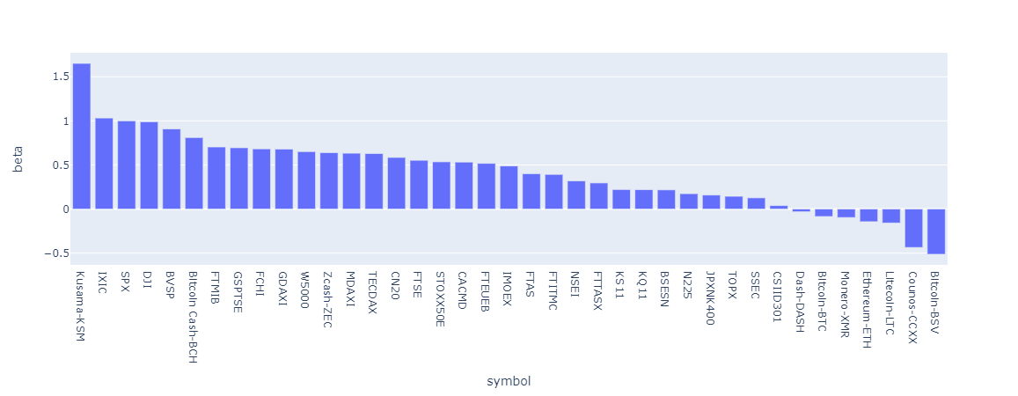
Part 3:
Global Indices vs. Cryptocurrencies
Digging little deeper, compared to the S&P500...
we see that a few cryptos move with global indices
Despite the wide range of volatility in the crypto markets, assets such as Kusama, Bitcoin Cash, and Zcash do move with global markets, relative to the standar S&P 500 in the U.S. market.
Interestingly, a few Asian indices (SSEC, JPNK400, and BSESN) are not far off to the major crypto markets in terms of relationship to the S&P 500

Slide 18
Retrospective
Left scope of project too broad since initial questions
Spending more time than planned finding, ingesting, and cleaning/shaping the applicable data
v2 of this project would include deeper analysis of the findings, curating datasets based on a variety of descriptive attributes (e.g. country, volume, etc.)
Having more exercises on “how-to’s” for git operations would have been helpful
Accomplished an end-to-end data product in a dashboard with analysis within 2 weeks, but would have liked to spend more time on analysis and dashboard “beautification” as majority of the time was spent on data ingestion and prep.
v3 would include the build of an app to alert a user on the trends/statistical thresholds identified for cryptocurrency price and its relationships to other asset classes
Notes:
Extra slide for reference

Slide 19
Appendix

Slide 20
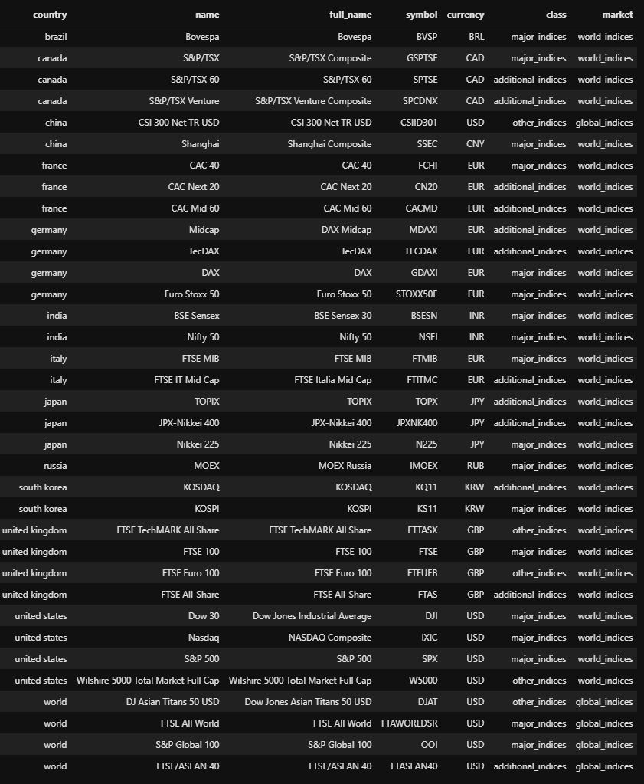
Global Indices
Reference used in datasets

Slide 21
Fiat and Crypto Currencies
What is fiat currency?
Government issued
Not backed by a commodity
No intrinsic value
What is cryptocurrency?
Digital currency
Encrypted
Distributed
Records stored in a ledger
What fiat currencies are accepted at exchanges?
USD - most popular
GBP, EUR, RUB are also accepted
Notes:
Extra slide for reference

